Slide 1
How to use peripherals on MCB1700
Vajih Montaghami
Douglas W. Harder

Slide 2
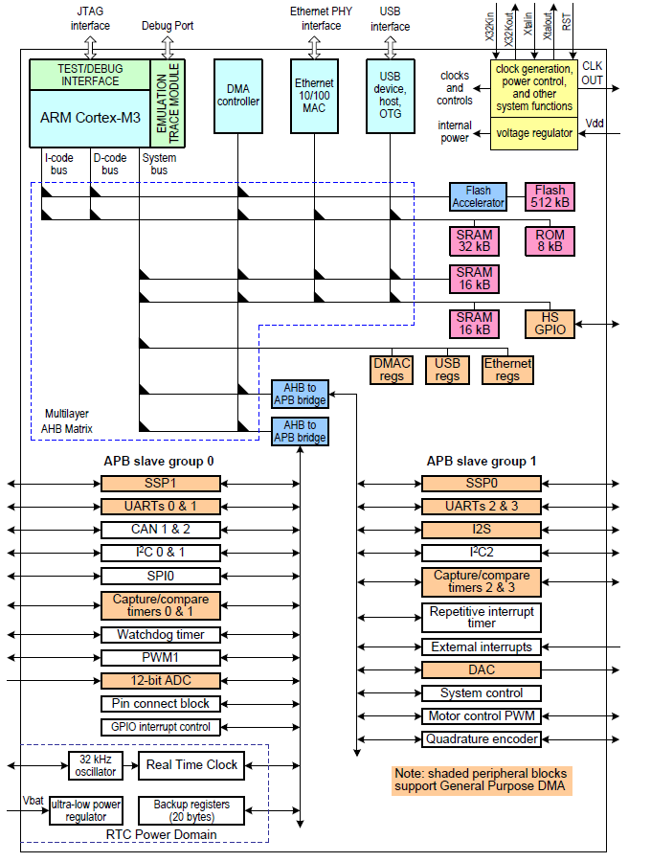
Peripherals
GPIO
ADC/DAC
Ethernet
USB
RS232
CAN
(UM10360, 2014)

Slide 3
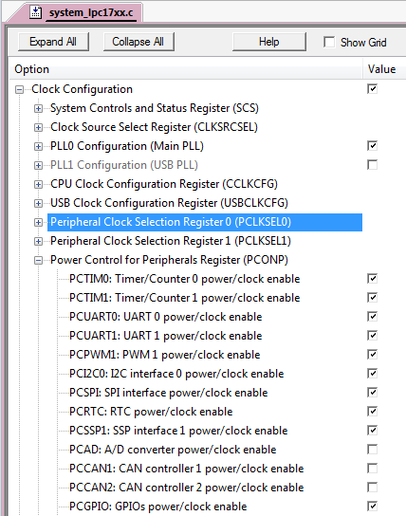
Power Control Block
Power is a major concern in ARM-based chips
  By powering down the unused peripherals,
  considerable power is saved
Peripheral power control register is referenced from CMSIS as LPC_SC->PCONP
  LPC_SC is a general system-control register block
  PCONP refers to Power CONtrol for Peripherals
  µVision provides the peripherals power through system_17xx.c

Slide 4
Pin Connect Block
Peripherals are connected to the chip through pins and controlled with ports.
There are five 32-bit ports, p0…p4, connecting the chip to environment. As stated in Table 74 (UM10360) some ports are not enable.
Most chip pins can perform up to four different functions
  You must specify what function you want each pin to be used for
Programming a set of registers known as the Pin Connect Block
  From CMSIS as a struct called LPC_PINCON, with fields called PINSEL1, PINSEL2, PINMODE1, PINMODE2 and so on
(UM10360, 2014)
(UM10360, 2014)

Slide 5
Interrupt Service Routine
Almost all peripherals can generate interrupts
The conditions on generating interrupts are different for each peripherals.
Interrupt Service Routines (ISR) in CMSIS is just a function with the interrupt source appended by _IRQHandler
  E.g. ADC_IRQHandler
CMIS provides APIs for enabling/disabling, prioritizing, and Pending ISRs:
Interrupts can be fired by setting an interrupt number to NVIC->STIR
But, they are cleared depending on the peripherals caused
    void NVIC_EnableIRQ( IRQn_Type IRQn )
    void NVIC_DisableIRQ( IRQn_Type IRQn )
    void NVIC_SetPriority( IRQn_Type IRQn, uint32_t priority )
    uint32_t NVIC_GetPriority( IRQn_Type IRQn )

Slide 6
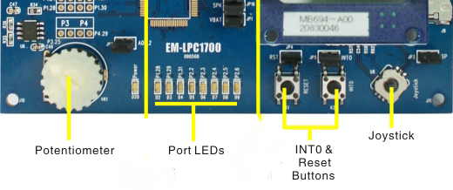
General-Purpose I/O
The chip directly communicates with its environment through ports in GPIO mode
  The ports can be set for input or output direction
  Port 0 and Port 2 can provide a single interrupt for any combination of port pins
  In case of MCB1700:
    8 LEDs are connected as output pins
    Joystick and INT0 button are connected as input pins
(UM10360, 2014)

Slide 7
Steps to Configure GPIO
Enable the power
Set Pins and their modes
  Selecting the GPIO LPC_PINCON->PINSEL[0-10]
  Input/output direction LPC_GPIO[0-4]->FIODIR
Set appropriate interrupts if needed
  Raising/falling edge LPC_GPIOINT->[IO[0 or 2]IntEnF OR IO[0 or 2] IntEnR]
  Registering NVIC_EnableIRQ( IRQn )
  Clearing interrupt LPC_GPIOINT->IO[0 or 2]IntClr
  Reading status LPC_GPIOINT->IO[0 or 2]IntStatus
Manipulating the ports
  Set an output port LPC_GPIO->FIOSET
  Read an input port LPC_GPIO->FIOPIN
  Clear an output port LPC_GPIO->FIOCLR
(UM10360, 2014)
Notes:
PINSEL register is explained in the section 8.1. There are 11 registers, each apparently 16-bit. Some are not used in the LPC1768.

Slide 8
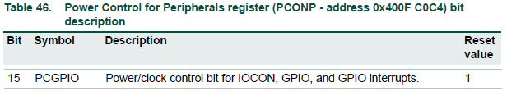
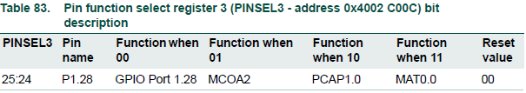
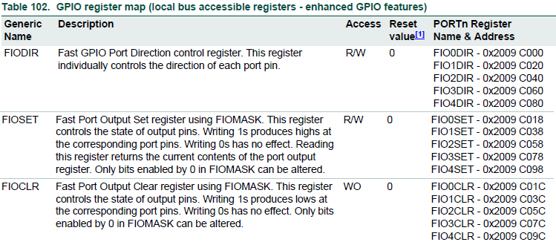
Example 1: Turning On/Off a LED
Enable power
  LPC_SC->PCONP |= (1 << 15);
LED connected to p1.28 is in GPIO mode
  LPC_PINCON->PINSEL3 &= ~(3 << 24);
LED connected to p1.28 is an output pin
  LPC_GPIO1->FIODIR |= (1 << 28);
Turning on the LED
  LPC_GPIO1->FIOSET |= (1 << 28);
Turning off the LED
  LPC_GPIO1->FIOCLR |= (1 << 28);
(UM10360, 2014)

Slide 9
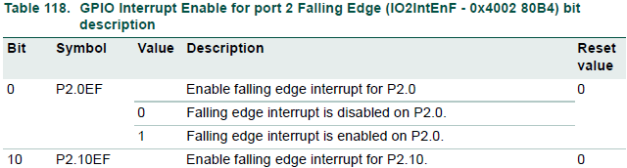
Example 2: Intercepting push-button click
Enable power
Push-button connected to p2.10 is in GPIO mode
  LPC_PINCON->PINSEL4 &= ~( 3 << 20 );
P2.10 is an input pin
  LPC_GPIO2->FIODIR &= ~( 1 << 10 );
P2.10 reads the falling edges to generate an interrupt
LPC_GPIOINT->IO2IntEnF |= ( 1 << 10 );
IRQ is enabled in NVIC
  NVIC_EnableIRQ( EINT3_IRQn );
Clear interrupt condition when it has been fired
  LPC_GPIOINT->IO2IntClr |= (1 << 10);
(mcb1700, 2009)
(UM10360, 2014)
Notes:
Register IO2IntEnR is for the rising edge.

Slide 10
Clocks
Clock in LPC1768 is very flexible to generate different frequencies at the same time
Clock source is selected through Clock Source Select register LPC_SC->CLKSRCSEL:
  Internal 4 MHz RC oscillator (this is the default)
  12 MHz external oscillator
  32 kHz real-time clock oscillator
The input clock is directly fed into PLL to increase the clock frequency and clock divider to decrease the clock
  The clock can be divided further for peripheral clockSetup the PLL and frequency devisors is complex and involves many registers
  µVision provides a straightforward interface to set the clock through system_17xx.c
(UM10360, 2014)

Slide 11
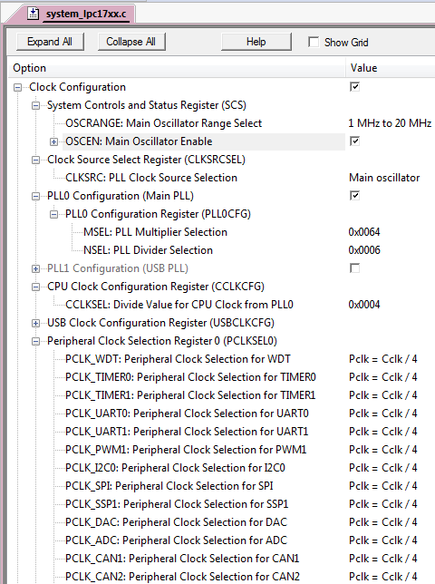
Configuring the main and peripheral clocks.
Select the Main oscillator
  The main oscillator generates 12 MHz clock, OSCRANGE has to cover it.
Select PLL0 to accelerate the clock
  The output frequency of PLL is 2 × M × F ÷ N
    F is input frequency
    6 ≤ M ≤ 512
    1 ≤ N ≤ 32
  E.g., 400 MHz = 2 × 100 × 12 ÷ 6
Pick a proper clock divider for 100 MHz ARM
  CCLKSEL = 4
Now the clock are ready for peripherals in
100 MHz, 50 MHz, 25 MHz and 12.5 MHz

Slide 12
Analogue to Digital Convertor
A 12-bit analog-to-digital converter
8 converting channels through 8-input analog mux
A potentiometer connected to analog input 2
Three registers are particularly to be configured
  The analog/digital control register LPC_ADC->ADCR
  The analog/digital global data register LPC_ADC->ADGDRThe
  The analog/digital status data register LPC_ADC->ADSTAT
  The analog/digital interrupt enable register LPC_ADC->ADINTEN
(mcb1700, 2009)

Slide 13
ADC configuration steps
Set Power using PCONP register
  Where is accessible in system_17xx.c
Enable ADC0 functionality pins through PINSEL registers
Set a Peripheral Clock using PCLKSEL0 register
  Already set through the IDE
Configure ADC through LPC_ADC->ADCR
Enable interrupts using CMSIS APIs
Now, start conversion.
  Wait until the ADC status shows the conversion is done after ~52 ticks.
  Response to the interrupt

Slide 14
Example3: Reading Potentiometer
Enable power
  LPC_SC->PCONP |= ( 1 << 12 );
Potentiometer connected to p0.25 is in ADC mode
  LPC_PINCON->PINSEL1 &= ~( 0x3 << 18 ); //clear bits
  LPC_PINCON->PINSEL1 |= ( 0x1 << 18 ); //set bits
Set the ADC control register
  LPC_ADC->ADCR = ( 1 << 2 ) | // Select the second channel
  ( 4 << 8 ) | // ADC clock is 25MHz/(4+1)
  ( 0 << 24 ) | // Do not start the conversion yet
  ( 1 << 21 ); // Enable ADC
Enable interrupt for all ADC channels
  LPC_ADC->ADINTEN = ( 1 << 8);
Register interrupt
  NVIC_EnableIRQ( ADC_IRQHandler );
Start Conversion
  LPC_ADC->ADCR |= ( 1 << 24 );
Read the converted value
  Polling (i.e. busy waiting) to see when the conversion is done. There is no need to activate and register interrupts in this way.
    // wait for conversion complete
    while (LPC->ADGDR & 0x8000 == 0);
    // read 12 bits result
    ADC_Value = (LPC_ADC->ADGDR >> 4) & 0xFFF;
  Response for the interrupt
  void ADC_IRQHandler( void ) {
  // Read ADC Status clears the interrupt condition
  aDCStat = LPC_ADC->ADSTAT;
  ADC_Value = (LPC_ADC->ADGDR >> 4) & 0xFFF;
  }

Slide 15
Resources
Montaghami, V. I/O example: Cascading LEDs
https://ece.uwaterloo.ca/~dwharder/icsrts/Keil_board/IO_examples/src/io_example_project.zip
LPC176x/5x User manual. (1, April 2014). 3.1, 846. NXP Semiconductor http://www.nxp.com/documents/user_manual/UM10360.pdf
Roehl, B. (2011, April 18). Lab Manual for ECE 455. 39. Waterloo, ON, Canada http://www.arm.com/files/pdf/ece455labmanual_preliminary.pdf
Yiu, J. (2009). The Definitive Guide to the ARM® Cortex-M3
MCB1700 Schematic, (29, July 2009). 1.2, 6, Keil.com
http://www.keil.com/mcb1700/mcb1700-schematics.pdf

Slide 16
Backup 1 – How to draw a shape on GLCD
GLCD library provides APIs to draw bitmaps.
Bitmap is a matrix of 0-1s
  0- off pixels
  1- on pixels
Each pixel’s color is set in 16-bit
Screen Size is 320×240
Example: draw a tiny cross in the middle of screen.
Practice
  Store the bitmap in bit, convert to 16-bit when drawing.
16-bit colors defined in glcd.h
#include <LPC17xx.h>
#include "glcd.h"
#define BG White
#define FG Blue
int main (void) {
unsigned short cross_bitmap[] = { FG, FG, BG, BG, BG, BG, BG, FG, FG,
BG, FG, FG, BG, BG, BG, FG, FG, BG,
BG, BG, FG, FG, BG, FG, FG, BG, BG,
BG, BG, BG, FG, FG, FG, BG, BG, BG,
BG, BG, BG, FG, FG, FG, BG, BG, BG,
BG, BG, FG, FG, BG, FG, FG, BG, BG,
BG, FG, FG, BG, BG, BG, FG, FG, BG,
FG, FG, BG, BG, BG, BG, BG, FG, FG};
SystemInit();
GLCD_Init();
GLCD_Clear(BG);
GLCD_Bitmap (160, 120, 9, 8, (unsigned char*)cross_bitmap);
while(1);
}
9×8 matrix coding ×
0≤ PositionX ≤320
0≤ PositionY ≤240
Bitmap matrix dimension

