Slide 1
Tort Law:
Product Liability
Douglas Wilhelm Harder, M.Math. LEL
Department of Electrical and Computer Engineering
University of Waterloo
Waterloo, Ontario, Canada
ece.uwaterloo.ca
dwharder@alumni.uwaterloo.ca
© 2013 by Douglas Wilhelm Harder. Some rights reserved.

Slide 2
Outline
An introduction to the engineering profession, including:
  Standards and safety
  Law: Charter of Rights and Freedoms, contracts, torts, negligent malpractice, forms of carrying on business
  Intellectual property (patents, trade marks, copyrights and industrial designs)
  Professional practice
    Professional Engineers Act
    Professional misconduct and sexual harassment
  Alternative dispute resolution
  Labour Relations and Employment Law
  Environmental Law

Slide 3
Product Liability
Liability for a tort caused by a product has been in force since Donahue v Stevenson
For such liability, it is necessary to show that the defendant owes a duty of care to the plaintiff
  What about intervening contracts?
  What if Ms. Donahue had purchased the ginger beer from the establishment — could she sue the manufacturer
    After all, she bought it from the establishment and not the manufacturer

Slide 4
Privacy of Contract
In MacPherson v. Buick Motor Co., 1916:
  The plaintiff purchased a car from a dealership
  A wooden wheel on the vehicle collapsed injuring the owner
  The manufacturer, Buick, claimed privacy of contract, as the plaintiff purchased the car from a dealership
  The defective wheel was made by a third party, but the defect could have been discovered upon inspection
The court found that Buick was liable in tort despite the intervening contract
  This was prior to Donoghue v Stevenson

Slide 5
Privacy of Contract
In the decision:
  “If the nature of a thing is such that it is reasonably certain to place life and limb in peril when negligently made, it is then a thing of danger. Its nature gives warning of the consequence to be expected. If to the element of danger there is added knowledge that the thing will be used by persons other than the purchaser, and used without new tests, then, irrespective of contract, the manufacturer of this thing of danger is under a duty to make it carefully. That is as far as we need to go for the decision of this case . . . . If he is negligent, where danger is to be foreseen, a liability will follow.”

Slide 6
Product Liability
For the manufacturer of a product to be liable for its operation, there must be a contract of sale
  This usually requires the production of a receipt
  These days, with electronic records, it’s much easier
In Donahue v Stevenson, the court extended liability to manufacturers of products
  This duty of care is extended to most other business entities related to the sale of products and services, including assemblers, installers, importers, wholesalers, retailers, distributors, repairers, and business suppliers [1]

Slide 7


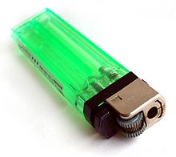
Duty to Warn
Many products are inherently dangerous
  It is the duty of the manufacturer to warn users of such dangers
  Failure to do so will result in liabilities both on the part of manufacturers and retailers
User: Haragayato
User: Man vyi

Slide 8
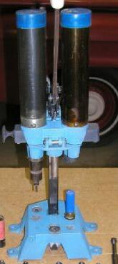
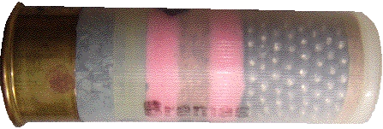
Duty to Warn
Consider George Ho Lem v Barotto Sports Ltd. and Ponsness-Warren, Inc.
  The plaintiff purchased a shotgun shell reloading machine
  He was instructed on its use and the machine came
  with instructions
  The plaintiff did not follow the instructions

Slide 9
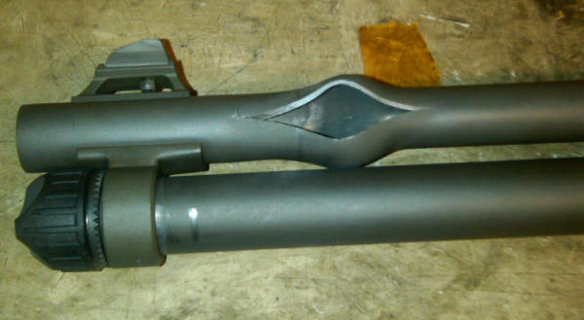
Duty to Warn
Consider George Ho Lem v Barotto Sports Ltd. and Ponsness-Warren, Inc.
  When the barrel on the shotgun subsequently burst, he claimed that there was inadequate warning of mismanufacturing a shell that appears normal
http://picsbox.biz/

Slide 10
Duty to Warn
The Appellate Court in Alberta determined that:
  The simple instructions and warnings provided by the manufacturer were adequate
  The training provided by the retailer was sufficient
  The damage suffered by the plaintiff was caused by his own negligence

Slide 11

Duty to Warn
However, in Lambert v Lastoplex Chemicals Co. Ltd. et al., the result was different:
  Lambert, a mechanical engineer, “purchased two one-gallon cans of a fast drying lacquer sealer... He proposed to use it to seal a parquet floor which he was installing in the recreation room of his home... The recreation room was in the basement of the house and was separated from a utility room in part by a plywood wall and in part by a fireplace. There was a door opening at one end between the two rooms, but no door. In the utility room there was a natural gas furnace and a natural gas water heater, each of which had a pilot light.”
Photo by Greg Hume

Slide 12
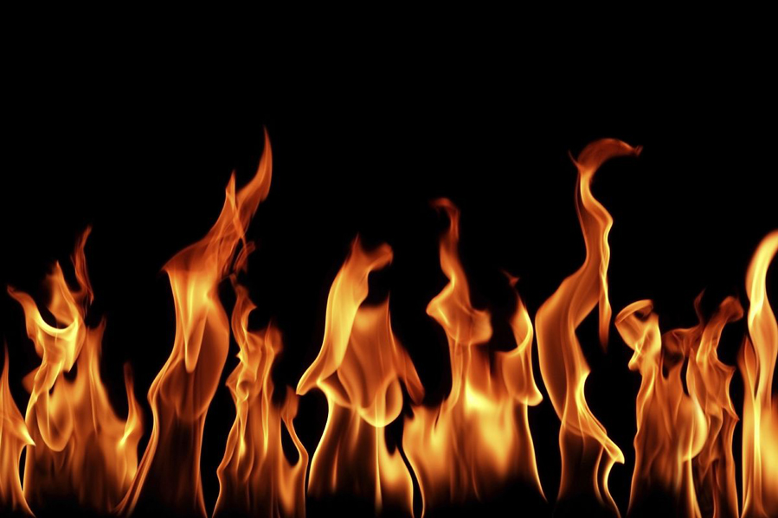
Duty to Warn
However, in Lambert v Lastoplex Chemicals Co. Ltd. et al., the result was different:
  “When he had done about five-sixths of the floor, he saw a line of flame advancing towards him from the far side of the recreation room. He ran up the stairs but an explosion occurred before he reached the top. The explosion caused burns to his body and property damage.”
http://www.chuckbauman.com/real-flames-photos.htm

Slide 13

Duty to Warn
These were the warnings on the cans:
CAUTION
KEEP AWAY FROM FIRE, HEAT AND OPEN-FLAME LIGHTS.
Caution inflammable!
Keep away from open flame!
CAUTION, INFLAMMABLE
Do not use near open flame or while smoking.
Ventilate room while using.
Danger – harmful if swallowed, avoid prolonged skin contact,
use with adequate ventilation, keep out of reach of children.
DO NOT DROP
LEAKING Packages Must be Removed to a Safe Place

Slide 14
Duty to Warn
Unfortunately, a competitor’s product had a clearer warning:
The Supreme Court of Canada found the warnings on the defendant’s cans did not provide adequate warnings concerning the danger of pilot lights for a reasonable user
DANGER—FLAMMABLE
DO NOT SMOKE. ADEQUATE VENTILATION TO THE OUTSIDE MUST BE PROVIDED. ALL SPARK PRODUCING DEVICES AND OPEN FLAMES (FURNACES, ALL PILOT LIGHTS, SPARK-PRODUCING SWITCHES, ETC.) MUST BE ELIMIATED, IN OR NEAR WORKING AREA.

Slide 15
Duty to Warn
In their decision, the judges stated:
  “The applicable principle of law ... may be stated as follows. Where manufactured products are put on the market for ultimate purchase and use by the general public and carry danger (in this case, by reason of high inflammability), although put to the use for which they are intended, the manufacturer, knowing of their hazardous nature, has a duty to specify the attendant dangers, which it must be taken to appreciate in a detail not known to the ordinary consumer or user. A general warning, as for example, that the product is inflammable, will not suffice where the likelihood of fire may be increased according to the surroundings in which it may reasonably be expected that the product will be used. The required explicitness of the warning will, of course, vary with the danger likely to be encountered in the ordinary use of the product.

Slide 16
Duty to Warn
In their decision, the judges stated:
  “In my opinion, the cautions on the labels affixed to the container cans of Supremo W-200 lacked the explicitness which the degree of danger in its use in a gas-serviced residence demanded. A home owner preparing to use that lacquer sealer could not reasonably be expected to realize by reading the three cautions that the product when applied as directed gives off vapours to such a degree as likely to create a risk of fire from a spark or from a pilot light in another part of the basement area.”

Slide 17
References
[1] D.L. Marston, Law for Professional Engineers, 4th Ed., McGraw Hill, 2008.
[2] Julie Vale, ECE 290 Course Notes, 2011.
[3] Wikipedia, http://www.wikipedia.org/
These course slides are provided for the ECE 290 class. The material in it reflects Douglas Harder’s best judgment in light of the information available to him at the time of preparation. Any reliance on these course slides by any party for any other purpose are the responsibility of such parties. Douglas W. Harder accepts no responsibility for damages, if any, suffered by any party as a result of decisions made or actions based on these course slides for any other purpose than that for which it was intended.

