Slide 1
Contract Law: Offer and Acceptance
Douglas Wilhelm Harder, M.Math. LEL
Department of Electrical and Computer Engineering
University of Waterloo
Waterloo, Ontario, Canada
ece.uwaterloo.ca
dwharder@alumni.uwaterloo.ca
© 2013 by Douglas Wilhelm Harder. Some rights reserved.

Slide 2
Outline
An introduction to the engineering profession, including:
  Standards and safety
  Law: Charter of Rights and Freedoms, contracts, torts, negligent malpractice, forms of carrying on business
  Intellectual property (patents, trade marks, copyrights and industrial designs)
  Professional practice
    Professional Engineers Act
    Professional misconduct and sexual harassment
  Alternative dispute resolution
  Labour Relations and Employment Law
  Environmental Law

Slide 3
Contract Law
The five essential elements of a contract are:
  An offer is made and accepted
  There is mutual intent to enter into the contract
  Consideration
  Capacity to contract
  Lawful purpose

Slide 4
Offer and Acceptance
Each contract has one party must offer the contract to the other
  This party is called the offeror
  The party to whom the contract is offered is the offeree
The offeree has two options:
  Accept the contract
  Reject the contract

Slide 5
Offer and Acceptance
When a contract is accepted, it must be clearly communicated to the offeror in an acceptable manner
An offeree can, at the same time, communicate the rejection of a contract
If an offeree does not agree to the terms of a contract, the offeree may modify the terms and make a counter-offer
  Now the rolls of the parties is changed: the offeree becomes the offeror

Slide 6
Counter-Offers
When the offeree makes a counter-offer, this signals a rejection of the original offer
  Even if the original offer was not formally rejected
Case: Hyde v. Wrench, 1840
  Wrench offers to sell his farm for £1200, which is declined by Hyde
  Wrench makes a final offer to sell his farm for £1000, which is declined later by Hyde
  Two days later, Hyde offers to buy the farm for £950, which is refused by Wrench approximately 20 days later
  Two days after this, Hyde agreed to buy the farm for £1000 and Wrench refused to sell
  Hyde sues for breech of contract
http://en.wikipedia.org/wiki/Hyde_v_Wrench

Slide 7
Counter-Offers
In his ruling, Lord Langdale said:
  “Under the circumstances stated in this bill, I think there exists no valid binding contract between the parties for the purchase of this property. The defendant offered to sell it for £1000, and if that had been at once unconditionally accepted there would undoubtedly have been a perfect binding contract; instead of that, the plaintiff made an offer of his own, to purchase the property for £950, and he thereby rejected the offer previously made by the defendant. I think that it was not afterwards competent for him to revive the proposal of the defendant, by tendering an acceptance of it; and that, therefore, there exists no obligation of any sort between the parties.”
http://en.wikipedia.org/wiki/Hyde_v_Wrench

Slide 8
Counter-Offers
A query for further information, however, does not constitute the rejection of the initial offer—the offer is still open
  “Under the circumstances stated in this bill, I think there exists no valid binding contract between the parties for the purchase of this property. The defendant offered to sell it for £1000, and if that had been at once unconditionally accepted there would undoubtedly have been a perfect binding contract; instead of that, the plaintiff made an offer of his own, to purchase the property for £950, and he thereby rejected the offer previously made by the defendant. I think that it was not afterwards competent for him to revive the proposal of the defendant, by tendering an acceptance of it; and that, therefore, there exists no obligation of any sort between the parties.”

Slide 9
Withdrawing Offers
An offer can be withdrawn by the offeror at any time prior to the offer being accepted by the offeree
  Once the offeree accepts the offer, the contract is established and all parties are bound by the terms of the contract

Slide 10
Timing
If an offer is made through post and it is agreed that the postal system (or a courier service today), the following standard is accepted
  An offer is only been withdrawn when the offeree receives the notice
  An offer is accepted, however, as soon as the offeree posts the acceptance
It is of critical importance to use registered mail in such cases
  It would likely not be equitable to allow one to not accept such a letter and to then claim that the withdrawal was not received

Slide 11
Timing
For instantaneous communications, including the telephone, telex, and likely e-mail, the contract is formed as soon as the acceptance is received
  The parties are aware of the communications and the possibility of any interruptions to the communications
  The offer is accepted in the location where the acceptance is read

Slide 12
Irrevocable Offers
An offeree may require time to consider accepting an offer, in which case, the offeror may include a term in the contract that makes the offer irrevocable for a specified period of time or a specific date
The offeree may accept the contract at any time prior to the end date specified in the contract

Slide 13
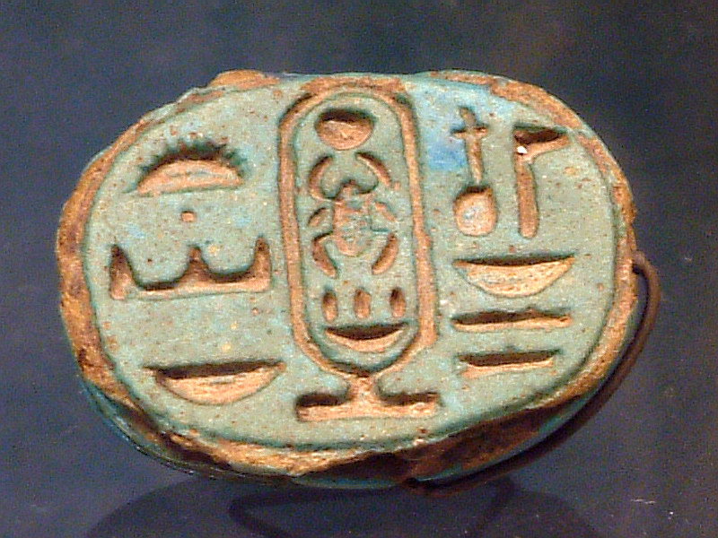


Irrevocable Offers
Because the irrevocability is itself a term that is already in force—even though the offer has not been accepted, there needs to be some recognition of that fact
In this case, the offeror must seal the offered contract
  We will deal with consideration in a future topic
Guillaume Blanchard
JP7
http://www.kcdecorativeseal.com/

Slide 14
Options
A special type of irrevocable contract is an option
The offeree has the right to exercise the option at a point in the future
  For example, the offeror gives the offeree the option of purchasing stocks in the future at the present price
  At some point in the future, the offeree may exercise the option

Slide 15
Lifespan of an Offer
Of course, if the offeror dies, the offer is no longer valid
If the offeree dies, there is currently no precedence for the offer to be invalid
  Can a lawyer for the offeree accept the offer on behalf of the offeree?
  It is reasonable to assume the answer is “no”, but we will have to wait...

Slide 16
References
[1] D.L. Marston, Law for Professional Engineers, 4th Ed., McGraw Hill, 2008.
[2] Julie Vale, ECE 290 Course Notes, 2011.
[3] Wikipedia, http://www.wikipedia.org/
These course slides are provided for the ECE 290 class. The material in it reflects Douglas Harder’s best judgment in light of the information available to him at the time of preparation. Any reliance on these course slides by any party for any other purpose are the responsibility of such parties. Douglas W. Harder accepts no responsibility for damages, if any, suffered by any party as a result of decisions made or actions based on these course slides for any other purpose than that for which it was intended.

