Slide 1
Occupational Health and Safety
Douglas Wilhelm Harder, M.Math. LEL
Department of Electrical and Computer Engineering
University of Waterloo
Waterloo, Ontario, Canada
ece.uwaterloo.ca
dwharder@alumni.uwaterloo.ca
© 2013 by Douglas Wilhelm Harder. Some rights reserved.

Slide 2
Outline
An introduction to the engineering profession, including:
  Standards and safety
  Law: Charter of Rights and Freedoms, contracts, torts, negligent malpractice, forms of carrying on business
  Intellectual property (patents, trade marks, copyrights and industrial designs)
  Professional practice
    Professional Engineers Act
    Professional misconduct and sexual harassment
  Alternative dispute resolution
  Labour Relations and Employment Law
  Environmental Law

Slide 3
Outline
The rules and regulations regarding workplace health and safety
  Internal Responsibility System
  Occupational Health and Safety Act
  The three rights of workers
  Joint Health and Safety Committees
  Health and Safety Representatives
  Duties, including duties of the engineer
  Harassment and violence
  Regulations
    Examples: Designated substances and WHMIS

Slide 4
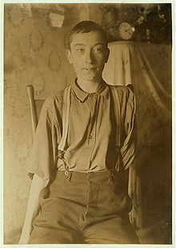
Background
Harry McShane, 16 years old
  1908
Notes:
Harry McShane lost his arm in 1908 at the age of 16 during an
accident at in a furniture factory —he received no compensation whatsoever
Later, he found employment as a switch and flag operator at a railway

Slide 5
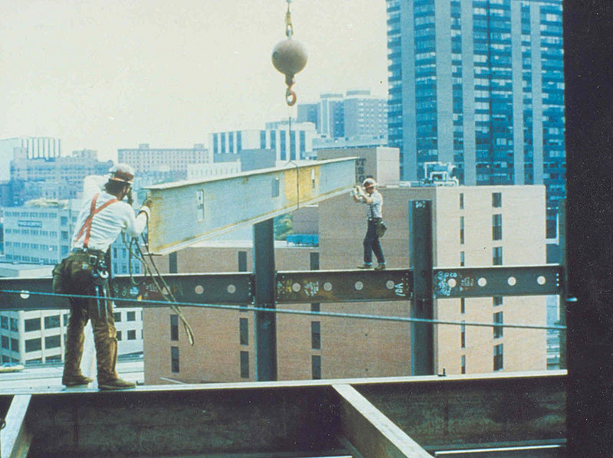
Internal Responsibility System
The core philosophy of the government’s approach to health and safety is to use a three-party approach
  Everyone has a role to play in keeping the workplace safe and healthy
  Workers have a duty to report
  while following safe practices
  Employers and supervisors
  are required to educate
  workers and facilitate a safe
  workplace
Notes:
Everyone must
have a sincere wish to prevent accidents and illnesses
accept that accidents and illnesses have causes that can be eliminated or greatly reduced;
accept that risk can be continually reduced, so that the time between accidents and illnesses get longer and longer;
accept that health and safety is an essential part of doing his or her work (health and safety is not an extra, it is part of doing the job);
Every person must
have a clear understanding of what he/she is responsible for; what he/she can do to change matters; and when things must be done;
be regularly asked to explain what they have done to ensure health and safety on the job and in the workplace;
have a clear understanding of their own skill, ability and limitations, and should have the capacity to carry out their responsibilities;
attempt to avoid conflict when trying to reduce risk;
As an individual, each person must go beyond just complying with health and safety rules and standards, and strive to improve work processes to reduce risk;
When an individual cannot reduce risk by him/herself, then they must cooperate with others to go beyond just complying with health and safety rules and standards, and strive to improve work processes to reduce risk;
Everyone must understand the IRS process, believe in it, and take steps to make it effective at all levels in the organization; and
No one should be fearful of reprisals when using IRS processes.

Slide 6
Health and Safety
The Act of the Provincial Parliament ensuring a safe workplace is the
Occupational Health and Safety Act
In federal workplaces, the statute is the
Canada Labour Code

Slide 7
Health and Safety
The statute covers:
  Workplace Health and Safety officers and committees
  Duties of employers and others
  Violence and harassment
  Codes of Practice
  Toxic Substances
  Right to refuse or to stop work
  Reprisals by the employer are prohibited
  Notices, enforcement, offences, penalties, and regulations

Slide 8


Health and Safety
The government issues a guide
that describes the Act
Compliance and Safety LLC

Slide 9
Health and Safety
The guidelines start with the
three rights of workers
  The right to know
  The right to participate
  The right to refuse

Slide 10
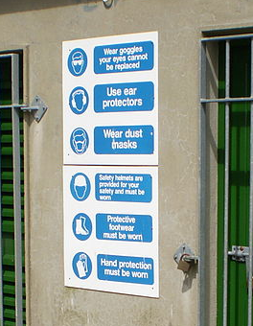
The Right to Know
Workers have the right to know about any potential hazards to which they may be exposed in the workplace
Employers can facilitate this by
  Providing information
  Providing training
  Supervision
Patrick McAleer

Slide 11
The Right to Participate
Workers have the right to participate in the process of identifying and resolving workplace health and safety concerns
Participation is through
  Worker membership on the Joint Health and Safety Committees
  Worker Health and Safety Representatives

Slide 12
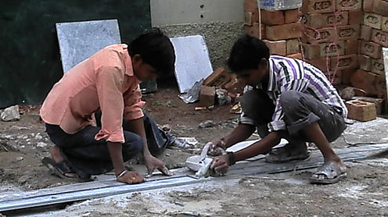
The Right to Refuse
Workers have the right to refuse work that they believe is dangerous to either their own health and safety or that of another worker
Section 43 of the Act describes the exact process
  Employers cannot engage in any act of reprisal against a worker who legitimately refuses to work
From:
User: Abhishek727

Slide 13
JHSCs
The core of workplace safety are the
Joint Heath and Safety Committees (JHSCs)
This committee comprises representatives of workers and management
  Half of the members must be workers
  Two co-chairs
Duties:
  Monitor
  Identify hazards
  Recommend improvements
From:
Notes:
Some members may have to be certified by taking courses
Monitor: monthly inspections,
investigates work refusals,
investigates critical injuries and fatalities
Identify Hazards: machinery, substances, production processes, working conditions, procedures, or anything else relevant
The employer has three weeks to respond
to any recommendations...

Slide 14
Health and Safety Representatives
Smaller workplaces require workers acting as a Health and Safety Representative
  Chosen by non-managerial workers or the union
From:

Slide 15

Representatives and Committees
The Ministry of Labour publishes a guide for both JHSC and Health and Safety Representatives
From:

Slide 16
Duties
Duties are specified for
  Employers
  Supervisors
  Constructors
  Owners
  Suppliers
  Corporate officers and directors
  Workers

Slide 17
Duties
The services of professional engineers may be required:
  54(1)(k) An inspector may require an employer to have equipment, machinery or devices tested by a professional engineer and to provide a report bearing the seal and signature of the professional engineer stating that the equipment, machine or device is not likely to endanger a worker.

Slide 18
Duties
Contraventions by Architects and Engineers
  Architects and engineers are in contravention of the Act if they negligently or incompetently give advice or a certification required under the Act and, as a result, a worker is endangered.
  Subsection 31(2)
Breaching the OHSA is immediately grounds for a charge of professional misconduct under 72(2)(d)

Slide 19
Workplace Harassment
Part of workplace health and safety is reducing harassment
  It is insufficient to reduce the threat of harm from the workplace
    We live in a society where all members are human
  Harassment is any course of vexatious comment or conduct
    Unwelcome words or actions that are offensive, embarrassing, humiliating or demeaning including discrimination
  It includes psychological and personal harassment
Notes:
This includes domestic violence

Slide 20

Workplace Harassment
Examples:
  Making remarks, jokes or innuendos that
  demean, ridicule, intimidate, or offend
  Displaying or circulating offensive
  pictures or materials in print or
  electronic form
  Bullying
  Repeated offensive or intimidating
  calls or e-mails
  Inappropriate sexual touching,
  advances, suggestions or
  requests
Notes:
This includes domestic violence

Slide 21
Workplace Harassment
The workplace harassment policy should:
  Show the employer’s commitment
  Consider all sources of workplace
  harassment including not only other
  employees and management but also
  customers, clients, strangers, and
  domestic/intimate partners
  Outline the roles and responsibilities
  of those supporting the policy
  Be signed and dated
Notes:
This includes domestic violence

Slide 22
Workplace Violence
Part of workplace health and safety is also reducing violence
  Violence is the exercise or attempted exercise of physical force that could cause injury or any statement or behaviour that threatens such force
  This includes domestic violence
Notes:
This includes domestic violence

Slide 23
Workplace Violence
Examples:
  Verbally threatening to attack a worker
  Leaving threatening notes at or sending threatening e-mails to a workplace
  Shaking a fist in a worker’s face
  Wielding a weapon at work
  Hitting or trying to hit a worker
  Throwing an object at a worker
  Sexual violence against a worker
  Kicking an object the worker is standing on such as a ladder
  Trying to run down a worker using a vehicle or equipment such as a forklift
Notes:
This includes domestic violence

Slide 24
Regulations
The OHSA makes provisions for numerous regulations:
Safety
  Construction Projects
  Industrial Establishments
  Mines and Mining Plants
  Critical Injury Defined
  Diving Operations
  Farming Operations
  Firefighters
  Health Care and Residential Facilities
  Needle Safety
  Oil and Gas—Offshore
  Roll-over Protective Structures
  University Academics and Teaching Assistants
  Window Cleaning
Designated Substances
  Asbestos on Construction Projects
  Designated Substances
General
  Biological or Chemical Agents, Control of Exposure to
  Hazardous Materials Inventories
  Workplace Hazardous Materials Information System (WHMIS)
Hazardous Physical Agents
  X-Ray Safety
Regulations that Directly Affect/Impact the Act
  Confined Spaces
  Training Programs
  Unilateral Work Stoppage
  Inventory of Agents or Combinations of Agents...
  Joint Health and Safety Committees—Exemption from Requirements

Slide 25
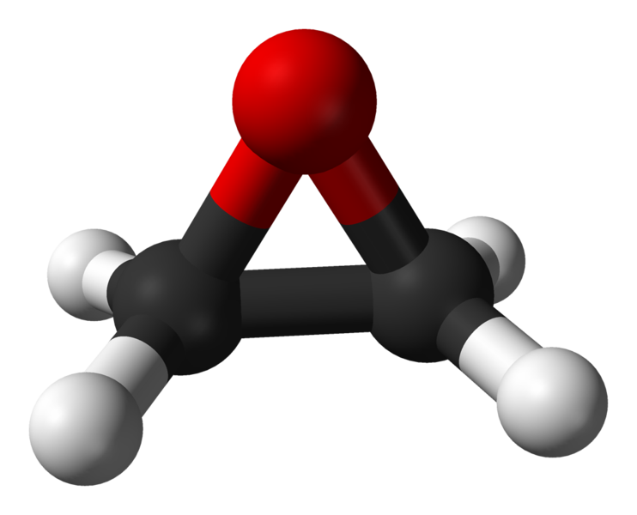
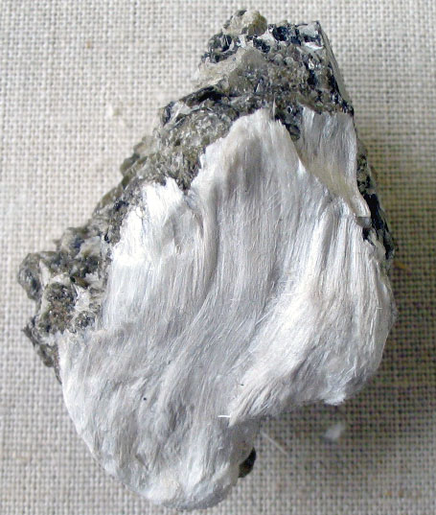
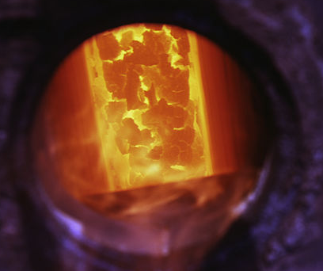
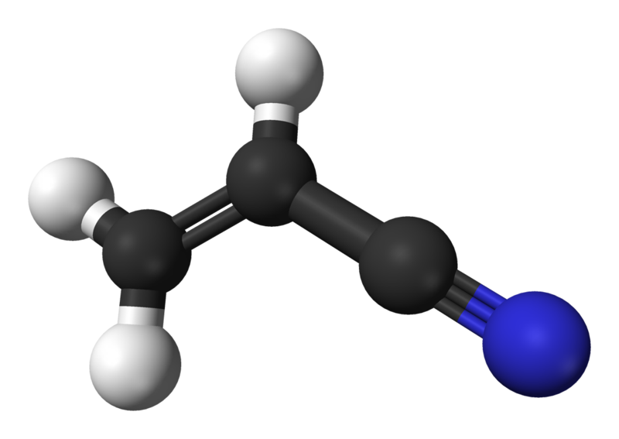

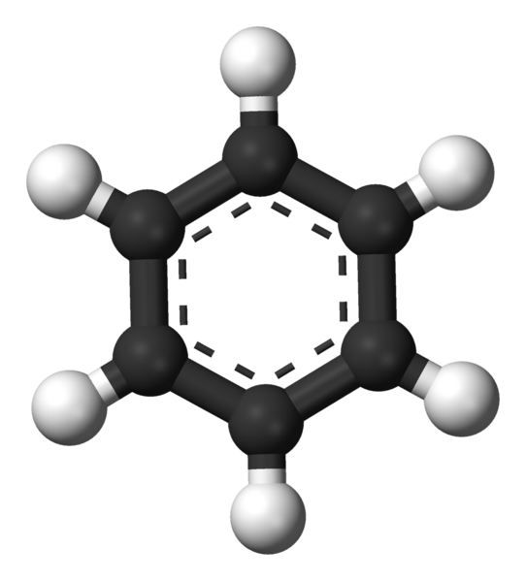
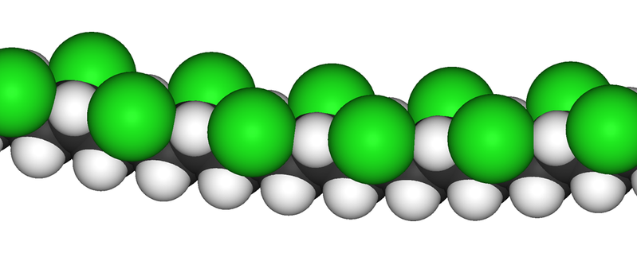
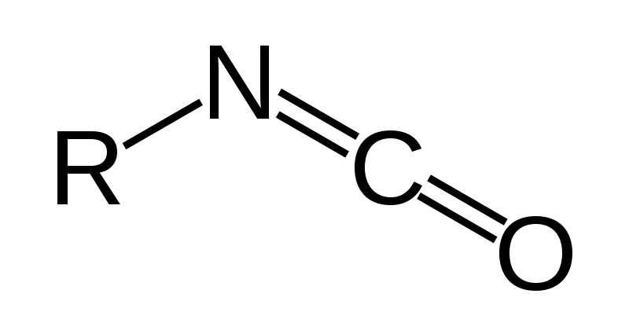
Designated Substances
For example, the regulations on designated substances focuses on
  Acrylonitrile
  Arsenic
  Asbestos
  Benzene
  Coke oven emissions
  Ethylene oxide
  Isocyanates
  Lead
  Mercury
  Silica
  Vinyl chloride
As
Hg
Pb
User: BigRiz
Notes:
Acrylonitrile, used in plastics
Arsenic, strenthening copper and lead, in semiconductors as a doping agent (gallium arsenide)
Asbestos
Benzene – an intermediate to other chemicals, e.g., styrene -> polymers and plastics
Coke ovens – a reducing agent in smelting iron ore
Ethylene oxide, used, for example, to make ethylene glycol
Isocyanates – used, for example, in making polyurethane
Lead and mercury
Silica – glass
Vinyl chloride – used, for example, in making PVC

Slide 26
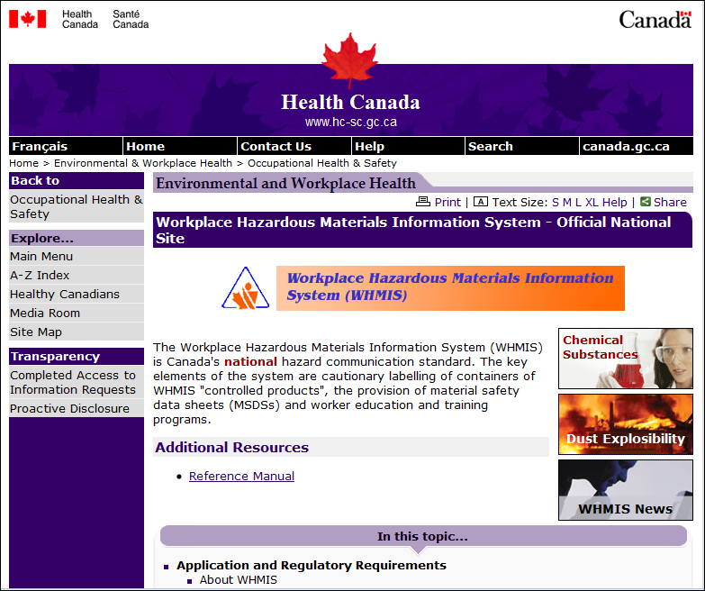
WHMIS

Slide 27
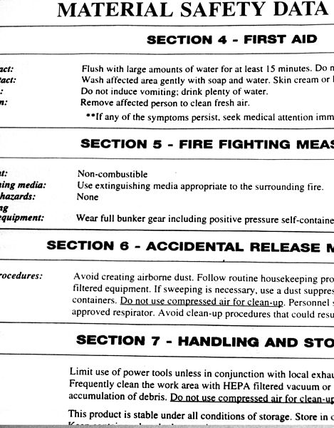








WHMIS
Workplace Hazardous Materials Information System
  Canada's national workplace hazard communication standard
  Labeling of controlled products
  Material safety data sheets (MSDS)
  Worker education and site-specific training
Jeffrey M. Vinocur

Slide 28
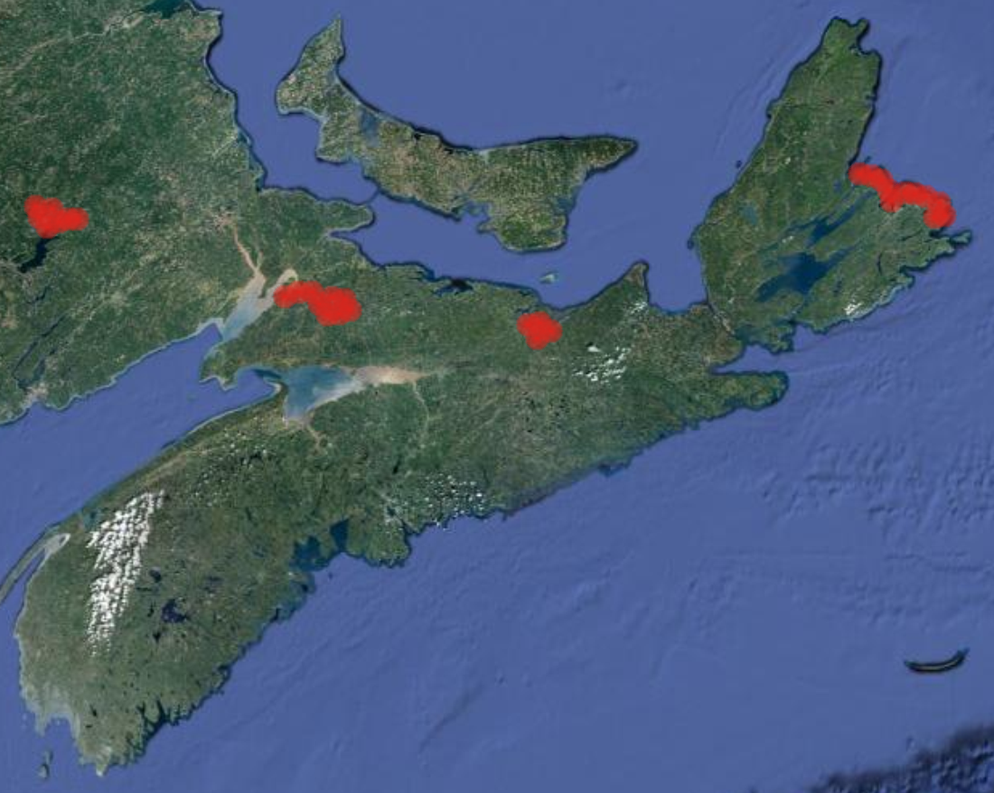
Case: Westray Mine Disaster
Late 1980s, Nova Scotia:
  The Pictou mine coalfield had
  been mined for 200 years
  The Foord coal seam tended to
  produce significant amounts of
  methane gas
  The previous mine, closed 50 years prior, had experienced eight
  methane explosions
  246 miners had been killed between 1838 to 1952 in such explosions
Background: (c) 2013 TerraMetrics

Slide 29

Case: Westray Mine Disaster
With high unemployment, Curragh Resources Inc. obtained provincial and federal funding to open a new coal mine
  Prime Minister Brian Mulroney was elected in the federal riding
  Premier Donald Cameron was also from the provincial riding
  300 jobs for 15 years were promised by the company
  The announcement was five days before a provincial election
  Nova Scotia Power Corp. entered into a contract to buy 700,000 tonnes of coal a year for 15 years

Slide 30
Threats
Two significant threats in any coal mine:
  Methane gas
  Coal dust
  Cave ins

Slide 31

Coal Dust
A methane explosion by itself is serious enough

Slide 32

Coal Dust
A methane explosion by itself is serious enough
  A shock wave will travel up the tunnel where the force diminishes only slightly as it travels down the tunnel
  In the open, the force of an explosion drops by 1/r²
  Confined to two dimensions, the force drops by 1/r
  In one dimension, the force does not drop unless absorbed by the walls

Slide 33
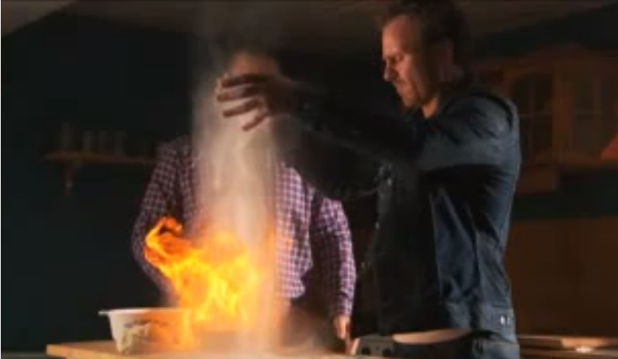
Coal Dust
Consider what happens when you add flour to a flame:
http://www.youtube.com/watch?v=F49r9wFkDgo

Slide 34

Coal Dust
A floor covered in coal dust causes positive feedback

Slide 35

Coal Dust
A floor covered in coal dust causes positive feedback
  The shockwave stirs up the coal dust

Slide 36

Coal Dust
A floor covered in coal dust causes positive feedback
  The shockwave stirs up the coal dust
  The coal dust, in turn, explodes amplifying the shock wave

Slide 37
Coal Dust
Additional issues:
  The atmosphere is already oxygen poor
  This results in high concentrations of carbon monoxide
  Drägerers, mining rescue workers, must operate in extremely dangerous conditions

Slide 38
Coal Dust
The solution is to mix coal dust with stone dust
  This leaves the coal dust non-hazardous
  At Westray, stonedusting was done sporadically—often prior to inspections
  Miners volunteered to do stonedusting after finishing 12-hour shifts

Slide 39
Methane
The only solution to deal with methane gas is adequate ventilation
  From Judge Richards’s report:

Slide 40
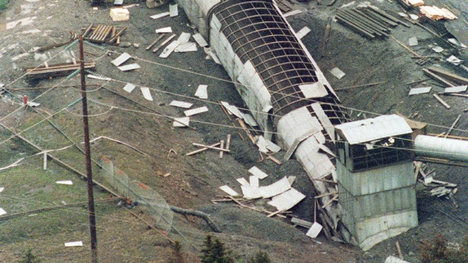
Westray Mine Disaster
At 5:18 a.m. on May 9th, 1992, a spark over a kilometre underground ignited methane gas
  The explosion shattered windows in Stellarton—half a kilometre away from the mine entrance and shook houses over a kilometre from the site
THE CANADIAN PRESS/Kerry Doubleday

Slide 41
Westray Mine Disaster
“A safe workplace demands a responsible and conscientious commitment from management—from the Chief Executive Officer down. Such a commitment was sadly lacking at the Westray mine.”
  Judge Richards

Slide 42
The 26 Miners
John Thomas Bates 56
Larry Arthur Bell 25
Bennie Joseph Benoit 42
Wayne Michael Conway 38
Ferris Todd Dewan 35
Adonis J. Dollimont 36
Robert Steven Doyle 22
Remi Joseph Drolet 38
Roy Edward Feltmate 33
Charles Robert Fraser 29
Myles Danial Gillis 32
John Philip Halloran 33
Randolph Brian House 27
Trevor Martian Jahn 36
Laurence Elwyn James 34
Eugene W. Johnson 33
Stephen Paul Lilley 40
Micheal Frederick MacKay 38
Angus Joseph MacNeil 39
Glenn David Martin 35
Harry Alliston McCallum 41
Eric Earl McIsaac 38
George James Munroe 38
Danny James Poplar 39
Romeo Andrew Short 35
Peter Francis Vickers 38

Slide 43
Aftermath
Bill C-45 was passed into federal statute in 2004:
  217.1 Every one who undertakes, or has the authority, to direct how another person does work or performs a task is under a legal duty to take reasonable steps to prevent bodily harm to that person, or any other person, arising from that work or task
  Person counselling offence
  22. (1) Where a person counsels another person to be a party to an offence and that other person is afterwards a party to that offence, the person who counselled is a party to that offence, notwithstanding that the offence was committed in a way different from that which was counselled.
  Idem
  (2) Every one who counsels another person to be a party to an offence is a party to every offence that the other commits in consequence of the counselling that the person who counselled knew or ought to have known was likely to be committed in consequence of the counselling.
  Definition of “counsel”
  (3) For the purposes of this Act, “counsel” includes procure, solicit or incite.

Slide 44
References
[1] Julie Vale, ECE 290 Course Notes, 2011.
[2] Wikipedia, http://www.wikipedia.org/
[3] Occupational Health and Safety Act
http://www.e-laws.gov.on.ca/html/statutes/english/elaws_statutes_90o01_e.htm
These course slides are provided for the ECE 290 class. The material in it reflects Douglas Harder’s best judgment in light of the information available to him at the time of preparation. Any reliance on these course slides by any party for any other purpose are the responsibility of such parties. Douglas W. Harder accepts no responsibility for damages, if any, suffered by any party as a result of decisions made or actions based on these course slides for any other purpose than that for which it was intended.

