Slide 1
Intellectual Property
Douglas Wilhelm Harder, M.Math. LEL
Department of Electrical and Computer Engineering
University of Waterloo
Waterloo, Ontario, Canada
ece.uwaterloo.ca
dwharder@alumni.uwaterloo.ca
© 2012 by Douglas Wilhelm Harder. Some rights reserved.

Slide 2
Outline
An introduction to the engineering profession, including:
  Standards and safety
  Law: Charter of Rights and Freedoms, contracts, torts, negligent malpractice, forms of carrying on business
  Intellectual property (patents, trade marks, copyrights and industrial designs)
  Professional practice
    Professional Engineers Act
    Professional misconduct and sexual harassment
  Alternative dispute resolution
  Labour Relations and Employment Law
  Environmental Law

Slide 3
Property
Property is divided into
  Real property
  Personal property or chattel
    Tangible personal property
    Intangible personal property
  The latter includes intellectual property...

Slide 4
Intellectual Property
Intellectual property is divided into:
  Rights concerning the reproduction of works
  Industrial property rights
Rights concerning the reproduction of works
  Copyright
Industrial property rights
  Patents
  Trademarks
  Industrial design
  Trade secrets

Slide 5
Intellectual Property
The importance of intellectual property was already recognized by the founding fathers of the United States:
Article I, Section 8, Clause 8 of the United States Constitution empowers the Congress:
  To promote the Progress of Science and useful Arts, by securing for limited Times to Authors and Inventors the exclusive Right to their respective Writings and Discoveries.

Slide 6
Intellectual Property
The importance of intellectual property was already recognized by the founding fathers of the United States:
Article I, Section 8, Clause 8 of the United States Constitution empowers the Congress:
  To promote the Progress of Science and useful Arts, by securing for limited Times to Authors and Inventors the exclusive Right to their respective Writings and Discoveries.

Slide 7
Intellectual Property
In Canada, legislation of copyrights and patents is a federal power (paraphrased):
  Legislative Authority of Parliament of Canada
  91. It shall be lawful for the Queen to make Laws for the Peace, Order, and good Government of Canada; and it is hereby declared that the exclusive Legislative Authority of the Parliament of Canada extends to the Subjects next hereinafter enumerated; that is to say,
  22. Patents of Invention and Discovery.
  23. Copyrights.

Slide 8
Copyright
Copyright gives the creator of an original work the exclusive right to its production, reproduction, performance or publication
  Copyright is generally in force for the life of the author plus anywhere from 50 to 100 years
  Term of copyright
  6. The term for which copyright shall subsist shall, except as otherwise expressly provided by this Act, be the life of the author, the remainder of the calendar year in which the author dies, and a period of fifty years following the end of that calendar year.

Slide 9
Copyright
What can be copyrighted?
From the Act:
  PART I Copyright and moral rights in works
  PART II Copyright in performer’s performances, sound recordings and communication signals and moral
  rights in performers’ performances

Slide 10
Moral Rights
What are moral rights?
  Despite being able to sell a copyright, the original author should still have the right to be attributed, to require the integrity of the work and with what the work is associated
For example, would you want a photograph you took associated with an advertisement for the KKK?

Slide 11
Copyright
For the copyright of a work to be assigned to another party, that assignment must be written and signed by the holder of the copyright

Slide 12
Industrial Property Rights
We will now cover four industrial property rights:
  Patents
  Trademarks
  Industrial design
  Trade secrets

Slide 13
Patents of Invention
A patent is a contract between an inventor and the public
  From Latin, patere means “to lay open”
  It is an agreement whereby the inventor makes the design available for public disclosure in return for a fixed period of time during which the inventor has exclusive rights to that invention

Slide 14
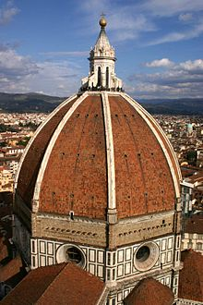
Patents of Invention
The earliest modern patent was to Filippo Brunelleschi who received a 3-year patent for a barge with hoisting gear that carried marble
Frank Kovalchek

Slide 15
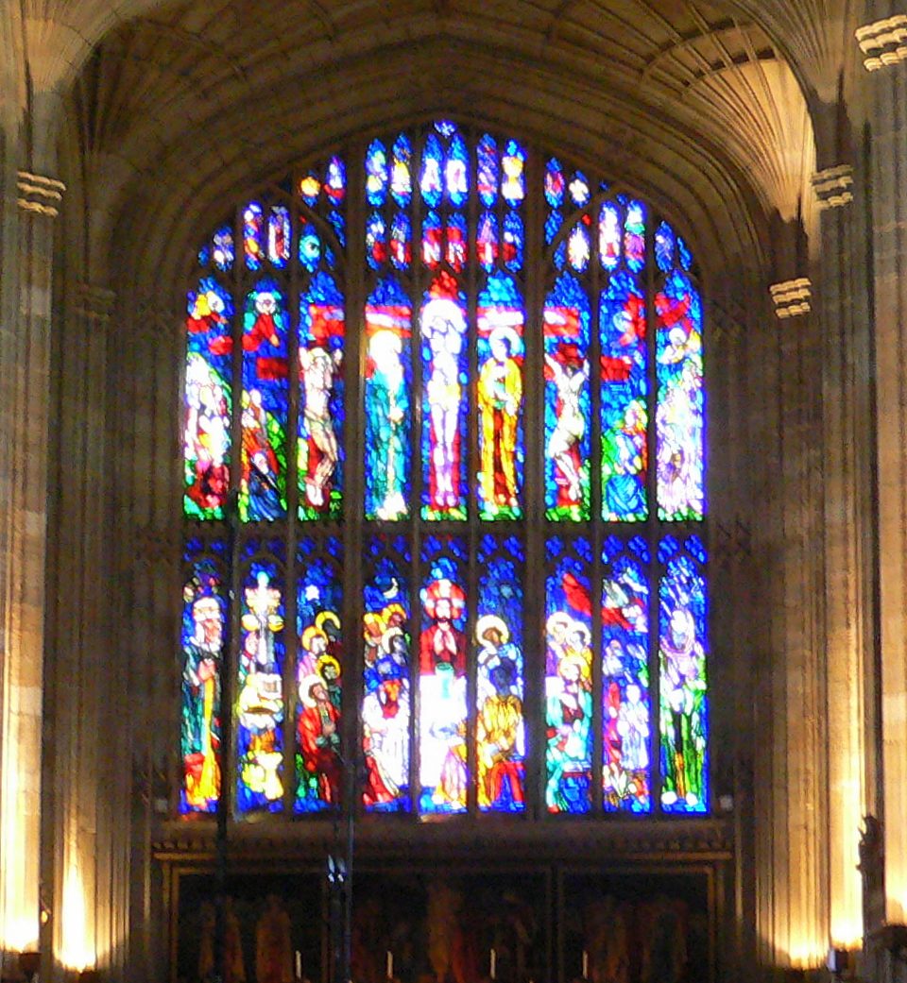
Patents of Invention
The first English patent was to John of Utynam who received a 20-year monopoly from King Henry VI in 1449 to make stained glass
Eton College
Herry Lawford

Slide 16
Patents in Canada
In Canada, patents are covered under the Patent Act
  “invention” means any new and useful art, process, machine, manufacture or composition of matter, or any new and useful improvement in any art, process, machine, manufacture or composition of matter
A patent expires 20 years following the day it was filed

Slide 17
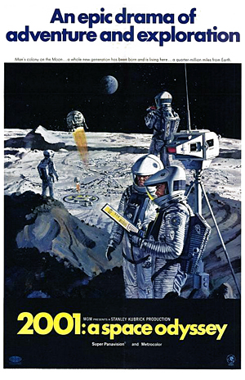
Patents in Canada
An invention is not patentable if it has either been disclosed or is known to the public
  In Canada and the United States, relative novelty allows the invention to be disclosed or known for no more one year prior to filing
  In Europe, absolute novelty does not allow any form of novelty
Interesting note:
  In a 1945 letter, Arthur C. Clarke gave such a
  complete description of a geostationary tele-
  communications satellite that when Bell Labs
  tried to patent the idea in 1954, it was refused
2001: A SPACE ODYSSEY © 1968 Turner Entertainment Co.

Slide 18
Patents in Canada
The test for an invention is that it must be novel, non-obvious and it must have utility
In Apotex Inc. v. Sanofi‑Synthelabo Canada Inc., the Supreme Court upheld the test for non-obviousness:
  Identify the notional “person skilled in the art” and identify the relevant common general knowledge of that person;
  Identify the inventive concept of the claim in question or if that cannot readily be done, construe it;
  Identify what, if any, differences exist between the matter cited as forming part of the “state of the art” and the inventive concept of the claim or the claim as construed;
  Viewed without any knowledge of the alleged invention as claimed, do those differences constitute steps which would have been obvious to the person skilled in the art or do they require any degree of invention?

Slide 19
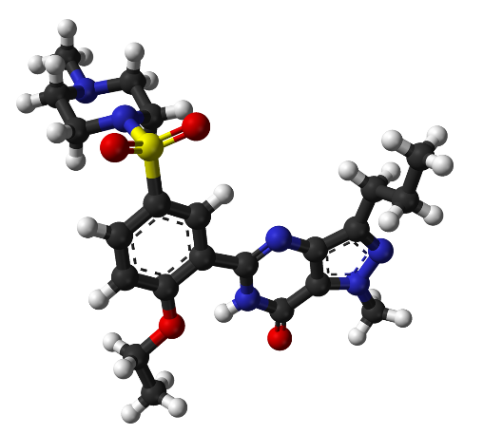
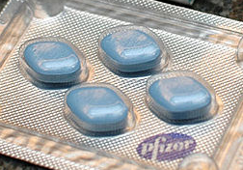
Sildenafil Patent
Note that a patent requires the applicant to disclose the invention at hand
In Teva Canada Limited v. Pfizer Canada Inc., et al., 2012, the Supreme Court of Canada invalidated Pfizer’s patent on the chemical sildenafil
  Also known as viagra
User: SElefant

Slide 20
Sildenafil Patent
In Teva Canada Limited v. Pfizer Canada Inc., et al., 2012, the court ruled:
  Pfizer holds Patent 2,163,446 for the use of a “compound of formula (I)” or a “salt thereof” as a medicament for the treatment of erectile dysfunction. The patent’s specification ends with seven cascading claims for successively smaller ranges of compounds, with Claims 6 and 7 relating to a single compound each. Only sildenafil, the subject of Claim 7 and the active compound in Viagra, had been shown to be effective in treating erectile dysfunction at the time of the patent application...

Slide 21
Sildenafil Patent
In Teva Canada Limited v. Pfizer Canada Inc., et al., 2012, the court ruled:
  ... Although the patent includes the statement that “one of the especially preferred compounds induces penile erection in impotent males”, the patent application does not disclose that the compound that works is sildenafil, that it is found in Claim 7, or that the remaining compounds had not been found to be effective in treating erectile dysfunction.

Slide 22
Sildenafil Patent
Basically, the Supreme Court ruled that Pfizer had not been sufficiently straightforward in disclosing the actual invention in question, the drug sildenafil
Consequently, the patent is invalid

Slide 23
Software Patents
Issues with software patents have been around for years — the issue is related to a more fundamental question:
What is invented and what is discovered?

Slide 24
Software Patents
For example, is mathematics invented or discovered?
  Is it a question of faculties or understanding?
  Incidentally, this is the intermediate value theorem...

Slide 25
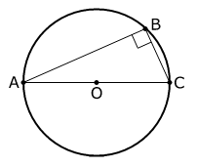
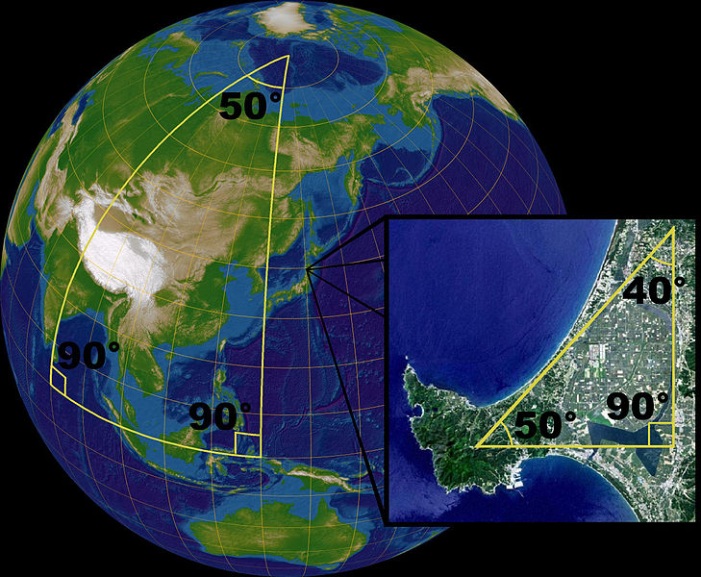
Software Patents
Consider the following:
  With one set of axioms, we get Euclidean geometry
  Determine a different axiom, and we get a
  different, non-Euclidean, geometry which
  is, never-the-less useful
Lars H. Rohwedder, User: Sarregouset

Slide 26
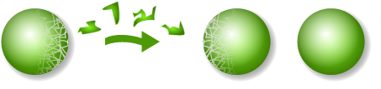
Software Patents
Mathematicians make their lives much simpler by assuming the Axiom of Choice
  Given a set of sets, there exists a function which maps each set in the set to an element in that set...
This is obvious for even countable sets:
{{1, 2, 3}, {2, 5}, {2, 4}, {3, 5}} → {2, 3, 4}
Unfortunately, if we apply this to larger, uncountable, sets, this leads to the Banach-Tarski_Paradox
Consequence? Any theorem which uses the full force of the Axiom of Choice has no application in the real world

Slide 27
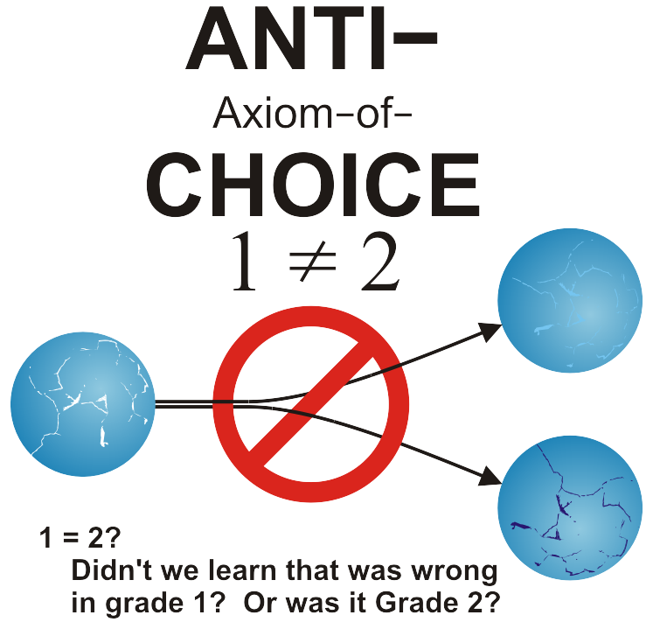
Software Patents
For fun...

Slide 28
Software Patents
Software is a collection of algorithms...
Consequently, the question is, is an algorithm mathematics or not?
  I.e., can you patent an algorithm?
The logic against:
  A program is a transcription of an algorithm in a programming language
  Every programming language can be expressed in terms of Church’s lambda calculus
  Thus, every program is a transcription of a mathematical expression

Slide 29
Software Patents
Other issues:
  There is no reasonable means of searching software patents
  If you do not enforce the use of a trademark, you loose that trademark
  With a software patent, failure to enforce it does not prevent them from enforcing it later and suing those who profited from using the patented algorithm
  That is, the holder need not make any legitimate attempt to licence the algorithm, but can never-the-less later come and sue programmers using the algorithm

Slide 30
Software Patents
Some history:
  Binary-coded decimal uses four bits to code decimal numbers
  01000010 → 0100 0010 → 42
  To convert this to a binary number, you need an algorithm:
  0100 × 1010 + 0010 = 101000 + 0010 = 101010
unsigned int bcd_to_binary( unsigned int x ) {
int shift = 28;
unsigned int binary = 0;
int i;
for ( i = 0; i < 8; ++i ) {
binary <<= 1;
binary += (binary << 2) + ((x >> shift) & 0xF);
shift -= 4;
}
return binary;
}
From Matlab: Horner’s rule...

Slide 31
Software Patents
Some history:
  Binary-coded decimal uses four bits to code decimal numbers
  01000010 → 0100 0010 → 42
  The application for this patent was denied

Slide 32
Software Patents
On the other hand, is not the non-obvious combination of mathematical algorithms, with a goal of performing something useful, possibly considered an invention?

Slide 33
Software Patents
In the United States, In re Alappat, 1994, it was determined that a mathematical algorithm for anti-aliasing integrated into, in this case, a digital oscillator, satisfied the physical requirement component
Unfortunately, this led to a vast influx of software patents, many of which were dubious and often had prior art

Slide 34
Software Patents
On that was issued in 1985 was for the Lempel-Ziv-Welch universal lossless data compression algorithm
  It was an improvement on the 1978 algorithm LZ78
  It was also easy to implement
  It was used in the gif image format in 1987 as a developer used the idea from an article published by Welch in IEEE
  In 1993, Unisys, the holder of the patent, entered into an agreement with CompuServe and
  This led to the development of PNG

Slide 35
Software Patents
The RSA encryption algorithm was patented in the United States with relative novelty — the algorithm was published in a paper in September 1977, three months prior to the filing in December 1977
  This made patenting in all countries using absolute novelty not possible...
  Oddly enough, Clifford Cooks had developed the algorithm in 1973, but it was classified until 1997

Slide 36
Software Patents
In 2011, there was one development
  The patent was on a method of detecting credit card fraud
  The court ruled you cannot patent what amounts to a mental process—even if programmed on a computer
  This rule only applies, however, if the mathematics is sufficiently completed that the use of a computer is required
The patent itself was rather absurd
  Any method of detecting fraud that used recorded IP addresses would have infringed on this patent...

Slide 38
References
[1] Teva Canada Limited v. Pfizer Canada Inc., et al., 2012
http://scc.lexum.org/decisia-scc-csc/scc-csc/scc-csc/en/item/12679/index.do
[2] Patent Act, 1985
laws-lois.justice.gc.ca/eng/acts/P-4/
[3] Julie Vale, ECE 290 Course Notes, 2011.
[4] Wikipedia, http://www.wikipedia.org/
These course slides are provided for the ECE 290 class. The material in it reflects Douglas Harder’s best judgment in light of the information available to him at the time of preparation. Any reliance on these course slides by any party for any other purpose are the responsibility of such parties. Douglas W. Harder accepts no responsibility for damages, if any, suffered by any party as a result of decisions made or actions based on these course slides for any other purpose than that for which it was intended.

