Slide 1
Ethics: A Psychological Basis
Douglas Wilhelm Harder, M.Math. LEL
Department of Electrical and Computer Engineering
University of Waterloo
Waterloo, Ontario, Canada
ece.uwaterloo.ca
dwharder@alumni.uwaterloo.ca
© 2012 by Douglas Wilhelm Harder. Some rights reserved.

Slide 2
Outline
An introduction to the engineering profession, including:
  Standards and safety
  Law: Charter of Rights and Freedoms, contracts, torts, negligent malpractice, forms of carrying on business
  Intellectual property (patents, trade marks, copyrights and industrial designs)
  Professional practice
    Professional Engineers Act
    Professional misconduct and sexual harassment
  Alternative dispute resolution
  Labour Relations and Employment Law
  Environmental Law

Slide 3
Ethics and Science
Ethics used to be entirely in the domain of philosophy
Today, by using knowledge of psychology and neuroscience together with genetics and evolution and the ability to , ethics is slowly being crossing the barrier from an art to science

Slide 4
Ethics and Science
Consider light:
  Light forms a continuous spectrum of infinitely many colours
  The human eye is sufficiently sensitive that we require 24-bit colour to represent colours faithfully: 2²⁴ = 16 777 216 different colours
  We don’t, however, require that many colours—each colour can be represented by different combinations of three colours
  It is a three-dimensional space

Slide 5


Ethics and Science
In elementary school, you learned that the subtractive primary colours were red, yellow, and blue
  This is wrong—it’s analogous to picking a non-orthogonal basis is linear algebra: it’s exceptionally inefficient
The additive colour basis can be
represented by red-green-and-blue
A subtractive colour basis is
cyan-magenta-and-yellow

Slide 6
Ethics and Science
Can we break ethics down into quantifiable items that can be measured?
  With functional magnetic resonance imaging (fMRI) we can now begin to probe the human brain
  The human brain—not surprisingly—seems to be finite dimensional, as well

Slide 7
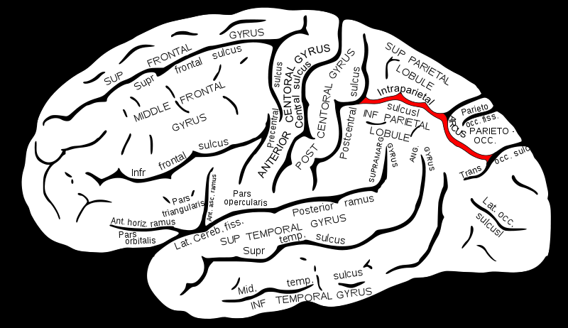
Ethics and Science
Example:
  A part of the brain is associated with counting small numbers
  In the intraparietal sulcus, different neurons will become excited if you view one, two, three, four, or more objects
  Infants respond to changes in stimulation and become uninterested in continuity
    Always showing two of particular
    items will soon disinterest the
    infant
    Showing different numbers of the
    same object will keep the infant’s
    attention—a different part of the
    brain is activated by the number

Slide 8
Ethics and Science
Similarly, Jonathan Haidt and his research group have proposed a basis for human morals
  A part of the brain is associated with counting small numbers
  In the intraparietal sulcus, different neurons will become excited if you view one, two, three, four, or more objects
  Infants respond to changes in stimulation and become uninterested in continuity
    Always showing two of particular
    items will soon disinterest the
    infant
    Showing different numbers of the
    same object will keep the infant’s
    attention—a different part of the
    brain is activated by the number

Slide 9
Ethics and Science
Suppose you were a bonobo—our cousins and closer cousins of chimpanzees
  Two bonobos (any gender) meet: sex
  Make up from a fight: sex
  Almost any issue what-so-ever: sex
They are friendlier than chimpanzees or humans:
  Universal sharing of food

Slide 10
Ethics and Science
Ethics is an evolved trait and depends on:
  The societies which we have evolved to live in
  The characteristics of the human species
Examples:
  Certain human contact is considered reasonable (shaking hands, etc.) because little or no harm can come of it
    This is, however, changing…
  Any contact with another person’s face is, however, unacceptable—too high a risk of damage
  If humans had thicker skin, greater protection around the eyes, such contact might be acceptable

Slide 11
Ethics and Science
Other examples:
  Drinking-and-driving is not seen as immoral because it is alcohol, but rather because alcohol adversely affects human performance and that degradation will adversely affect others
  Humans are mortal, and killing another human is seen as unacceptable
    Exception: if another human is threatening your life or the life of your family or associates, killing is acceptable
    Exception: if two nations, people, etc., are at war, at least the respective governments would hope to say that killing is acceptable
    Exception: some societies still see killing as an acceptable form of punishment
    Exception: some even see killing as an acceptable response to blasphemy

Slide 12
Ethics and Science
Using fMRI, it is possible to determine which parts of the brain are activated when the subject is shown different scenes

Slide 13
Ethics and Science
Examining the brain in this way suggests the following partially orthogonal values:
Positive | Negative
Care | Harm
Fairness | Cheating
Liberty | Oppression
Sanctity | Degradation
Loyalty | Betrayal
Authority | Subversion

Slide 14
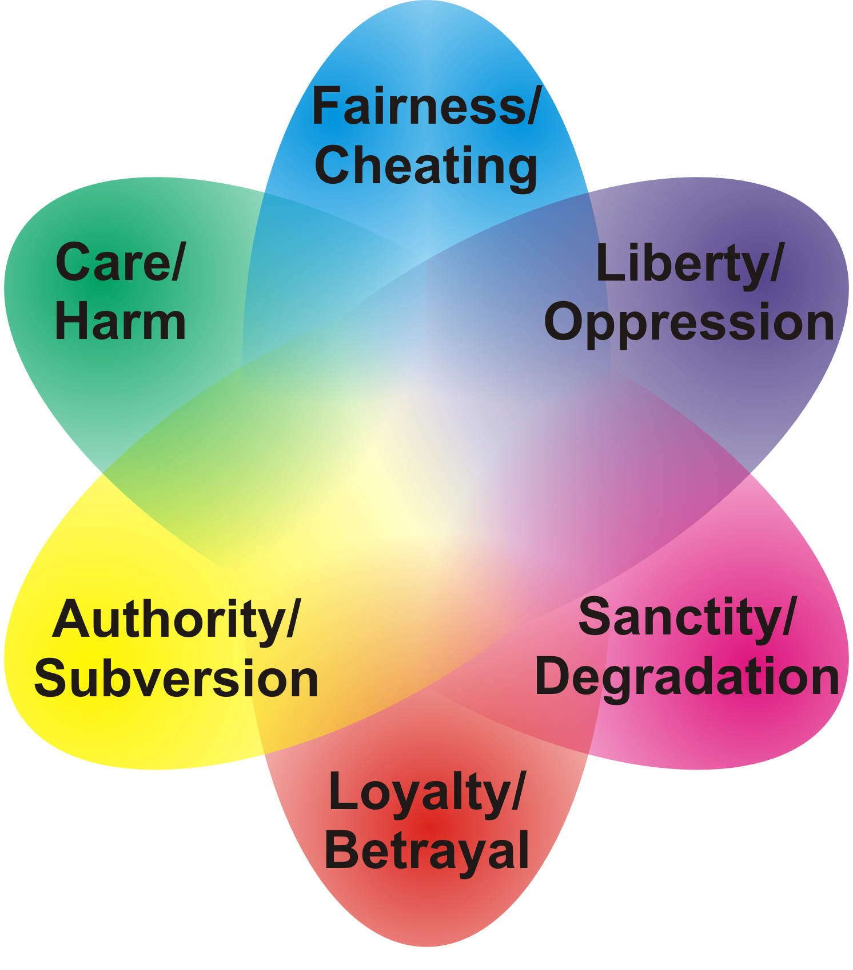
Ethics and Science
One may consider ethics in this light as the interconnections between these values:

Slide 15
Ethics and Science
Consider nepotism:
  From Italian for nephew—Middle Age popes and bishops would favour their nephews when they had no sons of their own
  Values favouring nepotism: care and loyalty to the family
  In some third-world countries, it would be a serious betrayal not to hire your relatives
  The head-of-government of Trinidad and
  Tobago recently took her niece on a world-wide
  tour charging her niece’s expenses to the
  country

Slide 16
Ethics and Science
Society however has recognized the harms of nepotism:
  Everyone else is affected: the company, the co-workers, and ultimately the country
  Values against nepotism:
    Fairness to all in society
    Harm to others and society

Slide 17
Ethics and Science
All of these values have some evolutionary advantage
  Evolutionary advantage, however, does not necessarily translate to values that support civilization
  As an engineer, when you consider any ethical situation, you must consider your choices and why you are taking those choices

Slide 18
Empathy
Primates, including humans, have empathy for others in their species
  Mirror neurons will fire when certain activities occur either to oneself or while one is watching
  Sociopathy is associated with an to feel empathy
  Narcissism is an abnormal focus on oneself

Slide 19
Empathy
Empathy will be enabled when watching other people in situations involving pain, disgust, or contact
  Most of you will feel pain
  Consider a picture of a Dalit, covered in excrement, coming up from having cleared a blockage in the sewers of an Indian city
  Consider two lovers kissing

Slide 20
Values
Note that certain values may override others
Consider two lovers kissing...
  What if one is a Conservative and the other a Liberal?
  What if one is a farmer and the other is a movie star?
  One is a Christian and the other a Muslim?
  What if one is a Dalit and the other is a Brahman?
  What if one is European and the other African?
  What if they are both men?
  What if one is 35 years old and the other
  13 years old?

Slide 21
Are there “Liberal” Values?
Are liberals less or more moral than conservatives?
  No
Liberals, however, tend to focus on specific values and lessen the impact of others
  Care, fairness, and liberty tend to be seen as liberal
  values
Libertarians place even greater emphasis
on liberty:
  A political philosophy that emphasize freedom,
  individual liberty, and voluntary association

Slide 22
What are “Conservative” Values?
Conservatives, however, do not place relatively less emphasis on care, fairness, and liberty
Instead, their approach is more balanced—each value tends to be treated more evenly
  Liberals tend to see less value in ethics such as
  authority, loyalty, and sanctity
Fascists, however, place greater emphasis
on authority and loyalty

Slide 23
Other Examples
All of these traits can be explained by evolutionary pressures—this does not mean, however, that all are beneficial to society
  There are evolutionary traits that are particularly harmful
  When you are attacked physically, your brain
  responds by entering into a defensive state
  which essentially bypasses the higher
  functioning of the brain
  With the evolution of reasoning, your brain
  will respond in a similar manner if your ideas
  are attacked

Slide 24
Sanctity/Degradation
It is necessary for any species to avoid harmful objects—e.g., rotten fruit and meat
  Keeping clean, eating healthy food, etc., is beneficial and consequently, we will have averse reactions to un-cleanliness
  One consequence manifestation of this is in the cleanliness of the body—both in and out
  Consider drug use...

Slide 25
Loyalty/Betrayal
You may notice the strong revulsion against spies—even those from the other side who help us
  Again, countries have co-opted and transferred what used to be a loyalty to the tribe to a geo-political organization
  As with real estate, the most important thing in politics is
  location, location, location.
  More important than anything else are the invisible
  lines we have chosen to partition this world
  into...

Slide 26
Applications
When you reach a different ethical conclusion from someone else, it’s not that they’re immoral—they simply have different values
  The United States Congress has an interesting aspects:
    The outside polarization of Republican—Democrat appears very strong when compared to the Canadian multi-party system
    There are, however, many more bi-partisan communication and significantly fewer restrictions w.r.t. voting along party lines
  In Canada, voting along party lines is considered much more essential due to non-confidence votes

Slide 27
Ethics and Professional Misconduct
Later in the course, we will see:
  The PEO’s Code of Ethics, and
  The definition of professional misconduct
We will examine these in light of these six values

Slide 28
References
[1] Julie Vale, ECE 290 Course Notes, 2011.
[2] Wikipedia, http://www.wikipedia.org/
These course slides are provided for the ECE 290 class. The material in it reflects Douglas Harder’s best judgment in light of the information available to him at the time of preparation. Any reliance on these course slides by any party for any other purpose are the responsibility of such parties. Douglas W. Harder accepts no responsibility for damages, if any, suffered by any party as a result of decisions made or actions based on these course slides for any other purpose than that for which it was intended.

