Slide 1
Ethics
Douglas Wilhelm Harder, M.Math. LEL
Department of Electrical and Computer Engineering
University of Waterloo
Waterloo, Ontario, Canada
ece.uwaterloo.ca
dwharder@alumni.uwaterloo.ca
© 2012 by Douglas Wilhelm Harder. Some rights reserved.

Slide 2
Outline
An introduction to the engineering profession, including:
  Standards and safety
  Law: Charter of Rights and Freedoms, contracts, torts, negligent malpractice, forms of carrying on business
  Intellectual property (patents, trade marks, copyrights and industrial designs)
  Professional practice
    Professional Engineers Act
    Professional misconduct and sexual harassment
  Alternative dispute resolution
  Labour Relations and Employment Law
  Environmental Law

Slide 3
The Runaway Train Car
We will now look at an ethical situation
  Six different scenarios will be presented
  In each case, you will have one of two options:
    Do nothing
    Pull the lever

Slide 4
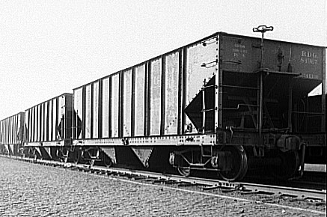
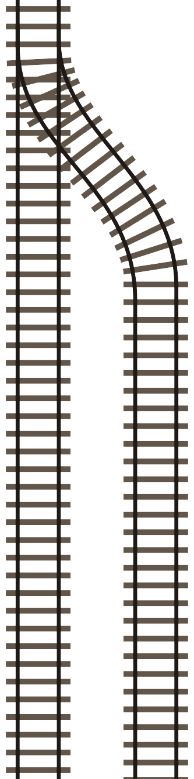
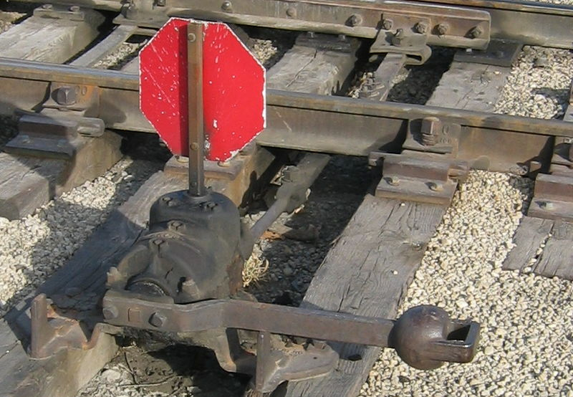
The Runaway Train Car
User: Fishdecoy
5 Workers
1 Worker
Case 1a.

Slide 5
The Runaway Train Car
1b. What if there are only two workers on the main line?
1c. What if there are fifty workers on the main line?
1d. What if there are twenty workers on the main line
and four on the side line?
1e. What if there is a car with an infant on the side line?

Slide 6
The Runaway Train Car
Suppose the train car is moving very fast and there is an 80 % chance that the deflection onto the side line will cause the train car to derail killing no one
Would you pull the switch if there were five workers on the main line and five on the parallel line?
Case 1f.

Slide 7
The Runaway Train Car
We will now look at a slightly different situation
  Four different scenarios will be presented
  In each case, you will have one of two options:
    Do nothing
    Push

Slide 8
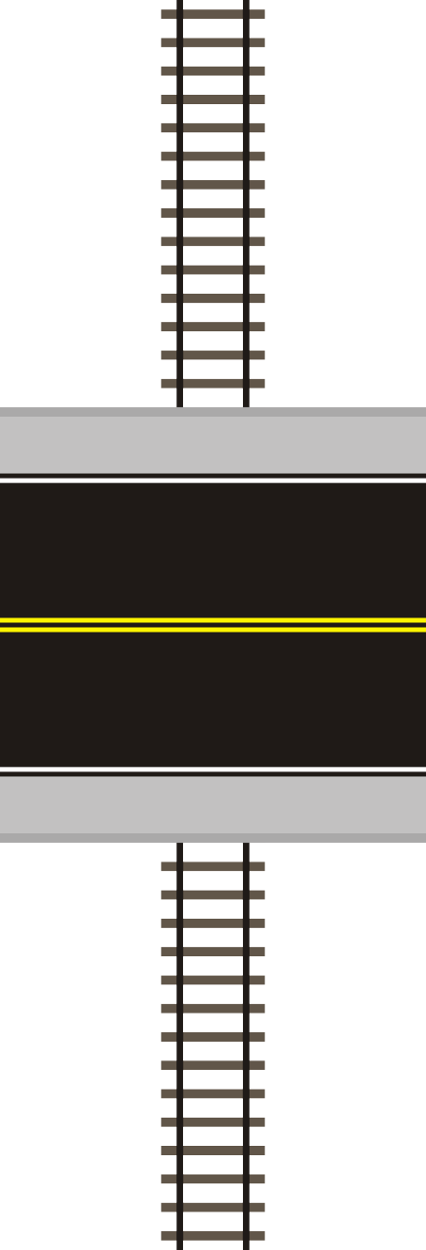
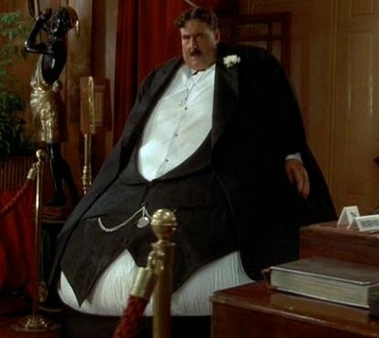
The Runaway Train Car
Monty Python’s The Meaning of Life
Universal Pictures
Case 2a.
5 Workers

Slide 9
The Runaway Train Car
2b. What if there are fifty workers on the main line?
2c. What if the railway car is packed with explosives and
it’s headed straight for a soccer stadium?
2d. What if the fat man asks you to help him over the
railing?
Is it a question of ethics if you are the fat one?

Slide 10
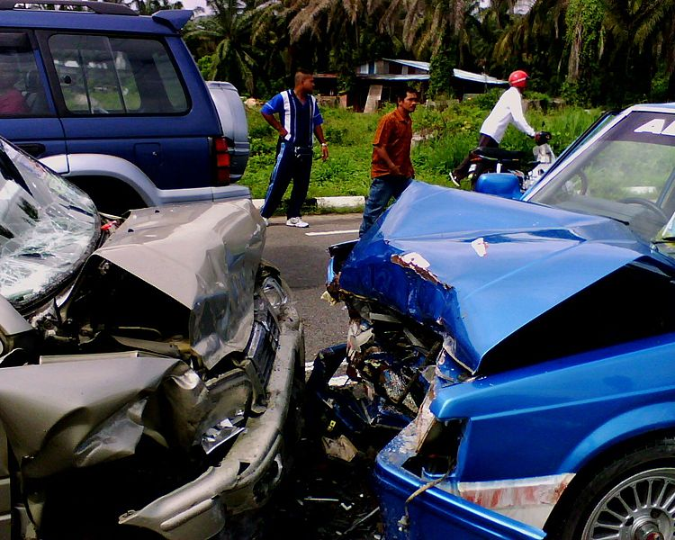
An Accident
A family of six is involved in an automobile accident
  Five are severely injured
  One is critically injured
  All are brought to the hospital
Damnsoft 09

Slide 11
An Accident
The five seriously injured have:
  A damaged kidney
  A damaged liver
  A ruptured spleen
  Two have burns requiring significant skin grafts
Without immediate attention, they could die
The sixth is dying from trauma and blood loss after having two legs and an arm severed

Slide 12
An Accident
Is it ethical to sacrifice the critically injured family member to save the other five? Yes/No
  All are unconscious
Case 3.

Slide 13
An Accident
Suppose instead there are five seriously injured individuals in an accident, all requiring immediate attention
In the waiting room is a patient who is coming to see the result of his blood test—looking over the charts, you notice that he is a perfect match for all the five injured
Do you sacrifice that individual to save the five? Yes/No
Case 4.

Slide 14
Railway Cars and Accidents
What is different?
For example, 1a, 1d, 1e and 1f are identical
and they are similar to 2a, 3 and 4
Also, 1c and 2b are similar

Slide 15
Ethics
The definition of professional misconduct includes those behaviours that a professional engineer in Ontario must not engage in
  These define an absolute line which must not be crossed
Note that one can be guilty of professional misconduct even if there are no negative consequences
  In general, however, complaints are a result of an action or behaviour having a negative consequence

Slide 16
Ethics
Consider the following questions?
  Should we regulate how professional engineers interact with other professionals?
  Should professional engineers exaggerate their abilities or the abilities of the profession?
  Should professional engineers malign the character of others in the profession?
  You find that your designs had a flaw due to an unknown effect not anticipated in normal engineering practice: is it sufficient to fix the mistake but not tell anyone about it?
  Is it right to take credit for the work done by your subordinates and co-op students working under you?

Slide 17
Morals
A moral, meaning a custom or a habit is an action, behaviour, character trait or desire that has been determined to be
  Right or wrong
  Good or bad
  Saintly or evil
  Honourable or dishonourable
  Brave or cowardly
It is based on a general consensus of society
  They are not based in law or regulations
  There are immoral rules and immoral orders

Slide 18
Ethics
The study of ethics or moral philosophy is the study of human interactions by determining or recommending whether an actions, behaviours, conduct or desires is right or wrong, including
  Actions
  Behaviours
  Characteristics
  Desires
Ethics is the evaluation of human interactions:
what is right and what is wrong

Slide 19
Ethics
There are two general definitions of ethics:
  A collection or system of moral principles or rules of conduct by which a person or association is guided.
  The science of morals; the department of study concerned with the principles of human duty.
Reference: Oxford English Dictionary, www.oed.com

Slide 20
Ethics
The Hippocratic Oath and Professional Engineers Ontario Code of Ethics are two examples of collections of rules of conduct
  In many jurisdictions, a code of ethics defines the boundary between professional conduct and misconduct
  We will see later, that PEO’s Code of Ethics provide a guide to conduct while, as we’ve seen, misconduct is explicitly defined in the regulations

Slide 21
Ethics: The Science of Morals
There are four branches of philosophy:
  Logic
  Epistemology
  Ethics
  Metaphysics
These focus on issues that are beyond the scope of scientific inquiry

Slide 22
Ethics: The Science of Morals
Ethics is itself broken into numerous categories:
  Meta-ethics
  the theoretical inquiry of moral principles and how their truth values (if any) may be determined
  Normative ethics
  Concerning the practical means of determining a moral course of action
  Applied ethics
  Situation-based moral outcomes
  Descriptive Ethics
  The study of extant ethical behaviour and comparative analysis
  Moral psychology
  The scientific study of the development and evolution of ethical behaviour

Slide 23
Normative Ethics
We will focus entirely on normative ethics:
  Concerning the practical means of determining a moral course of action
  Normative ethics tends to be prescriptive: it prescribes how to deal with a particular ethical situation
  Descriptive ethics is empirical: it investigates a society’s response in dealing with a particular ethical situation
For example, in collecting your responses, I am investigating what the class considers to be ethical

Slide 24
Normative Ethics
Under normative ethics, we will look at four approaches:
  Two historical:
    Virtue ethics
    Role ethics
  Two modern:
    Deontology
    Teleology or Consequentialism

Slide 25
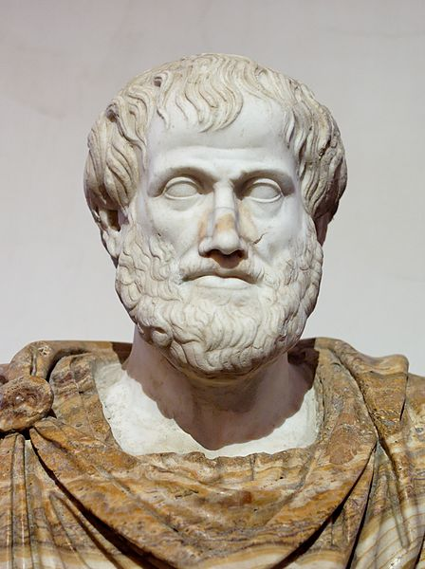
Virtue Ethics
Virtue ethics asks how a response to a situation will affect the perceived character of the person
  Helping a person in need would be charitable
  A decision on whether or not to lie would be judged on how that falsehood reflects on the individual’s character
First discussed in western philosophy by
Plato and then Aristotle
  Plato lists four cardinal moral virtues:
  courage, temperance, justice, and prudence
  Each is the golden mean between two extremes
Straight-forward to teach...

Slide 26
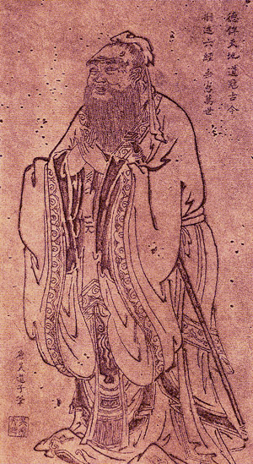
Role Ethics
Morality is derived from people’s relationship with their community and is not individualistic
Confuianism demonstrates this through
the concept of filial piety as a desire and
not only as an action
  “In serving his parents,
  a filial son reveres them in daily life;
  he makes them happy while he nourishes them;
  he takes anxious care of them in sickness;
  he shows great sorrow over their death; and
  he sacrifices to them with solemnity.”
孔丘
孝
Notes:
Kong Qui

Slide 27
References
[1] Julie Vale, ECE 290 Course Notes, 2011.
[2] Wikipedia, http://www.wikipedia.org/
These course slides are provided for the ECE 290 class. The material in it reflects Douglas Harder’s best judgment in light of the information available to him at the time of preparation. Any reliance on these course slides by any party for any other purpose are the responsibility of such parties. Douglas W. Harder accepts no responsibility for damages, if any, suffered by any party as a result of decisions made or actions based on these course slides for any other purpose than that for which it was intended.

