Slide 1
Environmental Ethics and Law
Douglas Wilhelm Harder, M.Math. LEL
Department of Electrical and Computer Engineering
University of Waterloo
Waterloo, Ontario, Canada
ece.uwaterloo.ca
dwharder@alumni.uwaterloo.ca
© 2012 by Douglas Wilhelm Harder. Some rights reserved.

Slide 2
Outline
An introduction to the engineering profession, including:
  Standards and safety
  Law: Charter of Rights and Freedoms, contracts, torts, negligent malpractice, forms of carrying on business
  Intellectual property (patents, trade marks, copyrights and industrial designs)
  Professional practice
    Professional Engineers Act
    Professional misconduct and sexual harassment
  Alternative dispute resolution
  Labour Relations and Employment Law
  Environmental Law

Slide 3
The Tragedy of the Commons
A story…

Slide 4
Outline
The rules and regulations of environmental ethics includes:
  The Canadian Environmental Protection Act
    Provisions
    Regulations
    Associated Acts
    Domestic Substances List
  The last commons: the oceans
    Ocean fertilization and carbon sequestering

Slide 5
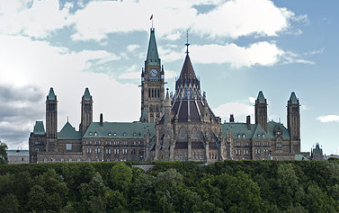
CEPA, 1999
The cornerstone of environmental protection in Canada is the Canadian Environmental Protection Act, 1999
This act provides for:
  Advisory committees
  Public participation
  Information gathering and research
  Pollution prevention
  Control of toxic substances
  Biotechnology
  Waste management
  Environmental emergencies
David Samuel

Slide 6
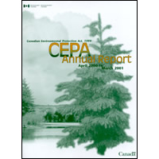

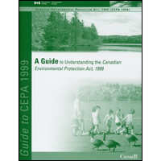
CEPA, 1999
Like the Professional Engineers Act, the Canadian Environmental Protection Act allows for
  Registries
  Objectives
  Guidelines
  Codes of practice
  Regulations
  Environmental rights
  Investigations
  Prevention of loss
  Compensation of loss

Slide 7
CEPA, 1999
Like the Professional Engineers Act, there are regulations:
Regulations
Regulations for the protection of the environment
209. (1) The Governor in Council may, on the recommendation of the Minister, make regulations
for the protection of the environment, including, but not limited to, regulations respecting
(a) the establishment of environmental management systems;
(b) pollution prevention and pollution prevention plans;
⁞
(g) any other matter necessary to carry out the purposes of this Part.
Content of the regulations
(2) Regulations with respect to any substance may provide for, or impose requirements respecting,
(a) the quantity or concentration of any substance that may be released into the environment
either alone or in combination with any other substance from any source or type of source;
(b) the places or areas where the substance may be released;
⁞
(x) the decommissioning and decontamination of storage, handling, transportation, disposal
and recycling sites for the substance.
Notes:
of anything that has come in contact with the substances

Slide 8
Other Acts
Twenty-two other federal Acts of Parliament are linked to the Canadian Environmental Protection Act
Access to Information Act
Aeronautics Act
Canada Shipping Act, 2001
Canada Transportation Act
Contraventions Act
Criminal Code
Environmental Enforcement Act
Feeds Act
Fertilizers Act
Financial Administration Act
Fisheries Act
Hazardous Materials Information Review Act
Health of Animals Act
Marine Liability Act
Motor Vehicle Safety Act
National Defence Act
Official Languages Act
Pest Control Products Act
Privacy Act
Seeds Act
Statutory Instruments Act
Yukon Act

Slide 9
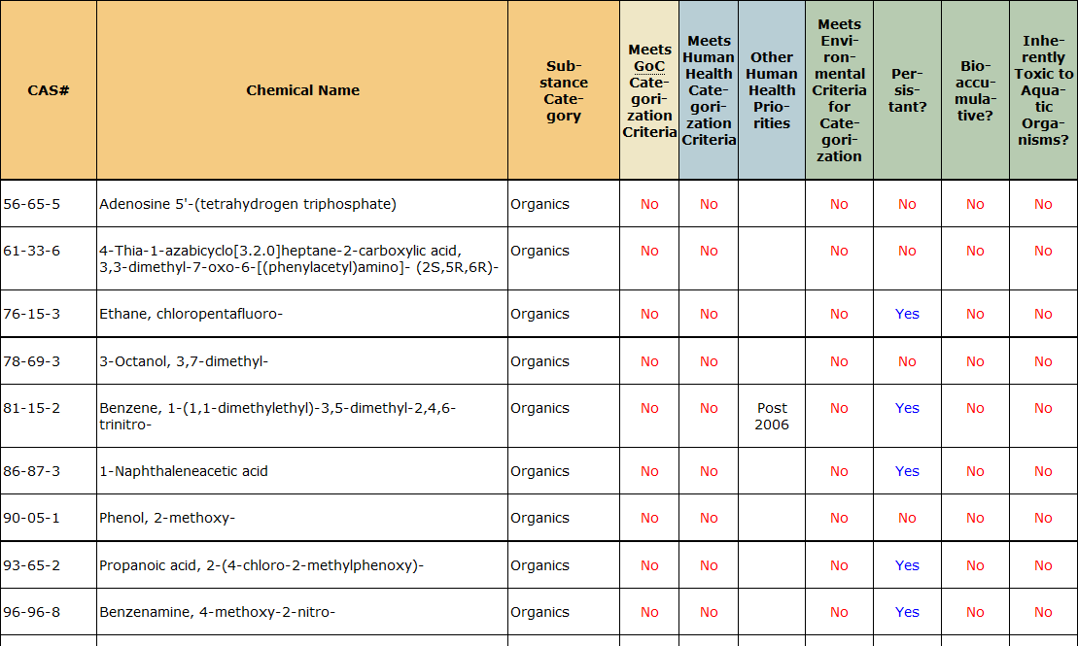
Domestic Substances List
The Act makes for maintain a Domestic Substances List
  Contains over 23 000 different substances
  This includes microbial strains and complex microbial cultures

Slide 10
The Last Commons
There are a number of commons around today:
  The atmosphere
  The oceans
  Near outer space
  Antarctica
  Inland bodies of water or rivers

Slide 11
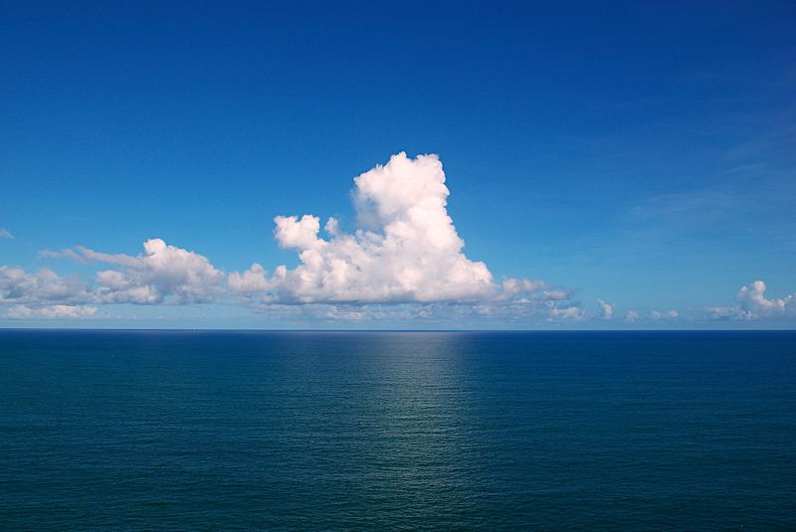
The Last Commons
The oceans are among the world’s last commons
  Almost all countries border on an ocean or saltwater sea
  These form the world’s largest garbage dumps
Tiago Fioreze
Notes:
reat Pacific Garbage Patch
One to 15 million square kilometres, depending on your definition of “garbage”.

Slide 12
The Last Commons
Similarly, the atmosphere is another commons
  We all breath the same air
  We have been pumping the atmosphere full of chemicals, particulates and biological material
Tiago Fioreze
Notes:
reat Pacific Garbage Patch
One to 15 million square kilometres, depending on your definition of “garbage”.

Slide 13
Geoengineering
The application of engineering principles to the climate:
  Solar radiation management
    Surface cool roof
    Troposphere cloud whitening
    Upper atmosphere H₂SO₄, H₂S, SO₂, Al₂O₃
    Near space orbit space-based sunshades
  Carbon dioxide removal
    Carbon capture and storage
    Tree planting
    Iron fertilization of the oceans

Slide 14
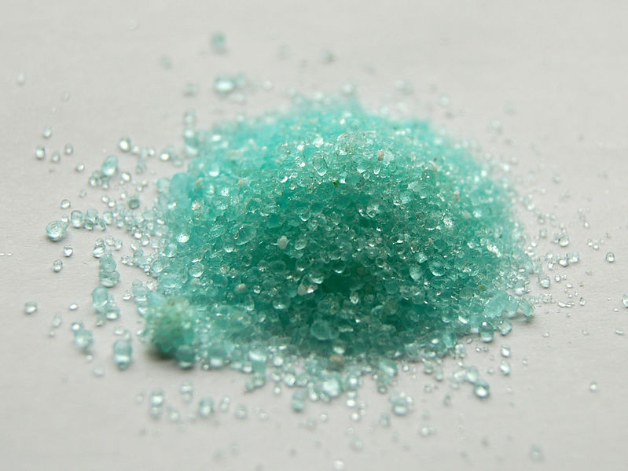
Ocean Fertilization
Iron is one of the limiting nutrients in the oceans
  Adding iron sulfide allows for
  temporary exponential growth
  of algae
  This algae absorbs carbon dioxide, dies, and then sinks
  A possibly effective form of carbon sequestering

Slide 15
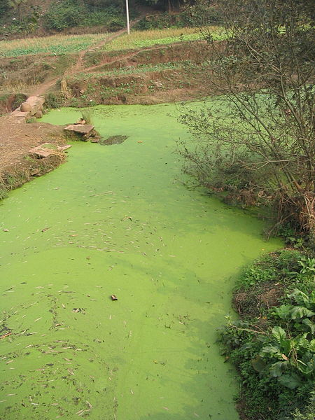
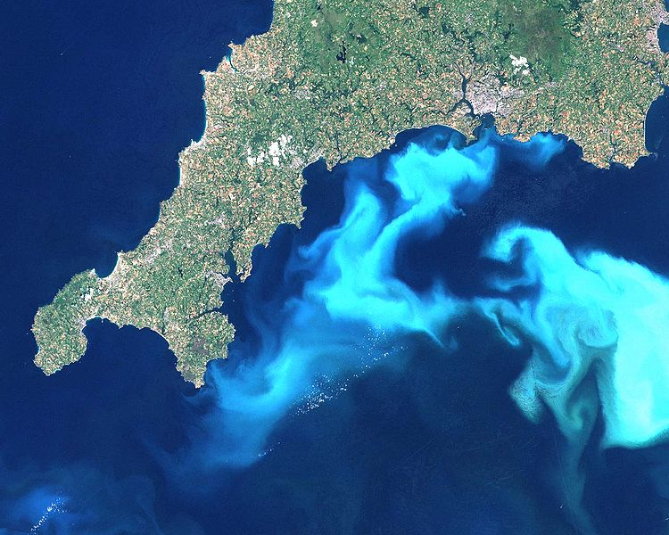
Ocean Fertilization
1 g of iron could potentially sequester 100 kg of carbon
Felix Andrews

Slide 16
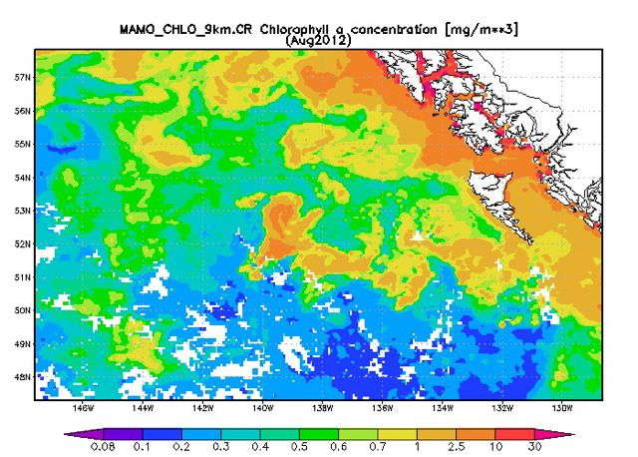
Ocean Fertilization
In August of 2012, Russ George dumped 100 tonnes of iron sulfide off the west coast of Canada
  This resulted in a 10 000 km² algae bloom
Problem: we do not know
all the possible effects
Regulations: two moratoria
on ocean fertilization were
issued by the UN

Slide 17
Ocean Fertilization
The 1996 Protocol to the 1972 Convention on the Prevention of Marine Pollution by Dumping...
  It adopts a polluters pay principle
  It also adopts a precautionary approach: if an action has a suspected risk to the public or environment, in the absence of scientific consensus that the action is harmful, the burden of proof that it is not harmful falls on those taking the action
The 2008 UN Convention on Biological Diversity conference halted the plans for ocean fertilization

Slide 18
Shared Bodies of Water
Consider
  The Great Lakes between Canada and the United States
  The Aral Sea between Uzbekistan and Kazakhstan

Slide 19
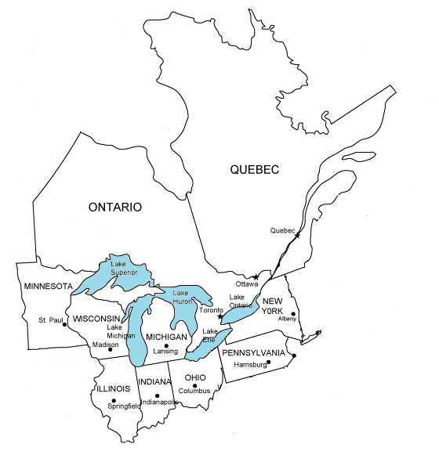


The Great Lakes
1985 Great Lakes Charter
2005 The Great Lakes-St. Lawrence River Basin
Sustainable Water Resources Agreement
2008 Great Lakes Compact

Slide 20
Great Lakes Compact
Purposes (abbreviated):
  To act together to protect, conserve, restore, improve and effectively manage the Basin;
  To provide for cooperative planning and action with respect to Water resources;
  To facilitate consistent approaches to Water management across the Basin;
  To facilitate the exchange of data, strengthen the scientific information base upon which decisions are made;
  To prevent significant adverse impacts of Withdrawals and losses on the Basin's ecosystems and watersheds;
  To promote interstate and State-Provincial comity; and
  To promote an Adaptive Management approach to the conservation and management of Basin Water resources

Slide 21
The Great Lakes: Issues
The St. Clair river was dredged as late as the 1960s to allow for a deeper navigation channel
  Increases the flow from the upper Great Lakes into Lake Erie
  Water is being diverted from the lakes for industrial purposes
January 2013: Lakes Huron and Michigan hit record lows
  74 cm below their long-term average
  43 cm lower than January 2012
Issues:
  Shippers are lobbying for further dredging due to more shallow navigation channels increasing the flow
  Building underwater speed bumps would slow the flow
Notes:
http://www.cbc.ca/news/canada/windsor/story/2013/02/06/wdr-lake-huron-lake-michigan-lowest-water.html

Slide 22
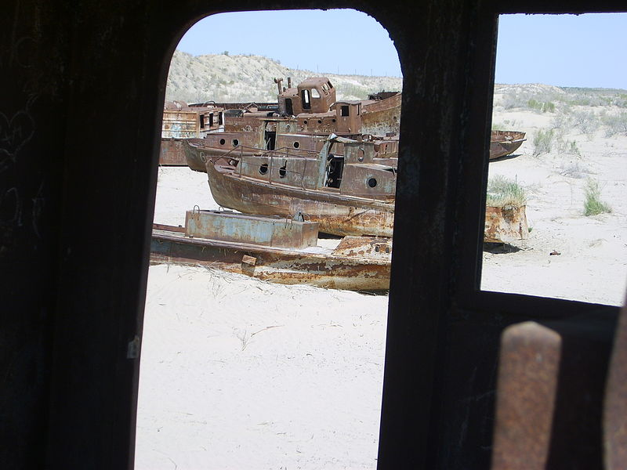
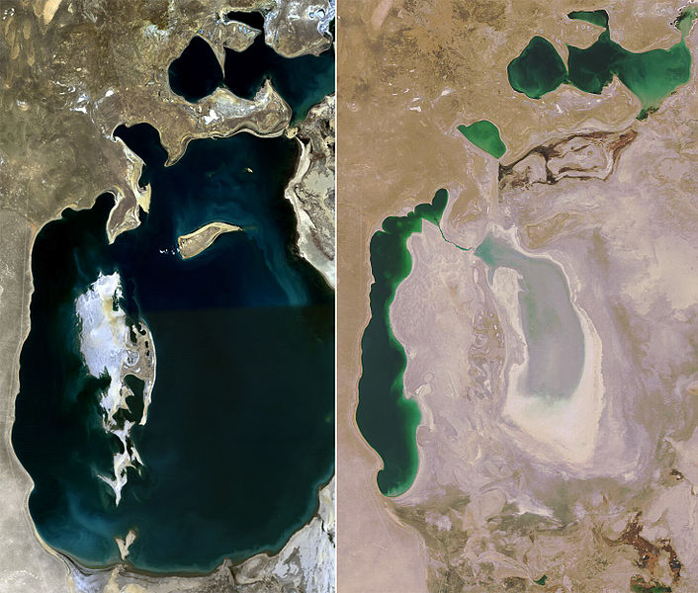


Aral Sea
Environmental issues:
  Higher salinity
  Exposed seabed covered with salt and
  toxic chemicals
    Resulting in serious health issues
  Dust storms depositing salt in agricultural fields
  Loss of moderating effect of the
  water
Kazakhstan has made efforts to
rehabilitate the North Aral Sea
Geoffrey Watson
2008
1989

Slide 23
Cradle-to-Grave Analysis
Considers factors such as:
  Raw-material production
  Manufacture
  Distribution
  Use
  Disposal

Slide 24
References
[1] Julie Vale, ECE 290 Course Notes, 2011.
[2] Wikipedia, http://www.wikipedia.org/
These course slides are provided for the ECE 290 class. The material in it reflects Douglas Harder’s best judgment in light of the information available to him at the time of preparation. Any reliance on these course slides by any party for any other purpose are the responsibility of such parties. Douglas W. Harder accepts no responsibility for damages, if any, suffered by any party as a result of decisions made or actions based on these course slides for any other purpose than that for which it was intended.

