Slide 1
Contract Law:
Discharging Contracts
Douglas Wilhelm Harder, M.Math. LEL
Department of Electrical and Computer Engineering
University of Waterloo
Waterloo, Ontario, Canada
ece.uwaterloo.ca
dwharder@alumni.uwaterloo.ca
© 2013 by Douglas Wilhelm Harder. Some rights reserved.

Slide 2
Outline
An introduction to the engineering profession, including:
  Standards and safety
  Law: Charter of Rights and Freedoms, contracts, torts, negligent malpractice, forms of carrying on business
  Intellectual property (patents, trade marks, copyrights and industrial designs)
  Professional practice
    Professional Engineers Act
    Professional misconduct and sexual harassment
  Alternative dispute resolution
  Labour Relations and Employment Law
  Environmental Law

Slide 3
Discharging Contracts
When is a contract completed?
  Performance
  Agreement
  Pursuant to expressed terms
  Novation
  Operation of law
  Impossibility, impracticality, and frustration
  Discharge by breach of contract

Slide 4
Discharge by Performance
A contract is considered discharged when all parties have performed their obligations under the terms of the contract
Contracts may have additional terms that go beyond the scope of performance, especially when related to warranties
  Construction and supply contracts will often include warranties whereby a party will remedy certain defects under specified limitations

Slide 5
Agreement to Discharge
A contract can be discharged as long as all parties agree that the contract is cancelled or terminated
  This will invariably include additional agreed upon terms or conditions, as some obligations in the original contract have not been satisifed

Slide 6
Discharge Due to Expressed Terms
The contract itself may contain terms that allow for the contract to be discharged:
  Failure to properly complete the required work
  Failure to comply with the requirements

Slide 7
Discharge by Novation
It is possible to either
  Exchange one obligation in a contract for another
  Replace one contracting party with another
Such a change is called a novation
  This requires the agreement of all parties to the contract and it produces a new contract, discharging the old
  The new contract requires consideration, which is usually the discharge of the old contract

Slide 8
Discharge by Operation of Law
There are certain conditions under which a contract will legally be discharged
  By the death of one of the parties when dealing with personal service
  In some circumstances, by bankruptcy
  By the rights and liabilities becoming owed by the same person
    A company purchases a supplier

Slide 9
Discharge by Impossibility,
Impracticality and Frustration
Next, we will look at two closely related, but distinct, forms of discharge:
  Discharge by impossibility
  Discharge by impracticality
  Discharge by frustration

Slide 10
Definitions
When it becomes objectively impossible to satisfy the obligations, the contract is discharged by impossibility
  It is not merely difficult or costly, but rather impossible to perform the obligations of the contract
Impracticality is a subject discharge when it becomes unfeasibly difficult or expensive to perform an obligation
When an event occurs that essentially undermines the purpose of one of the parties participating in the contract, the contract is said to be discharged by frustration
  The purpose of the individual entering into the contract is frustrated

Slide 11
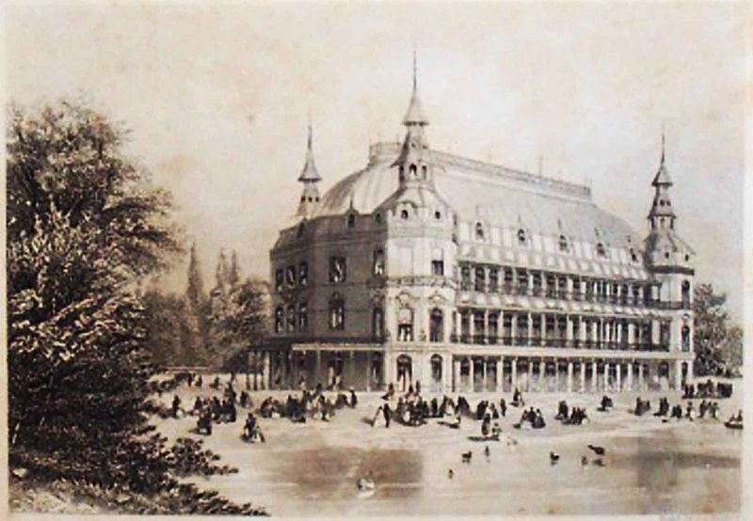
Discharge by Impossibility
Consider the case of Taylor v Caldwell, 1863
  The plaintiff rented a music hall which, one week prior to the performance, burned down
  The plaintiff sued for breach of contract: the defendant failed to rent the music hall
  Lord Blackburn based his ruling on French civil code and Roman law and the English common law precedence that when a party to a contract dies, the obligations are
  not passed onto the executors
It was impossible to rent a hall
that was burned down

Slide 12
Discharge by Impracticality
In the United States, the following is a test for discharge by impracticality:
  There must be an occurrence of a condition, the nonoccurrence of which was a basic assumption of the contract
  The occurrence must make performance extremely expensive or difficult
  This difficulty was not anticipated by the parties to the contract
Again, such a subjective test is often difficult to apply
  Hell or high water clauses may be added to prevent discharge by either impossibility or impracticality
  Such clauses are often included in leasing agreements

Slide 13
Discharge by Frustration
When the purpose of one party entering into the contract is eliminated, the contract may be discharged by frustration
  “Where, after a contract is made, a party's principal purpose is substantially frustrated without his fault by the occurrence of an event the non-occurrence of which was a basic assumption on which the contract was made, his remaining duties to render performance are discharged, unless the language or circumstances [of the contract] indicate the contrary.”
All parties are left as is at the time of discharge

Slide 14
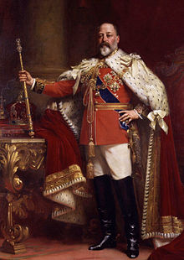
Discharge by Frustration
Frustration is seldom used: it may be used at times of war or, in the case of bars and taverns, during the introduction of Prohibition
Following Taylor v Caldwell, the doctrine of frustration was developed in Krell v Henry where the
defendant hired a room to watch the
coronation of King Edward VII, an event
which was subsequently cancelled due
to appendicitis

Slide 15
Discharge by Frustration
Possible causes of frustration:
  Destruction of subject matter
  Supervening illegality
    Subsequent laws render satisfying the obligations impossible
  Incapacity or death
In Denny, Mott & Dickson Ltd v James B Fraser & Co Ltd., 1944, a contract signed prior to 1939 was declared discharged by frustration as the Control of Timber (No 4) Order 1939 prevented further transactions

Slide 16
Acts of God
Any natural event that makes performance impractical or impossible is said to be an Act of God
  “Natural” is defined as anything that is beyond human control where no one is responsible
  Unless, of course, you are Italian geoscientist failing to properly communicate the dangers of the 2009 L’Aquila earthquake

Slide 17
Force Majeure Provisions
Contracts can contain force majeure provisions that provide for extensions in extenuating circumstances

Slide 18
Trends
The trend appears to be that internal socio-economic situations will not be considered grounds for frustration or impracticality but Acts of God and wars may be grounds
  You are protected from everything but the current economy

Slide 19
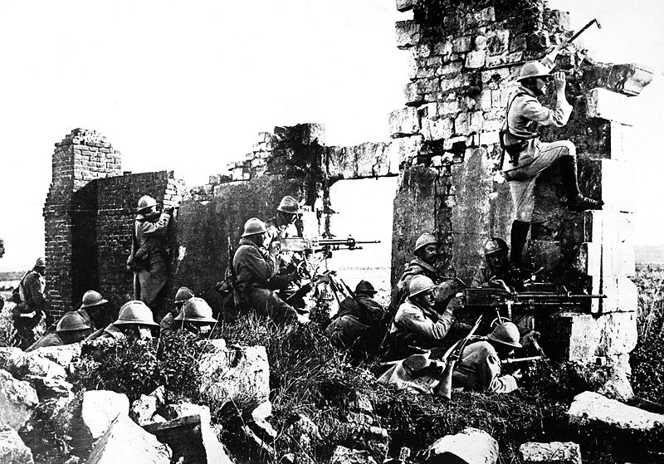
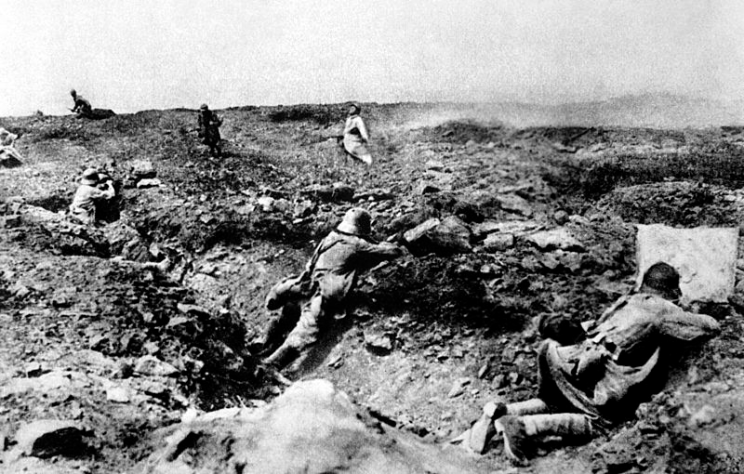
Examples
In Metropolitan Water Board v Dick, Kerr and Co. Ltd., 1917, a contract entered into in July of 1914 was halted in 1967 by an order of the Ministry of Munitions
  The contract was discharged by frustration even though there was a force majeure provision

Slide 20

Examples
In Davis Contractors Ltd. v Fareham Urban District Council, 1956, a labour shortage resulted in an 8-month project to build 78 houses being prolonged to a 22-month project
  The contract was not
  discharged, it was merely
  considered more difficult
  than expected

Slide 21

Examples
In Swanson Construction Co. Ltd. v Government of Manitoba, 1963, a contractor ended up completing work in winter conditions instead of the planned summer conditions because the site was not ready on time
  The contract was not discharged, as the contractor should have
  taken this possibility into account in preparing his bid
User: Wpg guy

Slide 22
Discharge by Breach
Apart from discharging a contract through performance, the next most common means that contracts are discharged is through a breach of contract
  One or more parties fail to perform an obligation under the terms of the contract
  This is an entirely different topic

Slide 23
References
[1] D.L. Marston, Law for Professional Engineers, 4th Ed., McGraw Hill, 2008.
[2] Julie Vale, ECE 290 Course Notes, 2011.
[3] Wikipedia, http://www.wikipedia.org/
These course slides are provided for the ECE 290 class. The material in it reflects Douglas Harder’s best judgment in light of the information available to him at the time of preparation. Any reliance on these course slides by any party for any other purpose are the responsibility of such parties. Douglas W. Harder accepts no responsibility for damages, if any, suffered by any party as a result of decisions made or actions based on these course slides for any other purpose than that for which it was intended.

