Slide 1
Contract Law: Contract Interpretation
Douglas Wilhelm Harder, M.Math. LEL
Department of Electrical and Computer Engineering
University of Waterloo
Waterloo, Ontario, Canada
ece.uwaterloo.ca
dwharder@alumni.uwaterloo.ca
© 2013 by Douglas Wilhelm Harder. Some rights reserved.

Slide 2
Outline
An introduction to the engineering profession, including:
  Standards and safety
  Law: Charter of Rights and Freedoms, contracts, torts, negligent malpractice, forms of carrying on business
  Intellectual property (patents, trade marks, copyrights and industrial designs)
  Professional practice
    Professional Engineers Act
    Professional misconduct and sexual harassment
  Alternative dispute resolution
  Labour Relations and Employment Law
  Environmental Law

Slide 3
Interpretation
There is the expression of the “spirit of the law” versus the “letter of the law” — the first gives the original intention, the second is what was actually written
  The legislature has an obligation to determine what they actually mean by a given law
For example, the Patriot Act was meant to fight what most people would consider “terrorism”; however, now, it is being applied much more broadly

Slide 4
Interpretation
The interpretation of contracts is similar: the courts will read the text of the contract to determine the benefits and obligations
Two possible approaches:
  Strict interpretation
  Liberal interpretation
A liberal approach can take into account, for example, the intentions behind the contract

Slide 5
Interpretation
In Hunter Engineering Company v Syncrude Canada Ltd. 1989, the Supreme court
  Syncrude entered into a contracted with Hunter Engineering and Allis-Chalmers to design gear boxes. Due to design flaws, the boxes were not usable for their intended purpose. Syncrude spent over $1 million to repair the boxes. Hunter sought protection under a limitation of liability clause within the contract.
The Supreme Court ruled that the limitation clause was clear and valid
  Strict interpretation should only be questioned when there is a matter of contractual unconscionability such as where parties have unequal bargaining power
  This is unlikely in the case of business contracts

Slide 6
The Million Dollar Comma
In a case of a contract between Rogers Communications and Bell Aliant,
  “This agreement shall be effective from the date it is made and shall continue in force for a period of five (5) years from the date it is made, and thereafter for successive five (5) year terms, unless and until terminated by one year prior notice in writing by either party.”

Slide 7
The Million Dollar Comma
A parenthetical phrase is one that can be removed from a sentence without affecting the original sentence
  “If you, as an engineering student, achieve a grade over 90, you will likely appear on the Dean’s Honour List.”
  “If you, as an engineering student, achieve a grade over 90, you will likely appear on the Dean’s Honour List.”
Parenthetical phrases are demarked by parentheses, commas, or dashes
  “He—the one who smashed into my car—decided to drive off as fast as possible.”
  “While I was writing the examination, I was thinking about how language may affect a student writing it.”

Slide 8
The Million Dollar Comma
What it says:
  “This agreement shall be effective from the date it is made and shall continue in force for a period of five (5) years from the date it is made, and thereafter for successive five (5) year terms, unless and until terminated by one year prior notice in writing by either party.”

Slide 9
The Million Dollar Comma
What they meant:
  “This agreement shall be effective from the date it is made and shall continue in force for a period of five (5) years from the date it is made, and thereafter for successive five (5) year terms unless and until terminated by one year prior notice in writing by either party.”

Slide 10
Contra Proferentem
When an ambiguity occurs in the language of a contract, precedence is that it will be interpreted against the party that authored the term
  From Latin: “against the one bringing forth”
  This is often related to the definition of a specific word
  Very often applied to adhesion contracts—that is, the take-it-or-leave-it contracts dictated by one party, e.g., insurance
It is necessary to track who made what changes to an agreement before it is signed—recall that offers and counter-offers can be made by both parties

Slide 11
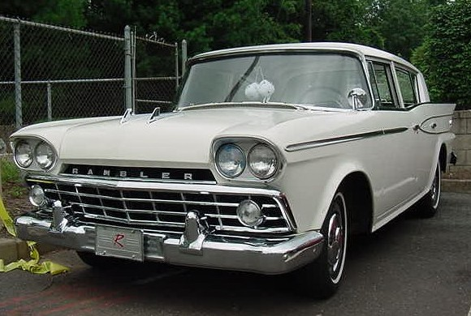
Contra Proferentem
Consider Hollier v Rambler Motors (AMC) Ltd, 1972, where an occasional customer failed to sign an invoice with the statement:
“company is not responsible for damage caused
by fire to customers’ cars on the premises.”
Through negligence of the owner, the garage burned down
First, the company tried to establish that the exclusion should apply even if he didn’t sign it this time
  The court found that there was neither a regular nor consistent course of dealings between the two parties

Slide 12
Contra Proferentem
In addition, the court noted the ambiguity of the statement:
“company is not responsible for damage caused
by fire to customers’ cars on the premises.”
If Rambler Motors wanted to make exclusions for their own negligence
“they ought to have done so in far plainer language”

Slide 13
Parol Evidence Rule
As already covered: oral evidence is inadmissible in the interpretation of a written contract
  It can be used to demonstrate that the contract does not exist, but it cannot be used for interpretation

Slide 14
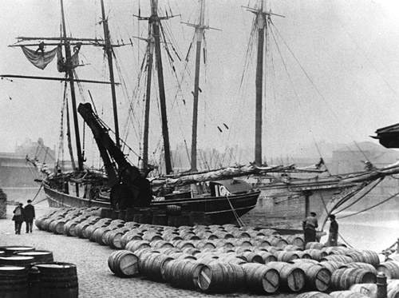
Implied Terms
Consider the case of the Moorcock, 1889
  The owner of the ship entered into a contract with the owner of a wharf to dock the ship
  When the tide went out, the hull hit a ridge which damaged the ship
  The terms of the contract made no provision for ensuring the ship’s safety while docked

Slide 15
Implied Terms
In his judgement, Bowen LJ stated:
  “In business transactions such as this, what the law desires to effect by the implication is to give such business efficacy to the transaction as must have been intended at all events by both parties who are business men; not to impose on one side all perils of the transaction, or to emancipate one side from all the chances of failure, but to make each party promise in law as much, at all events as it must have been in the contemplation of both parties that he should be responsible for in respect to those perils or chances.”

Slide 16
Implied Terms
This lead to the implication that a contract can have terms that are not explicitly written into the contract, but are implied by the nature of the contract
In Pigott Construction Co. Ltd v W.J. Crowe Ltd., 1961, the court formulated the following guideline:
  “I have for a long time understood that rule to be that the Court has no right to imply in a written contract any such stipulation, unless , on considering the terms of the contract in a reasonable and business manner, an implication necessarily arises that the parties must have intended that the suggested stipulation should exist.”

Slide 17
Implied Terms
Further to this, in Markland Associates Ltd. v Lohnes, 1973, the Nova Scotia Supreme Court ruled that a building contract has a number of implied terms:
  that the work and materials would be of reasonable quality and meet standards
  the work was to be conducted in a normal manner
  the final product would be usable and meet needs
  the work would be done in reasonable time.
http://engineeronadisk.com/notes_engineer/cases_canada.html

Slide 18
Implied Terms
In G. Ford Homes Ltd. v Draft Masonry (York) Co. Ltd., 1983, the subcontractor was in the business of fabricating and installing staircases
  The subcontractor offered the contractor a selection of possible options, of which, the contractor picked one
  The resulting installation it was 1½" short on headspace
  This required that the staircase be replaced, a cost the contractor sought to recover
  The court found that the subcontractor was an “expert” and should have been aware of the Ontario Building Code

Slide 19
References
[1] D.L. Marston, Law for Professional Engineers, 4th Ed., McGraw Hill, 2008.
[2] Julie Vale, ECE 290 Course Notes, 2011.
[3] Wikipedia, http://www.wikipedia.org/
These course slides are provided for the ECE 290 class. The material in it reflects Douglas Harder’s best judgment in light of the information available to him at the time of preparation. Any reliance on these course slides by any party for any other purpose are the responsibility of such parties. Douglas W. Harder accepts no responsibility for damages, if any, suffered by any party as a result of decisions made or actions based on these course slides for any other purpose than that for which it was intended.

