Slide 1
Code of Ethics
Douglas Wilhelm Harder, M.Math. LEL
Department of Electrical and Computer Engineering
University of Waterloo
Waterloo, Ontario, Canada
ece.uwaterloo.ca
dwharder@alumni.uwaterloo.ca
© 2012 by Douglas Wilhelm Harder. Some rights reserved.

Slide 2
Outline
An introduction to the engineering profession, including:
  Standards and safety
  Law: Charter of Rights and Freedoms, contracts, torts, negligent malpractice, forms of carrying on business
  Intellectual property (patents, trade marks, copyrights and industrial designs)
  Professional practice
    Professional Engineers Act
    Professional misconduct and sexual harassment
  Alternative dispute resolution
  Labour Relations and Employment Law
  Environmental Law

Slide 3
Code of Ethics
Recall the two definitions of ethics:
  A collection or system of moral principles or rules of conduct by which a person or association is guided.
  The science of morals; the department of study concerned with the principles of human duty.
We have focused on the philosophy and science of morals—we will now look at the application of the first definition to the practice of professional engineering in Ontario
Reference: Oxford English Dictionary, www.oed.com

Slide 4
Professional Engineers Ontario
Enforceable codes of Ethics
  In most jurisdictions, the Code of Ethics is enforceable
  A violation of the code of ethics is professional misconduct
Ontario has a different approach:
  The Code of Ethics is not enforceable
  Instead, it lists items considered to be best practices
  Professional misconduct is defined in section 72 of the regulations

Slide 5
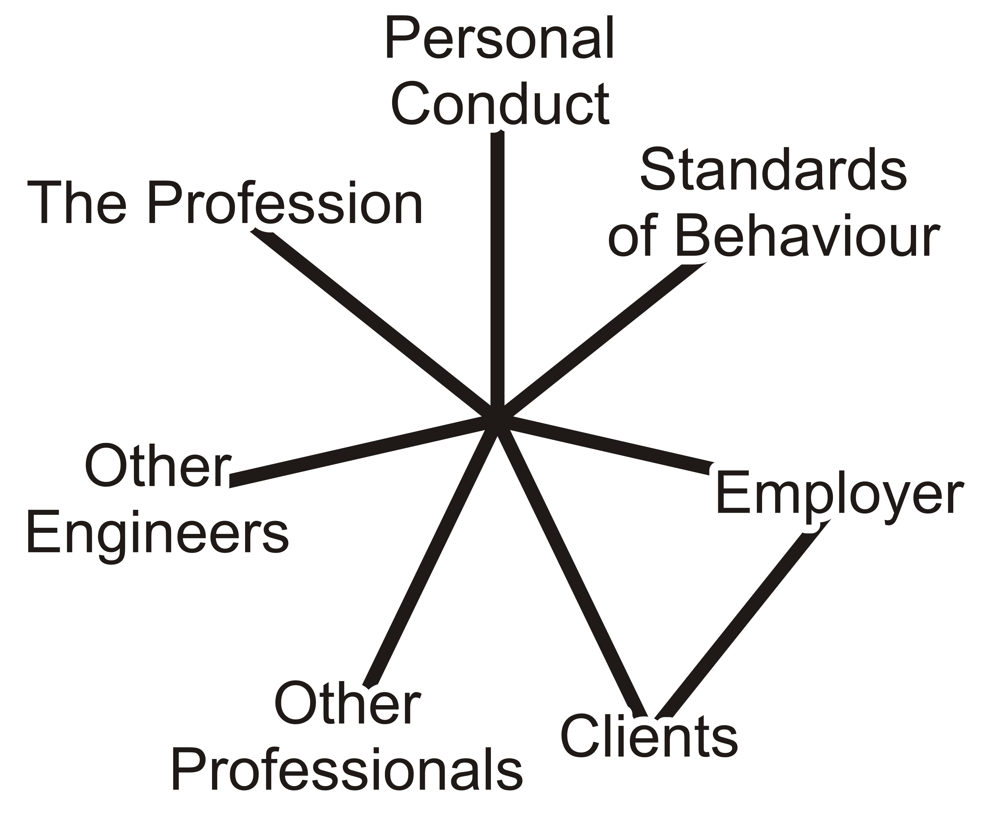
Code of Ethics
The Code of Ethics focuses on seven target groups engineers will interact with:
  Personal Conduct
  Standards of behaviour
  Their employers
  Their clients
  Other professionals
  Other practitioners of professional engineering
  The profession of engineering
Notes:
Put start figure from web
General: relate to misconduct (weakly). At end, anything in misconduct not in ethics.

Slide 6
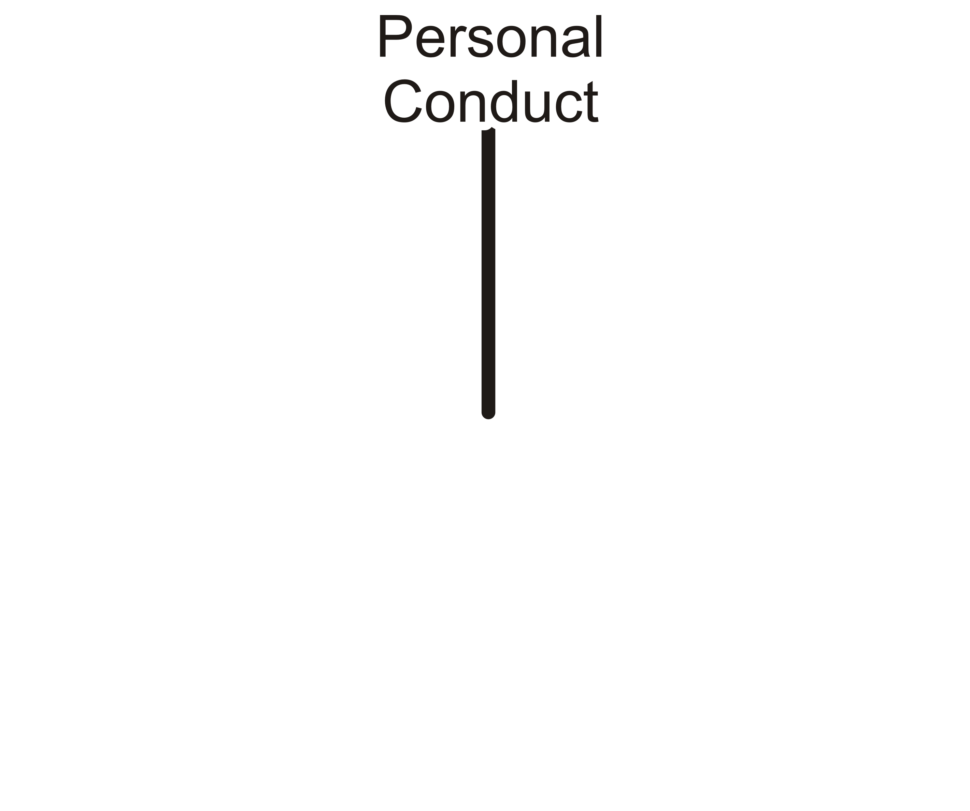
Personal Conduct
How should an engineer conduct themselves?
Notes:
Put start figure from web
General: relate to misconduct (weakly). At end, anything in misconduct not in ethics.

Slide 7
Personal Conduct
77.1 It is the duty of a practitioner...to act at all times with
  Fairness and loyalty
Fairness and loyalty to the practitioner's associates, employers, clients, subordinates and employees

Slide 8
Personal Conduct
77.1 It is the duty of a practitioner...to act at all times with
  Fairness and loyalty
  Fidelity
Fidelity to public needs

Slide 9
Personal Conduct
77.1 It is the duty of a practitioner...to act at all times with
  Fairness and loyalty
  Fidelity
  Devotion
Devotion to high ideals of personal honour and professional integrity

Slide 10
Personal Conduct
77.1 It is the duty of a practitioner...to act at all times with
  Fairness and loyalty
  Fidelity
  Devotion
  Knowledge
Knowledge of developments in the area of professional engineering relevant to any services that are undertaken

Slide 11
Personal Conduct
77.1 It is the duty of a practitioner...to act at all times with
  Fairness and loyalty
  Fidelity
  Devotion
  Knowledge
  Competence
Competence in the performance of any professional engineering services that are undertaken

Slide 12
Personal Conduct
72(2)(h) For the purposes of the Act and this Regulation, “professional misconduct” means undertaking work the practitioner is not competent to perform by virtue of the practitioner’s training and experience.
Competence in the performance of any professional engineering services that are undertaken

Slide 13
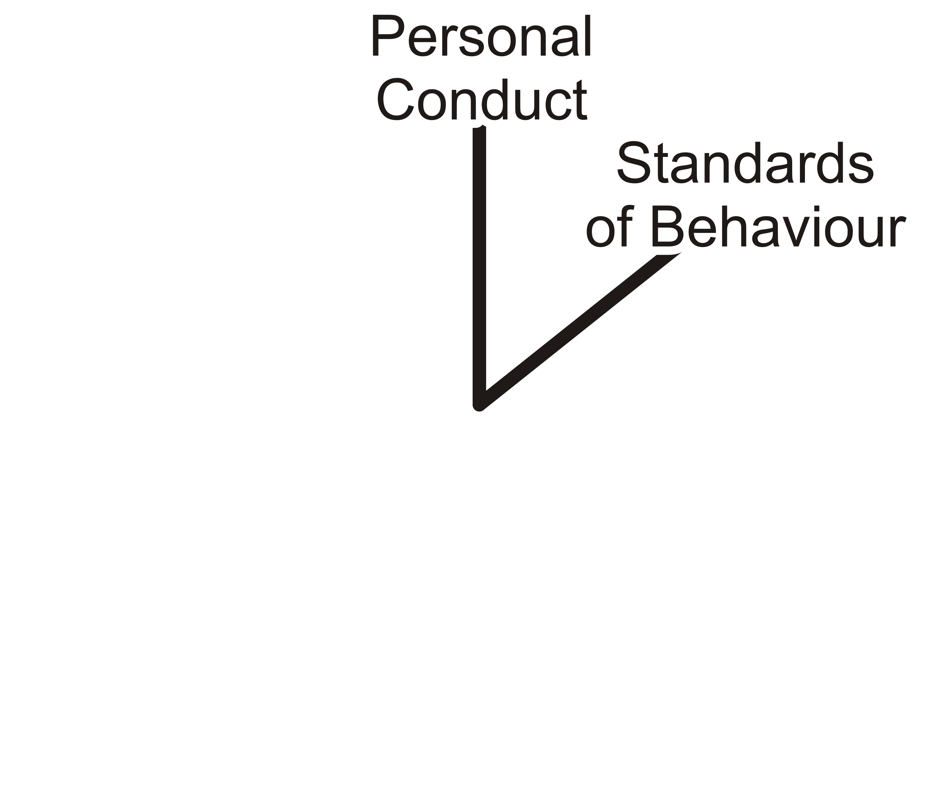
Standards of Behaviour
What personal standards should professional engineers hold themselves to?

Slide 14
Standards of Behaviour
77.2 With respect to their personal standards:
  Duty to public welfare
A practitioner shall regard the practitioner's duty to public welfare as paramount

Slide 15
Standards of Behaviour
77.2 With respect to their personal standards:
  Duty to public welfare
  Enhance public regard
A practitioner shall endeavour at all times to enhance the public regard for the practitioner's profession by extending the public knowledge thereof and discouraging untrue, unfair or exaggerated statements with respect to professional engineering

Slide 16
Standards of Behaviour
77.2 With respect to their personal standards:
  Duty to public welfare
  Enhance public regard
  Opinions must be founded on knowledge and conviction
A practitioner shall not express publicly, or while the practitioner is serving as a witness before a court, commission or other tribunal, opinions on professional engineering matters that are not founded on adequate knowledge and honest conviction

Slide 17
Standards of Behaviour
77.2 With respect to their personal standards:
  Duty to public welfare
  Enhance public regard
  Opinions must be founded on knowledge and conviction
  Display of licence
A practitioner shall endeavor to keep the practitioner's licence, temporary licence, limited licence or certificate of authorization, as the case may be, permanently displayed in the practitioner's place of business

Slide 18
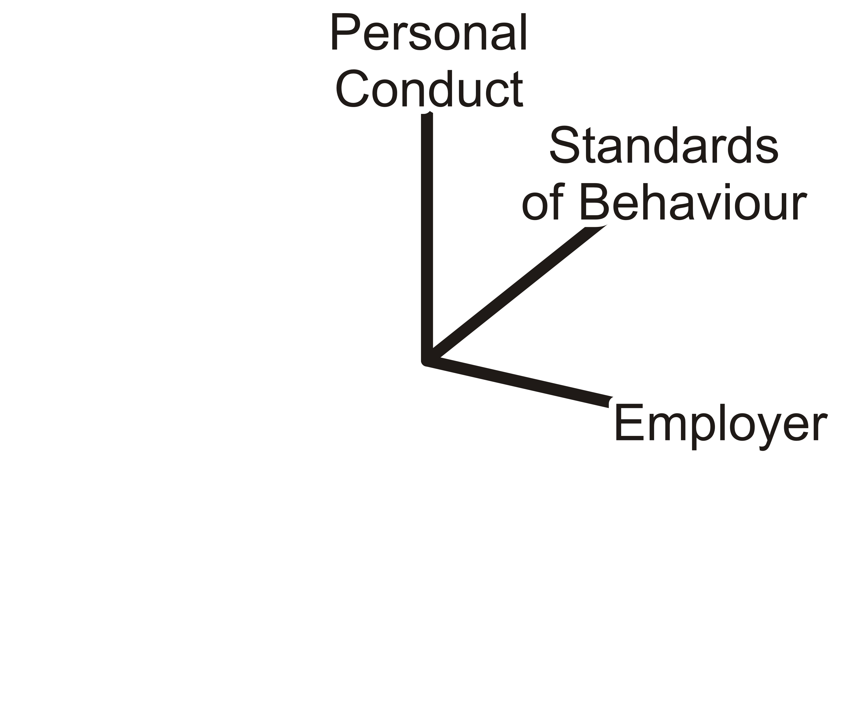
Employers
Engineers may either work as employee-engineers or may solicit clients for whom they will work
How should a professional engineers act with respect to their employers?

Slide 19
Employers
77.3 With respect to employee engineers, they will
  Act faithfully
Act in professional engineering matters for each employer as a faithful agent or trustee

Slide 20
Employers
77.3 With respect to employee engineers, they will
  Act faithfully
  Maintain confidence of information
Regard as confidential information obtained by the practitioner as to the business affairs, technical methods or processes of an employer

Slide 21
Employers
77.3 With respect to employee engineers, they will
  Act faithfully
  Maintain confidence of information
  Avoid or disclose conflict of interest
Avoid or disclose a conflict of interest that might influence the practitioner's actions or judgment

Slide 22
Employers
77.3 With respect to employee engineers, they will
  Act faithfully
  Maintain confidence of information
  Avoid or disclose conflict of interest
These are in addition to any conditions in the employment contract and any N.D.A.

Slide 23
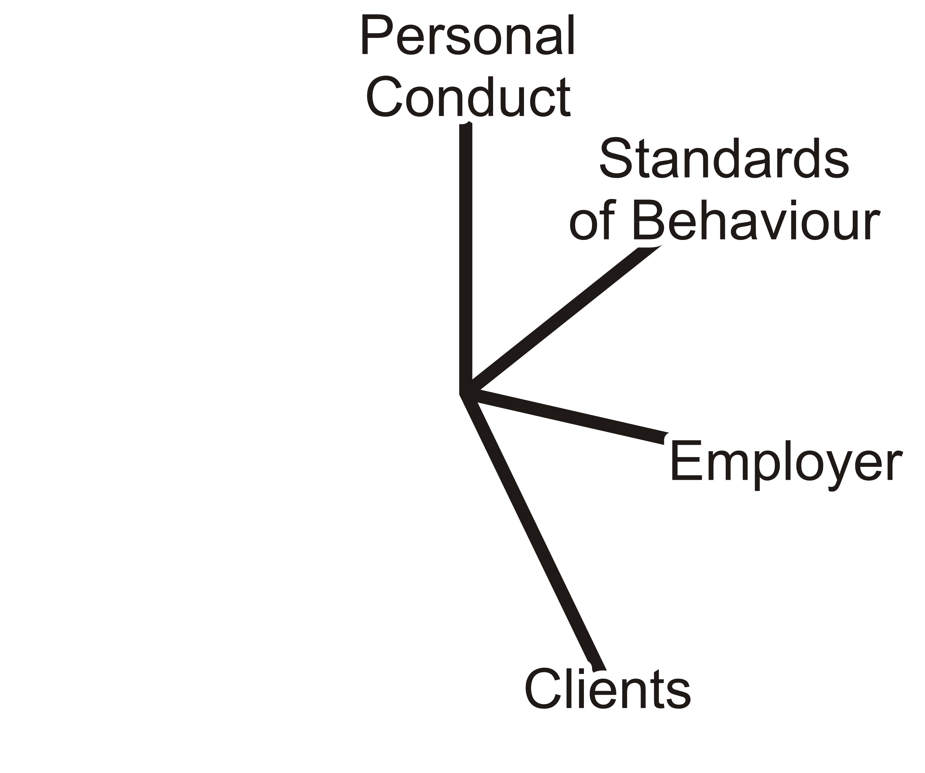
Clients
How should a professional engineer interact with his clients?

Slide 24
Clients
77.4 A practitioner must disclose immediately to the practitioner's client any interest, direct or indirect, that might be construed as prejudicial in any way to the professional judgment of the practitioner in rendering service to the client.

Slide 25
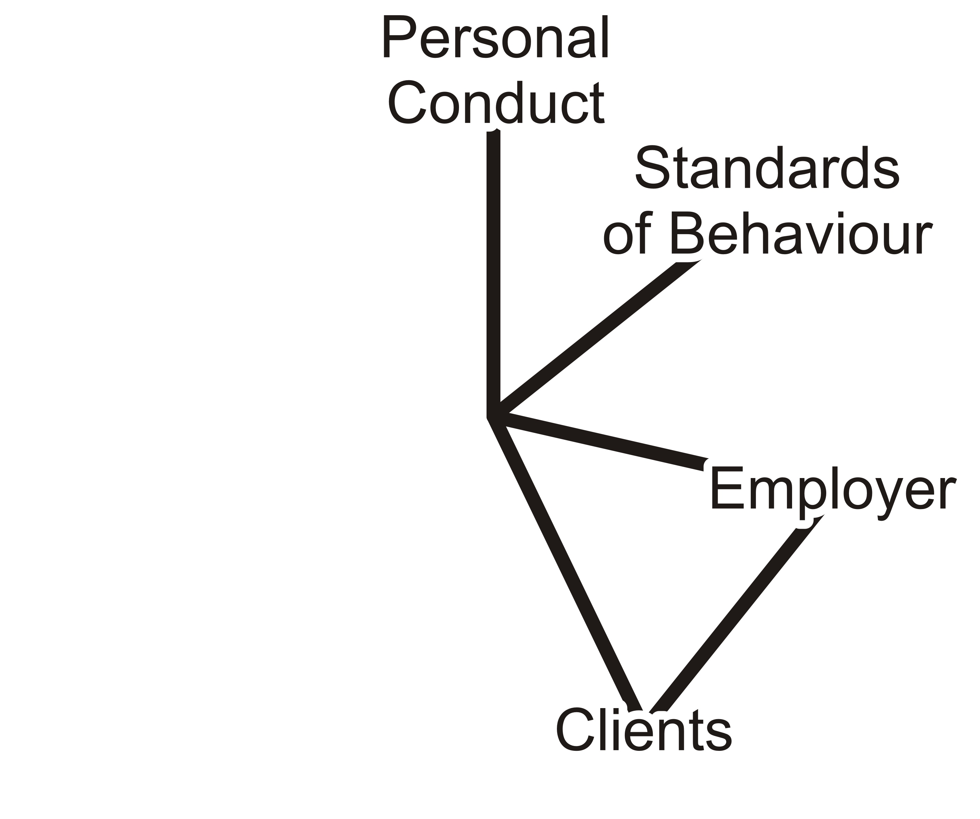
Employers and Clients
It is possible for an engineer to act as both an employee while at the same time soliciting contracts from clients
  The work for the clients must, of course, be entirely independent of the work for the employer
  An employee engineer does not require a Certificate of Authorization, but soliciting clients does

Slide 26
Employers and Clients
77.5 A practitioner who is an employee-engineer and is contracting in the practitioner’s own name to perform professional engineering work for other than the practitioner's employer, must
  Provide the practitioner’s client with a written statement of
              The nature of the practitioner’s status as an employee and the attendant limitations on the practitioner’s services to the client

Slide 27
Employers and Clients
77.5 A practitioner who is an employee-engineer and is contracting in the practitioner’s own name to perform professional engineering work for other than the practitioner's employer, must
  Provide the practitioner’s client with a written statement of
              The nature of the practitioner’s status as an employee and the attendant limitations on the practitioner’s services to the client
              Must satisfy the practitioner that the work will not conflict with the practitioner’s duty to the practitioner’s employer

Slide 28
Employers and Clients
77.5 A practitioner who is an employee-engineer and is contracting in the practitioner’s own name to perform professional engineering work for other than the practitioner's employer, must
  Provide the practitioner’s client with a written statement of
              The nature of the practitioner’s status as an employee and the attendant limitations on the practitioner’s services to the client
              Must satisfy the practitioner that the work will not conflict with the practitioner’s duty to the practitioner’s employer
              Must inform the practitioner’s employer of the work

Slide 29
Employers and Clients
77.5 A practitioner who is an employee-engineer and is contracting in the practitioner’s own name to perform professional engineering work for other than the practitioner's employer, must
  Provide the practitioner’s client with a written statement of
              The nature of the practitioner’s status as an employee and the attendant limitations on the practitioner’s services to the client
              Must satisfy the practitioner that the work will not conflict with the practitioner’s duty to the practitioner’s employer
              Must inform the practitioner’s employer of the work
The Moonlighting Clause

Slide 30
Employers and Clients
72 (2)(i) 4 For the purposes of the Act and this Regulation, “professional misconduct” means failure to make prompt, voluntary and complete disclosure of an interest, direct or indirect, that might in any way be, or be construed as, prejudicial to the professional judgment of the practitioner in rendering service to the public, to an employer or to a client, and in particular, without limiting the generality of the foregoing, contracting in the practitioner’s own right to perform professional engineering services for other than the practitioner’s employer.

Slide 31
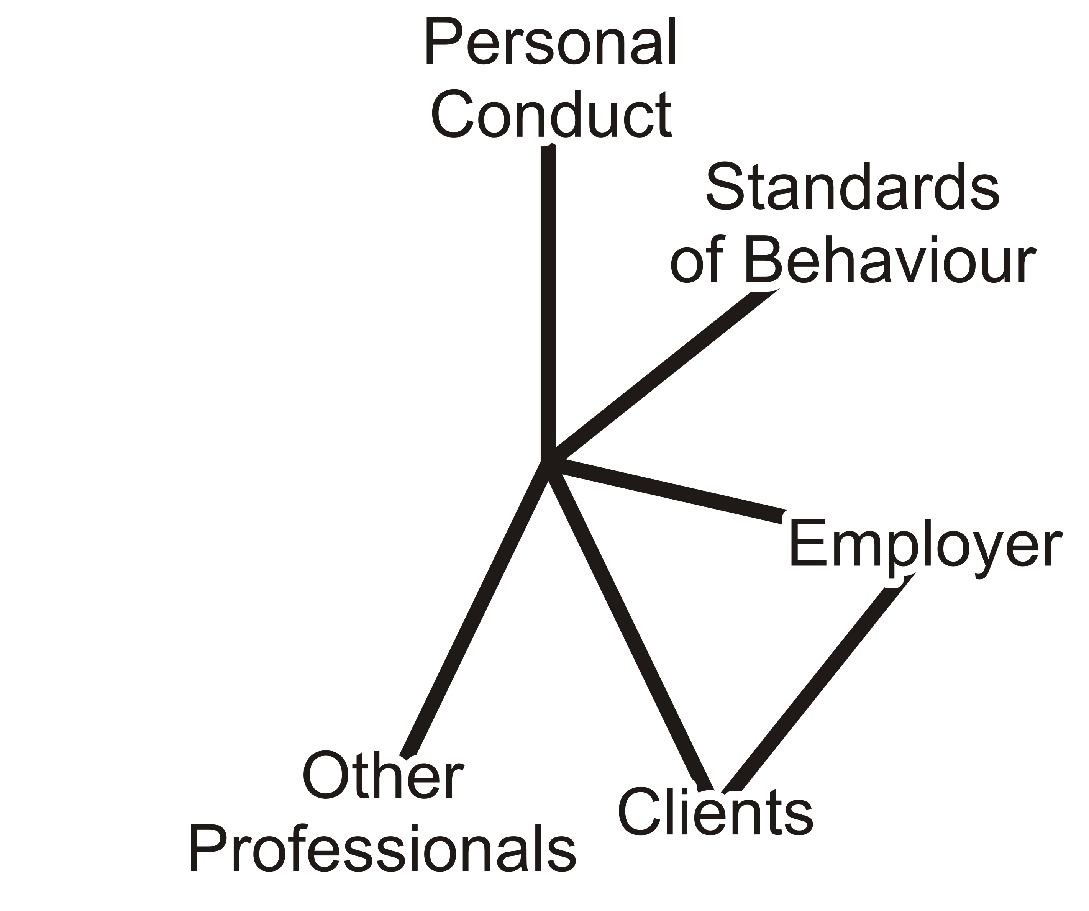
Other Professionals
How should professional engineers interact with other professionals?

Slide 32
Other Professionals
77.6 With respect to other professionals:
  A practitioner must co-operate in working with other professionals engaged on a project

Slide 33
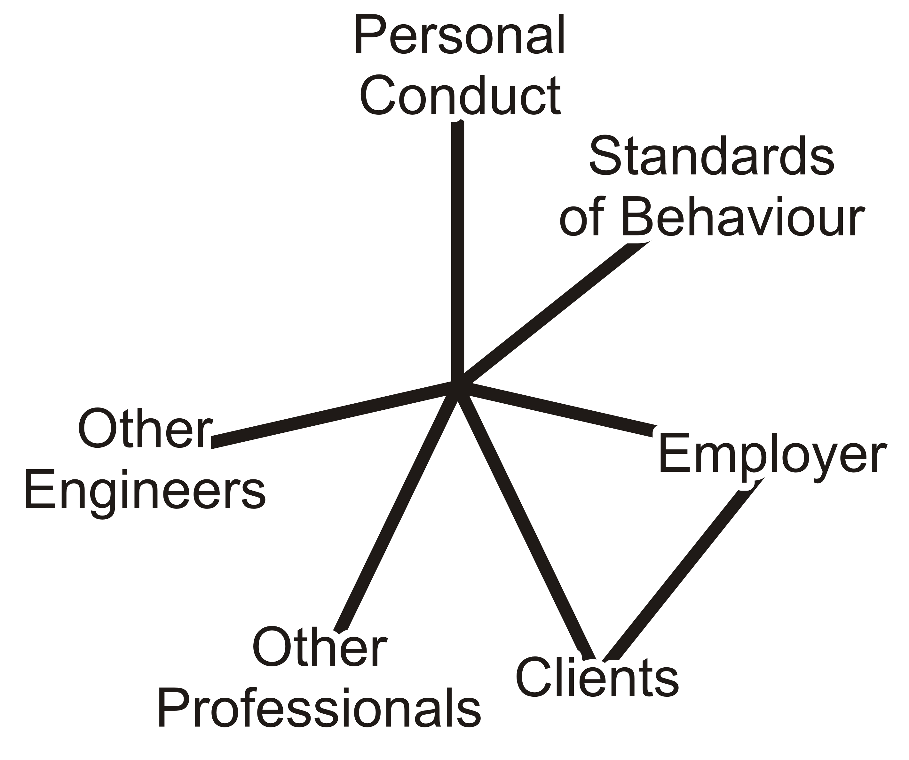
Other Practitioners
How should professional engineers interact with other engineering practitioners?

Slide 34
Other Practitioners
77.7 An engineer shall:
  Act with courtesy and good faith
Act towards other practitioners with courtesy and good faith

Slide 35
Other Practitioners
77.7 An engineer shall:
  Act with courtesy and good faith
  Not review other practitioner’s work
Not accept an engagement to review the work
of another practitioner for the same employer
except with the knowledge of the other practitioner or except where the connection of the other practitioner with the work has been terminated

Slide 36
Other Practitioners
77.7 An engineer shall:
  Act with courtesy and good faith
  Not review other practitioner’s work
  Not maliciously injure the reputation
Not maliciously injure the reputation or business of another practitioner

Slide 37
Other Practitioners
77.7 An engineer shall:
  Act with courtesy and good faith
  Not review other practitioner’s work
  Not maliciously injure the reputation
  Not pay or accept commissions
Not attempt to gain an advantage over other practitioners by paying or accepting a commission in securing professional engineering work

Slide 38
Other Practitioners
72(2)(i) 1 For the purposes of the Act and this regulation, “professional misconduct” means failure to make prompt, voluntary and complete disclosure of an interest, direct or indirect, that might in any way be, or be construed as, prejudicial to the professional judgment of the practitioner in rendering service to the public, to an employer or to a client, and in particular, without limiting the generality of the foregoing, accepting compensation in any form for a particular service from more than one party.

Slide 39
Other Practitioners
77.7 An engineer shall:
  Act with courtesy and good faith
  Not review other practitioner’s work
  Not maliciously injure the reputation
  Not pay or accept commissions
  Give credit
Give proper credit for engineering work

Slide 40
Other Practitioners
77.7 An engineer shall:
  Act with courtesy and good faith
  Not review other practitioner’s work
  Not maliciously injure the reputation
  Not pay or accept commissions
  Give credit, uphold the principle of adequate compensation
Uphold the principle of adequate compensation for engineering work

Slide 41
Other Practitioners
77.7 An engineer shall:
  Act with courtesy and good faith
  Not review other practitioner’s work
  Not maliciously injure the reputation
  Not pay or accept commissions
  Give credit, uphold the principle of adequate compensation,
  give opportunities
Provide opportunity for professional development and advancement of the practitioner's associates and subordinates

Slide 42
Other Practitioners
77.7 An engineer shall:
  Act with courtesy and good faith
  Not review other practitioner’s work
  Not maliciously injure the reputation
  Not pay or accept commissions
  Give credit, uphold the principle of adequate compensation,
  give opportunities, and interchange information and experience
Extend the effectiveness of the profession through the interchange of engineering information and experience

Slide 43
To the Profession
What are the duties of a professional engineer to the profession of engineering?

Slide 44
To the Profession
77.8 The engineer shall:
  Maintain the honour and integrity of the practitioner's profession
  Without fear or favour expose before the proper tribunals unprofessional, dishonest or unethical conduct by any other practitioner

Slide 45
The Code of Ethics
The Code of Ethics is a statement of duties of the engineer
  It is deontological in nature
  It lists those duties that an engineer should follow

Slide 46
The Code of Ethics
Recall that the Code of Ethics is deontological in nature
Engineers, in general, prefer deontological statements:
  As long as the rules are followed, one is not behaving unethically—that is, one is not engaging in professional misconduct
  Consider however the issue with utilitarianism:
    It is very closer to ethics engineering
      What are the requirements for a successful outcome?
      What are the metrics in this particular case?
      What are the criteria by which we will consider a reasonable action?
      What are the available options?
      Are there examples from which experience can be drawn from?
    In some cases, there may be no ethical action

Slide 47
Other Codes of Ethics
In many jurisdictions, not following the Code of Ethics is by definition professional misconduct:
  For example, the Alberta Code of Ethics is such a code

Slide 48
Alberta
CODE OF ETHICS
Established pursuant to section 20(1)(k) of the Engineering, Geological and Geophysical Professions Act,
Preamble
  Professional engineers, geologists and geophysicists shall recognize that professional ethics is founded upon integrity, competence, dignity and devotion to service. This concept shall guide their conduct at all times.
  Practitioners shall, in their areas of practice, hold paramount the health, safety and welfare of the public and have regard for the environment.

Slide 49
Alberta
  Practitioners shall undertake only work that they are competent to perform by virtue of their training and experience.
  Practitioners shall conduct themselves with integrity, honesty, fairness and objectivity in their professional activities.
  Practitioners shall comply with applicable statutes, regulations and bylaws in their professional practices.
  Practitioners shall uphold and enhance the honour, dignity and reputation of their professions and thus the ability of the professions to serve the public interest.

Slide 50
References
[1] Professional Engineers Act,
http://www.e-laws.gov.on.ca/html/statutes/english/elaws_statutes_90p28_e.htm
[2] Ontario Regulation 941,
http://www.e-laws.gov.on.ca/html/regs/english/elaws_regs_900941_e.htm
[3] Julie Vale, ECE 290 Course Notes, 2011.
[4] Wikipedia, http://www.wikipedia.org/
These course slides are provided for the ECE 290 class. The material in it reflects Douglas Harder’s best judgment in light of the information available to him at the time of preparation. Any reliance on these course slides by any party for any other purpose are the responsibility of such parties. Douglas W. Harder accepts no responsibility for damages, if any, suffered by any party as a result of decisions made or actions based on these course slides for any other purpose than that for which it was intended.

