Slide 1
Contract Law: Capacity
Douglas Wilhelm Harder, M.Math. LEL
Department of Electrical and Computer Engineering
University of Waterloo
Waterloo, Ontario, Canada
ece.uwaterloo.ca
dwharder@alumni.uwaterloo.ca
© 2013 by Douglas Wilhelm Harder. Some rights reserved.

Slide 2
Outline
An introduction to the engineering profession, including:
  Standards and safety
  Law: Charter of Rights and Freedoms, contracts, torts, negligent malpractice, forms of carrying on business
  Intellectual property (patents, trade marks, copyrights and industrial designs)
  Professional practice
    Professional Engineers Act
    Professional misconduct and sexual harassment
  Alternative dispute resolution
  Labour Relations and Employment Law
  Environmental Law

Slide 3
Contract Law
The five essential elements of a contract are:
  An offer is made and accepted
  There is mutual intent to enter into the contract
  Consideration
  Capacity to contract
  Lawful purpose

Slide 4
Capacity
For an agreement to be legally binding, each party must be capable of entering into a legally binding contract
  That is, they must have capacity to contract

Slide 5
Age of Majority
The age of majority is the legally recognized point when one enters adulthood and thus one ceases to be a minor
At this point, it terminates the legal control and responsibilities of parents or guardians
It is also the point at which one can enter into a contract

Slide 6
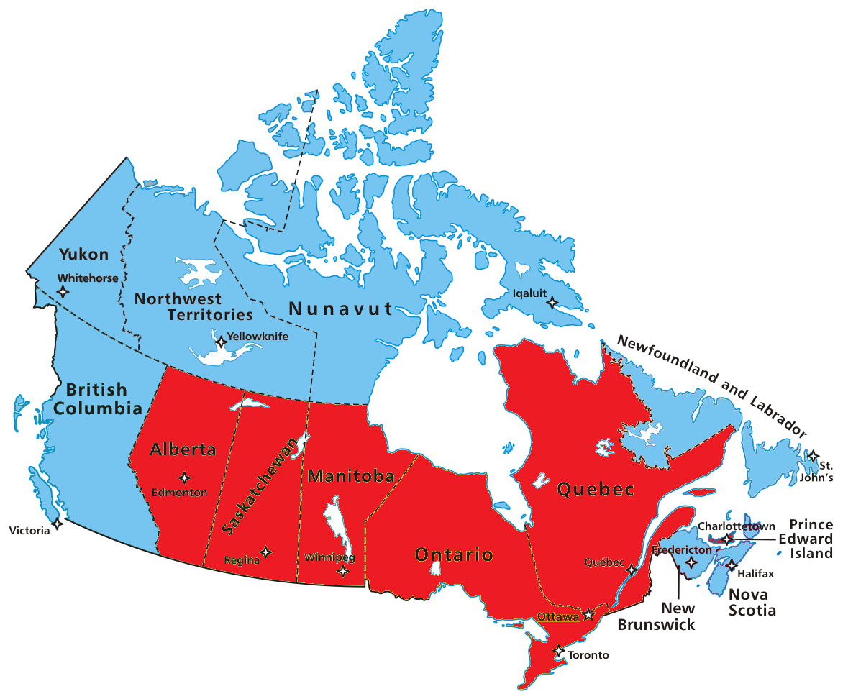
Age of Majority
The age of majority differs in Canada between the provinces and territories:
18 y.o. Ontario, Alberta, Manitoba, P.E.I., Quebec
and Saskatchewan
19 y.o. British Columbia, New Brunswick,
Newfoundland and Labrador,
Nova Scotia, N.W.T.,
Nunavut, Yukon

Slide 7
Contracts with Minors
A contract with a minor is not enforceable by the other party unless:
  The contract concerns providing a necessity of life for the minor, including food, clothing, shelter, etc.
  When the minor reaches the age of majority, he or she must ratify the contract
The contracting party need not know they are dealing with a minor in order to be bound to an unenforceable contract

Slide 8
Mental Incompetence
In Hart v O’Connor, Lord Brightman wrote:
  “... the validity of a contract entered into by a lunatic who is ostensibly sane is to be judged by the same standards as a contract by a person of sound mind, and is not voidable by the lunatic or his representatives by reason of ‘unfairness' unless such unfairness amounts to equitable fraud which would have enabled the complaining party to avoid the contract even if he had been sane.”

Slide 9
Intoxication
Individuals who are intoxicated do not have the capacity to enter into contracts
In the words of Lord Ellenborough, they have “no agreeing mind.”
A drunkard may, however, ratify a contract once they have sobered up...

Slide 10
Corporations
The objects of a corporation must be stated in the constitutive documents of incorporation
Any endeavour that is not allowed for under the objects of incorporation are ultra vires, and thus, beyond the power of the corporation
Any contract that is ultra vires is unenforceable

Slide 11
References
[1] D.L. Marston, Law for Professional Engineers, 4th Ed., McGraw Hill, 2008.
[2] Julie Vale, ECE 290 Course Notes, 2011.
[3] Wikipedia, http://www.wikipedia.org/
These course slides are provided for the ECE 290 class. The material in it reflects Douglas Harder’s best judgment in light of the information available to him at the time of preparation. Any reliance on these course slides by any party for any other purpose are the responsibility of such parties. Douglas W. Harder accepts no responsibility for damages, if any, suffered by any party as a result of decisions made or actions based on these course slides for any other purpose than that for which it was intended.

