Slide 1
Canadian Law
Douglas Wilhelm Harder, M.Math. LEL
Department of Electrical and Computer Engineering
University of Waterloo
Waterloo, Ontario, Canada
ece.uwaterloo.ca
dwharder@alumni.uwaterloo.ca
© 2013 by Douglas Wilhelm Harder. Some rights reserved.

Slide 2
Outline
An introduction to the engineering profession, including:
  Standards and safety
  Law: Charter of Rights and Freedoms, contracts, torts, negligent malpractice, forms of carrying on business
  Intellectual property (patents, trade marks, copyrights and industrial designs)
  Professional practice
    Professional Engineers Act
    Professional misconduct and sexual harassment
  Alternative dispute resolution
  Labour Relations and Employment Law
  Environmental Law

Slide 3
Prior to the Constitution
The courts establish precedence by making rulings on cases
Parliament passes statutes that take precedence over prior court decisions
  Concept of the Supremacy of Parliament
Courts now make rulings interpreting those laws and thus establishing further precedences

Slide 4
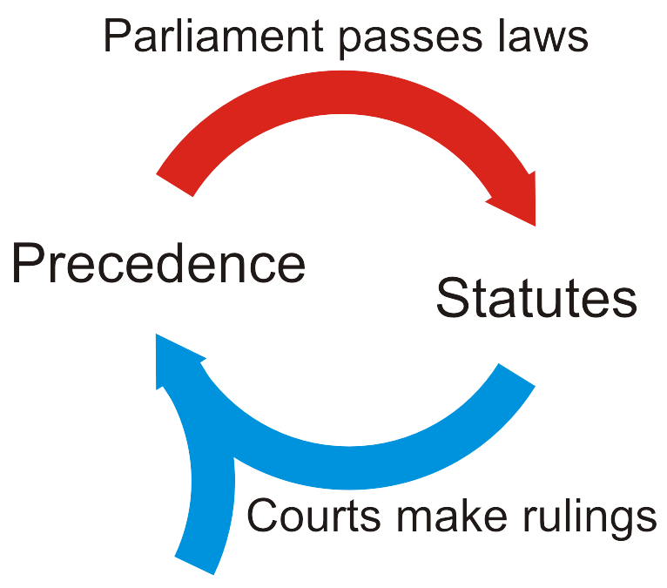
Prior to the Constitution
The courts establish precedence by making rulings on cases
Parliament passes statutes that take precedence over prior court decisions
  Concept of the Supremacy of Parliament
Courts now make rulings interpreting
those laws and thus establishing
further precedence

Slide 5
Interpretation of the Constitution
The courts may also interpret the Constitution Act
  The Supreme Court is the highest interpreter of the law in Canada
  Interpretations of the Constitution by the Supreme Court are binding precedence

Slide 6
Interpretation of the Constitution
Example:
  15. (1) Every individual is equal before and under the law and has the right to the equal protection and equal benefit of the law without discrimination and, in particular, without discrimination based on race, national or ethnic origin, colour, religion, sex, age or mental or physical disability.
  (2) Subsection (1) does not preclude any law, program or activity that has as its object the amelioration of conditions of disadvantaged individuals or groups including those that are disadvantaged because of race, national or ethnic origin, colour, religion, sex, age or mental or physical disability.

Slide 7
Interpretation of the Constitution
What is equality under the law?
  To prevent “violation of essential human dignity and freedom through the imposition of disadvantage, stereotyping, or political and social prejudices, and to promote a society in which all persons enjoy equal recognition at law as human beings or as members of Canadian society, equally capable and equally deserving of concern, respect and consideration.”

Slide 8
Interpretation of the Constitution
Thus, the courts recognized four dimensions of equality:
  Equality before the law is equality in the administration of justice, where all individuals are subject to the same criminal laws in the same manner by law enforcement and the courts.
  Equality under the law is equality in the substance of the law, where the content of the law is equal and fair to everyone so that everyone experiences the same result.
  Equal benefit of the law ensures that benefits imposed by law will be proportionate.
  Equal protection of the law ensure that the protections imposed by law will be proportionate so that the human dignity of every person is equally safeguarded by the law.

Slide 9
Precedence
Since the Charter has come into force, numerous Supreme Court decisions have expanded upon which laws cannot discriminate:
Persons committing crimes outside Canada
Having a “taste for marijuana”
Sexual orientation
Employment status
Litigants against the Crown
Marital status
Citizenship
Membership in military
Off-reserve aboriginal status
New resident of a province
Begging and extreme poverty

Slide 10
Criticism:
  The Americanization of Canada: a focus on corporate and individual rights while ignoring social and group rights
  Claims have been made that the federal government has allied itself with rights claimants, thereby limiting provincial powers
  It is a cosmopolitan and not a Canadian document

Slide 11
References
[1] D.L. Marston, Law for Professional Engineers, 4th Ed., McGraw Hill, 2008.
[2] Julie Vale, ECE 290 Course Notes, 2011.
[3] Wikipedia, http://www.wikipedia.org/
These course slides are provided for the ECE 290 class. The material in it reflects Douglas Harder’s best judgment in light of the information available to him at the time of preparation. Any reliance on these course slides by any party for any other purpose are the responsibility of such parties. Douglas W. Harder accepts no responsibility for damages, if any, suffered by any party as a result of decisions made or actions based on these course slides for any other purpose than that for which it was intended.

