Slide 1
Canadian Government
Douglas Wilhelm Harder, M.Math. LEL
Department of Electrical and Computer Engineering
University of Waterloo
Waterloo, Ontario, Canada
ece.uwaterloo.ca
dwharder@alumni.uwaterloo.ca
© 2013 by Douglas Wilhelm Harder. Some rights reserved.

Slide 2
Outline
An introduction to the engineering profession, including:
  Standards and safety
  Law: Charter of Rights and Freedoms, contracts, torts, negligent malpractice, forms of carrying on business
  Intellectual property (patents, trade marks, copyrights and industrial designs)
  Professional practice
    Professional Engineers Act
    Professional misconduct and sexual harassment
  Alternative dispute resolution
  Labour Relations and Employment Law
  Environmental Law

Slide 3
Topic Outline
We will look at:
  Governance
  Sovereign states, countries and nations
  Unitary, federal and confederal states
  Heads of State
  Sources of law
    Legislative assemblies, parliament
    Unicameral and bicameral legislatures
  Administration of law
    Responsible government
    Parliamentary, presidential and semi-presidential systems
  Interpretation and application of law
    The judiciary
    Judicial independence and review

Slide 4
Governance
How are people governed?
  Law gives the policies that must be followed
  These policies must be enacted, administered, interpreted, applied, policed and enforced
The government is the collection of all institutions that are involved in these actions
In 350 BCE, Aristotle said that “the rule of law is better than the rule of any individual.”

Slide 5
States and State Organization
We will begin by looking at states and the relationships between states and subdivisions of that state
  What is a sovereign state?
  State organization
    Unitary states
    Federal states
    Confederations

Slide 6

Sovereign States
States and
State Organization
A sovereign state is a political organization that has independent authority to determine policy within its domain
  There is no role for any external agencies for the domain
A country is the geographic territory controlled by a sovereign state
  Not all sovereign states are countries:
  Sovereign Military Order of Malta

Slide 7
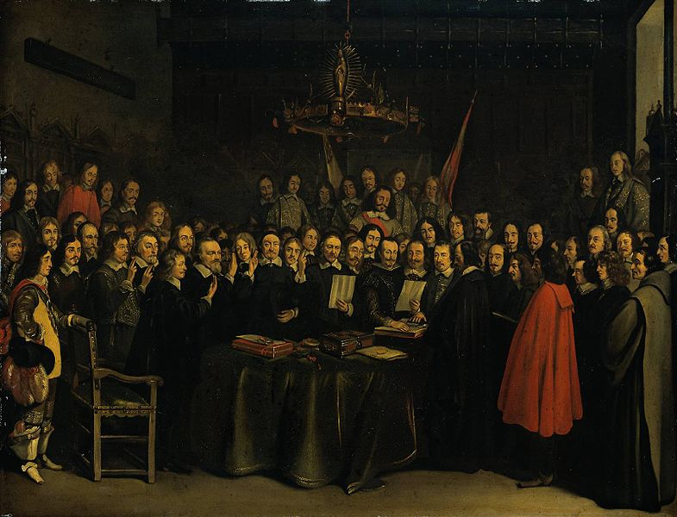
Nation
States and
State Organization
Note that the term nation tends to refer to a group of people who share common language, culture or ethnicity
  Sovereign states, as they are defined today, only came into existence with the Peace of Westphalia of 1648
  Stateless nations comprise ethnic groups
  without sovereign territory
    In the Indian subcontinent, the Tamils, Naga and Boda people
    In Great Britain, the Scots and Welsh
    In sub-Saharan Africa, theYoruba and Igbo people
    In the Iberian peninsula, the Basque and Catalan people
    In the Middle East, the Kurds and Assyrians
    In the Far East, the Uyghur, Hmong, Acehnese and Tibetan peoples
    In Mali and Niger, the Tuareg people
  The Romani people are a stateless nation with no aspirations toward statehood

Slide 8
State Subdivisions
States and
State Organization
In governance, is the power to govern held by a single government, or is at least some power shared with subdivisions of the state?
There are three models in use today:
  Unitary
  Federal
  Confederal
Others include rule of a state from an external agency:
  Imperial (direct rule) and hegemony (indirect rule)

Slide 9
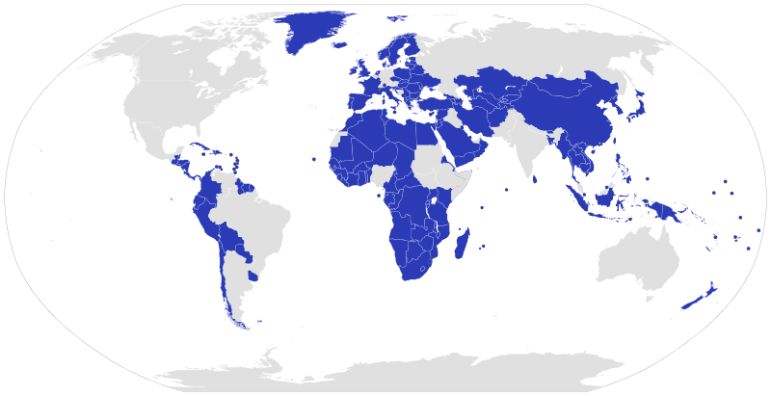
Unitary States
States and
State Organization
If a central government holds all power, it is said to be unitary
  Most states are unitary
  Any political subdivisions of the state exist with the consent of the state
  Power can be granted to political subdivisions (devolution) but this is with the consent of
  the central government
  The United Kingdom
  is unitary with
  Scotland, Wales
  and Northern
  Ireland holding no
  independent power
Lokal_Profil

Slide 10
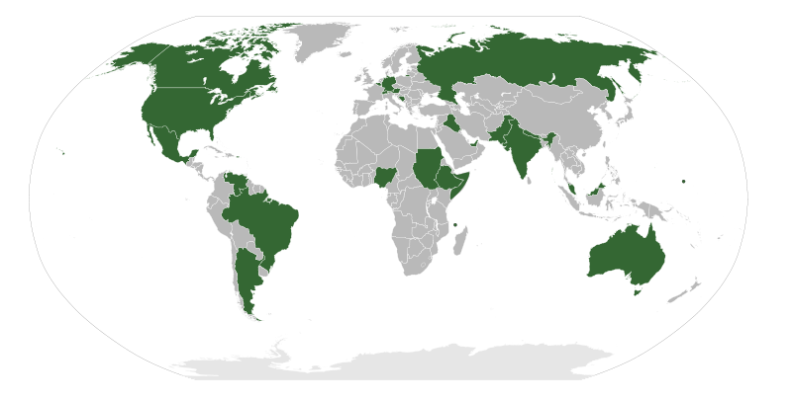
Federal States
States and
State Organization
If power is shared between a central government and subdivisions in that state, it is said to be a federal state
  From Latin: foedus, foederis for “covenant”
  The central government is the federal government
  Canada is a federal state with power shared between the governments of the provinces and the federal government
Lokal_Profil

Slide 11
Federal States
States and
State Organization
Note that the approach can be different:
  In Canada, the powers of the provinces is clearly defined in the Constitution — everything else is within the jurisdiction of the federal government
  In the United States, the powers of the federal government are well defined — everything else is within the power of the state governments
What are the benefits
and drawbacks of each?
Lokal_Profil

Slide 12
Confederations
States and
State Organization
A confederation is a union of sovereign states
  The only recent example was the political union of Serbia and Montenegro (2003–2006)
  Canada is not and never was a confederation
  The Swiss Confederation is also not a confederation:
    In 1291, it was originally created as a confederation of cantons
    When Catholic cantons attempted to separate in 1845, the state
    took on a federal character

Slide 13
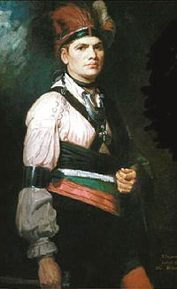
Confederations
States and
State Organization
The Iroquois league or confederacy was a political union of six tribes in upstate New York and southern Quebec
  Mohawk, Oneida, Onondaga, Cayuga, Seneca and Tuscarora
They were granted a reserve in Southern Ontario: the Six Nations of the Grand River First Nation
  Originally, the land grant was significant, but
  Joseph Brant (c.f., Brantford) sold most of this land
  and the reserve is now reduced to 46,000 acres,
  down from 950,000 acres

Slide 14
Municipalities and Cities
All cities and municipalities in Canada are under the control of the provincial governments
  The provincial government imposed the structure of regional municipalities and cities
  When the province amalgamated the Municipality of Metropolitan Toronto to the City of Toronto, the individual cities attempted to prevent it
    See Toronto’s Legal Challenge to Amalgamation by Dr. Beth Milroy
  Cities in Canada are corporations that have certain rights, in Ontario, under the Municipalities Act
    This act specifies what a municipality can regulate

Slide 15
Heads of State
Next, we will look at the overall authority for a state: the Head of State
  An individual versus a group
  Range of powers:
    Ceremonial
    Supervisory
    Executive
    Absolute
  Forms:
    Monarchy
    Republics

Slide 16
Heads of State
Heads of State
The highest officer and chief representative of a sovereign state is termed the Head of State
  This is the individual responsible for all aspects of governance in a sovereign state
  This is the position originally held by a monarch or ruler
In most countries, the Head of State is an individual
  Four countries have a body of individuals:
    Federal Council of Switzerland (7 individuals)
    Bosnia (one Bosniak, one Croat and one Serb)
    Captains Regent of San Marino (2)
    Co-princes of Andorra (2)

Slide 17
Heads of State
Heads of State
In some countries, the Head of State is largely ceremonial and supervisory
  In Canada, the Queen is the Head of State and her representative is the Governor General
  In Germany and Israel, the President is also ceremonial
  The Emperor of Japan and King of Sweden are the respective Heads of State, but they do not have even supervisory authority
In the Presidential System, the Head of State wields significant political power — the ability to influence policy
  The President holds significant power and is independent of other institutions of governance
  Named after the United States and adopted by many South and Central American countries

Slide 18
Monarchies and Republics
Heads of State
A monarchy is any country where the Head of State is a usually hereditary position monarch
  An absolute monarchy is where the monarch has few restraints
    Saudi Arabia, Vatican City, Qatar, Oman, Brunei, Swaziland
  A constitutional monarchy has constraints on the power weilded
    Morocco, Jordan, Kuwait, Bahrain, UAE, Bhutan, Monaco, Lichtenstein
  Often only supervisory and even only ceremonial
    United Kingdom et al., Norway, Sweden, Denmark, Netherlands, Belgium, Spain, Thailand, Cambodia, Japan, Malaysia
A republic is any country where the Head of State is not a hereditary position — that is, either elected or appointed
  That individual can be a dictator resulting from a military coup

Slide 19
Heads of State
Heads of State
In practice, no policy gains force of law until it is approved by the Head of State or a representative thereof
  Usually in the form of a signature
  The Governor General represents the Head of State for all federal matters
  As Canada is a federation, the Head of State is represented by the Lieutenant Governors for all provincial matters
Treaties, agreements, protocols, etc. between sovereign states are also usually signed by the respective Heads of State

Slide 20
Source of Law
In antiquity, the ruler was the source of law
  Absolute monarchies and dictatorships
We will look at this history:
  The source of laws in most countries today comes from a legislative branch of government
  Forms of legislatures
    Unicameral
    Bicameral

Slide 21
Source of Law
Source of Law
Where do laws actually come from?
  In an absolute monarchy and military dictatorships, the ruling power is the source of law
  In constitutional monarchies, usually the monarchs is restricted to either supervisory or ceremonial roles
  In most countries, a significant source of law is a legislative assembly
    Usually, this assembly is elected
  Countries without legislative assemblies:
    Saudi Arabia, Vatican City, Mali, Guinea, Yemen, Madagascar
  Legislative, adj.
    That legislates or makes laws; having the function of legislating.
  www.oed.com

Slide 22
Source of Law
Source of Law
In the Roman Republic and Empire, the Senate was a legislative assembly that issued senatus consulta, which, while not legally binding, were followed
There were two legislative assemblies:
  Assembly of the Centuries
  Assembly of the Tribes
  Plebeian Council
The assemblies could pass laws that would be enforced by elected magistrates

Slide 23
Source of Law
Source of Law
When William the Conqueror invaded England, he imposed feudalism
  The exchange of land for service or labour
William retained 20 % of the land (crown lands)
  55 % of the land was divided between 180 barons
  The king and his barons would further grant land to knights who provided military services
  Any of these could grant farmland to freemen (in return for rent) or villeins (in return for services)
In this hierarchy, the individual immediately above you was your “lord”

Slide 24
Source of Law
Source of Law
Now, in England, William was King; however, in France, William was also Duke of Normandy
King Henry II and others obtained other titles:
  Count of Anjou
  Duke of Aquitaine
  Count of Poitiers
The Duke of Brittany was made a vassal of the Duke of Normandy
All these were inherited by John who, nominally, owed allegiance to the King of France

Slide 25
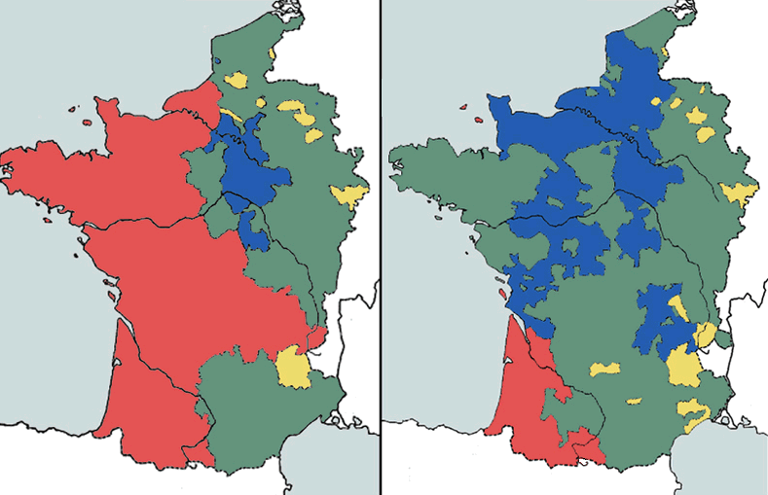
Magna Carta
Source of Law
King John’s reign resulted in a number of issues
  A prolonged war in France resulted in the loss of almost all lands in France of John and his barons
  Higher taxes were required to support these battles and to compensate for the lost tax revenue from the lost territories
  Taxes were raised or introduced without the customary consultation of the barons
  Arbitrary justice and defaulters
  were harshly treated
User: Vol de nuit

Slide 26
Magna Carta
Source of Law
One of the articles in the Magna Carta required that the King could not raise or introduce taxes without the consent of his Great Council, or Magnum Concilium
  This was comprised of the King’s officers and the immediate vassals of the king, including his barons and ecclesiastics
  This council existed prior to the Magna Carta, but it was not necessarily consulted

Slide 27
Parliament
Source of Law
  King John’s successor, King Henry III, was crowned at nine years old
  When his infancy ended, he began to be influenced by his foreign relatives
  The 1236 council was the first to be termed a parliament from concilium regis in parliamento
  In 1254, Henry III also called two knights from each county to parliament
Middle French parlement, n. Discussion, conversation, meeting, negotiation www.oed.com
c.f. parler, v. To talk.

Slide 28
Parliament
Source of Law
After the Oxford Parliament of 1258, Henry III was forced to sign the Provisions of Oxford which abolished the absolutist monarchy and established a privy (private) council for the King
  The privy council was composed of those who ministered to the king’s administrative needs
  These parliaments were led by Simon de Montford, whose example lead to the establishment of the Speaker of Parliament
  The Baron’s Revolt started in 1264
  In 1265, de Montford called a parliament without royal approval
    Each shire sent two knights
    Each borough (semi-autonomous settlements) sent two elected representatives, or burgesses

Slide 29
Parliament
Source of Law
In 1275, under King Edward I, the Statute of Westminster was a codification of many of the laws that had evolved under common law over the past century
  One act of this statute is still in force today in England and Wales: the Freedom of Election Act
  It says:
    There shall be no Disturbance of Free Elections.
    AND because Elections ought to be free, the King commandeth upon great Forfeiture, that no Man by force of Arms, nor by Malice, or Menacing, shall disturb any to make free Election.

Slide 30
Parliament
Source of Law
In 1295, King Edward I required new taxes and called what is to be termed the Model Parliament
  49 lords, aristocratic and ecclesiastic representatives
  292 representatives of the community of the realm:
    Two knights per shire
    Two burgesses per borough
    Two citizens per city (new)
  This second group was termed “the Commons”

Slide 31
Parliament
Source of Law
Prior to 1341, the king would call on the lords if he required advice, but would call both the lords and the Commons if he needed to raise taxes
In 1341, the Commons met separately from the Lords
  This established a lower chamber and an upper chamber

Slide 32
Parliament
Source of Law
In 1376, the Good Parliament met during which time the Commons attempted to address growing corruption
  Peter de la Mare, the elected to be the speaker of the House of Commons to the House of Lords
  They attempted to impeach corrupt councillors within the King’s privy council
  He was imprisoned after and the 1377 Bad Parliament undid the acts of the Good Parliament

Slide 33
Parliament
Source of Law
Under the next king, Richard II, the House of Commons began to impeach corrupt councillors within the privy council and began to insist that they could control public expenditures as well as taxation
The authority of parliament waxed and waned in inverse relation to the ability of the monarchy to impose its authority
  Never-the-less, the monarch could never bypass
  parliament—its only means was to control parliament

Slide 34

Parliament
Source of Law
The War of the Roses weakened the aristocracy and thus the House of Lords and parliament as a whole
  Parliament was significantly weaker during the Tutor reign
    This included Queen Elizabeth I as the last Tutor monarch
  This was changed during the subsequent rule of the
  House of Stuart and then again during the reign of the
  House of Hanover

Slide 35
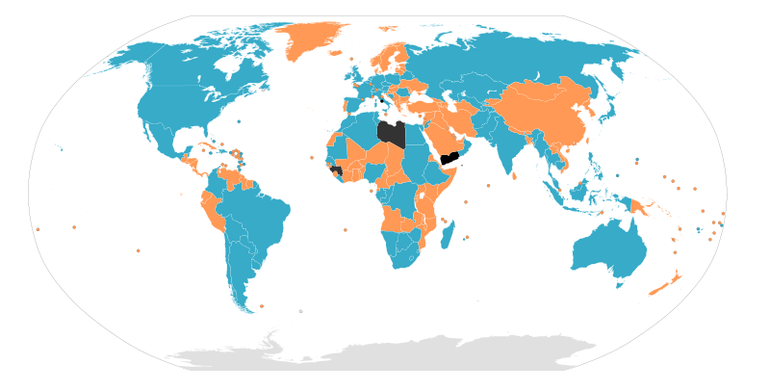
Legislative Bodies
Source of Law
Legislative branches consist of either one or two bodies:
  If broken into two legislative bodies, it is termed bicameral
    Any legislation must have a concurrent majority
  With one legislative body, it is unicameral
Bicameral legislature
Unicameral legislature
No legislative branch
User: Canuckguy

Slide 36
Legislative Bodies
Source of Law
In Canada:
  The federal legislature is bicameral:
    The House of Commons and the Senate
  The provincial legislatures are unicameral
    Provincial Legislative Assemblies
    Ontario stylizes its legislature as the Provincial Parliament
    Quebec stylizes its legislature as the National Assembly
    Newfoundland and Labrador, and Nova Scotia stylize their legislatures as Houses of Assembly
  In the Constitution, they are all referred to as Legislative Assemblies and their members are Members of the Legislative Assembly or MLAs

Slide 37
Legislative Bodies
Source of Law
The United States is a federal state:
  The federal legislature and almost all state legislatures are
  bicameral
  Only the State of Nebraska has a unicameral legislature, the Nebraska Legislature
Australia is a federal state:
  The federal legislature is bicameral as are most states and
  territories
  Queensland, Northern Territory and the Australian Capital
  Territory are unicameral
New Zealand is a unitary state with a unicameral legislature

Slide 38
Administration of Law
The largest branch of government is the executive branch—it is the branch that administers the law
  The function of all ministries, departments, agencies, crown corporations, etc.
We will look at:
  The control of the administration
  The evolution of responsible government
  The presidential system

Slide 39
Administration of Law
Administration
of Law
In a dictatorship or absolute monarchy, the administration of the law is under the control of either
  A single individual: an absolute monarchy or dictatorship
  A small group or oligarchy
An alternative is to have the control of the administration under a group that is answerable to either:
  The legislative branch: responsible government
  The public directly: the presidential model

Slide 40
Responsible Government
Administration
of Law
With Charles I, the second Stuart king, he took as his council a group within the larger privy council
  He stylized this group his cabinet council
With the reign of King George I (1714 – 27), the first Hanoverian king, control of the government passed to the Cabinet
  These were members of the Houses of Commons and Lords and ministers to the king
  The speaker for the Cabinet was stylized as the Prime Minister

Slide 41
Responsible Government
Administration
of Law
With the defeat of Britain at Yorktown during the American Revolution, the Parliament voted that they
  “can no longer repose confidence in the present ministers”
The Prime Minister requested to King George III that he be allowed to resign and a new Cabinet was formed
The finer details were developed in the early 1900s

Slide 42
Responsible Government
Administration
of Law
This is the defining feature of the Parliamentary System
  The executive branch of government controls the administration of government and law
  The controlling body of the executive branch is the Cabinet
  The Cabinet derives its legitimacy from the legislative branch of government
    In England, the Houses of Commons and Lords
    In Canada, the House of Commons and the Senate
  If the legislative branch loses confidence in the executive branch, the executive branch must resign and either a new Cabinet is formed or an election is held

Slide 43
Parliamentary System
Administration
of Law
In Commonwealth countries, the head of the executive branch is known as the Head of Government
Any government where the head of the executive branch is responsible to the legislative branch is said to be under the Parliamentary System
  The executive branch gains its legitimacy from the legislative branch

Slide 44
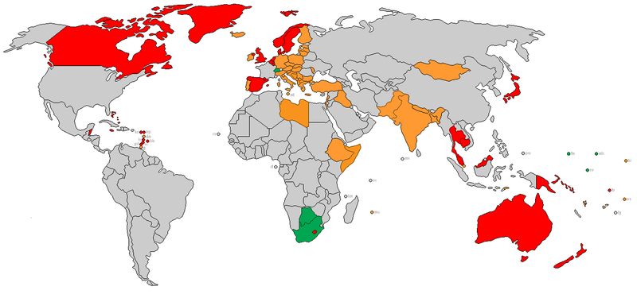
Parliamentary System
Administration
of Law
The highlighted countries use a parliamentary system
Constitutional monarchy
Parliamentary republic with a separate Head of State
Parliamentary republic with a president elected by the legislative branch

Slide 45
Presidential System
Administration
of Law
When the Americans wrote their constitution, they wanted to eliminate many of the ambiguities that were present in the British parliamentary system
  Recall that responsible government was the consequence of the American Revolution
  Prior to this, it was the Cabinet who called elections at their convenience, provided it was within approximately a five-year period
  England, at this point, had 56 rotten boroughs—settlements with almost no population where those living there could be bought
  Prior to 1832, only approximately 10 % of men had the right to vote

Slide 46
Presidential System
Administration
of Law
Without a monarch as a Head of State, they devised a system where
  The Head of State is the Head of Government
  Originally, the President was the individual who presided over the Continental Congress
  With the Constitution, the executive branch was split from the legislative branch, but the title remained
  The President can veto a bill passed by the legislative branch
  The Presidents decide who sits in their Cabinets, but these choices may require legislative approval

Slide 47
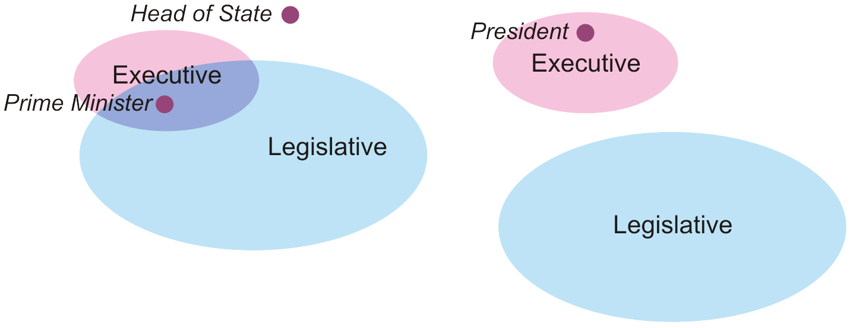
Presidential System
Administration
of Law
One critical feature of a presidential system is that the Head of Government and the Cabinet are separated from the legislature
Parliamentary System
Presidential System

Slide 48
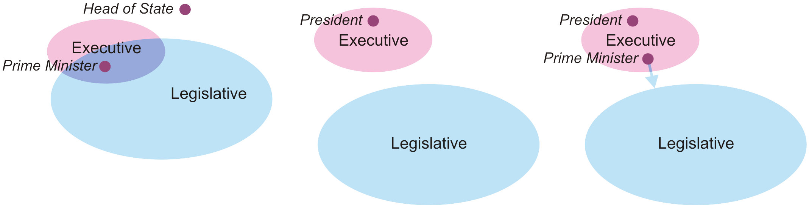
Semi-Presidential System
Administration
of Law
A variation on the Presidential system, adopted by France, is the semi-presidential system
  The President is the Head of State
    This position holds significant political power, including veto power
  The Head of Government is appointed by the President, but is also responsible to the legislative branch
Parliamentary System
Presidential System
Semi-presidential System

Slide 49
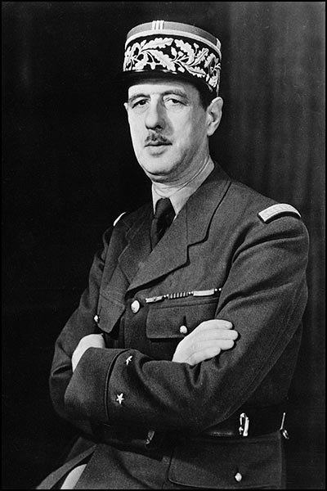
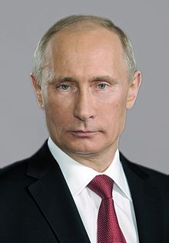
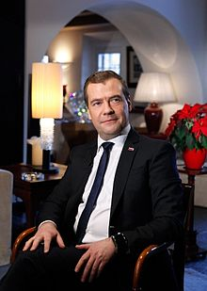
Semi-Presidential System
Administration
of Law
Examples of a semi-presidential model:
  France: The President and the Premier
  Russian: The President and the Chairman
When Putin stepped down after two terms, his Chairman, Medvedev, was elected President for one term at which point Putin became the Chairman
kremlin.ru
government.ru

Slide 50
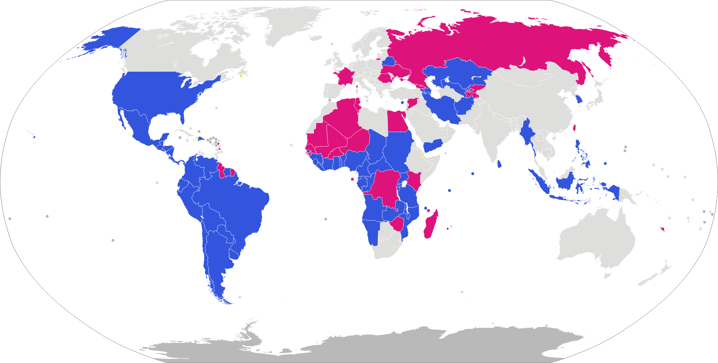
Presidential and
Semi-presidential Systems
Countries with presidential and semi-presidential systems:
Presidential model
Semi-presidential model

Slide 51
Parliamentary Republics
Administration
of Law
The difference between a semi-presidential system and a parliamentary republic is that the Head of State is restricted to either supervisory or ceremonial roles
  Germany: The President and a Chancellor
  Most countries: The President and a Prime Minister
This is why, in the news, you will always hear of Germany’s Chancellor, or Israel’s Prime Minister, but
France’s and Russian’s Presidents

Slide 52
Interpretation and
Application of Law
The next question is one on the interpretation of law
  A body has passed a law—who now interprets and applies the law?

Slide 53
History of the
Legal Profession
Interpretation and
Application of Law
First, a quick history of the legal profession:
  In the 1st century CE, Emperor Claudius allowed advocates, iuris consulti, to charge for advocating for clients
  By 460 CE, the Byzantine Emperor Leo I required proof of competence in the form of testimonials from their teachers
  Within a century, a four-year course of study was required
  The collapse of the Western Roman Empire ended the profession west of Greece

Slide 54
History of the
Legal Profession
Interpretation and
Application of Law
The re-emergence of the profession in England:
  In 1268, the City of London granted the right to its citizens to have access to pleaders (sergeants) and attorneys
  By 1275, the Statute of Westminster included the Fraud Act against deceitful lawyers
  The London Ordnance of 1280 regulated admission and conduct of lawyers, and required the swearing of an oath
  The London Ordnance of 1296 again regulated admission but also limited the number of those practicing
  By Queen Elizabeth I, attorney-client privilege was well established

Slide 55
Interpretation and
Application of Law
Interpretation and
Application of Law
Lawyers, while practicing law, did not judge it
  Under William the Conqueror, the king and his Curia Regis interpreted and applied the law
  The judges sent out by King Henry II were appointed by him
  Initially, the Lord Chancellor was chosen from the ecclesiastics, but with the appointment of Thomas More in 1529, Lord Chancellors were selected from the legal professional
  The kings who followed Queen Elizabeth I, however, attempted to control Parliament by controlling the appointment of judges
  The Act of Settlement of 1701 finally gave judges tenure upon appointment and they could only be removed by an act of both houses of Parliament

Slide 56
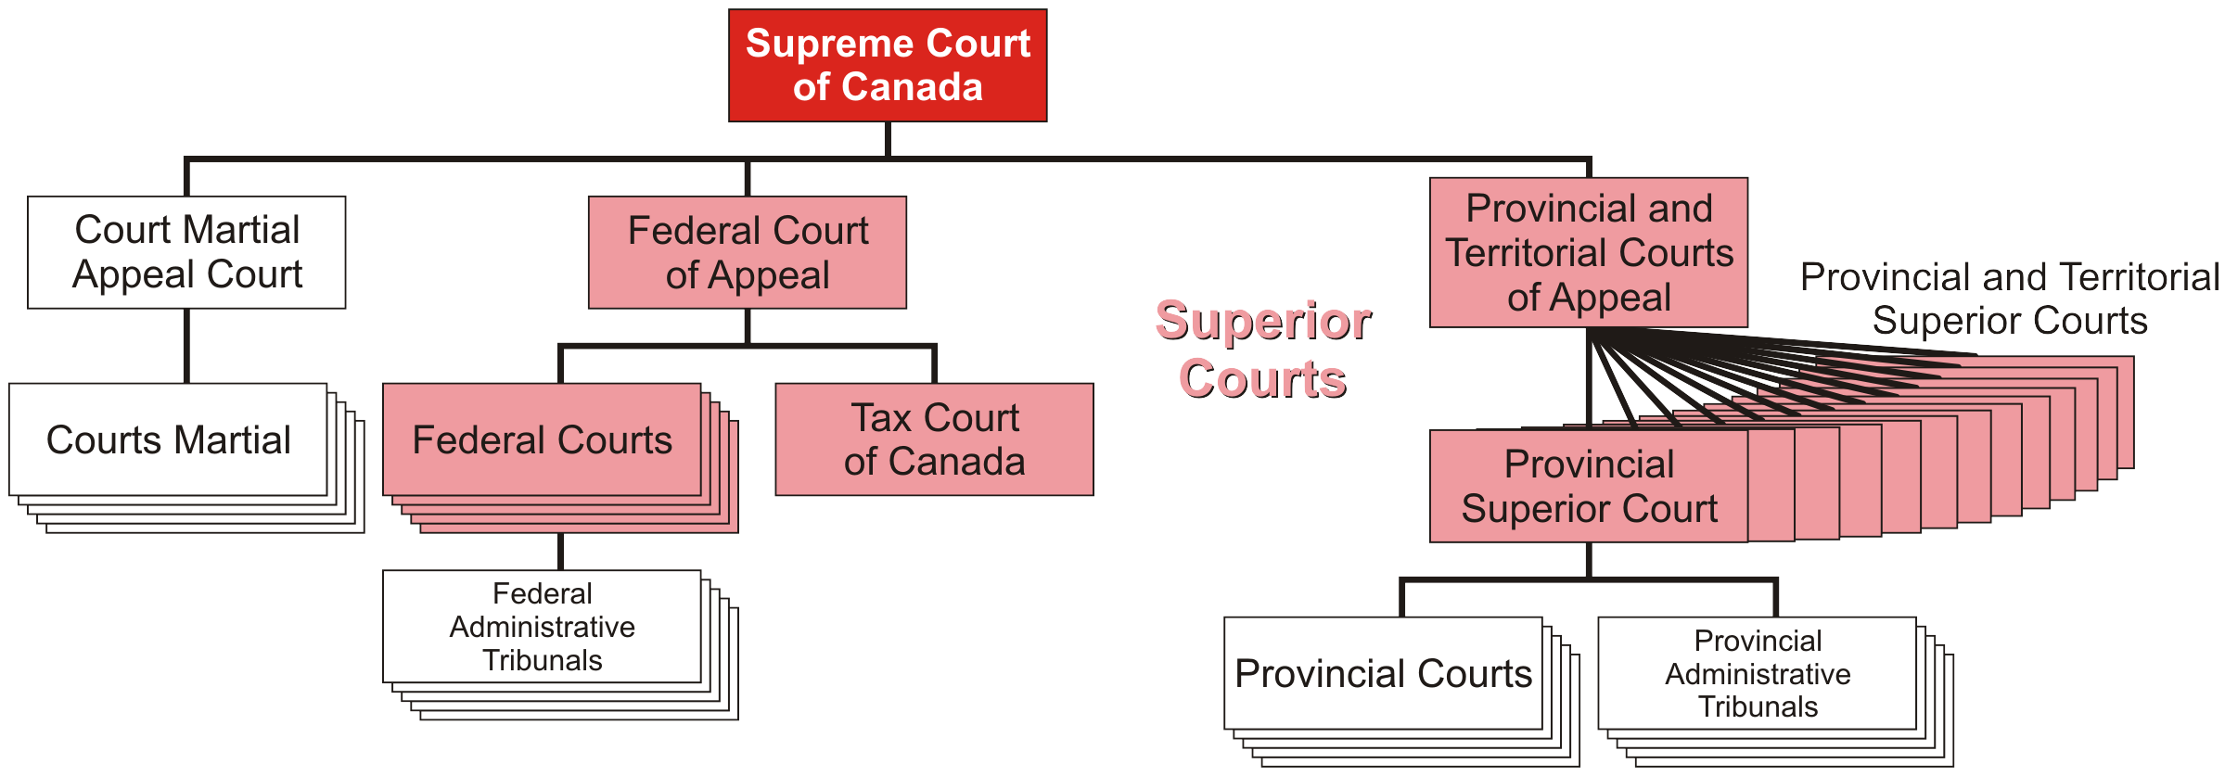
Hierarchical Structure
In our topic on common-law development, we already saw how the courts of England eventually adopted the hierarchical structure of the United States
  After a century, Britain also restructured its court systems
  Canada has adopted a similar structure
  The federal government appoints and pays superior court judges

Slide 57
Administration of Justice
In Canada, the following are held by the same individual:
  The Attorney General is the chief legal advisor to the administration and is a member of the Cabinet
  The Minister of Justice is the member of the Cabinet responsible for the Department of Justice
The Minister for Justice, however, does not interfere with the judicial system

Slide 58
Judicial Independence
Interpretation and
Application of Law
Today, judges are chosen from those lawyers who are members of the Bar: those qualified to practice law
  Judges must be members of the Bar for at least five years, though usually ten
There are restrictions on judges; they may not
  Engage in public debate about any of their decisions
  Express personal opinions on major social issues that could lead to a perception of bias
  Engage in any outside business
http://www.cbc.ca/news/canada/story/2010/08/31/f-judges-how-they-are-chosen.html

Slide 59
Judicial Review
What is the relationship between the judiciary and the other branches of government?
  In Britain, there evolved the concept of parliamentary sovereignty
  Under this doctrine, Parliament is absolute—it may pass and repeal laws, its legislation may not be reviewed by the judiciary nor is it bound by precedence, and it may even override a constitution
    Examples: United Kingdom, Finland, Israel, New Zealand, Jamaica
  The European Court of Justice has the nominal right to review the laws of European Union nations
    The review of British laws has lead to significant issues

Slide 60
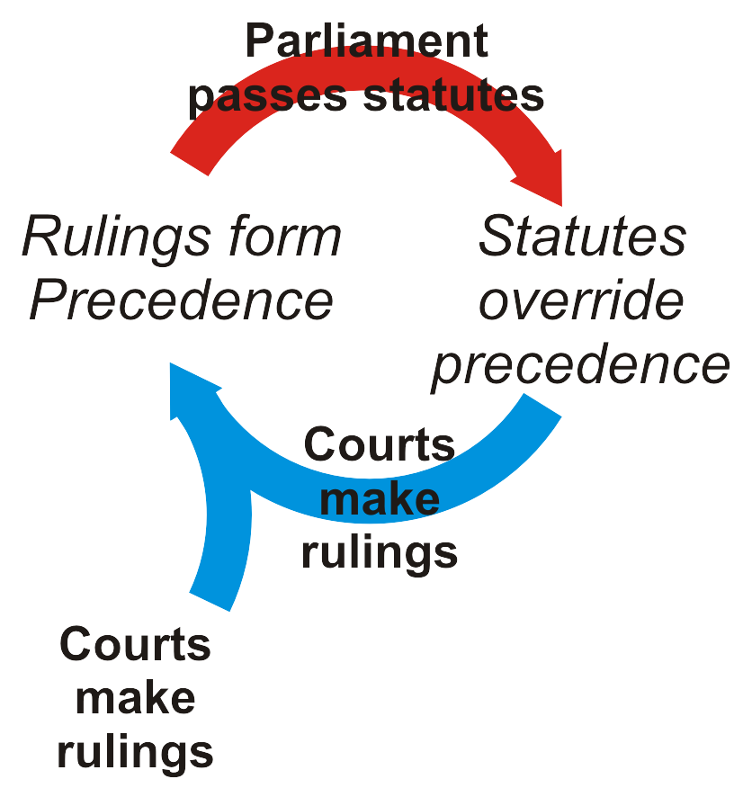
Judicial Review
Thus, in Britain, the following cycle developed
  Courts make rulings
  These rulings form precedence
  Occasionally, Parliament will pass statutes
  These statues overrule all previous precedence
  The courts make rulings based on
  these new statutes
  These rulings form precedence
  Etc.

Slide 61
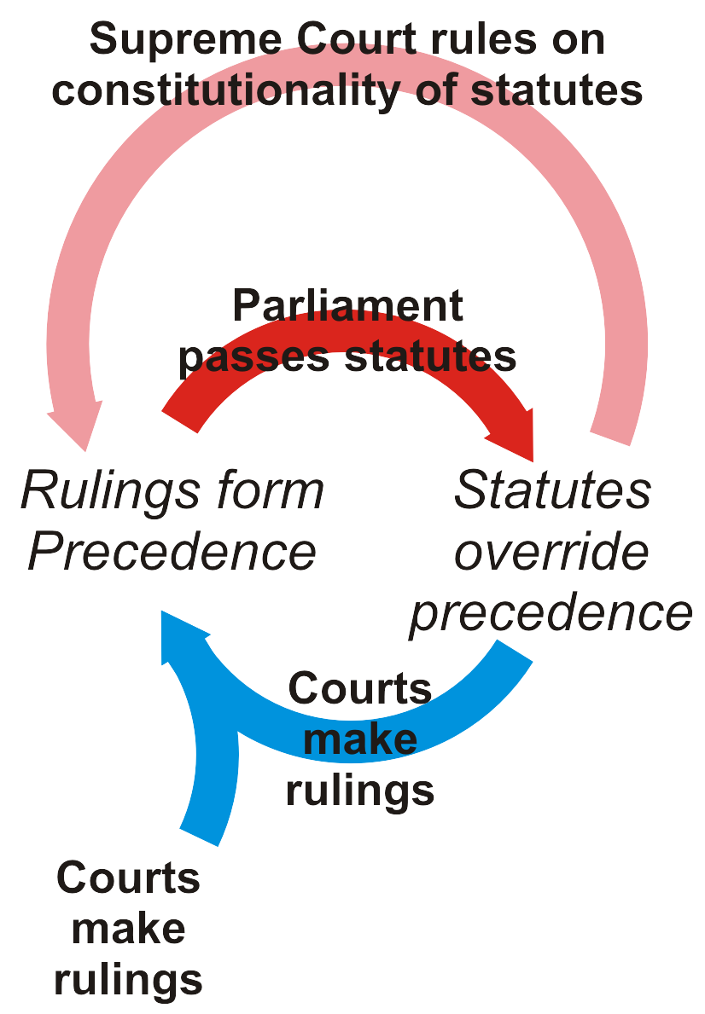
Judicial Review
With a Constitution, the United States introduced a Supreme Court that could rule on the constitutionality of the statues passed by the legislature
  Canada has adopted a similar structure

Slide 62
Judicial Review
Canada and the United States differ on the application of the Bill of Rights
  In the United States, the Bill of Rights forms
  part of the Constitution and no law in the
  United States may breach the Bill of Rights
  In Canada, the Charter of Rights and
  Freedoms is also part of the Constitution,
  but the notwithsanding clause allows the
  Legislature to override the Charter
  However, any override of the Charter must
  be renewed every five years

Slide 63
The Canadian Government
The Canadian Government is therefore
  A federal system with power divided between the federal government and the provincial governments by the Constitution Act, 1867
  Her Majesty Queen Elizabeth II is the Head of State
  She is represented by the Governor General at the federal level and by the Lieutenant Governors at the provincial levels
  Both federal and provincial legislative branches follow the parliamentary system
  The legislative branch is bicameral at the federal level and unicameral at the provincial levels
  The judiciary is independent of the executive and legislative branches but may only review laws with respect to their constitutionality

Slide 64
Summary
In this topic, we have seen that:
  The world is divided into sovereign states
  These are either unitary or federal
  The Head of State is the chief representative
  Even going back to Roman time, legislative assemblies were sources of law
    There are unicameral and bicameral legislatures
  Administration of law is by the executive branch
    The Cabinet is responsible to the legislature in the parliamentary and semi-presidential systems, but not in presidential systems
  The judiciary interprets and applies the law
    Judicial independence and review

Slide 65
References
[1] Wikipedia, http://www.wikipedia.org/
These course slides are provided for the ECE 290 class. The material in it reflects Douglas Harder’s best judgment in light of the information available to him at the time of preparation. Any reliance on these course slides by any party for any other purpose are the responsibility of such parties. Douglas W. Harder accepts no responsibility for damages, if any, suffered by any party as a result of decisions made or actions based on these course slides for any other purpose than that for which it was intended.

