Slide 1
Introductory Project

Slide 2
Outline
In this introductory project, we will:
  Review pass-by-reference and pass-by-value
  Describe remote logins
  Give an introduction to Unix
  Create a hello world program
  Create a header file for an Array class
  Discuss bug fixing
  Introduce five other functions and three statistical functions
  Other features of classes
  Templates
  Our testing environment

Slide 3
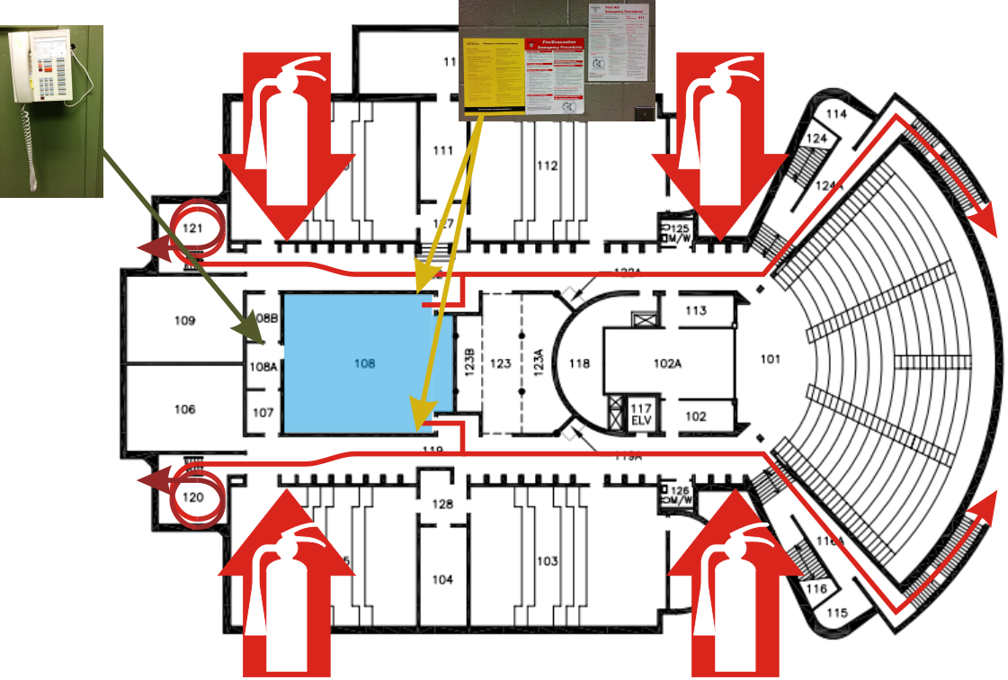
Safety first
This is RCH 108 and in case of an emergency:
  There two room exits and four available building exits
    Exit promptly and orderly if a fire alarm goes off
  Emergency information posters are at both doors
    The location of the first-aid kit is listed on the First Aid Emergency Procedures poster
  A phone is in the back room
    Call 911 in an emergency
  Fire extinguishers are located
  in the hallways towards the
  building exits

Slide 4
Project requirements
Project requirements include:
  Submissions are individual
  You can work together, but the authoring of code must be done alone
  Projects 1, 2, 3, 4 are due at 22:00 (10:00 PM) on the Tuesday immediately following the laboratory corresponding with the project
  Project 5 is due at midnight on the last day of class
  Project submissions are through Learn
  The Drop box is open for late submissions until 6:00 AM the next morning
  All submissions are compiled and graded on ecelinux.uwaterloo.ca
  Project details at ece.uwaterloo.ca/~dwharder/aads/Projects/

Slide 5
Outline
In this laboratory, we will:
  Review pass-by-value versus pass-by-reference
  Get you logged into ecelinux
  Have you save, compile and execute a Hello World! program
  We will introduce you to C++ in Visual Studio
  The introduction will be through an Array class
    We will implement and add additional functionality
    We will create executable functions using this class
    We will use this class in our testing framework
  We will then copy this class to ecelinux and test it there
  We will conclude with topics such as:
    Recursion

Slide 6
Pass-by-value and pass-by-reference
Normally, when you pass an argument to a function, the parameter in the function is assigned the value of the argument, but the parameter is a different variable
  Changes to the parameters of a function do not affect the arguments
    #include <iostream>
    void swap( int x, int y ) {
    int tmp = x;
    x = y;
    y = tmp;
    }
    int main() {
    int m = 5, n = 17;
    swap( m, n );
    std::cout << "m = " << m << " and n = " << n << std::endl;
    return 0;
    }

Slide 7
Pass-by-value and pass-by-reference
If you want changes in the functions to affect the original arguments, we must pass the arguments by reference:
    #include <iostream>
    void swap( int &x, int &y ) {
    int tmp = x;
    x = y;
    y = tmp;
    }
    int main() {
    int m = 5, n = 17;
    swap( m, n );
    std::cout << "m = " << m << " and n = " << n << std::endl;
    return 0;
    }

Slide 8
Pass-by-value and pass-by-reference
In object-oriented programming, a pass-by-value of an object must make a complete copy of the object
  This may be prohibitively expensive
  Passing an Array object by value makes a complete copy of the array and that copy is deleted when the function exits…
  We will therefore often pass objects by reference
    Problem: objects passed by reference may be changed—what if we don’t want the function to change the object
    Solution: pass-by-constant-reference
The notation for pass-by-constant-reference is:
    void f( int const &x ) {
    // x refers to the argument, but you cannot change the value of x
    x = y;
    y = tmp;
    }
  We will discuss this later in relation to objects

Slide 9
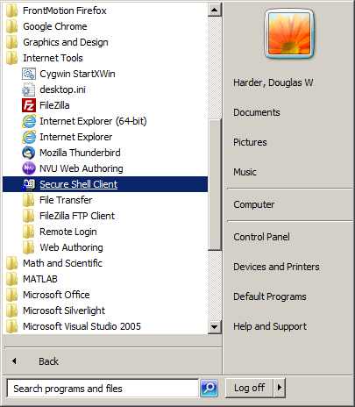
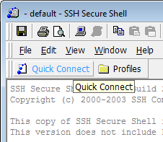
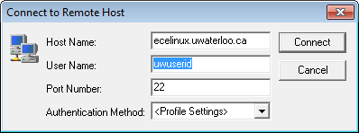

Remote logins
You can log into a Unix machine by using a terminal program
  Launch the Secure Shell Client (SSh)
  All Nexus terminals have SSh installed under Internet Tools
  Select the Quick Connect button
  Set the Host Name to ecelinux.uwaterloo.ca
  Set the User Name to your
  uWaterloo User ID (e.g., dwharder)
  Select Connect and use your Nexus password

Slide 10
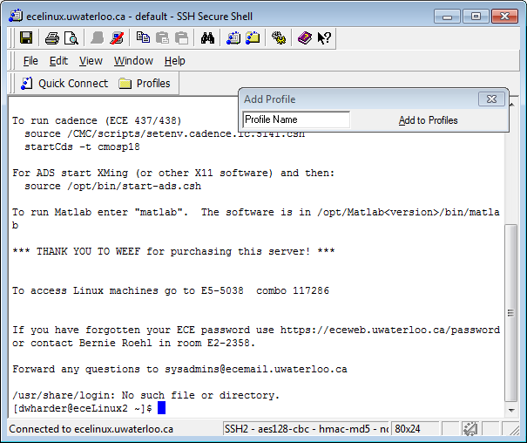
Remote logins
You have now established a remote shell user interface
You can optionally
add a profile to save
your Host and User
names under Profiles
You will be randomly
logged onto one of
eceLinux1
eceLinux2
eceLinux3
etc.

Slide 11
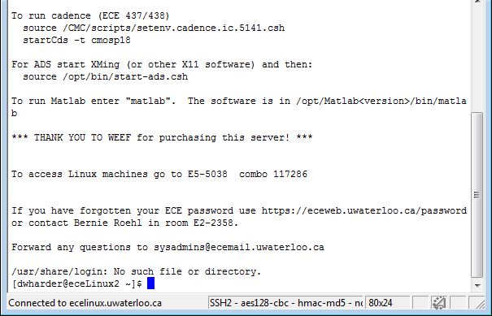
Remote logins
A shell passes commands to the host machine
  You enter commands at the prompt ($)
  The shell passes the commands to the host computer
  There, the shell converts your commands into system calls

Slide 12
Remote logins
Aside:
  If you have Linux at home, you can log in remotely through the shell:
  $ ssh dwharder@ecelinux.uwaterloo.ca

Slide 13
Remote logins
When you log onto ecelinux, the current (or working) directory you are viewing is your home directory, e.g.,
/home/dwharder
Windows uses drives to differentiate between different storage devices, e.g., C:\Users\dwharder
  Unix makes no such distinction
  Drives are subdirectories of the /mnt directory

Slide 14
Introduction to Unix
We can ask for a listing of files and directories in the working directory:
  $ pwd
  /home/dwharder
  $ ls
  $
pwd Print working directory
ls List directory contents

Slide 15
Introduction to Unix
Let’s create a directory:
  $ mkdir ece250
  $ ls
  ece250
  $ cd ece250
  $ mkdir lab0
  $ cd lab0
  $ pwd
  /home/dwharder/ece250/lab0
cd Change directory

Slide 16
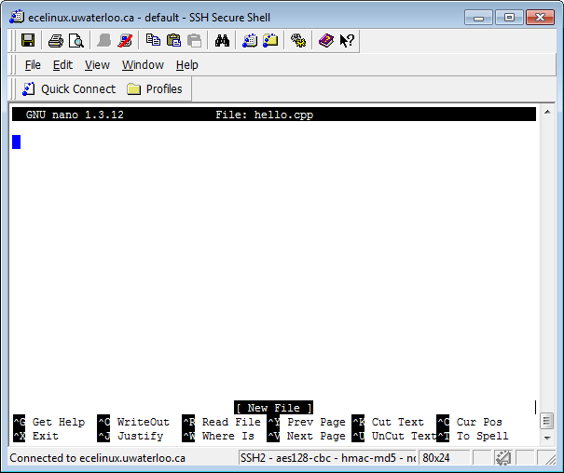
Hello world!
The next step is to edit a file:
  $ nano hello.cpp

Slide 17
Hello world!
Many of the important commands are listed at the bottom
    Ctrl-g Get help
    Ctrl-o Write out
    Ctrl-r Read a file
    Ctrl-x Exit
    Ctrl-y Previous page
    Ctrl-v Next page
    Ctrl-k Cut text
    Ctrl-u Paste text
    Ctrl-c Cursor position
    Ctrl-j Justify
    Ctrl-w Search
    Ctrl-t Spell checker

Slide 18
Hello world!
If you are familiar with vi or emacs, you can use:
  $ vi hello.cpp
  $ emacs hello.cpp
  Do not use these if you are not familiar…
    To quit vi, use :q!
    To quit emacs, use Ctrl-x Ctrl-c

Slide 19
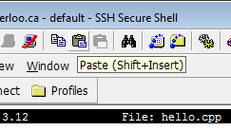
Hello world!
In your editor of choice, enter the text
      #include <iostream>
      using namespace std;
      int main() {
      cout << "Hello world!" << endl;
      return 0;
      }
To cut-and-paste, you must first use Ctrl-c in Windows and then use Edit→Paste in the SSh window
Next, save the file (Ctrl-o) and exit (Ctrl-x)

Slide 20
Hello world!
At the shell, we can list the contents of the working directory:
  $ ls
  hello.cpp
We now want g++ to compile the source code into an executable file or program
  $ g++ hello.cpp
  $ ls
  a.out hello.cpp
Let us now execute the command
  $ ./a.out
  Hello world!
a.out Assembler output

Slide 21
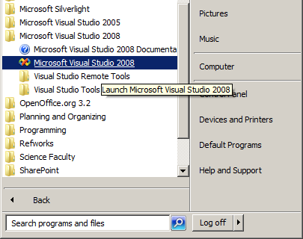
Creating a project
We will now leave Unix and go back to Windows Visual Studio
First, launch Visual Studio and create a new project
  Select a General project type
  Use the Empty Project installed template
  Use Lab0 as the project name

Slide 22
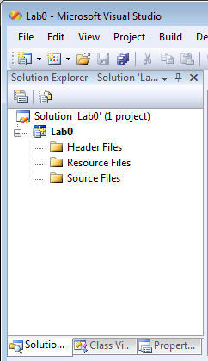
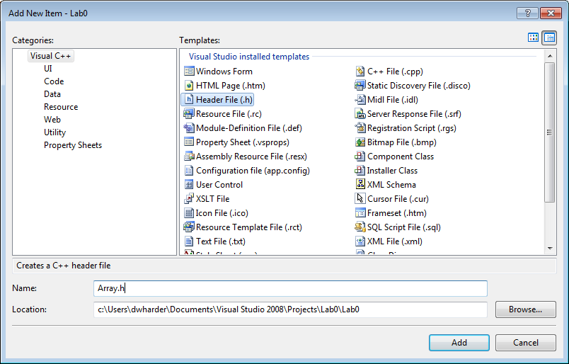
Adding a header file
This creates a project with locations for header, resource, and source files
  We’ll use the first and third
First, let’s create a new header file:
  Right-click on the Header Files folder
  Select Add→New Item…
    This brings up the
    Add New Item dialog
  Select the Header file (.h)
  template, enter the name
  Array.h
  and select Add

Slide 23
Creating the header file
We will fill the array class:
    #ifndef ARRAY_H
    #define ARRAY_H
    class Array {
    private:
    int array_capacity;
    int *internal_array;
    int array_size;
    public:
    Array( int );
    int size() const;
    void append( int );
    };
    // member function definitions go here...
    #endif
The capacity is the number of things the
container can hold, while the size is the
number of objects the container is holding

Slide 24
Creating the header file
The member function definitions follow:
    Array::Array( int n ):
    array_capacity( n ),
    internal_array( new int[array_capacity] ),
    array_size( 0 ) {
    // does nothing
    }
    int Array::size() const {
    return array_size;
    }
    void Array::append( int obj ) {
    // currently, entries 0, ..., array_size - 1 are occupied
    internal_array[array_size] = obj;
    ++array_size;
    }

Slide 25
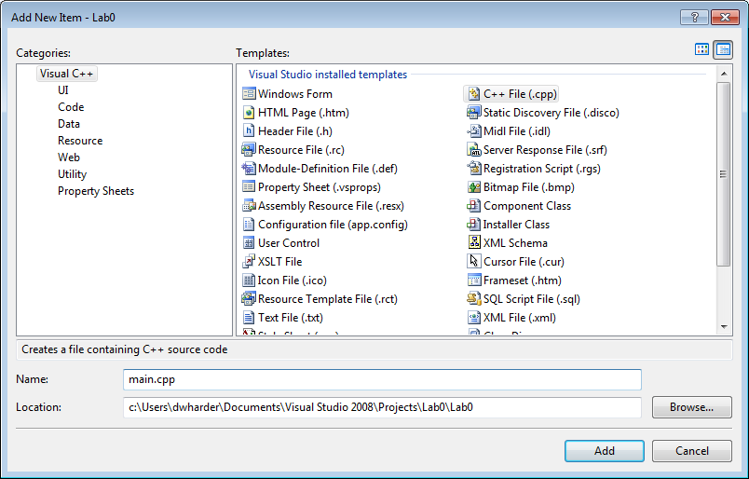
Creating an executable file
You can now save the header file
  We want to execute a program, but the header file only contains the description of the array class—it doesn’t do anything
We have to create a .cpp file with a main function
  Right-click on the Source Files folder
  Select Add→New Item…
  Select the C++ file (.cpp)
  template, name it main.cpp,
  and select Add

Slide 26
Creating an executable file
We create an executable that adds entries into an array:
    #include <iostream>
    #include "Array.h"
    int main() {
    // Create an array of size 10
    Array info( 10 );
    std::cout << "The size of the array is " << info.size() << std::endl;
    info.append( 42 );
    info.append( 91 );
    std::cout << "The size of the array is now " << info.size() << std::endl;
    return 0;
    }

Slide 27

Creating an executable file
We must now:
  Save all the files:
  File→Save All or Shift-Ctrl-s or
  Attempt to build the solution:
  Build→Build Solution or F7 or
  Note: if the Build Solution icon does not appear in your toolbar, select
  View→Toolbars→Build

Slide 28
Creating an executable file
The compiler will now attempt to build a solution and the output appears in the lower output panel
  For a successful build, the output will be something like:
1>------ Build started: Project: Lab0, Configuration: Debug Win32 ------
1>Compiling...
1>main.cpp
1>Linking...
1>LINK : C:\Users\dwharder\Documents\Visual Studio 2008\Projects\Lab0\Debug\Lab0.exe not found 1>Embedding manifest...
1>Build log was saved at "file://c:\Users\dwharder\Documents\Visual Studio 2008\Projects\Lab0\
1>Lab0 - 0 error(s), 0 warning(s)
========== Build: 1 succeeded, 0 failed, 0 up-to-date, 0 skipped ==========
= Build: 1 succeeded, 0 failed, 0 up-to-date, 0 skipped =

Slide 29
Creating an executable file
The compiler will now attempt to build a solution and the output appears in the lower output panel
  For an unsuccessful build, the compiler will try to tell you something about the error
1>------ Build started: Project: Lab0, Configuration: Debug Win32 ------
1>Compiling...
1>main.cpp
1>c:\users\dwharder\documents\visual studio 2008\projects\lab0\lab0\main.cpp(8) : error C2065: 1>c:\users\dwharder\documents\visual studio 2008\projects\lab0\lab0\main.cpp(8) : error C2146: 1>c:\users\dwharder\documents\visual studio 2008\projects\lab0\lab0\main.cpp(8) : error C3861: 1>c:\users\dwharder\documents\visual studio 2008\projects\lab0\lab0\main.cpp(10) : error C2065 1>c:\users\dwharder\documents\visual studio 2008\projects\lab0\lab0\main.cpp(10) : error C2228 1> type is ''unknown-type''
1>c:\users\dwharder\documents\visual studio 2008\projects\lab0\lab0\main.cpp(11) : error C2065 1>c:\users\dwharder\documents\visual studio 2008\projects\lab0\lab0\main.cpp(11) : error C2228 1> type is ''unknown-type''
1>c:\users\dwharder\documents\visual studio 2008\projects\lab0\lab0\main.cpp(12) : error C2065 1>c:\users\dwharder\documents\visual studio 2008\projects\lab0\lab0\main.cpp(12) : error C2228
1> type is ''unknown-type''
1>c:\users\dwharder\documents\visual studio 2008\projects\lab0\lab0\main.cpp(13) : error C2065
1>c:\users\dwharder\documents\visual studio 2008\projects\lab0\lab0\main.cpp(13) : error C2228
1> type is ''unknown-type''
1>Build log was saved at "file://c:\Users\dwharder\Documents\Visual Studio 2008\Projects\Lab0\
1>Lab0 - 11 error(s), 0 warning(s)
========== Build: 0 succeeded, 1 failed, 0 up-to-date, 0 skipped ==========
= Build: 0 succeeded, 1 failed, 0 up-to-date, 0 skipped =

Slide 30

Creating an executable file
One option...
http://gyropsychology.com/blog/managing-temper-tantrums/

Slide 31
Creating an executable file
…or you start reading the first line of the errors:
1>c:\users\dwhr...projects\lab0\lab0\main.cpp(8) : error C2065: 'Arry' : undeclared identifier
It tells you:
  The file name main.cpp
  The line number 8
  The problem: 'Arry' is not declared
If you double-click on the error, it highlights line 8 in the file main.cpp
main.cpp(8) : error C2065: 'Arry' : undeclared identifier

Slide 32
Creating an executable file
The compiler does not immediately stop when it finds an error
  It attempts to continue, perhaps giving further information
  In others, the first error causes subsequent errors
  In this case, fixing the first error corrects all the remaining errors

Slide 33

Creating an executable file
We now want to execute the program
  Select Debug→Start Debugging or F5 or
  A black window appears and disappears
    We need to get it to pause before exiting
  At the end of your main function, add:
system( "pause" );
return 0;
}

Slide 34
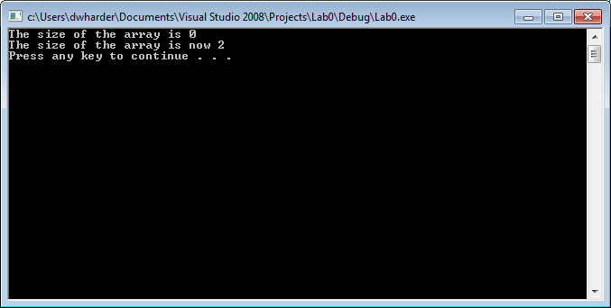
Creating an executable file
Now we see:
The system( "pause" ) generates the
Press any key to continue . . .

Slide 35
Default values of parameters
  Currently, explicitly pass the capacity of the array
    Array info( 10 );
  What happens if the user attempts to call
    Array info;
  Currently, this causes a compilation error:
    1>c:\users\dwharder\documents\visual studio 2008\projects\lab0\
    lab0\main.cpp(8) : error C2512:
    'Array' : no appropriate default constructor available
This says, there is no constructor that takes no arguments

Slide 36
Default values of parameters
We have two options:
  Consider this a user error—the user failed to provide an array capacity
  Declare a default value for the parameter
To specify the default value, we do so in the class definition:
    class Array {
    private:
    int array_capacity;
    int *internal_array;
    int array_size;
    public:
    Array( int = 10 );
    int size() const;
    void append( int );
    };

Slide 37
Correcting a possible error
What do we do if the user does:
    Array info( 0 );
    Array info( -5 );
  It makes sense that the capacity should be at least 1:
    Array::Array( int n ):
    array_capacity( std::max( 1, n ) ),
    internal_array( new int[array_capacity] ),
    array_size( 0 ) {
    // does nothing
    }
  We must now also include a library with std::max
  #include <algorithm>

Slide 38
Correcting another possible error
Consider:
    void Array::append( int obj ) {
    // currently, entries 0, ..., array_size - 1 are occupied
    internal_array[array_size] = obj;
    ++array_size;
    }
and the function
    int main() {
    Array info( 10 );
    for ( int i = 0; i < 20; ++i ) {
    info.append( i );
    }
    std::cout << "The size is " << info.size() << std::endl;
    }

Slide 39

Correcting another possible error
Neither C nor C++ care if you go outside the bounds of your array
  Suppose you allocate an array of 10 ints (40 bytes)
  int *ptr = new int[10];
  Suppose ptr is now assigned 0x0039af78
  0x0039af78

Slide 40
Correcting another possible error
Suppose you access ptr[5]
  0x0039af78 + 5 × 4 = 0x0039af8c is calculated
  Whatever is there is accessed
Suppose you access ptr[10]
  0x0039af78 + 10 × 4 = 0x0039afa0
  Whatever is there is accessed
Unfortunately, this may be allocated to something else
  0x0039af78
  0x0039af8c
  0x0039afa0

Slide 41
Correcting another possible error
What do we do if we append to an array that is full?
  We could ignore the append
  We could change the return value to bool which signals whether or not an append was successful
  We could throw an exception
We will use the second solution
  In a future function, we will use exceptions

Slide 42
Correcting another possible error
It is necessary to update the return value in both the class definition and the member function definition
    class Array {
    // ...
    bool append( int );
    // ...
    };
    bool Array::append( int obj ) {
    if ( array_size == array_capacity ) {
    return false;
    }
    // currently, entries 0, ..., array_size - 1 are occupied
    internal_array[array_size] = obj;
    ++array_size;
    return true;
    }

Slide 43
Updating the class
Let’s add some more functionality:
  A function that returns the capacity
  Two Boolean-valued functions determining if the array is empty or full
To do this, we must:
  Add three member function declarations to the class definition
  Add three member functions definitions below the class

Slide 44
Updating the class
The member function declarations in the class definition could be:
  int capacity() const;
  bool empty() const;
  bool full() const;
  void clear();
The first three member functions return queries based on the current state of the array object—nothing is changed
  Thus, we declare these as const or read-only
  If we accidently try to change a member variable, the compiler will issue an error

Slide 45
Updating the class
In the class definition, we should separate the accessors from the mutators
    class Array {
    private:
    int array_capacity;
    int *internal_array;
    int array_size;
    public:
    Array( int = 10 );
    // Accessors
    int size() const;
    int capacity() const;
    bool empty() const;
    bool full() const;
    // Mutators
    void append( int );
    void clear();
    };

Slide 46
bool empty() const
For the first Boolean-valued function, we could try:
      bool Array::empty() const {
      if ( array_size == 0 ) {
      return true;
      } else {
      return false;
      }
      }
Note, however, that == is a Boolean-valued operator
  It returns either true or false
  Why not just return the value generated by ==?

Slide 47
bool empty() const
A better implementation is:
      bool Array::empty() const {
      return ( array_size == 0 );
      }
Note: the parentheses are not necessary—they give clarity
  return is a statement, not a function!

Slide 48
bool empty() const
Another solution:
return ( size() == 0 );
  If you accidently use size() = 0, the compiler will signal an error
    You can’t assign to the return value of a function!
Some programmers prefer:
  return ( 0 == array_size );
  If they accidently use 0 = array_size, the compiler will signal an error
    You can’t assign a value to a number!
  If you accidently use array_size = 0, it assigns array_size the value of zero and then returns 0

Slide 49
void clear()
The last empties the array object:
  void clear();
In this case, the function is not declared const
  It will change the object
It will simply set the size member variable to zero
  It does not have to zero out the array—as new objects arrive, they will replace what currently exists in the array

Slide 50
void clear()
  Question:
  What error do you get if you have
  void clear();
  in the class definition, but
  void Array::clear() const {
  // ...
  }
  in the member function definition?

Slide 51
void clear()
  Answers:
  In the first case, the member function definition does not match any of
  the member function declarations in the class definition:
  'void Array::clear(void) const' : overloaded member
  function not found in 'Array'
  The error message in g++ is actually more helpful:
  Array.h:36: error: prototype for'void Array::clear() const'
  does not match any in class 'Array'
  Array.h:17: error: candidate is: void Array::clear()

Slide 52
void clear()
  Question:
  What error do you get if you have const in both?
  void clear() const ;
  void Array::clear() const {
  // ...
  }

Slide 53
void clear()
  Answers:
  The signatures match up, but now you are trying to assign to a member variable in a read-only function:
  l-value specifies const object
  Again, the error message in g++ is actually more helpful:
  Array.h:37: error: assignment of data-member 'Array::array_size' in read-only structure
The term read-only is synonymous with the
concept of const in C++
Incidentally, Stroustrup wanted to use the keyword readonly in the first version of C++

Slide 54
void clear()
  Question:
  What happens if you call a non-read-only member function from within a read-only (const) member function?
  bool Array::empty() const {
  clear();
  return ( size() == 0 );
  }

Slide 55
void clear()
  Answers:
  The error message in g++ is
  Array.h: In member function 'bool Array::empty() const':
  Array.h:178: error: passing 'const Array' as 'this‘
  argument of 'void Array::clear()' discards qualifiers
  You cannot call a non-read-only member function from a read-only (const) member function

Slide 56
Updating the class
Implement these functions…

Slide 57
Four statistical functions
Finally, let us add four statistical functions:
  int sum() const;
  double average() const;
  double variance() const;
  double std_dev() const;
These will return formulas where the sample standard deviation is the square root of the variance

Slide 58
Four statistical functions
Some provisos:
  The sum of an empty list is 0
  The sample average is not defined if the size is zero
  The sample variance and standard deviations are not defined if the size is zero or one
In both cases, we must notify the user

Slide 59
Four statistical functions
Let’s declare a class
      class exception {
      // empty class
      };
      class underflow : public exception {
      // empty class
      };
We can throw an instance of this exception:
      double Array::average() const {
      if ( empty() ) {
      throw underflow();
      }
      // find the average
      }

Slide 60
Four statistical functions
The class underflow is defined in the file Exception.h found at
http://ece.uwaterloo.ca/~dwharder/aads/Projects/src/
Copy this file into the same directory as your Array.h file and then include this header file into your project in Visual Studio
At the top of the Array.h file, include the line:
#include "Exception.h"

Slide 61
Four statistical functions
The use of empty() is also better than
      int Array::min() const {
      if ( 0 == array_size ) {
      throw underflow();
      }
      // find the minimum entry
      }
Someone reading this must have to try to figure out the significance of the Boolean check…

Slide 62
Four statistical functions
  A function calling average() can try to catch the thrown exception:
      double av;
      Array info( 10 );
      try {
      av= info.average();
      } catch ( underflow excpt ) {
      // the array 'info' is empty--use a default value
      av = 0.0;
      }

Slide 63
Four statistical functions
In implementing these functions:
  Use sum() in average()
  Use average() in variance()
  Use variance() in std_dev()

Slide 64
Four statistical functions
  Why can’t we use the following implementation?
  double Array::average() const {
  if ( empty() ) {
  throw underflow();
  }
  // The average is the sum of the entries divided by the size
  return sum()/size();
  }

Slide 65
Four statistical functions
  Answer: the division operator sees two integers
  double Array::average() const {
  if ( empty() ) {
  throw underflow();
  }
  // The average is the sum of the entries divided by the size
  return sum()/size();
  }
It will use integer division before converting the result into a double

Slide 66
Four statistical functions
  Solution: tell the complier you want to convert each to a double
  double Array::average() const {
  if ( empty() ) {
  throw underflow();
  }
  // The average is the sum of the entries divided by the size
  return static_cast<double>( sum() ) /
  static_cast<double>( size() );
  }
Now the compiler will use double-precision floating-point division

Slide 67
Four statistical functions
  Why can’t we use the following implementation?
  double Array::variance() const {
  if ( size() <= 1 ) {
  throw underflow();
  }
  double av = average();
  double ssdiff = 0.0;
  for ( int i = 0; i < size(); ++i ) {
  ssdiff += (internal_array[i] - av)^2;
  }
  return ssdiff/(size() - 1);
  }

Slide 68
Four statistical functions
  Answer: ^ is the binary exclusive-or (xor) operator
  double Array::variance() const {
  if ( size() <= 1 ) {
  throw underflow();
  }
  double av = average();
  double ssdiff = 0.0;
  for ( int i = 0; i < size(); ++i ) {
  ssdiff += (internal_array[i] - av)^2;
  }
  return ssdiff/(size() - 1);
  }

Slide 69
Four statistical functions
  Solution: explicitly perform the squaring
  double Array::variance() const {
  if ( size() <= 1 ) {
  throw underflow();
  }
  double av = average();
  double ssdiff = 0.0;
  for ( int i = 0; i < size(); ++i ) {
  ssdiff += (internal_array[i] - av)*(internal_array[i] - av);
  }
  return ssdiff/(size() - 1);
  }

Slide 70
Four statistical functions
  Note: the compiler knows that ssdiff is of type double
  double Array::variance() const {
  if ( size() <= 1 ) {
  throw underflow();
  }
  double av = average();
  double ssdiff = 0.0;
  for ( int i = 0; i < size(); ++i ) {
  ssdiff += (internal_array[i] - av)*(internal_array[i] - av);
  }
  return ssdiff/(size() - 1);
  }
the compiler calculates size() - 1 and converts the result to a double

Slide 71
Four statistical functions
  In calculating the standard deviation, we must now include the
  cmath library
  #include <cmath>
  The square root function is within the std namespace
  As we have already written a function to calculate the variance, we
  should simply call this function
  It already throws an exception if the size is less than two

Slide 72
Updating main()
Now, update your main() function to print the results of some of the other functions
  First, add a few more integers and then print the output of some of the other functions that we have just written

Slide 73
Memory deallocation
One issue we haven’t addressed is memory deallocation
  The constructor made an explicit request to the operating system for some memory using the new operator
  The new operator returns the address of the first location allocated
  The operating system will keep that memory allocated until that same address is returned using the delete command

Slide 74
Memory deallocation
What happens here?
      void f() {
      Array a( 100 );
      // do nothing else...
      }
      int main() {
      for ( int i = 0; i < 10000; ++i ) {
      f();
      }
      return 0;
      }
This is said to form a memory leak

Slide 75
Memory deallocation
When a local variable goes out of scope, the memory allocated for it on the call stack gets reused
  Unfortunately, in the constructor, a call to the new operator was made
    That memory has not been deallocated
  We need to also deallocate that additional memory when the object goes out of scope

Slide 76
Memory deallocation
To perform this clean-up, C++ uses a member function called the destructor:
    class Array {
    private:
    // private member variables and private member functions
    public:
    Array( int = 10 );
    ~Array();

Slide 77
Memory deallocation
The implementation deletes the contents of the array:
    // Constructor
    Array::Array( int n ):
    array_capacity( std::max( 1, n ) ),
    internal_array( new int[array_capacity] ),
    array_size( 0 ) {
    // does nothing
    }
    // Destructor
    // - deallocate the memory for the array
    Array::~Array() {
    delete [] internal_array;
    }

Slide 78
Memory deallocation
Note:
  If the memory was allocated with
  Class *ptr = new Class( args... );
  you must call
  delete ptr;
  If the memory was allocated with
  Class *ptr = new Class[ARRAY_SIZE];
  you must call
  delete [] ptr;

Slide 79
Accessing an entry
So, we’re storing objects in an array—but we can’t get at them
  We’ve added 20 things into an array; how do we access the 15th?
It might be reasonable to write some sort of ‘at’ function:
    int Array::at( int n ) const {
    if ( n < 0 || n >= size() ) {
    throw out_of_range();
    }
    return internal_array[n];
    }

Slide 80
Accessing an entry
Thus, our code might look something like:
    for ( int i = 0; i < info.size(); ++i ) {
    cout << info.at( i ) << " " << endl;
    }
This works…but wouldn’t it be nice if you could do the following?
    for ( int i = 0; i < info.size(); ++i ) {
    cout << info[i] << " " << endl;
    }
Problem: indexing only works on C++ arrays, and info is an instance of the Array class

Slide 81
Operator overloading
Solution: let the compiler know what to do if you call info[15]
    int Array::operator[]( int n ) const {
    return internal_array[n];
    }
Now, if the user ever calls info[i], it will call the above function with the argument i
  Essentially, info[i] is identical to info.operator[]( i )
  Think of operator[] as the name of a function that happens to be called if the user ever calls info[i]

Slide 82
Further functionality
Now we’re going to go more into the gory details of C++
  Swapping two instances of the Array class
  Array a( 3 ), b( 5 );
  b.append( 52 );
  // now swap 'a' and 'b' so that 'a' is of size 5
  // and holds the entry 52, and
  // 'b' is empty and size 3
  Creating a copy of an instance of the Array class
  Array a( 5 );
  a.append( 35 );
  a.append( 42 );
  Array b( a ); // make b a copy of 'a'
  Assigning an instance of the Array class to a variable already storing
  Array a( 5 );
  a.append( 35 );
  Array b( 7 );
  b.append( 42 );
  a = b; // 'a' is now of size 7 containing 42 while the array
  // of size 5 with 35 is gone

Slide 83
Swapping two instances
Suppose we want to swap the contents of two variables storing instances of our Array class
  We want to swap all of the member variables
  We can use the std::swap function
    void Array::swap( Array &other ) {
    std::swap( array_capacity, other.array_capacity );
    std::swap( internal_array, other.internal_array );
    std::swap( array_size, other.array_size );
    }
  Note that we must use pass-by-reference: we want to swap the argument that is being passed with this object

Slide 84
Swapping two instances
Now we can call:
  Array a( 3 ), b( 5 );
  a.append( 54 );
  a.append( 25 );
  a.append( 37 );
  b.append( 92 );
  b.append( 82 );
  a.swap( b );

Slide 85
Making a copy
Recall that for swap, we used pass-by-reference
  What happens if we pass an object by value?
  Answer: by default, a new instance is created and its member variables are assigned the member variables of the argument
  This may be okay for a complex number class, but does it work with the Array class?
What happens here?
    void f( Array second ) {
    // do something
    }
int main() {
Array first( 5 );
first.append( 13 );
first.append( 17 );
first.append( 39 );
first.append( 666 );
f( first );
return 0;
}

Slide 86
Making a copy
Having executed the first five statements, this is our state:
int main() {
Array first( 6 );
first.append( 13 );
first.append( 17 );
first.append( 39 );
first.append( 666 );
f( first );
cout << first[0];
return 0;
}
first
array_capacity 6 internal_array 0x000b3820 array_size 4
0x000b3820 0x000b3824 0x000b3828 0x000b382c 0x000b3830 0x000b3834 | 13 17 39 666 ? ?

Slide 87
Making a copy
Calling f, a new Array is allocated on the stack and all member variables are copied over—including the array
int main() {
Array first( 6 );
first.append( 13 );
first.append( 17 );
first.append( 39 );
first.append( 666 );
f( first );
cout << first[0];
return 0;
}
first
array_capacity 6 internal_array 0x000b3820 array_size 4
second
array_capacity 6 internal_array 0x000b3820 array_size 4
0x000b3820 0x000b3824 0x000b3828 0x000b382c 0x000b3830 0x000b3834 | 13 17 39 666 ? ?
void f( Array second ) {
// do something
}

Slide 88
Making a copy
When f returns, the destructor is called on the instance second
  This deallocates the memory of the array
int main() {
Array first( 6 );
first.append( 13 );
first.append( 17 );
first.append( 39 );
first.append( 666 );
f( first );
cout << first[0];
return 0;
}
first
array_capacity 6 internal_array 0x000b3820 array_size 4
second
array_capacity 6 internal_array 0x000b3820 array_size 4
0x000b3820 0x000b3824 0x000b3828 0x000b382c 0x000b3830 0x000b3834 | 13 17 39 666 ? ?
void f( Array second ) {
// do something
}

Slide 89
Making a copy
Now first is referring still to memory that has been deallocated!
int main() {
Array first( 6 );
first.append( 13 );
first.append( 17 );
first.append( 39 );
first.append( 666 );
f( first );
cout << first[0];
return 0;
}
first
array_capacity 6 internal_array 0x000b3820 array_size 4
second
array_capacity 6 internal_array 0x000b3820 array_size 4
0x000b3820 0x000b3824 0x000b3828 0x000b382c 0x000b3830 0x000b3834 | 13 17 39 666 ? ?
void f( Array second ) {
// do something
}

Slide 90
Making a copy
When the values of the member variables are all simply copied over, this is said to be a shallow copy
first
array_capacity 6 internal_array 0x000b3820 array_size 4
second
array_capacity 6 internal_array 0x000b3820 array_size 4
0x000b3820 0x000b3824 0x000b3828 0x000b382c 0x000b3830 0x000b3834 | 13 17 39 666 ? ?

Slide 91
Making a copy
What we require is that the copy allocates memory for a new array and copies over the values
  This is called a deep copy
first
array_capacity 6 internal_array 0x000b3820 array_size 4
second
array_capacity 6 internal_array 0x00176a48 array_size 4
0x000b3820 0x000b3824 0x000b3828 0x000b382c 0x000b3830 0x000b3834 | 13 17 39 666 ? ?
0x00176a48 0x00176a4c 0x00176a50 0x00176a54 0x00176a58 0x00176a5c | 13 17 39 666 ? ?

Slide 92
Making a copy
We then need to copy over the values from the first array
  Now, when the function exits, the object second is destroyed and its copy of the array is deleted
  The array allocated to first is unaffected
first
array_capacity 6 internal_array 0x000b3820 array_size 4
second
array_capacity 6 internal_array 0x00176a48 array_size 4
0x000b3820 0x000b3824 0x000b3828 0x000b382c 0x000b3830 0x000b3834 | 13 17 39 666 ? ?
0x00176a48 0x00176a4c 0x00176a50 0x00176a54 0x00176a58 0x00176a5c | 13 17 39 666 ? ?

Slide 93
Making a copy
The copy constructor must create a new array and copy over all the values
  The default copy constructor (a shallow copy) is identical to
      Array::Array( Array const &other ):
      array_capacity( other.array_capacity ),
      internal_array( other.internal_array ),
      array_size( other.array_size ) {
      // empty
      }

Slide 94
Making a copy
Instead, we require a deep copy
  We must allocate memory for an array and copy the values over
      Array::Array( Array const &other ):
      array_capacity( other.array_capacity ),
      internal_array( new int[array_capacity] ),
      array_size( other.array_size ) {
      // copy over the values from one array to the other
      for ( int i = 0; i < size(); ++i ) {
      internal_array[i] = other.internal_array[i];
      }
      }

Slide 95
Pass by value
When an instance of a class is passed-by-value, if a copy constructor is declared, it will be called
  Example:
      int init( Array data, ... ) {
      // 'data' is passed-by-value and, because a
      // copy constructor is declared, it will be
      // initialized with the first argument of init(...)
      // passed as the argument to the copy constructor
      // Append 42 to the copy
      data.append( 42 );
      return 0;
      // Just before the function returns,
      // the destructor is called on 'data'
      }

Slide 96
Pass by reference
With pass-by-reference, no copy is made
  Example:
      int init( Array &data, ... ) {
      // Here, the parameter 'data' refers to the original
      // first argument passed to the init(...) function
      // Append 42 to the original argument
      data.append( 42 );
      return 0;
      // No destructor is called on 'data'
      // the original continues to exist
      }

Slide 97
Pass by constant reference
With pass-by-constant-reference, no copy is made but also, the
function init(…) can only call accessors of the Array class
  Example:
      int init( Array const &data, ... ) {
      // Here, the parameter 'data' refers to the original
      // first argument passed to the init(...) function
      // We can call data.size(), data.sum(), data.average(), etc.,
      // but we cannot call data.append(…) or data.clear()
      return 0;
      // No destructor is called on 'data'
      // the original continues to exist
      }

Slide 98
Assigning an object
What happens if we execute the following?
We must:
  Delete the memory allocated to a
  Create a copy of b
This can be done with:
      Array &Array::operator=( Array rhs ) {
      swap( rhs );
      return *this;
      }
  Array a( 3 );
  a.append( 35 );
  Array b( 5 );
  b.append( 42 );
  a = b;

Slide 99
Assigning an object
What happens here is really slick:
  Array a( 3 );
  a.append( 35 );
  a.append( 75 );
  Array b( 5 );
  b.append( 42 );
  a = b;
Array &Array::operator=( Array rhs ) {
swap( rhs );
return *this;
}
a
array_capacity 3 internal_array 0x000b3820 array_size 2
b
array_capacity 5 internal_array 0x00176a48 array_size 1
0x000b3820 0x000b3824 0x000b3828 | 35 75 ?
0x00176a48 0x00176a4c 0x00176a50 0x00176a54 0x00176a58 | 42 ? ? ? ?

Slide 100
Assigning an object
When operator= is called on a, b is the argument
  The copy constructor is called and b is passed by value as rhs
  Array a( 3 );
  a.append( 35 );
  a.append( 75 );
  Array b( 5 );
  b.append( 42 );
  a = b;
Array &Array::operator=( Array rhs ) {
swap( rhs );
return *this;
}
a
array_capacity 3 internal_array 0x000b3820 array_size 2
rhs
array_capacity 5 internal_array 0x005b9a04 array_size 1
b
array_capacity 5 internal_array 0x00176a48 array_size 1
0x000b3820 0x000b3824 0x000b3828 | 35 75 ?
0x005b9a04 0x005b9a08 0x005b9a0c 0x005b9a10 0x005b9a14 | 42 ? ? ? ?
0x00176a48 0x00176a4c 0x00176a50 0x00176a54 0x00176a58 | 42 ? ? ? ?

Slide 101
Assigning an object
Next, we swap the member variables of a and rhs
  Array a( 3 );
  a.append( 35 );
  a.append( 75 );
  Array b( 5 );
  b.append( 42 );
  a = b;
Array &Array::operator=( Array rhs ) {
swap( rhs );
return *this;
}
a
array_capacity 5 internal_array 0x005b9a04 array_size 1
rhs
array_capacity 3 internal_array 0x000b3820 array_size 2
b
array_capacity 5 internal_array 0x00176a48 array_size 1
0x000b3820 0x000b3824 0x000b3828 | 35 75 ?
0x005b9a04 0x005b9a08 0x005b9a0c 0x005b9a10 0x005b9a14 | 42 ? ? ? ?
0x00176a48 0x00176a4c 0x00176a50 0x00176a54 0x00176a58 | 42 ? ? ? ?

Slide 102
Assigning an object
Now, when operator= exits, the object rhs is destroyed
  Array a( 3 );
  a.append( 35 );
  a.append( 75 );
  Array b( 5 );
  b.append( 42 );
  a = b;
Array &Array::operator=( Array rhs ) {
swap( rhs );
return *this;
}
a
array_capacity 5 internal_array 0x005b9a04 array_size 1
rhs
array_capacity 3 internal_array 0x000b3820 array_size 2
b
array_capacity 5 internal_array 0x00176a48 array_size 1
0x000b3820 0x000b3824 0x000b3828 | 35 75 ?
0x005b9a04 0x005b9a08 0x005b9a0c 0x005b9a10 0x005b9a14 | 42 ? ? ? ?
0x00176a48 0x00176a4c 0x00176a50 0x00176a54 0x00176a58 | 42 ? ? ? ?

Slide 103
Assigning an object
a is now a deep copy of b and the old memory is cleaned up
  Array a( 3 );
  a.append( 35 );
  a.append( 75 );
  Array b( 5 );
  b.append( 42 );
  a = b;
Array &Array::operator=( Array rhs ) {
swap( rhs );
return *this;
}
a
array_capacity 5 internal_array 0x005b9a04 array_size 1
b
array_capacity 5 internal_array 0x00176a48 array_size 1
0x005b9a04 0x005b9a08 0x005b9a0c 0x005b9a10 0x005b9a14 | 42 ? ? ? ?
0x00176a48 0x00176a4c 0x00176a50 0x00176a54 0x00176a58 | 42 ? ? ? ?

Slide 104

Printing an array
What happens if we try to print an instance of an Array class?
  Array a( 5 );
  a.append( 35 );
  a.append( 42 );
  std::cout << a << std::endl;
This will result in a compile-time error—how do you print an array?
We can, however, define a function that says how to print an array
  We must declare this function to be a friend of our class
  This function must then describe how to print the array

Slide 105
Printing an array
We must declare the function to be a friend
    class Array {
    // private and public member functions and variables
    // A friend to print the array
    friend std::ostream &operator<<( std::ostream &, Array const & );
    };

Slide 106
Printing an array
That function must now print the object…
    std::ostream &operator<<( std::ostream &out, Array const &para ) {
    if ( para.empty() ) {
    out << "-";
    } else {
    out << para.internal_array[0];
    }
    for ( int i = 1; i < para.size(); ++i ) {
    out << " " << para.internal_array[i];
    }
    for ( int i = para.size(); i < para.capacity(); ++i ) {
    out << " -";
    }
    return out;
    }
Here, we print out those items that were appended
and for everything else (up to the capacity), we
print a hyphen

Slide 107


Update
It’s 5:30, you’ve just finished your implementation of Array
  Your boss walks up and says “I need an array of doubles, now!”
The Office (U.S. TV series), NBC Universal Television

Slide 108
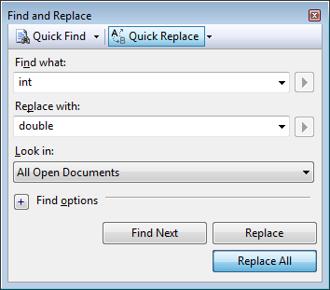
Update
Your first thought:

Slide 109
Update
Then you realize this might not be a good idea…
    // A friend to prdouble the array
    friend std::ostream &operator<<( std::ostream &, Array const & );
  double Array::size() const {
  return array_size;
  }
  double Array::variance() const {
  if ( size() <= 1 ) {
  throw underflow();
  }
  double av = average();
  double ssdiff = 0;
  for ( double i = 0; i < size(); ++i ) {
  ssdiff += (internal_array[i] - av)*(internal_array[i] - av);
  }
  return ssdiff/(size() - 1);
  }

Slide 110
Templates
Instead of using an array of int, let’s just define an arbitrary symbol
int Array::size() const {
return array_size;
}
bool Array::append( Type obj ) {
if ( full() ) {
return false;
}
// currently, entries 0, ..., array_size – 1
// are occupied
internal_array[array_size] = obj;
++array_size;
return true;
}
#include <algorithm>
class Array {
private:
int array_capacity;
Type *internal_array;
int array_size;
public:
Array( int = 10 );
int size() const;
bool append( Type );
// etc.
};
Array::Array( int n ):
array_capacity( std::max( 1, n ) ),
internal_array( new Type[array_capacity] ),
array_size( 0 ) {
// does nothing
}

Slide 111
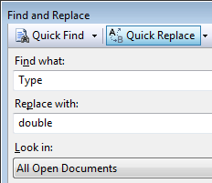
Templates
Now, you can do your own find-and-replace of the type whenever you need a new Array structure
On the other hand,
if this is so obvious, why can’t C++ do this for you????

Slide 112
Templates
Fortunately, it can, with a concept called templates
All you have to do is tell the compiler that Type is meant to be dictated by the programmer using the array class

Slide 113
Templates
Instead of using an array of int, let’s just define an arbitrary type
#ifndef ARRAY_H
#define ARRAY_H
#include <algorithm>
template <typename Type>
class Array {
private:
int array_capacity;
Type *internal_array;
int array_size;
public:
Array( int = 10 );
int size() const;
bool append( Type );
// etc.
};
template <typename Type>
Array<Type>::Array( int n ):
array_capacity( std::max( 1, n ) ),
internal_array( new Type[array_capacity] ),
array_size( 0 ) {
// does nothing
}
template <typename Type>
int Array<Type>::size() const {
return array_size;
}
template <typename Type>
bool Array<Type>::append( Type obj ) {
if ( full() ) {
return false;
}
// currently, entries 0, ..., array_size – 1
// are occupied
internal_array[array_size] = obj;
++array_size;
return true;
}

Slide 114
Templates
Note that template <typename Type> is simply a modifier for each structure, be it a function or class
  Just like it is necessary that each function have a return type, any function or class declaration or definition must be prefixed by this statement if the structure uses templates

Slide 115
Templates
There is just one subtlety with friends:
template <typename Type>
class Array {
// private and public member variables and member functions
// Friends
template <typename T>
friend std::ostream &operator<<( std::ostream &, Array<T> const & );
};
template <typename T>
std::ostream &operator<<( std::ostream &out, Array<T> const &rhs ) {
if ( rhs.empty() ) {
out << "-";
} else {
out << rhs.internal_array[0];
}
for ( int i = 1; i < rhs.size(); ++i ) {
out << " " << rhs.internal_array[i];
}
for ( int i = rhs.size(); i < rhs.capacity(); ++i ) {
out << " -";
}
return out;
}

Slide 116
Templates
Now, in the main function, we would specify the type of the array:
    #include <iostream>
    #include "Array.h"
    int main() {
    // Create an array of size 10
    Array<int> info( 10 );
    std::cout << "The size of the array is " << info.size() << std::endl;
    info.append( 42 );
    info.append( 91 );
    info.append( 35 );
    info.append( 83 );
    std::cout << "The size of the array is now " << info.size() << std::endl;
    std::cout << "The average and variance are " << info.average()
    << " and " << info.variance() << std::endl;
    return 0;
    }

Slide 117
Templates
If we had an array of doubles:
    #include <iostream>
    #include "Array.h"
    int main() {
    // Create an array of size 10
    Array<double> info( 10 );
    std::cout << "The size of the array is " << info.size() << std::endl;
    info.append( 42.52 );
    info.append( 91.41 );
    info.append( 35.91 );
    info.append( 83.19 );
    std::cout << "The size of the array is now " << info.size() << std::endl;
    std::cout << "The average and variance are " << info.average()
    << " and " << info.variance() << std::endl;
    return 0;
    }

Slide 118
Testing
Our testing environment includes a program called a driver and we provide numerous testing input
The driver instantiates an instance of the data structure and the testing input indicates how to manipulate it
We provide one set of test cases—you will need to generate your own test cases, as well

Slide 119
Testing
The testing environment is made up of:
Feature | Sample names | Description
Testing environment | Array_tester.h | The testing environment, framework, and interpreter
Testing executable | Array_driver.cpp | Contains an executable which sets up the testing environment
Test inputs | int.in.txt double.in.txt | The input commands
Test outputs | int.out.txt double.out.txt | The expected output

Slide 120
Testing
Download Array_tester.h and Array_driver.cpp from
http://ece.uwaterloo.ca/~dwharder/aads/Projects/src/
and download Tester.h and ece250.h from
http://ece.uwaterloo.ca/~dwharder/aads/Projects/src/
Place them all in the same directory as Array.h
  Right-click on Header Files, select Add→Existing Item… and select the header (.h) files Array_tester.h, Tester.h and ece250.h
  Right-click on Source Files, select Add→Existing Item… and select the C++ (.cpp) file Array_driver.cpp

Slide 121
Testing
Warning!
IDEs such as Visual Studio, Eclipse, etc., only allow any one project to have exactly ONE source file that contains an
int main()
function
You must right-click on main.cpp under Source Files and
select Exclude From Project
You will forget this and you will run into a frustrating error!!!!

Slide 122
Testing
Now when build your project, it will, again create an executable, but now we have pass the file int.in.txt as input
Open a Command-line Window
  The easiest way is to type cmd and press Enter in the Start menu:
cmd

Slide 123
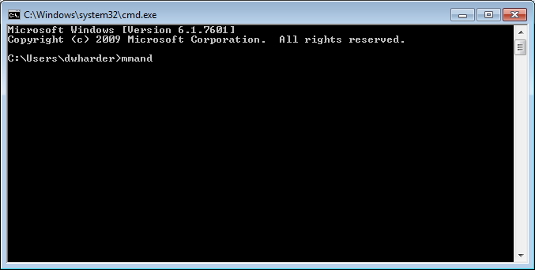
Testing
This launches a Command-line Window
Change directory (cd) into the directory containing your source files:
  C:\Users\dwharder\Documents\Visual Studio 2008\Projects\Lab0

Slide 124
Testing
In the Debug sub-directory, there is an executable Lab0.exe
When you execute this function, you are met with a prompt
> Lab0.exe int
1 %
You can now type in various commands
Note: the command-line argument int indicates we should be generating Array<int>
  Alternatively, if you want Array<double>, use
  > Lab0.exe double

Slide 125
Testing
Two possible commands:
new
new: n
When you execute this function, you are met with a prompt
> Lab0.exe int
1 % new: 3
Okay
2 %
This creates a new instance of your Array class with the value 3 passed to the constructor
  The same as calling Array *object = new Array( 3 );

Slide 126
Testing
Two other commands are:
size n
capacity n
You can check that
2 % size 0
Okay
3 % capacity 3
Okay
4 %
These test:
object->size() == 0
object->capacity() == 3

Slide 127
Testing
Another command is
append n b
You can check that
4 % append 42 1
Okay
5 % append 37 1
Okay
6 % append 51 1
Okay
7 % append 68 0
Okay
8 %
These test:
object->append( 42 ) == 1
object->append( 37 ) == 1
object->append( 51 ) == 1
object->append( 68 ) == 0
Recall that 1 is true and 0 is false…

Slide 128
Testing
Other examples:
at i n
at! i
You can check that
8 % at 1 37
Okay
9 % at 2 51
Okay
10 % at! 3
Okay
11 %
These test:
(*object)[1] == 37
(*object)[2] == 51
and that (*object)[3] throws an exception

Slide 129
Testing
We can end with
11 % delete
Okay
12 % details
SUMMARY OF MEMORY ALLOCATION:
Memory allocated: 64
Memory deallocated: 64
INDIVIDUAL REPORT OF MEMORY ALLOCATION:
Address Using Deleted Bytes
0x49860a0 new Y 24
0x49860d0 new[] Y 12
13 % exit
Finishing Test Run
>
The first calls
delete object;

Slide 130
Testing
A list of all possible commands is always found at the top of the Array_tester.h file in the comments
    * new new Array() create a new array with default capacity
    * new: n new Array( n ) create a new array with capacity n
    * size n size the size equals n
    * capacity n capacity the capacity equals n
    * empty b empty empty() returns the Boolean value b
    * full b full full() returns the Boolean value b
    * sum n sum the sum of the entries is n
    * prod n prod the product of the entries is n
    * min n min the minimum entry is n
    * min! min an underflow exception is thrown
    * max n max the maximum entry is n
    * max! max an underflow exception is thrown
    * average d average the average of the entries is d
    * average! average an underflow exception is thrown
    * variance d variance the variance of the entries is d
    * variance! variance an underflow exception is thrown
    * std_dev d std_dev the standard deviation of the entries is d
    * std_dev! std_dev an underflow exception is thrown
    * at i m operator[] object[i] returns m
    * at! i operator[] object[i] throws an out_of_range
    * append n b append attempting to append n returns the Boolean value b
    * clear clear empties the array--always succeeds as a test
    * cout cout << Array print the Array (for testing only)
    * assign operator = assign this Array to a new Array object
    * summary prints the amount of memory allocated
    * minus the memory deallocated
    * details prints a detailed description of which
    * memory was allocated with details
    * !! use the previous command, e.g. 5 append 3
    * 6 !! 7 // same as append 7
    * !n use the command used in line n 7 append 7
    * 8 !7 9 // same as append 9

Slide 131
Testing
If you ask for something incorrect, you get an error message:
1 % new
Okay
2 % append 52 1
Okay
3 % at 0 53
Failure in instance[0]: expecting the value '53' but got '52'
Suppose you forgot to implement an error condition:
4 % at! 1
Failure in instance[1]: expecting to catch an exception but nothing
was raised.

Slide 132
Testing
Now, you could enter these commands over and over again, or you could save these instructions in a text file and then redirect them as input to the interpreter
  Our tests are provided to you as text files
  Move the provided .txt files to the project Debug directory
At the command line, type:
> Lab0.exe int < int.in.txt
> type int.out.txt
> Lab0.exe double < double.in.txt
> type double.out.txt
Your output should be identical to the corresponding *.out.txt

Slide 133
Testing
Note: If your code does not work, you are welcome to examine the sample solution at
http://ece.uwaterloo.ca/~dwharder/aads/Projects/0/src/Array.h
The solution contains what would be reasonably considered to be the minimum amount of acceptable comments
Note: If you do not make a serious attempt to write your own implementation before you check the solution, you will have wasted your time… ☹
  It would be much better for you and your friends if you asked your friends for help…

Slide 134
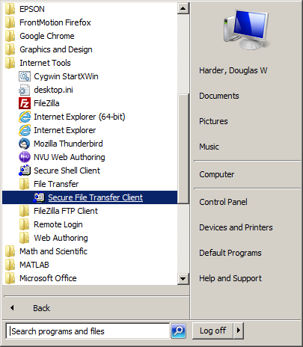
Going back to ecelinux
So, now we must try compiling this in Unix
  First, we must move the files over
To copy files between operating
systems, we must use the
file-transfer protocol (ftp)

Slide 135
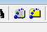
Going back to ecelinux
The easiest is if you still have the SSh window open, just select the ftp icon in the toolbar:
This opens an SSh Secure File Transfer window
  Don’t worry about the left-hand local panel
  Navigate to ece250/lab0 in the right-hand remote panel
Now you can open a Windows Explorer window and drag-and-drop all of the .h, .cpp, and .txt files into the right-hand remote panel

Slide 136
Going back to ecelinux
In your SSh shell, you can now see these files:
  $ pwd
  /home/dwharder/ece250/lab0
  $ ls
  a.out Array.h Array_driver.cpp
  Array_tester.h double.in.txt double.out.txt
  ece250.h hello.cpp int.in.txt
  int.out.txt Tester.h main.cpp
  $ g++ Array_driver.cpp
g++ will overwritten the a.out file

Slide 137
Going back to ecelinux
We can test the files, too:
  $ ./a.out int < int.in.txt
  output...
  $ cat int.out.txt
  it should appear the same...
If you want to be certain they’re the same, diff should have no output:
  $ ./a.out int < int.in.txt > output.txt
  $ diff int.out.txt output.txt
  $

Slide 138
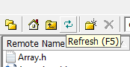
Project submission
You are now ready to create your submission:
  $ tar –cvf uwuserid_p0.tar Array.h
  $ ls
  ... uwuserid_p0.tar ...
  $ gzip uwuserid_p0.tar
  $ ls
  ... uwuserid_p0.tar.gz ...
You can now copy the files back to Windows by dragging and dropping them from the right-hand panel in ftp to your Windows file system
  You might have to refresh to
  see the newly created file

Slide 139
Recursion
Recursion is defined as when a the value of a function is defined in terms of other values of the function
  The value of the function will be known for at least one point
We will look at the factorial function and the Fibonacci numbers

Slide 140
Factorial function
There are two definitions of the factorial function:
Explicit:
Recursive:

Slide 141
Factorial function
In this case, the two implementations are:
    double factorial( int n ) {
    double result = 1;
    for ( double i = 2; i <= n; ++i ) {
    result *= i;
    }
    return result;
    }
    double factorial_r( int n ) {
    if ( n <= 1 ) {
    return 1;
    } else {
    return n*factorial_r( n - 1 );
    }
    }

Slide 142
Factorial function
Why double and not int or long?
2³¹ – 1 = 2147483647
13! = 6227020800
2⁶³ – 1 = 9223372036854775807
21! = 51090942171709440000

Slide 143
Fibonacci numbers
There are two definitions of the Fibonacci numbers:
Explicit:
Recursive:

Slide 144
Fibonacci numbers
In this case, the two implementations are:
    double fibonacci( int n ) {
    double phi = (std::sqrt(5.0) + 1.0)/2.0;
    double result = (
    std::pow( phi, n ) - std::pow( 1.0 - phi, n )
    )/std::sqrt( 5.0 );
    std::floor( result + 0.5 );
    }
    double fibonacci_r( int n ) {
    if ( n <= 2 ) {
    return 1;
    } else {
    return fibonacci_r( n - 1 ) + fibonacci_r( n - 2 );
    }
    }

Slide 145
Fibonacci numbers
Why double and not int or long?
2³¹ – 1 = 2147483647
F(47) = 2971215073
2⁶³ – 1 = 9223372036854775807
F(93) = 12200160415121876738

Slide 146
Trying it out…
In this case, the two implementations are:
    #include <iostream>
    using namespace std;
    int main() {
    // print 17 digits of precision in the output
    cout.precision( 17 );
    for ( int i = 0; i <= 100; i += 1 ) {
    cout << "Explicit: " << i << "! = " << factorial( i ) << endl;
    cout << "Recursive: " << i << "! = " << factorial_r( i ) << endl;
    cout << "Explicit: F(" << i << ") = " << fibonacci( i ) << endl;
    cout << "Recursive: F(" << i << ") = " << fibonacci_r( i ) << endl;
    }
    return 0;
    }

Slide 147
Trying it out…
How long does this take for you to run?

Slide 148
Usage Notes
These slides are made publicly available on the web for anyone to use
If you choose to use them, or a part thereof, for a course at another institution, I ask only three things:
  that you inform me that you are using the slides,
  that you acknowledge my work, and
  that you alert me of any mistakes which I made or changes which you make, and allow me the option of incorporating such changes (with an acknowledgment) in my set of slides
  Sincerely,
  Douglas Wilhelm Harder, MMath
  dwharder@alumni.uwaterloo.ca

