Slide 1
Radix sort

Slide 2
Outline
This topic covers radix sort:
  Bucket sort is Θ(n + m)
  Is it possible to capitalize on the linear behaviour?
  Consider sorting digits

Slide 3
Radix Sort
Suppose we want to sort 10 digit numbers with repetitions
  We could use bucket sort, but this would require the use of 10¹⁰ buckets
  With one byte per counter, this would require 9 GiB
This may not be very practical…

Slide 4
Radix Sort
Consider the following scheme
  Given the numbers
16 31 99 59 27 90 10 26 21 60 18 57 17
  If we first sort the numbers based on their last digit only, we get:
90 10 60 31 21 16 26 27 57 17 18 99 59
  Now sort according to the first digit:
10 16 17 18 21 26 27 31 57 59 60 90 99

Slide 5
Radix Sort
The resulting sequence of numbers is a sorted list
Thus, consider the following algorithm:
  Suppose we are sorting decimal numbers
  Create an array of 10 queues
  For each digit, starting with the least significant
    Place the ith number in to the bin corresponding with the current digit
    Remove all digits in the order they were placed into the bins in the order of the bins

Slide 6
Radix Sort
Suppose that two n-digit numbers are equal for the first m digits:
a = a_{n}a_{n – 1}a_{n – 2}...a_{n – m + 1}a_{n – m}...a₁a₀
b = a_{n}a_{n – 1}a_{n – 2}...a_{n – m + 1}b_{n – m}...b₁b₀
where a_{n – m} < b_{n – m}
For example, 103574 < 103892 because 1 = 1, 0 = 0, 3 = 3 but 5 < 8
Then, on iteration n – m, a will be placed in a lower bin than b
When they are taken out, a will precede b in the list

Slide 7
Radix Sort
For all subsequent iterations, a and b will be placed in the same bin, and will therefore continue to be taken out in the same order
Therefore, in the final list, a must precede b

Slide 8
Example 1
Sort the following decimal numbers:
86 198 466 709 973 981 374 766 473 342
First, interpret 86 as 086

Slide 9
Example 1
Next, create an array of 10 queues:
0
1
2
3
4
5
6
7
8
9

Slide 10
Example 1
Push according to the 3rd digit:
086 198 466 709 973 981 374 766 473 342
and dequeue: 981 342 973 473 374 086 466 766 198 709
0
1 | 981
2 | 342
3 | 973 | 473
4 | 374
5
6 | 086 | 466 | 766
7
8 | 198
9 | 709

Slide 11
Example 1
Enqueue according to the 2nd digit:
981 342 973 473 374 086 466 766 198 709
and dequeue: 709 342 466 766 973 473 374 981 086 198
0 | 709
1
2
3
4 | 342
5
6 | 466 | 766
7 | 973 | 473 | 374
8 | 981 | 086
9 | 198

Slide 12
Example 1
Enqueue according to the 1st digit:
709 342 466 766 973 473 374 981 086 198
and dequeue: 086 198 342 374 466 473 709 766 973 981
0 | 086
1 | 198
2
3 | 342 | 374
4 | 466 | 473
5
6
7 | 709 | 766
8
9 | 973 | 981

Slide 13
Example 1
The numbers
086 198 342 374 466 473 709 766 973 981
are now in order
The next example uses the binary representation of numbers, which is even easier to follow

Slide 14
Example 2
Sort the following base 2 numbers:
1111 11011 11001 10000 11010 101 11100 111 1011 10101
First, interpret each as a 5-bit number:
01111 11011 11001 10000 11010 00101 11100 00111 01011 10101
Next, create an array of two queues:
0
1

Slide 15
Example 2
Place the numbers
01111 11011 11001 10000 11010 00101 11100 00111 01011 10101
into the queues based on the 5th bit:
Remove them in order:
10000 11010 11100 01111 11011 11001 00101 00111 01011 10101
0
1
0 | 10000 | 11010 | 11100
1 | 01111 | 11011 | 11001 | 00101 | 00111 | 01011 | 10101

Slide 16
Example 2
Place the numbers
10000 11010 11100 01111 11011 11001 00101 00111 01011 10101
into the queues based on the 4th bit:
Remove them in order:
10000 11100 11001 00101 10101 11010 01111 11011 00111 01011
0 | 10000 | 11100 | 11001 | 00101 | 10101
1 | 11010 | 01111 | 11011 | 00111 | 01011
0
1

Slide 17
Example 2
Place the numbers
10000 11100 11001 00101 10101 11010 01111 11011 00111 01011
into the queues based on the 3rd bit:
Remove them in order:
10000 11001 11010 11011 01011 11100 00101 10101 01111 00111
0 | 10000 | 11001 | 11010 | 11011 | 01011
1 | 11100 | 00101 | 10101 | 01111 | 00111
0
1

Slide 18
Example 2
Place the numbers
10000 11001 11010 11011 01011 11100 00101 10101 01111 00111
into the queues based on the 2nd bit:
Remove them in order:
10000 00101 10101 00111 11001 11010 11011 01011 11100 01111
0 | 10000 | 00101 | 10101 | 00111
1 | 11001 | 11010 | 11011 | 01011 | 11100 | 01111
0
1

Slide 19
Example 2
Place the numbers
10000 00101 10101 00111 11001 11010 11011 01011 11100 01111
into the queues based on the 1st bit:
Remove them in order:
00101 00111 01011 01111 10000 10101 11001 11010 11011 11100
0 | 00101 | 00111 | 01011 | 01111
1 | 10000 | 10101 | 11001 | 11010 | 11011 | 11100
0
1

Slide 20
Example 2
The numbers
00101 00111 01011 01111 10000 10101 11001 11010 11011 11100
are now in order
This required 5n enqueues and dequeues
  In this case, it n = 10

Slide 21
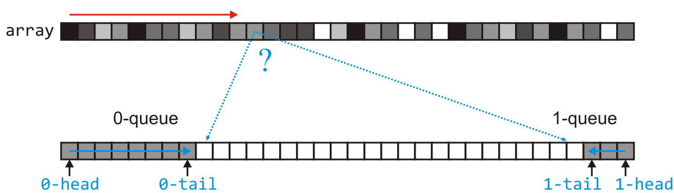
Sorting binary numbers
The implementation of multiple queues requires a lot of memory
  Note, however, that the sum of the entries in the two queues is always n
  Create a new array of size n for a two-ended queues where
    If the relevant bit is 0, enqueue it at at the front
    Otherwise, the relevant bit is 1, so enqueue it at the back

Slide 22
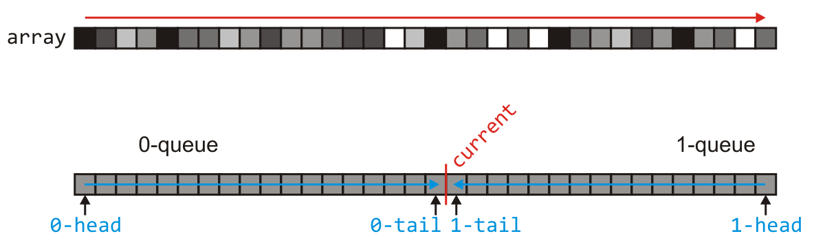
Sorting binary numbers
Once we finish, the two queues have n entries
  Now, suppose the 0-queue has current entries
    To iterate through the entries: go from 0 to current – 1,
    then from n - 1 down to current
    Go to the next bit and now use the original array as the queue

Slide 23
Example
Consider sorting the following 20 3-bit numbers
  These are the numbers
  6 7 1 3 5 2 0 4 2 1 7 2 1 3 5 2 7 5 0 4
110 | 111 | 001 | 011 | 101 | 010 | 000 | 100 | 010 | 001 | 111 | 010 | 001 | 011 | 101 | 010 | 111 | 101 | 000 | 100

Slide 24
Example
Allocate a new array
110 | 111 | 001 | 011 | 101 | 010 | 000 | 100 | 010 | 001 | 111 | 010 | 001 | 011 | 101 | 010 | 111 | 101 | 000 | 100

Slide 25
Example
Sort on the least-significant bit
110 | 111 | 001 | 011 | 101 | 010 | 000 | 100 | 010 | 001 | 111 | 010 | 001 | 011 | 101 | 100 | 111 | 101 | 000 | 100
110 | 010 | 000 | 100 | 010 | 010 | 010 | 000 | 100 | 101 | 111 | 101 | 011 | 001 | 111 | 001 | 101 | 011 | 001 | 111

Slide 26
Example
Consider the original array as empty
110 | 010 | 000 | 100 | 010 | 010 | 010 | 000 | 100 | 101 | 111 | 101 | 011 | 001 | 111 | 001 | 101 | 011 | 001 | 111

Slide 27
Example
Sort on the intermediate bit
000 | 100 | 000 | 100 | 001 | 101 | 001 | 001 | 101 | 101 | 111 | 011 | 111 | 011 | 111 | 010 | 010 | 010 | 010 | 110
110 | 010 | 000 | 100 | 010 | 010 | 010 | 000 | 100 | 101 | 111 | 101 | 011 | 001 | 111 | 001 | 101 | 011 | 001 | 111

Slide 28
Example
Consider the other array as empty
000 | 100 | 000 | 100 | 001 | 101 | 001 | 001 | 101 | 101 | 111 | 011 | 111 | 011 | 111 | 010 | 010 | 010 | 010 | 110

Slide 29
Example
Sort on the most-significant bit
000 | 100 | 000 | 100 | 001 | 101 | 001 | 001 | 101 | 101 | 111 | 011 | 111 | 011 | 111 | 010 | 010 | 010 | 010 | 110
000 | 000 | 001 | 001 | 001 | 010 | 010 | 010 | 010 | 011 | 011 | 111 | 111 | 111 | 110 | 101 | 101 | 101 | 100 | 100

Slide 30
Example
Now we must copy back, swapping the second half
000 | 000 | 001 | 001 | 001 | 010 | 010 | 010 | 010 | 011 | 011 | 111 | 111 | 111 | 110 | 101 | 101 | 101 | 100 | 100

Slide 31
Example
Now we must copy back, swapping the second half
000 | 000 | 001 | 001 | 001 | 010 | 010 | 010 | 010 | 011 | 011 | 100 | 100 | 101 | 101 | 101 | 110 | 111 | 111 | 111
000 | 000 | 001 | 001 | 001 | 010 | 010 | 010 | 010 | 011 | 011 | 111 | 111 | 111 | 110 | 101 | 101 | 101 | 100 | 100

Slide 32
Example
Deleting the temporary array and we are finished
  Thus,
  6 7 1 3 5 2 0 4 2 1 7 2 1 3 5 2 7 5 0 4
  is now
  0 0 1 1 1 2 2 2 2 3 3 4 4 5 5 5 6 7 7 7
000 | 000 | 001 | 001 | 001 | 010 | 010 | 010 | 010 | 011 | 011 | 100 | 100 | 101 | 101 | 101 | 110 | 111 | 111 | 111

Slide 33
Implementation
template <typename Type>
void radix_sort( Type *array, size_t n ) {
// Acknowledgement: Jake Greenberg
Type *queue = new Type[n];
size_t q0 = n, q1 = 0;
bool copy_back = false;
for ( Type bit = 1; bit; bit <<= 1 ) {
size_t current = q0;
q0 = 0; q1 = n - 1; // q0, q1 next tail location for 0- and 1-queues
copy_back = !copy_back;
// Copy the entries of 'array' to either queue based on
// if the bit of array[k] is 0 or 1
// - the 0-queue in 'array' starts at 0 to 'current – 1',
// while the 1-queue starts at n - 1 and goes down to 'current'
std::swap( array, queue ); // Alternate between the two arrays
}
// Clean up

Slide 34
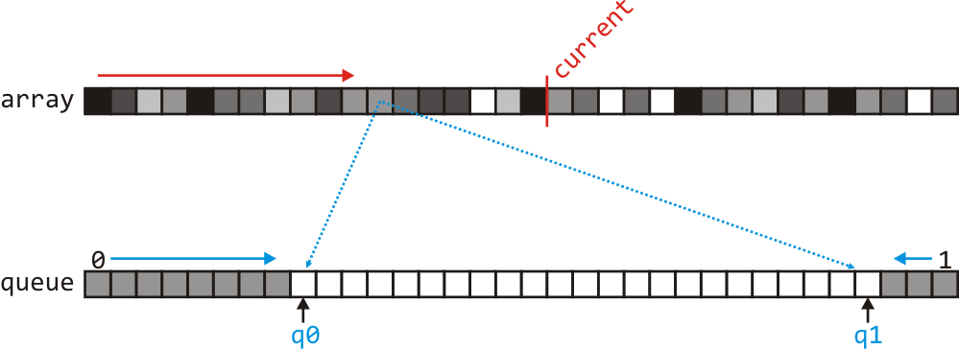
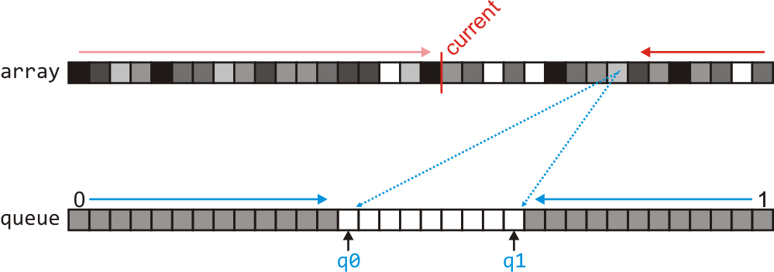
Copy the entries
// Start at front and go up to 'current - 1'
for ( size_t k = 0; k < current; ++k ) {
if ( array[k] & bit ) {
queue[q1] = array[k];
--q1;
} else {
queue[q0] = array[k];
++q0;
}
}
// Start at the end and return to 'current'
for ( size_t k = n - 1; k >= current; --k ) {
if ( array[k] & bit ) {
queue[q1] = array[k];
--q1;
} else {
queue[q0] = array[k];
++q0;
}
}

Slide 35
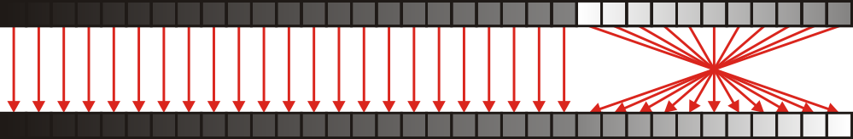
Clean up
if ( copy_back ) {
size_t k = 0;
for ( ; k < q0; ++k ) {
queue[k] = array[k];
}
for ( size_t j = n - 1; j >= q0; --j, ++k ) {
queue[k] = array[j];
}
delete [] array;
} else {
for ( size_t j = q0, k = n - 1; j < k; ++j, --k ) {
std::swap( array[j], array[k] );
}
delete [] queue;
}

Slide 36
Signed integers and floating-point numbers
Some observations:
  This implement works with positive doubles as well as unsigned integer datatypes
  If we are using signed integers stored using 2s complement,
  we need only store all 1s first and then all 0s
  If we are sorting arbitrary doubles, we must also reverse the order of the numbers identified as negative—those with a leading bit equal to 1

Slide 37
A fast implementation
void radix_sort( int *array, size_t n, bool find_max = true ) {
int *queue = new int[n];
unsigned int copy_from = 1;
int *const a0[2] = {array, queue};
int *const r0[2] = {array + (n - 1), queue + (n - 1)};
int *const an = array + n;
int *q0 = an, *q1 = r0[0];
unsigned int all_0 = 0, all_1 = ~all_0;
if ( find_max ) {
for ( int *p = a0[0]; p != an; ) {
all_0 |= *p;
all_1 &= *p++;
}
all_0 = ~all_0;
}
Find any bit that are either all 0s or all 1s
– This is better than finding the maximum entry
– Don’t sort these bits

Slide 38
A fast implementation
for ( unsigned int mask = 1; mask; mask <<= 1 ) {
// Do not sort a bit that is all 0s or all 1s
if ( !(all_0 & mask) && !(all_1 & mask) ) {
int const *const c0 = q0;
int const *const c1 = q1;
q0 = a0[copy_from];
q1 = r0[copy_from];
copy_from ^= 1;
for ( int *p = a0[copy_from]; p != c0; )
(*p & mask ) ? ( *q1-- = *p++ ) : ( *q0++ = *p++ );
for ( int *p = r0[copy_from]; p != c1; )
( *p & mask ) ? ( *q1-- = *p-- ) : ( *q0++ = *p-- );
}
}
Iterate forward, placing entries as appropriate
Iterate backward, placing entries as appropriate

Slide 39
A fast implementation
Reverse entries in the 1-queue
if ( copy_from ) {
for ( int *p = q0, *q = r0[0]; p < q; ) {
std::swap( *p++, *q-- );
}
} else {
int *p = array;
for ( int *q = a0[1]; q != q0; ) {
*p++ = *q++;
}
for ( int *q = r0[1]; q != q1; ) {
*p++ = *q--;
}
}
delete [] queue;
}
Copy entries back to the original array,
reversing the entries in in the 1-queue
6.5 × faster than the previous implementation

Slide 40
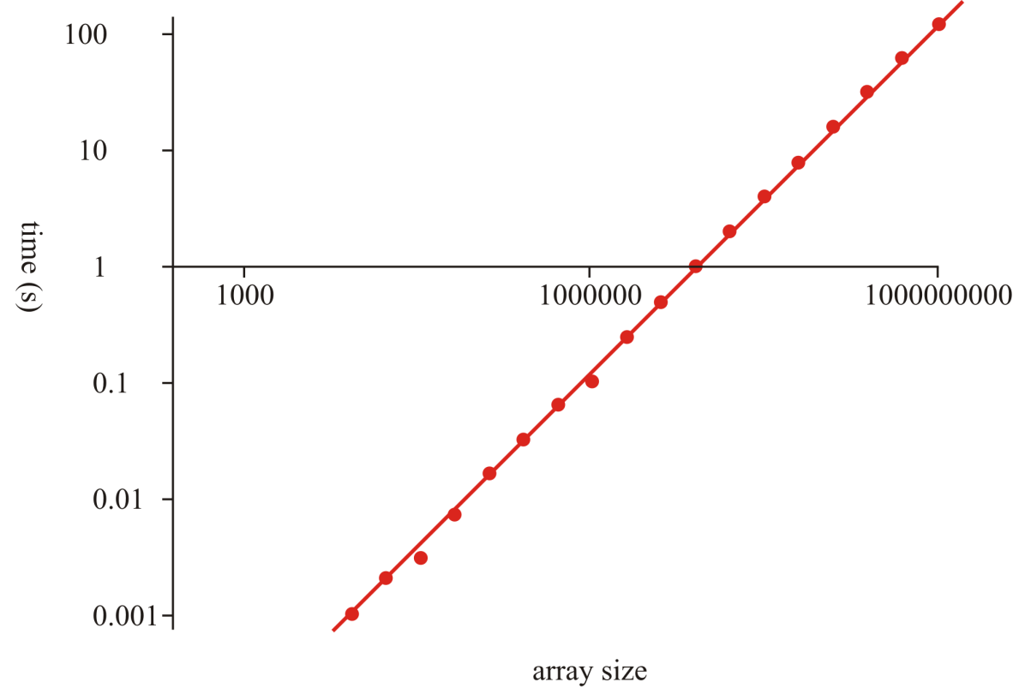
A fast implementation
Some run times:
  On ecelinux, it takes 132 s to sort 2³⁰ int
    That’s 123 ns per entry
    One-and-a-half days to sort a trillion integers

Slide 41
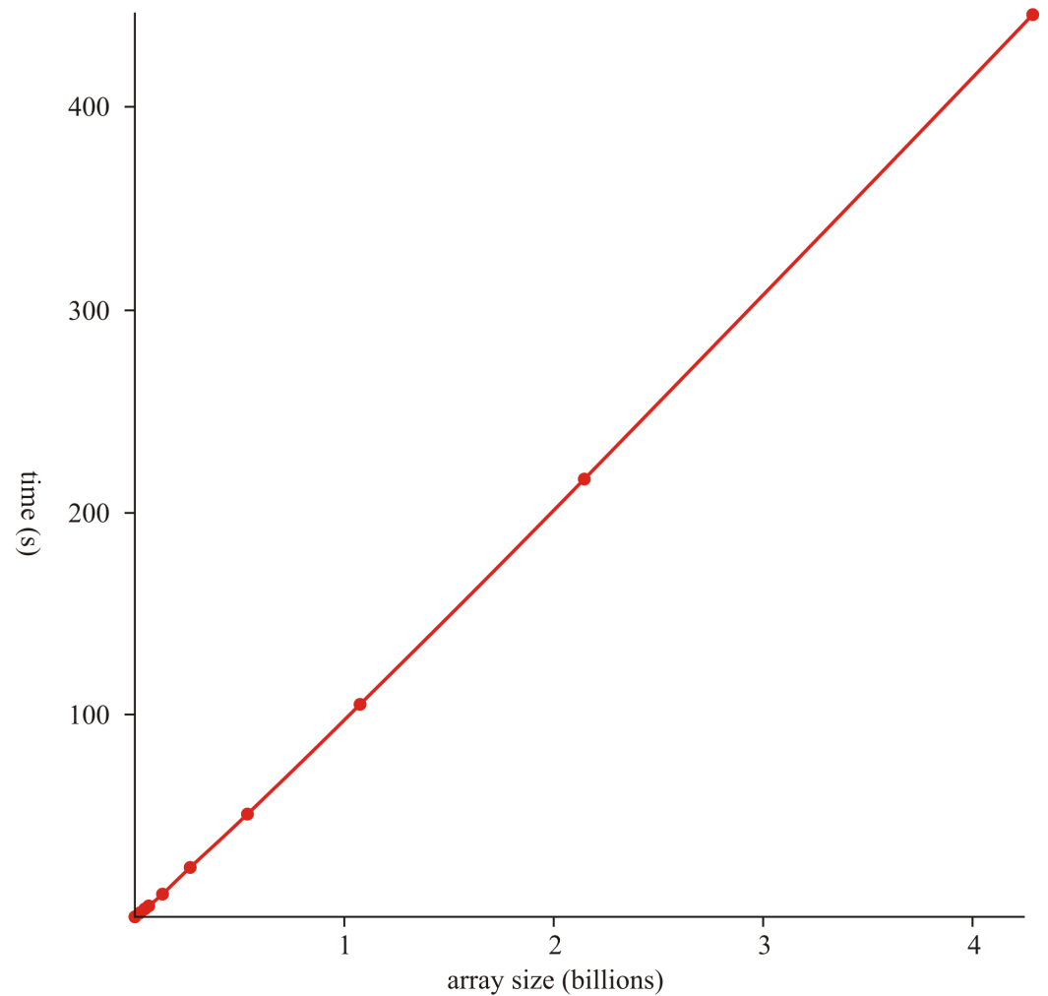
A fast implementation
We can also run these tests with the Standard Template Library
  #include <algorithm>
  sort( array, array + n );
  In some cases, our radix sort
  is faster
  For sorting 2³⁰ entries,
    The STL is 25 % faster
    Requires less memory
    Has Θ(n ln(n)) growth
    The STL uses comparison,
    so it is more general than
    radix sort

Slide 42
Run-time analysis
Bucket sort is Θ(n + m) where m is the number of buckets
  Restricting ourselves to either decimal digits or bits ensures that m = Θ(1)
How often must we iterate to sort numbers on the range 0, …, m – 1?
  We require ⌊log₁₀(m)⌋ + 1 digits or ⌊log₂(m)⌋ + 1 bits
  This is why Arabic numbers are so powerful
Run time is therefore Θ(n ln(m))
  For this to be faster than previous sorting algorithms, it must be true that ln(m) < ln(n) or m << n
  Therefore, it is only truly useful if we are sorting lists of relatively small range of numbers with very significant amount of duplications

Slide 43
Run-time analysis
The following table summarizes the run-times of bucket sort for sorting n numbers on the range 0, …, m – 1
It requires Θ(n) memory for the queues
  It is only useful to use radix sort over quicksort if n = ω(m)
Case | Run Time | Comments
Worst | Θ(n ln(m)) | No worst case
Average | Θ(n ln(m))
Best | Θ(n ln(m)) | No best case

Slide 44
Sorting a million 32-bit integers
  Senator Obama was asked
  “What is the most efficient way to sort a million 32-bit integers.”
  Many claim that radix sort would be fastest
  What is the problem?
  Radix sort would require 32 million binary comparisons
  Quicksort would require 20 million bitwise operations

Slide 45
Summary
Radix sort uses bucket sort on each digit of a set of numbers
  Interesting in theory, less useful in practice
  Useful only if sorting numbers with significant duplication
  The idea is used elsewhere

Slide 46
References
[1] Donald E. Knuth, The Art of Computer Programming, Volume 3: Sorting and Searching, 2nd Ed., Addison Wesley, 1998, §5.2.3, p.144-8.
[2] Cormen, Leiserson, and Rivest, Introduction to Algorithms, McGraw Hill, 1990, Ch. 7, p.140-9.
[3] Weiss, Data Structures and Algorithm Analysis in C++, 3rd Ed., Addison Wesley, §7.5, p.270-4.

Slide 47
References
Wikipedia, http://en.wikipedia.org/wiki/Radix_sort
[1] Donald E. Knuth, The Art of Computer Programming, Volume 3: Sorting and Searching, 2nd Ed., Addison Wesley, 1998, §5.2.3, p.144-8.
[2] Cormen, Leiserson, and Rivest, Introduction to Algorithms, McGraw Hill, 1990, Ch. 7, p.140-9.
[3] Weiss, Data Structures and Algorithm Analysis in C++, 3rd Ed., Addison Wesley, §7.5, p.270-4.
These slides are provided for the ECE 250 Algorithms and Data Structures course. The material in it reflects Douglas W. Harder’s best judgment in light of the information available to him at the time of preparation. Any reliance on these course slides by any party for any other purpose are the responsibility of such parties. Douglas W. Harder accepts no responsibility for damages, if any, suffered by any party as a result of decisions made or actions based on these course slides for any other purpose than that for which it was intended.

