Slide 1
Red-black trees

Slide 2
Outline
In this topic, we will cover:
The idea behind a red-black tree
Defining balance
Insertions and deletions
The benefits of red-black trees over AVL trees

Slide 3
Red-Black Trees
A red black tree “colours” each node within a tree either red or black
This can be represented by a single bit
In AVL trees, balancing restricts the difference in heights to at most one
For red-black trees, we have a different set of rules related to the colours of the nodes

Slide 4
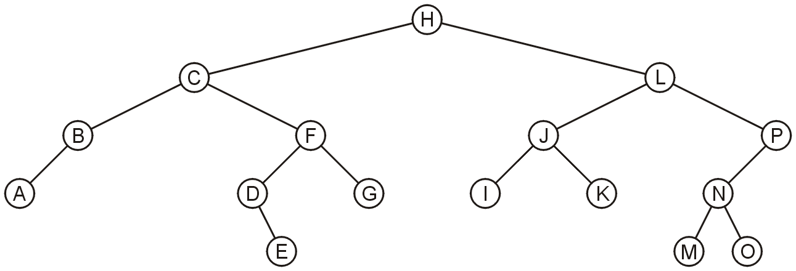
Red-Black Trees
Define a null path within a binary tree as any path starting from the root where the last node is not a full node
Consider the following binary tree:

Slide 5
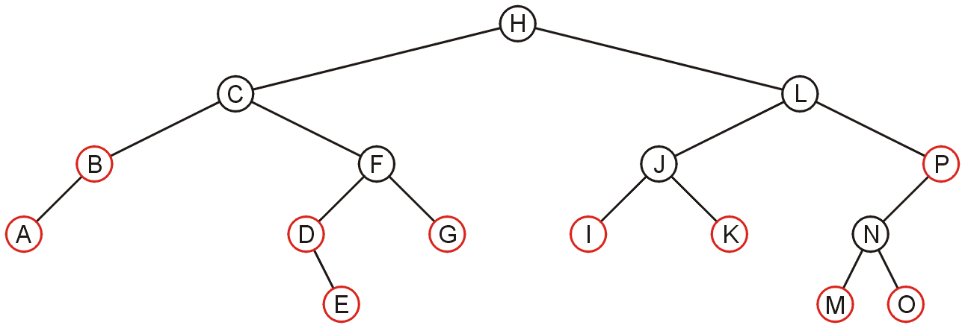
Red-Black Trees
All null paths include:
(H, C, B) (H, C, F, D) (H, L, J, I) (H, L, P)
(H, C, B, A) (H, C, F, D, E) (H, L, J, K) (H, L, P, N, M)
(H, C, F, G) (H, L, P, N, O)

Slide 6
Red-Black Trees
The three rules which define a red-black tree are
1. The root must be black,
2. If a node is red, its children must be black, and
3. Each null path must have the same number of black nodes

Slide 7
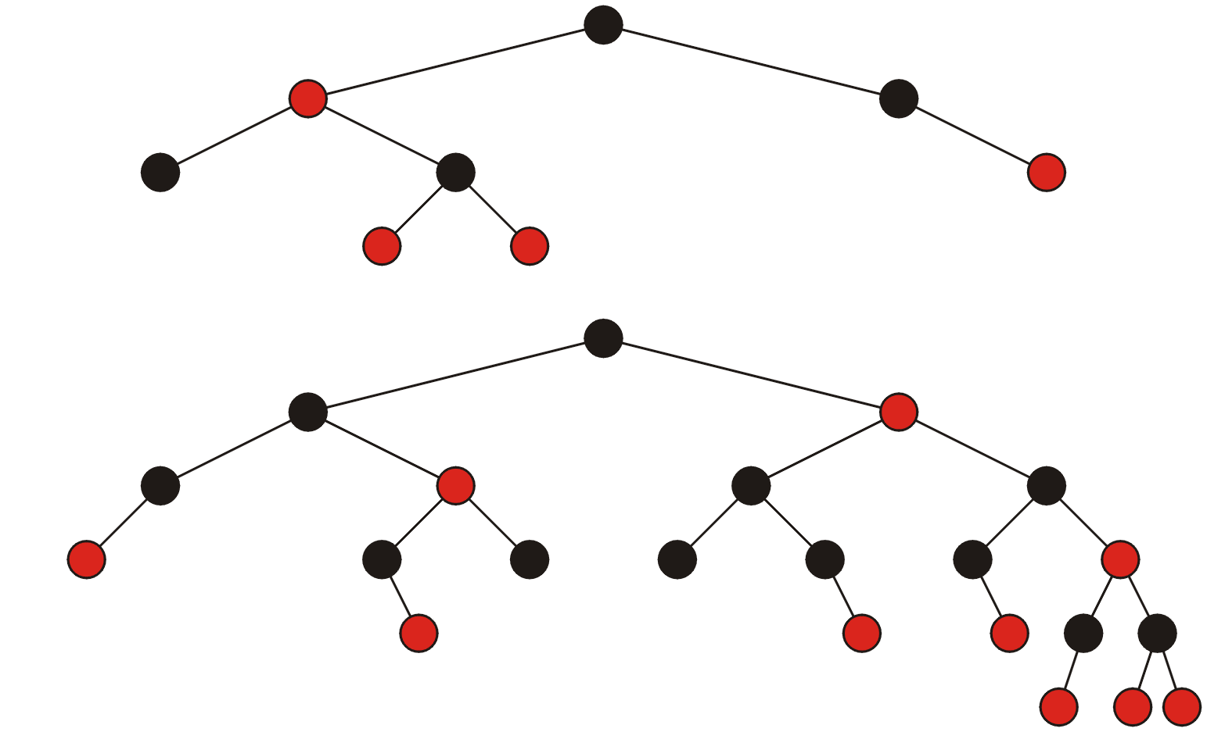
Red-Black Trees
These are two examples of red-black trees:

Slide 8
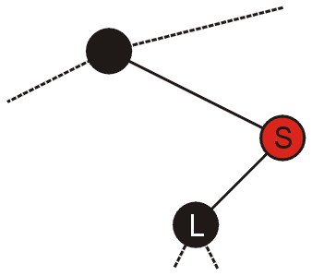
Red-Black Trees
Theorem:
Every red node must be either
A full node (with two black children), or
A leaf node
Proof:
Suppose node S has one child:
The one child L must be black
The null path ending at S has k black nodes
Any null path containing the node L will therefore have at least k + 1 black nodes

Slide 9
Red-Black Trees
In our two examples, you will note that all red nodes are either full or leaf nodes

Slide 10
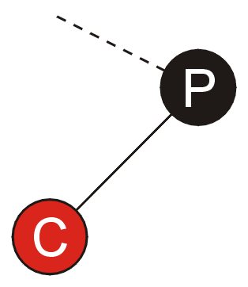
Red-Black Trees
Another consequence is that if a node P has exactly one child:
The one child must be red,
The one child must be a leaf node, and
That node P must be black

Slide 11
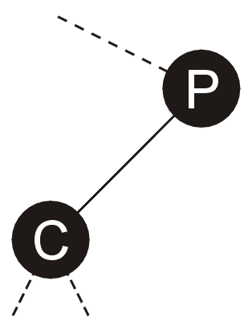
Red-Black Trees
Suppose that the child is black
then the null path ending in P will have one fewer black nodes than the null path passing through C
this contradicts the requirement that each null path has the same number of black nodes
therefore the one child must be red

Slide 12
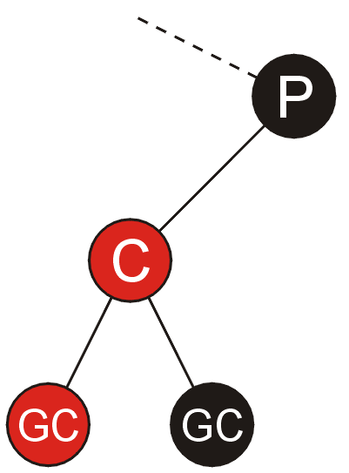
Red-Black Trees
Suppose the child is not a leaf node:
Since it is red, its children:
cannot be red because that would contradict the requirement that all children of a red node are black, and
cannot be black, as that would cause any leaf node under the child to have more black nodes than the null path ending in P
Contradiction, therefore the child must be a leaf node

Slide 13
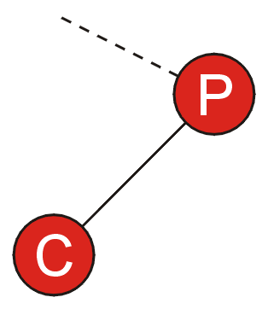
Red-Black Trees
Since the one child is red and it must be a leaf node, the parent P must be black
otherwise, we would contradict the requirement that the child of a red node must be black

Slide 14
Red-Black Trees
Again, in our examples, the only nodes with a single child are black and the corresponding children are red

Slide 15
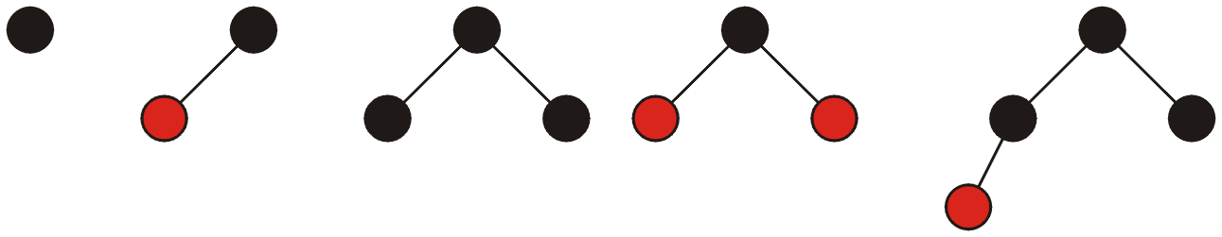
Red-Black Trees
All red-black trees with 1, 2, 3, and 4 nodes:

Slide 16
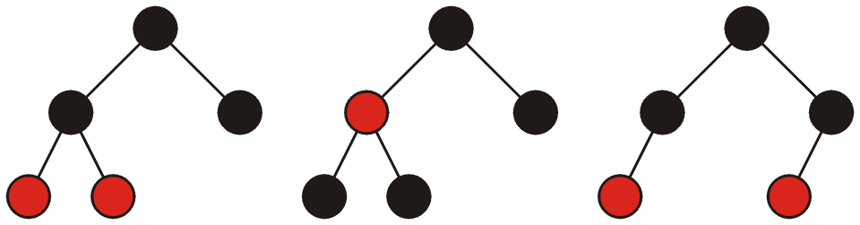
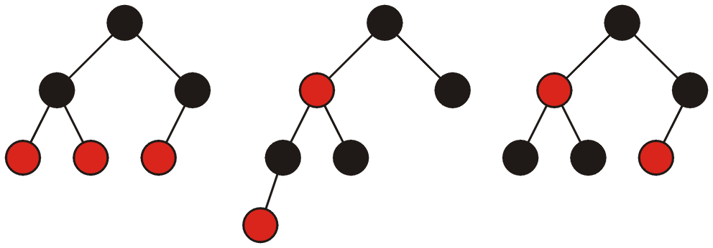
Red-Black Trees
All red-black trees with 5 and 6 nodes:

Slide 17
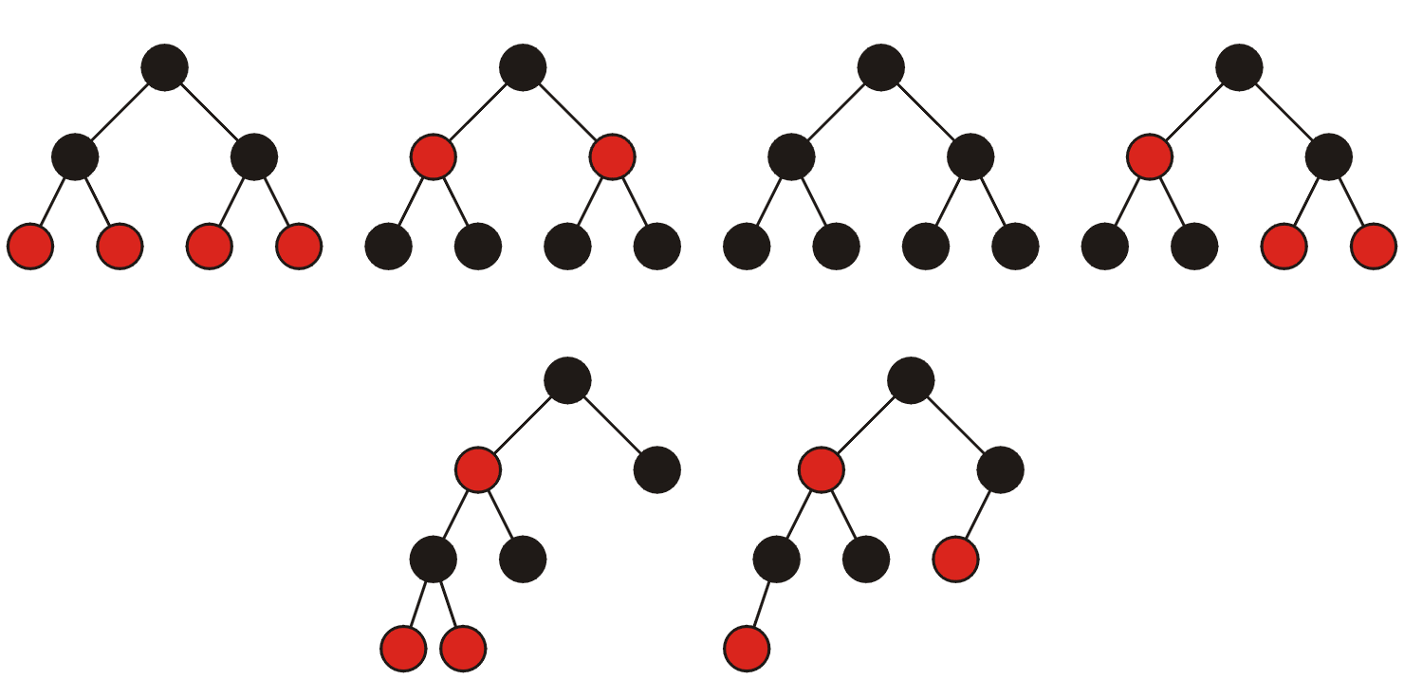
Red-Black Trees
All red-black trees with seven nodes—most are shallow:

Slide 18
Red-Black Trees
Every perfect tree is a red-black tree if each node is coloured black
A complete tree is a red-black tree if:
each node at the lowest depth is coloured red, and
all other nodes are coloured black
What is the worst case?

Slide 19
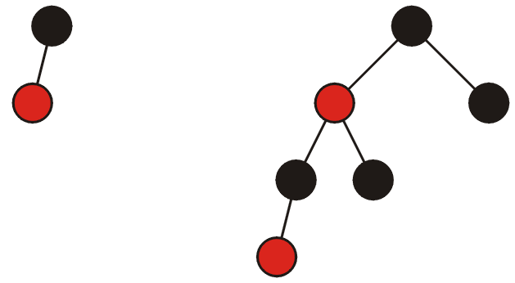
Red-Black Trees
Any worst-case red-black tree must have an alternating red-black pattern down one side
The following are the worst-case red-black trees with 1 and 2 black nodes per null path (i.e., heights 1 and 3)

Slide 20
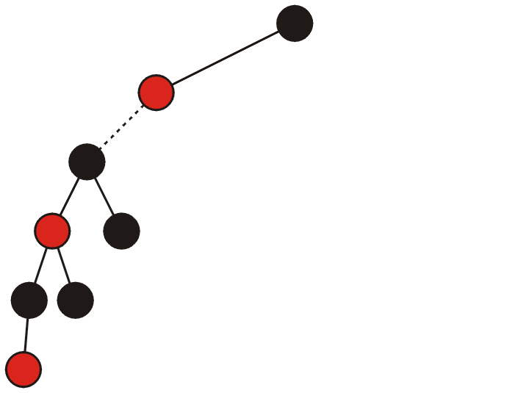
Red-Black Trees
To create the worst-case for paths with 3 black nodes per path, start with a black and red node and add the previous worst-case for paths with 2 nodes

Slide 21
Red-Black Trees
This, however, is not a red-black tree because the two top nodes do not have paths with three black nodes
To solve this, add the optimal red-black trees with two black nodes per path

Slide 22
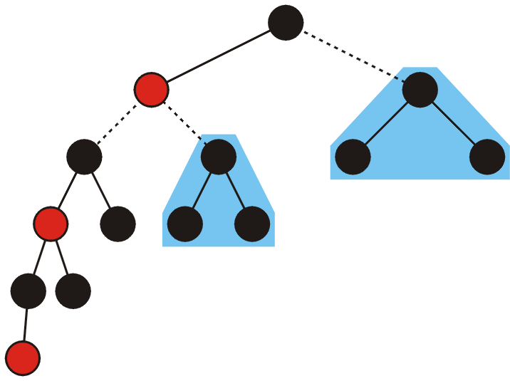
Red-Black Trees
That is, add two perfect trees with height 1 to each of the missing sub-trees

Slide 23
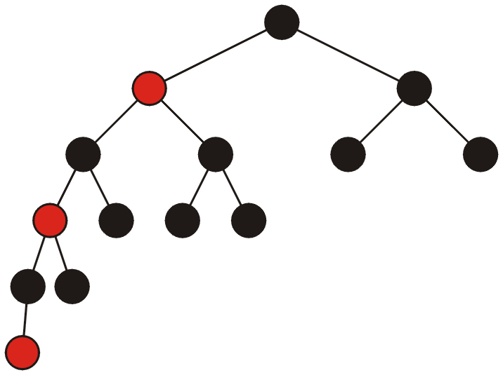
Red-Black Trees
Thus, we have the worst-case for a red-black tree with three black nodes per path (or a red-black tree of height 5)

Slide 24
Red-Black Trees
Note that the left sub-tree of the root has height 4 while the right has height 1
Thus suggests that AVL trees may be better...

Slide 25
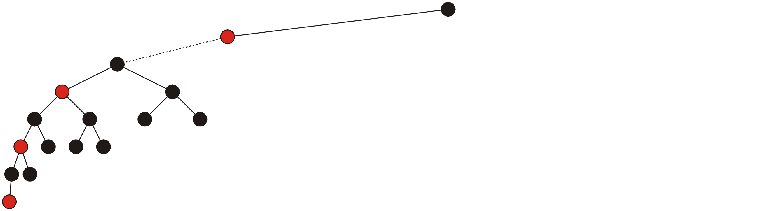
Red-Black Trees
To create the worst-case scenario for red-black trees with 4 black nodes per null path (i.e., height 7), again, start with two nodes and add the previous worst-case tree:

Slide 26
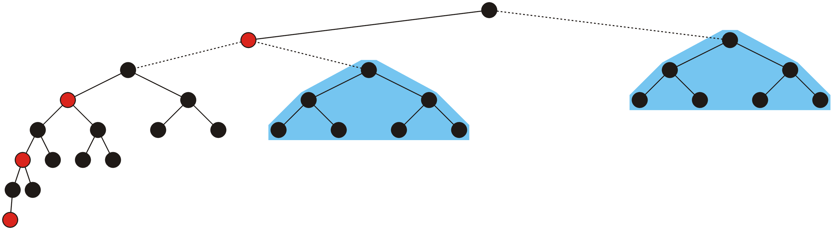
Red-Black Trees
To satisfy the definition of the red-black tree, add two perfect trees of height 2:

Slide 27
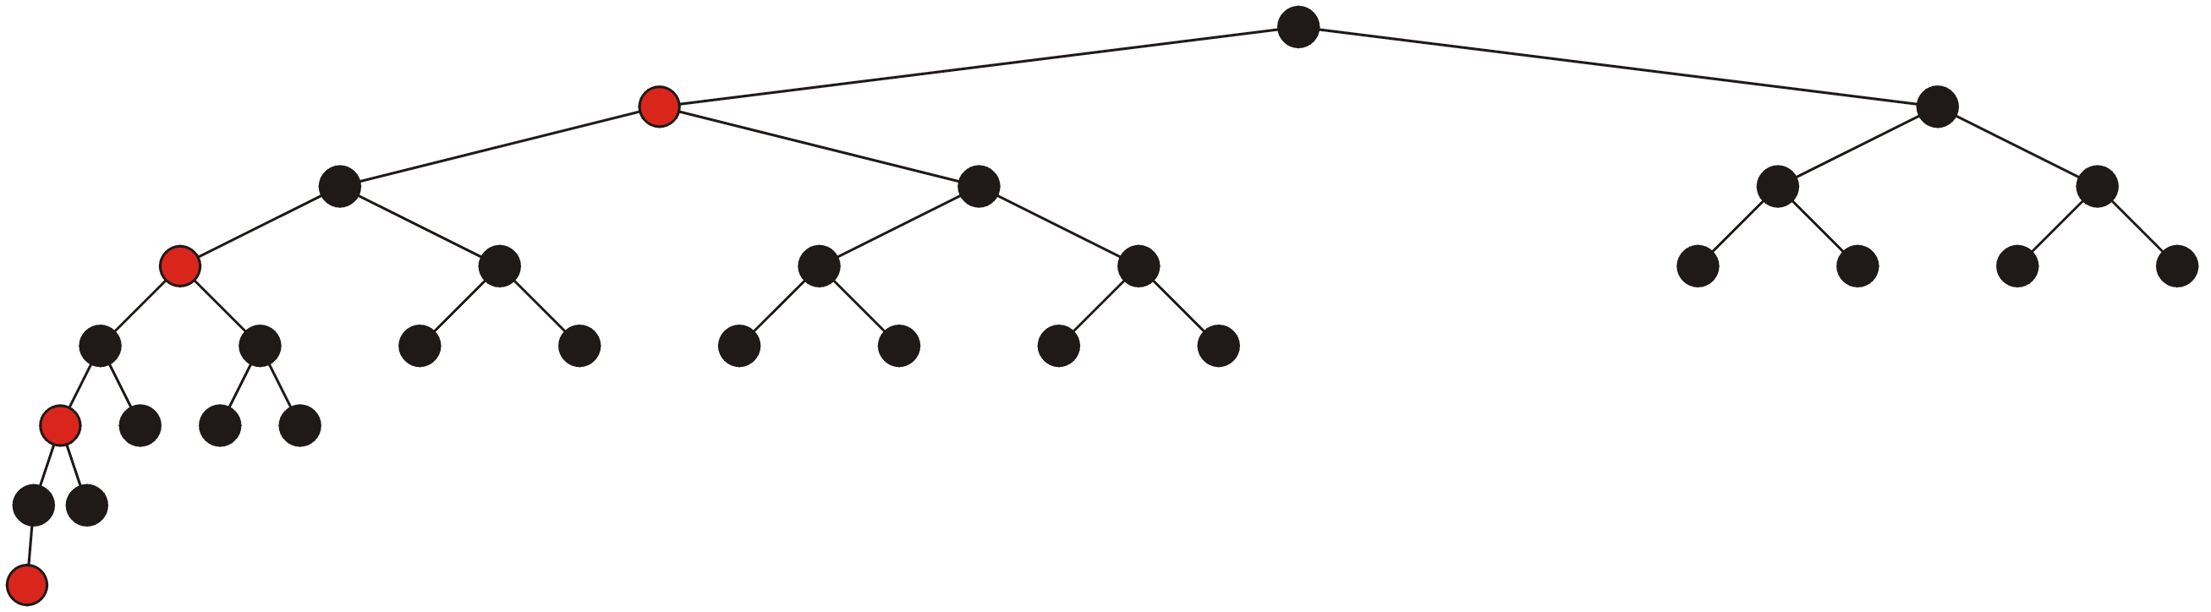
Red-Black Trees
Thus, with 30 nodes, the worst case red-black tree has height 7
The worst-case AVL tree with 33 nodes has height 6...

Slide 28
Red-Black Trees
Let k represent the number of black nodes per null path and h = 2k – 1 represent the height of the worst-case tree
To determine F(k), the number of nodes in the worst-case tree, we note that F(1) = 2 and:
F(k) = F(k – 1) + 2 + 2(2^{k – 1} – 1)
the number of nodes in the
worst-case red-black tree with
k – 1 nodes per null path
two perfect trees of height k – 2
the two extra nodes

Slide 29



Red-Black Trees
Use Maple:
> rsolve( {F(1) = 2, F(k) = 2 + F(k-1) + 2*(2^(k–1)–1)}, F(k) );
2 2^{k} – 2
> solve( {h = 2*k - 1}, k ); # solve equation for k
> eval( 2*2^k - 2, % ); # evaluate at k = h/2 – 1/2
> solve( {n = %}, h ); # solve for h

Slide 30
Red-Black Trees
A little manipulation shows that the worst-case height simplifies to
h_{worst} = 2 lg(n + 2) – 3
This grows quicker than the worst-case height for an AVL tree
h_{worst} = log_{φ}( n ) – 1.3277

Slide 31
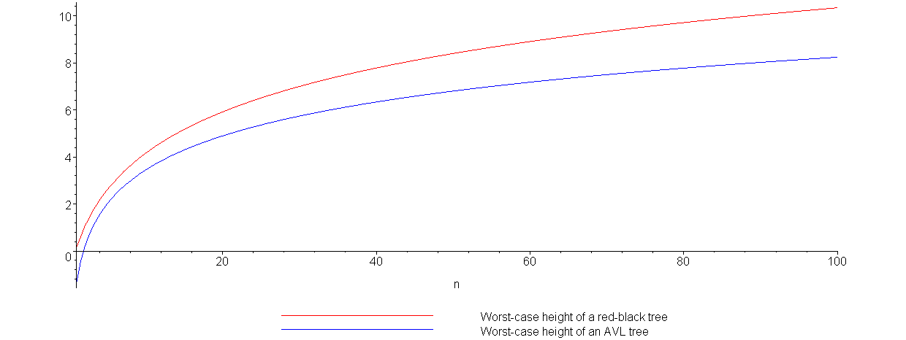
Red-Black Trees
Plotting the growth of the height of the worst-case red-black tree (red) versus the worst-case AVL tree (blue) demonstrates this:

Slide 32
Red-Black Trees
Height | AVL Tree | Red-Black Tree
1 | 2 | 2
3 | 7 | 6
5 | 20 | 14
7 | 54 | 30
9 | 143 | 62
11 | 376 | 126
13 | 986 | 254
15 | 2583 | 510
17 | 6764 | 1022
19 | 17710 | 2046
21 | 46367 | 4094
23 | 121492 | 8190
25 | 317810 | 16382
27 | 832039 | 32766
29 | 2178308 | 65534
31 | 5702886 | 131070
33 | 14930351 | 262142
This table shows the number of nodes in a worst-case trees for the given heights
Thus, an AVL tree with 131070 nodes has a height of 23 while a red-black tree could have a height as large as 31

Slide 33
Red-Black Trees
Comparing red-black trees with AVL trees, we note that:
Red-black trees require one extra bit per node
AVL trees require one byte per node (assuming the height will never exceed 255)
aside: we can reduce this to two bits, storing one of –1, 0, or 1 indicating that the node is left heavy, balanced, or right heavy, respectively

Slide 34
Red-Black Trees
AVL trees are not as deep in the worst case as are red-black trees
therefore AVL trees will perform better when numerous searches are being performed,
however, insertions and deletions will require:
more rotations with AVL trees, and
require recursions from and back to the root
thus AVL trees will perform worse in situations where there are numerous insertions and deletions

Slide 35
Insertions
We will consider two types of insertions:
bottom-up (insertion at the leaves), and
top-down (insertion at the root)
The first will be instructional and we will use it to derive the second case

Slide 36
Bottom-Up Insertions
After an insertion is performed, we must satisfy all the rules of a red-black tree:
1. The root must be black,
2. If a node is red, its children must be black, and
3. Each path from a node to any of its descendants which are is not a full node (i.e., two children) must have the same number of black nodes
The first and second rules are local: they affect a node and its neighbours
The third rule is global: adding a new black node anywhere will cause all of its ancestors to become unbalanced

Slide 37
Bottom-Up Insertions
Thus, when we add a new node, we will add a node so as to break the global rule:
the new node must be red
We will then travel up the tree to the root fixing the requirement that the children of a red node must be black

Slide 38
Bottom-Up Insertions
If the parent of the inserted node is already black, we are done
Otherwise, we must correct the problem
We will look at two cases:
the initial insertion, and
the recursive steps back to the root

Slide 39
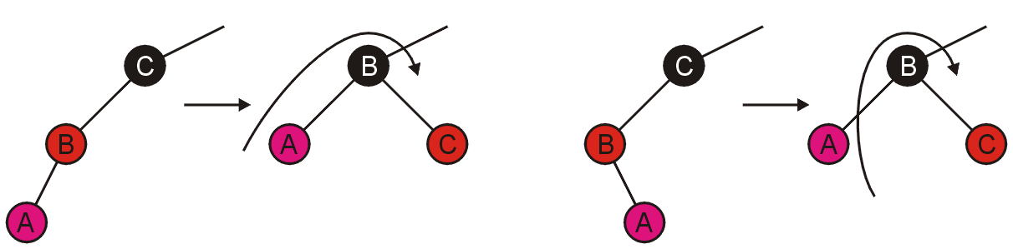
Bottom-Up Insertions
For the initial insertion, there are two possible cases:
the grandparent has one child (the parent), or
the grandparent has two children (both red)
Inserting A, the first case can be fixed with a rotation:
Consequently, we are finished...

Slide 40
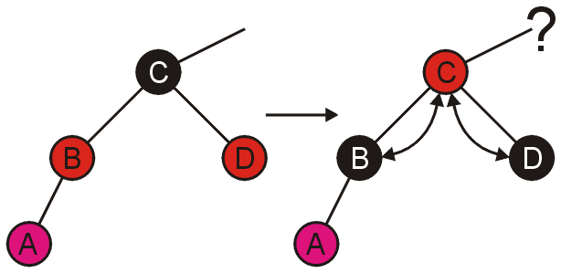
Bottom-Up Insertions
The second case can be fixed more easily, just swap the colours:
Unfortunately, we now may cause a problem between the parent and the grandparent....

Slide 41
Bottom-Up Insertions
Fortunately, dealing with problems caused within the tree are identical to the problems at the leaf nodes
Like before, there are two cases:
the grandparent has one child (the parent), or
the grandparent has two children (both red)

Slide 42
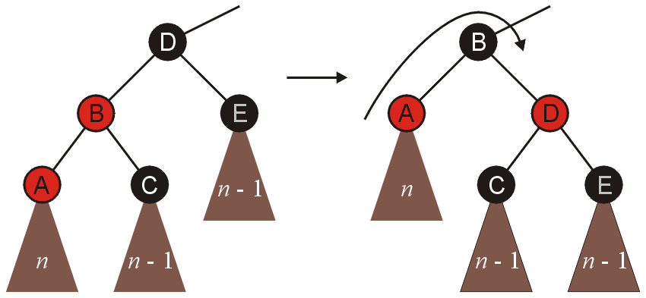
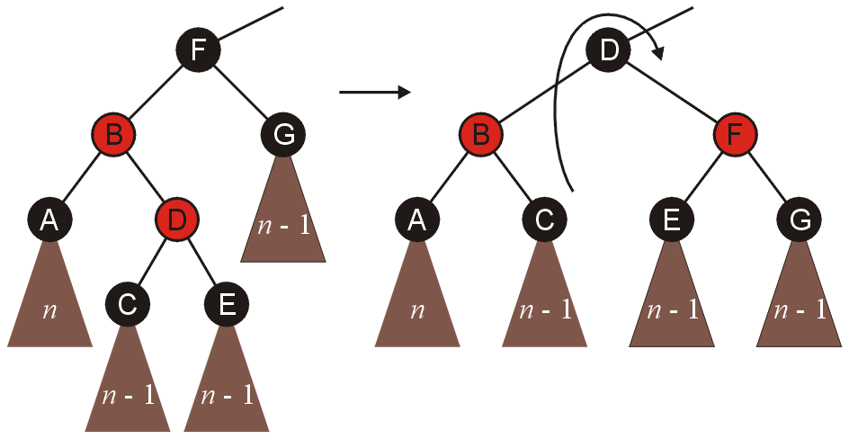
Bottom-Up Insertions
Suppose that A and D, respectively were swapped
In both these cases, we perform similar rotations as before, and we are finished

Slide 43
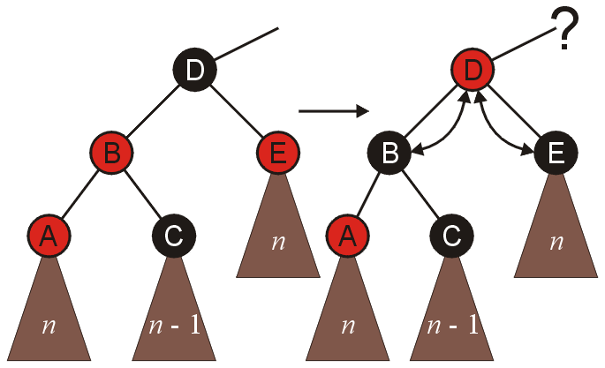
Bottom-Up Insertions
In the other case, where both children of the grandparent are red, we simply swap colours, and recurs back to the root

Slide 44
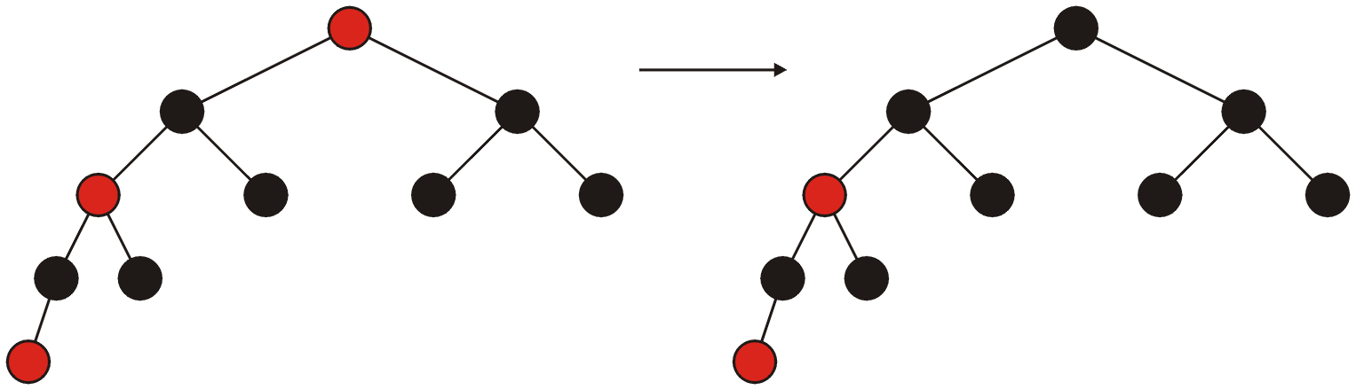
Bottom-Up Insertions
If, at the end, the root is red, it can be coloured black

Slide 45
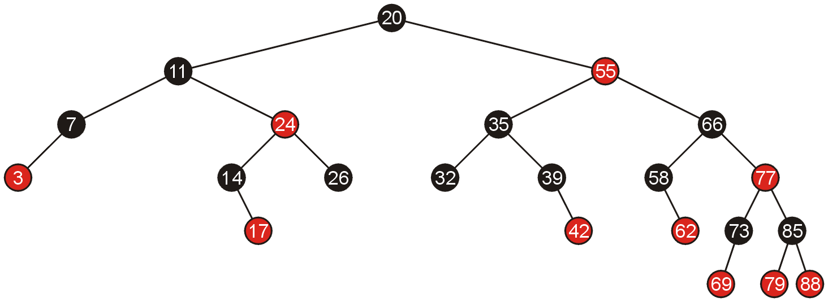
Examples of Insertions
Given the following red-black tree, we will make a number of insertions

Slide 46
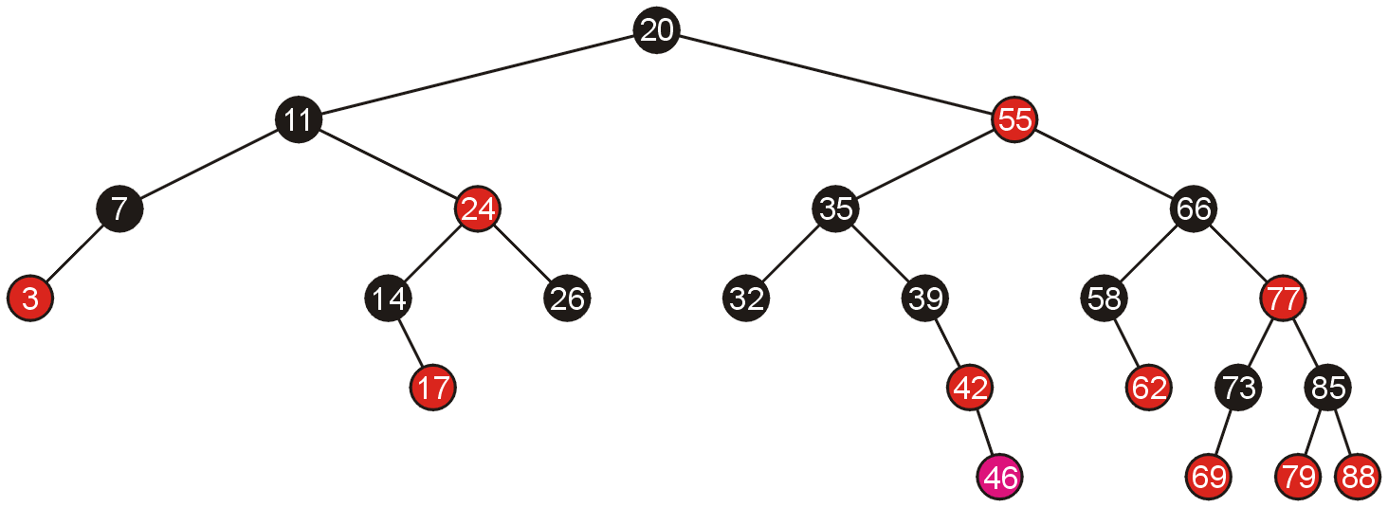
Examples of Insertions
Adding 46 creates a red-red pair which can be corrected with a single rotation

Slide 47
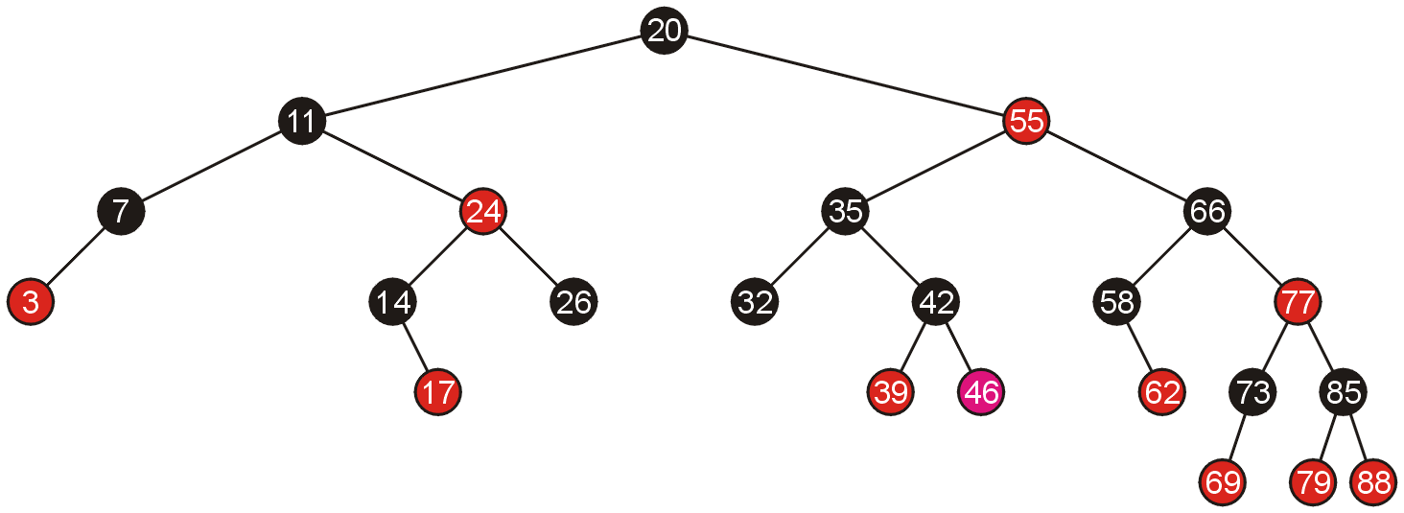
Examples of Insertions
Because the pivot is still black, we are finished

Slide 48
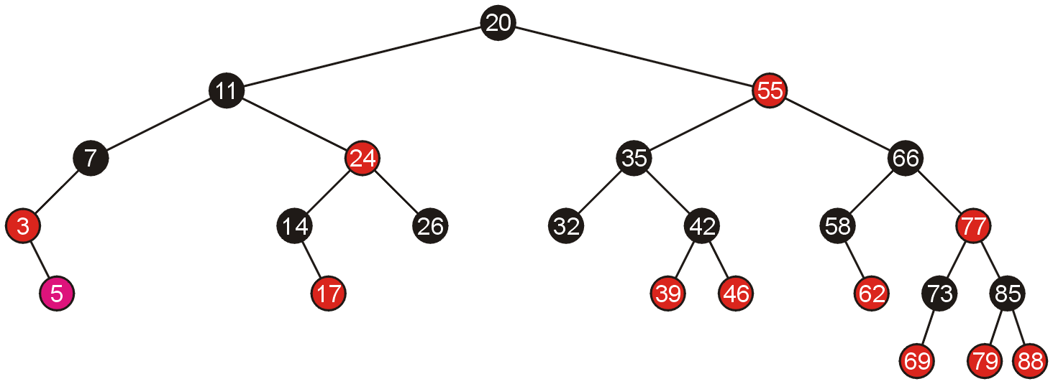
Examples of Insertions
Similarly, adding 5 requires a single rotation

Slide 49
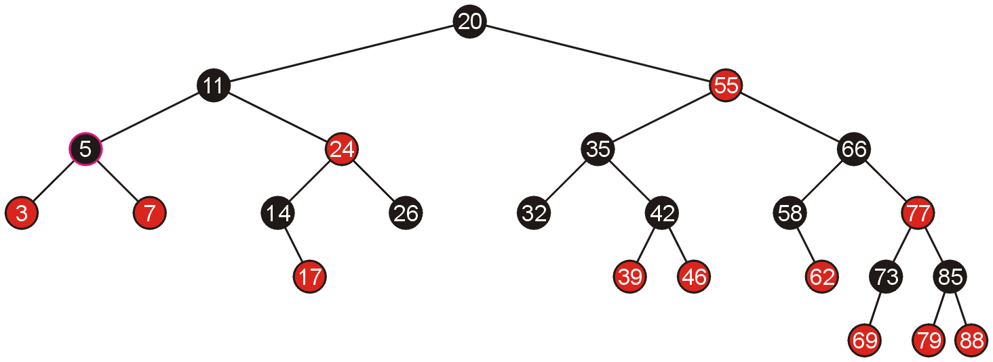
Examples of Insertions
Which again, does not require any additional work

Slide 50
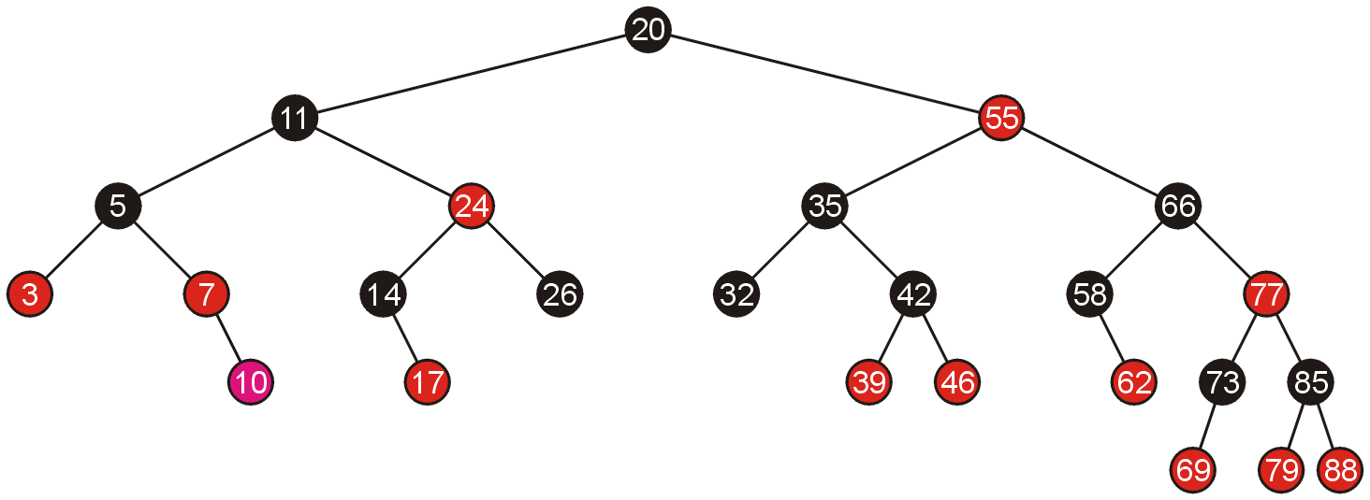
Examples of Insertions
Adding 10 allows us to simply swap the colour of the grand parent and the parent and the parent’s sibling

Slide 51
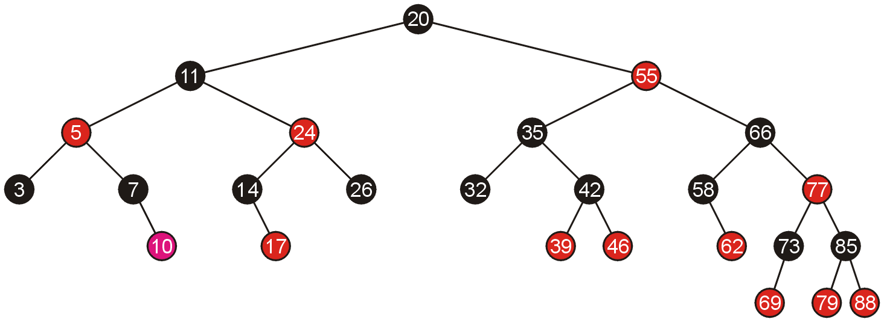
Examples of Insertions
Because the parent of 5 is black, we are finished

Slide 52
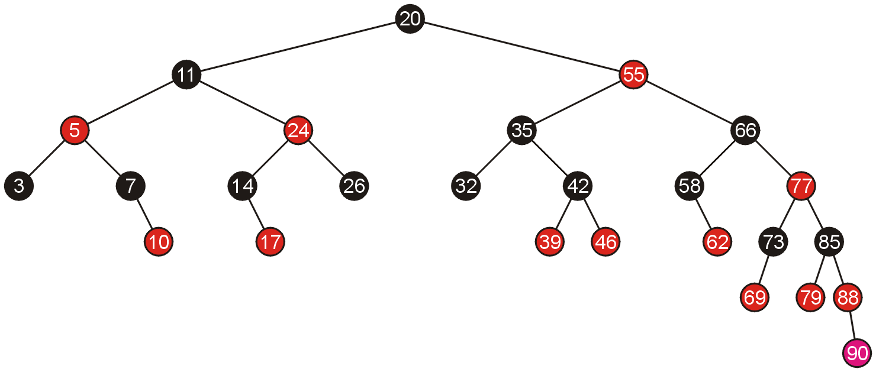
Examples of Insertions
Adding 90 again requires us to swap the colours of the grandparent and its two children

Slide 53
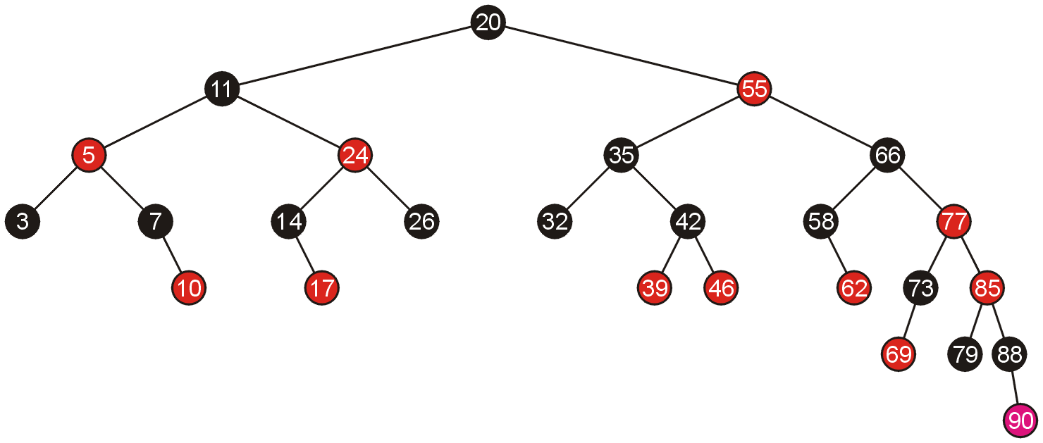
Examples of Insertions
This causes a red-red parent-child pair, which now requires a rotation

Slide 54
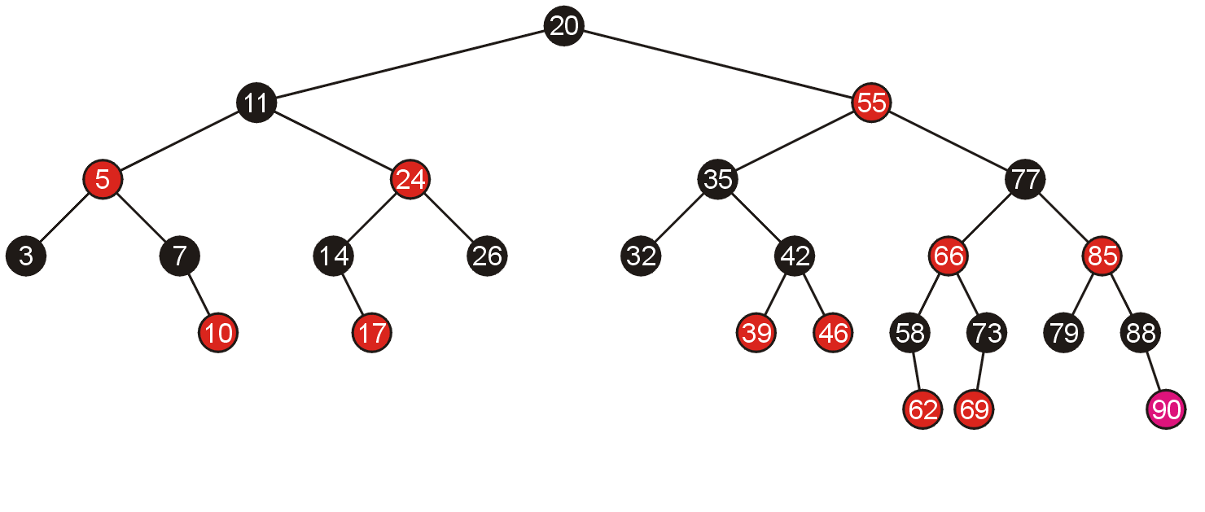
Examples of Insertions
A rotation does not require any subsequent modifications, so we are finished

Slide 55
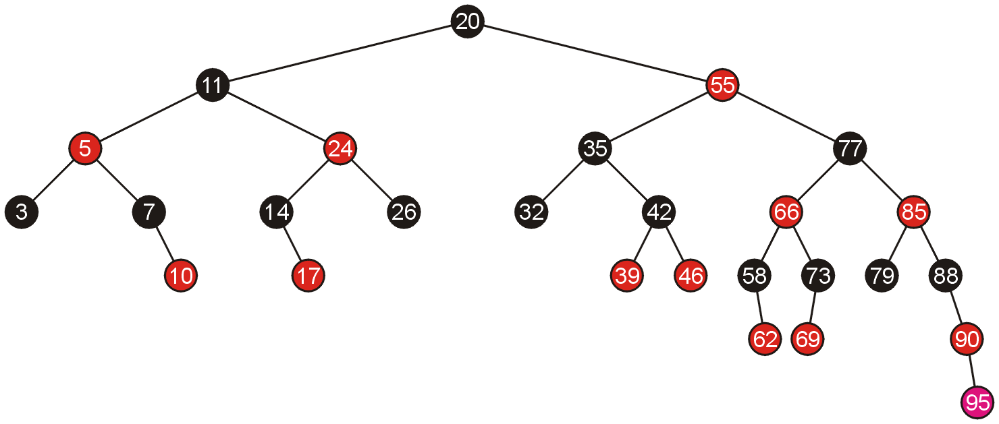
Examples of Insertions
Inserting 95 requires a single rotation

Slide 56
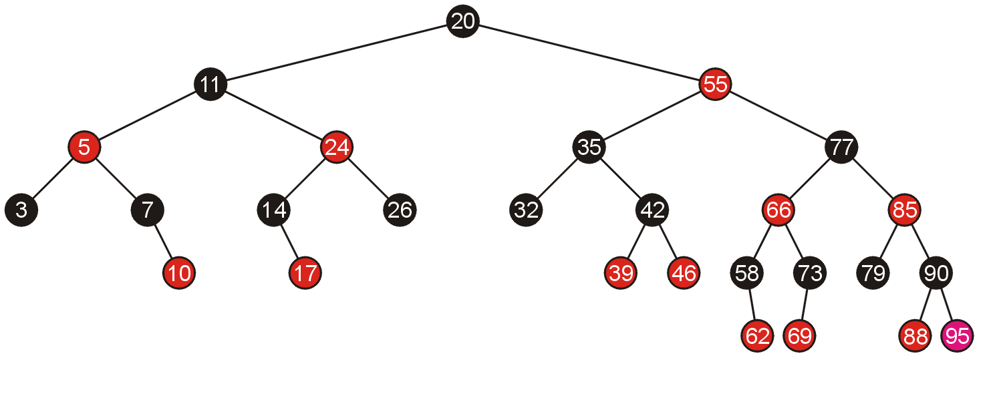
Examples of Insertions
And consequently, we are finished

Slide 57
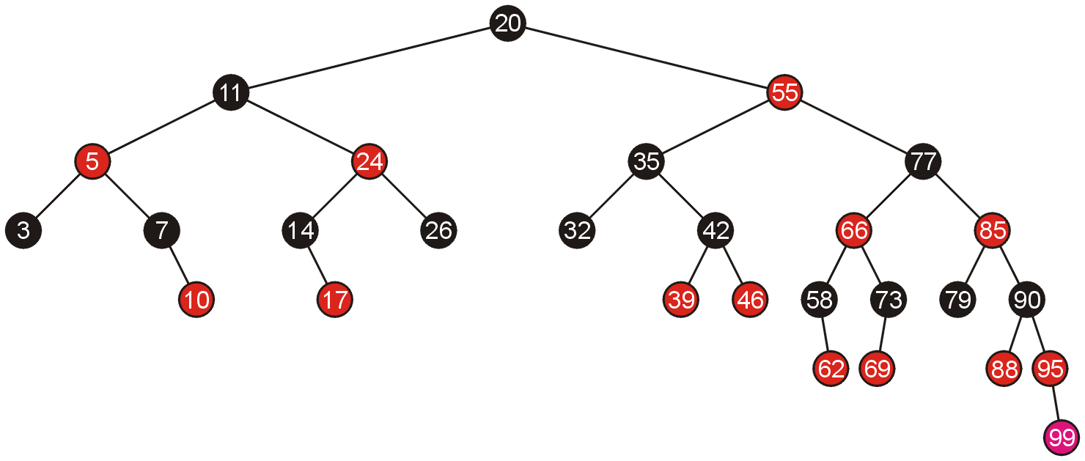
Examples of Insertions
Adding 99 requires us to swap the colours of its grandparent and the grandparent’s children

Slide 58
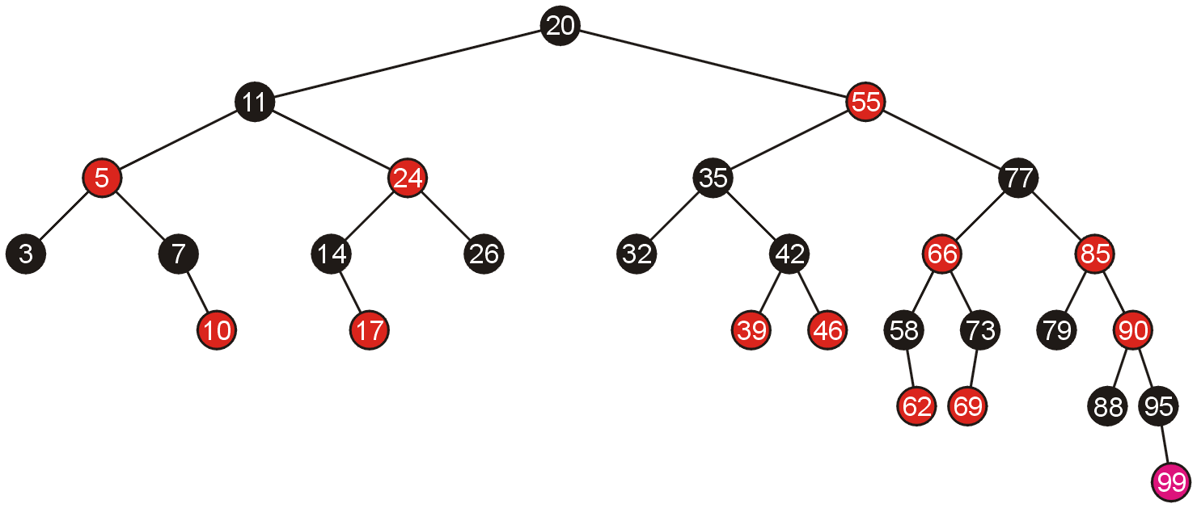
Examples of Insertions
This causes another red-red child-parent conflict between 85 and 90 which must be fixed, again by swapping colours

Slide 59
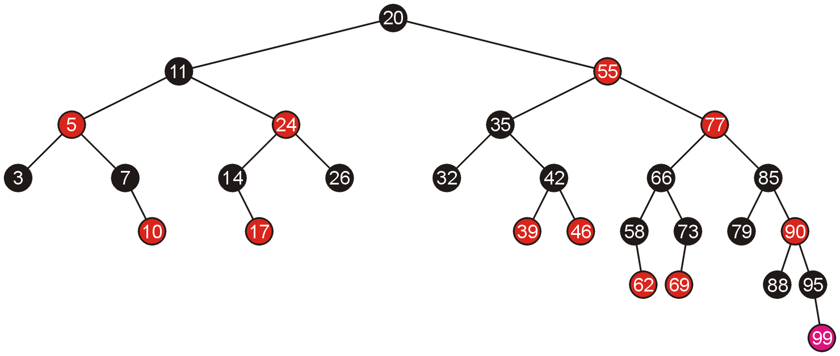
Examples of Insertions
This results in another red-red parent-child conflict, this time, requiring a rotation

Slide 60
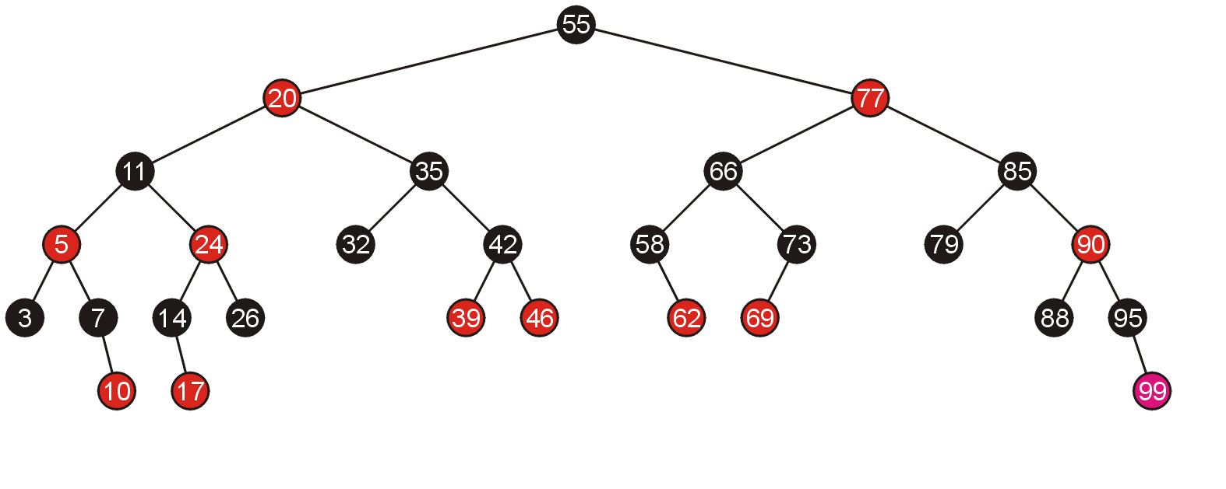
Examples of Insertions
Thus, the rotation solves the problem

Slide 61
Top-Down Insertions and Deletions
With a bottom-up insertion, it is first necessary to search the tree for the appropriate location, and only then recurs back to the root correcting any problems
This is similar to AVL trees
With red-black trees, it is possible to perform both insertions and deletions strictly by starting at the root, but not requiring the recurs back to the root

Slide 62
Top-Down Insertions
The important observation is:
swapping may require recursive corrections going back all the way to the root
rotations do not require recursive steps back to the root
Therefore, while moving down from the root, automatically swap the colours of any black node with two red children
this may require at most one rotation at the parent of the now-red node

Slide 63
Examples of Top-Down Insertions
We will start with the same red-black tree as before, but make top-down insertions (no recursion):

Slide 64

Examples of Top-Down Insertions
Adding 46 does not find any (necessarily black) parent with two red children

Slide 65
Examples of Top-Down Insertions
However, it does require one rotation at the end

Slide 66
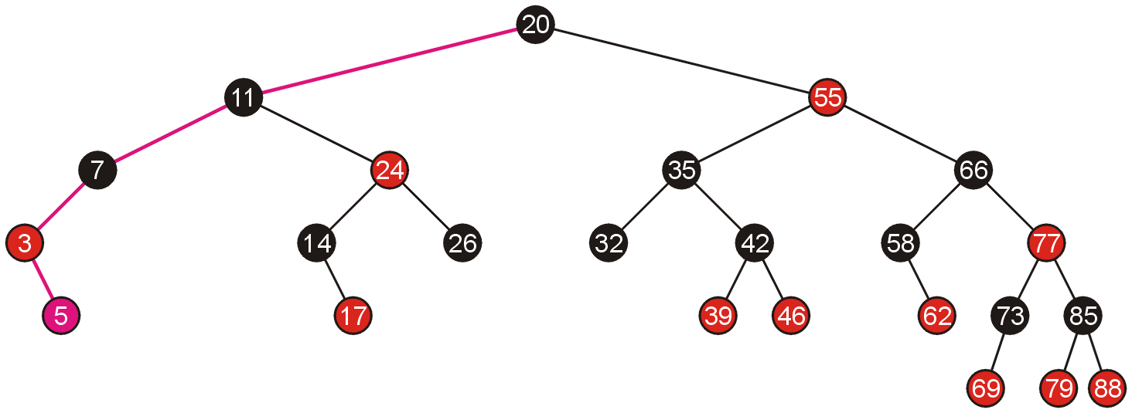
Examples of Top-Down Insertions
Similarly, adding 5 does not meet any parent with two red children:

Slide 67
Examples of Top-Down Insertions
A rotation solves the last problem

Slide 68
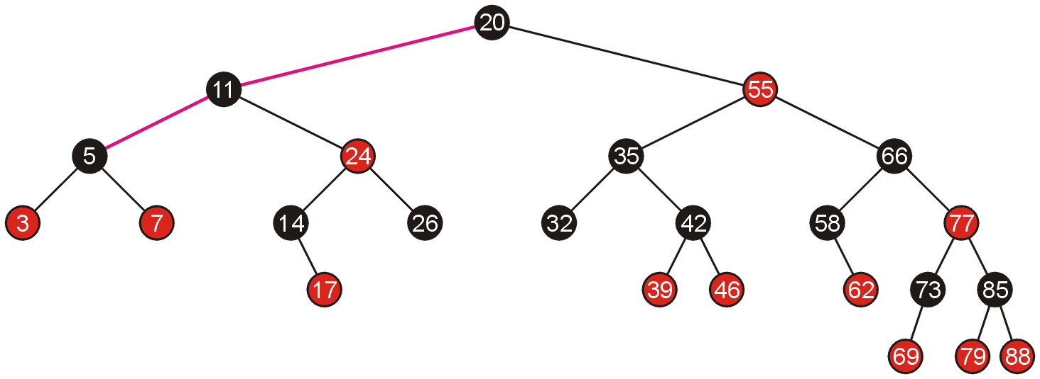
Examples of Top-Down Insertions
Adding 10 causes us to search down two edges before we meet node 5 with two red children

Slide 69
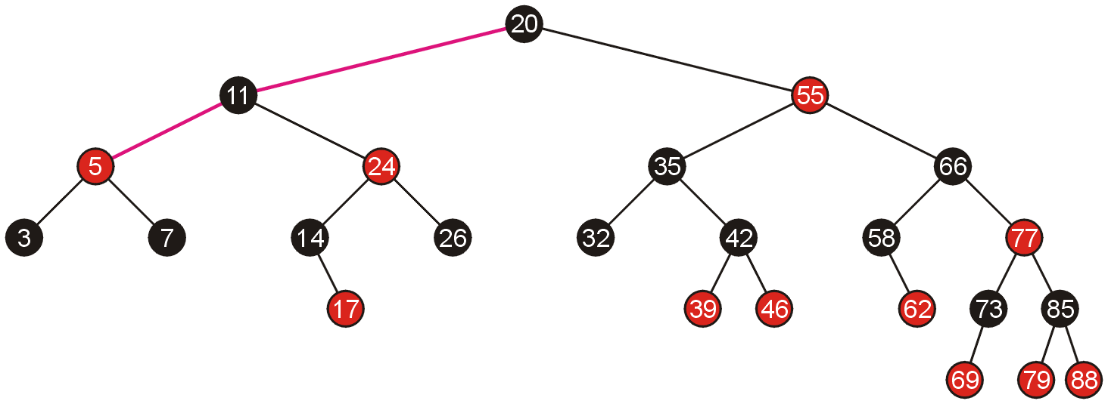
Examples of Top-Down Insertions
We swap the colours, and this does not cause a problem between 5 and 11

Slide 70

Examples of Top-Down Insertions
We continue and place 10 in the appropriate location
No further rotations are required

Slide 71
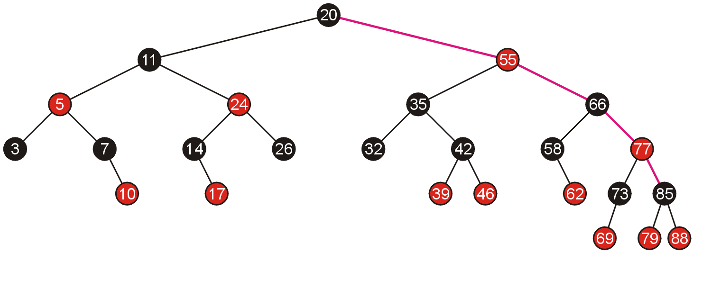
Examples of Top-Down Insertions
To add the node 90, we traverse down the right tree until we reach 85 which has two red children

Slide 72
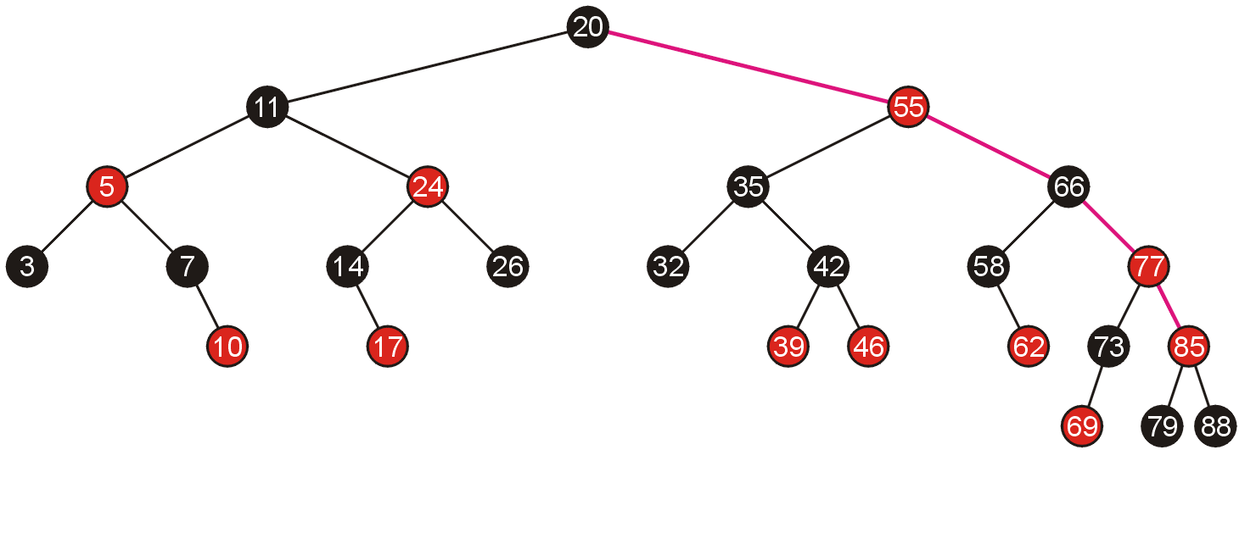
Examples of Top-Down Insertions
We swap the colours, however this creates a red-red pair between 85 and its parent

Slide 73
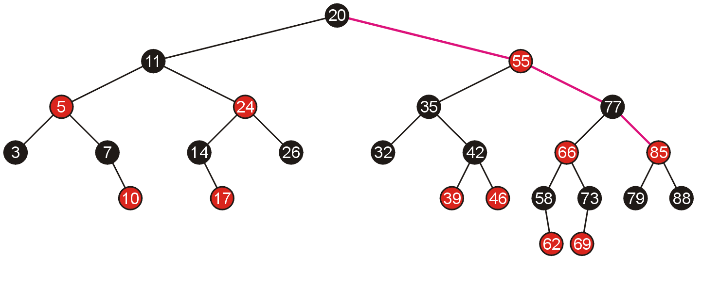
Examples of Top-Down Insertions
We require only one rotation to solve this problem, and we are guaranteed that this will not cause any problem for its parents

Slide 74
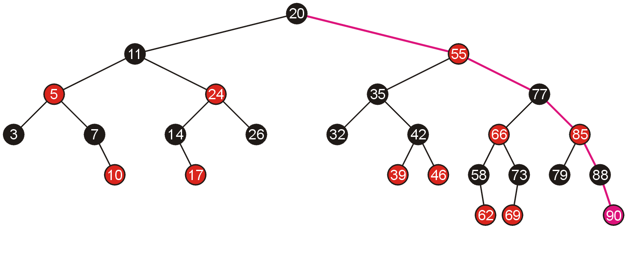
Examples of Top-Down Insertions
We continue to search down the right path and add 90 in the appropriate location—no further corrections are required

Slide 75
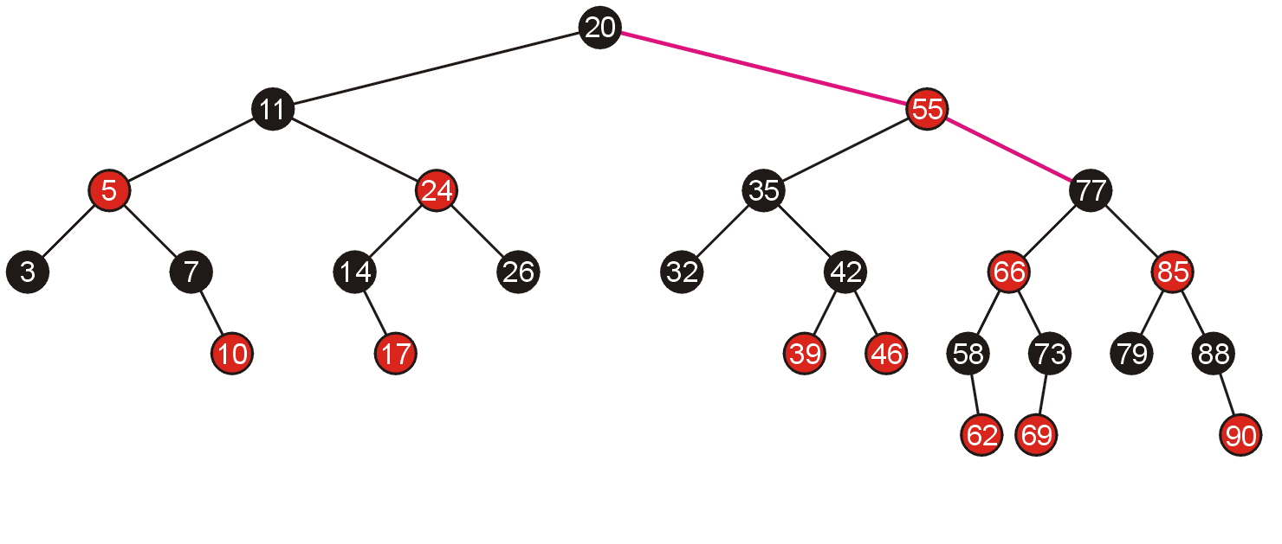
Examples of Top-Down Insertions
Next, adding 95, we traverse down the right-hand until we reach node 77 which has two red children

Slide 76

Examples of Top-Down Insertions
We swap the colours, which causes a red-red parent-child combination which must be fixed by a rotation

Slide 77

Examples of Top-Down Insertions
The rotation is around the root
Note this rotation was not necessary with the bottom-up insertion of 95

Slide 78

Examples of Top-Down Insertions
We can now proceed to add 95 by following the right-hand branch, and the insertion causes a red-red parent-child combination

Slide 79

Examples of Top-Down Insertions
This is fixed with a single rotation
We are guaranteed that this will not cause any further problems

Slide 80


Examples of Top-Down Insertions
If we compare the result of doing bottom-up insertions (left, seen previously) and top-down insertions (right), we note the resulting trees are different, but both are still valid red-black trees

Slide 81
Examples of Top-Down Insertions
If we add 99, the first thing we note is that the root has two red children, and therefore we swap the colours

Slide 82

Examples of Top-Down Insertions
At this point, each path to a non-full node still has the same number of black nodes, however, we violate the requirement that the root is black

Slide 83

Examples of Top-Down Insertions
We change the colour of the root to black
This adds one more black node to each path

Slide 84

Examples of Top-Down Insertions
Moving to the right, we now reach node 90 which has two red children and therefore we swap the colours

Slide 85

Examples of Top-Down Insertions
We continue down the right to add 99

Slide 86

Examples of Top-Down Insertions
This does not violate any of the rules of the red-black tree and therefore we are finished

Slide 87


Examples of Top-Down Insertions
Again, comparing the result of doing bottom-up insertions (left) and top-down insertions (right), we note the resulting trees are different, but both are still valid red-black trees

Slide 88


Top-Down Deletions
If we are deleting a red leaf node X, then we are finished
If we are deleting a node X with one child, we only need to replace the value of the deleted node with the value of the leaf node

Slide 89
Top-Down Deletions
If we are deleting a full node, we use the same strategy used in standard binary search trees:
replace the node with the minimum element in the right sub-tree
then delete that element from the right sub-tree

Slide 90
Top-Down Deletions
That minimum element must be either:
a red leaf node,
a black node with a single red leaf node, or
a black leaf node
The first two cases are solved, consequently, we need only deal with the possibility that the leaf node we are deleting is black

Slide 91
Top-Down Deletions
Similar to top-down insertions, we will adopt a strategy which ensures that the leaf node being deleted is not black
...to be completed...

Slide 92
Red-Black Trees
In this topic, we have covered red-black trees
simple rules govern how nodes must be distributed based on giving each node a colour of either red or black
insertions and deletions may be performed without recursing back to the root
only one bit is required for the “colour”
this makes them, under some circumstances, more suited than AVL trees

Slide 93
References
[1] Cormen, Leiserson, and Rivest, Introduction to Algorithms, McGraw Hill, 1990, Ch.14, p.261-80.
[2] Weiss, Data Structures and Algorithm Analysis in C++, 3rd Ed., Addison Wesley, §12.2, p.525-34.

Slide 94
References
Wikipedia, http://en.wikipedia.org/wiki/Hash_function
[1] Cormen, Leiserson, and Rivest, Introduction to Algorithms, McGraw Hill, 1990.
[2] Weiss, Data Structures and Algorithm Analysis in C++, 3rd Ed., Addison Wesley.
These slides are provided for the ECE 250 Algorithms and Data Structures course. The material in it reflects Douglas W. Harder’s best judgment in light of the information available to him at the time of preparation. Any reliance on these course slides by any party for any other purpose are the responsibility of such parties. Douglas W. Harder accepts no responsibility for damages, if any, suffered by any party as a result of decisions made or actions based on these course slides for any other purpose than that for which it was intended.

