Slide 1
Perfect binary trees

Slide 2
Outline
Introducing perfect binary trees
Definitions and examples
Number of nodes: 2^{h + 1} – 1
Logarithmic height
Number of leaf nodes: 2^{h}
Applications

Slide 3
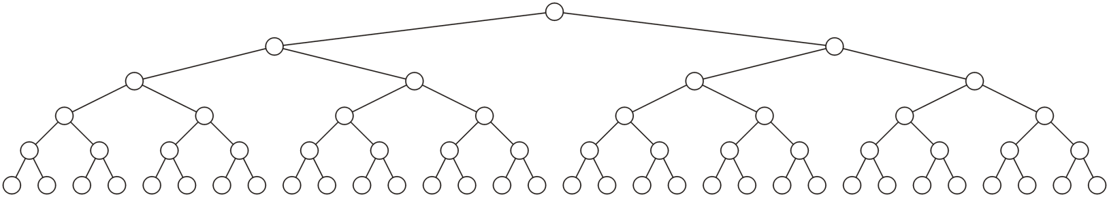
Definition
5.2.1
Standard definition:
A perfect binary tree of height h is a binary tree where
All leaf nodes have the same depth h
All other nodes are full

Slide 4
Definition
5.2.1
Recursive definition:
A binary tree of height h = 0 is perfect
A binary tree with height h > 0 is a perfect if both sub-trees are prefect binary trees of height h – 1

Slide 5
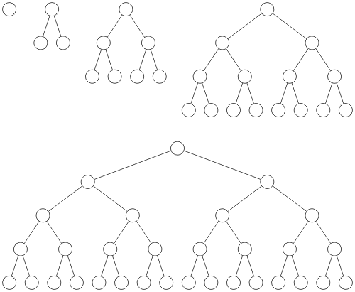
Examples
5.2.1
Perfect binary trees of height h = 0, 1, 2, 3 and 4

Slide 6
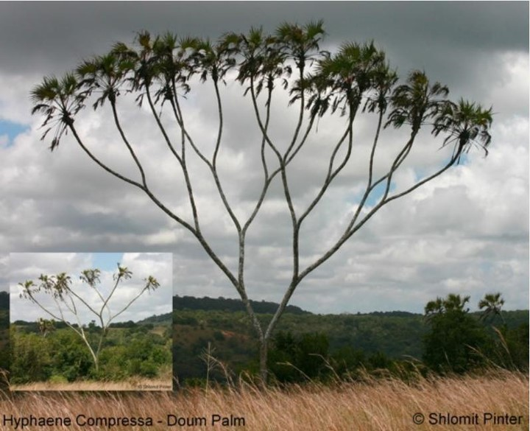
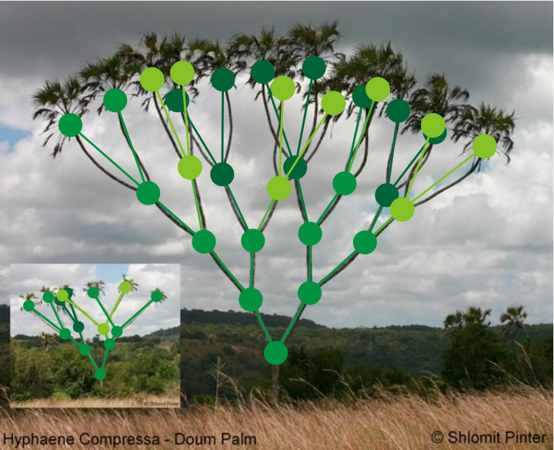
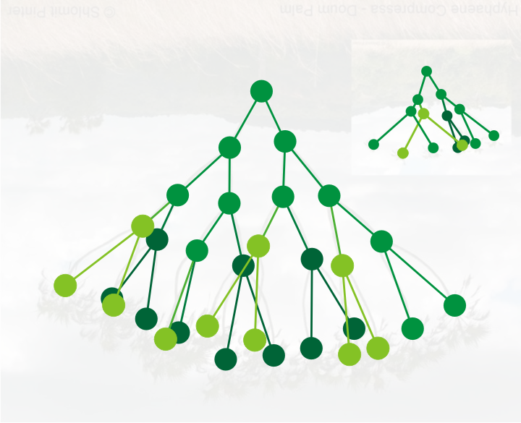
Examples
Perfect binary trees of height h = 3 and h = 4
Note they’re the wrong-way up…

Slide 7
Theorems
5.2.2
We will now look at four theorems that describe the properties of perfect binary trees:
A perfect tree has 2^{h + 1} – 1
The height is Θ(ln(n))
There are 2^{h} leaf nodes
The average depth of a node is Θ(ln(n))
The results of these theorems will allow us to determine the optimal run-time properties of operations on binary trees

Slide 8
2^{h + 1} – 1 Nodes
5.2.2.1
Theorem
A perfect binary tree of height h has 2^{h + 1} – 1 nodes
Proof:
We will use mathematical induction:
Show that it is true for h = 0
Assume it is true for an arbitrary h
Show that the truth for h implies the truth for h + 1

Slide 9
2^{h + 1} – 1 Nodes
5.2.2.1
The base case:
When h = 0 we have a single node n = 1
The formula is correct: 2⁰ ⁺ ¹ – 1 = 1

Slide 10
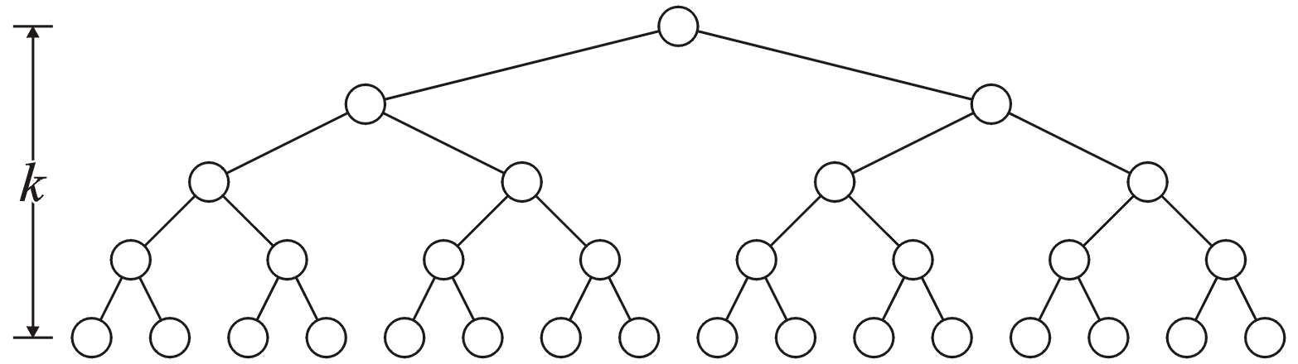
2^{h + 1} – 1 Nodes
5.2.2.1
The inductive step:
If the height of the tree is h, then assume that the number of nodes is n = 2^{h + 1} – 1
h

Slide 11
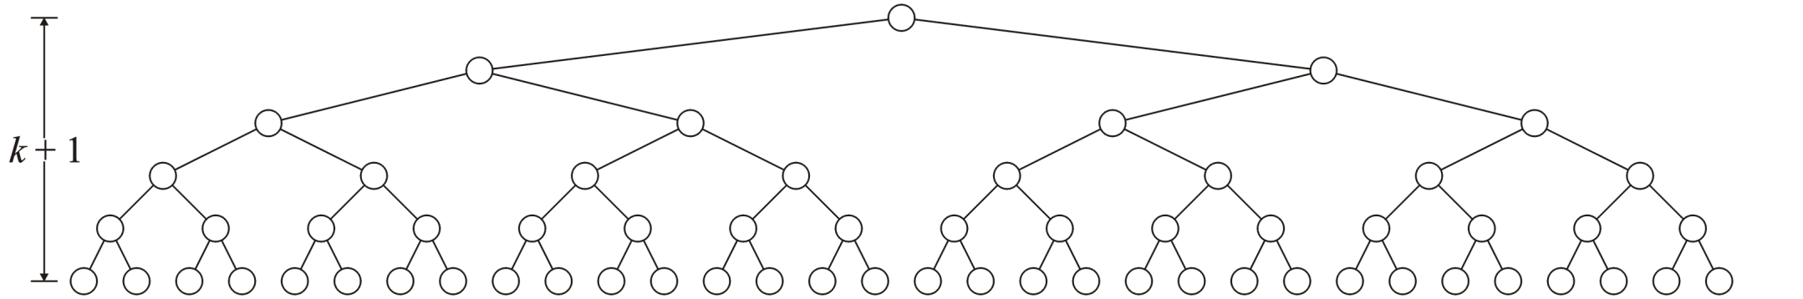
2^{h + 1} – 1 Nodes
5.2.2.1
We must show that a tree of height h + 1 has n = 2^{(h + 1) + 1} – 1 = 2^{h + 2} – 1 nodes
h + 1

Slide 12
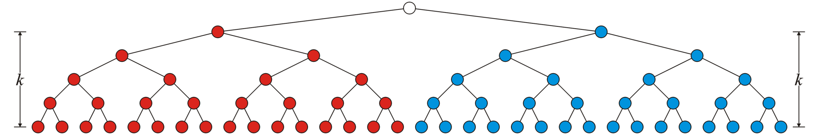
2^{h + 1} – 1 Nodes
5.2.2.1
Using the recursive definition, both sub-trees are perfect trees of height h
By assumption, each sub-tree has 2^{h + 1} – 1 nodes
Therefore the total number of nodes is
(2^{h + 1} – 1) + 1 + (2^{h + 1} – 1) = 2^{h + 2} – 1
h
h

Slide 13
2^{h + 1} – 1 Nodes
5.2.2.1
Consequently
The statement is true for h = 0 and the truth of the statement for an
arbitrary h implies the truth of the statement for h + 1.
Therefore, by the process of mathematical induction, the statement
is true for all h ≥ 0

Slide 14
Logarithmic Height
5.2.2.2
Theorem
A perfect binary tree with n nodes has height lg(n + 1) – 1
Proof
Solving n = 2^{h + 1} – 1 for h:
n + 1 = 2^{h + 1}
lg(n + 1) = h + 1
h = lg(n + 1) – 1

Slide 15
Logarithmic Height
5.2.2.2
Lemma
lg(n + 1) – 1 = Θ(ln(n))
Proof

Slide 16
2^{h} Leaf Nodes
5.2.2.3
Theorem
A perfect binary tree with height h has 2^{h} leaf nodes
Proof (by induction):
When h = 0, there is 2⁰ = 1 leaf node.
Assume that a perfect binary tree of height h has 2^{h} leaf nodes and observe that both sub-trees of a perfect binary tree of height h + 1 have 2^{h} leaf nodes.
Consequence: Over half all nodes are leaf nodes:

Slide 17
The Average Depth of a Node
5.2.2.4
Consequence:
50-50 chance that a randomly selected node is a leaf node
The average depth of a node in a perfect binary tree is
Depth
Count
0
1
1
2
2
4
3
8
4
16
5
32
Sum of the
depths
Number of nodes

Slide 18
Applications
5.2.3
Perfect binary trees are considered to be the ideal case
The height and average depth are both Θ(ln(n))
We will attempt to find trees which are as close as possible to perfect binary trees

Slide 19
Summary
We have defined perfect binary trees and discussed:
The number of nodes: n = 2^{h + 1} – 1
The height: lg(n + 1) – 1
The number of leaves: 2^{h}
Half the nodes are leaves
Average depth is Θ(ln(n))
It is an ideal case

Slide 20
Usage Notes
These slides are made publicly available on the web for anyone to use
If you choose to use them, or a part thereof, for a course at another institution, I ask only three things:
that you inform me that you are using the slides,
that you acknowledge my work, and
that you alert me of any mistakes which I made or changes which you make, and allow me the option of incorporating such changes (with an acknowledgment) in my set of slides
Sincerely,
Douglas Wilhelm Harder, MMath
dwharder@alumni.uwaterloo.ca

