Slide 1
ECE 250 Algorithms and Data Structures
Maximum flow
Douglas Wilhelm Harder, M.Math. LEL
Department of Electrical and Computer Engineering
University of Waterloo
Waterloo, Ontario, Canada
ece.uwaterloo.ca
dwharder@gmail.com
© 2006-2013 by Douglas Wilhelm Harder. Some rights reserved.

Slide 2
Outline
This topic will:
  Define the maximum flow problem
  Look at an example
  Describe two algorithms that solve this problem:
    Ford-Fulkerson method
    Edmonds–Karp algorithm

Slide 3
Problem
11.8
Suppose you have a directed graph where
  You have
    A starting or source vertex
    A finishing or sink vertex
  The weight on each directed edge represents the maximum capacity that edge can transport per unit time
Problem:
  What is the maximum capacity at which items can be transported from the source to the sink per unit time?
    The maximum flow through any edge is its capacity
  That is, what is the maximum flow between the source and sink?

Slide 4
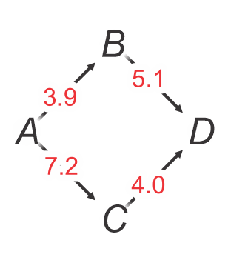
Example
5.1
For example, suppose our source is A and our sink is D:
  The flow from A to B is 3.9
    All of that can continue from B to D
    The bottleneck is the first edge
  The flow from A to C is 7.2
    There is a bottleneck from C to D allowing only 4.0
  Thus, the maximum flow between A and D is 3.9 + 4.0 = 7.9

Slide 5
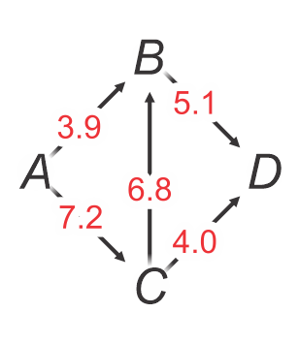
Example
5.1
Suppose we add an edge from C to D with a maximum flow of 6.8:
  Of the 3.2 excess from A to C that cannot pass through D directly
    An additional 1.2 can move along the edge from C to B
    and then continue to D

Slide 6
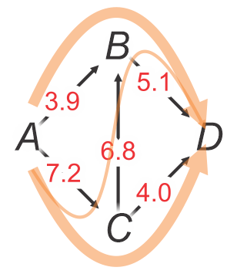
Example
5.1
Suppose we add an edge from C to D with a maximum flow of 6.8:
  Of the 3.2 excess from A to C that cannot pass through D directly
    An additional 1.2 can move along the edge from C to B
    and then continue to D
  Now, the maximum flow from A to D is 3.9 + 4.0 + 1.2 = 9.1
  The bottlenecks are now (B, D) and (C, D),
  as increasing the capacity of either would increase the flow

Slide 7
A sub-optimal solution
5.1.1
Consider the following sub-optimal solution:
  Make a copy of the original flow network
  While there is a simple path from the source to the sink in the copy with all positive weights
    Find the minimum weight and subtract it from all the edges in the copy
  The difference between the original flow network and the copy represents the flow along each edge
    The maximum flow can be calculated by either
      Summing the flows leaving the source, or
      Summing the flows entering the sink
Unfortunately, this does not work…

Slide 8
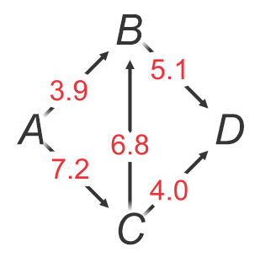
A sub-optimal solution
5.1.1
Let’s go back to our example:

Slide 9
A sub-optimal solution
5.1.1
Let’s go back to our example:
  Suppose our firth path is A-C-B-D

Slide 10
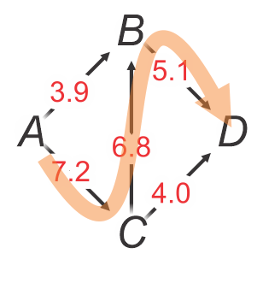
A sub-optimal solution
5.1.1
Let’s go back to our example:
  Suppose our firth path is A-C-B-D
  The bottleneck is 5.1
    Subtract 5.1 from each of the edges in this path
5.1

Slide 11
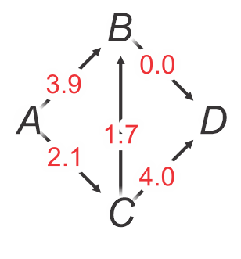
A sub-optimal solution
5.1.1
Let’s go back to our example:
  Thus, we have only one more path: A-C-D
5.1

Slide 12
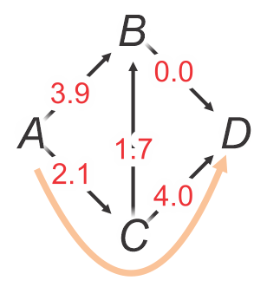
A sub-optimal solution
5.1.1
Let’s go back to our example:
  Thus, we have only one more path: A-C-D
  The bottleneck is 2.1
    Subtract 2.1 from each of the edges in this path
5.1 + 2.1

Slide 13
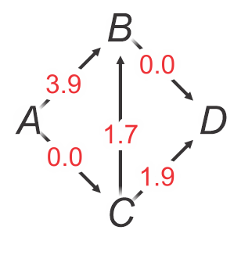
A sub-optimal solution
5.1.1
Let’s go back to our example:
  There are no more viable paths
5.1 + 2.1

Slide 14
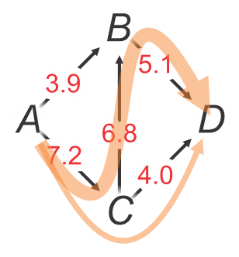
A sub-optimal solution
5.1.1
Let’s go back to our example:
  There are no more viable paths
  The maximum flow found is 7.2
5.1 + 2.1 = 7.2

Slide 15
A sub-optimal solution
5.1.1
Let’s go back to our example:
  There are no more viable paths
  The maximum flow found is 7.2
  This is less than the optimal flow we found visually: 9.1

Slide 16
A sub-optimal solution
5.1.1
To get from the current state to the optimal state:
  We must reduce the flow through C-B
  This allows us to both
    Increase the flow through C-D
    Allow flow from A-B to
    continue through B-D

Slide 17
Ford-Fulkerson method
5.1.1
Ford and Fulkerson proposed a method or approach to find
the maximum flow algorithmically
  Create a new complete directed graph:
    This residual graph is a copy of the original graph with all other edges zero
  Now iterate:
    Find a simple source-to-sink path in the residual graph
    with all non-zero weighted edges
      Let c be the minimum weight along this path
    In the residual graph,
    subtract c to each edge in the direction of the path
    add c to each edge in the opposite direction of the path
  The flow along each edge contributing to the maximum flow can be found by subtracting the corresponding weight of the residue graph from any edge in the original graph
    Any edges with a negative difference are set to zero
  The sum of the edges leading out of the source or entering the sink also equals the flow

Slide 18
Problems
5.1.1
There are issues with the Ford-Fulkerson method as stated:
  The algorithm for finding the next path is not described
    A poor choice of the next path can lead to sub-optimal results
  If all the edges are integers,
  the run-time can still be exceptionally slow
    If f is the maximum flow, the run time is O(|E| f )
  If the edges are real numbers,
  the algorithm may never terminate, and
  if it doesn’t terminate,
  it may not even be converging to an optimal solution
  If you are interested, you can view Uri Zwick’s pathological case here:
    https://jeffe.cs.illinois.edu/teaching/algorithms/book/10-maxflow.pdf

Slide 19
Edmonds-Karp/Dinitz algorithm
5.1.1
Edmonds, Karp and Dinitz proposed an approach to find
the maximum flow algorithmically
  Edmonds and Karp showed always using
  a simple source-to-sink path with a
    non-zero minimum weight, and
    minimum path length
  guarantees a polynomial run time even with real weights
    The run time is O(|E|²|V|)
  Such a shortest path may be found with a breadth-first traversal
    Place the source node and continue until the sink is put into the queue
  Dinitz’s algorithm provides additional optimizations
    The run time is O(|E||V|²)
    Called “Dinic’s” algorithm due to a typo…
    He solved this problem as an exercise given in an algorithms course taught by Adelson-Velsky who, together with Landis, defined AVL trees

Slide 20
Breadth-first traversals
5.1.1
For a tree, a breadth-first traversal proceeds as follows:
  Starting with an empty queue, enqueue the root node
  While the queue is non-empty,
    dequeue the node at the front of the queue, and
    enqueue all of its children at the back of the queue
  The run-time is linear in the number of nodes
For a graph, a breadth-first traversal proceeds as follows:
  Starting with an empty queue, enqueue the source vertex
  While the queue is non-empty,
    dequeue the vertex at the front of the queue, and
    enqueue all of its neighboring vertices that have not previously been enqueued at the back the queue
  The run-time is linear in the number of vertices and the number of edges:
  O(|V| + |E|)

Slide 21
Breadth-first traversals
5.1.1
We will use a breadth-first traversal to find the shortest path from
an initial given vertex to every other vertex connected to it
Given a graph with |V| vertices, this requires:
  A queue with a maximum possible capacity of |V| – 1
  A Boolean-valued array with |V| with all entries set to false
  A predecessor array that will store an identifier of the vertex preceding it in the path from the first vertex
    We initialize each entry by having the vertex reference itself
    We will walk back to the initial given vertex
    At the end, if a vertex still references itself,
    it is not connected to the initial given vertex
  As we only require the shortest path between the source and the sink,
  if such a path even exits,
  there are a number of optimizations we can make. ☺

Slide 22
Breadth-first traversals
5.1.1
// Assume that the vertices are numbered 0, ..., N - 1
std::vector<std::size_t> find_path(
Graph const &graph,
std::size_t const source,
std::size_t const sink
) {
std::size_t const N{ graph.vertex_size() };
// A path has not been found to vertex 'k' and that vertex has not
// been enqueued if the predecessor of that vertex is 'N'
std::vector<std::size_t> predecessor( N, N );
std::queue<std::size_t> traversal;
// The source is the start of the path,
// so this is marked by having itself be its own predecessor
traversal.push( source );
predecessor[source] = source;

Slide 23
Breadth-first traversals
5.1.1
while( !traversal.empty() ) {
std::size_t current{ traversal.front() };
traversal.pop();
// If we can iterate through the neighbors, this can be faster
for ( std::size_t k{ 0 }; k < N; ++k ) {
if ( (predecessor[k] == N)
&& (graph.edge_weight( current, k ) > 0.0) ) {
predecessor[k] = current;
if ( k == sink ) {
return predecessor;
}
traversal.push( k );
}
}
}
assert( predecessor[sink] == N ); // No path exists
return predecessor;
}

Slide 24
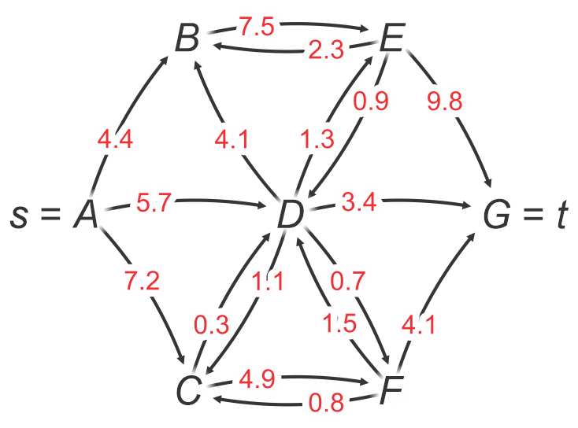
Edmonds-Karp/Dinitz example
We will perform the Edmond-Karp algorithm on this graph
  Note the in-degree of A and out-degree of G are both zero
  This is not required,
  but such edges cannot contribute to the maximum flow
  The algorithm works with or without such edges

Slide 25
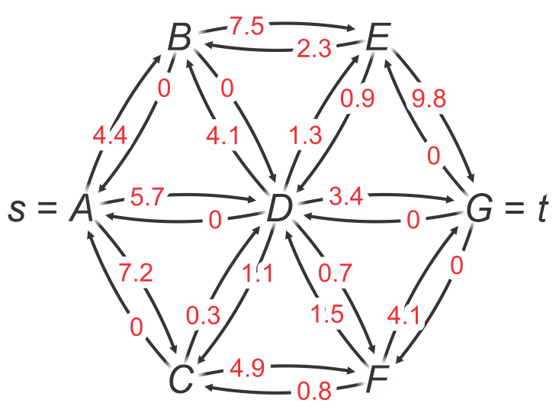
Edmonds-Karp/Dinitz example
First create the corresponding complete residual graph
  All non-existent edges are given weight zero

Slide 26
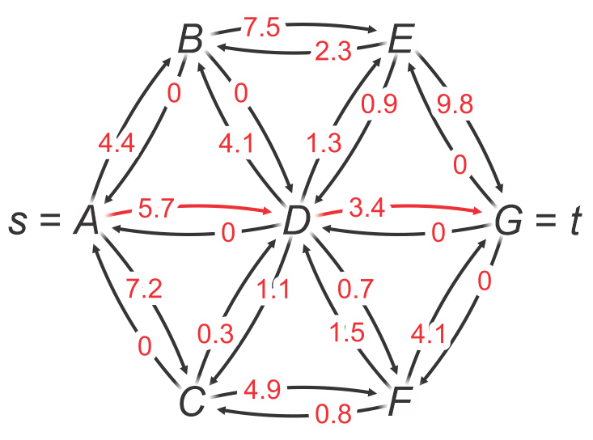
Edmonds-Karp/Dinitz example
Perform a breadth-first search
  The shortest path is A-D-G
  The bottleneck is 3.4
A | B | C | D | E | F | G
A | A | A | A | B | C | G

Slide 27
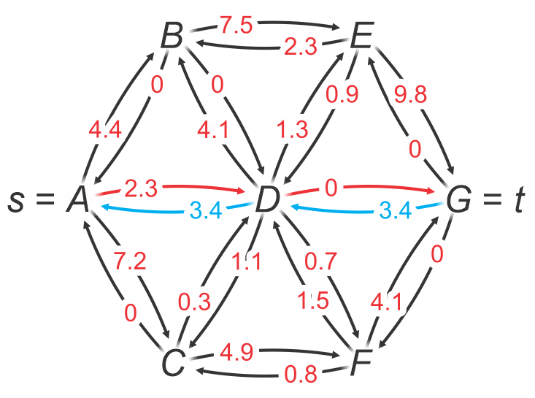
Edmonds-Karp/Dinitz example
Update the graph:
  3.4 is subtracted from each edge in the path
  3.4 is added to each edge in the opposite direction

Slide 28
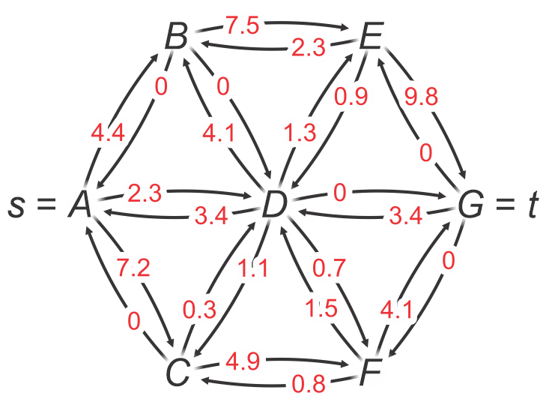
Edmonds-Karp/Dinitz example
Our residual graph is now as follows:

Slide 29
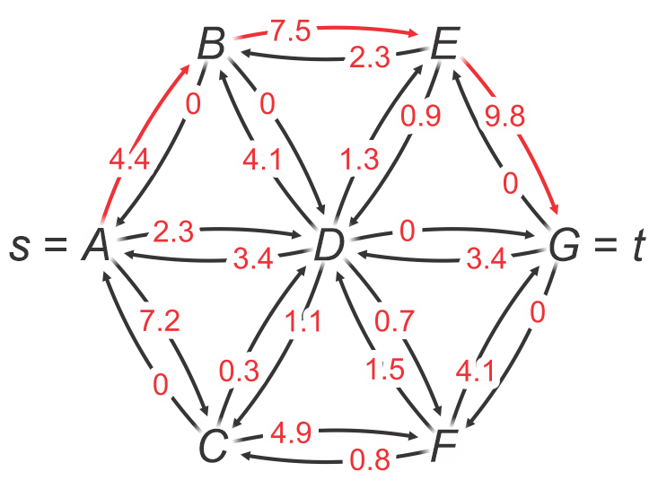
Edmonds-Karp/Dinitz example
Perform a breadth-first search
  The shortest path is A-B-E-G
  The bottleneck is 4.4
A | B | C | D | E | F | G
A | A | A | A | B | C | E

Slide 30
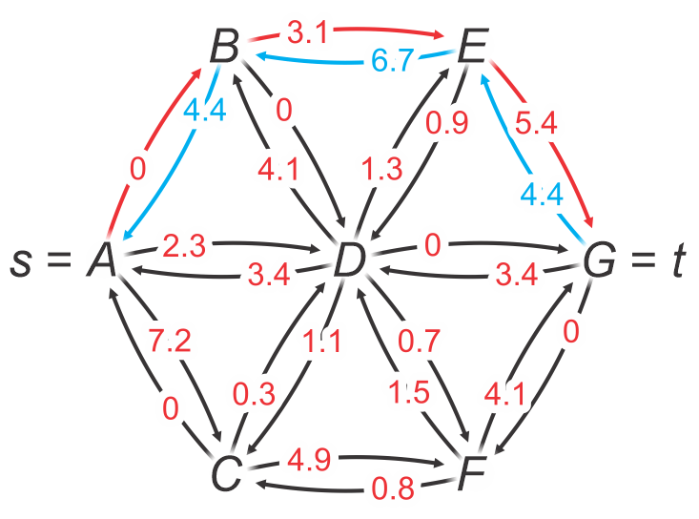
Edmonds-Karp/Dinitz example
Update the graph:
  4.4 is subtracted from each edge in the path
  4.4 is added to each edge in the opposite direction

Slide 31
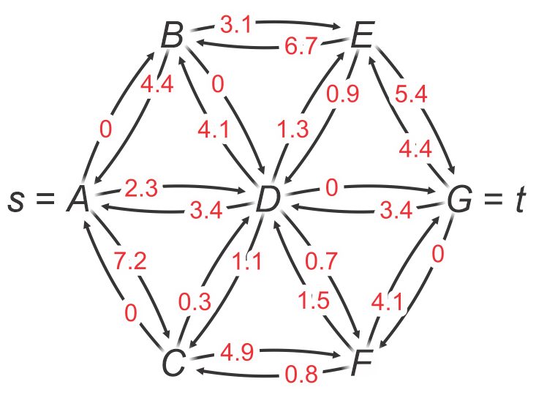
Edmonds-Karp/Dinitz example
Our residual graph is now as follows:

Slide 32
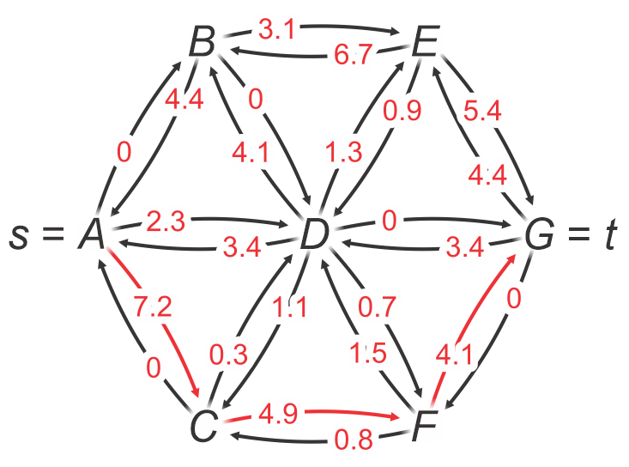
Edmonds-Karp/Dinitz example
Perform a breadth-first search
  The shortest path is A-C-F-G
  The bottleneck is 4.1
A | B | C | D | E | F | G
A | D | A | A | D | C | F

Slide 33
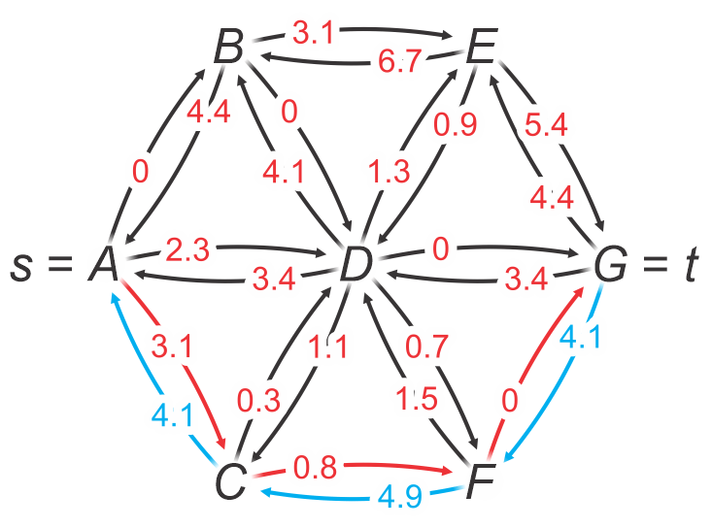
Edmonds-Karp/Dinitz example
Update the graph:
  4.1 is subtracted from each edge in the path
  4.1 is added to each edge in the opposite direction

Slide 34
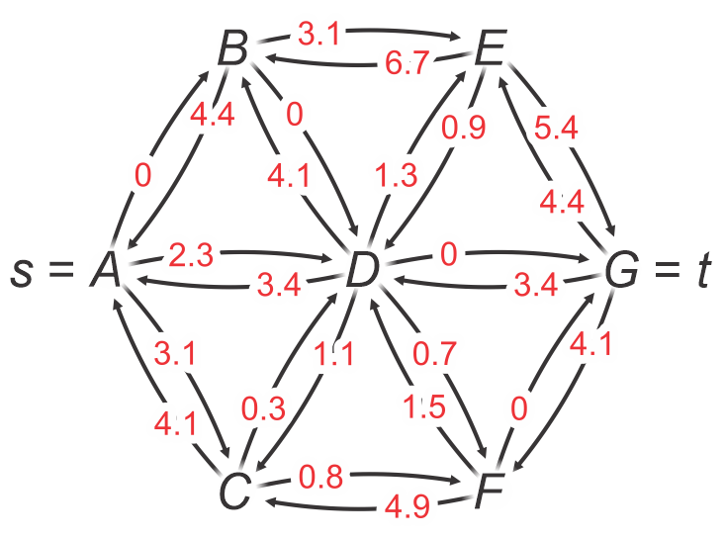
Edmonds-Karp/Dinitz example
Our residual graph is now as follows:

Slide 35
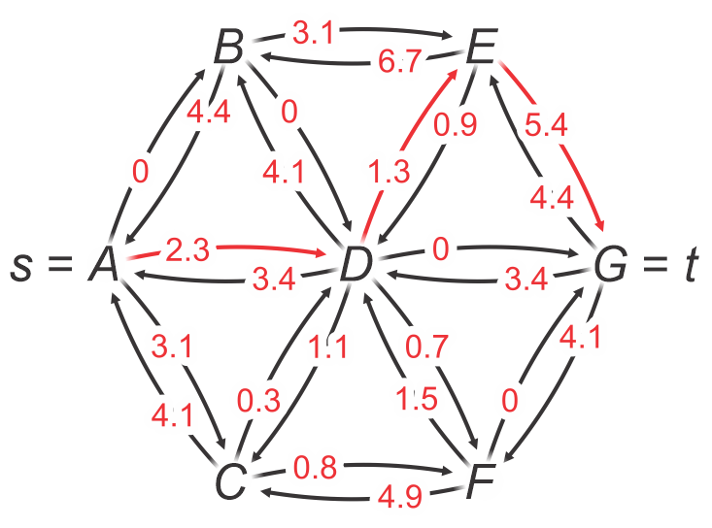
Edmonds-Karp/Dinitz example
Perform a breadth-first search
  The shortest path is A-D-E-G
  The bottleneck is 1.3
A | B | C | D | E | F | G
A | D | A | A | D | C | E

Slide 36
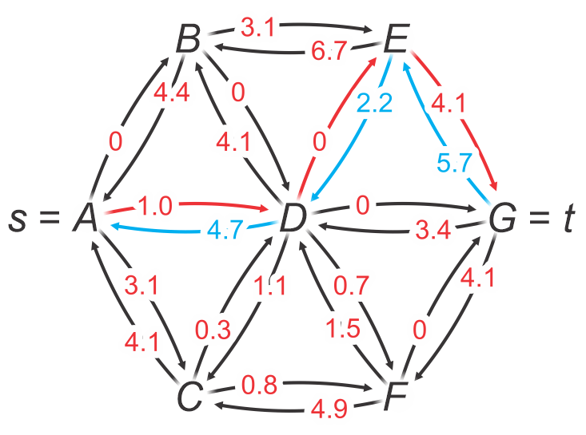
Edmonds-Karp/Dinitz example
Update the graph:
  1.3 is subtracted from each edge in the path
  1.3 is added to each edge in the opposite direction

Slide 37
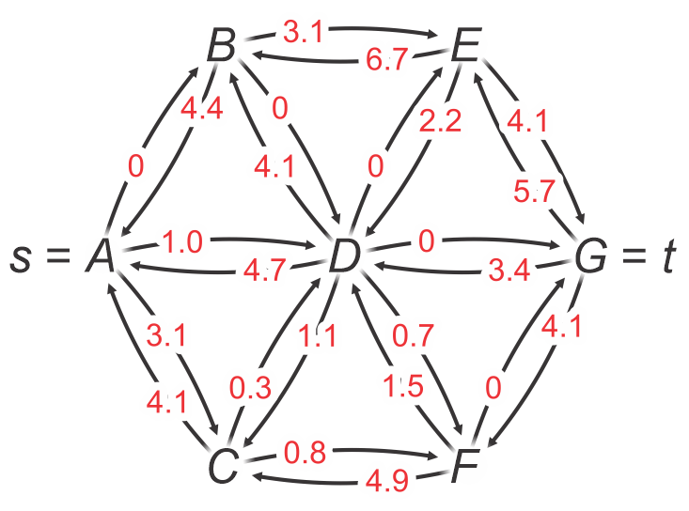
Edmonds-Karp/Dinitz example
Our residual graph is now as follows:

Slide 38
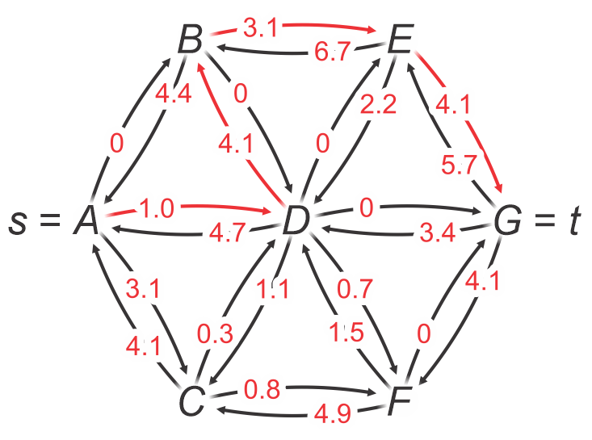
Edmonds-Karp/Dinitz example
Perform a breadth-first search
  The shortest path is A-D-B-E-G
  The bottleneck is 1.0
A | B | C | D | E | F | G
A | D | A | A | B | C | E

Slide 39
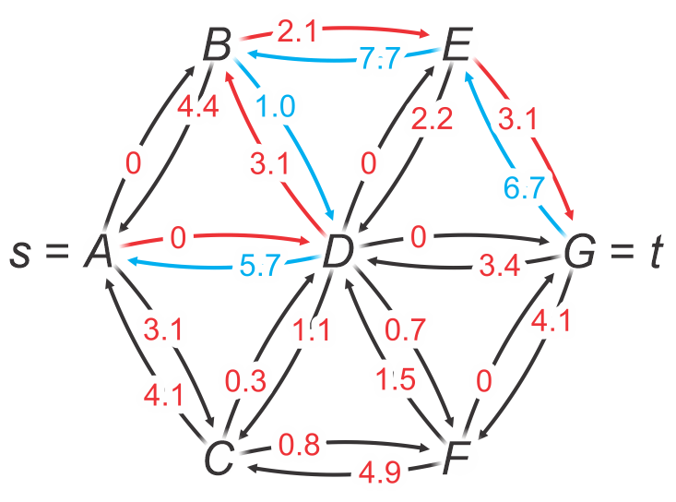
Edmonds-Karp/Dinitz example
Update the graph:
  1.0 is subtracted from each edge in the path
  1.0 is added to each edge in the opposite direction

Slide 40
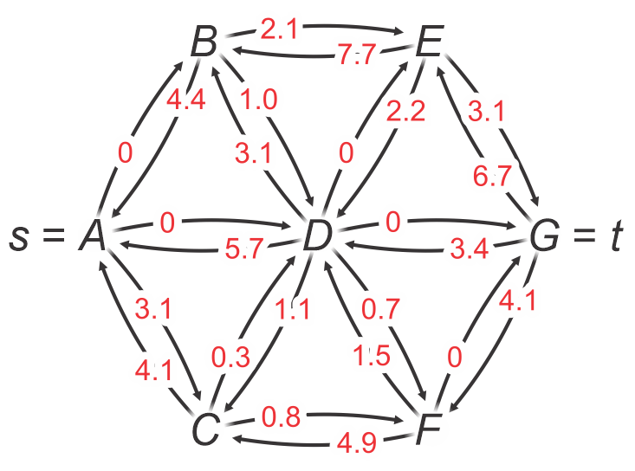
Edmonds-Karp/Dinitz example
Our residual graph is now as follows:

Slide 41
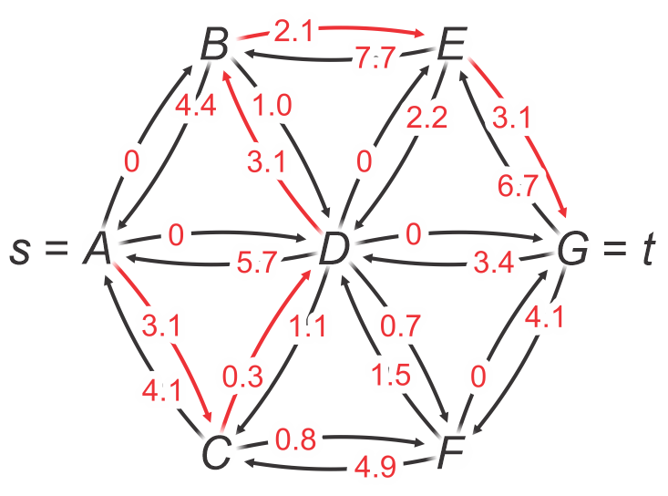
Edmonds-Karp/Dinitz example
Perform a breadth-first search
  The shortest path is A-C-D-B-E-G
  The bottleneck is 1.1
A | B | C | D | E | F | G
A | D | A | C | B | C | E

Slide 42
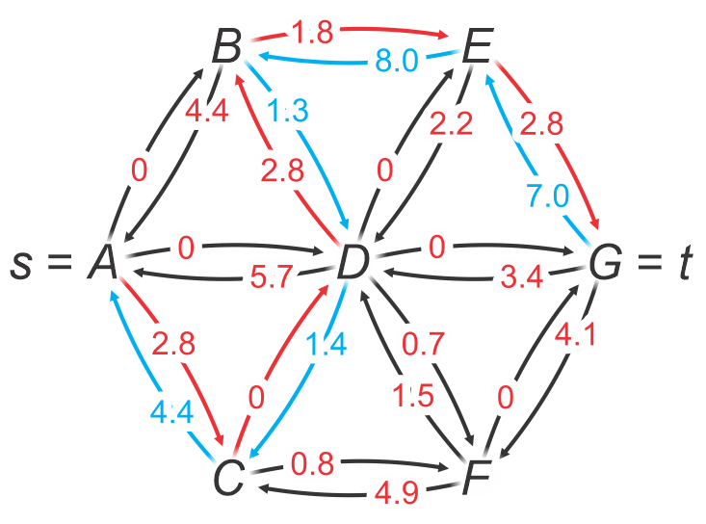
Edmonds-Karp/Dinitz example
Update the graph:
  1.1 is subtracted from each edge in the path
  1.1 is added to each edge in the opposite direction

Slide 43
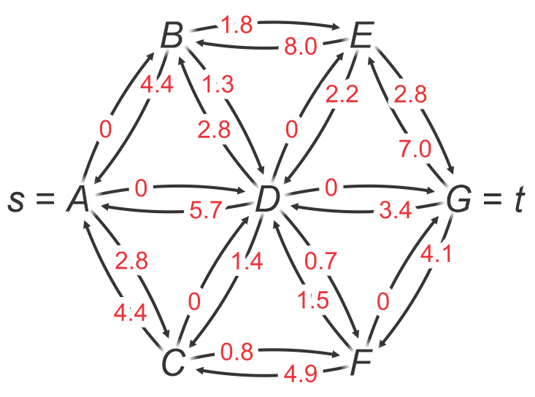
Edmonds-Karp/Dinitz example
Our residual graph is now as follows:

Slide 44
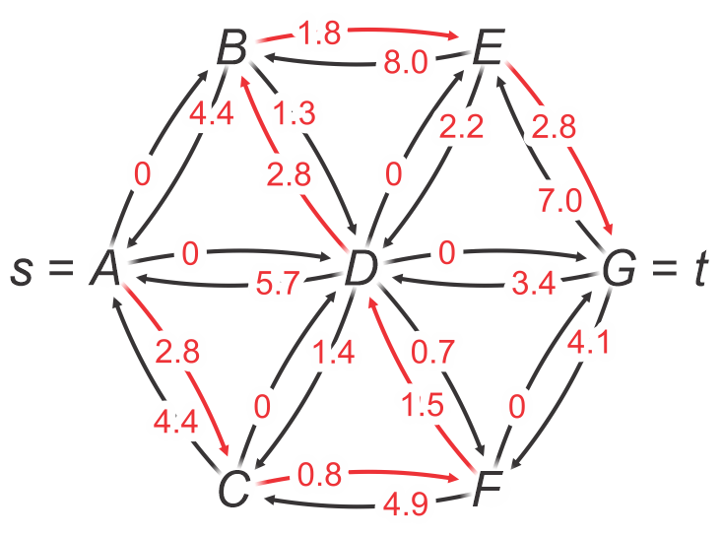
Edmonds-Karp/Dinitz example
Perform a breadth-first search
  The shortest path is A-C-F-D-B-E-G
  The bottleneck is 0.8
A | B | C | D | E | F | G
A | D | A | F | B | C | E

Slide 45
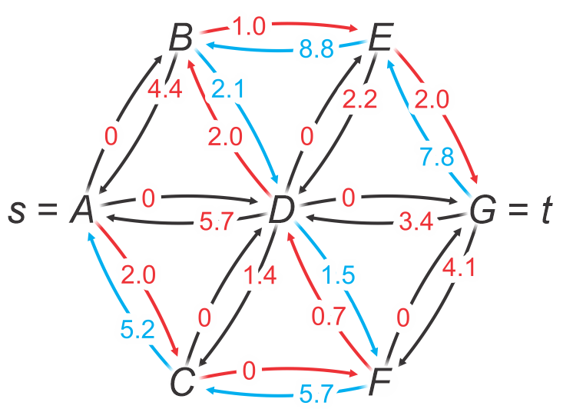
Edmonds-Karp/Dinitz example
Update the graph:
  0.8 is subtracted from each edge in the path
  0.8 is added to each edge in the opposite direction

Slide 46
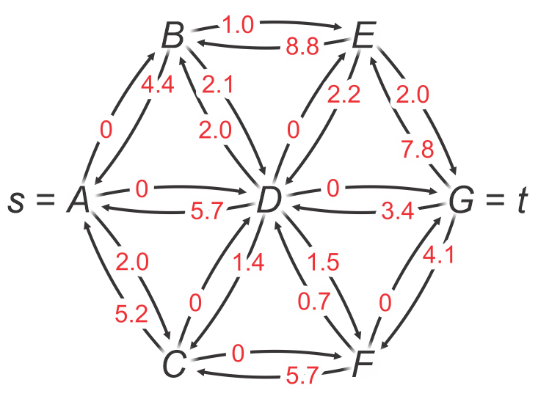
Edmonds-Karp/Dinitz example
Our residual graph is now as follows:

Slide 47
Edmonds-Karp/Dinitz example
Performing a breadth-first traversal finds no shortest path to G
  After getting from A to C, all other out-going edges have weight 0
A | B | C | D | E | F | G
A | B | A | D | E | F | G

Slide 48
Edmonds-Karp/Dinitz example
Thus, we are left with this as the final residual graph

Slide 49
Edmonds-Karp/Dinitz example
For each edge in the original graph,
subtract off the corresponding residual weight
  If the result is negative, set it to zero
1.3 – 0 = 1.3
7.5 – 1.0 = 6.5
0.9 – 2.2 ≤ 0
2.3 – 8.8 ≤ 0
7.2 – 1.0
= 5.2
0.7 – 1.5 ≤ 0
1.5 – 0.7 = 0.8

Slide 50
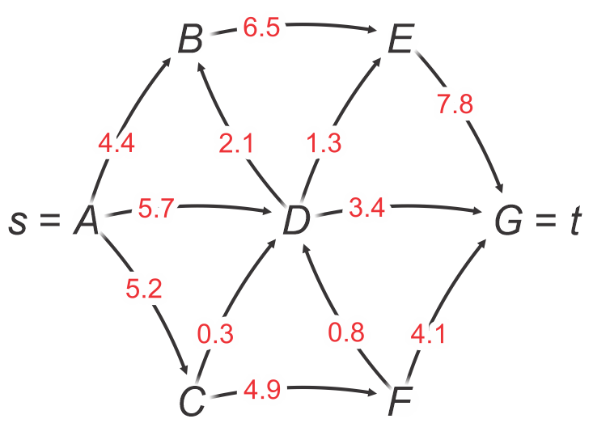
Edmonds-Karp/Dinitz example
5.1.1
Here is the resulting flow graph
  The maximum flow is
  4.4 + 5.2 + 5.7 = 15.3 = 3.4 + 7.8 + 4.1

Slide 51
Comments
In other implementations, there are some issues:
  Some claim the in-degree of the source and the out-degree of the sink must both be zero
  This is false, the algorithm will still find the maximum flow
  Some claim that one must also create a maximum flow graph
  This is unnecessarily expensive in run time and memory; rather than always updating this maximum flow graph, the maximum flow graph can be found at the end by simply taking the difference in the weights of the edges in the original graph and the final residual graph
  Some keep track of the maximum flow
  It is easier—and less work—to calculate at the maximum flow by summing the flows along those edges emanating from the source
Notes:
51

Slide 52
Summary
This topic, we:
  Introduced the idea of maximum flow
  Considered a naïve sub-optimal algorithm
  Described the approach by Ford and Fulkerson
    Discussed issues with this algorithm
  Described the improvements made by Edmonds, Karp and Dinitz
  Looked at an example
Notes:
52

Slide 53
References
Cormen, Leiserson, Rivest and Stein,
Introduction to Algorithms, The MIT Press, 2001, §25.2, pp.629-35.
Mark A. Weiss,
Data Structures and Algorithm Analysis in C++, 3rd Ed., Addison Wesley, 2006, Ch.?, p.?.
Joh Kleinberg and Eva Tardos,
Algorithm Design, Pearson, 2006.
Elliot B. Koffman and Paul A.T. Wolfgang,
Objects, Abstractions, Data Structures and Design using C++, Wiley, 2006.
These slides are provided for the ECE 250 Algorithms and Data Structures course. The material in it reflects Douglas W. Harder’s best judgment in light of the information available to him at the time of preparation. Any reliance on these course slides by any party for any other purpose are the responsibility of such parties. Douglas W. Harder accepts no responsibility for damages, if any, suffered by any party as a result of decisions made or actions based on these course slides for any other purpose than that for which it was intended.

