Slide 1
ECE 250 Algorithms and Data Structures
Dijkstra’s algorithm
Douglas Wilhelm Harder, M.Math. LEL
Department of Electrical and Computer Engineering
University of Waterloo
Waterloo, Ontario, Canada
ece.uwaterloo.ca
dwharder@alumni.uwaterloo.ca
© 2006-2013 by Douglas Wilhelm Harder. Some rights reserved.

Slide 2
Outline
This topic will:
  Describe Dijkstra’s algorithm for finding a shortest path from a single source vertex
  s

Slide 3
Dijkstra’s algorithm
Dijkstra’s algorithm solves the single-source shortest path problem
  It is very similar to Prim’s algorithm
  Assumption: all the weights are positive

Slide 4
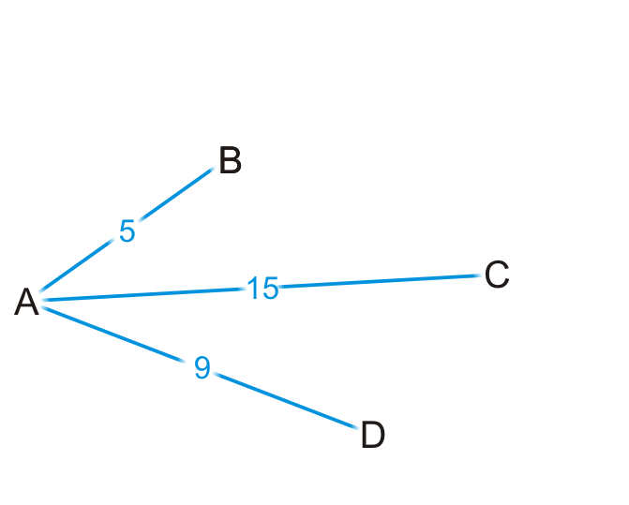
Strategy
Suppose you are at vertex A
  You are aware of all vertices adjacent to it
  This information is either in an adjacency list or adjacency matrix

Slide 5
Strategy
Is 5 the shortest distance to B via the edge (A, B)?
  Why or why not?

Slide 6
Strategy
Are you guaranteed that the shortest path to C is (A, C), or
that (A, D) is the shortest path to vertex D?

Slide 7
Strategy
We accept that (A, B) is the shortest path to vertex B from A
  Let’s see where we can go from B

Slide 8
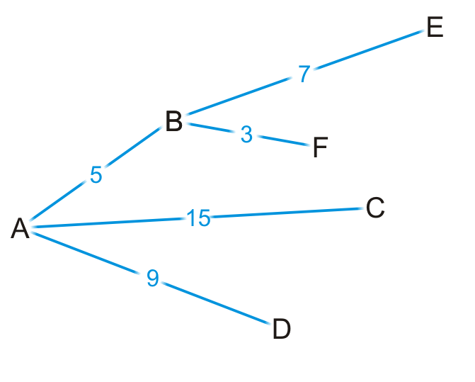
Strategy
By some simple arithmetic, we can determine that
  There is a path (A, B, E) of length 5 + 7 = 12
  There is a path (A, B, F) of length 5 + 3 = 8

Slide 9
Strategy
Is (A, B, F) is the shortest path from vertex A to F?
  Why or why not?

Slide 10
Strategy
Are we guaranteed that any other path we are currently aware of is also going to be the shortest path?

Slide 11
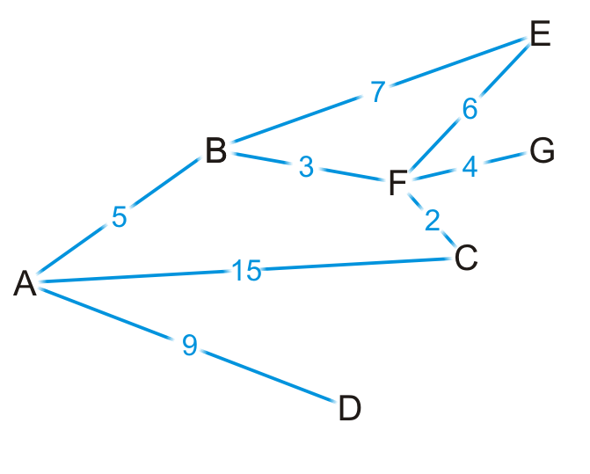
Strategy
Okay, let’s visit vertex F
  We know the shortest path is (A, B, F) and it’s of length 8

Slide 12
Strategy
There are three edges exiting vertex F, so we have paths:
  (A, B, F, E) of length 8 + 6 = 14
  (A, B, F, G) of length 8 + 4 = 12
  (A, B, F, C) of length 8 + 2 = 10

Slide 13
Strategy
By observation:
  The path (A, B, F, E) is longer than (A, B, E)
  The path (A, B, F, C) is shorter than the path (A, C)

Slide 14
Strategy
At this point, we’ve discovered the shortest paths to:
  Vertex B: (A, B) of length 5
  Vertex F: (A, B, F) of length 8

Slide 15
Strategy
At this point, we have the shortest distances to B and F
  Which remaining vertex are we currently guaranteed to have the shortest distance to?

Slide 16
Dijkstra’s algorithm
Like Prim’s algorithm, we initially don’t know the distance to any vertex except the initial vertex
  We require an array of distances, all initialized to infinity except for the source vertex, which is initialized to 0
  Each time we visit a vertex, we will examine all adjacent vertices
    We need to track visited vertices—a Boolean table of size |V|
  Do we need to track the shortest path to each vertex?
    That is, do I have to store (A, B, F) as the shortest path to vertex F?
  We really only have to record that the shortest path
  to vertex F came from vertex B
    We would then determine that the shortest
    path to vertex B came from vertex A
    Thus, we need an array of previous vertices,
    all initialized to null

Slide 17
Dijkstra’s algorithm
Thus, we will iterate |V| times:
  Find that unvisited vertex v that has a minimum distance to it
  Mark it as having been visited
  Consider every adjacent vertex w that is unvisited:
    Is the distance to v plus the weight of the edge (v, w) less than our currently known shortest distance to w
    If so, update the shortest distance to w and record v as the previous pointer
  Continue iterating until all vertices are visited or all remaining vertices have a distance to them of infinity

Slide 18
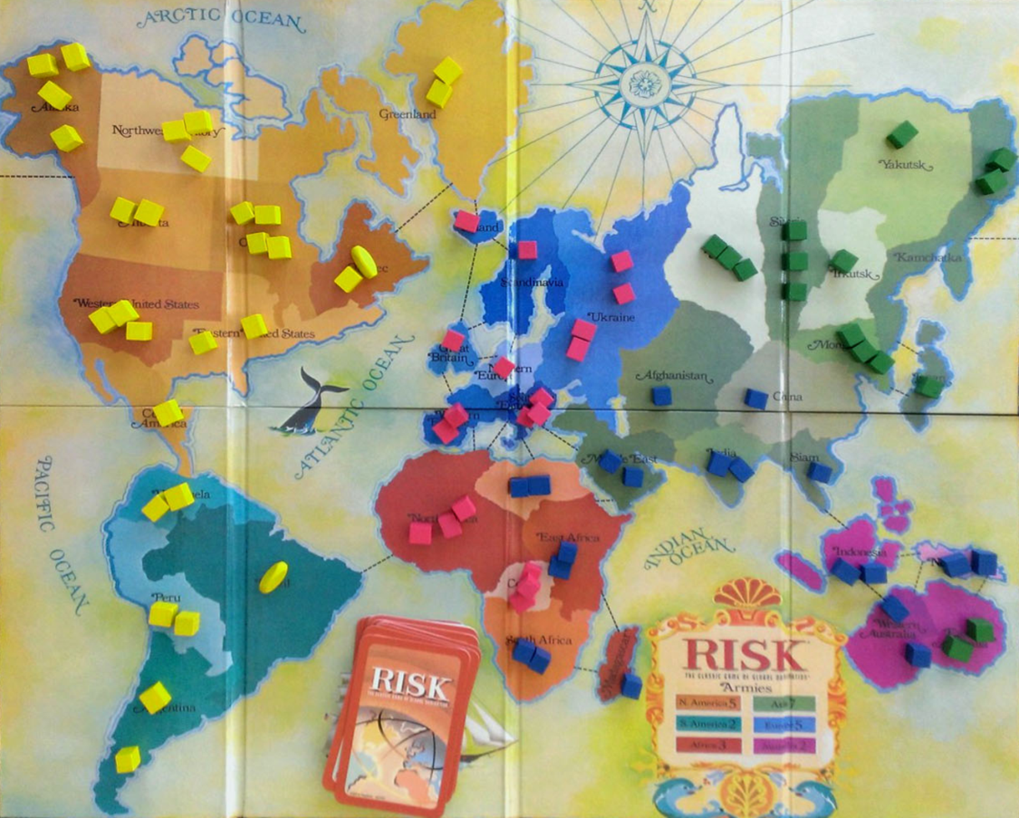
Example
Consider the game of Risk from Parker Brothers
  A game of world domination
  The world is divided into 42 connected regions
http://thunderbird37.com/tag/parker-brothers/

Slide 19
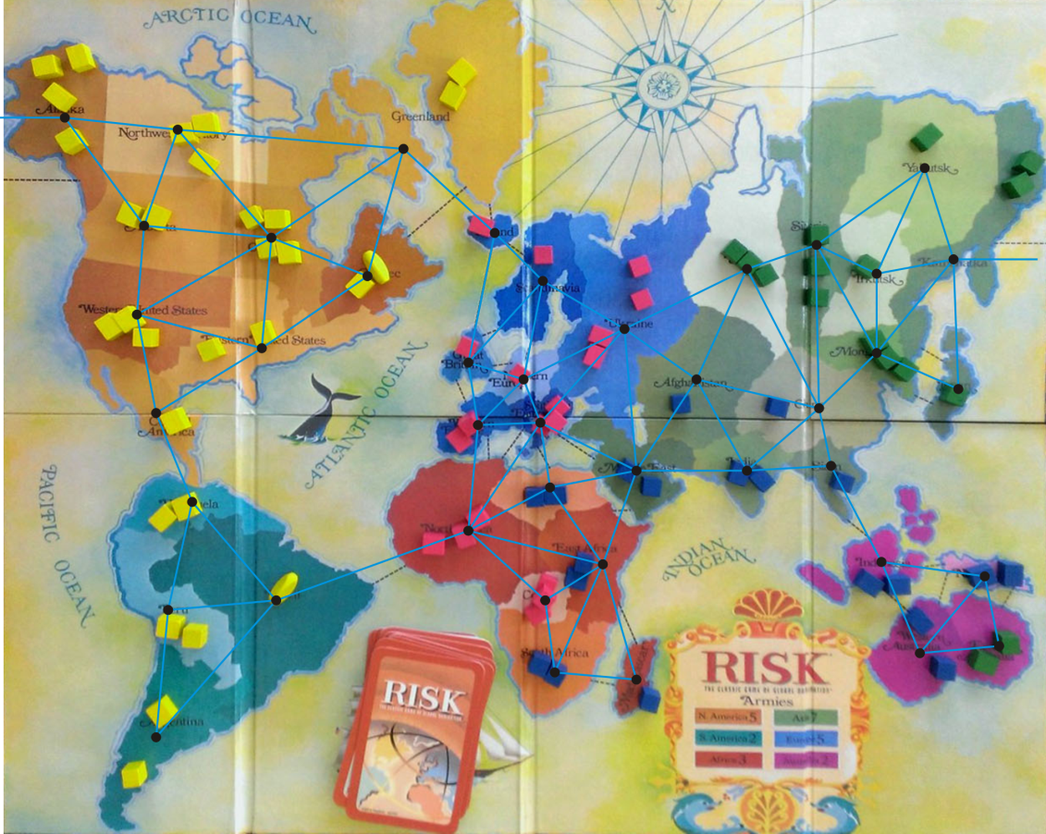
Example
Consider the game of Risk from Parker Brothers
  A game of world domination
  The world is divided into 42 connected regions
  The regions are vertices and edges indicate adjacent regions
http://thunderbird37.com/tag/parker-brothers/

Slide 20
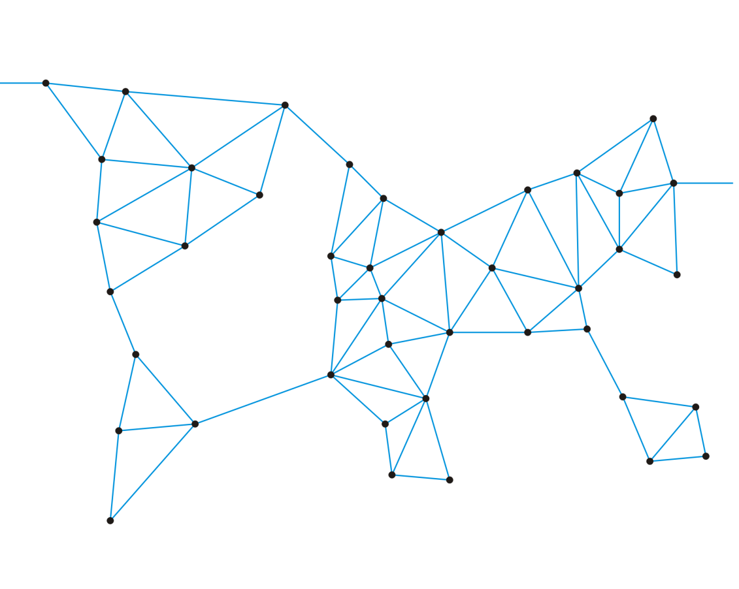
Example
Consider the game of Risk from Parker Brothers
  A game of world domination
  The world is divided into 42 connected regions
  The regions are vertices and edges indicate adjacent regions
  The graph is sufficient to describe the game

Slide 21
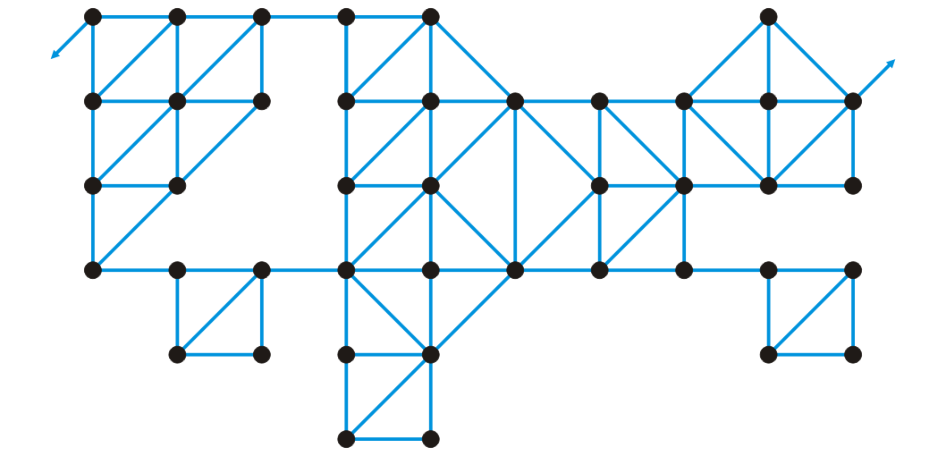
Example
Consider the game of Risk from Parker Brothers
  Here is a more abstract representation of the game board
  Suddenly, it’s less interesting: “I’ve conquered the graph!”

Slide 22
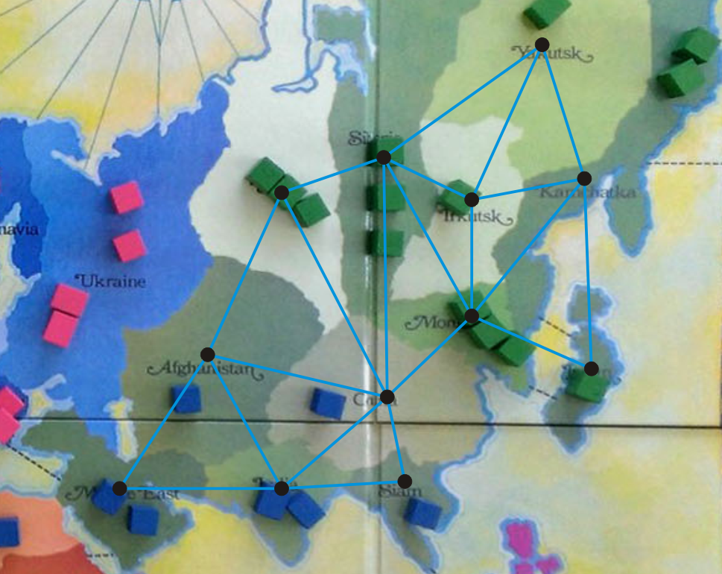
Example
We’ll focus on Asia
http://thunderbird37.com/tag/parker-brothers/

Slide 23
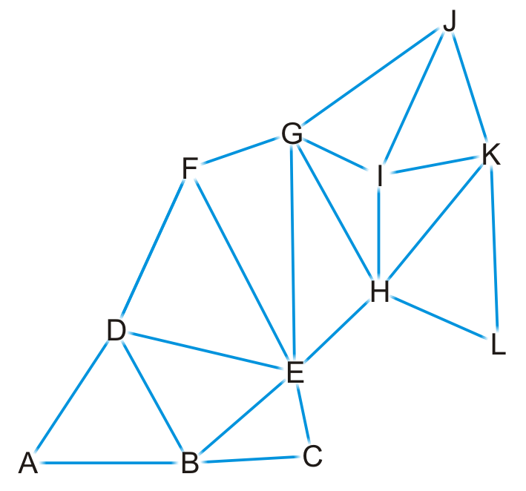
Example
Here is our abstract representation

Slide 24
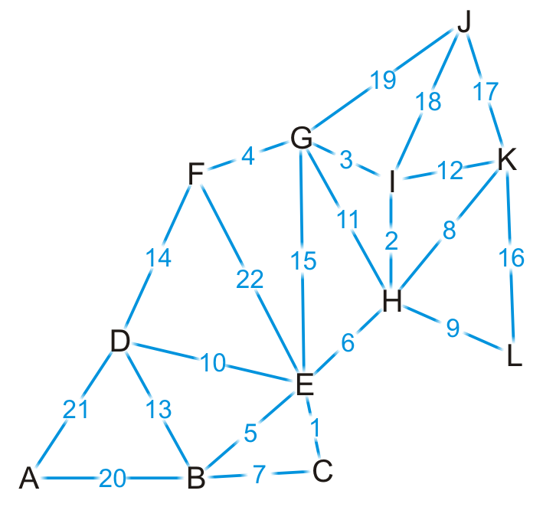
Example
Let us give a weight to each of the edges

Slide 25

Example
Find the shortest distance from Kamchatka (K) to every other region

Slide 26
Example
We set up our table
  Which unvisited vertex has the minimum distance to it?
Vertex | Visited | Distance | Previous
A | F | ∞ | Ø
B | F | ∞ | Ø
C | F | ∞ | Ø
D | F | ∞ | Ø
E | F | ∞ | Ø
F | F | ∞ | Ø
G | F | ∞ | Ø
H | F | ∞ | Ø
I | F | ∞ | Ø
J | F | ∞ | Ø
K | F | 0 | Ø
L | F | ∞ | Ø

Slide 27
Example
We visit vertex K
Vertex | Visited | Distance | Previous
A | F | ∞ | Ø
B | F | ∞ | Ø
C | F | ∞ | Ø
D | F | ∞ | Ø
E | F | ∞ | Ø
F | F | ∞ | Ø
G | F | ∞ | Ø
H | F | ∞ | Ø
I | F | ∞ | Ø
J | F | ∞ | Ø
K | T | 0 | Ø
L | F | ∞ | Ø

Slide 28
Example
Vertex K has four neighbors: H, I, J and L
Vertex | Visited | Distance | Previous
A | F | ∞ | Ø
B | F | ∞ | Ø
C | F | ∞ | Ø
D | F | ∞ | Ø
E | F | ∞ | Ø
F | F | ∞ | Ø
G | F | ∞ | Ø
H | F | ∞ | Ø
I | F | ∞ | Ø
J | F | ∞ | Ø
K | T | 0 | Ø
L | F | ∞ | Ø

Slide 29
Example
We have now found at least one path to each of these vertices
Vertex | Visited | Distance | Previous
A | F | ∞ | Ø
B | F | ∞ | Ø
C | F | ∞ | Ø
D | F | ∞ | Ø
E | F | ∞ | Ø
F | F | ∞ | Ø
G | F | ∞ | Ø
H | F | 8 | K
I | F | 12 | K
J | F | 17 | K
K | T | 0 | Ø
L | F | 16 | K

Slide 30
Example
We’re finished with vertex K
  To which vertex are we now guaranteed we have the shortest path?
Vertex | Visited | Distance | Previous
A | F | ∞ | Ø
B | F | ∞ | Ø
C | F | ∞ | Ø
D | F | ∞ | Ø
E | F | ∞ | Ø
F | F | ∞ | Ø
G | F | ∞ | Ø
H | F | 8 | K
I | F | 12 | K
J | F | 17 | K
K | T | 0 | Ø
L | F | 16 | K

Slide 31
Example
We visit vertex H: the shortest path is (K, H) of length 8
  Vertex H has four unvisited neighbors: E, G, I, L
Vertex | Visited | Distance | Previous
A | F | ∞ | Ø
B | F | ∞ | Ø
C | F | ∞ | Ø
D | F | ∞ | Ø
E | F | ∞ | Ø
F | F | ∞ | Ø
G | F | ∞ | Ø
H | T | 8 | K
I | F | 12 | K
J | F | 17 | K
K | T | 0 | Ø
L | F | 16 | K

Slide 32
Example
Consider these paths:
  (K, H, E) of length 8 + 6 = 14 (K, H, G) of length 8 + 11 = 19
  (K, H, I) of length 8 + 2 = 10 (K, H, L) of length 8 + 9 = 17
  Which of these are
  shorter than any
  known path?
Vertex | Visited | Distance | Previous
A | F | ∞ | Ø
B | F | ∞ | Ø
C | F | ∞ | Ø
D | F | ∞ | Ø
E | F | ∞ | Ø
F | F | ∞ | Ø
G | F | ∞ | Ø
H | T | 8 | K
I | F | 12 | K
J | F | 17 | K
K | T | 0 | Ø
L | F | 16 | K

Slide 33
Example
We already have a shorter path (K, L), but we update the other three
Vertex | Visited | Distance | Previous
A | F | ∞ | Ø
B | F | ∞ | Ø
C | F | ∞ | Ø
D | F | ∞ | Ø
E | F | 14 | H
F | F | ∞ | Ø
G | F | 19 | H
H | T | 8 | K
I | F | 10 | H
J | F | 17 | K
K | T | 0 | Ø
L | F | 16 | K

Slide 34
Example
We are finished with vertex H
  Which vertex do we visit next?
Vertex | Visited | Distance | Previous
A | F | ∞ | Ø
B | F | ∞ | Ø
C | F | ∞ | Ø
D | F | ∞ | Ø
E | F | 14 | H
F | F | ∞ | Ø
G | F | 19 | H
H | T | 8 | K
I | F | 10 | H
J | F | 17 | K
K | T | 0 | Ø
L | F | 16 | K

Slide 35
Example
The path (K, H, I) is the shortest path from K to I of length 10
  Vertex I has two unvisited neighbors: G and J
Vertex | Visited | Distance | Previous
A | F | ∞ | Ø
B | F | ∞ | Ø
C | F | ∞ | Ø
D | F | ∞ | Ø
E | F | 14 | H
F | F | ∞ | Ø
G | F | 19 | H
H | T | 8 | K
I | T | 10 | H
J | F | 17 | K
K | T | 0 | Ø
L | F | 16 | K

Slide 36
Example
Consider these paths:
  (K, H, I, G) of length 10 + 3 = 13 (K, H, I, J) of length 10 + 18 = 28
Vertex | Visited | Distance | Previous
A | F | ∞ | Ø
B | F | ∞ | Ø
C | F | ∞ | Ø
D | F | ∞ | Ø
E | F | 14 | H
F | F | ∞ | Ø
G | F | 19 | H
H | T | 8 | K
I | T | 10 | H
J | F | 17 | K
K | T | 0 | Ø
L | F | 16 | K

Slide 37
Example
We have discovered a shorter path to vertex G, but (K, J) is still the shortest known path to vertex J
Vertex | Visited | Distance | Previous
A | F | ∞ | Ø
B | F | ∞ | Ø
C | F | ∞ | Ø
D | F | ∞ | Ø
E | F | 14 | H
F | F | ∞ | Ø
G | F | 13 | I
H | T | 8 | K
I | T | 10 | H
J | F | 17 | K
K | T | 0 | Ø
L | F | 16 | K

Slide 38
Example
Which vertex can we visit next?
Vertex | Visited | Distance | Previous
A | F | ∞ | Ø
B | F | ∞ | Ø
C | F | ∞ | Ø
D | F | ∞ | Ø
E | F | 14 | H
F | F | ∞ | Ø
G | F | 13 | I
H | T | 8 | K
I | T | 10 | H
J | F | 17 | K
K | T | 0 | Ø
L | F | 16 | K

Slide 39
Example
The path (K, H, I, G) is the shortest path from K to G of length 13
  Vertex G has three unvisited neighbors: E, F and J
Vertex | Visited | Distance | Previous
A | F | ∞ | Ø
B | F | ∞ | Ø
C | F | ∞ | Ø
D | F | ∞ | Ø
E | F | 14 | H
F | F | ∞ | Ø
G | T | 13 | I
H | T | 8 | K
I | T | 10 | H
J | F | 17 | K
K | T | 0 | Ø
L | F | 16 | K

Slide 40
Example
Consider these paths:
  (K, H, I, G, E) of length 13 + 15 = 28 (K, H, I, G, F) of length 13 + 4 = 17
  (K, H, I, G, J) of length 13 + 19 = 32
  Which do we
  update?
Vertex | Visited | Distance | Previous
A | F | ∞ | Ø
B | F | ∞ | Ø
C | F | ∞ | Ø
D | F | ∞ | Ø
E | F | 14 | H
F | F | ∞ | Ø
G | T | 13 | I
H | T | 8 | K
I | T | 10 | H
J | F | 17 | K
K | T | 0 | Ø
L | F | 16 | K

Slide 41
Example
We have now found a path to vertex F
Vertex | Visited | Distance | Previous
A | F | ∞ | Ø
B | F | ∞ | Ø
C | F | ∞ | Ø
D | F | ∞ | Ø
E | F | 14 | H
F | F | 17 | G
G | T | 13 | I
H | T | 8 | K
I | T | 10 | H
J | F | 17 | K
K | T | 0 | Ø
L | F | 16 | K

Slide 42
Example
Where do we visit next?
Vertex | Visited | Distance | Previous
A | F | ∞ | Ø
B | F | ∞ | Ø
C | F | ∞ | Ø
D | F | ∞ | Ø
E | F | 14 | H
F | F | 17 | G
G | T | 13 | I
H | T | 8 | K
I | T | 10 | H
J | F | 17 | K
K | T | 0 | Ø
L | F | 16 | K

Slide 43
Example
The path (K, H, E) is the shortest path from K to E of length 14
  Vertex G has four unvisited neighbors: B, C, D and F
Vertex | Visited | Distance | Previous
A | F | ∞ | Ø
B | F | ∞ | Ø
C | F | ∞ | Ø
D | F | ∞ | Ø
E | T | 14 | H
F | F | 17 | G
G | T | 13 | I
H | T | 8 | K
I | T | 10 | H
J | F | 17 | K
K | T | 0 | Ø
L | F | 16 | K

Slide 44
Example
The path (K, H, E) is the shortest path from K to E of length 14
  Vertex G has four unvisited neighbors: B, C, D and F
Vertex | Visited | Distance | Previous
A | F | ∞ | Ø
B | F | ∞ | Ø
C | F | ∞ | Ø
D | F | ∞ | Ø
E | T | 14 | H
F | F | 17 | G
G | T | 13 | I
H | T | 8 | K
I | T | 10 | H
J | F | 17 | K
K | T | 0 | Ø
L | F | 16 | K

Slide 45
Example
Consider these paths:
  (K, H, E, B) of length 14 + 5 = 19 (K, H, E, C) of length 14 + 1 = 15
  (K, H, E, D) of length 14 + 10 = 24 (K, H, E, F) of length 14 + 22 = 36
  Which do we
  update?
Vertex | Visited | Distance | Previous
A | F | ∞ | Ø
B | F | ∞ | Ø
C | F | ∞ | Ø
D | F | ∞ | Ø
E | T | 14 | H
F | F | 17 | G
G | T | 13 | I
H | T | 8 | K
I | T | 10 | H
J | F | 17 | K
K | T | 0 | Ø
L | F | 16 | K

Slide 46
Example
We’ve discovered paths to vertices B, C, D
Vertex | Visited | Distance | Previous
A | F | ∞ | Ø
B | F | 19 | E
C | F | 15 | E
D | F | 24 | E
E | T | 14 | H
F | F | 17 | G
G | T | 13 | I
H | T | 8 | K
I | T | 10 | H
J | F | 17 | K
K | T | 0 | Ø
L | F | 16 | K

Slide 47
Example
Which vertex is next?
Vertex | Visited | Distance | Previous
A | F | ∞ | Ø
B | F | 19 | E
C | F | 15 | E
D | F | 24 | E
E | T | 14 | H
F | F | 17 | G
G | T | 13 | I
H | T | 8 | K
I | T | 10 | H
J | F | 17 | K
K | T | 0 | Ø
L | F | 16 | K

Slide 48
Example
We’ve found that the path (K, H, E, C) of length 15 is the shortest
path from K to C
  Vertex C has one unvisited neighbor, B
Vertex | Visited | Distance | Previous
A | F | ∞ | Ø
B | F | 19 | E
C | T | 15 | E
D | F | 24 | E
E | T | 14 | H
F | F | 17 | G
G | T | 13 | I
H | T | 8 | K
I | T | 10 | H
J | F | 17 | K
K | T | 0 | Ø
L | F | 16 | K

Slide 49
Example
The path (K, H, E, C, B) is of length 15 + 7 = 22
  We have already discovered a shorter path through vertex E
Vertex | Visited | Distance | Previous
A | F | ∞ | Ø
B | F | 19 | E
C | T | 15 | E
D | F | 24 | E
E | T | 14 | H
F | F | 17 | G
G | T | 13 | I
H | T | 8 | K
I | T | 10 | H
J | F | 17 | K
K | T | 0 | Ø
L | F | 16 | K

Slide 50
Example
Where to next?
Vertex | Visited | Distance | Previous
A | F | ∞ | Ø
B | F | 19 | E
C | T | 15 | E
D | F | 24 | E
E | T | 14 | H
F | F | 17 | G
G | T | 13 | I
H | T | 8 | K
I | T | 10 | H
J | F | 17 | K
K | T | 0 | Ø
L | F | 16 | K

Slide 51
Example
We now know that (K, L) is the shortest path between these
two points
  Vertex L has no unvisited neighbors
Vertex | Visited | Distance | Previous
A | F | ∞ | Ø
B | F | 19 | E
C | T | 15 | E
D | F | 24 | E
E | T | 14 | H
F | F | 17 | G
G | T | 13 | I
H | T | 8 | K
I | T | 10 | H
J | F | 17 | K
K | T | 0 | Ø
L | T | 16 | K

Slide 52
Example
Where to next?
  Does it matter if we visit vertex F first or vertex J first?
Vertex | Visited | Distance | Previous
A | F | ∞ | Ø
B | F | 19 | E
C | T | 15 | E
D | F | 24 | E
E | T | 14 | H
F | F | 17 | G
G | T | 13 | I
H | T | 8 | K
I | T | 10 | H
J | F | 17 | K
K | T | 0 | Ø
L | T | 16 | K

Slide 53
Example
Let’s visit vertex F first
  It has one unvisited neighbor, vertex D
Vertex | Visited | Distance | Previous
A | F | ∞ | Ø
B | F | 19 | E
C | T | 15 | E
D | F | 24 | E
E | T | 14 | H
F | T | 17 | G
G | T | 13 | I
H | T | 8 | K
I | T | 10 | H
J | F | 17 | K
K | T | 0 | Ø
L | T | 16 | K

Slide 54
Example
The path (K, H, I, G, F, D) is of length 17 + 14 = 31
  This is longer than the path we’ve already discovered
Vertex | Visited | Distance | Previous
A | F | ∞ | Ø
B | F | 19 | E
C | T | 15 | E
D | F | 24 | E
E | T | 14 | H
F | T | 17 | G
G | T | 13 | I
H | T | 8 | K
I | T | 10 | H
J | F | 17 | K
K | T | 0 | Ø
L | T | 16 | K

Slide 55
Example
Now we visit vertex J
  It has no unvisited neighbors
Vertex | Visited | Distance | Previous
A | F | ∞ | Ø
B | F | 19 | E
C | T | 15 | E
D | F | 24 | E
E | T | 14 | H
F | T | 17 | G
G | T | 13 | I
H | T | 8 | K
I | T | 10 | H
J | T | 17 | K
K | T | 0 | Ø
L | T | 16 | K

Slide 56
Example
Next we visit vertex B, which has two unvisited neighbors:
  (K, H, E, B, A) of length 19 + 20 = 39 (K, H, E, B, D) of length 19 + 13 = 32
  We update the path length to A
Vertex | Visited | Distance | Previous
A | F | 39 | B
B | T | 19 | E
C | T | 15 | E
D | F | 24 | E
E | T | 14 | H
F | T | 17 | G
G | T | 13 | I
H | T | 8 | K
I | T | 10 | H
J | T | 17 | K
K | T | 0 | Ø
L | T | 16 | K

Slide 57
Example
Next we visit vertex D
  The path (K, H, E, D, A) is of length 24 + 21 = 45
  We don’t update A
Vertex | Visited | Distance | Previous
A | F | 39 | B
B | T | 19 | E
C | T | 15 | E
D | T | 24 | E
E | T | 14 | H
F | T | 17 | G
G | T | 13 | I
H | T | 8 | K
I | T | 10 | H
J | T | 17 | K
K | T | 0 | Ø
L | T | 16 | K

Slide 58
Example
Finally, we visit vertex A
  It has no unvisited neighbors and there are no unvisited vertices left
  We are done
Vertex | Visited | Distance | Previous
A | T | 39 | B
B | T | 19 | E
C | T | 15 | E
D | T | 24 | E
E | T | 14 | H
F | T | 17 | G
G | T | 13 | I
H | T | 8 | K
I | T | 10 | H
J | T | 17 | K
K | T | 0 | Ø
L | T | 16 | K

Slide 59
Example
Thus, we have found the shortest path from vertex K to each of
the other vertices
Vertex | Visited | Distance | Previous
A | T | 39 | B
B | T | 19 | E
C | T | 15 | E
D | T | 24 | E
E | T | 14 | H
F | T | 17 | G
G | T | 13 | I
H | T | 8 | K
I | T | 10 | H
J | T | 17 | K
K | T | 0 | Ø
L | T | 16 | K

Slide 60
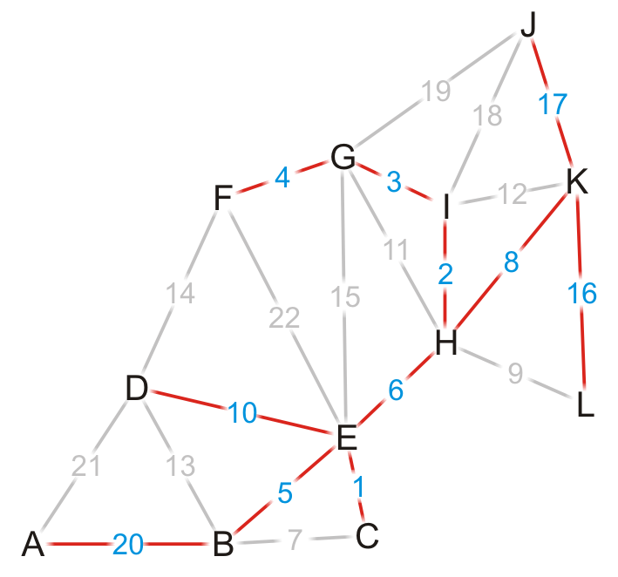
Example
Using the previous pointers, we can reconstruct the paths
Vertex | Visited | Distance | Previous
A | T | 39 | B
B | T | 19 | E
C | T | 15 | E
D | T | 24 | E
E | T | 14 | H
F | T | 17 | G
G | T | 13 | I
H | T | 8 | K
I | T | 10 | H
J | T | 17 | K
K | T | 0 | Ø
L | T | 16 | K

Slide 61
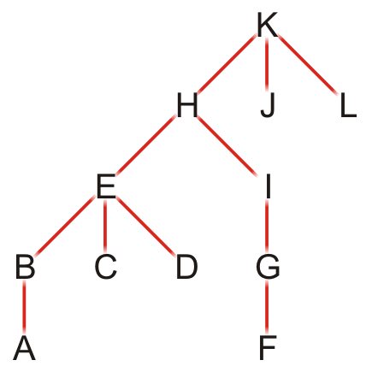
Example
Note that this table defines a rooted parental tree
  The source vertex K is at the root
  The previous pointer is the parent of the vertex in the tree
Vertex | Previous
A | B
B | E
C | E
D | E
E | H
F | G
G | I
H | K
I | H
J | K
K | Ø
L | K

Slide 62
Comments on Dijkstra’s algorithm
Questions:
  What if at some point, all unvisited vertices have a distance ∞?
    This means that the graph is unconnected
    We have found the shortest paths to all vertices in the connected subgraph containing the source vertex
  What if we just want to find the shortest path between vertices v_{j} and v_{k}?
    Apply the same algorithm, but stop when we are visiting vertex v_{k}
  Does the algorithm change if we have a directed graph?
    No

Slide 63
Implementation and analysis
  The initialization requires Θ(|V|) memory and run time
  We iterate |V| – 1 times, each time finding next closest vertex to the source
  Iterating through the table requires is Θ(|V|) time
  Each time we find a vertex, we must check all of its neighbors
  With an adjacency matrix, the run time is Θ(|V|(|V| + |V|)) = Θ(|V|²)
  With an adjacency list, the run time is Θ(|V|² + |E|) = Θ(|V|²) as |E| = O(|V|²)
  Can we do better?
  Recall, we only need the closest vertex
  How about a priority queue?
    Assume we are using a binary heap
    We will have to update the heap structure—this requires additional work

Slide 64
Implementation and analysis
  The initialization still requires Θ(|V|) memory and run time
  The priority queue will also requires Ο(|V|) memory
  We must use an adjacency list, not an adjacency matrix
  We iterate |V| times, each time finding the closest vertex to the source
  Place the distances into a priority queue
  The size of the priority queue is Ο(|V|)
  Thus, the work required for this is O(|V| ln(|V|))
  Is this all the work that is necessary?
  Recall that each edge visited may result in a new edge being pushed to the very top of the heap
  Thus, the work required for this is O(|E| ln(|V|))
  Thus, the total run time is O(|V| ln(|V|) + |E| ln(|V|)) = O(|E| ln(|V|))

Slide 65
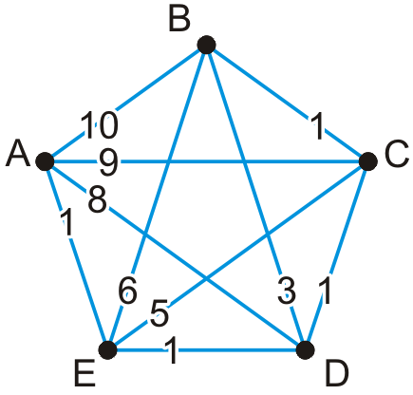
Implementation and analysis
Here is an example of a worst-case scenario:
  Immediately, all of the vertices are placed into the queue
  Each time a vertex is visited, all the remaining vertices are checked, and in succession, each is pushed to the top of the binary heap

Slide 66
Implementation and analysis
We could use a different heap structure:
  A Fibonacci heap is a node-based heap
  Pop is still O(ln(|V|)), but inserting and moving a key is Θ(1)
  Thus, because we are only calling pop |V| – 1 times, the work required reduces to O(|E| + |V| ln(|V|))
  Thus, the overall run-time is O(|E| + |V| ln(|V|))

Slide 67
Implementation and analysis
Thus, we have two run times when using
  A binary heap: O(|E| ln(|V|))
  A Fibonacci heap: O(|E| + |V| ln(|V|))
Questions: Which is faster if |E| = Θ(|V|)? How about if |E| = Θ(|V|²)?

Slide 68
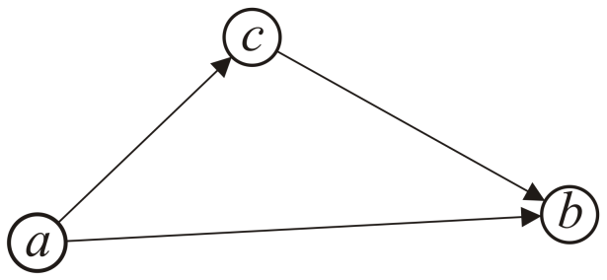
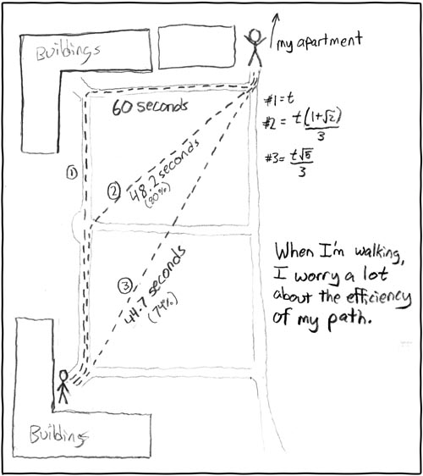
Triangle Inequality
If the distances satisfy the triangle inequality,
  That is, the distance between a and b is less than the distance from a to c plus the distance from c to b,
we can use the A* search which is faster
than Dijkstra’s algorithm
  All Euclidean distances satisfy
  the triangle inequality
http://xkcd.com/85/

Slide 69
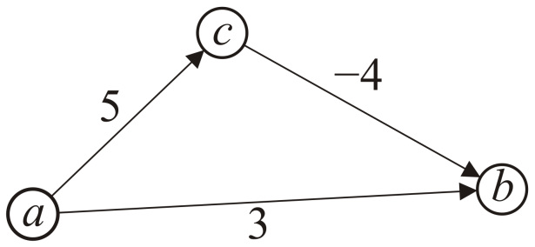
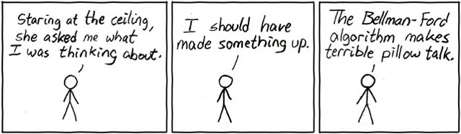
Negative Weights
If some of the edges have negative weight, so long as there are no cycles with negative weight, the Bellman-Ford algorithm will find the minimum distance
  It is slower than Dijkstra’s algorithm
http://xkcd.com/69/

Slide 70
Summary
We have seen an algorithm for finding single-source shortest paths
  Start with the initial vertex
  Continue finding the next vertex that is closest
Dijkstra’s algorithm always finds the next closest vertex
  It solves the problem in O(|E| + |V| ln(|V|)) time

Slide 71
References
Cormen, Leiserson, Rivest and Stein,
Introduction to Algorithms, The MIT Press, 2001, §25.2, pp.629-35.
Mark A. Weiss,
Data Structures and Algorithm Analysis in C++, 3rd Ed., Addison Wesley, 2006, Ch.?, p.?.
Joh Kleinberg and Eva Tardos,
Algorithm Design, Pearson, 2006.
Elliot B. Koffman and Paul A.T. Wolfgang,
Objects, Abstractions, Data Structures and Design using C++, Wiley, 2006.
These slides are provided for the ECE 250 Algorithms and Data Structures course. The material in it reflects Douglas W. Harder’s best judgment in light of the information available to him at the time of preparation. Any reliance on these course slides by any party for any other purpose are the responsibility of such parties. Douglas W. Harder accepts no responsibility for damages, if any, suffered by any party as a result of decisions made or actions based on these course slides for any other purpose than that for which it was intended.

