Slide 1
Proof by Induction

Slide 2
Outline
This topic gives an overview of the mathematical technique of a proof by induction
  We will describe the inductive principle
  Look at ten different examples
  Four examples where the technique is incorrectly applied
  Well-ordering of the natural numbers
  Strong induction
  Geometric problems

Slide 3
Definition
1.4
Suppose we have a formula F(n) which we wish to show is true for all values n ≥ n₀
  Usually n₀ = 0 or n₀ = 1
For example, we may wish to show that
for all n ≥ 0

Slide 4
Definition
1.4
We then proceed by:
  Demonstrating that F(n₀) is true
  Assuming that the formula F(n) is true for an arbitrary n
  If we are able to demonstrate that this assumption allows us to also show that the formula is true for F(n + 1), the inductive principle allows us to conclude that the formula is true for all n ≥ n₀

Slide 5
Definition
1.4
Thus, if F(n₀) is true, F(n₀ + 1) is true
and, if F(n₀ + 1) is true, F(n₀ + 2) is true
and, if F(n₀ + 2) is true, F(n₀ + 3) is true
and so on, and so on, for all n ≥ n₀

Slide 6
Formulation
1.4.1
Often F(n) is an equation:
  For example, F(n) may be an equation such as:
It may also be a statement:
  The integer n³ – n is divisible by 3 for all n ≥ 1

Slide 7
Examples
1.4.2
We will now look at ten examples
At each case, we will show the inductive process...

Slide 8
Example 1
1.4.2.1
Prove that is true for n ≥ 0
  When n = 0:
  Assume that the statement is true for a given n:
  We now show:

Slide 9
Example 1
1.4.2.1
Prove that is true for n ≥ 0
  When n = 0:
  Assume that the statement is true for a given n:
  We now show:

Slide 10
Example 2
1.4.2.2
Prove that the sum of the first n odd integers is n²:
  When n = 1:
  Assume that the statement is true for a given n:
  We now show:

Slide 11
Example 2
1.4.2.2
Prove that the sum of the first n odd integers is n²:
  When n = 1:
  Assume that the statement is true for a given n:
  We now show:

Slide 12
Example 3
1.4.2.3
Prove that for n ≥ 0
  When n = 0:
  Assume that the statement is true for a given n:
  We now show:

Slide 13
Example 3
1.4.2.3
Prove that for n ≥ 0
  When n = 0:
  Assume that the statement is true for a given n:
  We now show:

Slide 14
Example 4
1.4.2.4
Prove that
  When n = 0:
  Assume that the statement is true for a given n:
  We now show:

Slide 15
Example 4
1.4.2.4
Prove that
  When n = 0:
  Assume that the statement is true for a given n:
  We now show:

Slide 16
Example 4
1.4.2.4
Prove that
  When n = 0:
  Assume that the statement is true for a given n:
  We now show:

Slide 17
Example 4
1.4.2.4
Prove that
  When n = 0:
  Assume that the statement is true for a given n:
  We now show:

Slide 18
Example 5
1.4.2.5
Prove that
  When n = 0:
  Assume that the statement is true for a given n:
  We now show:

Slide 19
Example 5
1.4.2.5
Prove that
  When n = 0:
  Assume that the statement is true for a given n:
  We now show:

Slide 20
Example 6
1.4.2.6
Prove by induction that n³ – n is divisible by 3 for all integers
  This is slightly different
    Choose a base case, say n = 0
    Next, prove that the truth of the formula for n implies the truth for n + 1
    Also, prove that the truth of the formula for n also implies the truth for n – 1
  When n = 0: 0³ – 0 = 0 is divisible by 3
  Assume that the statement is true for a given n: n³ – 3 is divisible by 3
  We now show:
    In both cases, the first term is divisible by 3,
    the second term is divisible by 3 by assumption;
    Consequently, their sum must also be divisible by 3

Slide 21
Example 6
1.4.2.6
Of course, proof-by-induction may not always be the only approach:
Proving that n³ – n is divisible by 3 for all integers
  An alternative proof could follow by observing that all integers may be written as either
  3m 3m + 1 3m + 2
  and then observing that

Slide 22
Example 7
1.4.2.7
Prove that the derivative of x^{n} w.r.t. x is nx^{n – 1} for n ≥ 1 using
  the chain rule, and
Proof
  When n = 1: the derivative of x is 1
  Assume that the derivative of x^{n} w.r.t. x is nx^{n – 1}
  We now show:

Slide 23
Example 7
1.4.2.7
Prove that the derivative of x^{n} w.r.t. x is nx^{n – 1} for n ≥ 1 using
  the chain rule, and
Proof
  When n = 1: the derivative of x is 1
  Assume that the derivative of x^{n} w.r.t. x is nx^{n – 1}
  We now show:

Slide 24
Example 8
1.4.2.8
Prove that for integer values of n ≥ 1
  When n = 1:
  Assume that
  We now show:

Slide 25
Example 8
1.4.2.8
Prove that for integer values of n ≥ 1
  When n = 1:
  Assume that
  We now show:

Slide 26
Example 9
1.4.2.9
Prove that
  When n = 0:
  Assume that the statement is true for a given n
  We now show:

Slide 27
Example 9
1.4.2.9
Prove that
  When n = 1:
  Assume that the statement is true for a given n
  We now show:

Slide 28
Example 10
1.4.2.10
Prove that
  When n = 1:
  Assume that the statement is true for a given n
  We now show:

Slide 29
Example 10
1.4.2.10
Prove that
  When n = 1:
  Assume that the statement is true for a given n
  We now show:

Slide 30
Non-Examples
1.4.3
All of these examples have been examples where proof by induction satisfies the desired result
  What happens if it fails?
  We will look at three cases:
    The inductive step fails
    The initial inductive step is false
    The “proof” is invalid

Slide 31
Non-Example 1
1.4.3.1
Suppose we have an incorrect formula—what happens?
Recall Fibonacci numbers:
Suppose you saw that F(2) = 2 and F(3) = 3 and ask:
  Is F(n) = n for n ≥ 1?
  When n = 1: F(1) = 1 by definition
  Assume that the statement is true for all k = 1, 2, …, n: F(k) = k
  However:
Thus, the formula is wrong!

Slide 32
Non-Example 2
1.4.3.2
Consider the recursive formula
  Can we find a closed form?
Suppose n > 1, then
or
  One may accidently conclude that
  This is incorrect: F(1) = F(0) = 1: the base case is at n = 1
  The correct closed-form formula is
+

Slide 33
Non-Example 3
1.4.3.3
In opposition to the statement that “x is a horse of a different color”, prove all horses are the same color
  A single horse has the same color as itself
  Assume that all horses in a set of size n have the same color
  Then, given a set of n + 1 horses {h₁, h₂, …, h_{n}, h_{n + 1}}, we may group them into two groups of size n:
  {h₁, h₂, …, h_{n}} and {h₂, …, h_{n}, h_{n + 1}}
  By assumption, all the horses in both sets of size n are the same color
  Therefore, all the horses in the set of n + 1 horses must be the same color
Problem: the inductive step fails if n + 1 = 2
  Given a set of two horses {Sea Horse, Barbaro}, there is no overlap in the two subsets {Sea Horse} and {Barbaro}

Slide 34
Non-Example 4
1.4.3.4
You cannot get full eating peas
  A person cannot become full eating one pea
  Assume a person is not full after eating n peas
  If a person has eaten n + 1 peas, this is one more than eating n peas and, by assumption, the person was not full after eating n peas and eating one more pea will not make him or her full, either

Slide 35
Non-Example 4
1.4.3.4
Issues:
  A person who is 130 cm in height may not be considered tall; however, one cannot argue that just because if someone is n cm is considered not tall, then adding one more centimetre will not make them tall, either
  If one pea is eaten at a time, the rate of digestion may in fact equal the rate of consumption
  “Full” is not a well defined value, either
    Hossein Rezazadeh, at his height, may have been able to clean and jerk
    240 kg with every attempt
    He was unable to ever achieve 265 kg
    Attempts to clean and jerk weights between these two values may succeed or fail based on numerous other factors

Slide 36
Justification
1.4.4
The induction principle can either be assumed in a mathematical system as an axiom, or it can be derived from other axioms
Alternatively, it can be deduced from other axioms, such as:
  The natural numbers (0, 1, 2, 3, …) are linearly ordered
  Every natural number is either 0 or the successor of another natural number
  The successor is by definition greater than what it succeeds

Slide 37
Justification
1.4.4
You may ask: “Suppose you’ve proved some formula F(n) for by induction to be true for all n = 0, 1, 2, …; all we really showed was that F(0) is true—could it not fail for some larger value F(k)?
Suppose that there is a k such that F(k) is false
  There must be a smallest value k > 0 such that
  F(k – 1) is true but
  F(k) is false
  But the inductive step showed that if F(k – 1) is true, it must also be true that F(k) is true!
  Thus, no such smallest k can exist
  Thus, no subset of N can have F(n) be false

Slide 38
Strong Induction
1.4.5
A similar technique is strong induction where we replace the statement
  Assume that true
with
  Assume that are all true
For example:
  Prove that with 3 and 7 cent coins, it is possible to make exact change for any amount greater than or equal to 12 cents

Slide 39
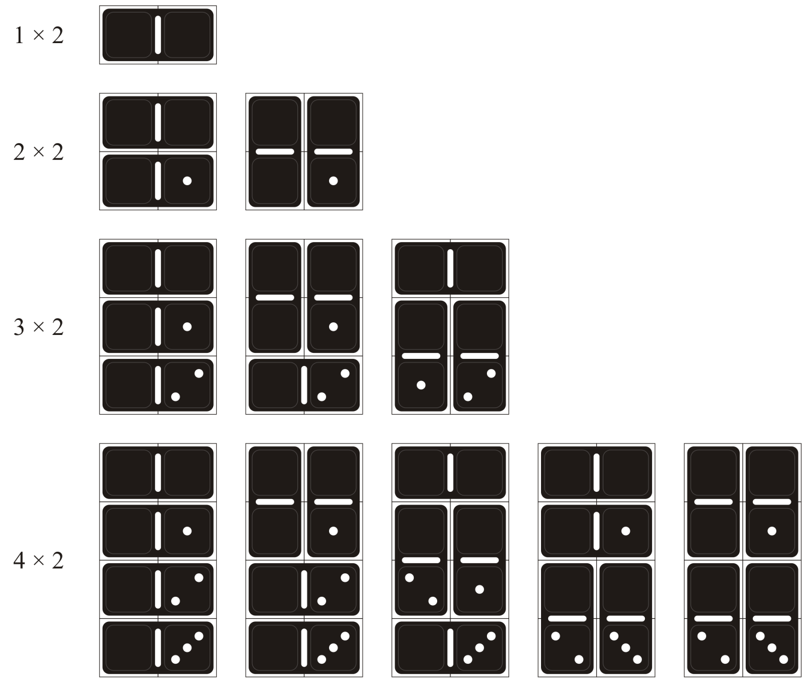
Geometric problems
1.4.6
Given an n × 2 grid,
how many ways can
that grid be covered
in dominos?
  Come up with a
  formula for d_{n},
  verify that it is
  correct for 5 × 2, and
  prove it is true by
  induction

Slide 40
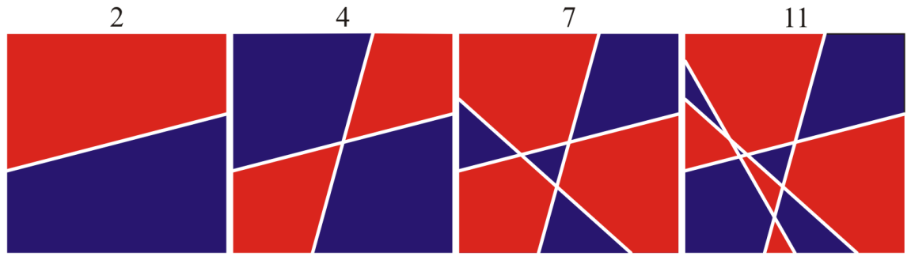
Geometric problems
1.4.6
Another:
  Come up with a recursive formula that demonstrates that lines
  will divide the plane into regions and show
  that the formula is correct using induction

Slide 41
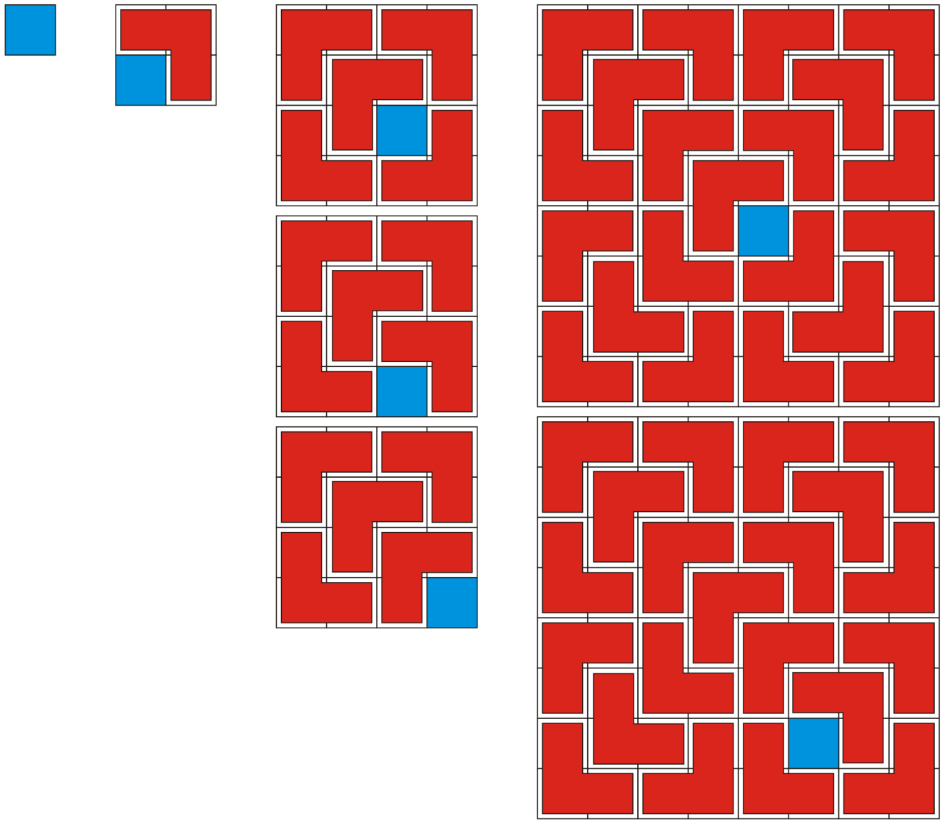
Geometric problems
1.4.6
And another:
  Demonstrate that any 2^{n} × 2^{n} grid
  with one square deleted may be
  tiled with triominos

Slide 42
Summary
In this topic, we have discussed:
  We discussed the inductive principle
  Ten different examples
  Proof by induction can be applied incorrectly
  Why it works
  Strong induction
  Some geometric problems

Slide 43
References
David Sumner, The Technique of Proof by Induction, http://www.math.sc.edu/~sumner/numbertheory/induction/Induction.html
Wikipedia, Mathematical induction, http://en.wikipedia.org/wiki/Mathematical_induction
Donald E. Knuth, The Art of Computer Programming,Vol 1, Fundamental Algorithms, 3rd Ed., Addison Wesley, 1997

Slide 44


Usage Notes
These slides are made publicly available on the web for anyone to use
If you choose to use them, or a part thereof, for a course at another institution, I ask only three things:
  that you inform me that you are using the slides,
  that you acknowledge my work, and
  that you alert me of any mistakes which I made or changes which you make, and allow me the option of incorporating such changes (with an acknowledgment) in my set of slides
  Sincerely,
  Douglas Wilhelm Harder, MMath
  dwharder@alumni.uwaterloo.ca

