Slide 1
Mathematical background

Slide 2
Outline
This topic reviews the basic mathematics required in this course:
  A justification for a mathematical framework
  The ceiling and floor functions
  L’Hôpital’s rule
  Logarithms
  Arithmetic and other polynomial series
    Mathematical induction
  Geometric series
  Recurrence relations
  Weighted averages
  Combinations

Slide 3
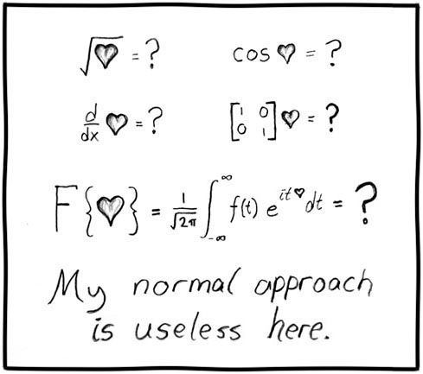
Mathematics and engineering
For engineers, mathematics is a tool:
  Of course, that doesn’t mean it always works...
http://xkcd.com/55/

Slide 4
Justification
However, as engineers, you will not be paid to say:
Method A is better than Method B
or
Algorithm A is faster than Algorithm B
Such comparisons are said to be qualitative:
qualitative, a. Relating to, connected or concerned with, quality or qualities.
Now usually in implied or expressed opposition to quantitative.
OED

Slide 5
Justification
Qualitative statements cannot guide engineering design decisions:
  Algorithm A could be better than Algorithm B, but Algorithm A would require three person weeks to implement, test, and integrate while Algorithm B has already been implemented and has been used for the past year
  There are circumstances where it may beneficial to use Algorithm A, but not based on the word better

Slide 6
Justification
Thus, we will look at a quantitative means of describing data structures and algorithms:
quantitative, a. Relating to, concerned with, quantity or its measurement;
ascertaining or expressing quantity. OED
This will be based on mathematics, and therefore we will look at a number of properties which will be used again and again throughout this course

Slide 7
Floor and ceiling functions
The floor function maps any real number x onto the greatest integer less than or equal to x:
  Consider it rounding towards negative infinity
The ceiling function maps x onto the least integer greater than or equal to x:
  Consider it rounding towards positive infinity
  The cmath library implements these as
  double floor( double ); double ceil( double );
Necessary because double
have a range just under 2¹⁰²⁴
long can only represent
numbers as large as 2⁶³ – 1

Slide 8
L’Hôpital’s rule
If you are attempting to determine
but both , it follows
Repeat as necessary…
Note: the k^{th} derivative will always be shown as

Slide 9
Logarithms
We will begin with a review of logarithms:
If n = e^{m}, we define
m = ln( n )
It is always true that e^{ln(n)} = n; however, ln(e^{n}) = n requires that n is real

Slide 10
Logarithms
Exponentials grow faster than any non-constant polynomial
for any d > 0
Thus, their inverses—logarithms—grow slower than any polynomial
Notes:
This can be also argued as follows:
The inverse of n^{d} is n^{1/d} and to assume otherwise would suggest that a polynomial grows as fast as an exponential, which is false simply by applying l’Hopital’s rule.

Slide 11
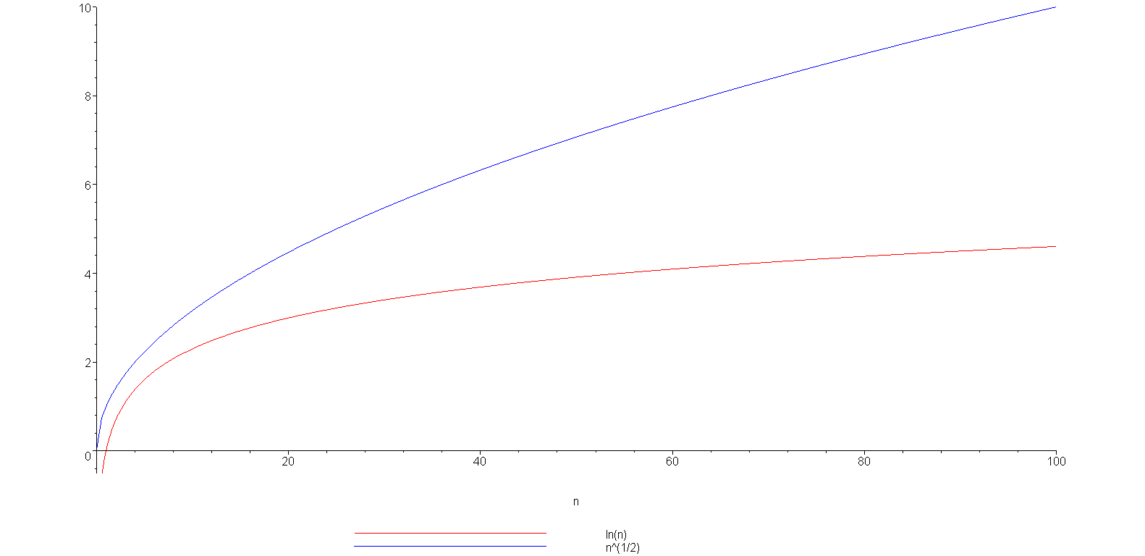
Logarithms
Example: is strictly greater than ln(n)
ln(n)

Slide 12
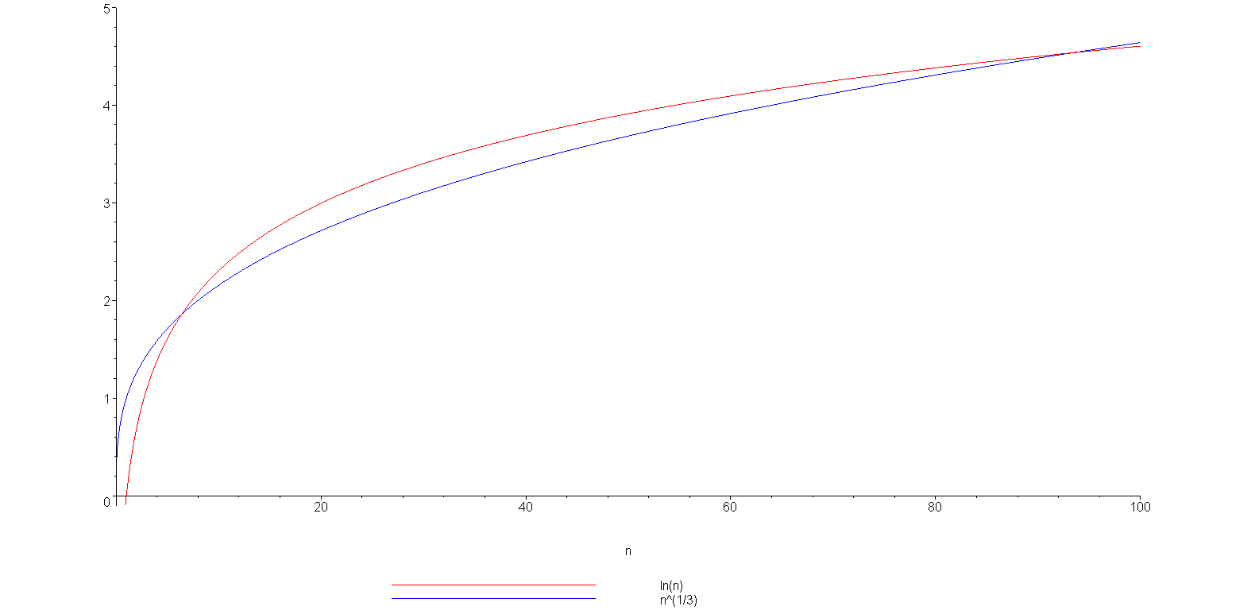
Logarithms
grows slower but only up to n = 93
(93.354, 4.536)
ln(n)

Slide 13
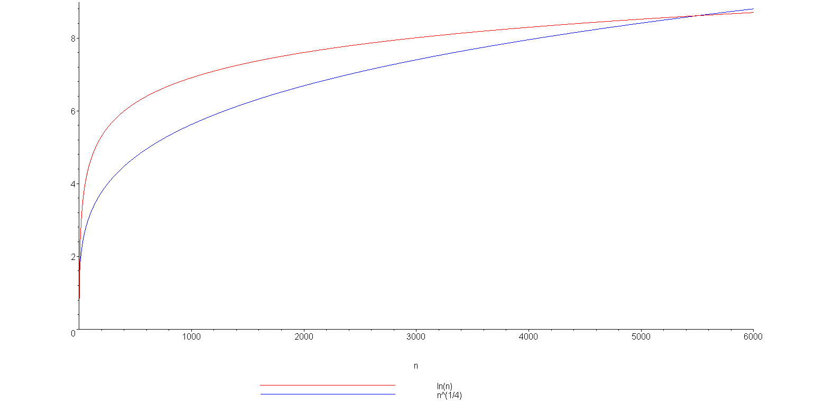
Logarithms
You can view this with any polynomial
ln(n)
(5503.66, 8.61)

Slide 14
Logarithms
We have compared logarithms and polynomials
  How about log₂(n) versus ln(n) versus log₁₀(n)
You have seen the formula
All logarithms are scalar multiples of each others
Constant

Slide 15
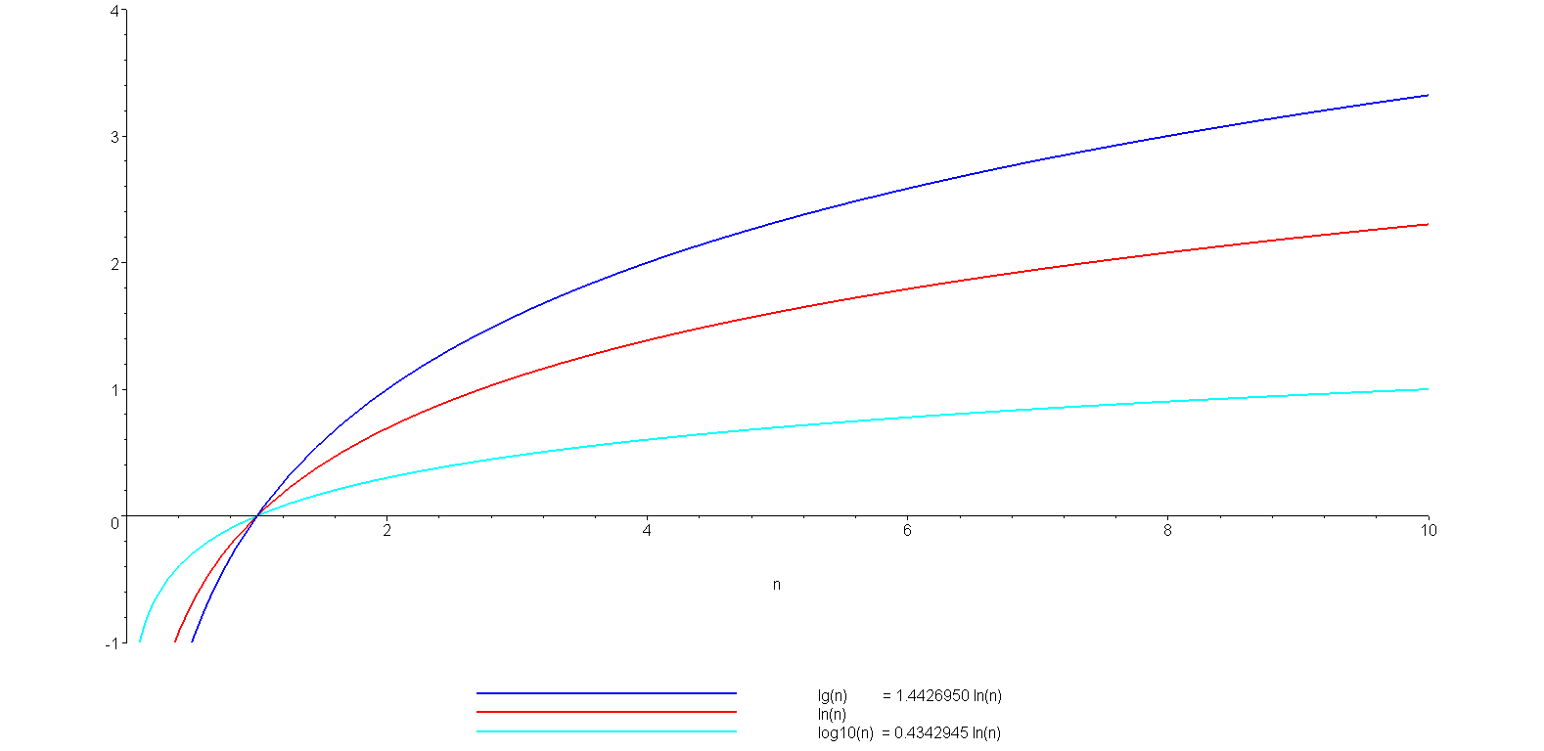
Logarithms
A plot of log₂(n) = lg(n), ln(n), and log₁₀(n)
lg(n)
ln(n)
log₁₀(n)

Slide 16
Logarithms
Note: the base-2 logarithm log₂(n) is written as lg(n)
It is an industry standard to implement the natural logarithm ln(n) as
double log( double );
The common logarithm log₁₀(n) is implemented as
double log10( double );

Slide 17
Logarithms
A more interesting observation we will repeatedly use:
n^{logb (m)} = m^{logb(n)},
a consequence of :
n^{logb (m)} = (b^{logb(n)})^{logb(m)}
= b^{logb(n) logb(m)}
= (b^{logb(m)})^{logb(n)}
= m^{logb(n)}

Slide 18
Logarithms
You should also, as electrical or computer engineers be aware of the relationship:
lg(2¹⁰) = lg(1024) = 10
lg(2²⁰) = lg(1 048 576) = 20
and consequently:
lg(10³) = lg(1000) ≈ 10 kilo
lg(10⁶) = lg(1 000 000) ≈ 20 mega
lg(10⁹) ≈ 30 giga
lg(10¹²) ≈ 40 tera

Slide 19
Arithmetic series
Next we will look various series
Each term in an arithmetic series is increased by a constant value (usually 1) :

Slide 20
Arithmetic series
Proof 1: write out the series twice and add each column
1 + 2 + 3 + . . . + n – 2 + n – 1 + n
+ n + n – 1 + n – 2 + . . . + 3 + 2 + 1
(n + 1) + (n + 1) + (n + 1) + . . . + (n + 1) + (n + 1) + (n + 1)
= n (n + 1)
Since we added the series twice, we must divide the result by 2

Slide 21
Arithmetic series
Proof 2 (by induction):
The statement is true for n = 0:
Assume that the statement is true for an arbitrary n:

Slide 22
Arithmetic series
Using the assumption that
for n, we must show that

Slide 23
Arithmetic series
Then, for n + 1, we have:
By assumption, the second sum is known:

Slide 24
Arithmetic series
The statement is true for n = 0 and
the truth of the statement for n implies
the truth of the statement for n + 1.
Therefore, by the process of mathematical induction, the statement is true for all values of n ≥ 0.
Reference: Mr. Oprendick

Slide 25
Other polynomial series
We could repeat this process, after all:
however, it is easier to see the pattern:

Slide 26
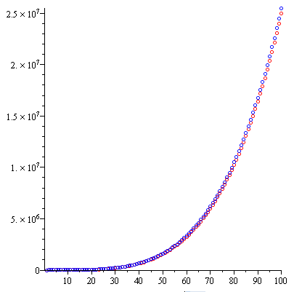
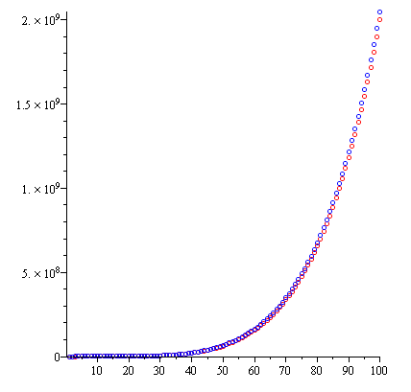
Other polynomial series
We can generalize this formula
Demonstrating with d = 3 and d = 4:

Slide 27
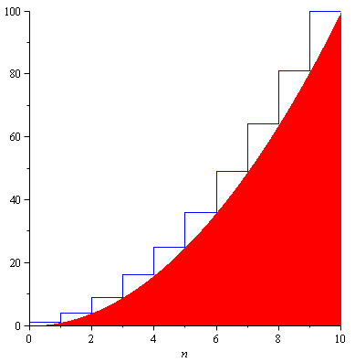
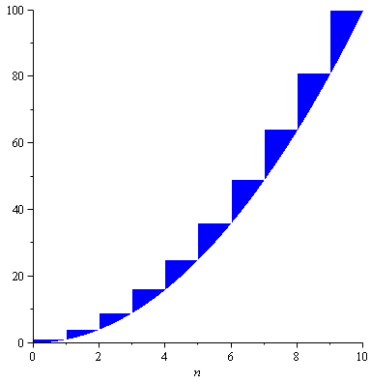
Other polynomial series
The justification for the approximation is that we are approximating the sum with an integral:
However, there is an
accumulating error:
n²

Slide 28

Other polynomial series
How large is the error?
  Assuming d > 1, shifting the errors, we see that they would be
n² = 100
n² = 10

Slide 29
Other polynomial series
The ratio between the error and the actual value goes to zero:
  In the limit, as n → ∞, the ratio between the sum and the approximation goes to 1
  The relative error of the approximation goes to 0

Slide 30
Geometric series
The next series we will look at is the geometric series with common ratio r:
and if |r| < 1 then it is also true that

Slide 31
Geometric series
Elegant proof: multiply by
Ref: Bret D. Whissel, A Derivation of Amortization
Telescoping series:
all but the first and last terms cancel

Slide 32
Geometric series
Proof by induction:
The formula is correct for n = 0:
Assume the formula is true for an arbitrary n; then
and therefore, by the process of mathematical
induction, the statement is true for all n ≥ 0.

Slide 33
Geometric series
Note that we can use a change-of-index with summations like we do with integration:
Letting j = i – 1:

Slide 34
Geometric series
A common geometric series will involve the ratios r = ½ and r = 2:

Slide 35
Recurrence relations
Finally, we will review recurrence relations:
  Sequences may be defined explicitly: x_{n} = 1/n
  1, ¹/₂, ¹/₃, ¹/₄, ...
  A recurrence relationship is a means of defining a sequence based on previous values in the sequence
  Such definitions of sequences are said to be recursive

Slide 36
Recurrence relations
Define an initial value: e.g., x₁ = 1
Defining x_{n} in terms of previous values:
  For example,
x_{n} = x_{n – 1} + 2
x_{n} = 2x_{n – 1} + n
x_{n} = x_{n – 1} + x_{n – 2}

Slide 37
Recurrence relations
Given the two recurrence relations
x_{n} = x_{n – 1} + 2 x_{n} = 2x_{n – 1} + n
and the initial condition x₁ = 1 we would like to find explicit formulae for the sequences
In this case, we have
x_{n} = 2n – 1 x_{n} = 2^{n + 1} – n – 2
respectively

Slide 38
Recurrence relations
We will use a functional form of recurrence relations:
Calculus | ECE 250
x₁ = 1............. | f(1) = 1...................
x_{n} = x_{n – 1} + 2.. | f(n) = f(n – 1) + 2...
x_{n} = 2x_{n – 1} + n | f(n) = 2 f(n – 1) + n

Slide 39
Recurrence relations
The previous examples using the functional notation are:
  f(n) = f(n – 1) + 2 g(n) = 2 g(n – 1) + n
With the initial conditions f(1) = g(1) = 1, the solutions are:
f(n) = 2n – 1 g(n) = 2^{n + 1} – n – 2

Slide 40
Recurrence relations
In some cases, given the recurrence relation, we can find the explicit formula:
  Consider the Fibonacci sequence:
f(n) = f(n – 1) + f(n – 2)
f(0) = f(1) = 1
  that has the solution
where φ is the golden ratio:

Slide 41
Weighted averages
Given n objects x₁, x₂, x₃, ..., x_{n}, the average is
Given a sequence of coefficients c₁ , c₂ , c₃ , … , c_{n} where
then we refer to
as a weighted average
For an average,

Slide 42
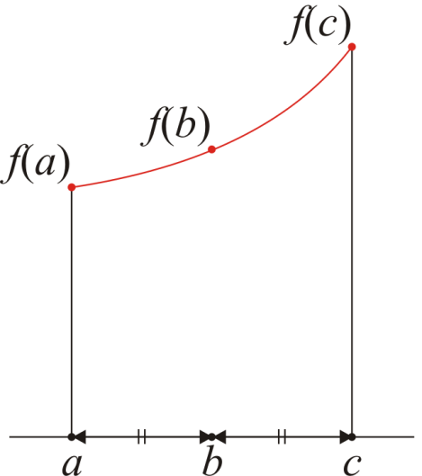
Weighted averages
Examples:
  Simpson’s method approximates an integral by sampling
  the function at three points: f(a), f(b), f(c)
  The average value of the function is approximated by
  It can be shown that that
  is a significant better approximation than

Slide 43
Weighted averages
Examples:
  Using the weighted average:
  Using a simple average:

Slide 44
Combinations
Given n distinct items, in how many ways can you choose k of these?
  I.e., “In how many ways can you combine k items from n?”
  For example, given the set {1, 2, 3, 4, 5}, I can choose three of these
  in any of the following ways:
  {1, 2, 3}, {1, 2, 4}, {1, 2, 5}, {1, 3, 4}, {1, 3, 5},
  {1, 4, 5}, {2, 3, 4}, {2, 3, 5}, {2, 4, 5}, {3, 4, 5},
The number of ways such items can be chosen is written
where is read as “n choose k”s
There is a recursive definition:

Slide 45
Combinations
The most common question we will ask in this vein:
  Given n items, in how many ways can we choose two of them?
  In this case, the formula simplifies to:
For example, given {0, 1, 2, 3, 4, 5, 6}, we have the following 21 pairs:
{0, 1}, {0, 2}, {0, 3}, {0, 4}, {0, 5}, {0, 6},
{1, 2}, {1, 3}, {1, 4}, {1, 5}, {1, 6},
{2, 3}, {2, 4}, {2, 5}, {2, 6},
{3, 4}, {3, 5}, {3, 6},
{4, 5}, {4, 6},
{5, 6}

Slide 46
Combinations
You have also seen this in expanding polynomials:
For example,

Slide 47
Combinations
These are also the coefficients of Pascal’s triangle:

Slide 48
Summary
In this topic, we have discussed:
  A review of the necessity of quantitative analysis in engineering
We reviewed the following mathematical concepts:
  The floor and ceiling functions
  L’Hôpital’s rule
  Logarithms
  Arithmetic and other polynomial series
    Mathematical induction
  Geometric series
  Recurrence relations
  Weighted average
  Combinations

Slide 49
Reference
[1] Cormen, Leiserson, and Rivest, Introduction to Algorithms, McGraw Hill, 1990, Chs 2-3, p.42-76.
[2] Weiss, Data Structures and Algorithm Analysis in C++, 3rd Ed., Addison Wesley, §§ 1.2-3, p.2-11.

Slide 50
Usage Notes
These slides are made publicly available on the web for anyone to use
If you choose to use them, or a part thereof, for a course at another institution, I ask only three things:
  that you inform me that you are using the slides,
  that you acknowledge my work, and
  that you alert me of any mistakes which I made or changes which you make, and allow me the option of incorporating such changes (with an acknowledgment) in my set of slides
  Sincerely,
  Douglas Wilhelm Harder, MMath
  dwharder@alumni.uwaterloo.ca

