Slide 1

On technical presentations
Part 2
TPM Technical Presentation Milestone
Douglas Wilhelm Harder
Department of Electrical and Computer Engineering
http://ece.uwaterloo.ca/~tppe000/
University of Waterloo
November 4, 2014
Copyright © 2008-13 by Douglas Wilhelm Harder. Some rights reserved.

Slide 2
Outline
The previous session covered:
  Background
  The milestone
  Bad presentations
  First two aspects of a good presentation:
    Interest and knowledge
    Organization

Slide 3
Outline
This session covers:
  Three further aspects of a good presentation:
    Visual aids
    Presentation skills
    Responses to questions
  Consequences of failures

Slide 4
Aspects of good presentations
With interest, knowledge and organization,
we must now prepare the supporting visual aids:
  Interest and knowledge
  Organization
  Visual aids
  Presentation skills
  Responding to questions

Slide 5
Visual aids
Visual aids are a standard component of technical presentations
Good visual aids will:
  Increase understanding
  Enhance retention
  Promote attentiveness and focus
  Help control nervousness
Examples: slides, videos, samples, mock-ups

Slide 6
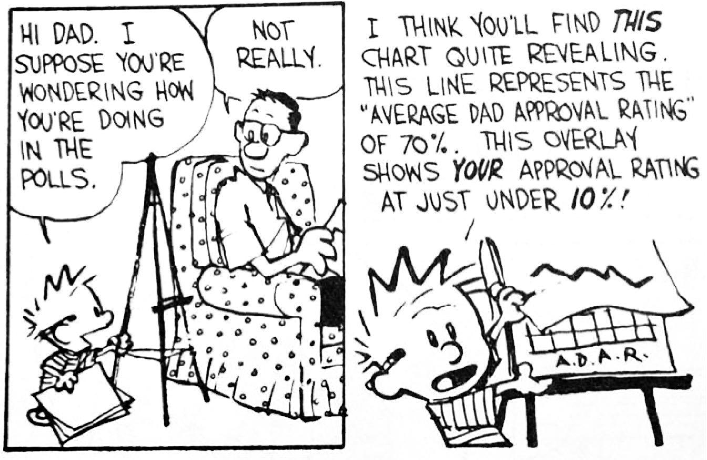
Visual aids
Slides are a common visual aid which:
  Summarize the discussion and data
  Provide continuous visual support
  Have become the de facto standard
© Universal Press Syndicate

Slide 7
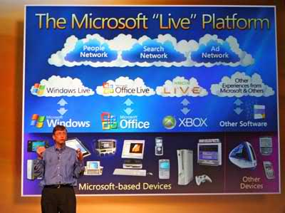
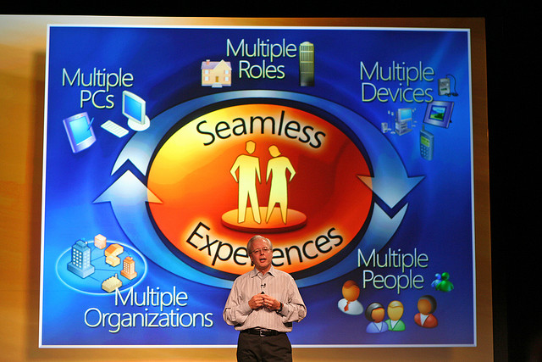
Visual aids
Slides and other visual aids should not:
  Become the focus of a presentation
  Replace the speaker
Crowded slides may even detract
from well organized presentations
niallkennedy Live platform in San Francisco on November 1, 2005

Slide 8
Visual aids
Visual aids
Aspects we will examine include:
  Look-and-feel
  Textual content
  Images
  Charts and graphs
  Other representations
  Presentation software

Slide 9
Look and feel
Visual aids
The format of slides should aid in presenting the material
  The format of the slide should not attract attention
  The format should not change from slide-to-slide
The overall format is commonly referred to as the look-and-feel of the presentation

Slide 10
Look and feel
Visual aids
Four aspects regarding the look-and-feel:
  Consistency
  Color scheme
  Slide background
  “Someone Else’s Slides” syndrome

Slide 11
Consistency
Visual aids
– Look and feel
The appearance of slides should not change from slide-to-slide
  The audience will learn where to look

Slide 12


On technical presentations
Consistency
The appearance of slides should not change from slide-to-slide
  The audience will learn where to look
  Less time will be spent navigating the format
Inconsistencies can be frustrating if they are significant…
http://www.peoplequake.com/

Slide 13
Consistency
Consistency
Consistency
Visual aids
– Look and feel
Small changes will distract the audience
  Movement attracts the eye
  Survival mechanism
Small changes will distract the audience
  Movement attracts the eye
  Survival mechanism
Small changes will distract the audience
  Movement attracts the eye
  Survival mechanism
Small changes
  Annoy the audience
  Appear unprofessional
Small changes
  Annoy the audience
  Appear unprofessional
Quickly flip through the slides to detect small changes

Slide 14
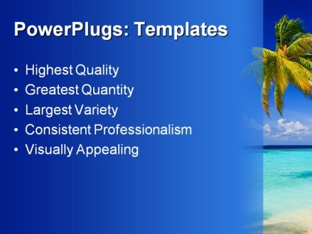

Color schemes
Visual aids
– Look and feel
Background images distract and potentially clash
A plain background is most appropriate for technical presentations
  Dark text on a white or light background is common
http://www.crystalgraphics.com

Slide 15
Color schemes
On technical presentations
14
Visual aids
– Look and feel
Background images distract and potentially clash
A plain background is most appropriate for technical presentations
  Dark text on a white or light background is common
  Some people prefer yellow on blue
    Anecdotal evidence suggests light-on-dark is better in larger rooms
http://www.crystalgraphics.com

Slide 16
Color schemes
On technical presentations
15
Visual aids
– Look and feel
Background images distract and potentially clash
A plain background is most appropriate for technical presentations
  Dark text on a white or light background is common
  Some people prefer yellow on blue
    Anecdotal evidence suggests light-on-dark is better in larger rooms
  Avoid red-green and other clashing colors
http://www.crystalgraphics.com

Slide 17
Color schemes
On technical presentations
16
Visual aids
– Look and feel
Background images distract and potentially clash
A plain background is most appropriate for technical presentations
  Dark text on a white or light background is common
  Some people prefer yellow on blue
    Anecdotal evidence suggests light-on-dark is better in larger rooms
  Avoid red-green and other clashing colors
  Warm colors tend to agitate audiences
http://www.crystalgraphics.com

Slide 18
Backgrounds
This speaker’s backgrounds are white with accents at the top

Slide 19

Backgrounds
This speaker’s backgrounds are white with accents at the top
Non-uniform backgrounds can cause issues
  The title font color literally blends in
  This background ships with PowerPoint

Slide 20
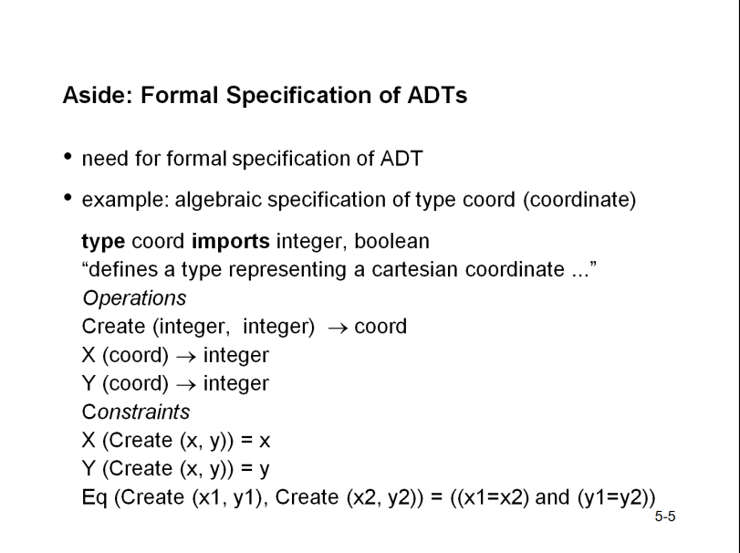
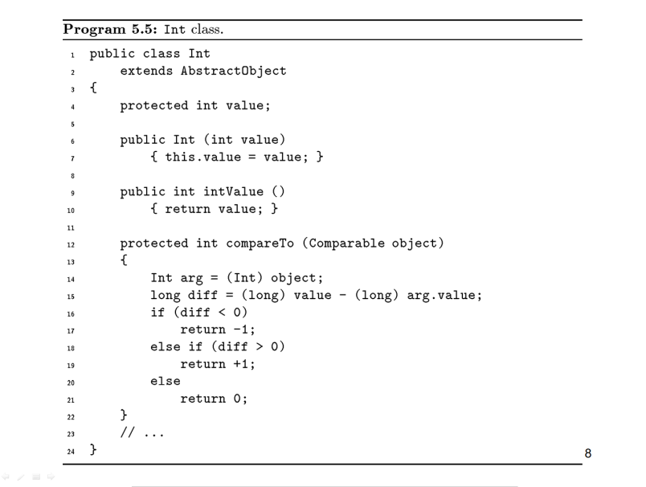
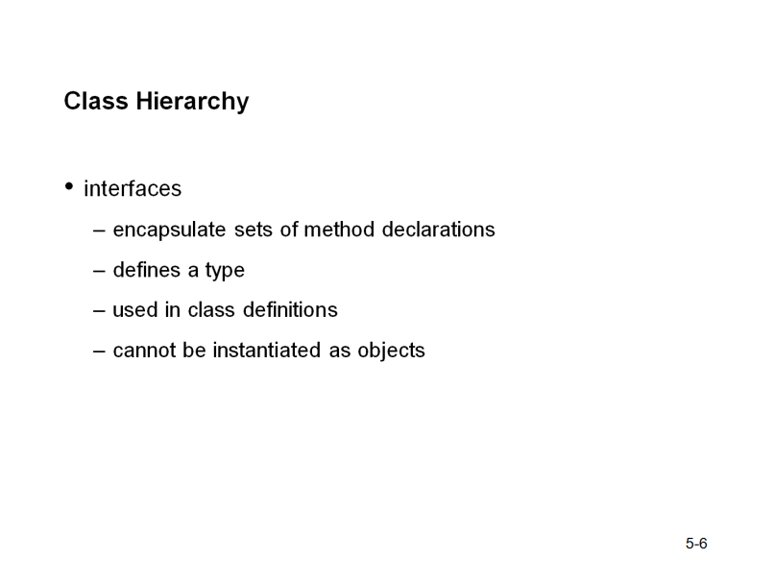
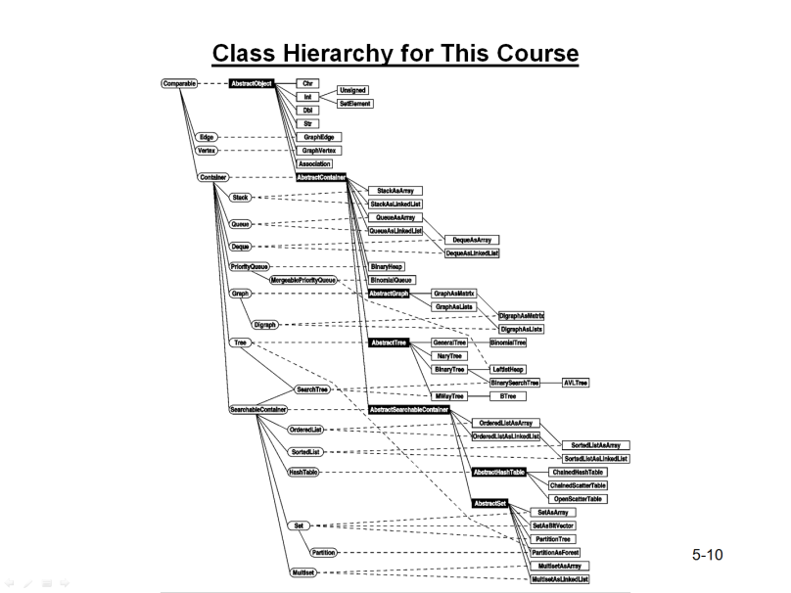
“Someone Else’s Slides”
Visual aids
– Look and feel
Don’t fall victim to “someone else’s slides” syndrome, it reduces
  Your preparation time
  The time you spend thinking about the presentation
B. Priess

Slide 21

“Someone Else’s Slides”
Visual aids
– Look and feel
Most importantly, you should avoid
  Plagiarism
http://methodwithmadness.blogspot.ca/2012/08/is-plagiarism-hampering-development-of.html

Slide 22
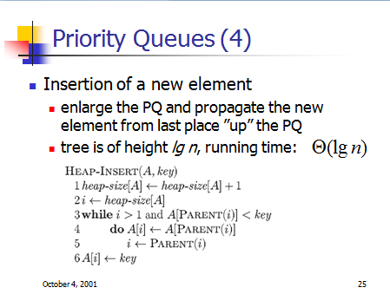
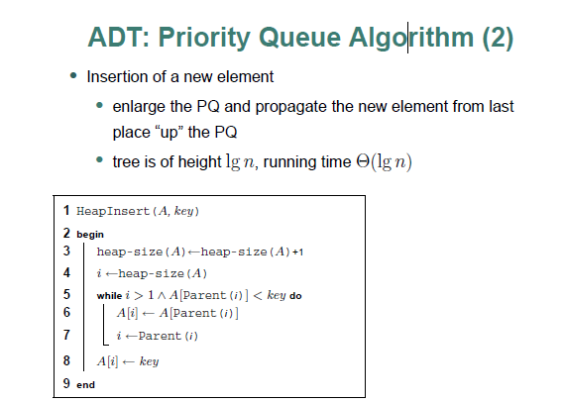
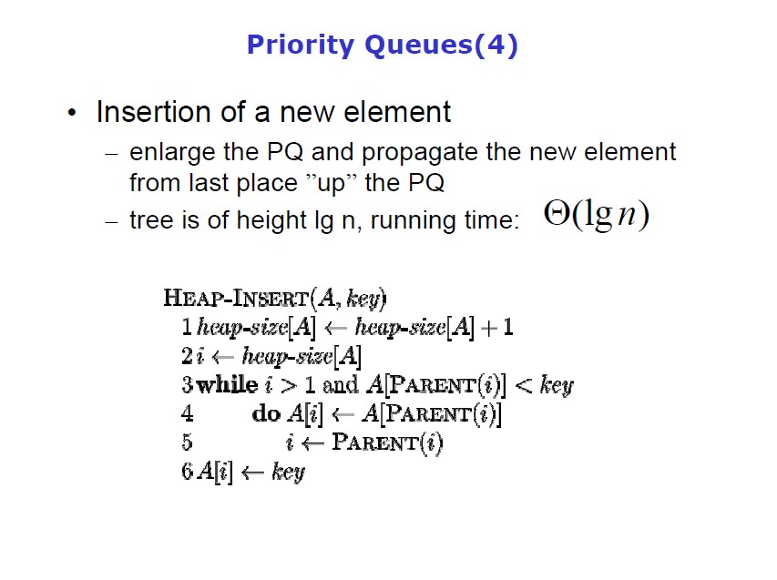
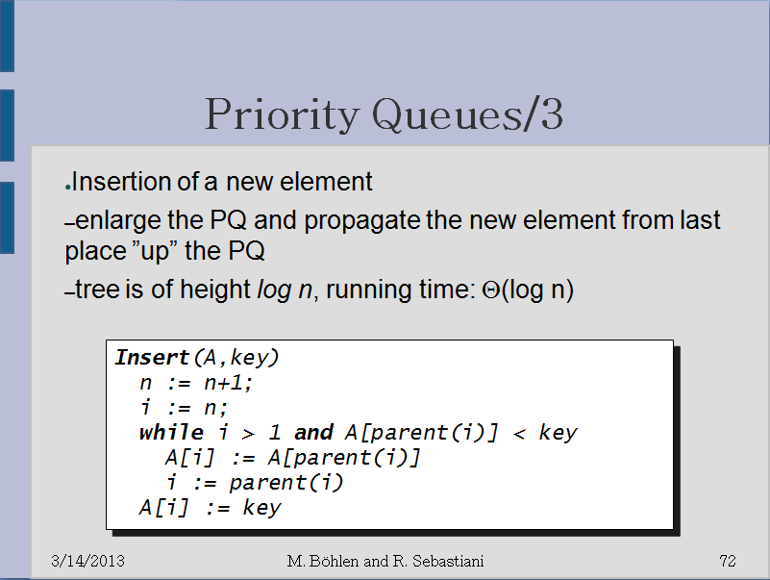
“Someone Else’s Slides”
Visual aids
– Look and feel
It is unfortunately common practice to copy slides, often with little or no form of attribution
  Copyists make small cosmetic changes
ght lg n, run
ght lg n, run
ght log n, run
ght lg n, run
Original: Simonas Šaltenis

Slide 23
Textual content
Visual aids
A significant amount of information is carried by text
Aspects concerning text:
  Layout
  Typeface
  Font size
  Language

Slide 24
Layout
Visual aids
– Textual content
Text should be laid out hierarchically
Linear text lack association
Audience will look at each point separately
PowerPoint has some nice features
It allows indentation
Text can appear progressively

Slide 25
Layout
Visual aids
– Textual content
Text should be laid out hierarchically
  Linear text lack association
  Audience will look at each point separately
PowerPoint has some nice features
  It allows indentation
  Text can appear progressively
Do not, however
  Use excessive
    And unnecessary
      And pointless hierarchical indentation
        Two levels at most
In contrast to the previous slide...

Slide 26
A slide presenting information about the foam that hit Columbia
Review of Test Data Indicates Conservatism for Tile
Penetration
The existing SOFI on tile test data used to create Crater
was reviewed along with STS-87 Southwest Research data
  Crater overpredicted penetration of tile coating
  significantly
    Initial penetration to described by normal velocity
      Varies with volume/mass of projectile (e.g., 200ft/sec for
      3cu.in)
    Significant energy is required for the softer SOFI particle
    to penetrate the relatively hard tile coating
      Test results do show that it is possible at sufficient mass
      and velocity
    Conversely, once tile is penetrated SOFI can cause
    significant damage
      Minor variation in total energy (above penetration level)
      can cause significant tile damage
  Flight condition is significantly outside of test database
    Volume of ramp is 1920cu in vs 3cu in for test
The critical information
2/21/03
6

Slide 27
Layout
Visual aids
– Textual content
Some people advocate using the 1-7-7 rule:
  Each slide will cover exactly one point
  Each slide has at most seven items
  Each item has at most seven words
  Do not add unnecessary points and words
  Filling up the page is not necessary
  After all, it is only a guideline

Slide 28
Layout
Visual aids
– Textual content
Aim for balance
  Each page should have approximately the same content

Slide 29
Layout
Visual aids
– Textual content
Avoid having a single word appear on a line as a result of a line wrap
  You can either rephrase, shorten, lengthen, or split the line into two items
  Otherwise it will look awkward—chances are the line is too long, anyway
  This is not the way to do it, people: it will definitely be noticed by the audience
Avoid line wraps with only one or two words
  Rephrase, shorten, lengthen, or split it
  It looks awkward—the line is probably too long
  This will be noticed by the audience

Slide 30


On technical presentations
Layout
Visual aids: Look and feel
Too many “features” alienate your audience
  You focus on the glitz
  The presentation suffers...
FAIL!
http://sonoranalliance.com/

Slide 31
Typeface
Visual aids
– Textual content
The selection of typeface is important
  The slides must be read from a distance
Use a sans serif typeface with a uniform nib
P P
Better for poster
and on-screen text
Better for printed text

Slide 32

Typeface
Visual aids
– Textual content
Sans serif examples:
  Arial abcdefghijklmnopqrstuvwxyz
  Trebuchet abcdefghijklmnopqrstuvwxyz
  Calibri abcdefghijklmnopqrstuvwxyz
Fonts with serifs may work as titles, but are harder to read:
  Georgia abcdefghijklmnopqrstuvwxyz
  Constantina abcdefghijklmnopqrstuvwxyz
  Times New Roman abcdefghijklmnopqrstuvwxyz
Avoid
Broadway
Museo
Comic Sans
Courier New

Slide 33
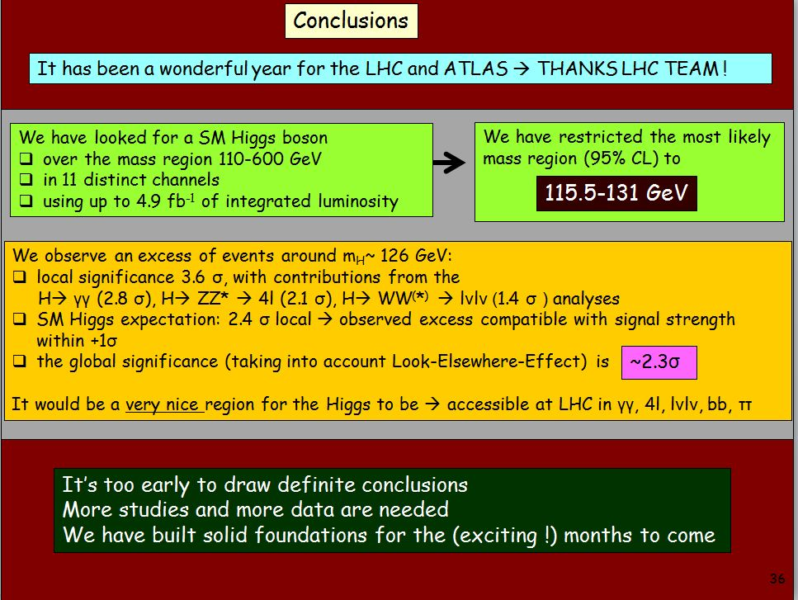
Typeface
Visual aids
– Textual content
“Using Comic Sans (except in comic strips)
is like doing physics in Imperial units.” Alastair Houghton
Fabiola Gianotti (CERN)

Slide 34
Font
Visual aids
– Textual content
Use a reasonable sized font
  This will prevent you from crowding your slides
20 pt
18 pt
A large font is annoying and fills up too much of the space available on the slide
A small font is almost impossible to read, especially for those people in the back who are squinting their eyes trying to figure out what is the $#!+ it is that you have on the slide.
Additionally, at this point, no one is listening to me and is instead desperately trying to figure out what it is that is written here. After all, it must be very important. Like I mentioned elsewhere, the slides should complement your talk, not replace it.
This is a 12 pt font which is great for normal text, but it is grossly inadequate for a talk.
As there are members of the audience who are slightly older than you (here, your evaluators, in the real world, your managers and vice presidents). They would like to see your slides, too.
Too much information on the slide

Slide 35
Language
Visual aids
– Textual content
Use correct grammar and spelling
  Each speling or gramatical mistake is a distraction
  Such errors will appear very unprofessonal
  If yew sea read underliming, cheque it
  Reread your slides after 48 hours
You must understand English grammar too abbreviate it

Slide 36


Observations
Visual aids
– Textual content
A few final observations:
  In general, use American spellings
    English is not everyone’s first language
  Use conventional capitalization
    WE ARE NOT USED TO READING IN ALL CAPITAL LETTERS
    It’s Also More Difficult To Read When The First Letters Are All Capitalized
  Avoid underling, boldface, and exclamation marks!

Slide 37

Images
Visual aids
A picture is worth a thousand words
Use them as they will
  Convey more information than text
  They’re more memorable
  Bad pictures are memorable, too
We will look at:
  Use
  Formats
  Image tools

Slide 38
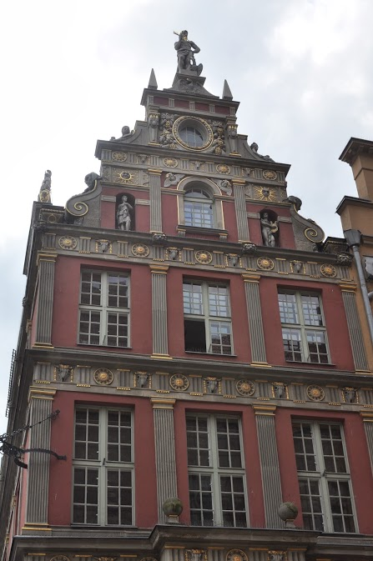


Spacing
Visual aids
– Images
Don’t crowd images
Each image should be
surrounded by both an
appropriate and bal-
anced amount of white-
space

Slide 39


Spacing
Visual aids
– Images
Don’t crowd images
  Whitespace allows the audience to focus
  on the individual images or graphs

Slide 40
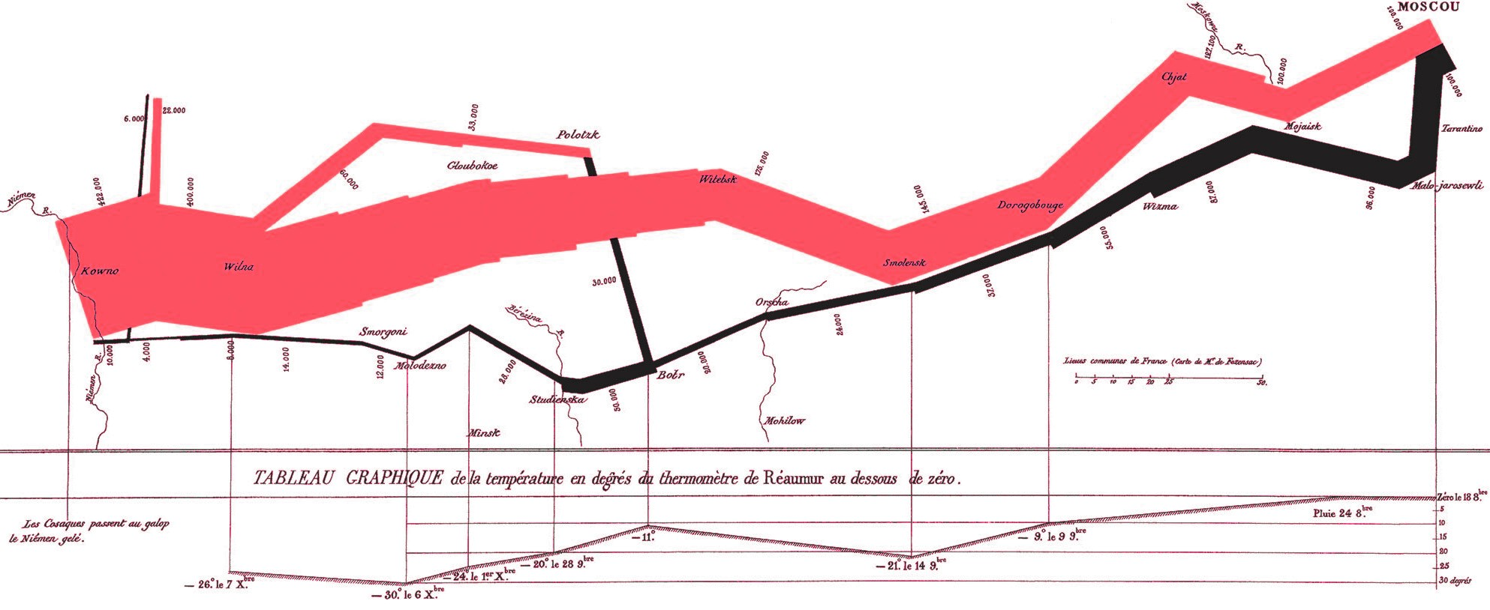
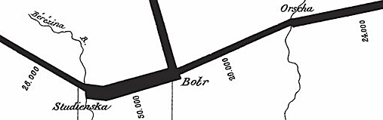
Use
Visual aids
– Images
This classic by Minard shows Napoleon’s advance on Moscow
  The path he took
  The number of surviving soldiers
  The effect of river crossings is clear
  The temperature during the retreat
  Reference your images…
145,000
400,000
24,000
4,000
Charles Minard, French Invasion of Russia, 1869

Slide 41














Use
Visual aids
– Images
Do not use images gratuitously—especially clipart
http://office.microsoft.com

Slide 42
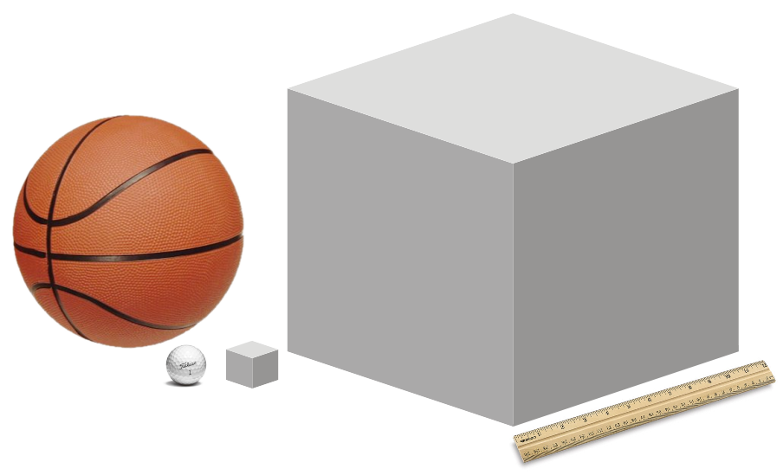

Use
Visual aids
– Images
Consider the Orbiter being hit by the foam during launch
  The simulations with a 3 cubic inch object predicted no damage
  Unfortunately, the foam that hit the space shuttle was 1920 cubic inches
www.titleist.com
http://www.acmeunited.com/
Michael Alley

Slide 43
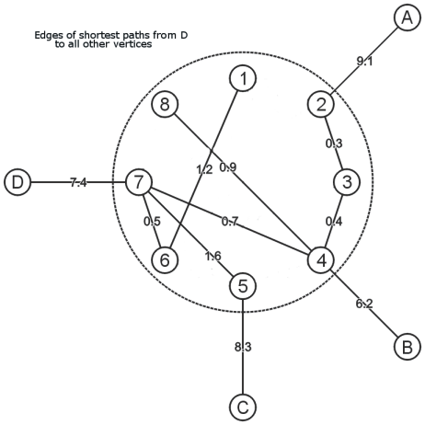
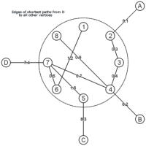
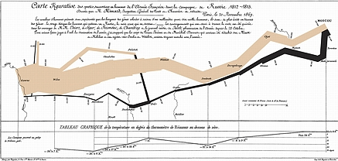
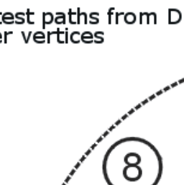

Use
Visual aids
– Images
Don’t blow up small images:
  Compare
  Imagine showing this image?
1200 × 1200
zoomed 200 × 200

Slide 44
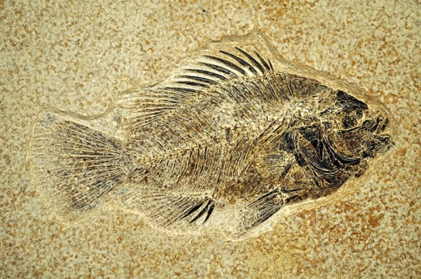
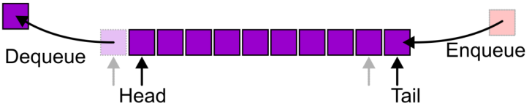
Formats
Visual aids
– Images
Two types of images:
  Photographs
  Graphics and line drawings
Image formats include:
  JPEG/JPG
  PNG
  GIF

Slide 45
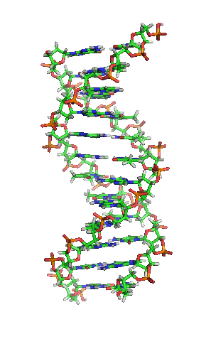

Formats
Visual aids
– Images
JPEG: Joint Photographic Expert Group
  Use with Photographs
PNG: Portable Network Graphics
  Use with graphics and line drawings
GIF: Graphics Interchange Format
  Don’t use it
  unless you need an animation
http://courses.bio.unc.edu/2011Fall/Biol202Section7/

Slide 46
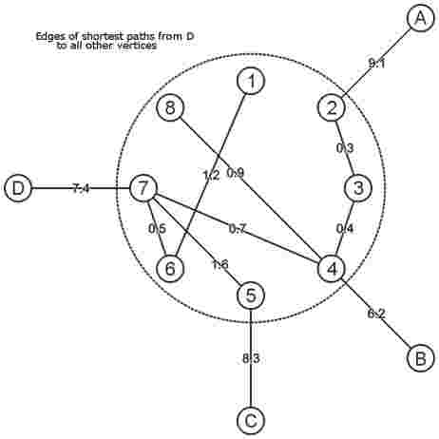

Formats
Visual aids
– Images
Comparing PNG and JPEG with graphics

Slide 47
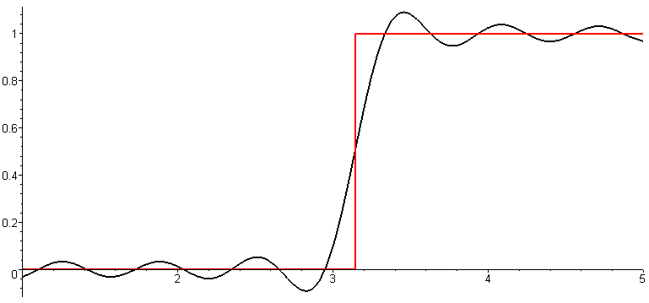
Formats
Visual aids
– Images
The waves are truncated Fourier series (MATH 211)
  Sharp transitions are smoothed
  Transients appear as speckles
Unit step function
Fourier approximation

Slide 48
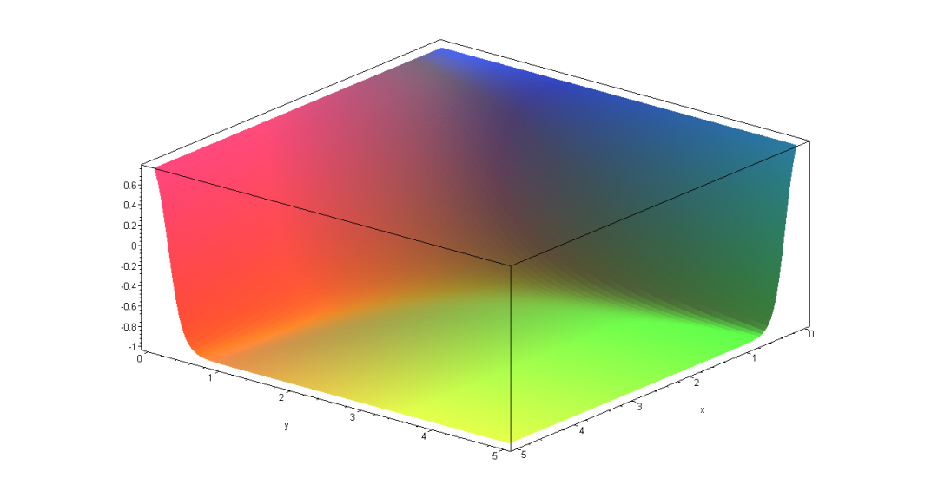



Formats
Visual aids
– Images
Comparing 24-bit PNG and 8-bit dithered GIF

Slide 49
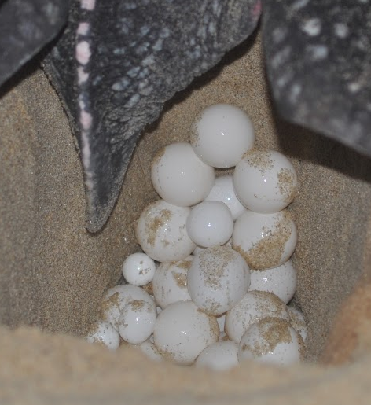
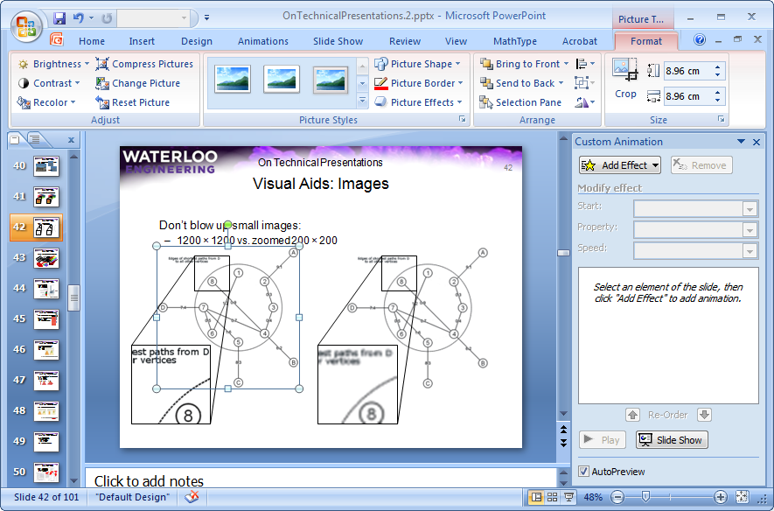

Tools
Visual aids
– Images
In PowerPoint, you can format images with Picture Tools
  Avoid Picture Styles
  Adjust the brightness and contrast
  Crop the image
  For example:

Slide 50
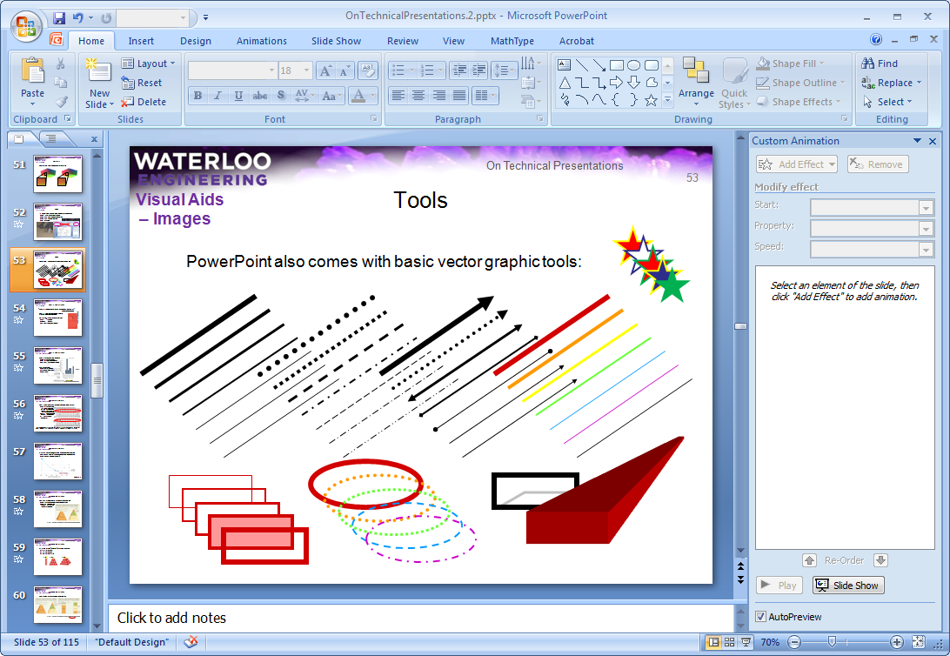
Tools
Visual aids
– Images
PowerPoint also comes with basic vector graphic tools:

Slide 51

Charts and graphs
Visual aids
“There are three kinds of lies: lies, damned lies, and statistics.”
Prime Minister Benjamin Disraeli
Charts and graphs are wonderful means of
presenting data, but be careful!
Darrell Huff's How to Lie with Statistics
  Fast: ~100 pages
  Cheap: $10-$20
  50 years old and still relevant!
http://www.wikipedia.org/

Slide 52
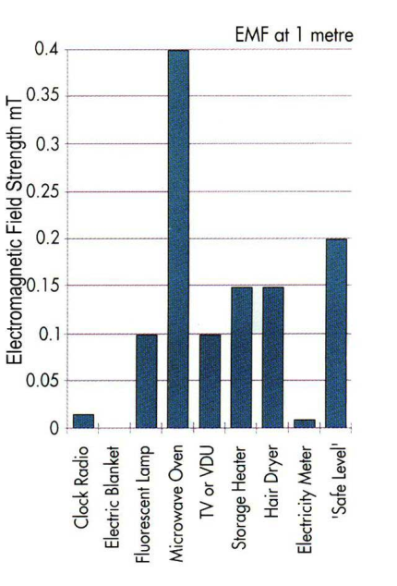
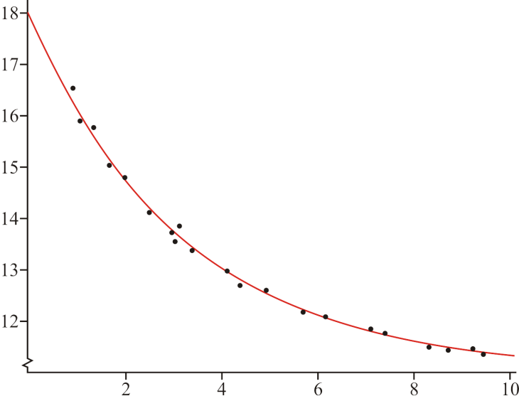
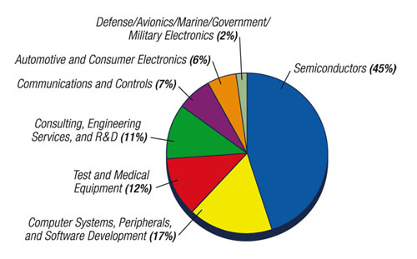
Charts and graphs
Visual aids
– Charts and graphs
They present your data graphically:
  Line graphs for trends
  Bar graphs for comparisons
  Pie charts for crude distributions
We will consider:
  Appropriate formats
  Manipulating graphs
  Chartjunk
www.designcon.com
www.official-documents.gov.uk

Slide 53
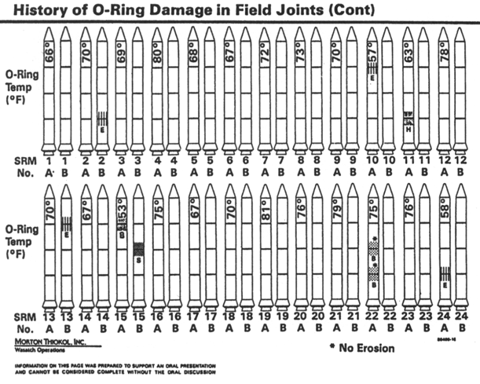
Appropriate format
Visual aids
– Charts and graphs
Don’t show graphs just to have images—the format is critical
  This graph was used
  to show issues with
  O-ring damage on the
  Space Shuttle prior to
  the Challenger launch
  Note the location of the
  launch temperatures
  It has a suitable
  disclaimer
INFORMATION ON THIS PAGE WAS PREPARED TO SUPPORT AN ORAL PRESENTATION
AND CANNOT BE CONSIDERED COMPLETE WITHOUT THE ORAL DISCUSSION

Slide 54
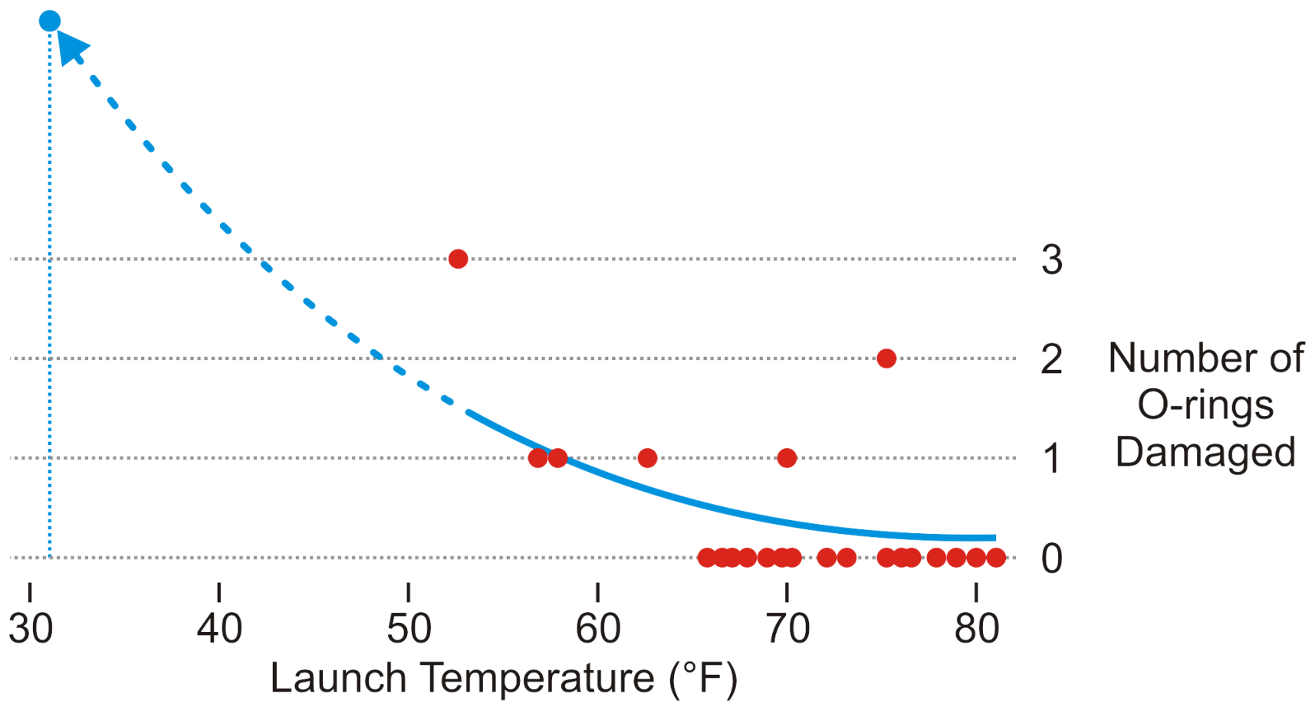
Appropriate format
Visual aids
– Charts and graphs
A more appropriate graph shows temperature versus damage
  No launch under 65 °F has not had at least one damaged O-ring
  The launch temperature was 31 °F
Edward Tufte

Slide 55
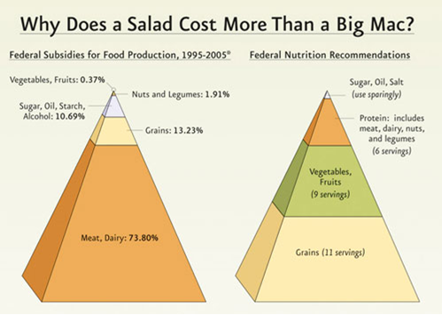
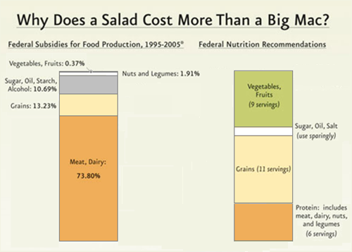
Manipulating graphs
Visual aids
– Charts and graphs
Don’t use images to mislead the audience:
  The left shows 1:4 as 1:64
From the PCRM: The Physicians Committee for Responsible (?) Medicine

Slide 56
Chartjunk
Visual aids
– Charts and graphs
Also, always be aware of chartjunk
  It would be difficult to allocate more pixels to showing just 12 data points
  Yet this is an example of a built-in chart in PowerPoint

Slide 57
Other representations
Visual aids
If you cannot use images or graphs to present your date, consider:
  Tables
  Mathematics or equations
  Source code
Use these sparingly and avoid if possible

Slide 58
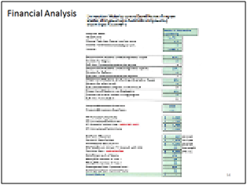
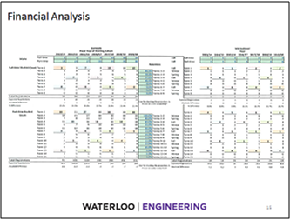
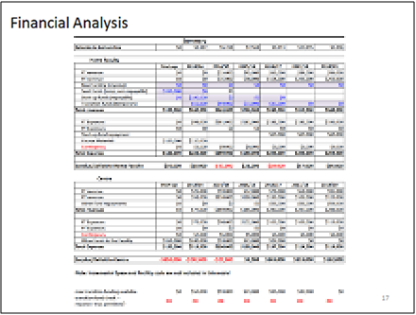
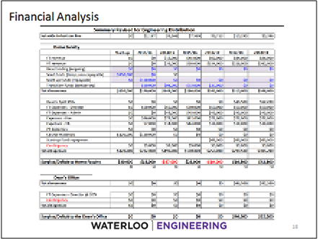
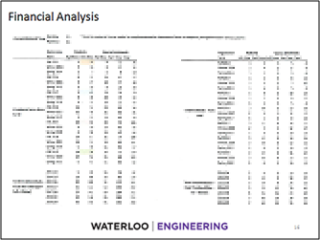
Tables
Visual aids
– Other representations
Raw tables of data will distract
and frustrate the audience
  Leave such tables for an appendix
  in a related report
7½ pt font
6 pt font
29 pt font

Slide 59
Tables
Visual aids
– Other representations
For the presentation, determine the essential information
  You could show interesting or relevant items
  Where possible, use statistics:
  If you’re too lazy to find what’s important, why should else should care?
Test | Power Rate [W/s] |  | d_{p}10³ [V] | C [A] | AT [s]
 | W_{p} | W_{a}
2 | 435 | 860 | 0.840 | 0.10 | 5.84
15 | 1157 | 925 | 4.000 | 0.65 | 0.13
Category | Mass Rate [W/s]
 | W_{p} | W_{a}
Small | 430 ± 30 | 8.8 ± 0.6
Large | 1140 ± 40 | 9.1 ± 0.8

Slide 60
Tables
Visual aids
– Other representations
If you include a table, minimize the PowerPoint “features”
  This table has a lot of chartjunk
Element | Atomic Number | Atomic Mass | State at STP | Filling Orbital | Element category
Hydrogen | 1 | 1.00794(7) g/mol | gas | 1s¹ | nonmetal
Helium | 2 | 4.002602(2) g/mol | gas | 1s² | noble gases
Lithium | 3 | 6.941(2) g/mol | solid | 2s¹ | alkali metal
Beryllium | 4 | 9.012182(3) g/mol | solid | 2s² | alkaline earth metal
Boron | 5 | 10.811(7) g/mol | solid | 1p¹ | metalloid
Carbon | 6 | 12.0107 g/mol | solid | 1p² | nonmetal
Gold | 79 | 196.966569(4) g/mol | solid | 6s¹ | metal

Slide 61
Tables
Visual aids
– Other representations
Use proper alignment and minimize unnecessary chartjunk
Units
Element | Atomic Number | Atomic Mass (g/mol) | State at STP | Filling Orbital | Element Category
Hydrogen | 1 | 1. 00794(7) | gas | 1s¹ | nonmetal
Helium | 2 | 4.002602(2) | gas | 1s² | noble gases
Lithium | 3 | 6.941(2) | solid | 2s¹ | alkali metal
Beryllium | 4 | 9.012182(3) | solid | 2s² | alkaline earth metal
Boron | 5 | 10.811(7) | solid | 1p¹ | metalloid
Carbon | 6 | 12.0107 | solid | 1p² | nonmetal
Gold | 79 | 196.966569(4) | solid | 6s¹ | metal
Element | Atomic Number | Atomic Mass | State at STP | Filling Orbital | Element category
Hydrogen | 1 | 1.00794(7) g/mol | gas | 1s¹ | nonmetal
Helium | 2 | 4.002602(2) g/mol | gas | 1s² | noble gases
Lithium | 3 | 6.941(2) g/mol | solid | 2s¹ | alkali metal
Beryllium | 4 | 9.012182(3) g/mol | solid | 2s² | alkaline earth metal
Boron | 5 | 10.811(7) g/mol | solid | 1p¹ | metalloid
Carbon | 6 | 12.0107 g/mol | solid | 1p² | nonmetal
Gold | 79 | 196.966569(4) g/mol | solid | 6s¹ | metal

Slide 62
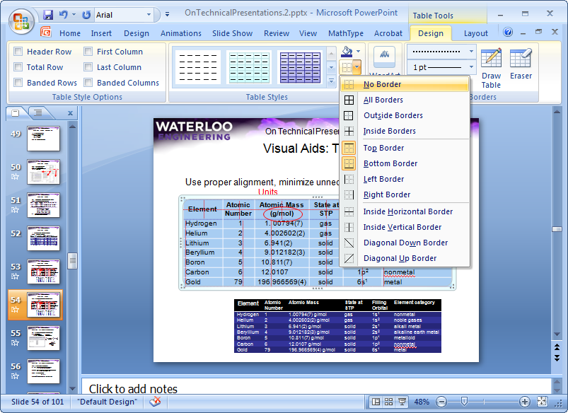
Tables
Visual aids
– Other representations
In PowerPoint, you can format tables
  Turn off all Table Style Options
  Select all cells of the table and select No Border
  Reinsert appropriate borders with the Draw Borders tool

Slide 63
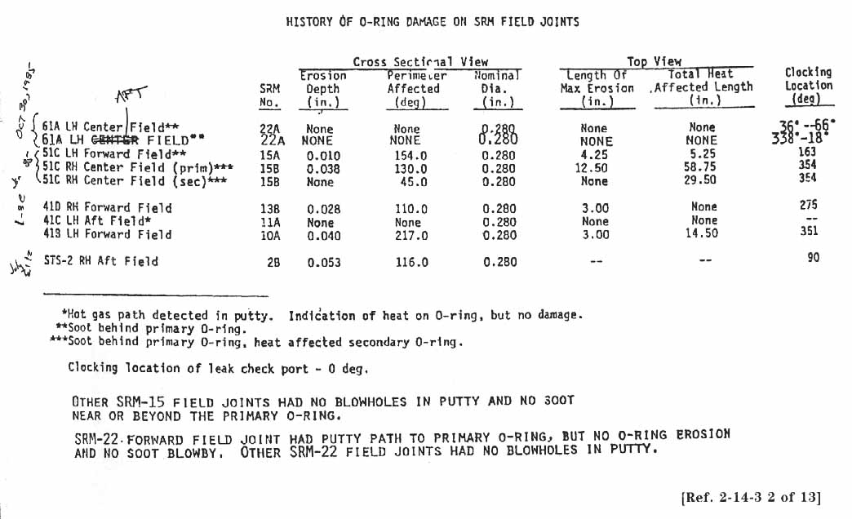
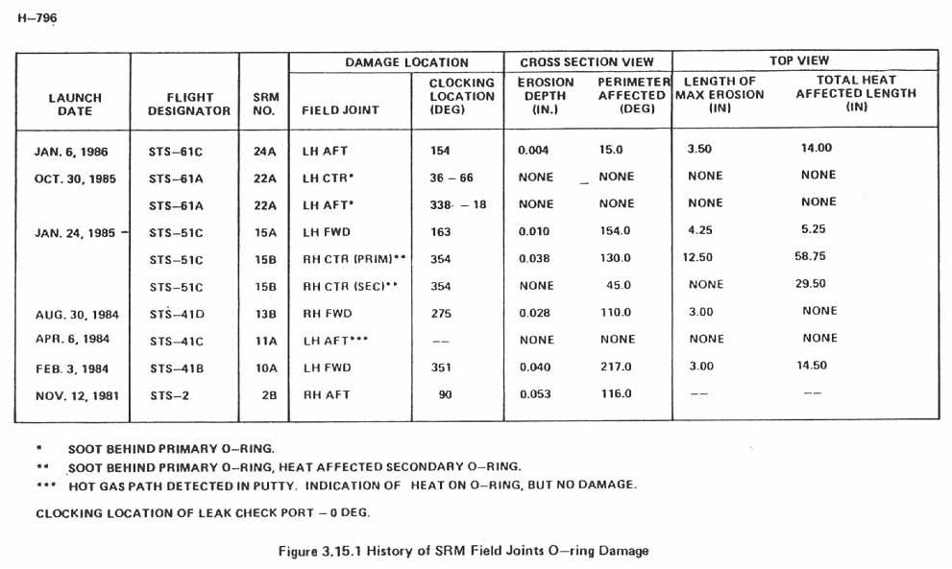
Tables
Even before PowerPoint, it was easy to make bad tables
  PowerPoint makes it easier

Slide 64
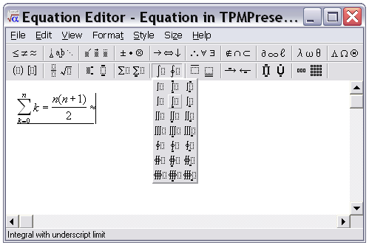
Mathematics
Visual aids
– Other representations
For mathematical expressions, use an equation editor
  In PowerPoint
    From the menu, select: Insert → Object...
    From the dialog box, select: Microsoft Equation 3.0

Slide 65
Mathematics
Visual aids
– Other representations
Use Times New Roman for mathematics
  Italics for variables, constants and arbitrary functions
  a + b + c + ... + x + y + z + e ^{jπ} + f (g(x))
  Roman (upright) for numbers, units, operators and standard functions
  3² + 4² = 5² 6 V × 9 C = 54 J sin(x)
  Bold for vectors and matrices
  Ax = b
  Do not use ‘x’ for multiplication, i.e., use 6 × 9 = 42, not 6 x 9 = 54
Symbol typeface

Slide 66
Source code
Visual aids
– Other representations
If you must use source code, use Consolas:
#include <iostream>
using namespace std;
int main() {
for ( int i = 1; i < 500; ++i ) {
cout << "I will NOT throw paper airplanes in class." << endl;
}
return 0;
}

Slide 67


Presentation software
Visual aids
Unless you’re keen, use PowerPoint:
  It has many best practices
  Be careful...it has many “features”, too
  A template is available on the web site
Other presentation software packages are available:
  Apple Keynote
  OpenOffice.org Impress
  Corel Presentations
  Beamer for L^{A}T_{E}X
Bring your own computer with an
analogue VGA connector/adaptor

Slide 68


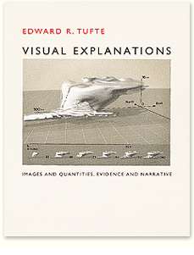
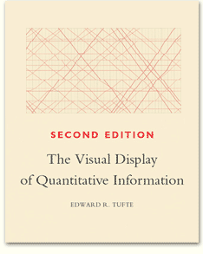
Visual aids
We have covered six aspects of visual aids:
  Look and feel
  Text
  Images
  Charts and graphs
  Other representations
  Presentation software
Consider any publication by
Edward Tufte
http://www.edwardtufte.com/

Slide 69
Aspects of good presentations
The slides are ready—now you must present the talk
  Interest and knowledge
  Organization
  Visual aids
  Presentation skills
  Responding to questions

Slide 70
Presentation skills
Aspects that will affect the speaker’s presentation:
  Fear
  Composure
  Communication
  Presentation aids

Slide 71

Fear
Presentation skills
Fear:
  Increases
    Blood flow and rate
    Blood-sugar levels
    Respiration
  Diverts blood to the brain and
  skeletal muscles
  Dilates pupils
  Increases perspiration and
  decreases saliva secretion
  Erects hair
  Causes faster blood clotting

Slide 72

Fear
Presentation skills
This is a natural animal response
  Sometimes termed “fight or flight”
You can harness this energy
  Accept that it will happen
  Use the extra energy in a positive manner
If fear is attacking you, pause for a few seconds
  Sip some water (do not gulp)
http://charuzu.wordpress.com/2009/01/14/the-most-precious-drink-of-all/

Slide 73


Fear
Presentation skills
Steps to avoid nervousness:
  Your audience wants you to succeed
  Be prepared and practice
  Stay within your bounds of knowledge
  Focus on the message
  Use the properties of fear
  Gain experience
  Bring a glass of water
  Dress up
Ignas Kukenys

Slide 74
Composure
Presentation skills
We will look at four aspects of composure:
  Appearance
  Stance
  Movement
  Mannerisms

Slide 75
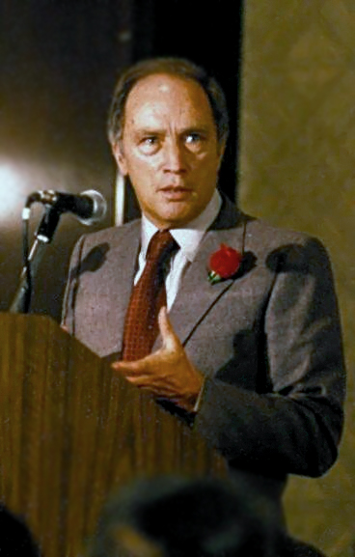

Appearance
Presentation skills
– Composure
Appearance:
  Dress up
    If you believe you look good, you will feel good
    Consider darker colors and shirts with collars
http://theglasshammer.com/

Slide 76

Stance
Presentation skills
– Composure
Stance:
  Stand up straight
  Your feet should be shoulder width apart
  Have approximately equal weight on both legs
  Don’t be too rigid nor too relaxed
http://gawkerassets.com/
http://theglasshammer.com/

Slide 77
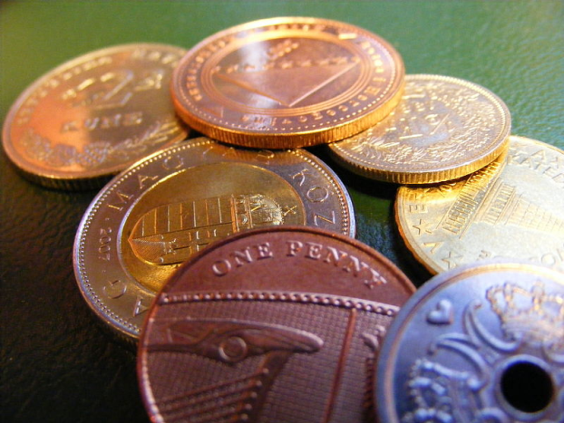
Movement
Presentation skills
– Composure
Movement:
  Don’t pace back-and-forth
  Use movement to indicate a transition
    Take two steps left or right when starting a new topic
  Act naturally
  Empty your pockets of anything that makes noise

Slide 78
Mannerisms/distractions
Presentation skills
– Composure
Mannerisms:
  We all have them—most of us don’t notice our own
  Get a friend to watch you
  Things to watch for:
    Hooking fingers in your belt
    Standing or holding your head crooked
    Odd hand positions
    Fiddling with watches, rings or other jewelry
    Playing with zippers
    Rocking back-and-forth on your feet

Slide 79
Communication
Presentation skills
Five aspects of communication:
  Eye contact
  Voice
  Language
  Interaction
  Humor

Slide 80

Eye contact
Presentation skills
– Communication
Maintain eye contact with the audience
  Avoid looking at your slides or notes, the screen, floor, ceiling, or walls
  Make eye contact with each audience member for at least a second
  Lack of eye contact suggests lack-of-trust
  Do not focus on one individual
Nineteen Eighty-Four, Virgin Films

Slide 81

Eye contact
Presentation skills
– Communication
Maintain eye contact by:
  Understanding your talk
  Practicing
  Having brief slides/notes
    Long notes will force you
    to search through them
Steve Jurvetson

Slide 82
Your voice
Presentation skills
– Communication
You must maintain the interest of your audience with your voice
  Your voice must be sufficiently loud for everyone to hear
    use a microphone if necessary
  A quiet voice implies insecurity or uncertainty
You must speak clearly
  Do not slur your words: the audience will focus on your speech,
  not what you say

Slide 83
Your voice
Presentation skills
– Communication
Your voice and speech has a number of characteristics which you can change, including:
  Volume
    Increase for emphasis, decrease for subtleties
  Pace
    160 words per minute—quicken for emphasis
  Tone
    Monotonic voices put readers to sleep
  Inflection
    Accents and emphasis will focus the audience

Slide 84
Language
Presentation skills
– Communication
The language you use should be professional…
Okay?
Umm....
Absolutely not!
Definitely!
despite the fact that...
Foobar
We will utilize ...
Well, ...
man-made
It is a definite fact, ...
..., you know?
Like, ...
I mean, ...
manpower
in light of the fact that...
Randi Speaks, Skeptics Guide to the Universe, Episode 181.

Slide 85
Language
Presentation skills
– Communication
The language you use should be professional…
  Avoid fillers, jargon, colloquialisms, slang, swearing, gender-specific or verbose language
Okay?
Umm....
Absolutely not!
Definitely!
No.
despite the fact that...
Foobar
because...
Yes.
synthetic
We will utilize ...
Well, ...
man-made
use
It is a definite fact, ...
..., you know?
Like, ...
I mean, ...
human resources
manpower
in light of the fact that...
because

Slide 86
Language
Presentation skills
– Communication
Just avoid noisy pauses and fillers…
Instead, a silent pause will not even be noticed by the audience
Okay!!!
Okay?
Okay!
Okay?
Okay?
Okay?
Okay?
Okay?
Okay?
Okay?!
Okay?
Okay!!!
Okay?
Okay?
Okay?
Okay?!
Okay?
Okay!!!
Okay!!!

Slide 87
Interaction
Presentation skills
– Communication
As part of your interaction, try making a personal connection
  What makes you, personally, interested in the subject matter?
  Can you convey that enthusiasm to the audience?
Do you want to interact with the audience?
  This depends on the audience:
    If significant amounts of new material are being presented,
    delay any discussions to the end
    If the audience is acquainted and informed, you can engage in a discussion if the subject matter is relevant
  Your technical presentations will not have audience interaction

Slide 88



Humor
Presentation skills
– Communication
Humor should be used sparingly
  Our attention begins to drop after 15-20 minutes
    Humor forms a distraction that can reset the brain
    The audience can listen for another 15-20 minutes
  The shorter and more critical the
  presentation, the more careful you
  must be when inserting humor
  Be natural
    Say something you think is funny
    Some people just can’t tell jokes…
    don’t worry about it
Ricardo Liberato
Blackadder, BBC1
© Pan Books

Slide 89
Presentation aids
Presentation skills
Presentation aids can significantly help
We will consider:
  Wireless remotes
  Laser pointers
  Using presenter view
  Built-in links

Slide 90


Wireless remotes
Presentation skills
– Presentation aids
Imagine Al Gore running back and forth to the computer to hit the space bar in An Inconvenient Truth
Fortunately, we provide you
with a wireless remote
An Inconvenient Truth
www.logitech.com

Slide 91

Laser pointers
On technical presentations
Presentation skills
– Presentation aids
A few words on laser pointers:
  Use them sparingly
People will play karaoke with the laser pointer
  Honest, your audience isn’t stupid
  If you’ve read one point
  They’ll probably figure out that you’re going to the next
  One presenter left the laser on for a full 20-minute talk
http://laser.ankaka.com/

Slide 92


Laser pointers
Presentation skills
– Presentation aids
Use the pointer to indicate details which you cannot easily describe
User:C J Cowie
Xilinx Inc.

Slide 93


Presenter view
Presentation skills
– Presentation aids
Normally, your presentation is on a separate screen
  The default is to view the presentation on both screens
  Selecting Use Presenter View under Slide Show→Monitors shows your notes as well as surrounding slides
ensceptico
Erlend Aakre
Intel Free Press
http://www.audiovisualsales.com.au/

Slide 94
Presentation skills
We have covered four aspects of presentation skills:
  Fear
  Composure
  Communication
  Presentation aids

Slide 95
Aspects of Good Presentations
You have now finished the presentation—you must now respond to questions from the audience:
  Interest and knowledge
  Organization
  Visual aids
  Presentation skills
  Responding to questions

Slide 96

Responding to questions
You finish your presentation
  You say “Are there any questions?”
  The timer stops
  You’re under 15 minutes
The audience may now ask you questions:
“the presentation after the presentation”
We will consider:
  Getting ready
  What to do
  What not to do
  No answer?
  Don’t be a dick
Welcome Back, Kotter
Warner Bros. Television Distribution

Slide 97
Getting Ready
Responding to questions
Following any technical presentation is an opportunity for the audience to ask questions
  This is the last (and most lasting) impression the audience will have
While preparing your talk, anticipate possible questions
  If possible, prepare additional slides for anticipated questions!
  Such slides would go into further depth than what was discussed
  If you don’t use them, it will benefit your talk never-the-less

Slide 98
What to do
Responding to questions
When answering questions:
  Repeat the question
    This makes sure you heard the correct question
    The audience may not have heard the question
    It gives you time to think about an answer
  Ensure you understand the question
    If necessary, ask for clarification
  Take a moment to think about your answer

Slide 99
What not to do
Responding to questions
Do not:
  Evaluate questions: “Great question!”
  Lie or make-up an answer
  Answer a similar—but easier—question
  Talk around or ignore the question
  Talk as if you’ve answered the question
These will negatively impact your talk
  One foolish answer will make the audience question everything
The inequality:
  10 h work + 15 min presentation + 1 stupid answer < 0

Slide 100

No answer?
Responding to questions
Valid non-answers (to at least some questions) are:
  “I don’t know”, or
  “I don’t know, but I’ll get back to you”
    but do get back to that person (credibility)...
Hedge your answers if necessary:
  “I may be wrong, but...”
  “It is my understanding that...”

Slide 101

Don’t be a dick
Responding to questions
Not all questions are valid:
  A question may be outside the scope of the presentation
The TPM sessions are not a forum to demonstrate
your superior intellect by crushing the speaker
© Paramount Pictures

Slide 102

Aspects of good presentations
We’ve covered five aspects of giving good technical presentations:
  Interest and knowledge
  Organization
  Visual aids
  Presentation skills
  Responding to questions
Mastering these skills takes
time and practice....
http://digitaljournal.com/article/295809

Slide 103

Failing your proficiency examination
Sew, you gave you’re presenting, butt yew
  Forgot
  Used
  wrote down everything you wanted to say on your slides and then sat there and read them to the audience, keeping your back to them while you drawl on...
  did not practice
  Waited until two days before the talk to start thinking about your topic
  picked your nose
  Went over time
  Printed your work-term report
  Lied
and you
Your
slides
the
wrong
font
and
COLOUR

Slide 104
Failing your proficiency examination
If you do not clear the milestone in 2B, you have one second opportunity either:
  In 3A, or
  In the work-term following 2B
    If near Waterloo
If you do not clear with this 2nd attempt, you must take SPCOM 223 or an equivalent course
  Attending 12 sessions of Toastmasters gives you another opportunity

Slide 105
Failing your proficiency examination
If you do not show up for your scheduled 2B presentation:
  No second opportunity
  You must take SPCOM 223 or an equivalent course
Illnesses require a Verification of Illness form with a serious illness
Interviews, in general, do not last three hours:
  We will accommodate you—contact the evaluators ASAP
  Bring proof of the interview

Slide 106
Failing your proficiency examination
Important points:
  2B is likely easier than 3A
  It takes 10-15 hours to prepare
  A course will require 36 hours plus preparation
  Giving the same talk twice will probably result in two fails

Slide 107



Summary
No one is a born public speaker
  Walking is intuitive only because you’ve been doing it for 17 years
I’ve made every mistake described in this talk
You can—and will—improve
with effort and practice
clubs.calvin.edu/
User: Zscout370
© 20th Century Fox

Slide 108
Summary
The last talk included:
  Interest and knowledge
  Organization
In the last hour, we’ve discussed:
  Visual aids
  Presentation skills
  Responding to questions
We concluded with the consequences of failing

Slide 109
Any questions?
A good presentation is a three-act play:
a beginning, a middle, and an end
Universities’ Study Transport Group
References
All references are listed on
http://ece.uwaterloo.ca/~tppe000/
http://ece.uwaterloo.ca/~dwharder/TechnicalPresentations/
All unreferenced images are either copyright free or are the work of the author
Some images are published under the GFDL
  http://www.gnu.org/copyleft/fdl.html

