Slide 1

On technical presentations
Part 1
TPM Technical Presentation Milestone
Douglas Wilhelm Harder
Department of Electrical and Computer Engineering
http://ece.uwaterloo.ca/~tppe000/
University of Waterloo
February 2, 2016
Copyright © 2008-13 by Douglas Wilhelm Harder. Some rights reserved.

Slide 2
Outline
This two-session presentation covers:
  Background
  The milestone
  Bad presentations
  Aspects of a good presentation:
    Interest and knowledge
    Organization
    Visual aids
    Presentation skills
    Responding to questions
  Consequences of failures

Slide 3
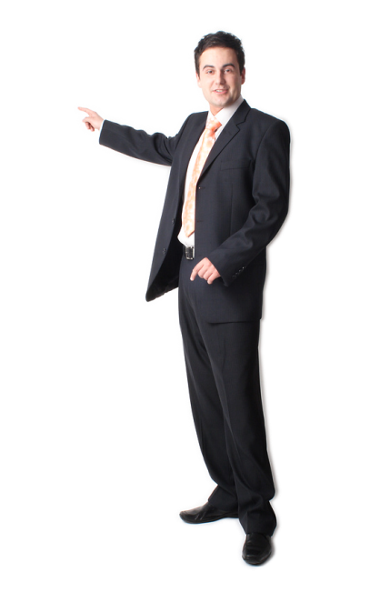

Background
Why do you care?
  Engineers, in general, work together
  However, on any project, the individual presenting is always
  perceived as having given the greatest contribution
Self Leadership International http://www.selfleadership.com/
Public Relations Society of America http://http://prsareno.org/

Slide 4

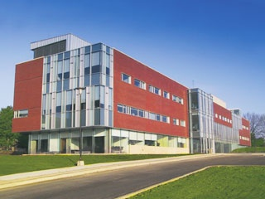
Background
The University of Waterloo has always had a co-op program
Our employers told us:
  “Your students cannot give presentations...”
We introduced the Technical Presentation Milestone
  Two evaluators and a peer audience
  A 12-15 minute slide-based presentation
  A questions-and-answers session follows
http://www.uwaterloo.ca/

Slide 5
Background
Two primary means of technical communication:
  Written reports
  Oral presentations
Each has its own distinctive characteristics
  Time scale, references, feedback, ...

Slide 6
Background
The benefits of presentations:
  The focus is on the speaker
  It’s interactive
  Emphasis of key points is easier
  The flow is dynamic
    You can gauge if the audience is interested, confused or bored
  Live personalities command attention
  Presentations use many senses
  The audience is guaranteed to have been exposed to the material

Slide 7
Background
The benefits of reports:
  The focus is on the information with more details
  There is no reliance on personalities and no time coordination
  Readers can
  Review relevant background at their own leisure
  Read at their own pace
  Review the material multiple times

Slide 8
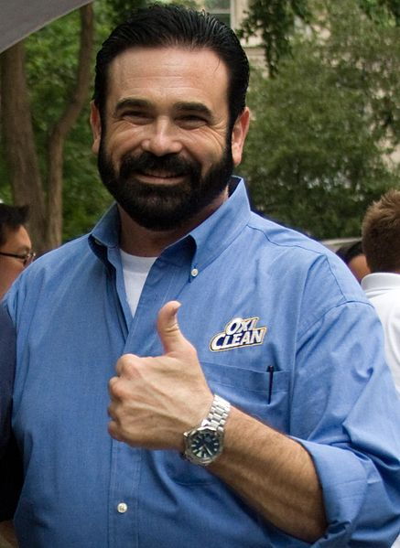
Background
A technical presentation
  Informs
  Persuades
A technical presentation does not
  Sell/pitch
  Teach/lecture
Sharese Ann Frederick

Slide 9
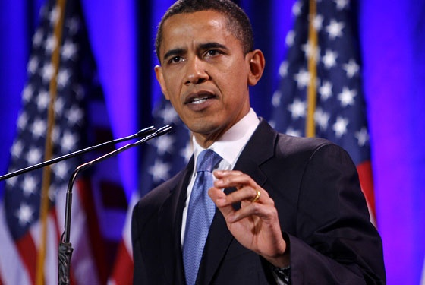
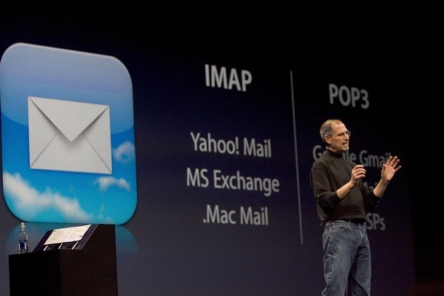
Background
Presentations may be with or without supporting visual aids
  Each choice has advantages and disadvantages
  Without visual aids, the speaker is the focus
  Dynamic and enthusiastic
  Requires significant preparation
  Difficult for presenting technical data
http://www.nymag.com/
Visual aids take attention from the speaker
  Greater focus on the data
  Helps the speaker recall the flow
  Not meant to be dynamic
http://www.daylive.com/

Slide 10
The Technical Presentation Milestone
2B students are scheduled in 3-hour sessions with five other students
  TPM 1X000
Each 2B student will:
  Bring a .ppt or .pptx presentation on a USB key
  Bring two copies of the TPM Evaluation Form
  Be present for all presentations (2-3 hours)
  Ask at least one question of another presenter
Bring your own computer if you choose a different format
  Your responsibility—and bring an analogue VGA adapter…

Slide 11
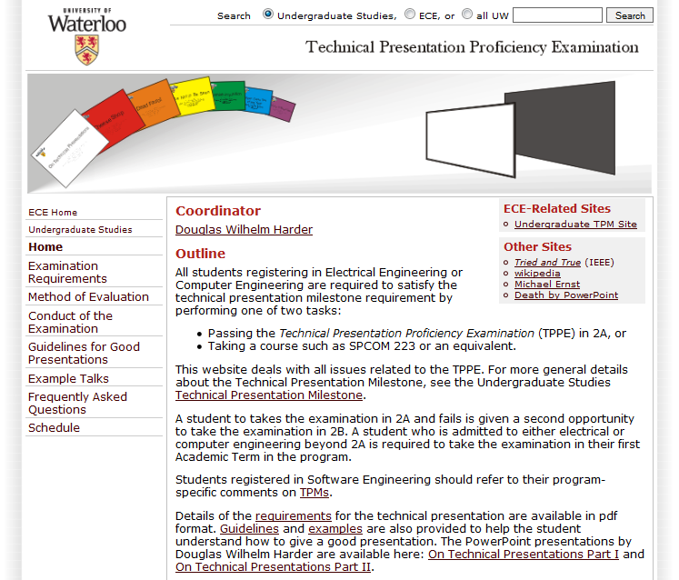
The Technical Presentation Milestone
Information available at:
  http://ece.uwaterloo.ca/~tppe000/
This site includes:
  Requirements and Evaluation
  Conduct
  Guidelines
  Example Talks
  FAQ
  Check List
  Schedule

Slide 12
The Technical Presentation Milestone
Grading is based on four aspects:
  Organization
  Visual aids
  Presentation skills
  Questions
Each is equally weighted
  A pass is 75%

Slide 13
The Technical Presentation Milestone
Statistics:
  Failure rates fluctuate between 2% and 25%
    Based on the attitude of the class—the evaluators don’t change
  Numerous students have ignored this milestone and were surprised when they were not enrolled in 4A (previously 3B)
  Question: How do they fail?

Slide 14
The 10 Commendments
The 10 Commendments for giving badly presentations
by David Patterson
Computer Science Division, University of California-Berkeley
I. Thou shalt not be neat
  Why waste research time preparing slides? Ignore spelling, grammer and legibility. Who cares hat 50 people think?
II. Thou shalt not waste space
    Don’t waste time changing slides. Your audience will understand the big picture better if they see all the information
    simultaneously.
III. Thou shalt not covet brevity
    Do you want to continue the stereotype that engineers can't write? Always use complete sentences, never just key words. If
    possible, use whole paragraphs and read every word.
IV. Thou shalt not expose thy naked slides
    You need the suspense! Expose only one point at at a time.
V. Thou shalt not write large
    Be humble: use a small font. You can fit more information into a slide. Importantpeople sit in front. Who cares about the riff-raff?
VI. Thou shalt not use color
    Flagrant use of color indicates imprecise research. It's also unfair to emphasize some words over others.
VII. Thou shalt not illustrate
    Confucius says “A picture equals a thousand words.”
    Dijkstra says “Pictures are for weak minds.”
VIII. Thou shalt not make eye contact
    You should avert eyes to show respect. Blocking screen can also add mystery.
IX. Thou shalt not skip slides in a long talk
    You prepared the slides; people came for your whole talk; so just talk faster. Skip your summary and conclusions if necessary. If you pack
    enough information onto each slide,

Slide 15
The 10 Commendments
X. THOU SHALT NOT PRACTISE
      THIS COMMENDMENT IS CRITICAL TO YOUR SUCCESS IN GIVING A BAD PRESENTATION

Slide 16
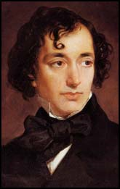
Aspects of good presentations
It is easy to say what not to do during a presentation
  Don’t read the screen with your back facing the audience
  Don’t play with your zippers
It is difficult to describe how to give a good presentation
  “How much easier it is to be critical than to be correct.”
Benjamin Disraeli .
http://www.spartacus.schoolnet.co.uk/

Slide 17
Aspects of good presentations
We will look at five aspects of a presentation:
  Interest and knowledge
  Organization
  Visual aids
  Presentation skills
  Responding to questions

Slide 18
Aspects of good presentations
We will begin with the fundamentals:
  Interest and knowledge
  Organization
  Visual aids
  Presentation skills
  Responding to questions

Slide 19
Interest and knowledge
Aspects of interest and knowledge:
  Interest and enthusiasm
  Knowledge and expertise

Slide 20

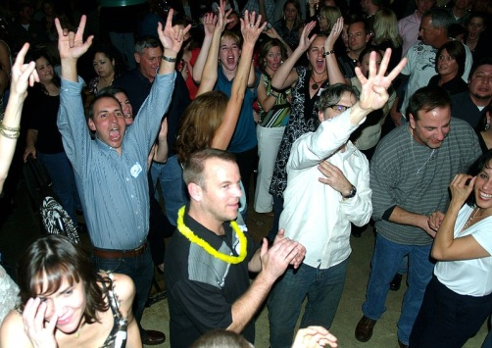
Interest
Interest and knowledge
“Nothing great has been accomplished without passion.”
  Georg Hegel
  19th-century philosopher
You must be interested in your topic
  Enthusiasm is contagious
  So is boredom
David Shankbone
Photo by Adam Jones adamjones.freeservers.com

Slide 21
Knowledge
Interest and knowledge
Technical presentations require knowledge and expertise
  Speaker must not present to the limit of their knowledge
  Requirements:
    A general understanding of the broader scope
    A solid understanding of the topic
    A general understanding of relevant specific details

Slide 22

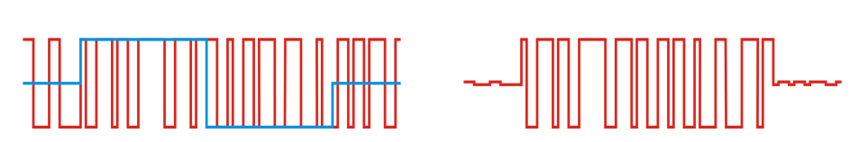
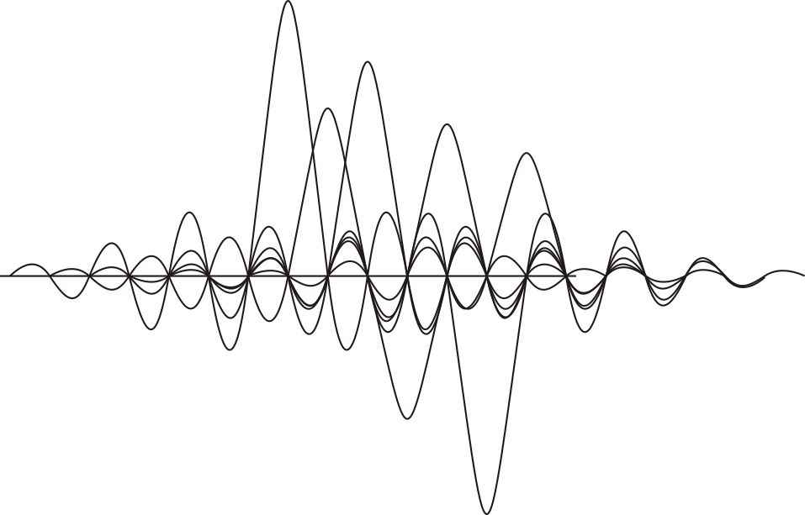
Knowledge
Interest and knowledge
Example: Wireless Local Area Networks standards
  Must have a general knowledge of wireless and modulation
  Must have an in-depth knowledge of IEEE 802.11a, b, and g
  Must have a general understanding of modulation techniques
    E.g., Direct-sequence spread spectrum
    Orthogonal frequency-division multiplexing

Slide 23
Interest and knowledge
Interest and knowledge are the foundation
  The topic interests you
  Take time to investigate and research the topic
Next, we will organize the talk…

Slide 24
Aspects of good presentations
Our second topic:
  Interest and knowledge
  Organization
  Visual aids
  Presentation skills
  Responding to questions

Slide 25
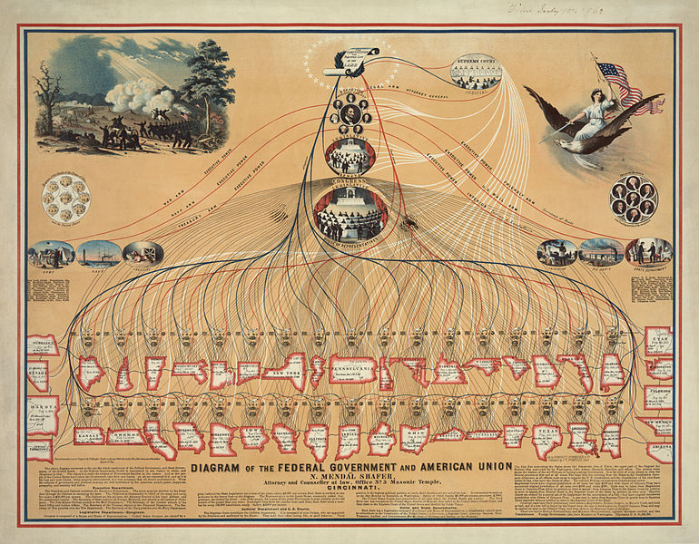
Organization
You must now organize your thoughts
Five aspects of organization:
  Situation
  Objective
  Structure
  Scalability and flow
  Timing

Slide 26

Situation
Organization
What is your situation?
  What is the motivation?
  Who is the audience?
    What is their technical level?
    What are their expectations?
    What are your expectations of them?
  How much time do you have?
  Any preconceived notions or misinformation?
  What time of the day will it be?
  Should I bring coffee?
Pedro Cardoso, “Stop Death By PowerPoint - Make Your Presentations "suck" Less”

Slide 27

Objective statement
Organization
You should summarize the objective in one sentence:
    “To introduce technical presentations and the milestone; and to
    give an overview of guidelines for a good technical presentation.”
This helps focus your talk:
  For any slide, image, bullet point: “Does it help me reach my objective?”
  If “no”, then save that gem for it for later
http://www.anniversaryrings.net/

Slide 28
Structure
Organization
We have our objective; we must now structure the talk:
  The speaker has one opportunity to present
  The audience has one opportunity to observe
  There is no opportunity for reviewing relevant background
  “Tell them what you’ll tell them, tell them, and tell them what you told them”
We will consider:
  Framing your talk
  The components of the talk

Slide 29
Framing
Organization
– Structure
The presentation must be appropriately framed
  This requires an introduction and conclusion
The talk must start with a point of reference:
  Introduction to the topic and speaker
  An brief overview
The talk must finish with a reinforcement:
  A summary and conclusions

Slide 30

Framing
Organization
– Structure
This framework is supported by three slides:
  A title slide
  An outline
  A summary and conclusions
All three are required in any presentation

Slide 31

Framing
Organization
– Structure
The Title Slide contains:
  A descriptive title
  The speaker’s name and affiliation
  Today’s date
At this point:
  Introduce yourself and your
  affiliation and collaborators
  Give a one- or two-sentence
  summary

Slide 32
Framing
Organization
– Structure
The second slide is the outline
  It is the framework for the talk
    Anticipation
    Familiarity
The second-last slide summarizes your thoughts
  Numerous ideas have been presented
    Emphasize the most significant
You may have one final slide with:
  “Questions?” or “Any questions?”
  A memorable and relevant quote or image
  Your references

Slide 33
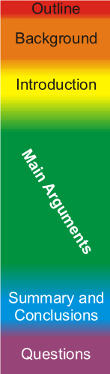
Components
Organization
– Structure
The Title, Outline, and Summary frame the talk
The presentation interpolates these with
  An introductory section
    Outline, background and introduction
    “The big picture”
  A body
    Your main arguments
  Concluding remarks
    Conclusions, recommendations and then a summary
    Discuss the scope within the bigger picture

Slide 34
Components
Organization
– Structure
The introduction includes:
  The title and outline slides
  The big picture: why is the audience here?
  Necessary background information
  The introduction of the topic
The introduction should be:
  Memorized
  Free of new information and facts

Slide 35
Background
Organization
– Structure
Background information should not be detailed
Give sufficient information for the audience to follow the presentation
  Understand the level of your audience
  Assume they are intelligent

Slide 36
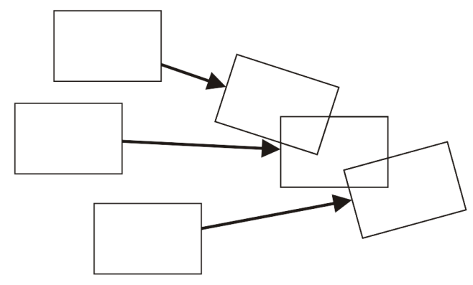
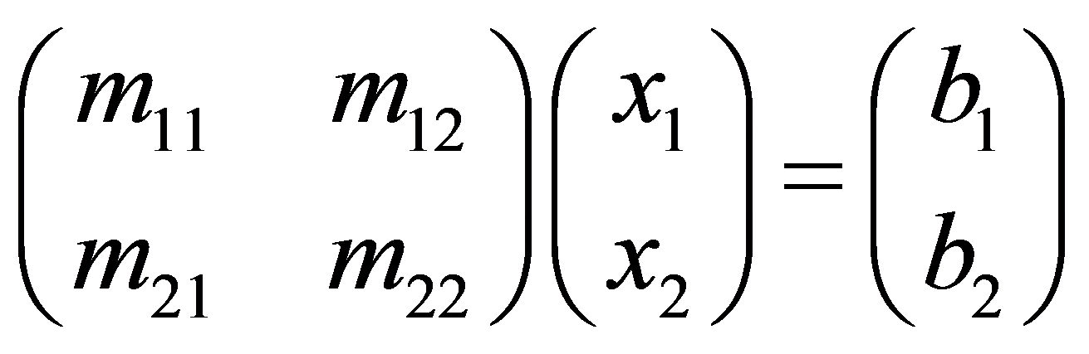
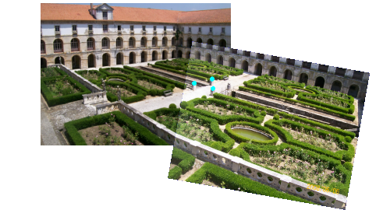
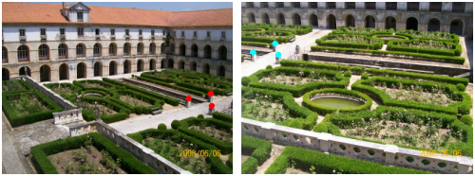
Background
Organization
– Structure
E.g., consider presenting software
which merges images
  The wrong background: a discussion
  of linear algebra
  The right background: an example

Slide 37
Body
Organization
– Structure
Next, the body supports the objective
You will have a number of supporting ideas
  Some ideas may support other ideas
Initially brainstorm these ideas
  Write down all your ideas

Slide 38
Groupings ideas
Organization
– Structure
Group the ideas under 3-5 main points
  Secondary points support main points
  Time permitting, tertiary points support secondary points
  Question whether outliers actually support the talk
All points should be mutually exclusive
  The same aspect should not be discussed multiple times

Slide 39
Ordering your thoughts
Organization
– Structure
Next we must order the main points:
  Chronologically
  Problem-Solution-Justification
  Problem-Reasoning-Solution
  Spatial
  Importance
This talk is presented chronologically

Slide 40
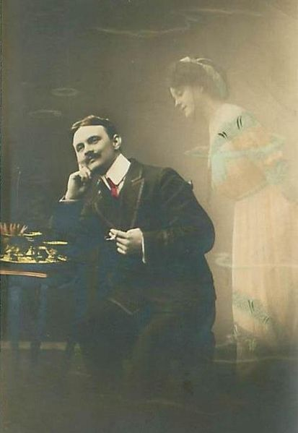
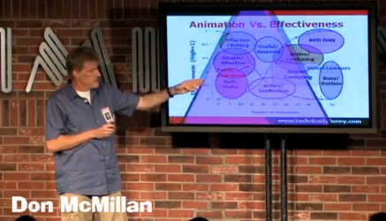
Finishing
Organization
– Structure
Finally, you’ve been presenting for 15 minutes
Your audience has thought of a lot of things
  Various distractions
  Their vacation (or lack thereof)
  What they’re doing this weekend
  The next meeting
  All the small problems with your talk...

Slide 41
Finishing
Organization
– Structure
It is now your responsibility to summarize and conclude
  Tell them what they must remember
  Flag what you think is important
  These will be your last words in the presentation

Slide 42
Scalability and flow
Organization
A good report is broken into sections
  Sections broken into sub-sections
  Sub-sections broken into sub-sub-sections
A presentation should be similar
  Main points should be supported by secondary points
  Secondary points may be supported by tertiary points
This allows scalability
  Dynamics
  Grouping
  Flow between ideas and flow within ideas

Slide 43
Dynamics
Organization
– Scalability and flow
Scalable allows dynamic changes to the pace:
For example, tertiary points may be
  Glossed over if time is short
  Expanded upon if the audience is interested

Slide 44
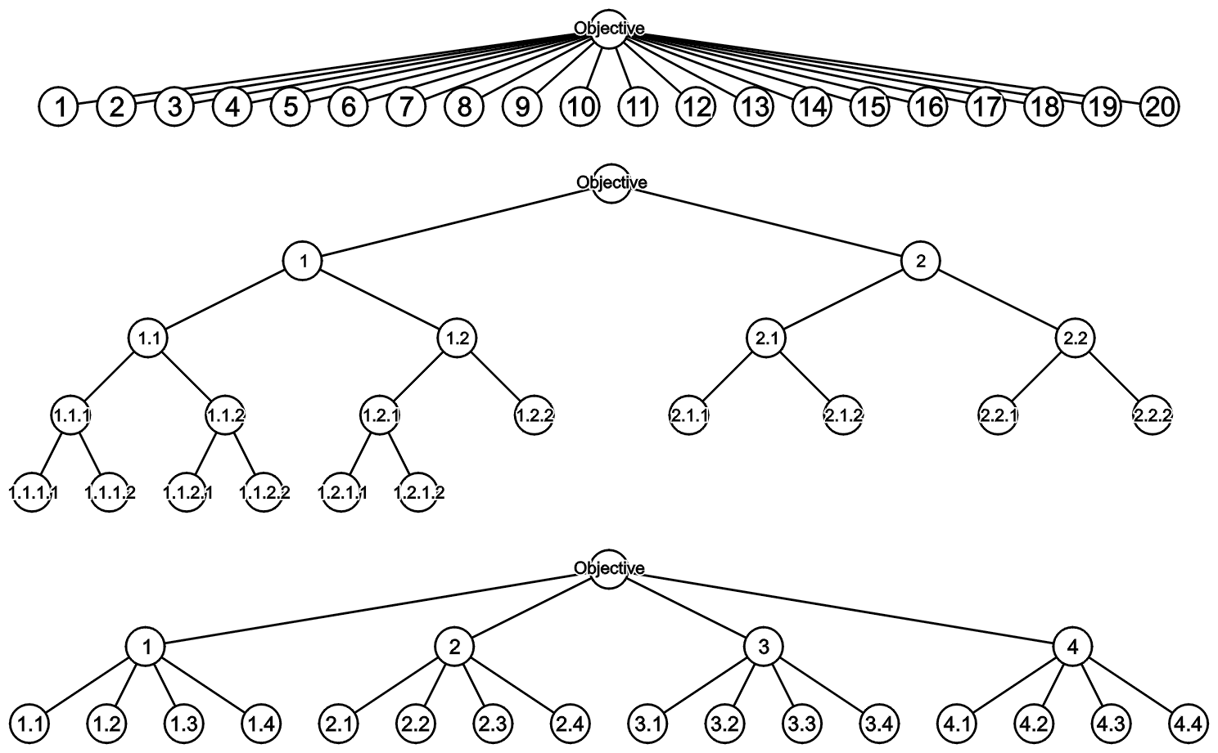
Grouping
Organization
– Scalability and flow
Consider grouping 20 points as follows:
  Linear and binary groupings are awkward
  Easier to visualize groupings of 4-6 points

Slide 45
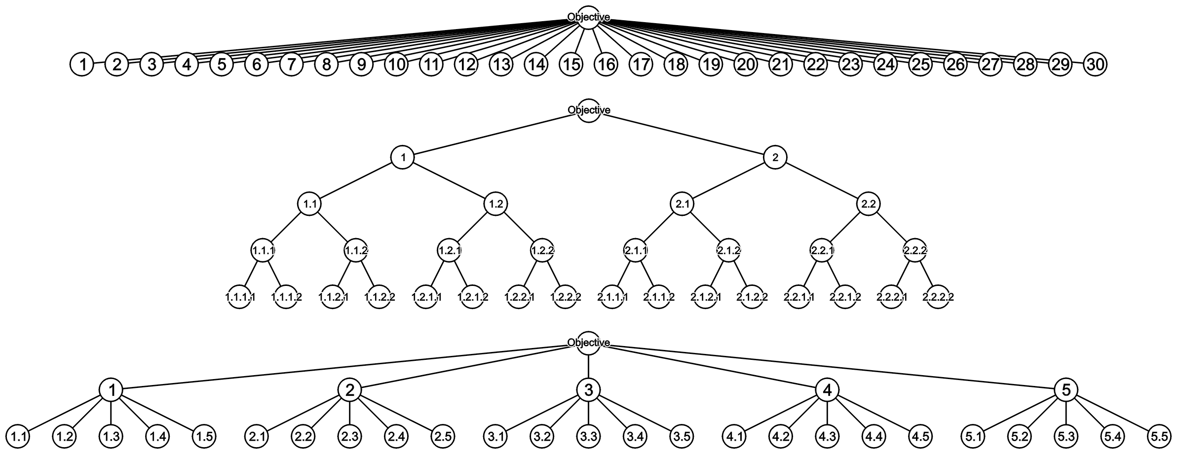
Grouping
Organization
– Scalability and flow
As the number of points grows, scalability is critical

Slide 46
Flow between topics
Organization
– Scalability and flow
The sequence of topics in a talk must flow:
  Each idea must transition to the next
  The audience expects a logical flow
    You have to describe the transitions
  Changes or discontinuity distract the audience

Slide 47
Flow within topics
Organization
– Scalability and flow
Suppose you are discussing a number of options or alternatives
  These items are introduced in a specific order
  Maintain a similar order throughout the presentation
Example: you describe Windows, GNU/Linux and then OS X
  Subsequent slides and tables should keep that order
 | Windows | GNU/Linux | OS X
1 | ··· | ··· | ···
2 | ··· | ··· | ···
3 | ··· | ··· | ···
4 | ··· | ··· | ···
5 | ··· | ··· | ···
 | A | B | C | D
Windows | ··· | ··· | ··· | ···
GNU/Linux | ··· | ··· | ··· | ···
OS X | ··· | ··· | ··· | ···

Slide 48
Timing
Organization
You are interested and prepared
  You know what you’re going to say and wow you’re going to say it
  However, the main question is How much time do you have to say it in?
We will look at a number of aspects with respect to the timing of a presentation
  Justification
  Requirements
  Planning
  Racing against the clock
  The timer

Slide 49
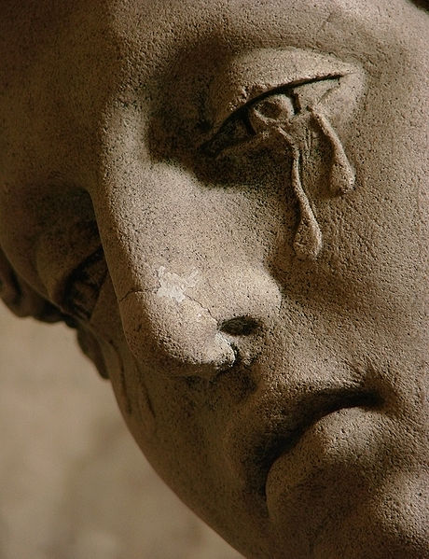
Justification
Organization
– Timing
A story from a co-op placement:
  A remote sales presentation scheduled for 50 min went on for 80 min
  Only the co-op was left watching
The product was not purchased...
User: Vassil

Slide 50
Requirements
Organization
– Timing
You are required to speak for 12-15 min
Timing is important:
  Audience members have schedules
  Executives are even less tolerant
  But don’t finish too early
You will fail for < 12:00 or ≥ 15:30

Slide 51
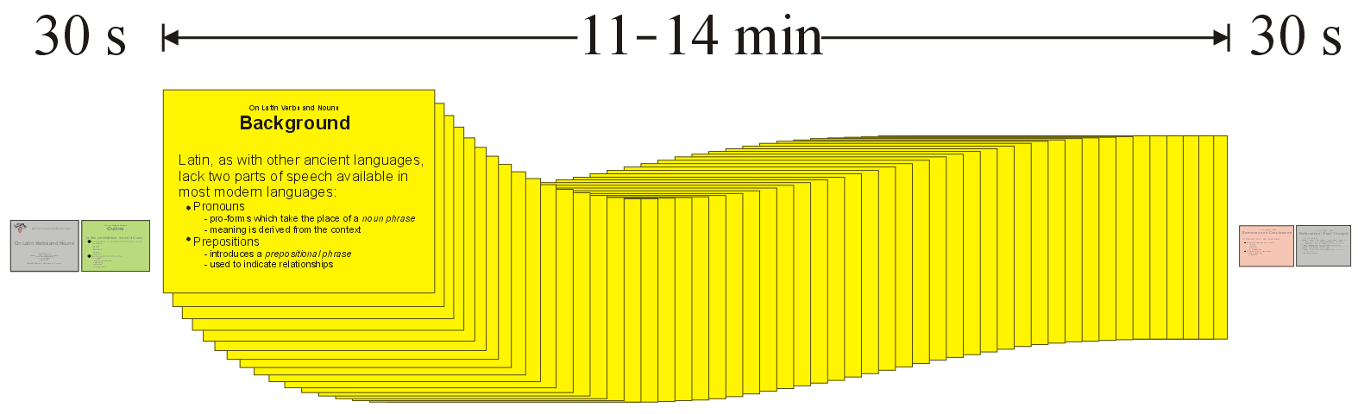
Planning
Organization
– Timing
The three slide occupy 30-60 s each
  This leaves 11-14 min

Slide 52
Planning
Organization
– Timing
Timing should be planned as follows:
  Introduction 15-25%
    Welcome and Outline minimal
    Background 10-15%
    Introduction of topic 5-10%
  Body 60-70%
  Conclusions 10-15%
  Questions left for after...

Slide 53
Racing against the clock
Organization
– Timing
Ultimately, a presentation is a race against the clock
  All enthused speakers love to talk
  Other factors affect time
  You can dynamically change the pace of your presentation if:
  Your talk is scalable and you practiced

Slide 54
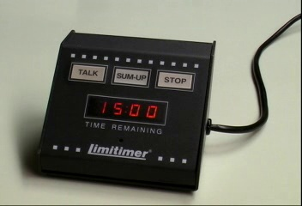
The timer
Organization
– Timing
A timer counts down from 15:00 to 0:00
The clock is started when you begin talking

Slide 55
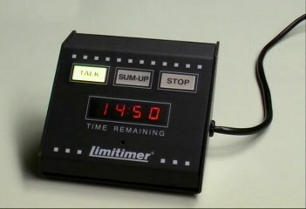
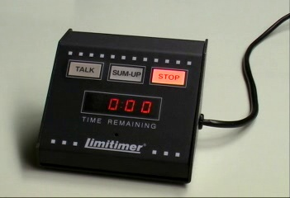
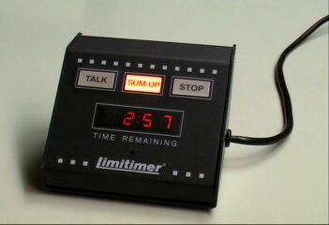
The timer
Organization
– Timing
When the timer starts: TALK
  As long as the light is green, keep talking
After 12 minutes: SUM-UP
  3 minutes left
After 15 minutes: STOP
  Maximum 1 for organization
  Listen to the given advice!

Slide 56
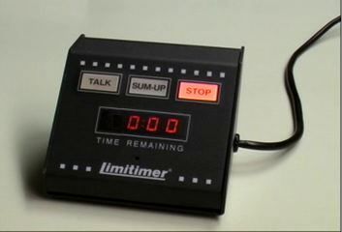

The timer
Organization
– Timing
If you talk for another 30 s
  The red light flashes
  The timer beeps
  You have failed
A bad talk cannot
be saved in 30 s...

Slide 57
Organization
We have seen how to organize a presentation through
  Your situation
  Defining the objective
  Structuring the talk
  Scalability and flow
  Timing

Slide 58
Aspects of good presentations
You are now interested and organized
  Interest and knowledge
  Organization
  Visual aids
  Presentation skills
  Responding to questions
Our theoretical foundation…

Slide 59
Aspects of good presentations
The next session:
  Interest and knowledge
  Organization
  Visual aids
  Presentation skills
  Responding to questions

Slide 60
Summary
In this presentation, we have seen:
  Background
  The Milestone
  10 Commandments of Bad Presentations
  Two foundational aspects of a good presentation:
    Interest and knowledge
    Organization
  Homework assignment

Slide 61
Summary
The next session will:
  Take-up of homework
  Consider those aspects which make a presentation out of interest and organization:
    Visual aids
    Presentation skills
    Responding to questions
  Consequences of failure

Slide 62
Questions?
“How much easier it is to be critical than to be correct.”
Benjamin Disraeli
References
All references are listed on
http://ece.uwaterloo.ca/~tppe000/
http://ece.uwaterloo.ca/~dwharder/TechnicalPresentations/
All unreferenced images are the work of the author
Some images are published under the GFDL
  http://www.gnu.org/copyleft/fdl.html

