Slide 1
Intellectual Property
Douglas Wilhelm Harder, M.Math.
Department of Electrical and Computer Engineering
University of Waterloo

Slide 2
Outline
This talk focuses on intellectual property
  There are numerous products of the mind
    Design, process, innovations, identifiers, works, look-and-feel
  The relevant statutes for:
    Patents of invention
    Trade Marks
    Copyrights
    Industrial design
  Common law issues with trade secrets

Slide 3
Background
Owners of real property have many rights under the law
There are numerous products of intellectual efforts including:
  Design, process, innovations, identifiers,
  works, recordings, look-and-feel
It is necessary to give rights to those who come up with these efforts

Slide 4
Intellectual Property
Five classifications of intellectual property have evolved over time:
  Patents of invention inventions
  Trade-marks distinguishing marks
  Copyright written or recorded works
  Industrial design identifiable appearance
  Trade secrets industrial know-how

Slide 5
Statute Law
The first four are protected by various statutes:
We will examine trade secrets at the end
Intellectual Property | Statute
Patents of invention | Patent Act (1985)
Trade marks | Trade-mark Act (1985)
Copyrights | Copyright Act (1985)
Industrial design | Industrial Design Act (1985)

Slide 6
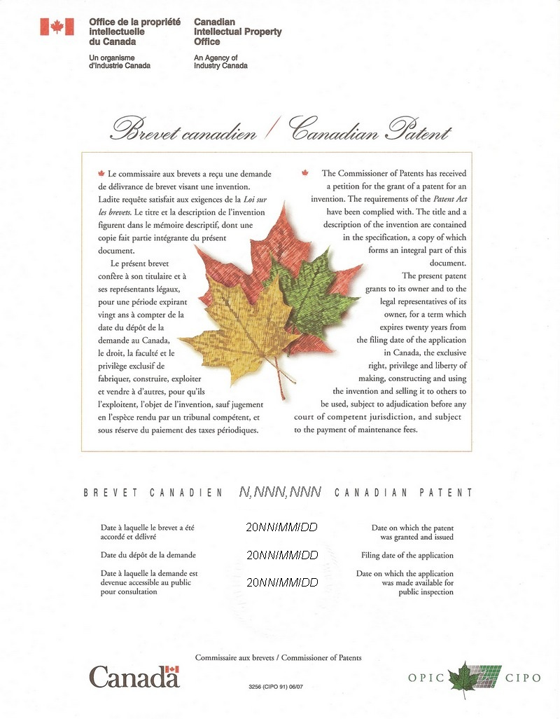
Patents of Invention
The Patent Act defines an invention as
  "any new and useful art, process, machine, manufacture or
  composition of matter, or any new and useful improvement in
  any art, process, machine, manufacture or composition of
  matter."

Slide 7
Patents of Invention
A patent on an invention allows the holder of the patent to use or licence others to use the invention for 20 years
  The patent may be assigned (sold) to another person or business organization with registration
Use of a patented invention without a licence allows the holder to sue for damages

Slide 8







Trade Marks
The Trade-mark Act defines a trade mark as
  “a mark that is used by a person for the purpose of distinguishing
  or so as to distinguish wares or services manufactured, sold,
  leased, hired or performed by him from those manufactured,
  sold, leased, hired or performed by others, a certification mark,
  a distinguishing guise, ...”

Slide 9
Trade Marks
The holder of a trade mark may use that mark to identify products to distinguish it from others
  Assists in branding and the development of a brand reputation
The holder of a trade mark may prevent others from using similar marks which may cause confusion
The holder of a trade mark may licence others to use it
Registration is valid for 15 years
  This registration may be renewed arbitrarily often for subsequent 15-year periods
Trade marks do not have to be registered

Slide 10

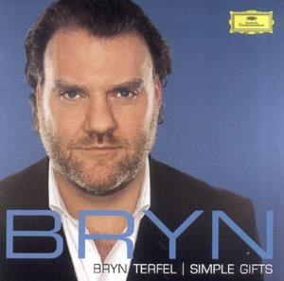
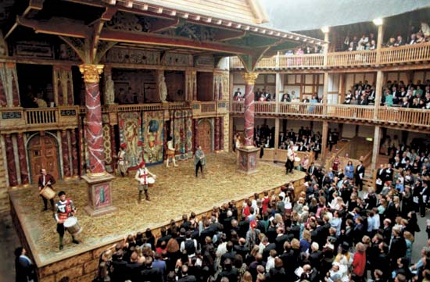
Copyrights
The Copyright Act defines a copyright as
  “the rights...of a work, a performer's performance, a sound
  recording, or a communication signal”
Copyright applies to:
  Written works
  Performances
  Recordings
  Communication signals
http://www.hometheaterhifi.com/
http://www.examiner.com/

Slide 11
Copyrights
They define the rights of an individual to copy their own works
Valid for 50 years after the death of the author
The rights are assignable, but this must be done in writing

Slide 12
Copyrights
Application to professional engineering:
  When a professional engineer provides services to the public in the form of engineer-client, the final drawings, specifications, plans, reports or other documents remain property of the professional engineer unless otherwise specified in the contract

Slide 13
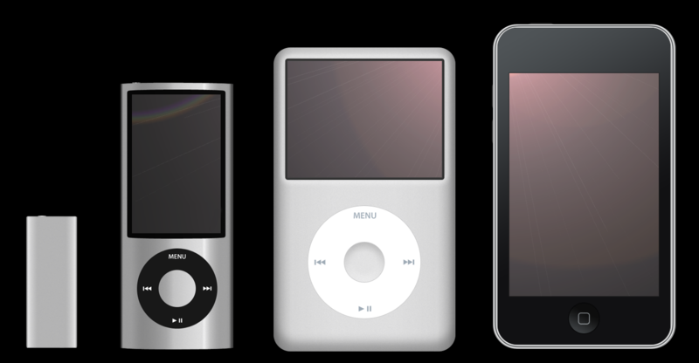
Industrial Designs
An industrial design is defined in the Industrial Design Act as
  “features of shape, configuration, pattern or ornament and any
  combination of those features that, in a finished article, appeal
  to and are judged solely by the eye”
Wikipedia: Kyro

Slide 14
Industrial Designs
Industrial designs may be licensed and are valid for 10 years and are assignable but, again, in writing

Slide 15
Trade Secrets
Trade secrets are protected by common law
In 1967, Lord Denning in Seager v. Copydex Ltd. gave the following description:
  “A trade secret may consist of any formula, pattern, device or
  compilation of information which is used in one's business, and
  which gives him an opportunity to obtain an advantage over
  competitors who do not know or use it. It may be a formula for a
  chemical compound, a process of manufacturing, treating or
  preserving materials, a pattern for a machine or other device, or
  a list of customers.”

Slide 16
Trade Secrets
Non-disclosure agreements and employment contracts will state that the signee agrees to maintain the confidentiality of the trade secrets of the employer
Courts will award damages for the disclosure of such secrets

Slide 17
Trade Secrets
Engineers have, in addition, an ethical responsibility to protect trade secrets:
  77.3 A practitioner...shall regard as confidential information obtained...as to the business affairs, technical methods or processes of an employer...
Failure to do so may result in an allegation of professional misconduct:
  72(2)(b) failure to make reasonable provision for the safeguarding of...property of a person who may be affected by the work for which the practitioner is responsible
  72(2)(j) conduct or an act...would reasonably be regarded by the engineering profession as disgraceful, dishonourable or unprofessional

Slide 18
Summary
This talk covered the five classes of intellectual property
  Patents of invention
  Trade marks
  Copyrights
  Industrial designs
  Trade secrets
The first four are protected through statutes
The last is protected by common law and, for the engineer, the Code of Ethics and definition of professional misconduct

Slide 19
References
[1] Gordon C. Andrews, Canadian Professional Engineering and Geoscience-Practice and Ethics, Nelson Education Ltd., 2009.
[2] Professional Engineers Act General R.R.O. 1990, Regulation 941.
http://www.e-laws.gov.on.ca/html/regs/english/elaws_regs_900941_e.htm
[3] Professional Engineers Act General R.R.O. 1990, Regulation 941.
http://www.e-laws.gov.on.ca/html/regs/english/elaws_regs_900941_e.htm

Slide 20
Copyright and Disclaimer
These slides are Copyright © 2010 by Douglas Wilhelm Harder.
All rights reserved.
These slides are made publicly available on the web for anyone to use
No warranty is given that any information in these slides is correct
The use of these slides in studying for the PPE is fully at your own risk
If you choose to use them, or a part thereof, for a course at another institution, I ask only three things:
  That you inform me that you are using the slides,
  That you acknowledge my work, and
  That you alert me of any mistakes which I made or changes which you make, and allow me the option of incorporating such changes (with an acknowledgment) in my set of slides
  Sincerely,
  Douglas Wilhelm Harder, MMath
  dwharder@alumni.uwaterloo.ca

