Slide 1
Professional Engineers of Ontario
Code of Ethics
Section 77 of the O. Reg. 941
Douglas Wilhelm Harder, M.Math., LEL
Department of Electrical and Computer Engineering
University of Waterloo

Slide 2
Outline
This talk focuses the Code of Ethics of the Association:
  Background of ethics
  Ethics are not enforceable
  An overview of the eight clauses
  A detailed look at each clause

Slide 3
Background
The Code of Ethics of the Association is Section 77 of the Professional Engineers Act Regulation 941
Ethics are guidelines which indicate how a practitioner should behave
  The balance of the Professional Engineers Act defines how an engineer must behave
Following the Code of Ethics, however, will:
  Help both him or herself promote the reasonable ideals and goals of engineers engineering as a profession
  Prevent the practitioner from engaging professional misconduct

Slide 4
Ethics are not Enforceable
The failure of a licensed professional engineer to adhere to the Code of Ethics will not be considered to be professional misconduct
72(2)(g) For the purposes of the Act and this Regulation,
“professional misconduct” means ...
breach of the Act or regulations, other than an
action that is solely a breach of the code of ethics, ...
and will therefore not result in discipline
Other provinces may have an enforceable code of ethics

Slide 5
Overview
The Code of Ethics has eight main clauses:
  General duties of action
  Duties in the relationships with
    Oneself (goals and ideals)
    Employers
    Clients
    Employers and clients: The moonlighting clause
    Other professionals
    Other practitioners
    The Profession

Slide 6
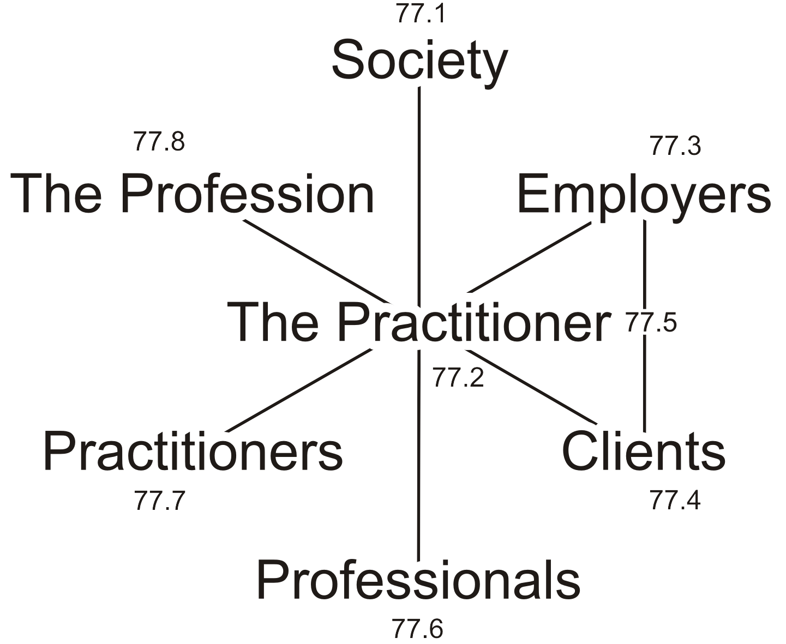
Overview
This diagram is a nice summary of the main clauses in the Code of Ethics
These clauses are not this mutually exclusive
  Society includes all categories including employees and subordinates
  The Practitioner includes aspects of The Profession
  Practitioners includes aspects of other colleagues

Slide 7
77.1 Duties of Action
Section 77.1 deals with the duties of action of the practitioner to society in general:
1. It is the duty of a practitioner to the public, to the practitioner's employer, to the practitioner's clients, to other members of the practitioner's profession, and to the practitioner to act at all times with,
  i. fairness and loyalty to the practitioner's associates, employers, clients, subordinates and employees,
  ii. fidelity to public needs,
  iii. devotion to high ideals of personal honour and professional integrity,
  iv. knowledge of developments in the area of professional engineering relevant to any services that are undertaken, and
  v. competence in the performance of any professional engineering services that are
  undertaken.

Slide 8
77.1 Duties of Action
77.1.i It is the duty of a practitioner to the public, to the practitioner's employer, to the practitioner's clients, to other members of the practitioner's profession, and to the practitioner to act at all times with fairness and loyalty to the practitioner's associates, employers, clients, subordinates and employees.

Slide 9
77.1 Duties of Action
77.1.ii It is the duty of a practitioner to the public, to the practitioner's employer, to the practitioner's clients, to other members of the practitioner's profession, and to the practitioner to act at all times with fidelity to public needs.

Slide 10
77.1 Duties of Action
77.1.iii It is the duty of a practitioner to the public, to the practitioner's employer, to the practitioner's clients, to other members of the practitioner's profession, and to the practitioner to act at all times with devotion to high ideals of personal honour and professional integrity.

Slide 11
77.1 Duties of Action
77.1.iv It is the duty of a practitioner to the public, to the practitioner's employer, to the practitioner's clients, to other members of the practitioner's profession, and to the practitioner to act at all times with knowledge of developments in the area of professional engineering relevant to any services that are undertaken.

Slide 12
77.1 Duties of Action
77.1.v It is the duty of a practitioner to the public, to the practitioner's employer, to the practitioner's clients, to other members of the practitioner's profession, and to the practitioner to act at all times with competence in the performance of any professional engineering services that are undertaken.

Slide 13
77.2 Goals and Ideals
Section 77.2 deals with duties towards oneself and ones goals and ideals:
2. A practitioner shall,
  regard the practitioner's duty to public welfare as paramount,
  endeavour at all times to enhance the public regard for the practitioner's profession by extending the public knowledge thereof and discouraging untrue, unfair or exaggerated statements with respect to professional engineering,
  not express publicly, or while the practitioner is serving as a witness before a court, commission or other tribunal, opinions on professional engineering matters that are not founded on adequate knowledge and honest conviction,
  endeavour to keep the practitioner's licence, temporary licence, limited licence or certificate of authorization, as the case may be, permanently displayed in the practitioner's place of business.

Slide 14
77.2 Goals and Ideals
77.2.i A practitioner shall regard the practitioner's duty to public welfare as paramount.

Slide 15
77.2 Goals and Ideals
77.2.ii A practitioner shall endeavour at all times to enhance the public regard for the practitioner's profession by extending the public knowledge thereof and discouraging untrue, unfair or exaggerated statements with respect to professional engineering.

Slide 16
77.2 Goals and Ideals
77.2.iii A practitioner shall not express publicly, or while the practitioner is serving as a witness before a court, commission or other tribunal, opinions on professional engineering matters that are not founded on adequate knowledge and honest conviction.

Slide 17
77.2 Goals and Ideals
77.2.iv A practitioner shall endeavour to keep the practitioner's licence, temporary licence, limited licence or certificate of authorization, as the case may be, permanently displayed in the practitioner's place of business.

Slide 18
77.3 Duties towards Employers
Section 77.3 deals with the relationship between the practitioner and his or her employer:
3. A practitioner shall act in professional engineering matters for each employer as a faithful agent or trustee and shall regard as confidential information obtained by the practitioner as to the business affairs, technical methods or processes of an employer and avoid or disclose a conflict of interest that might influence the practitioner's actions or judgment.

Slide 19
77.4 Duties towards Clients
Section 77.4 deals with the relationship between the practitioner and clients:
4. A practitioner must disclose immediately to the practitioner's client any interest, direct or indirect, that might be construed as prejudicial in any way to the professional judgment of the practitioner in rendering service to the client.

Slide 20
77.5 The Moonlighting Clause
Section 77.5 deals with the possibility of providing services for both an employer and clients:
5. A practitioner who is an employee-engineer and is contracting in the practitioner's own name to perform professional engineering work for other than the practitioner's employer, must provide the practitioner's client with a written statement of the nature of the practitioner's status as an employee and the attendant limitations on the practitioner's services to the client, must satisfy the practitioner that the work will not conflict with the practitioner's duty to the practitioner's employer, and must inform the practitioner's employer of the work.

Slide 21
77.6 Duties towards Other Professionals
Section 77.6 deals with the relationship between the practitioner and other professionals:
6. A practitioner must co-operate in working with other professionals engaged on a project.

Slide 22
77.7 Duties towards Other Practitioners
Section 77.7 deals with the relationship with the practitioner and other colleague practitioners:
7. A practitioner shall,
  act towards other practitioners with courtesy and good faith,
  not accept an engagement to review the work of another practitioner for the same employer except with the knowledge of the other practitioner or except where the connection of the other practitioner with the work has been terminated,
  not maliciously injure the reputation or business of another practitioner,
  not attempt to gain an advantage over other practitioners by paying or accepting a commission in securing professional engineering work, and
  give proper credit for engineering work, uphold the principle of adequate compensation for engineering work, provide opportunity for professional development and advancement of the practitioner's associates and subordinates, and extend the effectiveness of the profession through the interchange of engineering information and experience.

Slide 23
77.7 Duties towards Other Practitioners
77.7.i A practitioner shall act towards other practitioners with courtesy and good faith.

Slide 24
77.7 Duties towards Other Practitioners
77.7.ii A practitioner shall not accept an engagement to review the work of another practitioner for the same employer except with the knowledge of the other practitioner or except where the connection of the other practitioner with the work has been terminated.

Slide 25
77.7 Duties towards Other Practitioners
77.7.iii A practitioner shall not maliciously injure the reputation or business of another practitioner.

Slide 26
77.7 Duties towards Other Practitioners
77.7.iv A practitioner shall not attempt to gain an advantage over other practitioners by paying or accepting a commission in securing professional engineering work.

Slide 27
77.7 Duties towards Other Practitioners
77.7.v A practitioner shall give proper credit for engineering work, uphold the principle of adequate compensation for engineering work, provide opportunity for professional development and advancement of the practitioner's associates and subordinates, and extend the effectiveness of the profession through the interchange of engineering information and experience.

Slide 28
77.8 Duties towards the Profession
Section 77.8 deals with the relationship between the practitioner the profession:
8. A practitioner shall maintain the honour and integrity of the practitioner's profession and without fear or favour expose before the proper tribunals unprofessional, dishonest or unethical conduct by any other practitioner.

Slide 29
Summary
This talk focuses the Code of Ethics of the Association
  Why we have ethics
  Ethics are not enforceable
  The eight clauses:
    General duties of action
    Duties in the relationship with
      Oneself (goals and ideals), employers, clients, the moonlighting clause, other professionals and practitioners, and the profession
  A detailed look at each clause

Slide 30
References
[1] Professional Engineers Act R.S.O. 1990, CHAPTER P.28
http://www.e-laws.gov.on.ca/html/statutes/english/elaws_statutes_90p28_e.htm
[2] Professional Engineers Act General R.R.O. 1990, Regulation 941.
http://www.e-laws.gov.on.ca/html/regs/english/elaws_regs_900941_e.htm
[3] The Code of Ethics of Professional Engineers Ontario, http://www.peo.on.ca/Ethics/code_of_ethics.html

Slide 31
Copyright and Disclaimer
These slides are Copyright © 2010 by Douglas Wilhelm Harder.
All rights reserved.
These slides are made publicly available on the web for anyone to use
No warranty is given that any information in these slides is correct
The use of these slides in studying for the PPE is fully at your own risk
If you choose to use them, or a part thereof, for a course at another institution, I ask only three things:
  That you inform me that you are using the slides,
  That you acknowledge my work, and
  That you alert me of any mistakes which I made or changes which you make, and allow me the option of incorporating such changes (with an acknowledgment) in my set of slides
  Sincerely,
  Douglas Wilhelm Harder, Mmath, LEL
  dwharder@alumni.uwaterloo.ca

