Slide 1
Poisson distribution

Slide 2
Outline

Slide 3
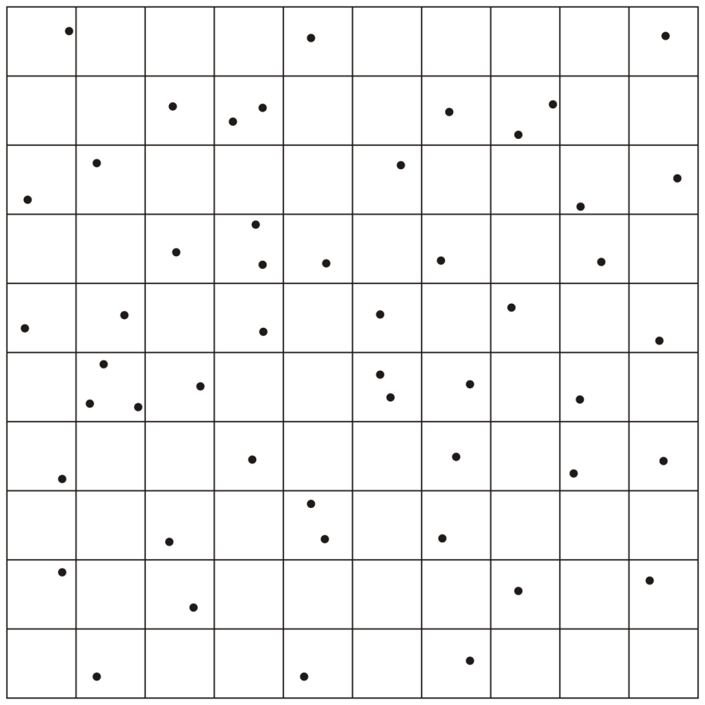

Slide 4
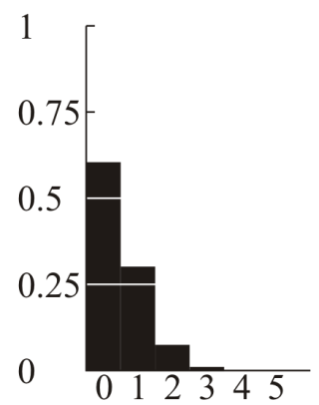

Slide 5
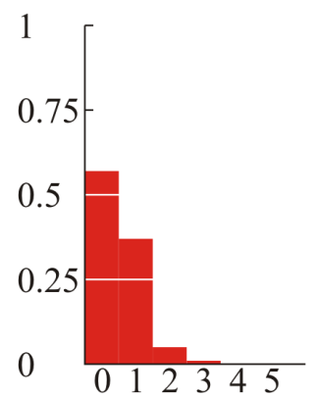
How

Slide 6
Summary
The Poisson distribution

Slide 7
References
Wikipedia, http://en.wikipedia.org/wiki/Hash_function
[1] Cormen, Leiserson, and Rivest, Introduction to Algorithms, McGraw Hill, 1990.
[2] Weiss, Data Structures and Algorithm Analysis in C++, 3rd Ed., Addison Wesley.
These slides are provided for the ECE 250 Algorithms and Data Structures course. The material in it reflects Douglas W. Harder’s best judgment in light of the information available to him at the time of preparation. Any reliance on these course slides by any party for any other purpose are the responsibility of such parties. Douglas W. Harder accepts no responsibility for damages, if any, suffered by any party as a result of decisions made or actions based on these course slides for any other purpose than that for which it was intended.

