Slide 1
Binomial heaps

Slide 2
Background
Leftist and skew heaps are fast; however, can we do better?
Binomial heaps use a forest of binomial trees to create a heap structure

Slide 3
The Idea
A binomial tree of order h has 2^{h} nodes
Any integer n can be written as a sum of powers of 2:
Binary representation of numbers
For example, 27 = 2⁴ + 2³ + 2¹ + 2⁰ = 11011₂

Slide 4
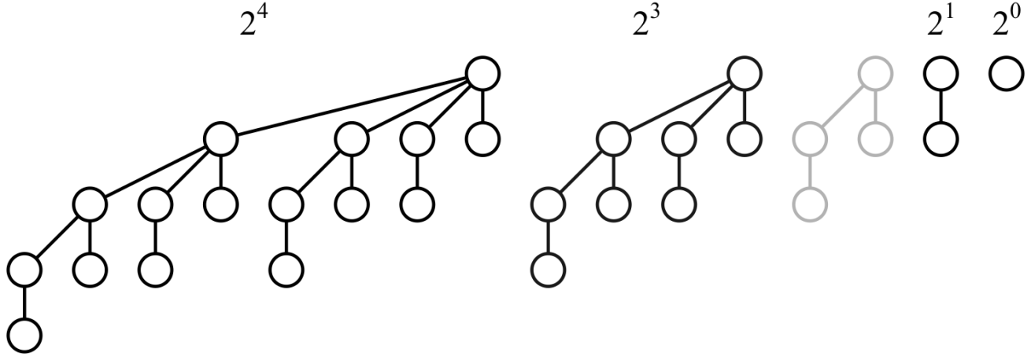
Storing n Nodes
Because 27 = 2⁴ + 2³ + 2¹ + 2⁰ = 11011₂, we can store 27 nodes within a forest of four binomial trees of order 0, 1, 3 and 4

Slide 5
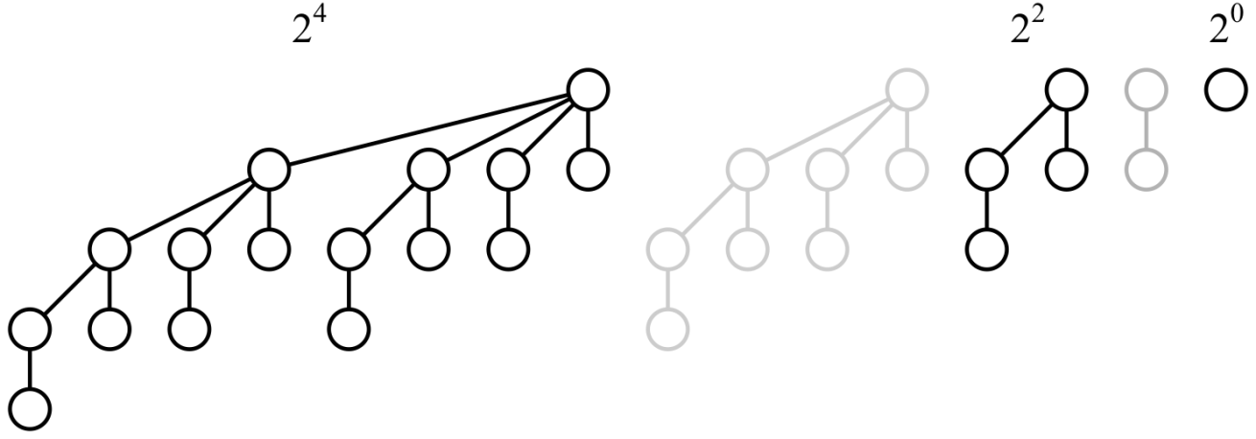
Storing n Nodes
Similarly, because 21 = 2⁴ + 2² + 2⁰ = 10101₂, we can store 21 nodes within a forest of three binomial trees of order 0, 2 and 4

Slide 6
Storing n Nodes
As a last example, because 42 = 2⁴ + 2² + 2⁰ = 10101₂, we can store 42 nodes within a forest of three binomial trees of order 1, 3 and 5

Slide 7
Binomial Heaps
We will define a binomial heap of n objects as a forest of binomial trees where each tree is a heap
Each binomial tree will satisfy the heap property
The minimum element of the forest of binomial trees will be one of the roots

Slide 8
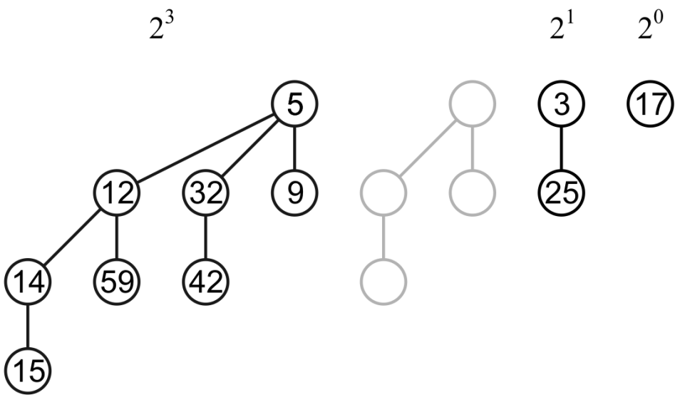
Binomial Heaps
For example, here we have a binomial heap with 11 entries:
3 5 9 12 14 15 17 25 32 42 59
Each binomial tree satisfies the heap property
The minimum element is the minimum of {5, 3, 17}

Slide 9
Binomial Heaps
For example, here we have a binomial heap with 11 entries:
3 5 9 12 14 15 17 25 32 42 59
Each binomial tree satisfies the heap property
The minimum element is the minimum of {5, 3, 17}

Slide 10
A Pop that Doesn’t Work
Suppose we pop the top and maintain the heap structure

Slide 11
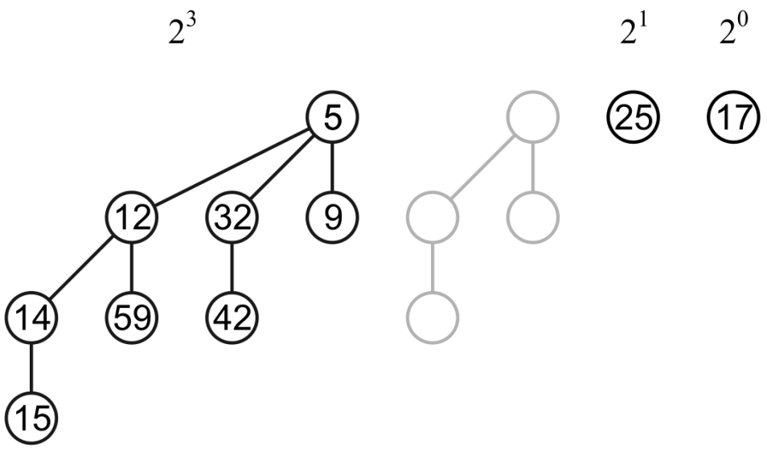
A Pop that Doesn’t Work
We now have two binomial trees of order 0
Consider popping the top, this time 5, again…

Slide 12
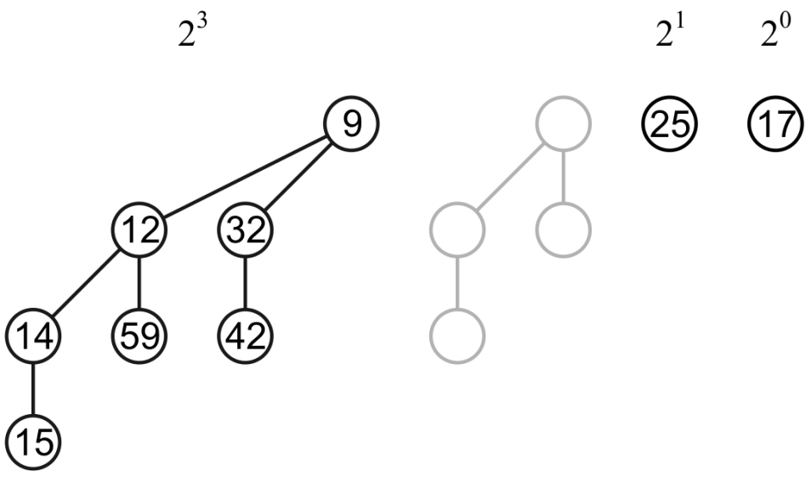
A Pop that Doesn’t Work
The tree on the left is no longer a binomial tree…
To solve this problem, we will first look at merging two binomial trees

Slide 13
Merging Binomial Trees
Consider two binomial trees with order h

Slide 14
Merging Binomial Trees
If both binomial trees have a heap structure, we can create a binomial tree with the heap structure by making the tree with the greater root a sub-tree of the root of the tree with the smaller root
This is a binomial tree of order h + 1

Slide 15
Merging Binomial Trees
For example, merging two binomial trees of order 0 yields a binomial tree of order 1

Slide 16
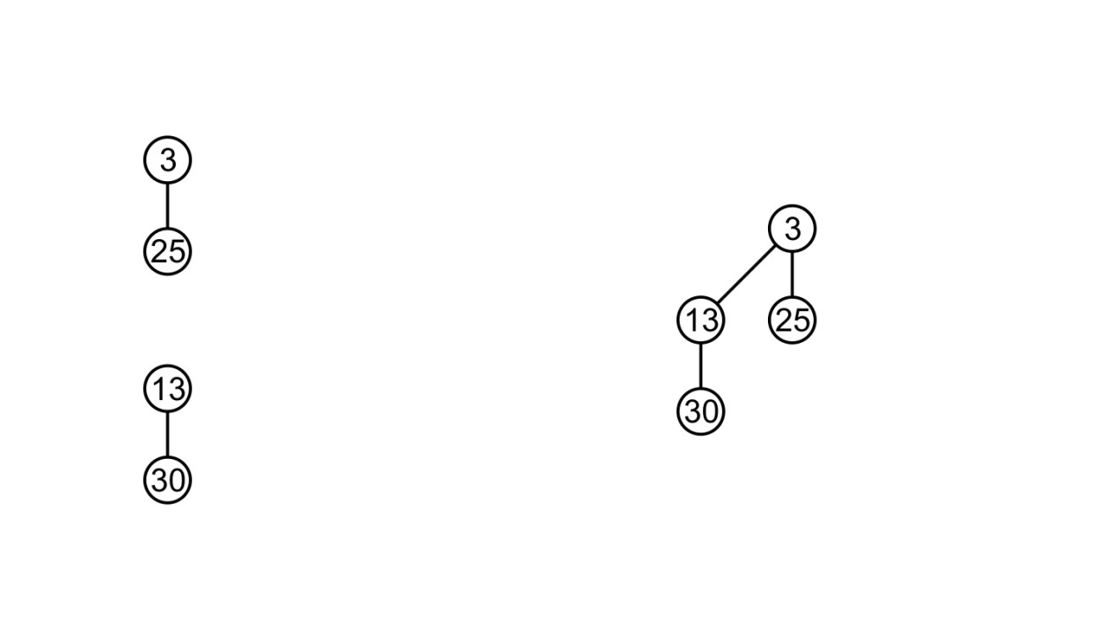
Merging Binomial Trees
For example, merging two binomial trees of order 1 yields a binomial tree of order 2

Slide 17
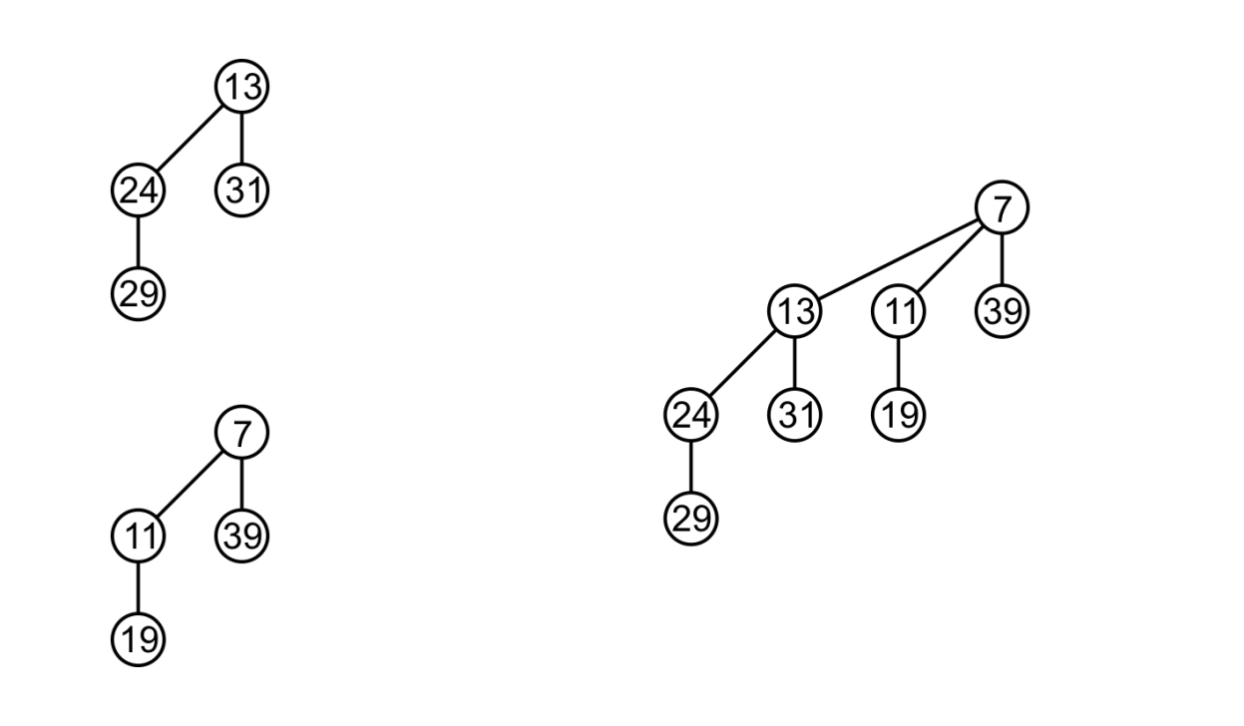
Merging Binomial Trees
For example, merging two binomial trees of order 2 yields a binomial tree of order 3

Slide 18
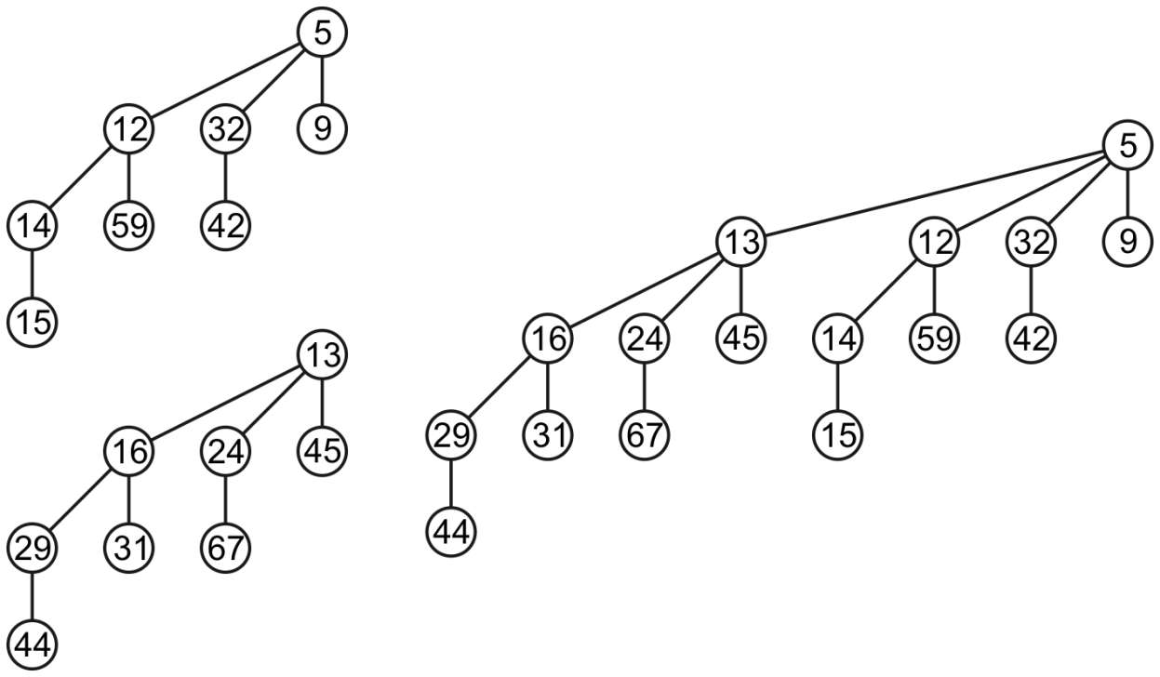
Merging Binomial Trees
For example, merging two binomial trees of order 3 yields a binomial tree of order 4
In all cases, the heap structure is maintained

Slide 19
Merging Binomial Trees
Now, suppose we have two binomial heaps and we intend to merge them…
Recall binary addition where we go from least significant to most significant:
Two 0s sum to 0,
A 0 and a 1 sum to 1
Two 1s sum to 0 with a carry of 1
1110100
+ 100110
10011010

Slide 20
Merging Binomial Trees
Now, consider two forests of binomial trees:
Recall binary addition:
No trees of order h leave nothing to merge
A single tree of order h can be left unchanged
Two trees of order h can be merged into a tree of order h + 1

Slide 21
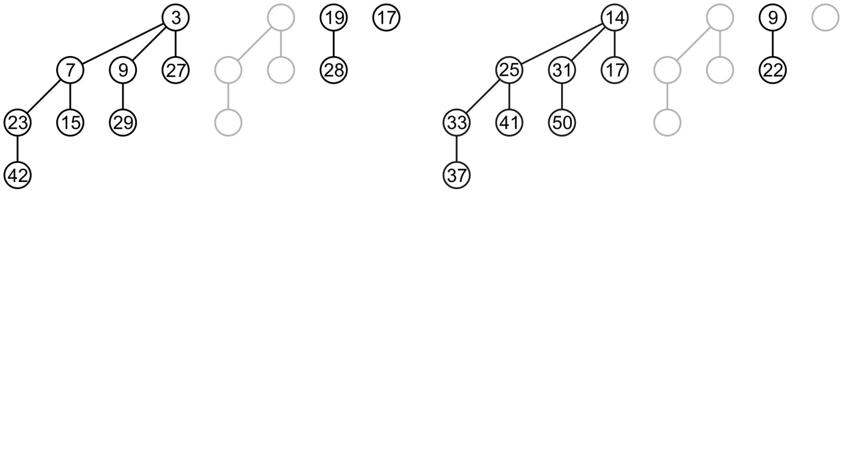
Merging Binomial Heaps
Suppose we wish to merge these two binomial heaps
We begin by merging the binomial trees of order 0

Slide 22
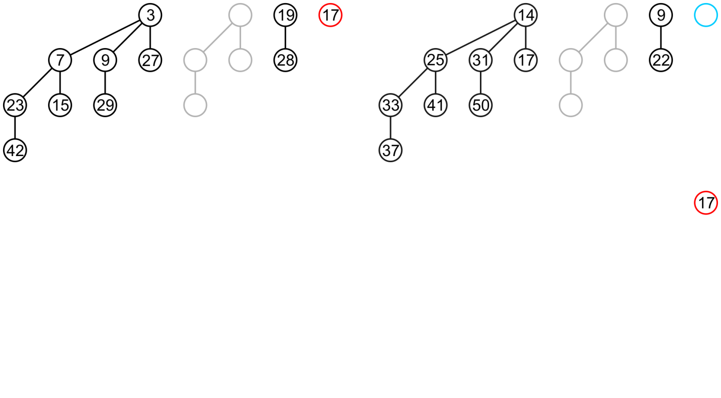
Merging Binomial Heaps
As there is only one, it is copied to the merged heap

Slide 23
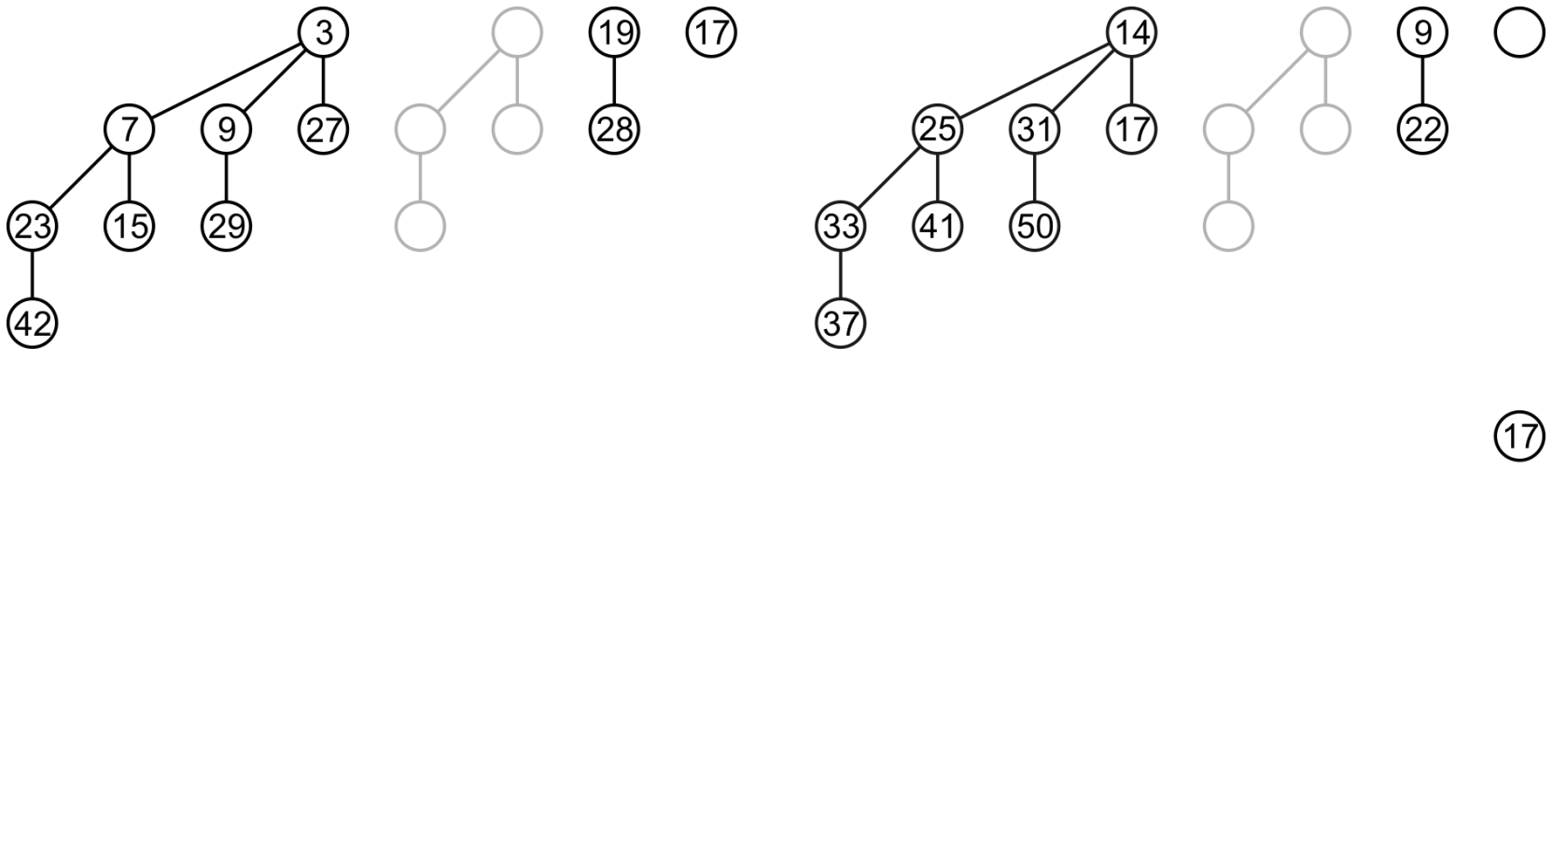
Merging Binomial Heaps
Next, we consider the binomial trees of order 1:
There are two, so we merge them into a binomial tree of order 2

Slide 24
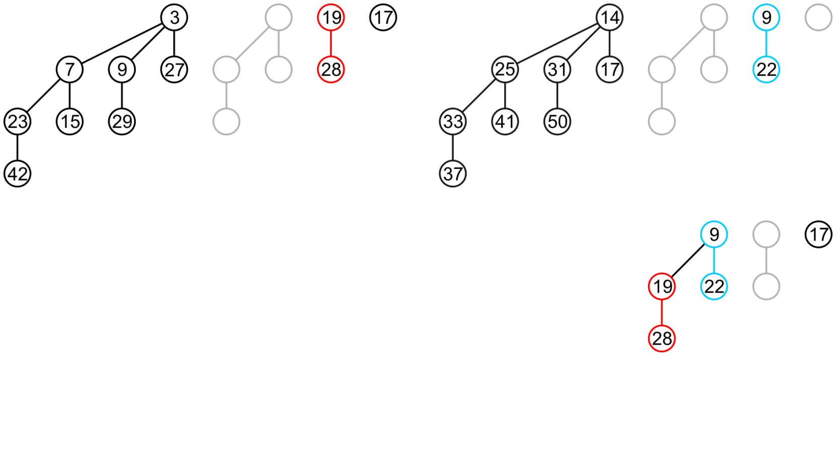
Merging Binomial Heaps
The minimum is from the right-hand tree

Slide 25
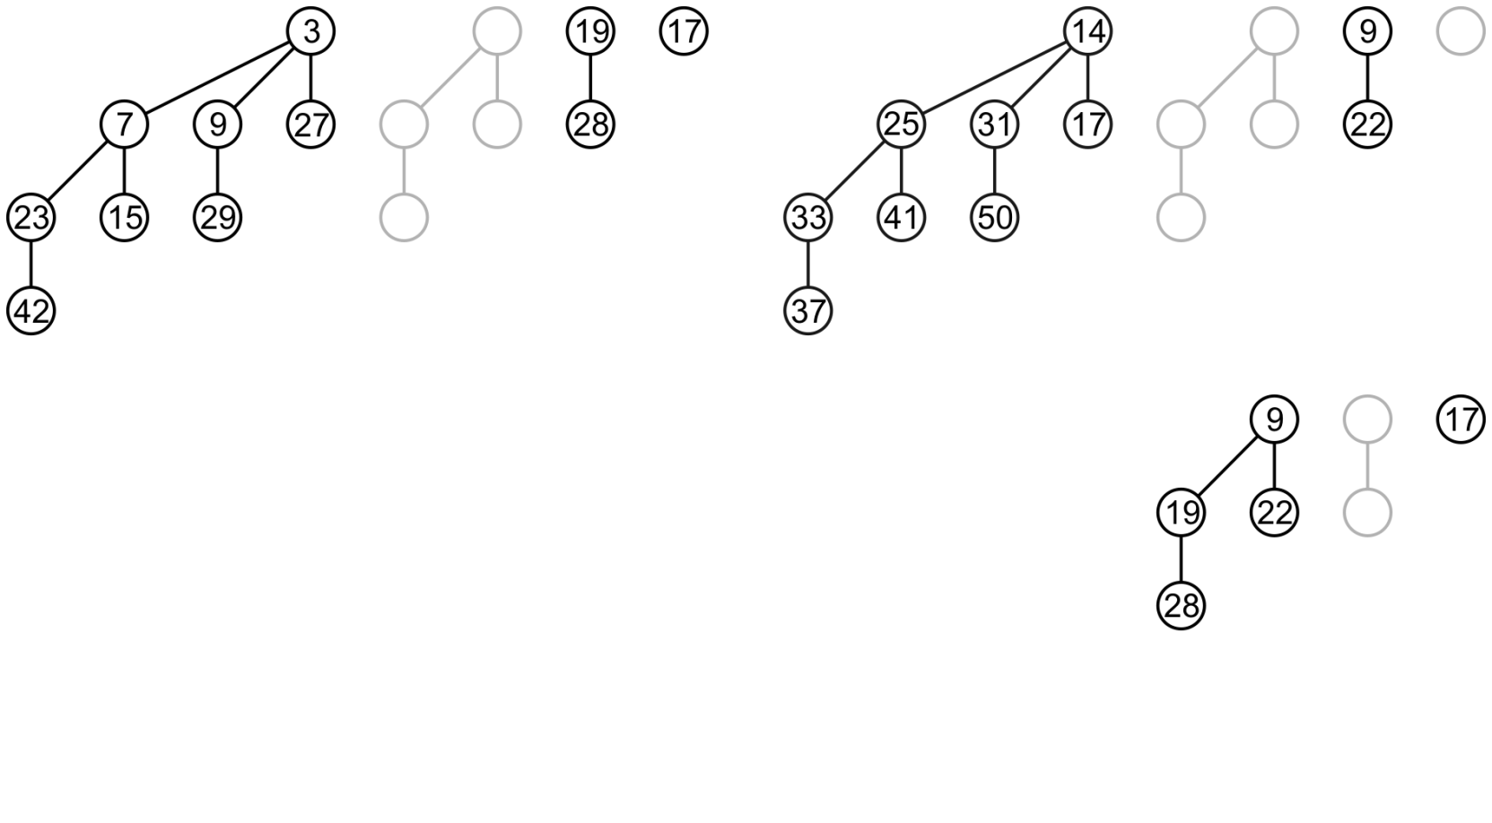
Merging Binomial Heaps
There are no binomial trees of order 2 so we go to the two binomial trees of order 3 and merge them

Slide 26
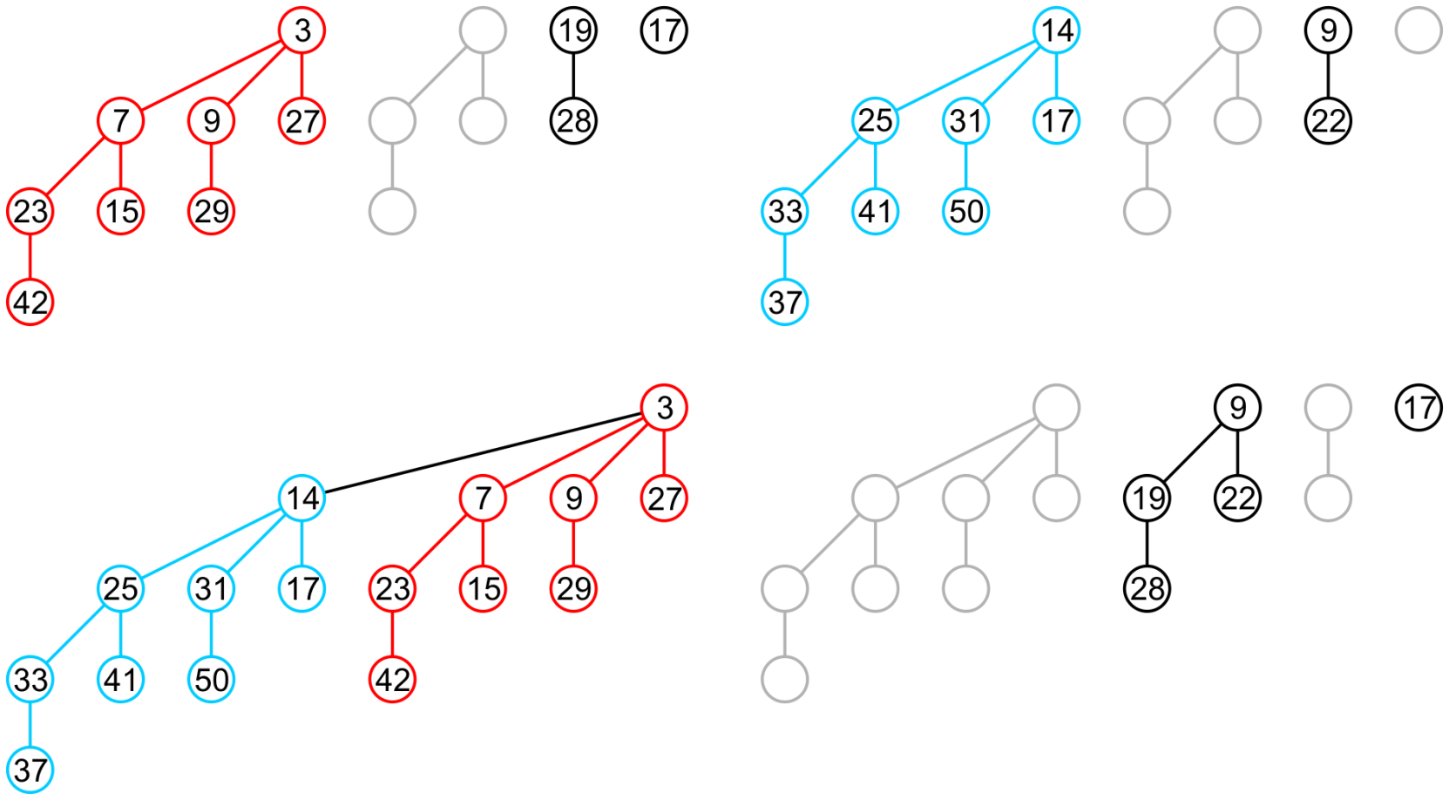
Merging Binomial Heaps
The minimum is from the left tree

Slide 27
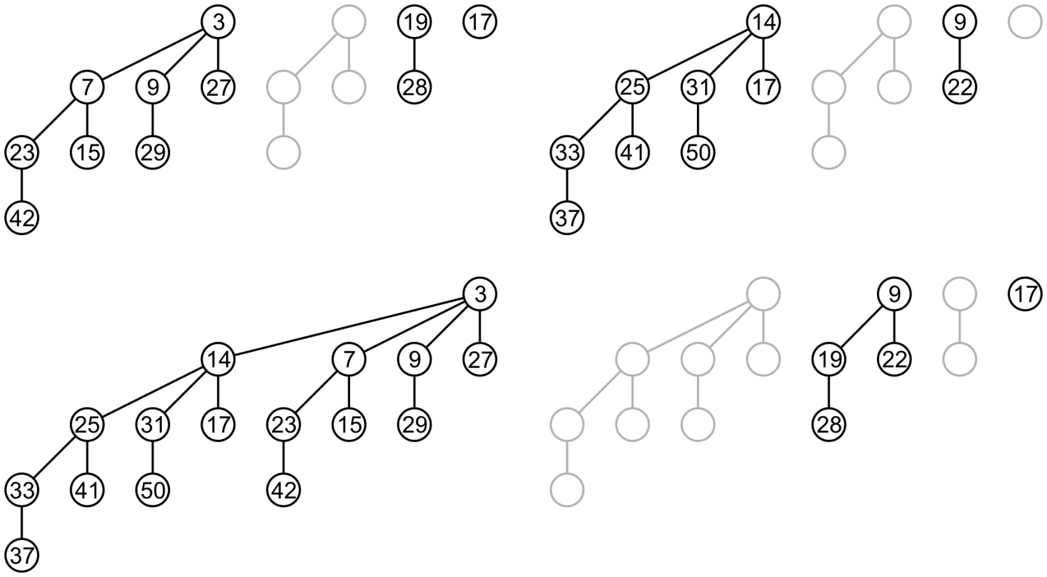
Merging Binomial Heaps
Thus, we have merged these two binomial heaps
The left had 8 + 2 + 1 nodes, the right 8 + 2, the result 16 + 4 + 1

Slide 28
Merging Binomial Heaps
Just like in binary addition, carries can occur
Assume that two trees of order h – 1 were merged to produce a tree of order h :
If only one of the original binomial heaps has a tree of order h, merge it with the carried heap
If both binomial heaps being merged have trees of order h, copy the carried heap into the result and merge the two trees of order h into one of order h + 1

Slide 29
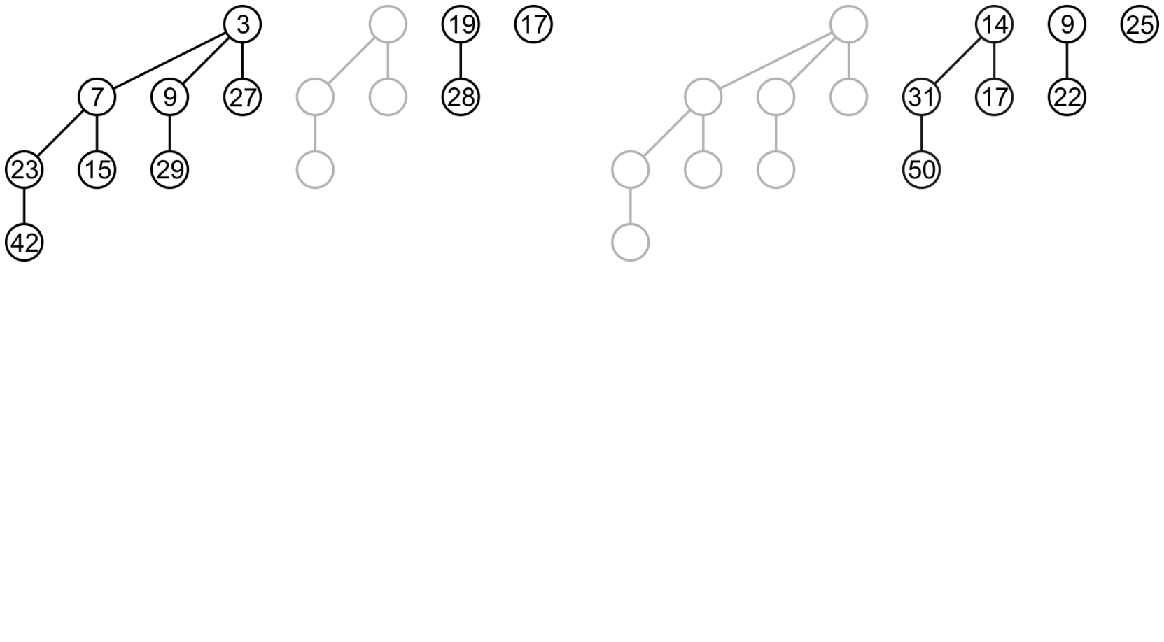
Merging Binomial Heaps
Suppose we wish to merge these two binomial heaps
Immediately, we have two binomial trees of order 0 to merge

Slide 30
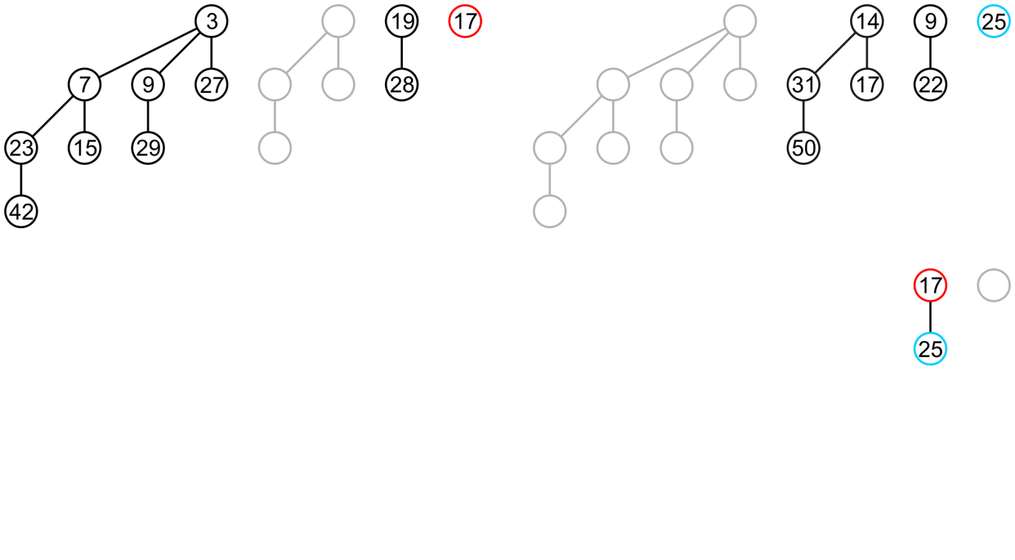
Merging Binomial Heaps
This becomes an order-1 binomial tree in the merged heap

Slide 31
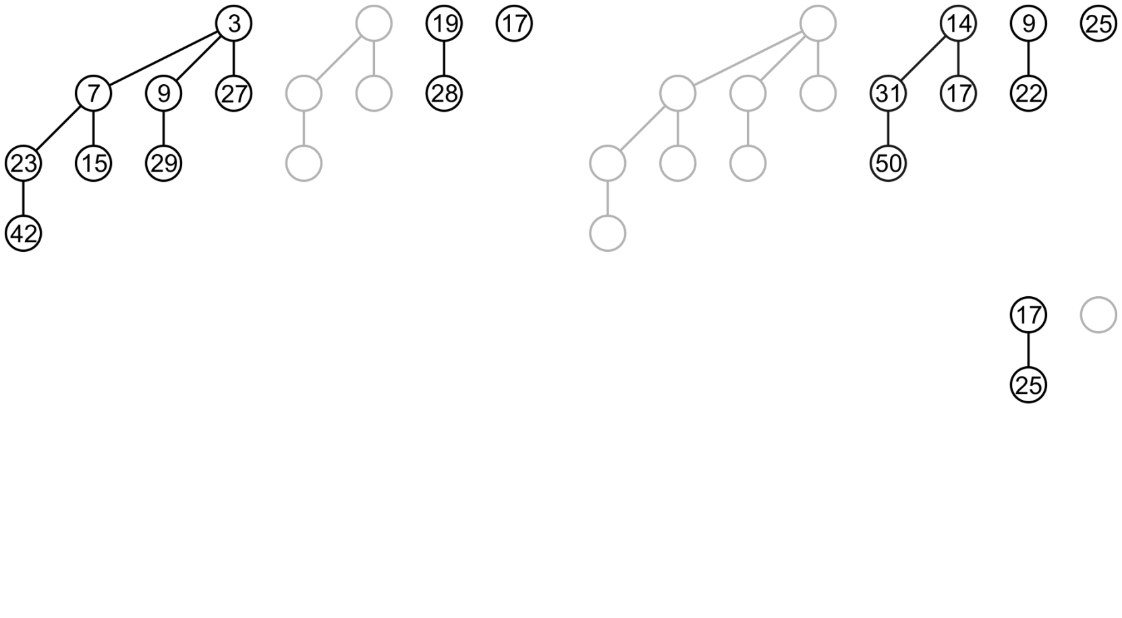
Merging Binomial Heaps
Moving on to the binomial trees of order 1, there is one in each heap and also one in the merged heap

Slide 32
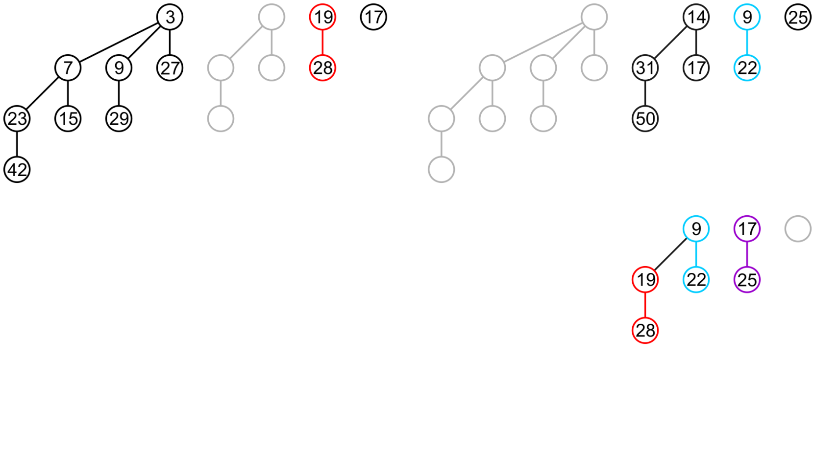
Merging Binomial Heaps
We will leave the heap in merged heap and merge the two binomial trees of order 1 to produce one of order 2

Slide 33
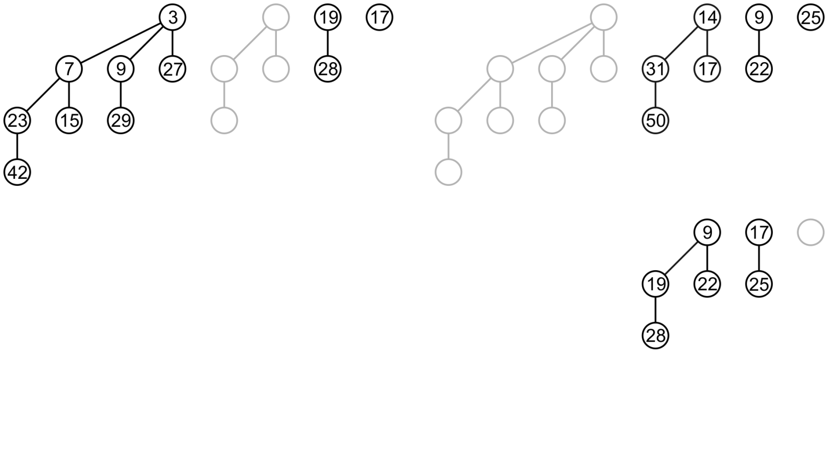
Merging Binomial Heaps
At this point, only the right tree has a binomial tree of order 2 as does the already-merged heap

Slide 34
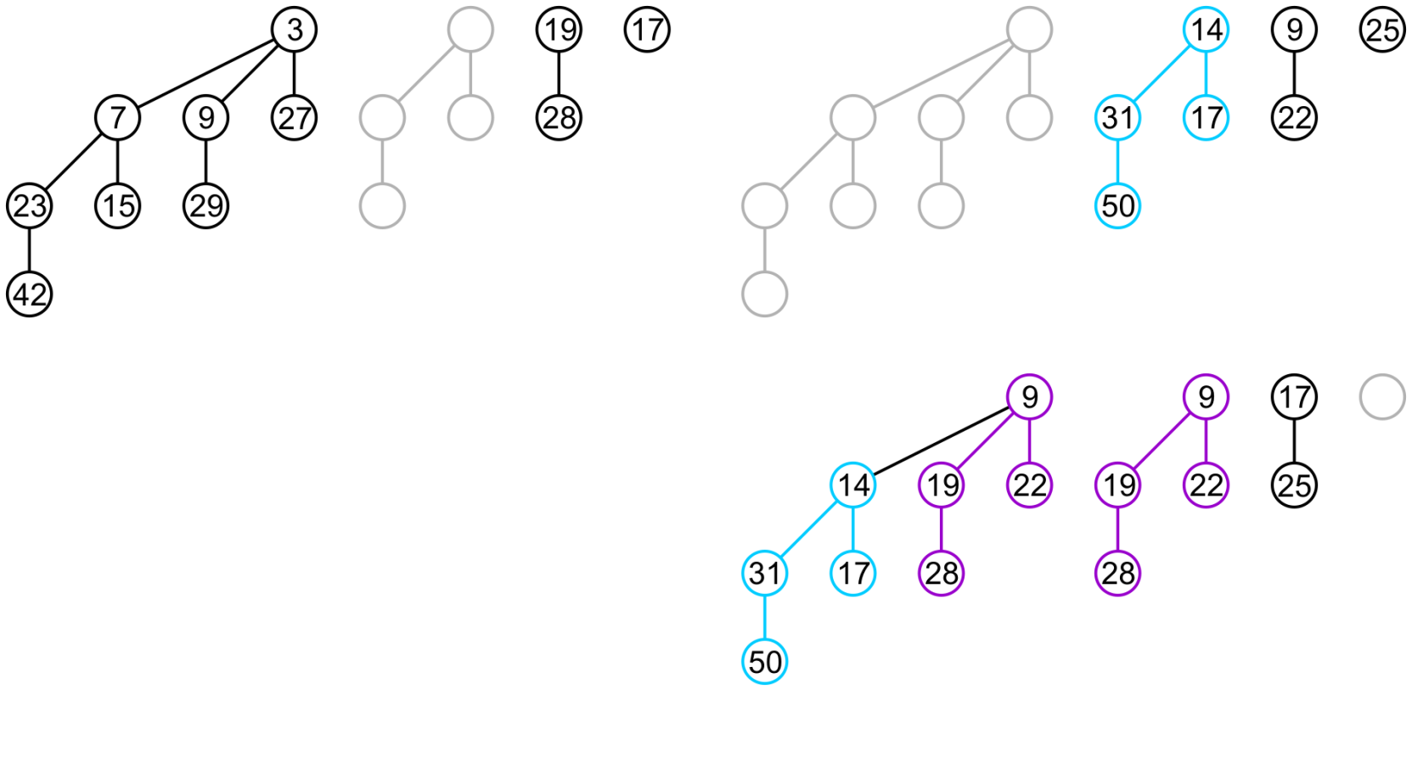
Merging Binomial Heaps
We will merge these to form a binomial tree of order 3

Slide 35
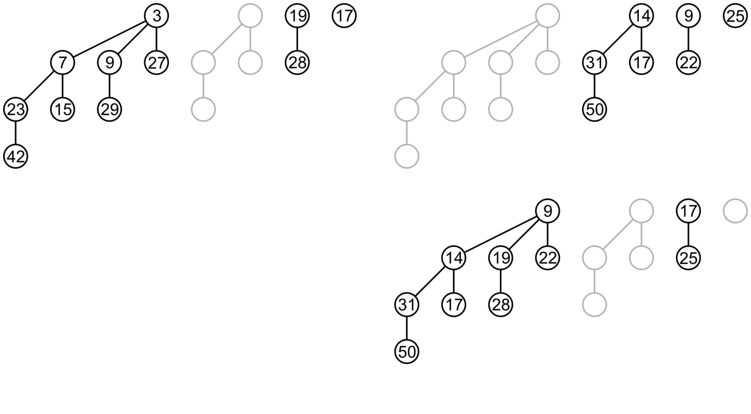
Merging Binomial Heaps
The merged heap now only contains the order-3 binomial tree
Finally, there are binomial trees of order 3 in both the merged heap and in the left heap

Slide 36
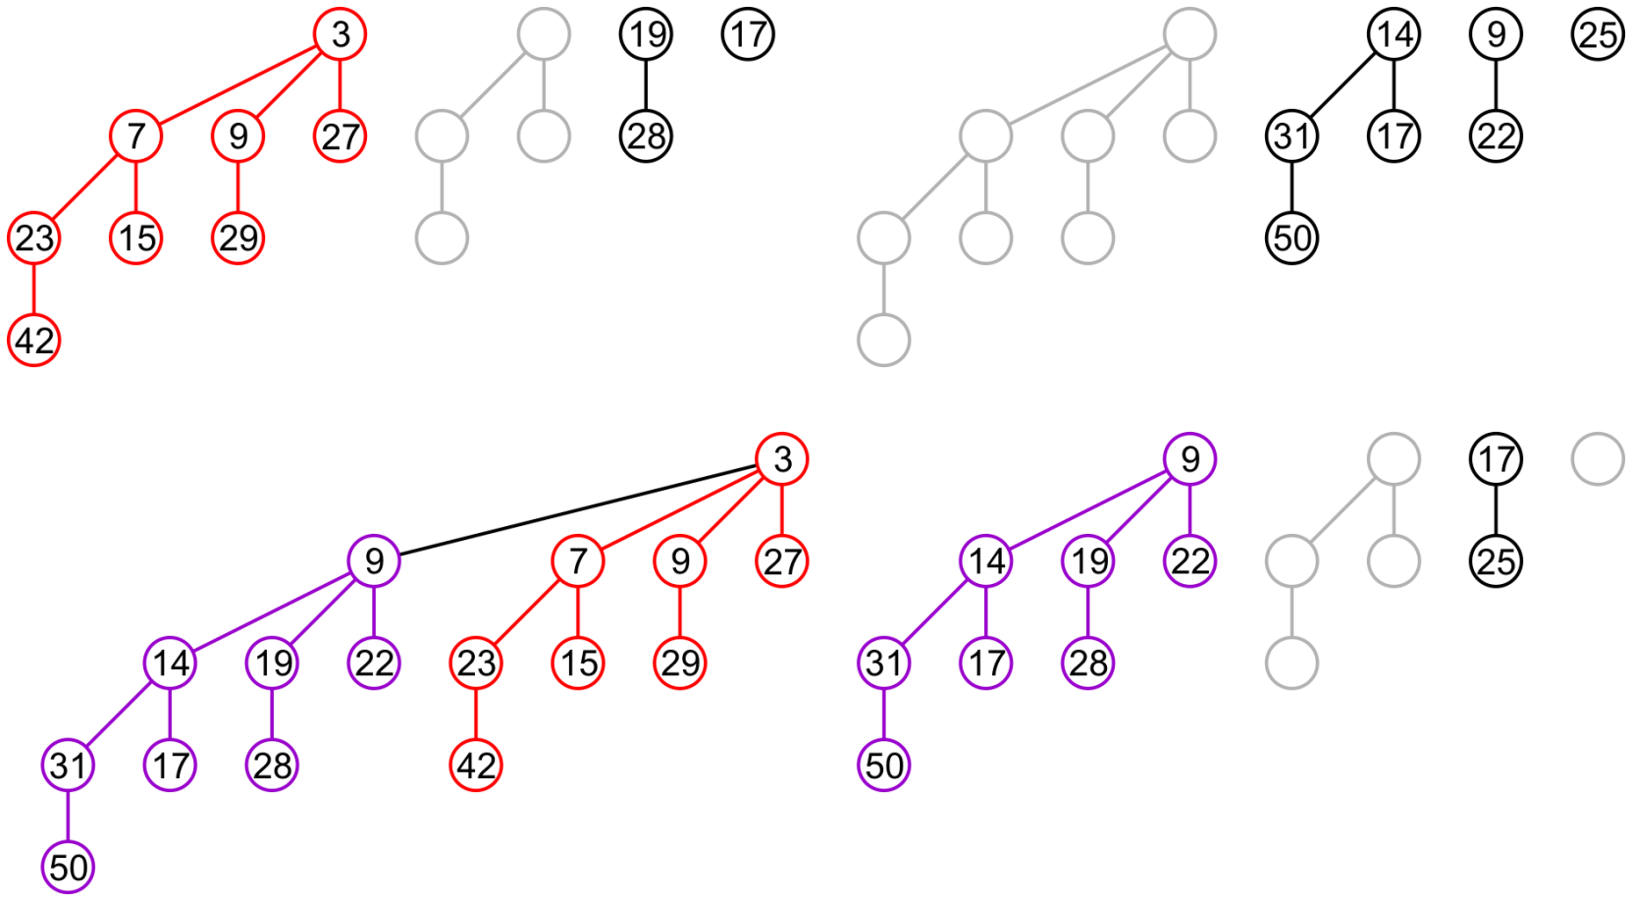
Merging Binomial Heaps
As before, we merge them and remove the binomial tree of order 3 from the heap

Slide 37
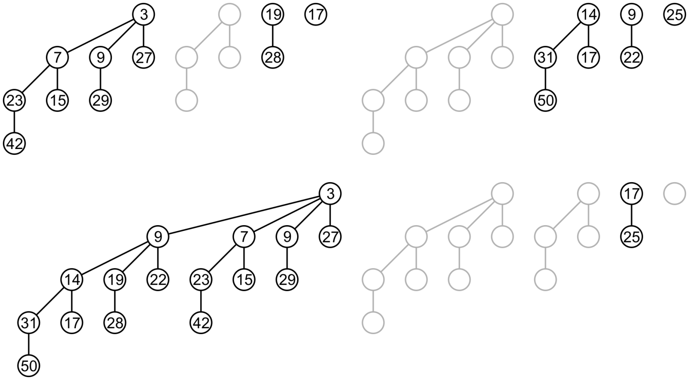
Merging Binomial Heaps
Thus, we have merged these two heaps with three carries
The left had 8 + 2 + 1 nodes, the right 4 + 2 + 1, the result 16 + 8 + 2

Slide 38
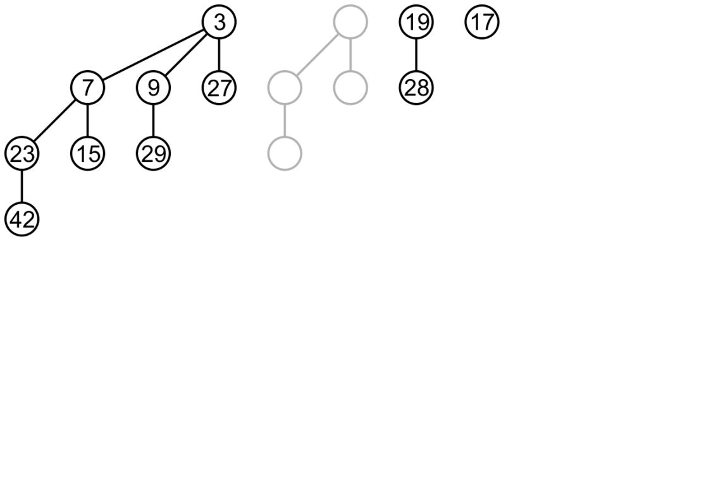
Push
Pushing a new node is performed by merging the existing binomial heap with one containing a single node
Consider adding 6 to this binomial heap

Slide 39
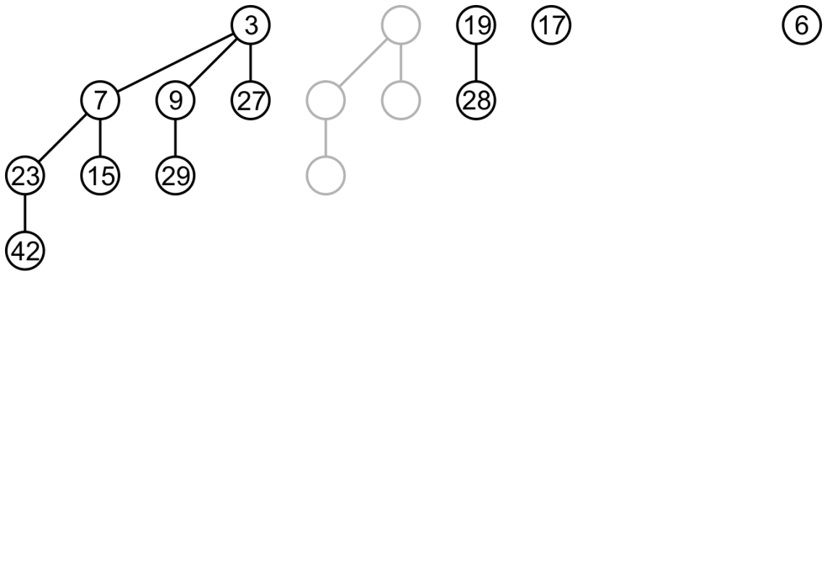
Push
First we create a second binomial heap containing just 6
We then begin by merging the two binomial trees of order 0

Slide 40
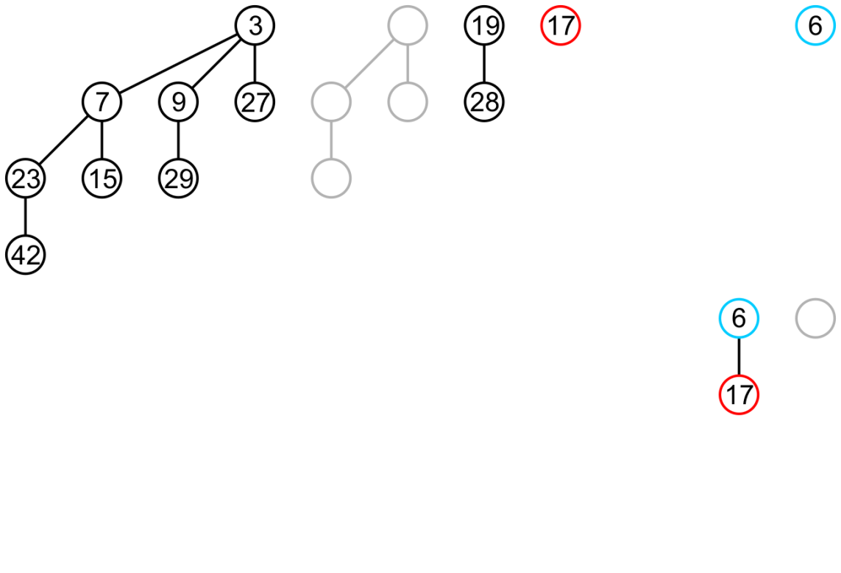
Push
This produces a binomial tree of order 1 in the result

Slide 41
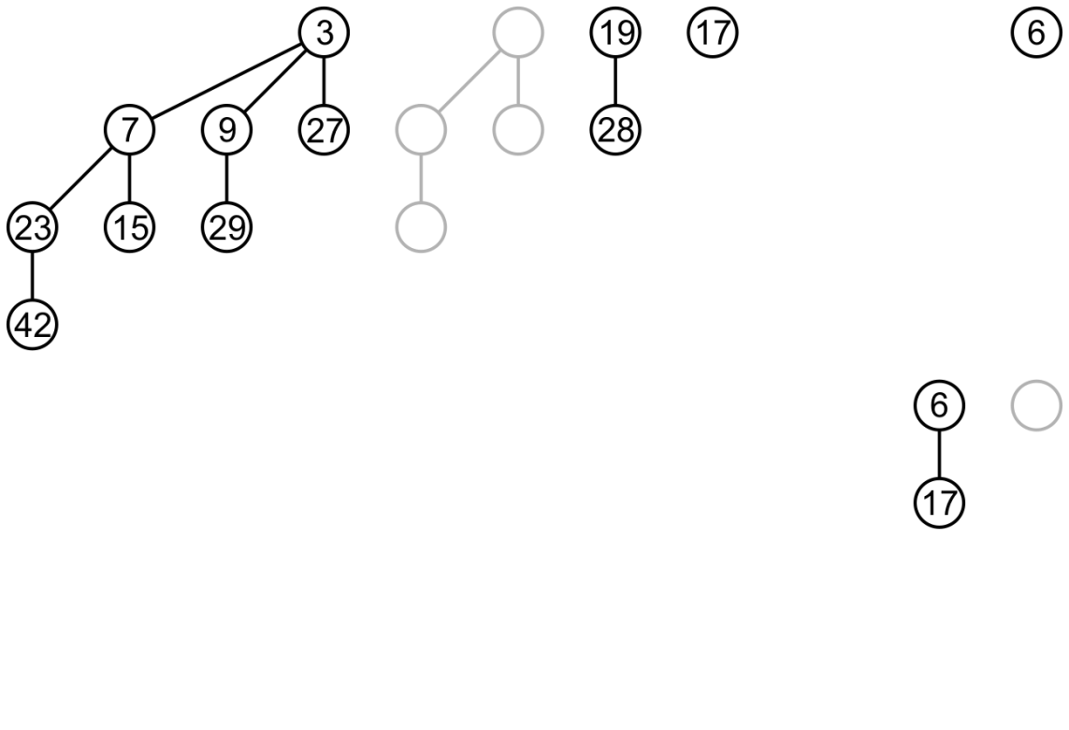
Push
Next, we merge the binomial trees of order 1

Slide 42
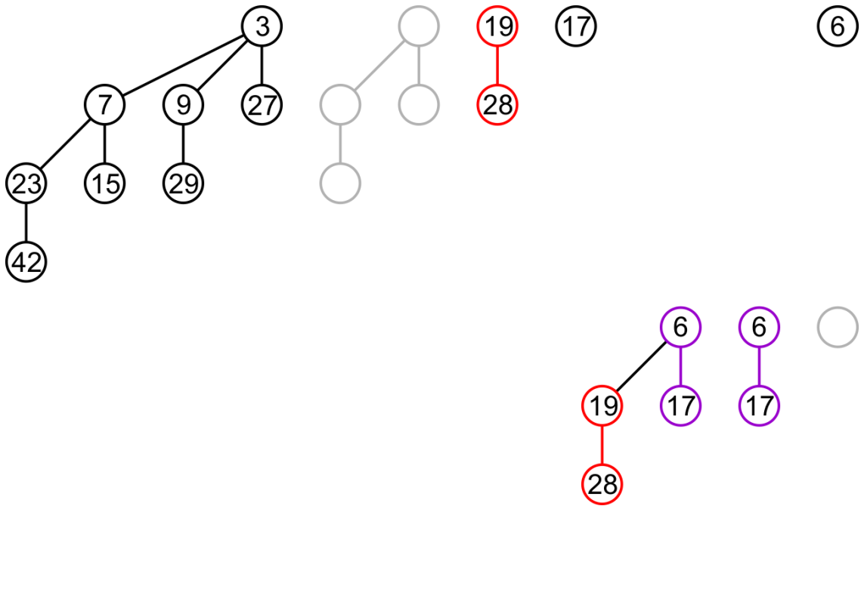
Push
This produces a binomial tree of order 2 in the solution

Slide 43
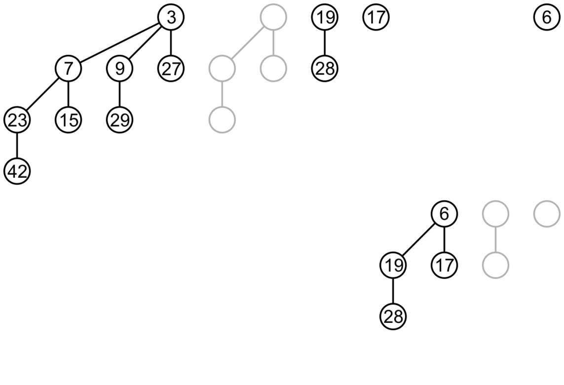
Push
Neither initial tree has a binomial tree of order 2 so we skip to the next binomial tree

Slide 44
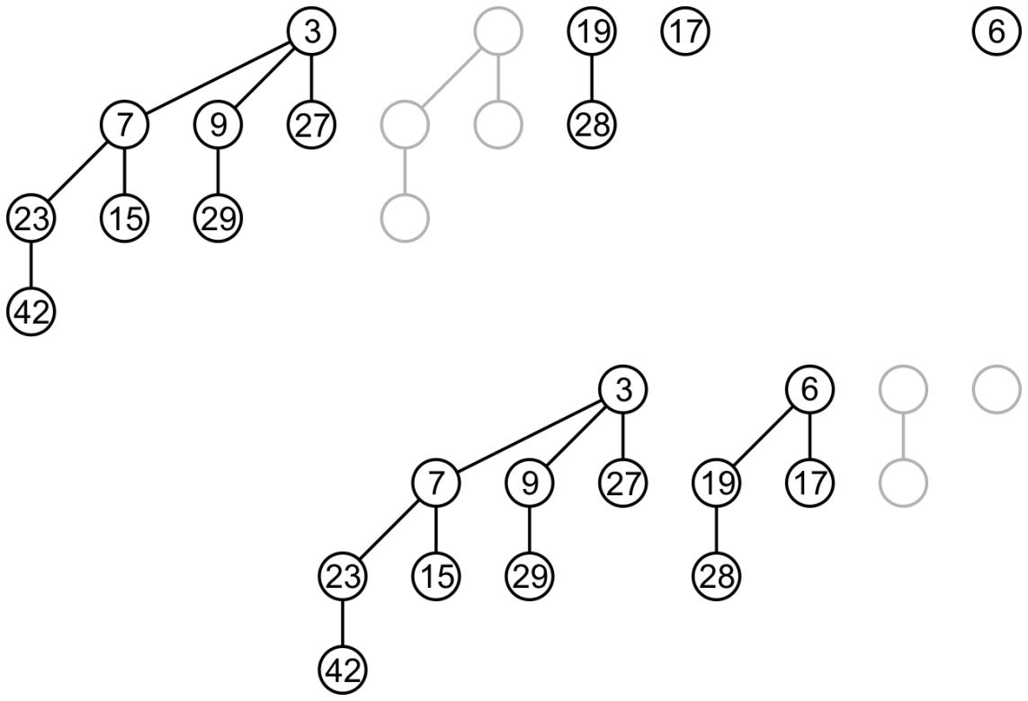
Push
There is only one, so we copy it down
The initial tree had 8 + 2 + 1 nodes, the final 8 + 4

Slide 45
Pop
Next we must address the question of popping the minimum element

Slide 46
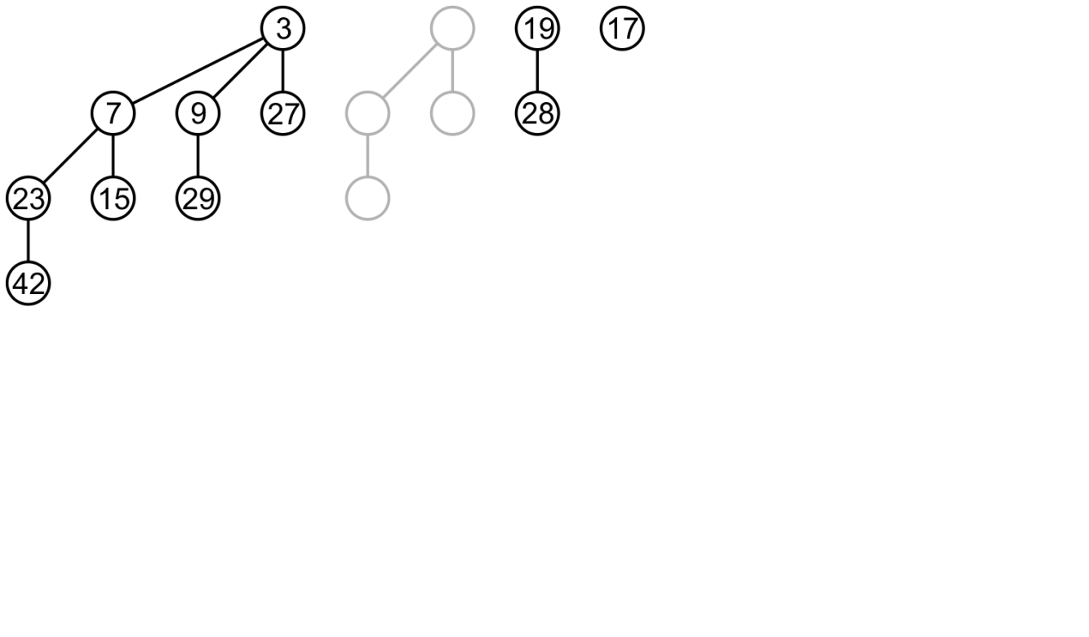
Pop
Consider popping the top of this binomial heap
The minimum element is in the binomial tree of order 3
Split it…

Slide 47
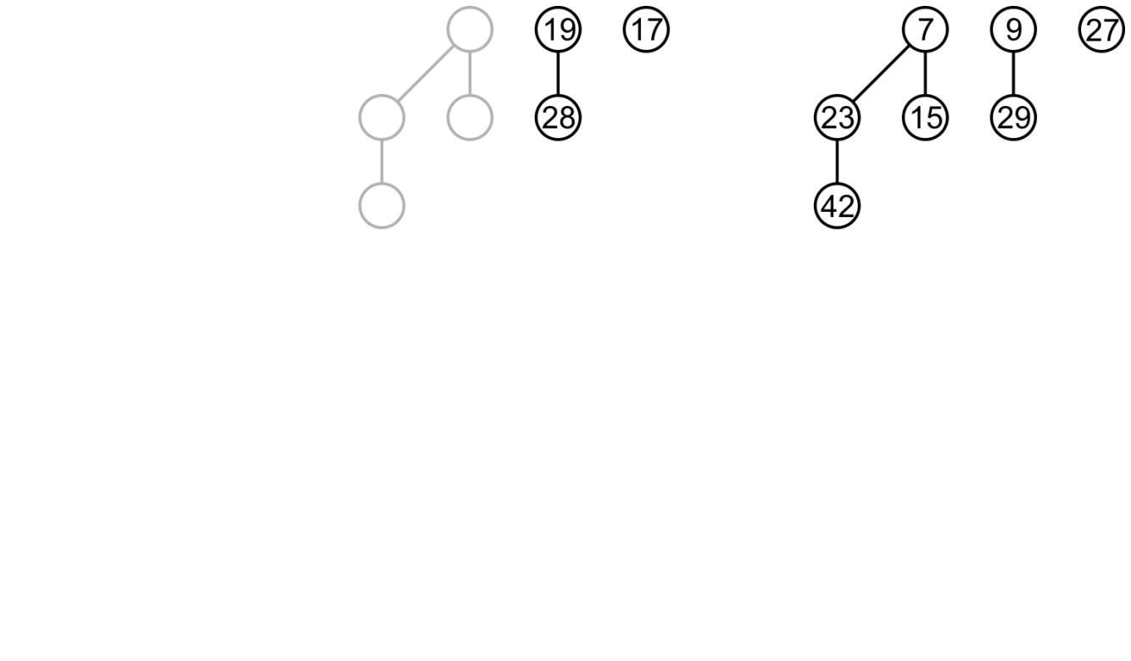
Pop
We now have two binomial heaps to merge
Start by merging 17 and 27

Slide 48
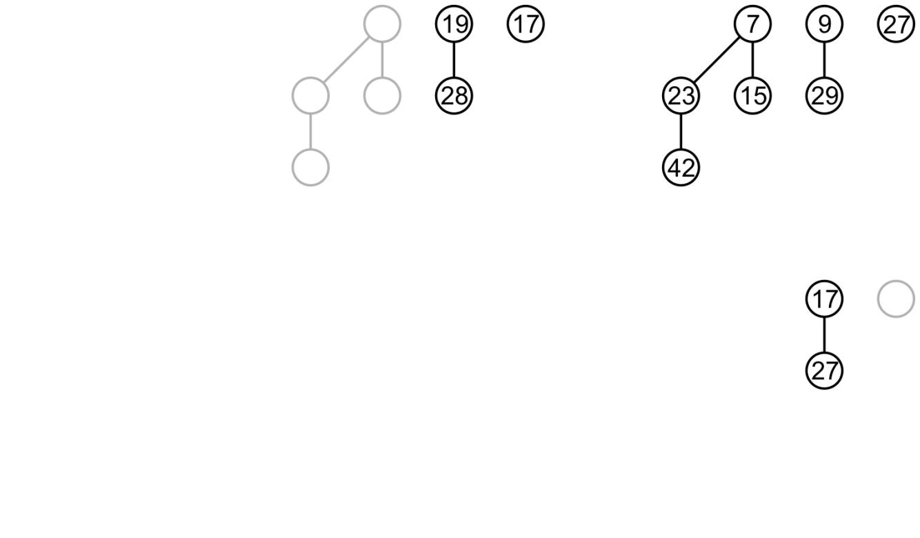
Pop
Next, each initial tree has a tree of order 1
Merge the trees with 9 and 19

Slide 49
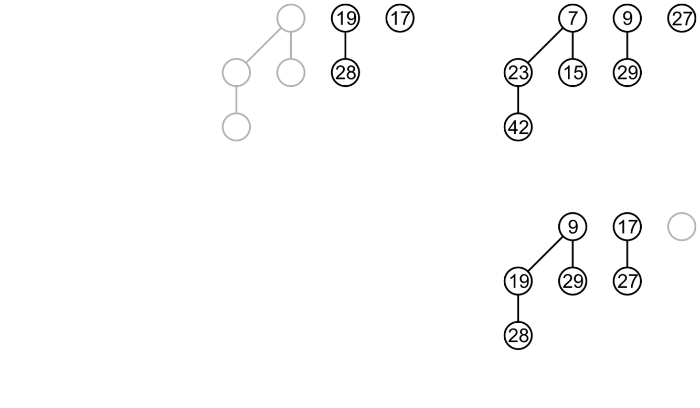
Pop
Next, merge the trees with roots 7 and 9

Slide 50
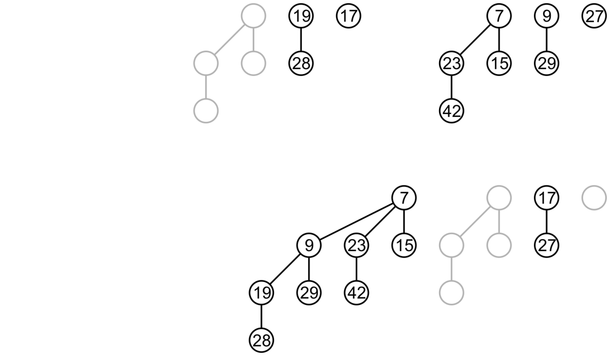
Pop
The result is a binomial heap with the minimum element popped

Slide 51
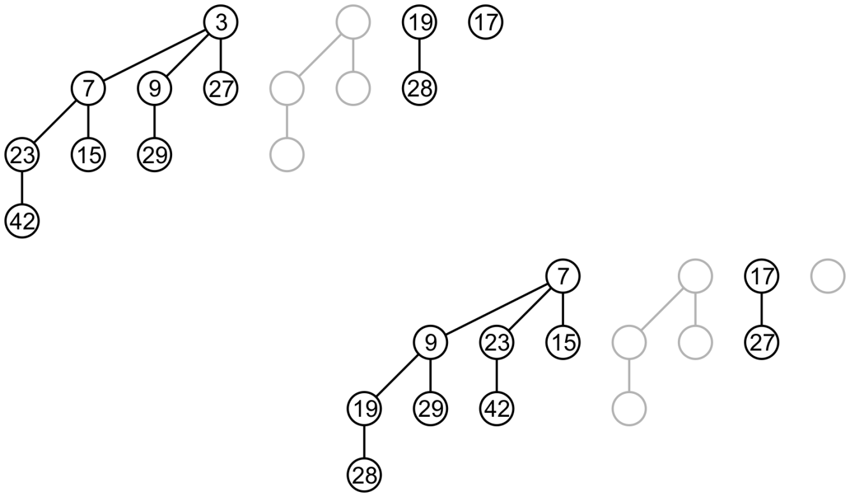
Pop
We started with a heap with 8 + 2 + 1 nodes and ended with one with 8 + 2 nodes with a top of 7

Slide 52
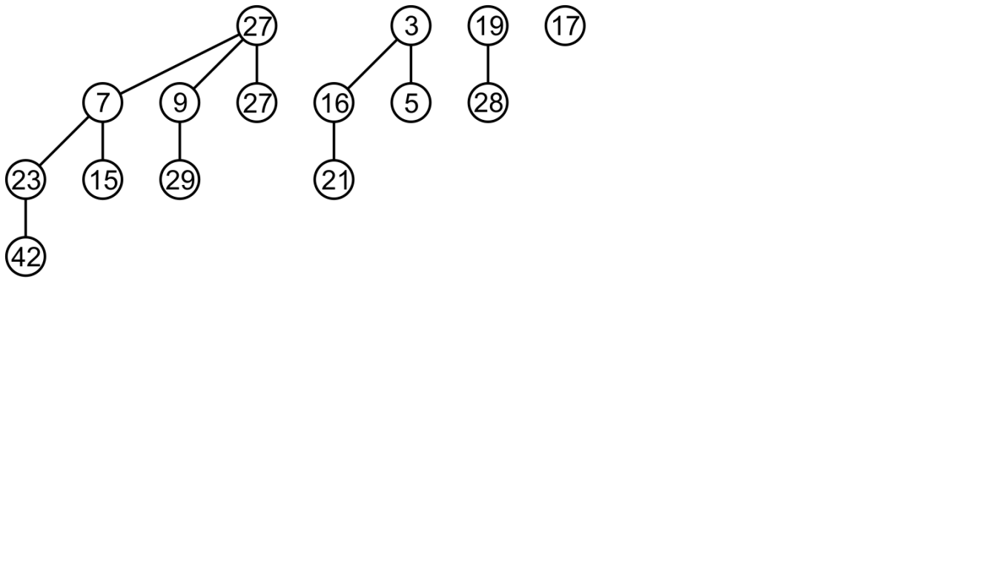
Pop
Again, consider popping the minimum element from this binomial heap: the tree of order 2 contains the minimum element
Split this tree into a binomial heap with trees rooted with 5 and 16

Slide 53
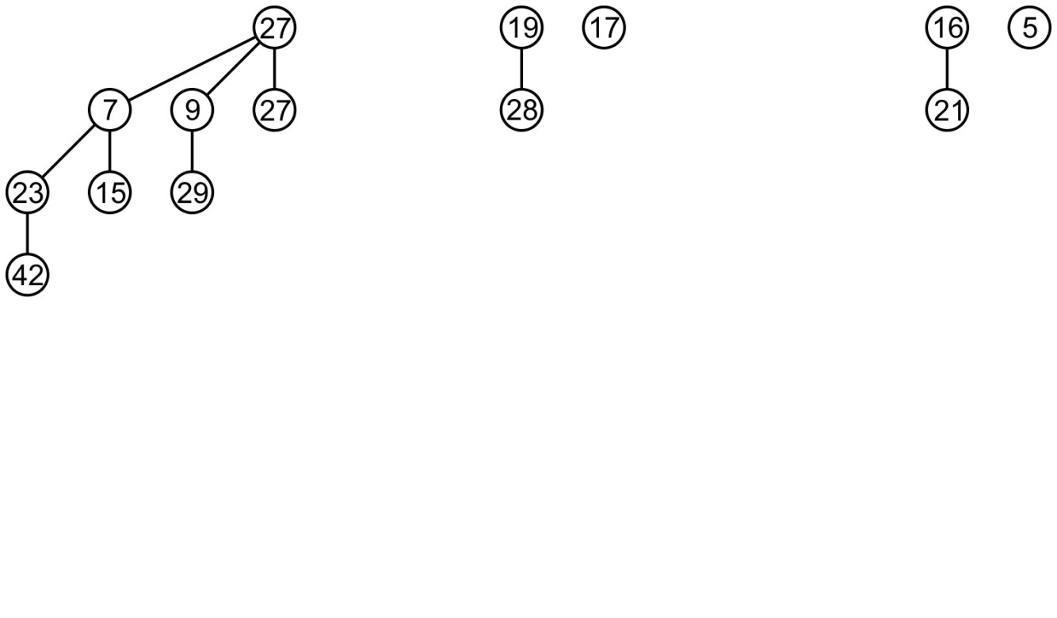
Pop
We continue by merging these two heaps
Begin by merging 5 and 17

Slide 54
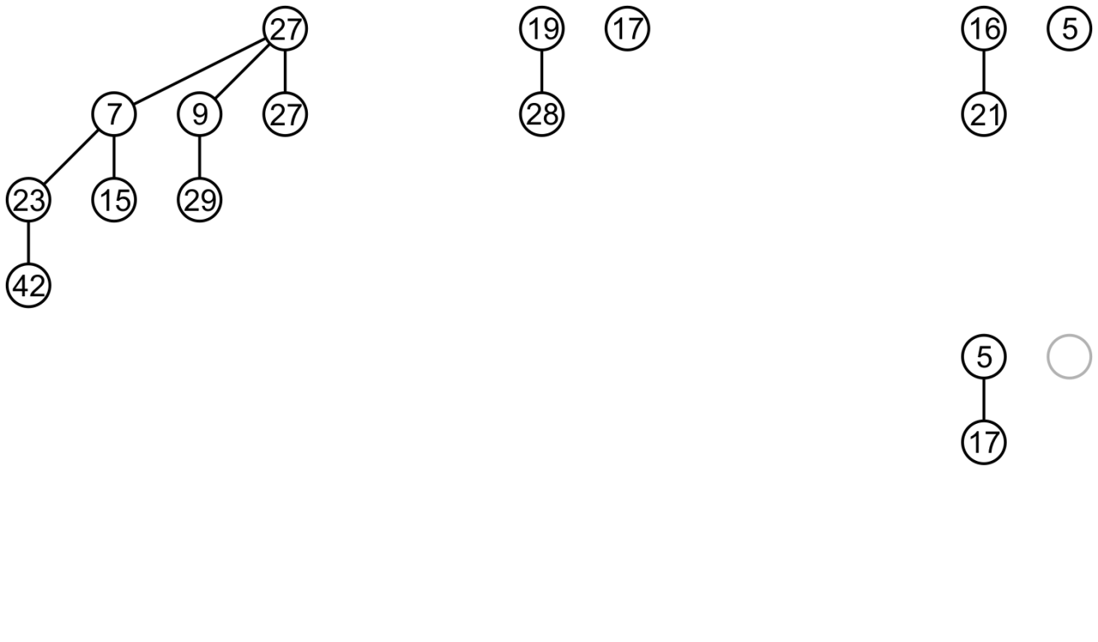
Pop
Next, merge the binomial trees with roots 16 and 19

Slide 55
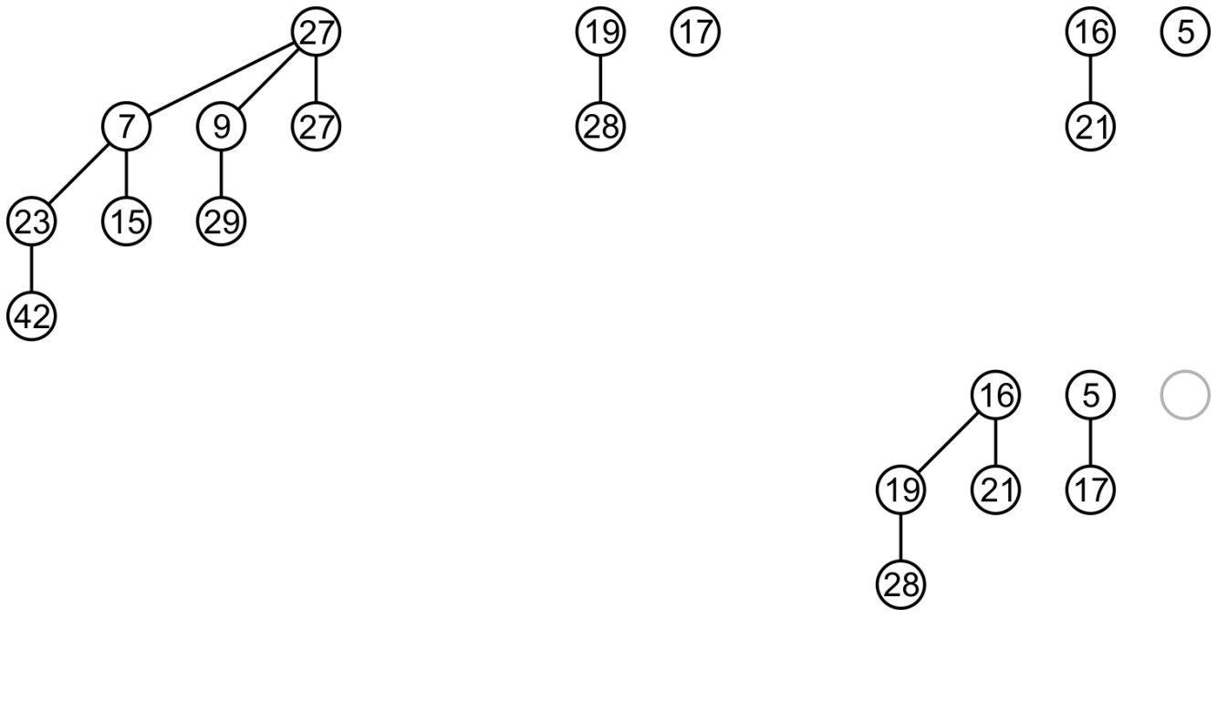
Pop
Finally, we simply copy the binomial tree of order 3

Slide 56
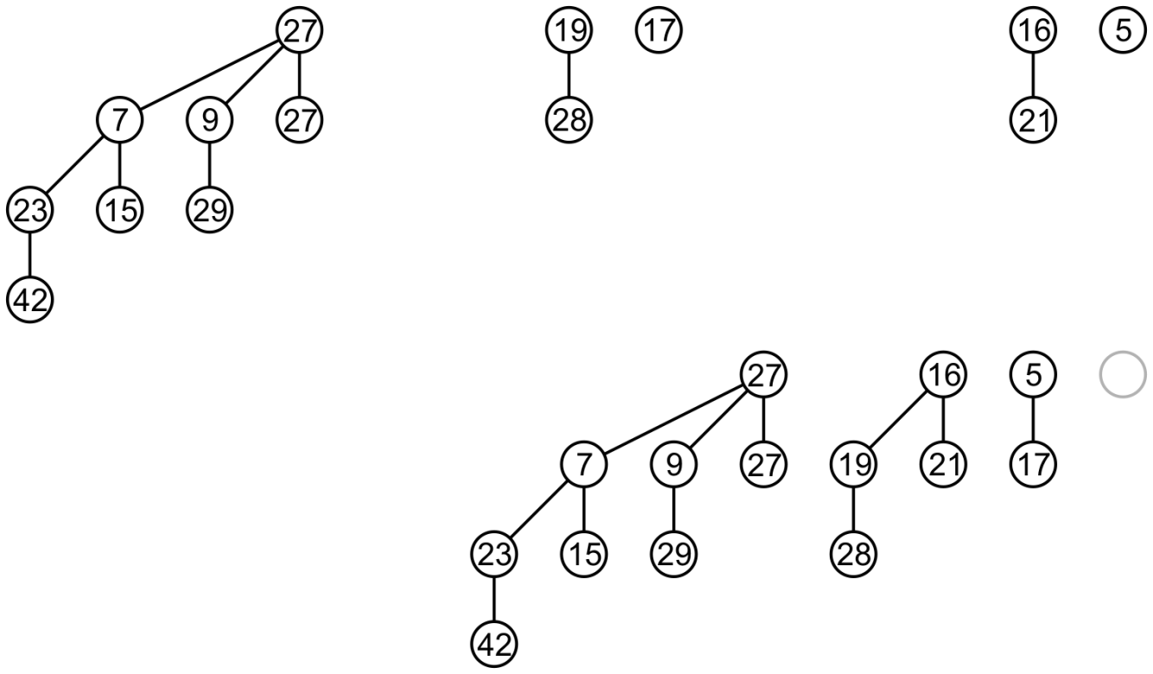
Pop
Thus, we have popped the minimum of this binomial heap

Slide 57
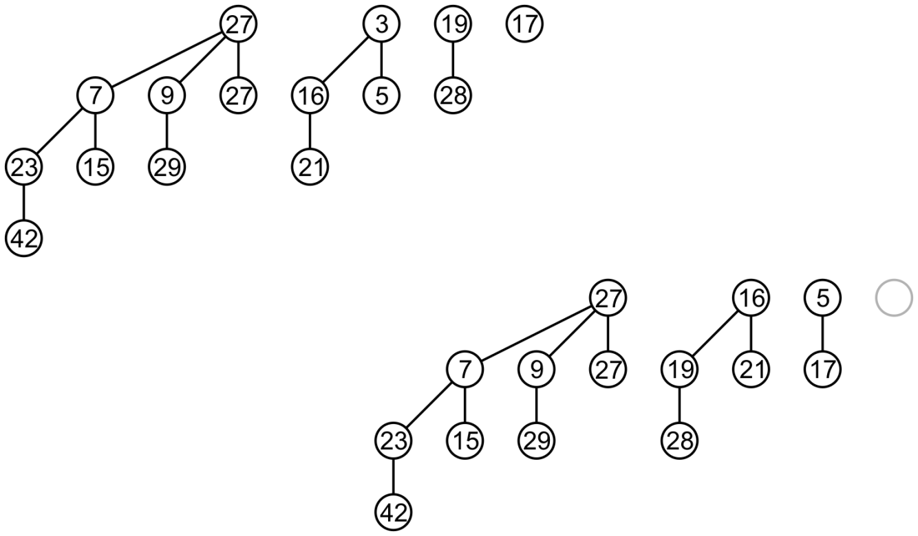
Pop
The initial tree had 8 + 4 + 2 + 1 nodes while the result has 8 + 4 + 2 nodes

Slide 58
Run Times
Finding the top requires us to check each tree
There are a maximum of trees: O(ln(n))
Merging two binomial trees is an Θ(1) operation
Therefore merging two heaps of comparable size, push and pop are also O(ln(n))
These operations are big-O because will not always be binomial trees in the heap
The worst-case run times are Θ(ln(n))

Slide 59
Implementation
An implementation of binomial heaps is available at
http://ece.uwaterloo.ca/~dwharder/aads/Algorithms/Binomial_heaps/

Slide 60
Summary
This topic has covered binomial heaps:
A forest of binomial trees each with the heap property
Merging is similar to binary addition
All operations are either O(ln(n)) or Θ(ln(n))
Unlike binary heaps, top is Θ(ln(n)) and not Θ(1)
They will allow us to introduce the next topic: Fibonacci heaps

Slide 61
References
[1] Cormen, Leiserson, Rivest and Stein, Introduction to Algorithms, 2nd Ed., MIT Press, 2001, Ch.19, pp.457-75.
[2] Weiss, Data Structures and Algorithm Analysis in C++, 3rd Ed., Addison Wesley, §6.8, p.240-50.

Slide 62
Usage Notes
These slides are made publicly available on the web for anyone to use
If you choose to use them, or a part thereof, for a course at another institution, I ask only three things:
that you inform me that you are using the slides,
that you acknowledge my work, and
that you alert me of any mistakes which I made or changes which you make, and allow me the option of incorporating such changes (with an acknowledgment) in my set of slides
Sincerely,
Douglas Wilhelm Harder, MMath
dwharder@alumni.uwaterloo.ca

