Slide 1
Left-child right-sibling binary tree

Slide 2
Background
Our simple tree data structure is node-based where children are stored as a linked list
Is it possible to store a general tree as a binary tree?

Slide 3
The Idea
Consider the following:
The first child of each node is its left sub-tree
The next sibling of each node is in its right sub-tree
This is called a left-child—right-sibling binary tree

Slide 4
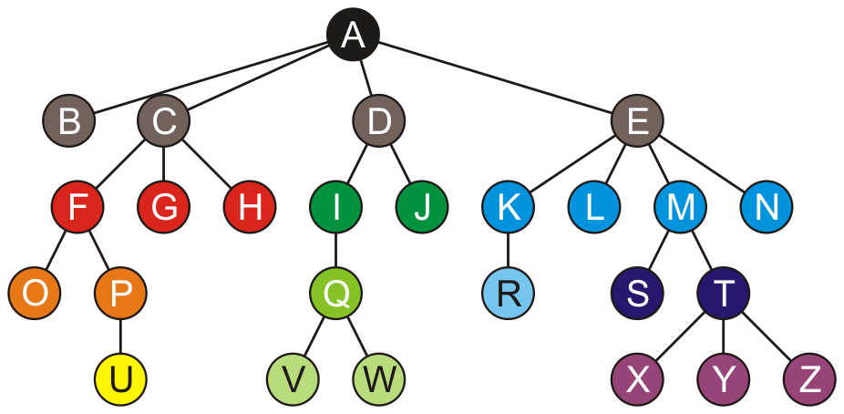
Example
Consider this general tree

Slide 5
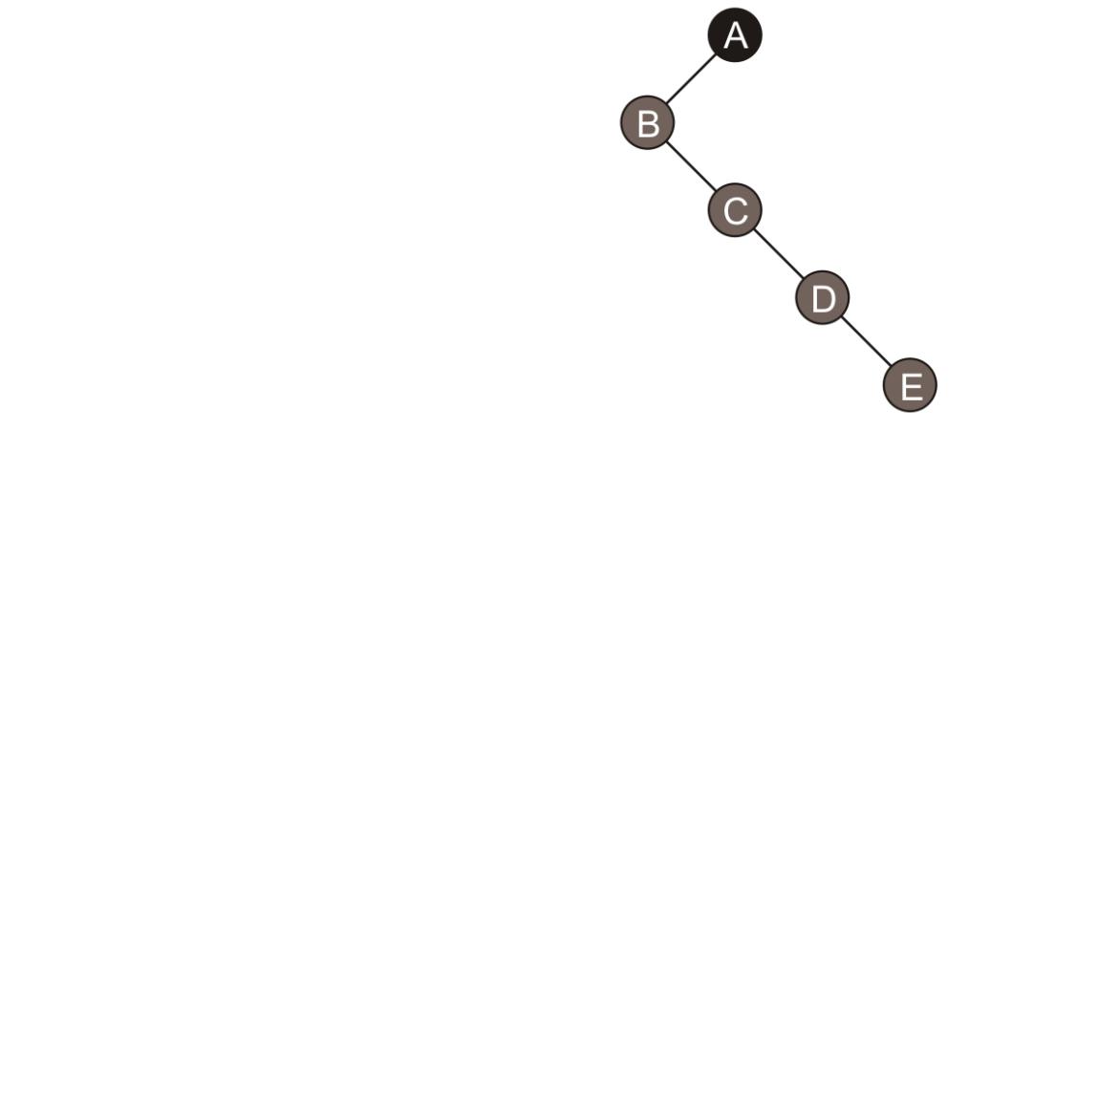
Example
B, the first child of A, is the left child of A
For the three siblings C, D, E:
C is the right sub-tree of B
D is the right sub-tree of C
E is the right sub-tree of D

Slide 6
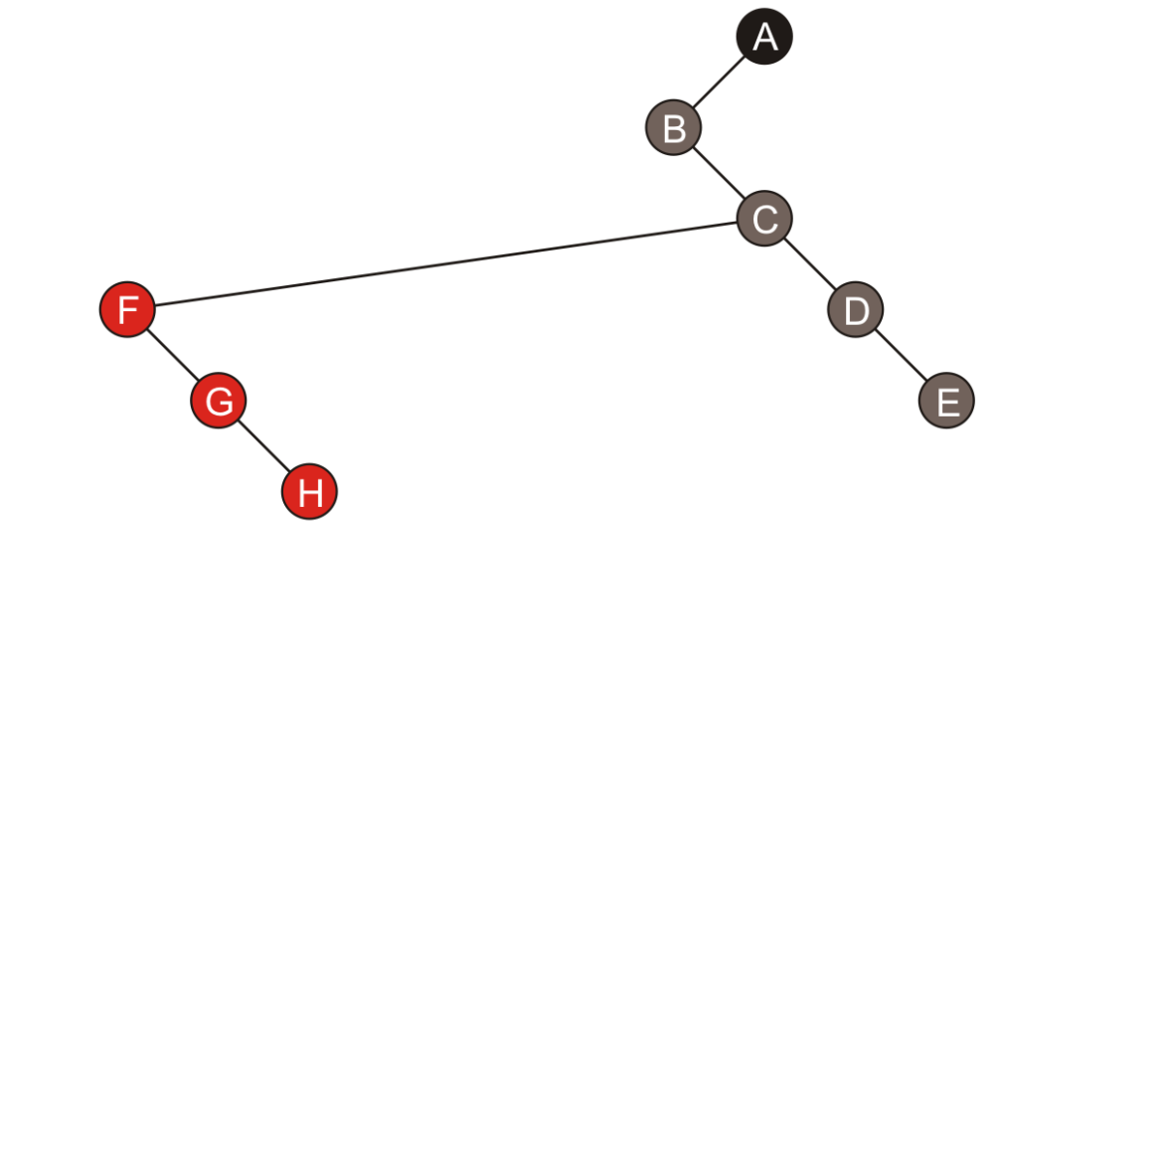
Example
B has no children, so it’s left sub-tree is empty
F, the first child of C, is the left sub-tree of C
For the next two siblings:
G is the right sub-tree of F
H is the right sub-tree of G

Slide 7
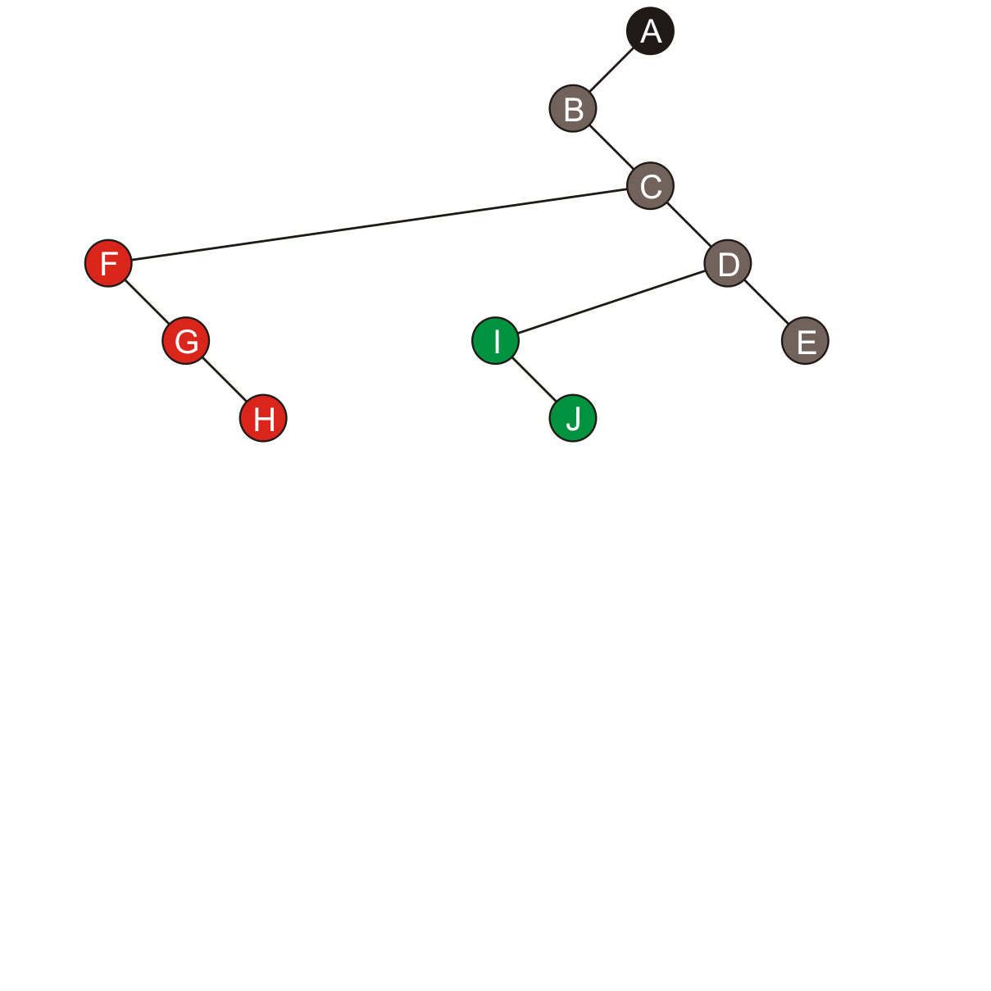
Example
I, the first child of D, is the left child of D
Its sibling J is the right sub-tree of I

Slide 8
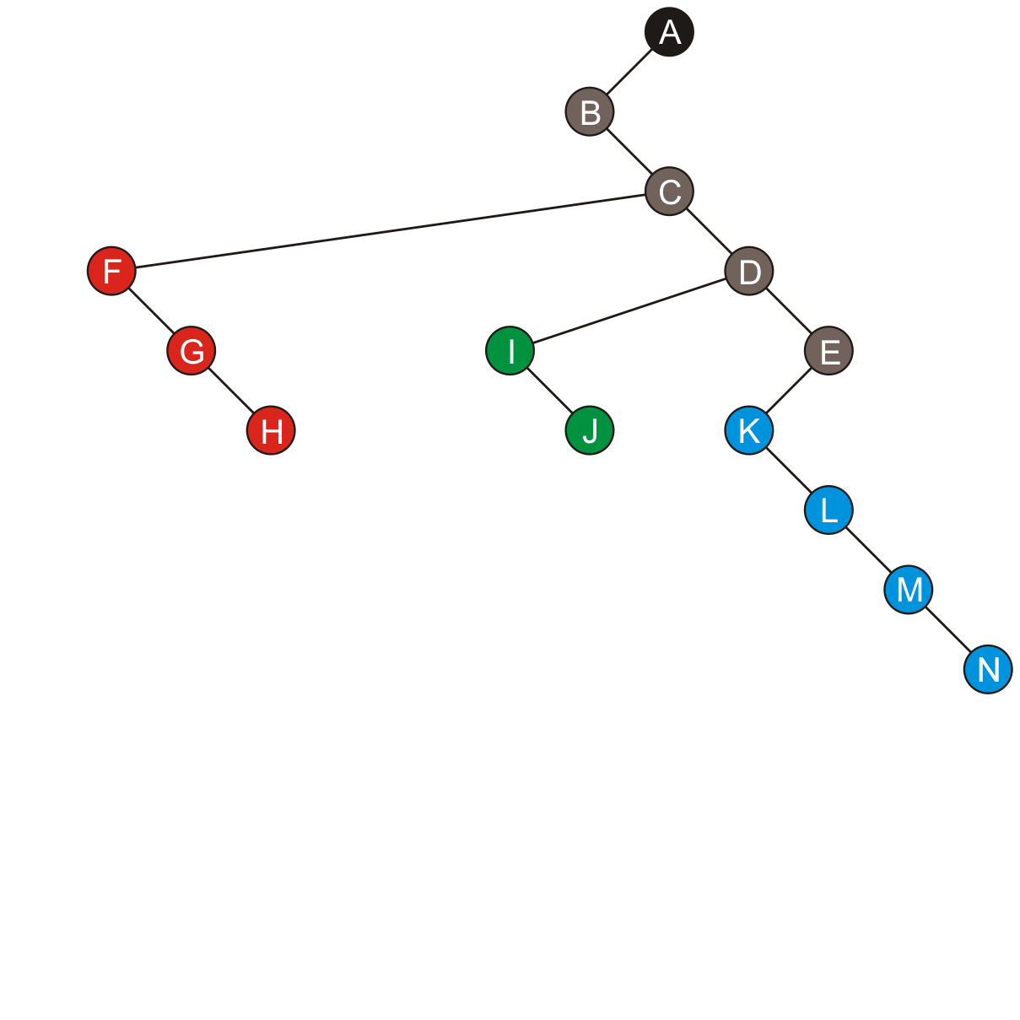
Example
Similarly, the four children of E start with K forming the left sub-tree of E and its three siblings form a chain along the left sub-trees

Slide 9
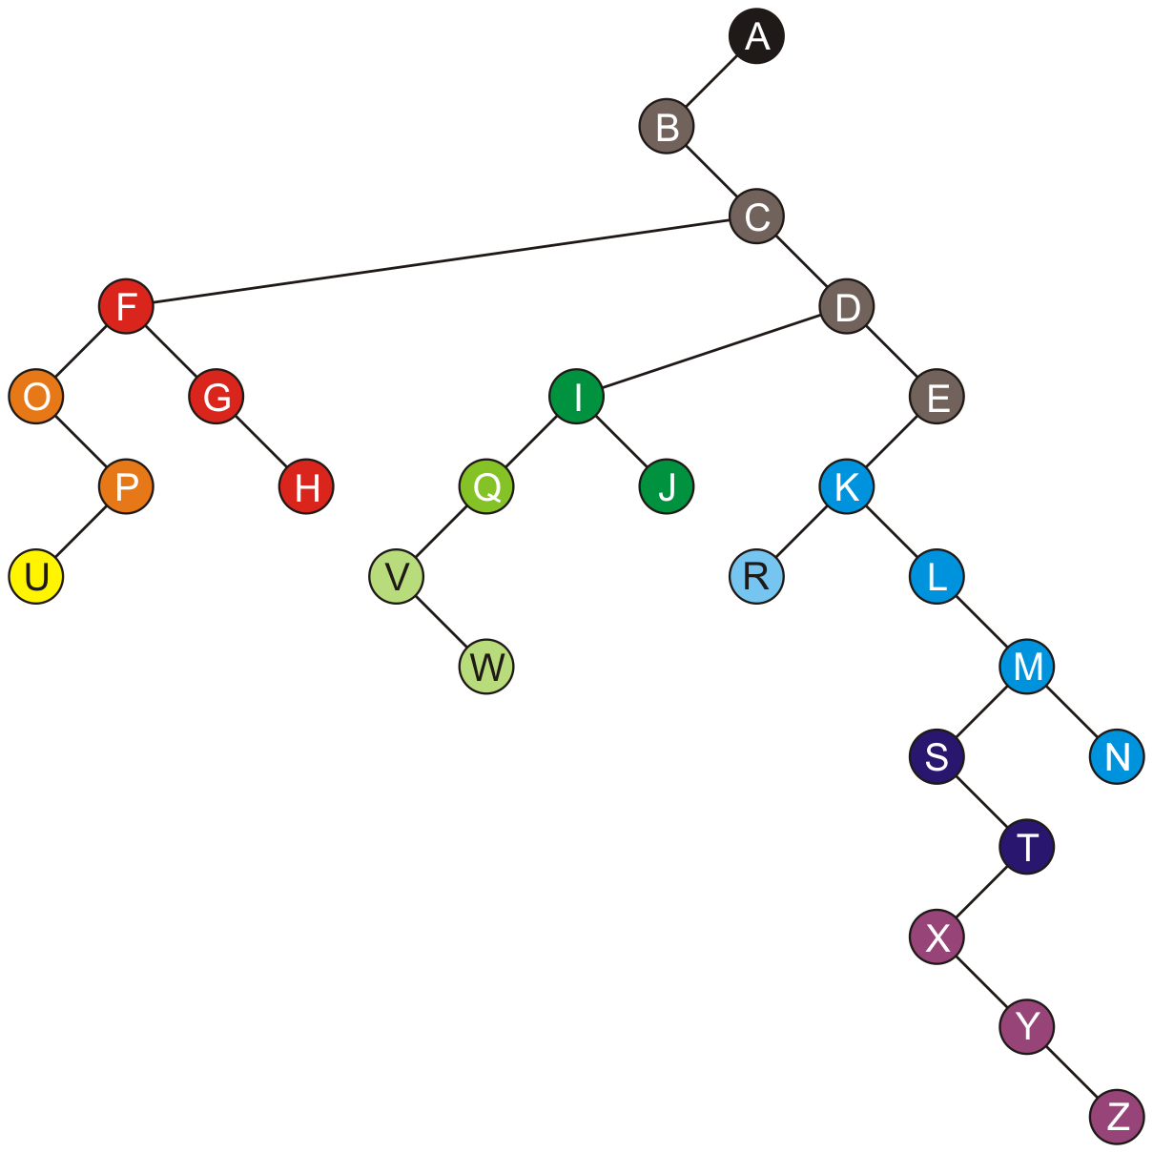
Example
The balance of the nodes in our general tree are shown here

Slide 10
Example
An empty left sub-tree indicates no children

Slide 11
Example
An empty right sub-tree indicates the node is the last of its siblings
The root node, has no siblings

Slide 12
Transformation
The transformation of a general tree into a left-child right-sibling binary tree has been called the Knuth transform

Slide 13
Traversals
A pre-order traversal of the original tree is identical to the pre-order traversal of the Knuth transform
A B C F O P U G H D I Q V W J E K R L M S T X Y Z N
Achieving a post-order traversal on the Knuth transform requires a different traversal:
The left sub-tree is traversed
The current node is visited
The right-sub-tree is traversed
Called an in-order traversal
B O U P F G H C V W Q I J D R K L S X Y Z T M N E A

Slide 14
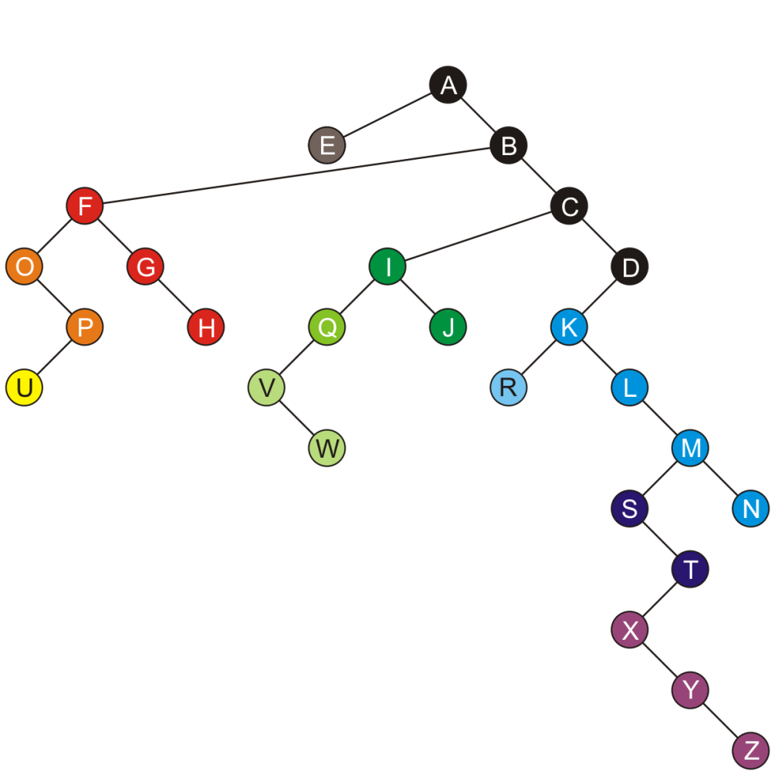
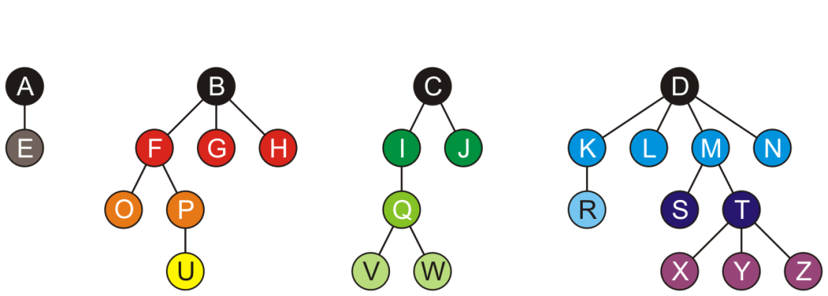
Forests
A forest, described in Topic 4.5, can be stored in this representation as follows:
Choose one of the roots of the trees as the root of the binary tree
Let each subsequent root of a tree be a right child of the previous root
This is the binary-tree representation of this forest
Think of the roots as siblings of each other

Slide 15
Implementation
The class is similar to that of a binary tree
template <typename Type>
class LCRS_tree {
private:
Type element;
LCRS_tree *first_child_tree;
LCRS_tree *next_sibling_tree;
public:
LCRS_tree();
LCRS_tree *first_child();
LCRS_tree *next_sibling();
// ...
};

Slide 16
Implementation
The implementation of various functions now differs
An iterative approach is much more desirable
template <typename Type>
int LCRS_tree<Type>::degree() const {
int count = 0;
for (
LCRS_tree<Type> *ptr = first_child();
ptr != nullptr;
ptr = ptr->next_sibling()
) {
++count;
}
return count;
}

Slide 17
Implementation
The implementation of various functions now differs
template <typename Type>
bool LCRS_tree<Type>::is_leaf() const {
return ( first_child() == nullptr );
}

Slide 18
Implementation
The implementation of various functions now differs
template <typename Type>
LCRS_tree<Type> *LCRS_tree<Type>::child( int n ) const {
if ( n < 0 || n >= degree() ) {
return nullptr;
}
LCRS_tree<Type> *ptr = first_child();
for ( int i = 0; i < n; ++i ) {
ptr = ptr->next_sibling();
}
return ptr;
}

Slide 19
Implementation
The implementation of various functions now differs
template <typename Type>
void LCRS_tree<Type>::append( Type const &obj ) {
if ( first_child() == nullptr ) {
first_child_tree = new LCRS_tree<Type>( obj );
} else {
LCRS_tree<Type> *ptr = first_child();
while ( ptr->next_sibling() != nullptr ) {
ptr = ptr->next_sibling();
}
ptr->next_sibling_tree = new LCRS_tree<Type>( obj );
}
}

Slide 20
Implementation
The implementation of various functions now differs
The size doesn’t care that this is a general tree…
template <typename Type>
int LCRS_tree<Type>::size() const {
return 1
+ ( first_child() == nullptr ? 0 : first_child()->size() )
+ ( next_sibling() == nullptr ? 0 : next_sibling()->size() );
}

Slide 21
Implementation
The implementation of various functions now differs
The height member function is closer to the original implementation
template <typename Type>
int LCRS_tree<Type>::height() const {
int h = 0;
for (
LCRS_tree<Type> *ptr = first_child();
ptr != nullptr;
ptr = ptr->next_sibling()
) {
h = std::max( h, 1 + ptr->height() );
}
return h;
}

Slide 22
Summary
This topic has covered a binary representation of general trees
The first child is the left sub-tree of a node
Subsequent siblings of that child form a chain down the right sub-trees
An empty left sub-tree indicates no children
An empty right sub-tree indicates no other siblings

Slide 23
References
[1] Cormen, Leiserson, Rivest and Stein, Introduction to Algorithms, 2nd Ed., MIT Press, 2001, §19.1, pp.457-9.
[2] Weiss, Data Structures and Algorithm Analysis in C++, 3rd Ed., Addison Wesley, §6.8.1, p.240.

Slide 24
Usage Notes
These slides are made publicly available on the web for anyone to use
If you choose to use them, or a part thereof, for a course at another institution, I ask only three things:
that you inform me that you are using the slides,
that you acknowledge my work, and
that you alert me of any mistakes which I made or changes which you make, and allow me the option of incorporating such changes (with an acknowledgment) in my set of slides
Sincerely,
Douglas Wilhelm Harder, MMath
dwharder@alumni.uwaterloo.ca

