Slide 1
Binary trees

Slide 2
Outline
In this talk, we will look at the binary tree data structure:
Definition
Properties
A few applications
Ropes (strings)
Expression trees

Slide 3
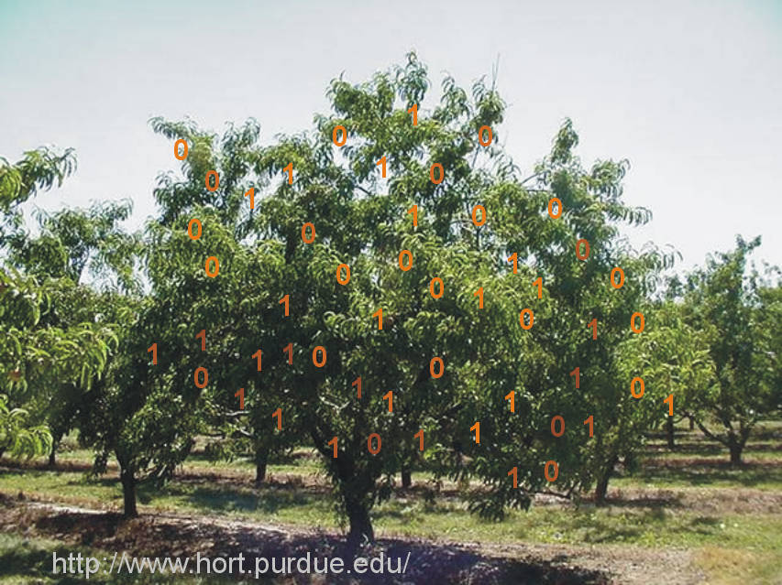
Definition
This is not a binary tree:

Slide 4
Definition
5.1
The arbitrary number of children in general trees is often unnecessary—many real-life trees are restricted to two branches
Expression trees using binary operators
An ancestral tree of an individual, parents, grandparents, etc.
Phylogenetic trees
Lossless encoding algorithms
There are also issues with general trees:
There is no natural order between a node and its children

Slide 5
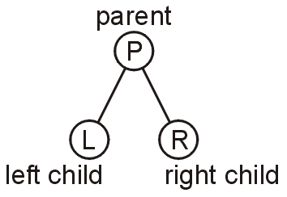
Definition
5.1.1
A binary tree is a restriction where each node has exactly two children:
Each child is either empty or another binary tree
This restriction allows us to label the children as left and right subtrees
At this point, recall that lg(n) = Θ(log_{b}(n)) for any b

Slide 6
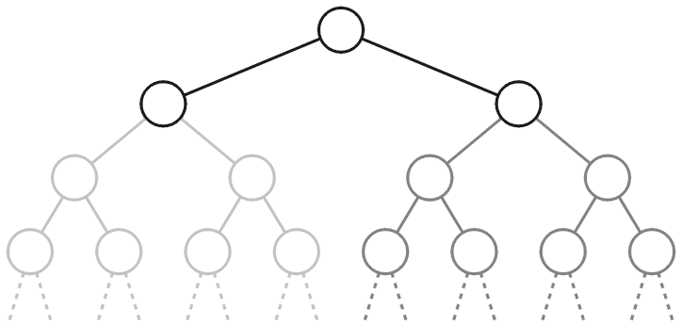
Definition
5.1.1
We will also refer to the two sub-trees as
The left-hand sub-tree, and
The right-hand sub-tree

Slide 7
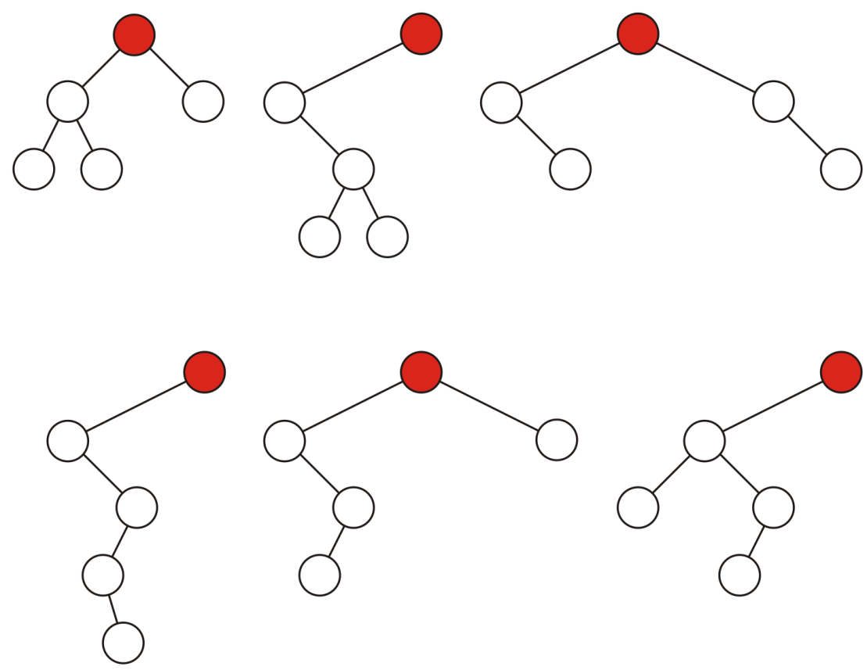
Definition
5.1.1
Sample variations on binary trees with five nodes:

Slide 8
Definition
5.1.1
A full node is a node where both the left and right sub-trees are non-empty trees
Legend:
full nodes neither leaf nodes

Slide 9
Definition
5.1.1
An empty node or a null sub-tree is any location where a new leaf node could be appended

Slide 10
Definition
5.1.1
A full binary tree is where each node is:
A full node, or
A leaf node
These have applications in
Expression trees
Huffman encoding

Slide 11
Binary Node Class
5.1.2
The binary node class is similar to the single node class:
#include <algorithm>
template <typename Type>
class Binary_node {
protected:
Type node_value;
Binary_node *p_left_tree;
Binary_node *p_right_tree;
public:
Binary_node( Type const & );
Type value() const;
Binary_node *left() const;
Binary_node *right() const;
bool is_leaf() const;
int size() const;
int height() const;
void clear();
}

Slide 12
Binary Node Class
5.1.2
We will usually only construct new leaf nodes
template <typename Type>
Binary_node<Type>::Binary_node( Type const &obj ):
node_value( obj ),
p_left_tree( nullptr ),
p_right_tree( nullptr ) {
// Empty constructor
}

Slide 13
Binary Node Class
5.1.2
The accessors are similar to that of Single_list
template <typename Type>
Type Binary_node<Type>::value() const {
return node_value;
}
template <typename Type>
Binary_node<Type> *Binary_node<Type>::left() const {
return p_left_tree;
}
template <typename Type>
Binary_node<Type> *Binary_node<Type>::right() const {
return p_right_tree;
}

Slide 14
Binary Node Class
5.1.2
Much of the basic functionality is very similar to Simple_tree
template <typename Type>
bool Binary_node<Type>::is_leaf() const {
return (left() == nullptr) && (right() == nullptr);
}

Slide 15
Size
5.1.2
The recursive size function runs in Θ(n) time and Θ(h) memory
These can be implemented to run in Θ(1)
template <typename Type>
int Binary_node<Type>::size() const {
if ( left() == nullptr ) {
return ( right() == nullptr ) ? 1 : 1 + right()->size();
} else {
return ( right() == nullptr ) ?
1 + left()->size() :
1 + left()->size() + right()->size();
}

Slide 16
Height
5.1.2
The recursive height function also runs in Θ(n) time and Θ(h) memory
Later we will implement this in Θ(1) time
int Binary_node<Type>::height() const {
if ( left() == nullptr ) {
return ( right() == nullptr ) ? 0 : 1 + right()->height();
} else {
return ( right() == nullptr ) ?
1 + left()->height() :
1 + left()->height() + right()->height();
}

Slide 17
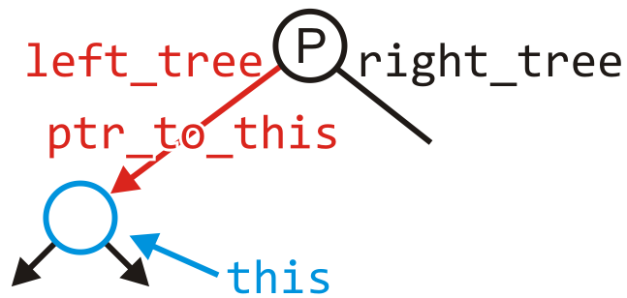
Clear
5.1.2
Removing all the nodes in a tree is similarly recursive:
template <typename Type>
void Binary_node<Type>::clear( Binary_node *&p_to_this ) {
if ( left() != nullptr ) {
left()->clear( p_left_tree );
}
if ( right() != nullptr ) {
right()->clear( p_right_tree );
}
delete this;
p_to_this = nullptr;
}

Slide 18
Run Times
5.1.3
Recall that with linked lists and arrays, some operations would run in Θ(n) time
The run times of operations on binary trees, we will see, depends on the height of the tree
We will see that:
The worst is clearly Θ(n)
Under average conditions, the height is
The best case is Θ(ln(n))

Slide 19
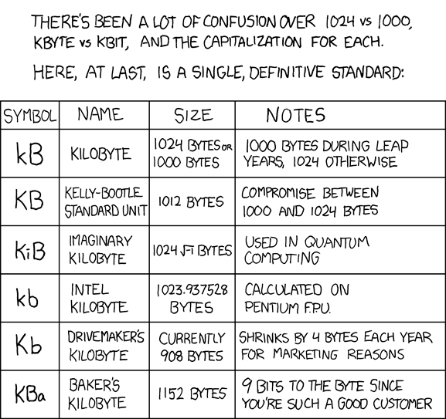
Run Times
5.1.3
If we can achieve and maintain a height Θ(lg(n)), we will see that many operations can run in Θ(lg(n)) we
Logarithmic time is not significantly worse than constant time:
lg( 1000 ) ≈ 10 kB
lg( 1 000 000 ) ≈ 20 MB
lg( 1 000 000 000 ) ≈ 30 GB
lg( 1 000 000 000 000 ) ≈ 40 TB
lg( 1000^{n} ) ≈ 10 n
http://xkcd.com/394/

Slide 20
Application: Ropes
5.1.4.1
In 1995, Boehm et al. introduced the idea of a rope, or a heavyweight string

Slide 21
Application: Ropes
5.1.4.1
Alpha-numeric data is stored using a string of characters
A character (or char) is a numeric value from 0 to 255 where certain numbers represent certain letters
For example,
‘A’ 65 01000001₂
‘B’ 66 01000010₂
‘a’ 97 01100001₂
‘b’ 98 01100010₂
‘ ’ 32 00100000₂
Unicode extends character encoding beyond the Latin alphabet
Still waiting for the Tengwar characters…
J.R.R. Tolkien

Slide 22
Application: Ropes
5.1.4.1
A C-style string is an array of characters followed by the character with a numeric value of 0
On problem with using arrays is the runtime required to concatenate two strings

Slide 23
Application: Ropes
5.1.4.1
Concatenating two strings requires the operations of:
Allocating more memory, and
Coping both strings Θ(n + m)

Slide 24
Application: Ropes
5.1.4.1
The rope data structure:
Stores strings in the leaves,
Internal nodes (full) represent the concatenation of the two strings, and
Represents the string with the right sub-tree concatenated onto the end of the left
The previous concatenation may now occur in Θ(1) time

Slide 25
Application: Ropes
5.1.4.1
The string
may be represented using the rope
References: http://en.wikipedia.org/wiki/Rope_(computer_science) J.R.R. Tolkien, The Hobbit

Slide 26
Application: Ropes
5.1.4.1
Additional information may be useful:
Recording the number of characters in both the left and right sub-trees
It is also possible to eliminate duplication of common sub-strings
References: http://en.wikipedia.org/wiki/Rope_(computer_science) J.R.R. Tolkien, The Hobbit

Slide 27
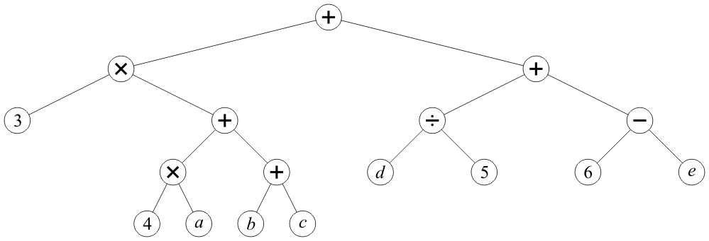
Application: Expression Trees
5.1.4.2
Any basic mathematical expression containing binary operators may be represented using a binary tree
For example, 3(4a + b + c) + d/5 + (6 – e)

Slide 28
Application: Expression Trees
5.1.4.2
Observations:
Internal nodes store operators
Leaf nodes store literals or variables
No nodes have just one sub tree
The order is not relevant for
Addition and multiplication (commutative)
Order is relevant for
Subtraction and division (non-commutative)
It is possible to replace non-commutative operators using the unary negation and inversion:
(a/b) = a b⁻¹ (a – b) = a + (–b)

Slide 29
Application: Expression Trees
5.1.4.2
A post-order depth-first traversal converts such a tree to the reverse-Polish format
3 4 a × b c + + × d 5 ÷ 6 e – + +

Slide 30
Application: Expression Trees
5.1.4.2
Humans think in in-order
Computers think in post-order:
Both operands must be loaded into registers
The operation is then called on those registers
Most use in-order notation (C, C++, Java, C#, etc.)
Necessary to translate in-order into post-order

Slide 31
Summary
In this talk, we introduced binary trees
Each node has two distinct and identifiable sub-trees
Either sub-tree may optionally be empty
The sub-trees are ordered relative to the other
We looked at:
Properties
Applications

Slide 32
Usage Notes
These slides are made publicly available on the web for anyone to use
If you choose to use them, or a part thereof, for a course at another institution, I ask only three things:
that you inform me that you are using the slides,
that you acknowledge my work, and
that you alert me of any mistakes which I made or changes which you make, and allow me the option of incorporating such changes (with an acknowledgment) in my set of slides
Sincerely,
Douglas Wilhelm Harder, MMath
dwharder@alumni.uwaterloo.ca

