Slide 1
The mechanics of recursion
Part 1

Slide 2
Outline
This topic will step through a recursive function call of the Simple_tree class
We will recursively calculate size() on a tree
We will be looking at the memory stack to see how local variables are saved
In the end, the recursion will give us the number of nodes in the tree

Slide 3
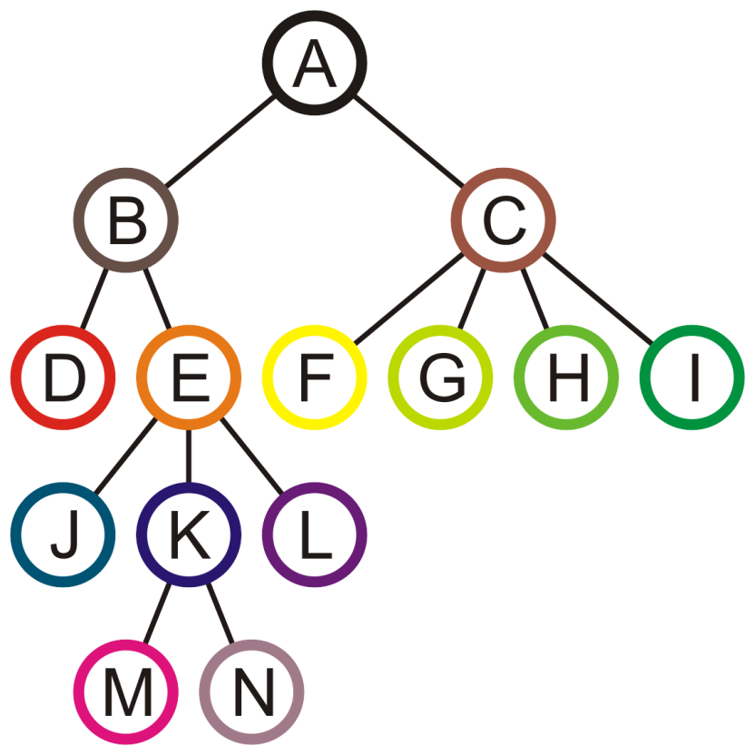
Recursion
19.1
We will use the following Simple_tree implementation to demonstrate how recursive functions work

Slide 4
Recursion
19.1
We will use the following Simple_tree implementation to demonstrate how recursive functions work
template <typename Type>
class Simple_tree {
private:
Type node_value;
Simple_tree *parent;
Single_list<Simple_tree *> children;
};

Slide 5
Recursion
19.1
Because children is declared as an explicit member variable, all the memory can be allocated together with the node_value
template <typename Type>
class Simple_tree {
private:
Type node_value;
Simple_tree *parent;
Single_list<Simple_tree *> children;
};

Slide 6
Recursion
19.1
The tree containing fourteen nodes
is represented by a reasonably complex object—assume the root node is stored in a pointer Simple_tree *root;

Slide 7
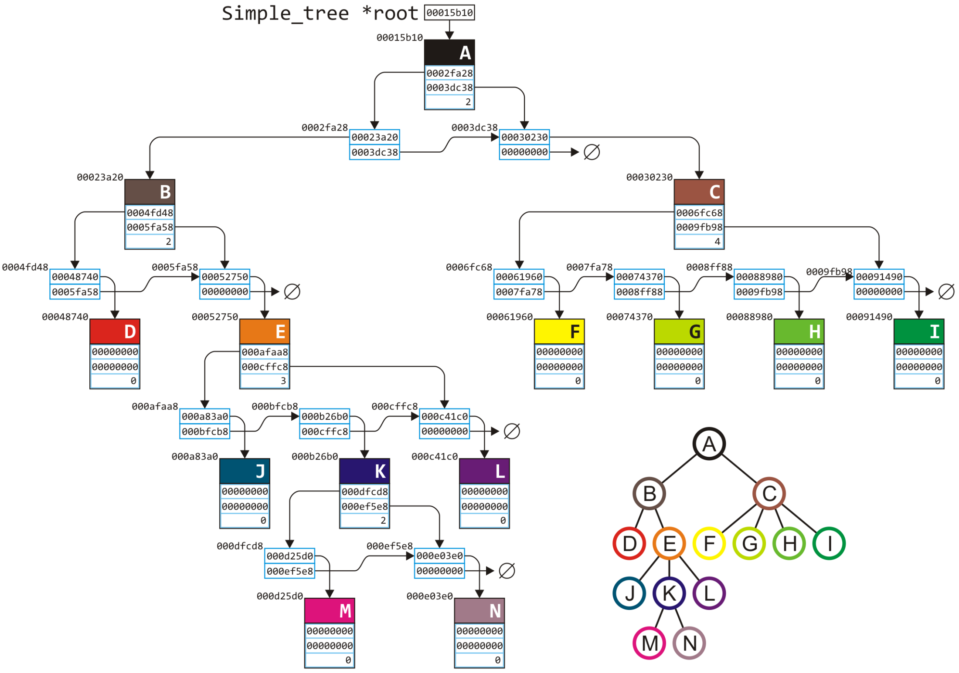
19.1
These diagrams do not include parent

Slide 8
Recursion
19.1
The memory required for such a structure is:
14*sizeof(Type) + 14*sizeof(int) + 69*sizeof(void *);
In general, a tree of n nodes would have the memory requirements
n*sizeof(Type) + n*sizeof(int) + (5*n - 1)*sizeof(void *);

Slide 9
Recursion
19.1
We will go through, step-by-step, what happens in memory when a recursive call to int size() is made:
template <typename Type>
int Simple_tree<Type>::size() const {
int s = 1;
for (
Single_node<Simple_tree *> *ptr = children.head();
ptr != 0; ptr = ptr->next()
) {
s += ptr->value()->size();
}
return s;
}

Slide 10
Recursion
19.1
This function has
two explicit local variables, and
one implied local variable
These are
int s;
Single_node<Simple_tree *> *ptr
Simple_tree const *this
Recall that every time a member function of Simple_tree is called, the local variable this is assigned the address of the object on which the call is made

Slide 11
Recursion
19.1
M.C. Hammer was right: you can’t touch this—it’s declared constant
The type depends on what a member function is called on...
Clearly Stanley Burrell was an early adopter of C++
Simple_tree const *this
M.C. Hammer/EMI http://www.youtube.com/watch?v=otCpCn0l4Wo

Slide 12
Recursion
19.1
From ECE 222, you know that memory for local variables is assigned on a stack
Each time a function is called, memory for that function is pushed on top of the stack
In ECE 222, you will see many other items that are placed onto the stack
For example, the memory location of where to jump to when the function returns
We will focus on simply the abstract memory locations

Slide 13
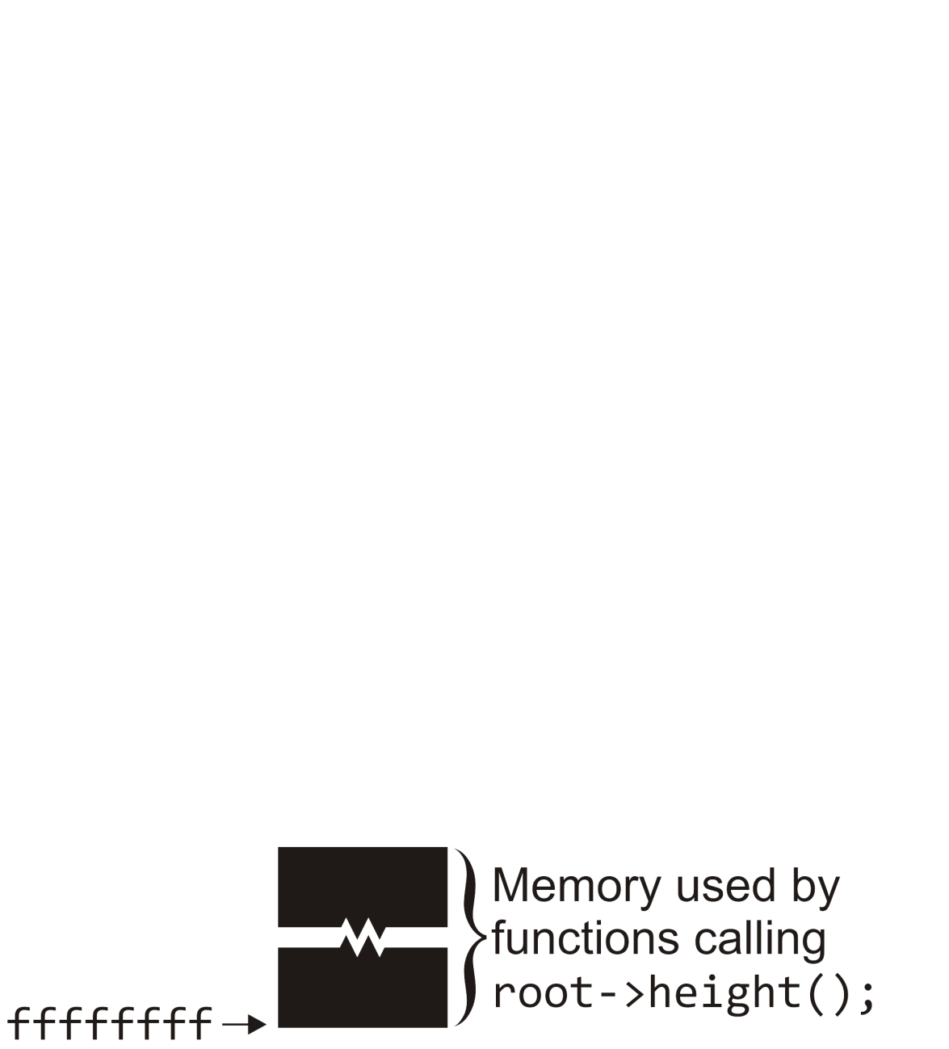
Example
19.1
Suppose the local variable root is assigned the address of the root of our tree: 00015b10
The first thing to occur is that some function must call
int h = root->size();
root->size();

Slide 14
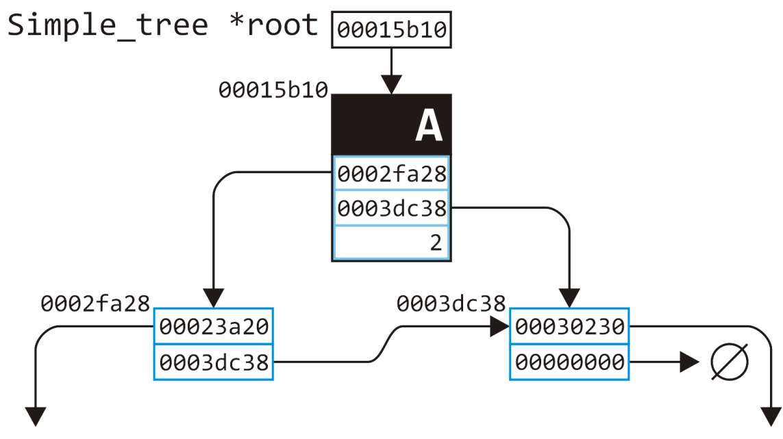
Example
19.1
Suppose the local variable root is assigned the address of the root of our tree: 00015b10
The first thing to occur is that some function must call
int h = root->size();
root->size();

Slide 15
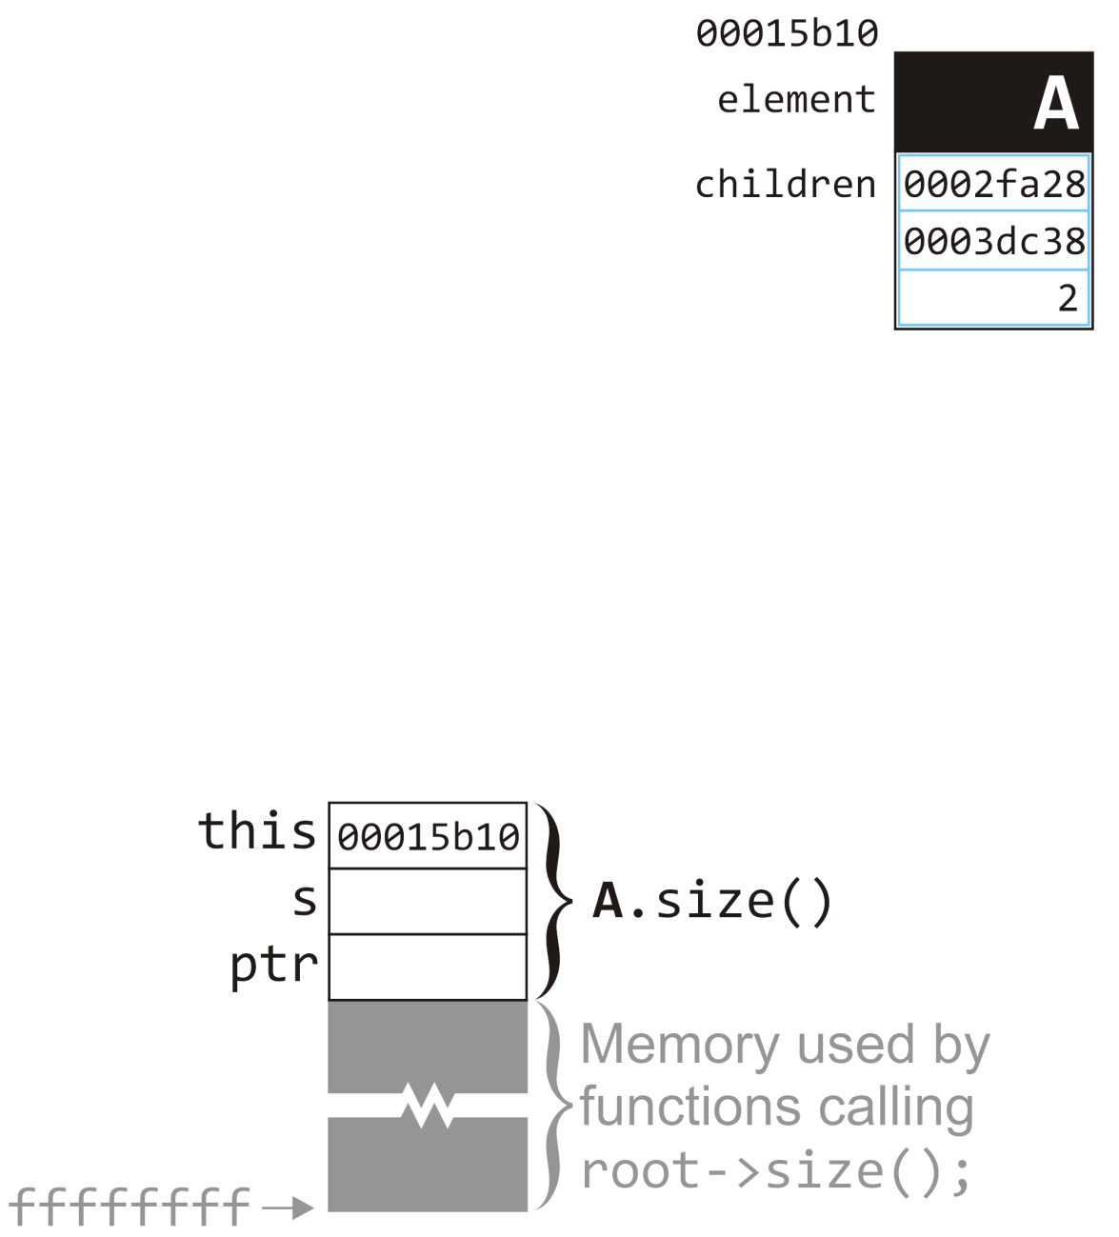
Example
19.1
Memory is allocated on the stack for the call to size call with memory for this, s, and ptr The implicit local variable this is assigned the address of the node
Simple_tree const *this
int Simple_tree::size() const {
int s = 1;
for (
Single_node<Simple_tree *> *ptr = children.head();
ptr != 0; ptr = ptr->next()
) {
s += ptr->value()->size();
}
return s;
}
A.size()
root->size();

Slide 16
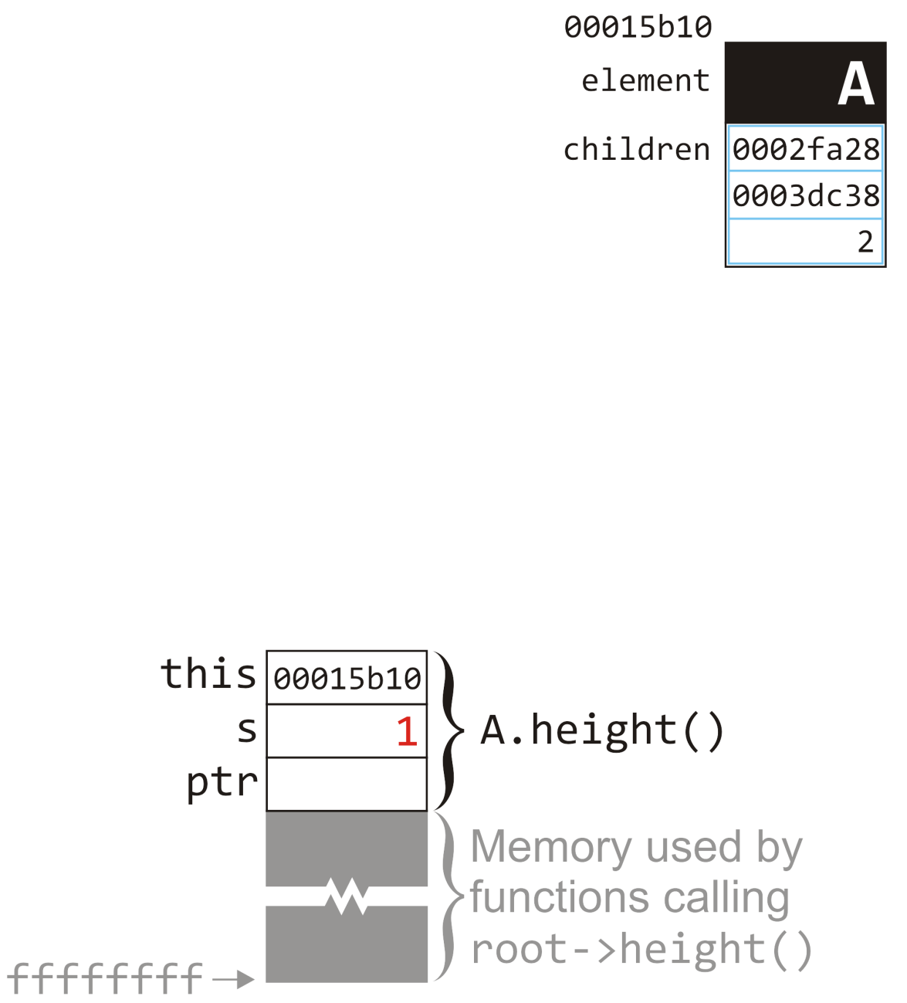
Example
19.1
First, the local variable s is set to 1
This sets the corresponding location on the stack
int Simple_tree::size() const {
int s = 1;
for (
Single_node<Simple_tree *> *ptr = children.head();
ptr != 0; ptr = ptr->next()
) {
s += ptr->value()->size();
}
return s;
}
A.size()
root->size();

Slide 17
Example
19.1
First, the local variable s is set to 1
This sets the corresponding location on the stack
The initialization of the for loop calls children.head()
The variable this tells us where to find this linked list
int Simple_tree::size() const {
int s = 1;
for (
Single_node<Simple_tree *> *ptr = children.head();
ptr != 0; ptr = ptr->next()
) {
s += ptr->value()->size();
}
return s;
}
A.size()
root->size();

Slide 18
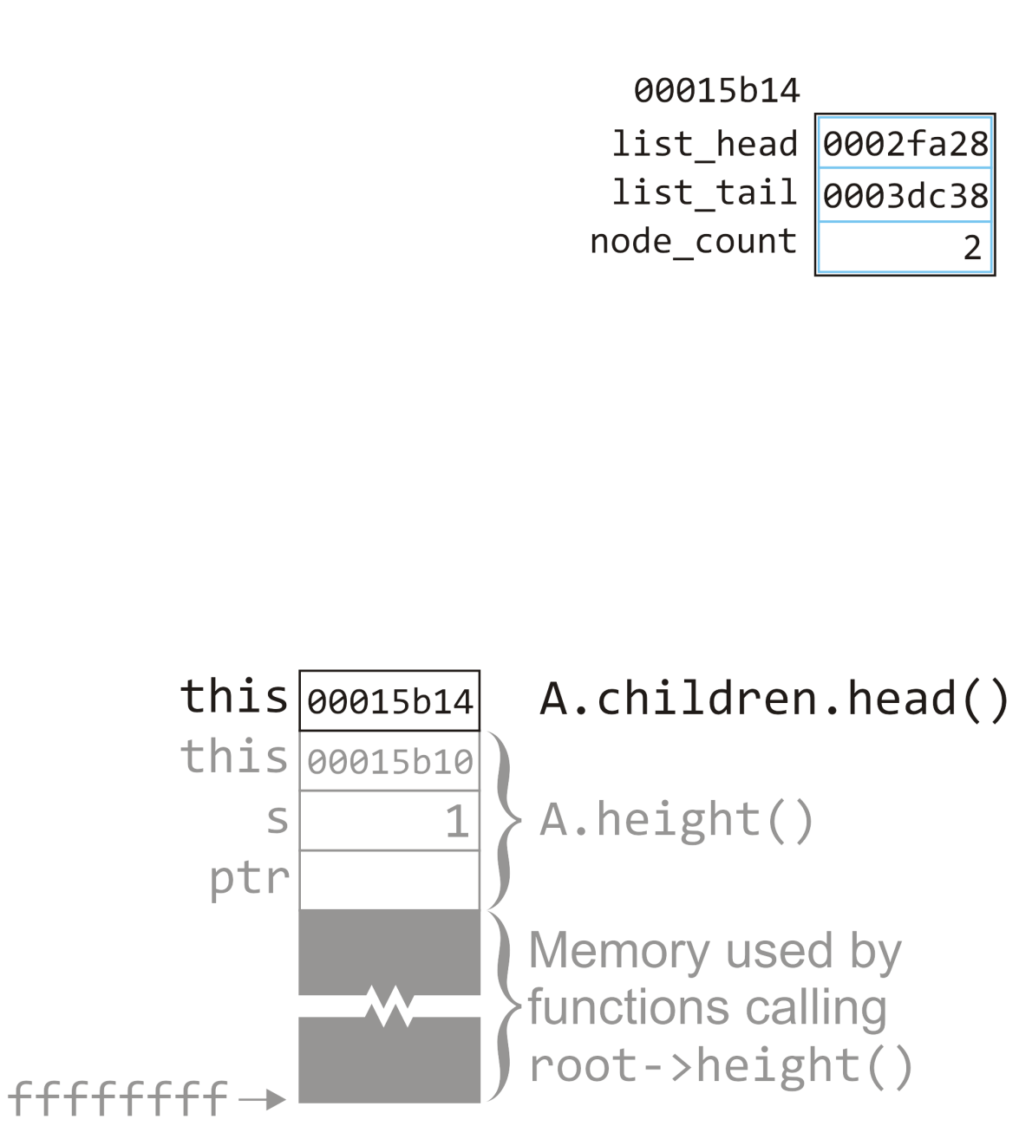
Example
19.1
For the call to children.head(), we must allocate new memory on the stack—in this case, it only stores the implicit local variable this
Note that the address is &A + 4
Simple_node *Single_list::head() const {
return list_head;
}
A.size()
root->size();

Slide 19
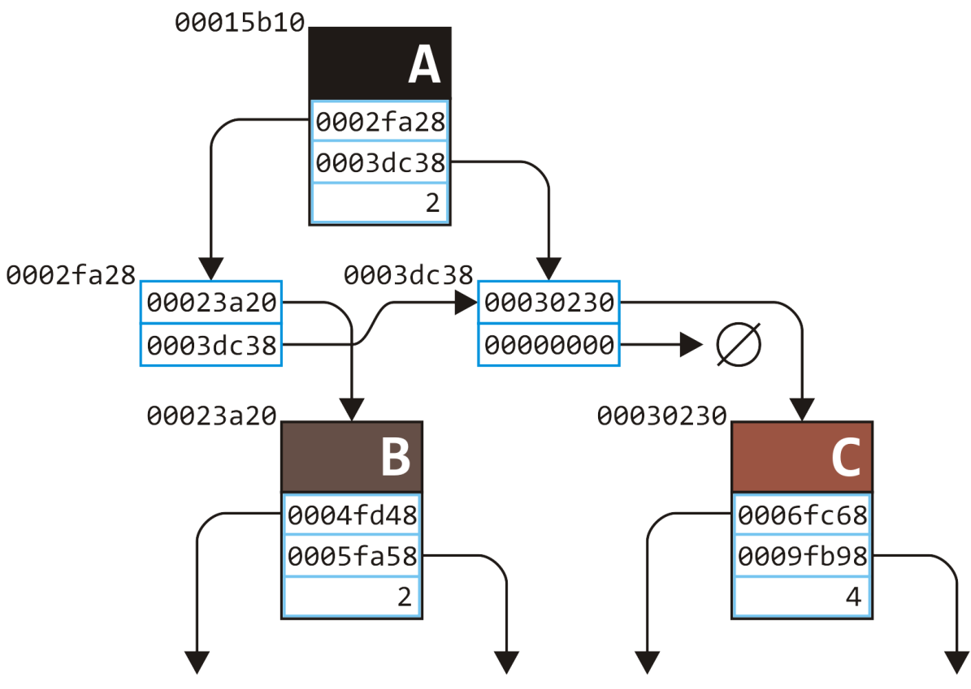
Example
19.1
For the call to children.head(), we must allocate new memory on the stack—in this case, it only stores the implicit local variable this
A.size()
root->size();

Slide 20
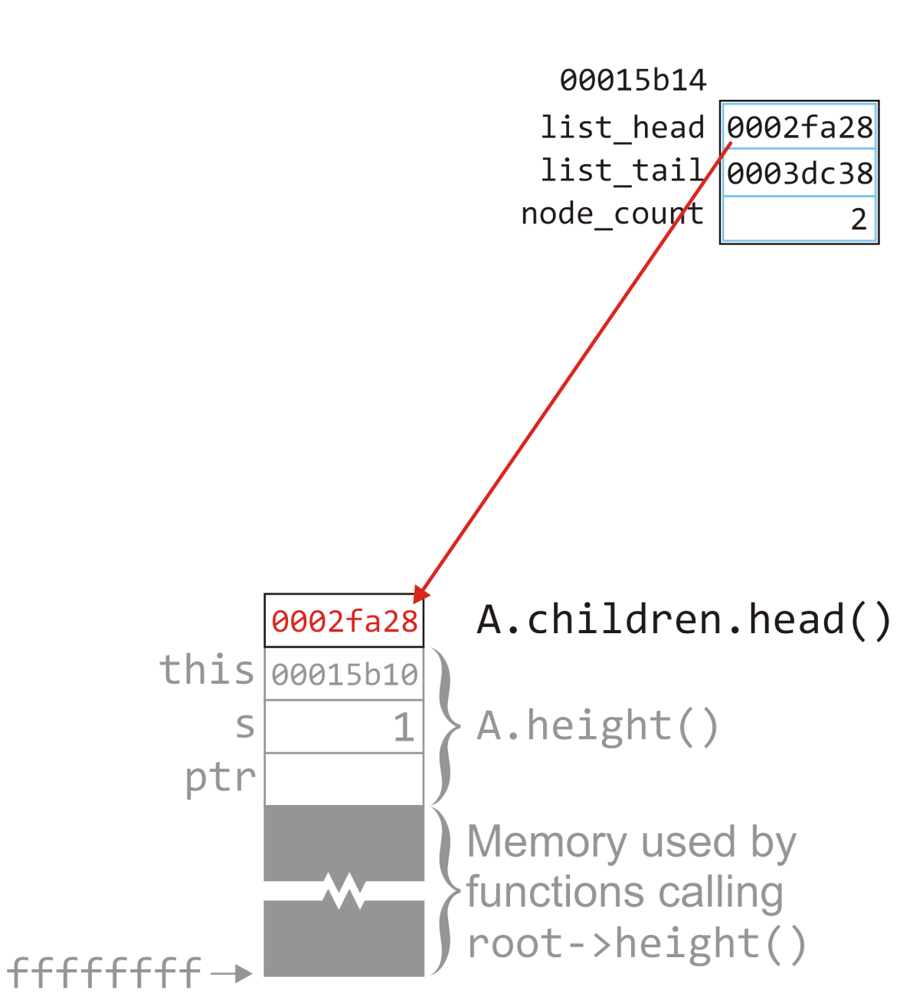
Example
19.1
All this member function does is returns the member variable list_head
This is copied immediately on top of the memory allocated for the calling function
Simple_node *Single_list::head() const {
return list_head;
}
A.size()
root->size();

Slide 21
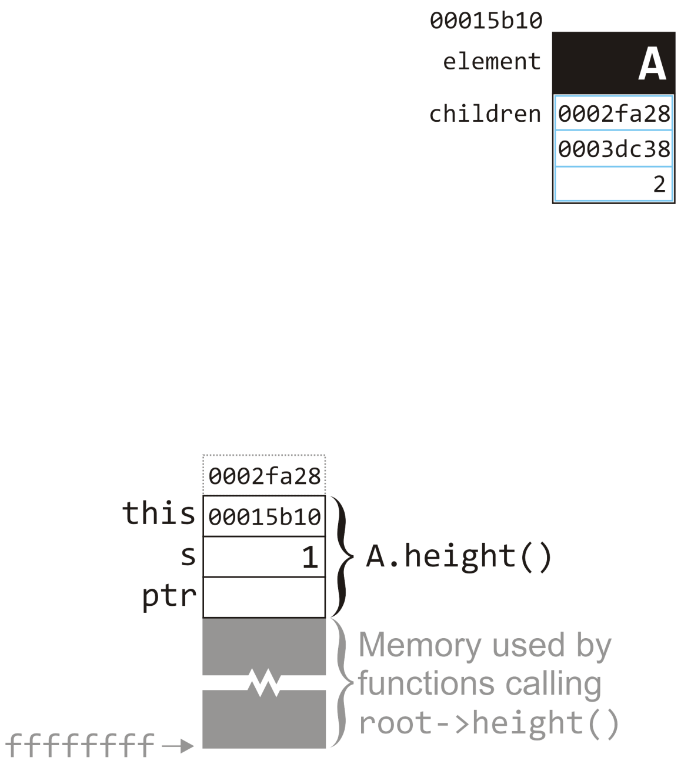
Example
19.1
We now return to the calling function
We take the return variable and assign it to ptr
int Simple_tree::size() const {
int s = 1;
for (
Single_node<Simple_tree *> *ptr = children.head();
ptr != 0; ptr = ptr->next()
) {
s += ptr->value()->size();
}
return s;
}
A.size()
root->size();

Slide 22
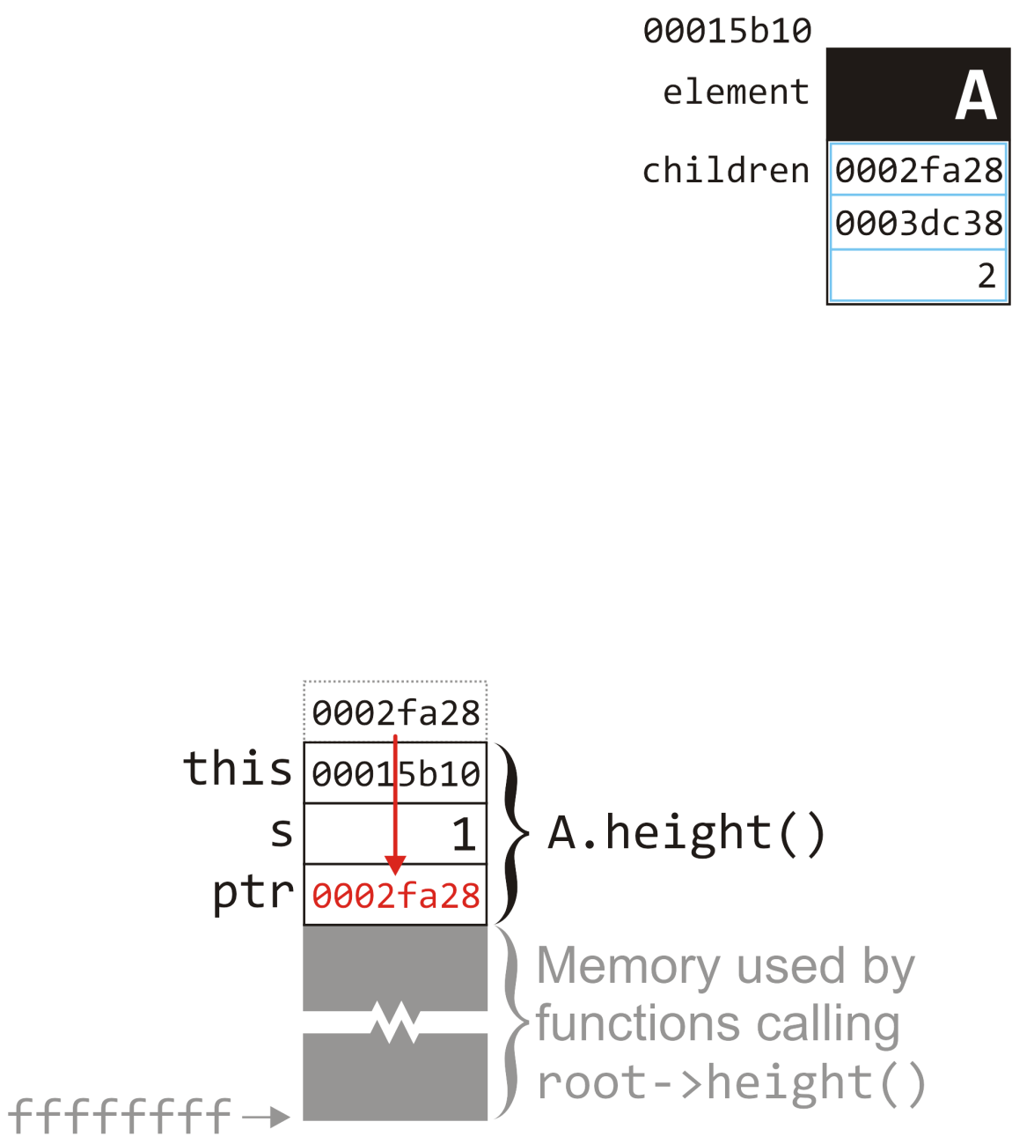
Example
19.1
The value stored immediately above the memory allocated for the current function call is copied to the memory allocated for ptr
int Simple_tree::size() const {
int s = 1;
for (
Single_node<Simple_tree *> *ptr = children.head();
ptr != 0; ptr = ptr->next()
) {
s += ptr->value()->size();
}
return s;
}
A.size()
root->size();

Slide 23
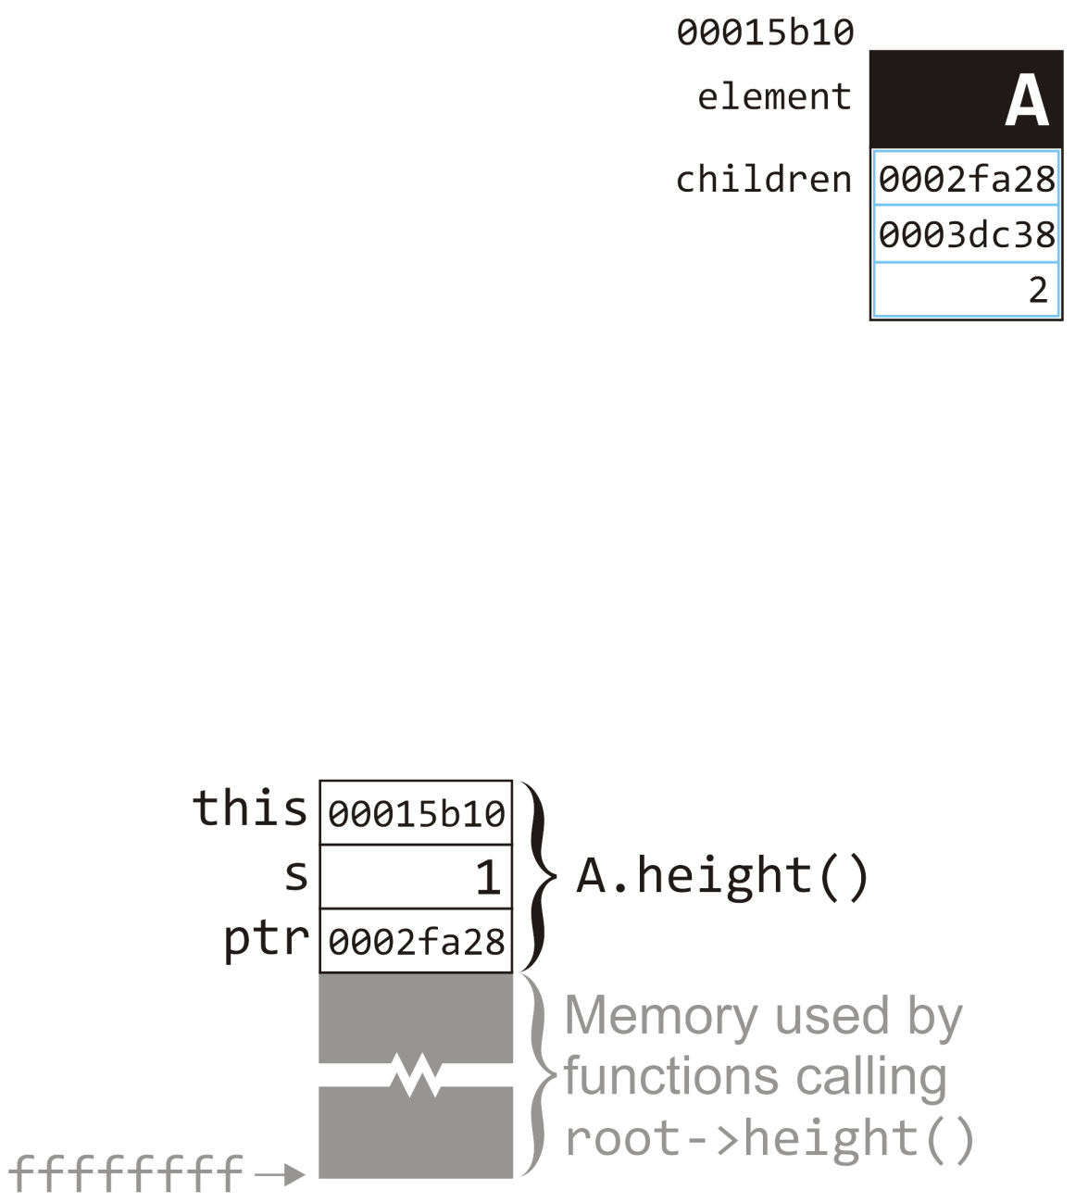
Example
19.1
We evaluate ptr != 0, determine this returns true, and we therefore proceed into the loop
int Simple_tree::size() const {
int s = 1;
for (
Single_node<Simple_tree *> *ptr = children.head();
ptr != 0; ptr = ptr->next()
) {
s += ptr->value()->size();
}
return s;
}
A.size()
root->size();

Slide 24
Example
19.1
We evaluate ptr != 0, determine this returns true, and we therefore proceed into the loop
The first thing we do in the loop is call ptr->value()
int Simple_tree::size() const {
int s = 1;
for (
Single_node<Simple_tree *> *ptr = children.head();
ptr != 0; ptr = ptr->next()
) {
s += ptr->value()->size();
}
return s;
}
A.size()
root->size();

Slide 25
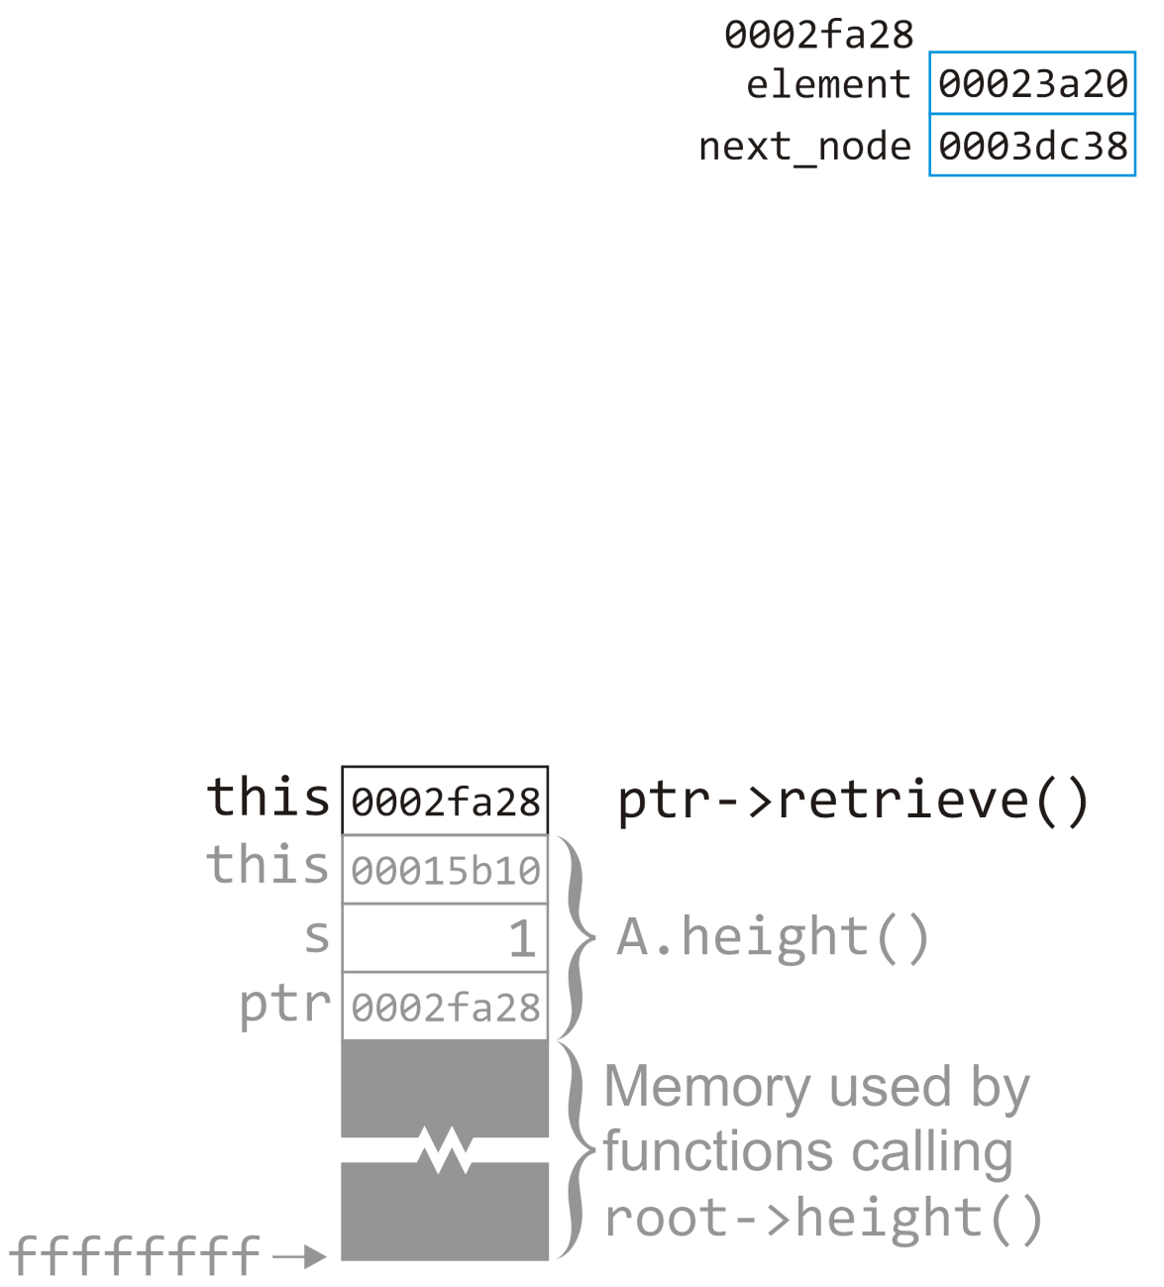
Example
19.1
In this call to value(), this is assigned the address of the node in question
Simple_tree *Single_node::value() const {
return node_value;
}
A.size()
root->size();

Slide 26
Example
19.1
In this call to value(), this is assigned the address of the node in question
A.size()
root->size();

Slide 27
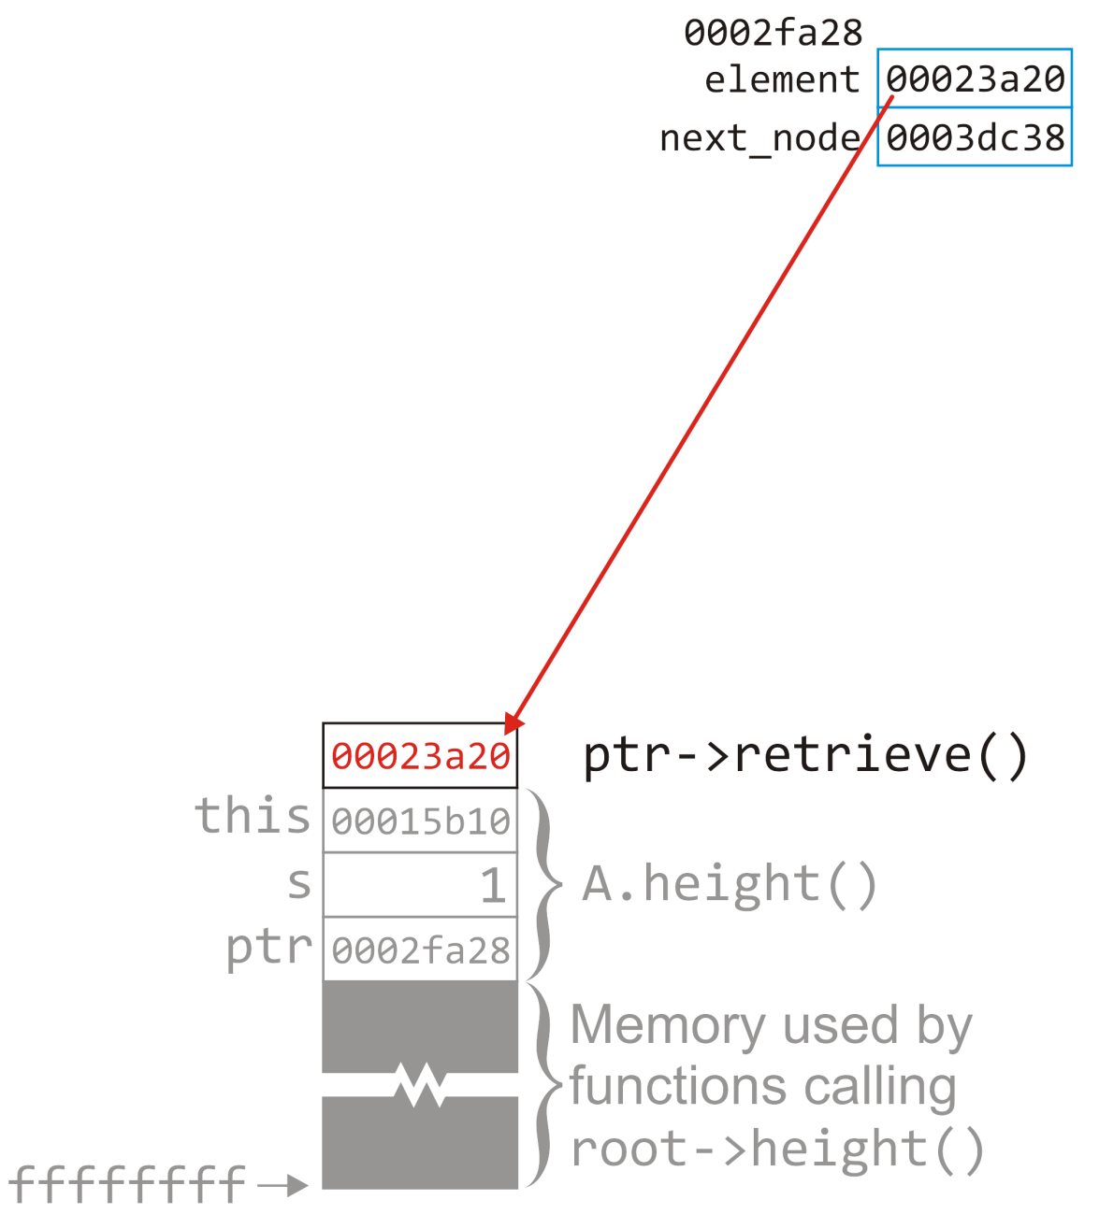
Example
19.1
The entry under node_value is copied to the location of the return value
Simple_tree *Single_node::value() const {
return node_value;
}
A.size()
root->size();

Slide 28
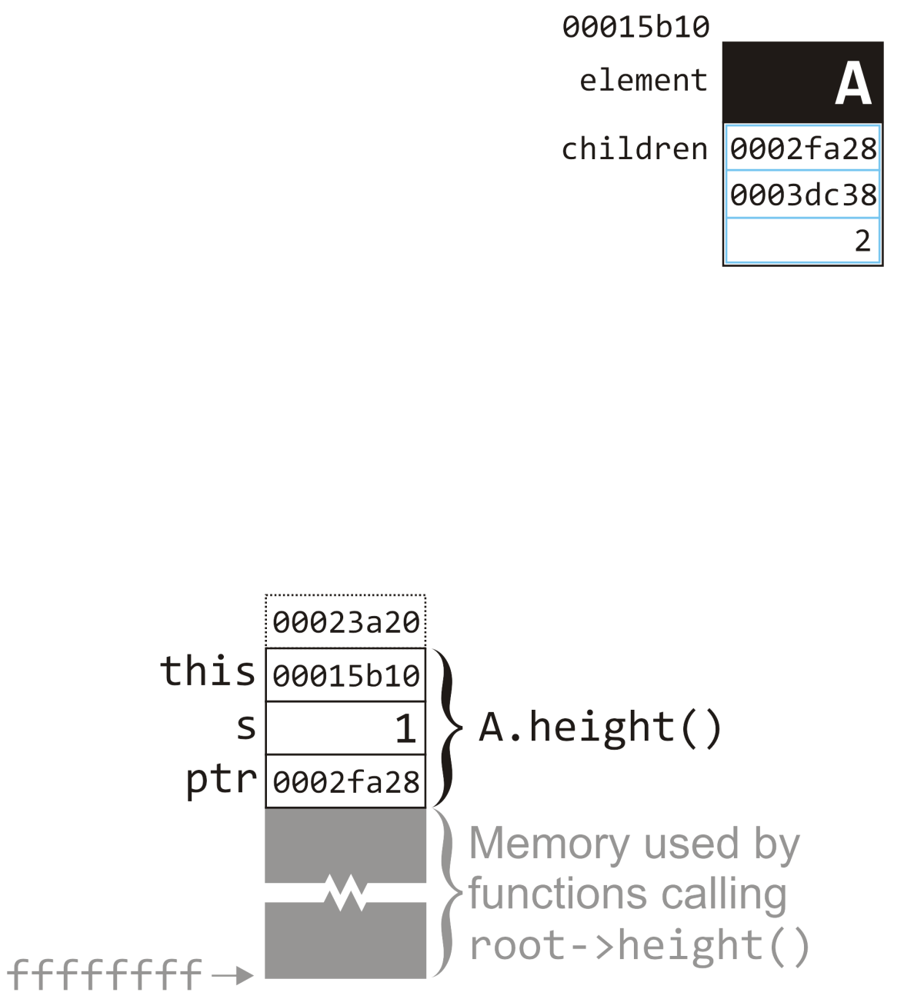
Example
19.1
We now return to the calling function
We don’t store this value; instead, we immediately recursively call size() on the node stored at this location
int Simple_tree::size() const {
int s = 1;
for (
Single_node<Simple_tree *> *ptr = children.head();
ptr != 0; ptr = ptr->next()
) {
s += ptr->value()->size();
}
return s;
}
A.size()
root->size();

Slide 29
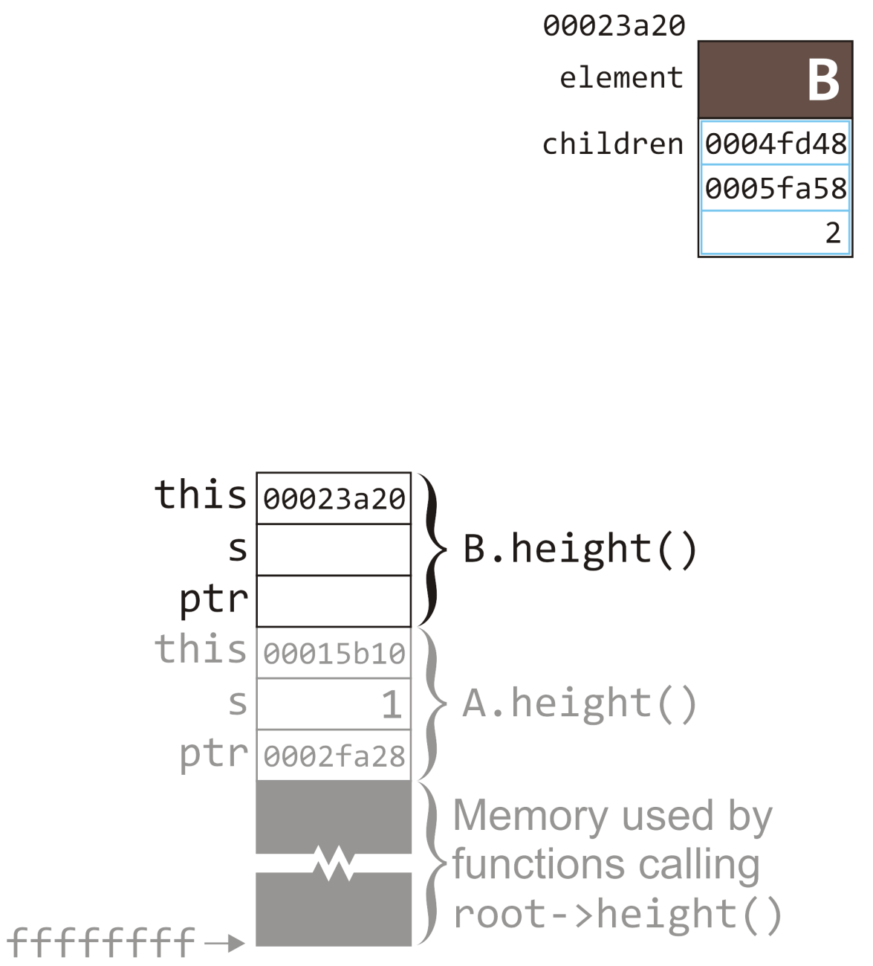
Example
19.1
So now we have a second call to size()
We must allocate memory for the three local variables this, s, and ptr and this is assigned the address of the object we are calling size() on—in this case, node B
Note that in this function call, we have no access to any of the local variables of the initiating call to size() on node A
B.size()
int Simple_tree::size() const {
int s = 1;
for (
Single_node<Simple_tree *> *ptr = children.head();
ptr != 0; ptr = ptr->next()
) {
s += ptr->value()->size();
}
return s;
}
A.size()
root->size();

Slide 30
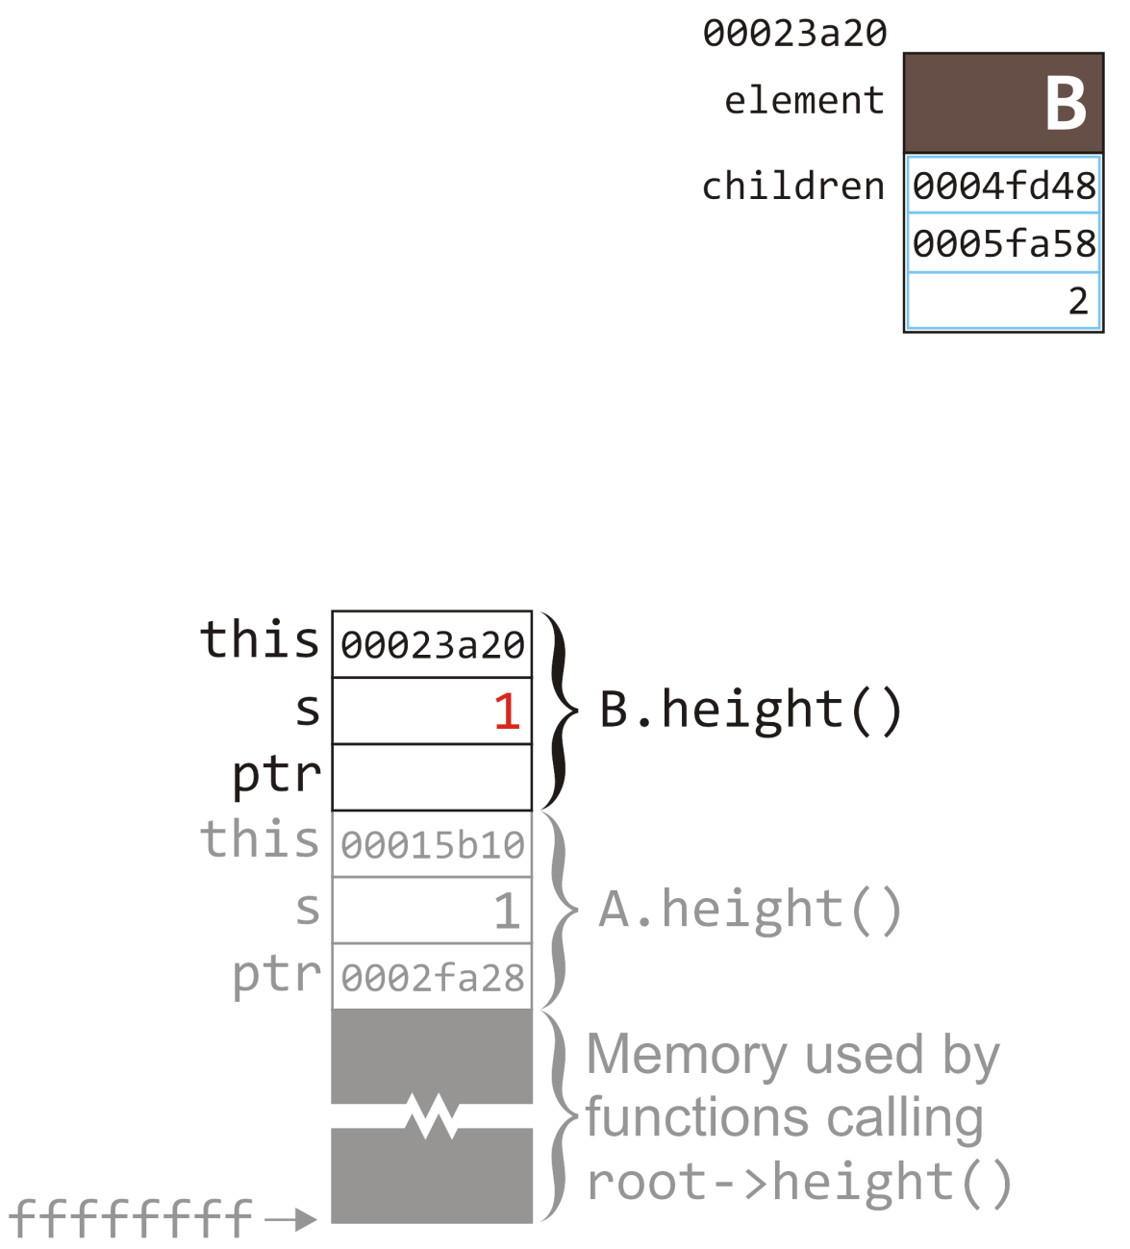
Example
19.1
Like before, we step through the function and begin by initializing s
B.size()
int Simple_tree::size() const {
int s = 1;
for (
Single_node<Simple_tree *> *ptr = children.head();
ptr != 0; ptr = ptr->next()
) {
s += ptr->value()->size();
}
return s;
}
A.size()
root->size();

Slide 31
Example
19.1
Like before, we step through the function and begin by initializing s
Again, we initialize the loop, but to the liked list associated with this node
B.size()
int Simple_tree::size() const {
int s = 1;
for (
Single_node<Simple_tree *> *ptr = children.head();
ptr != 0; ptr = ptr->next()
) {
s += ptr->value()->size();
}
return s;
}
A.size()
root->size();

Slide 32
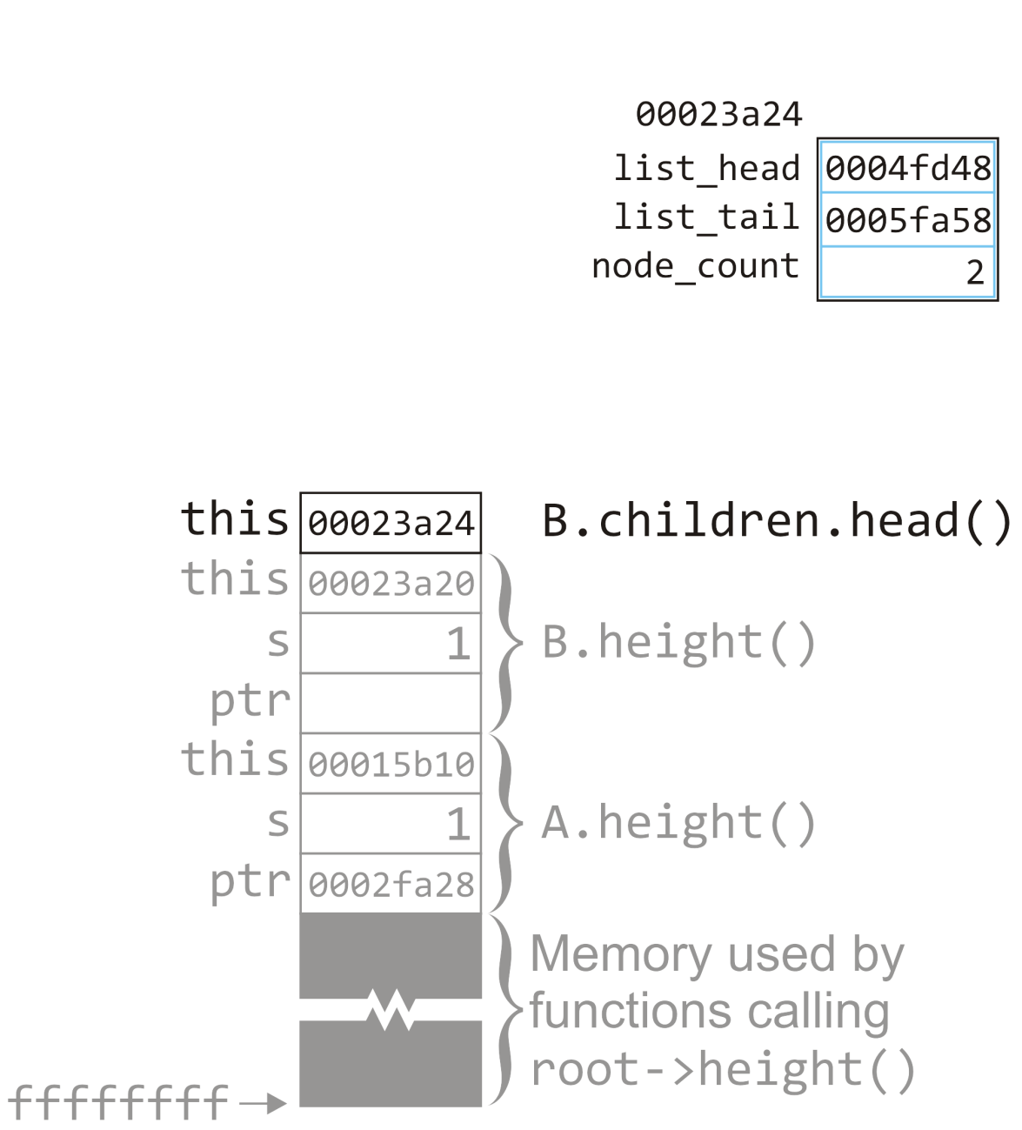
Example
19.1
The call to children.head() will return the list_head of this singly linked list
B.size()
A.size()
root->size();

Slide 33
Example
19.1
The call to children.head() will return the list_head of this singly linked list
The return value is 0004fd48 and this will be placed on top of the stack
B.size()
Simple_node *Single_list::head() const {
return list_head;
}
A.size()
root->size();

Slide 34
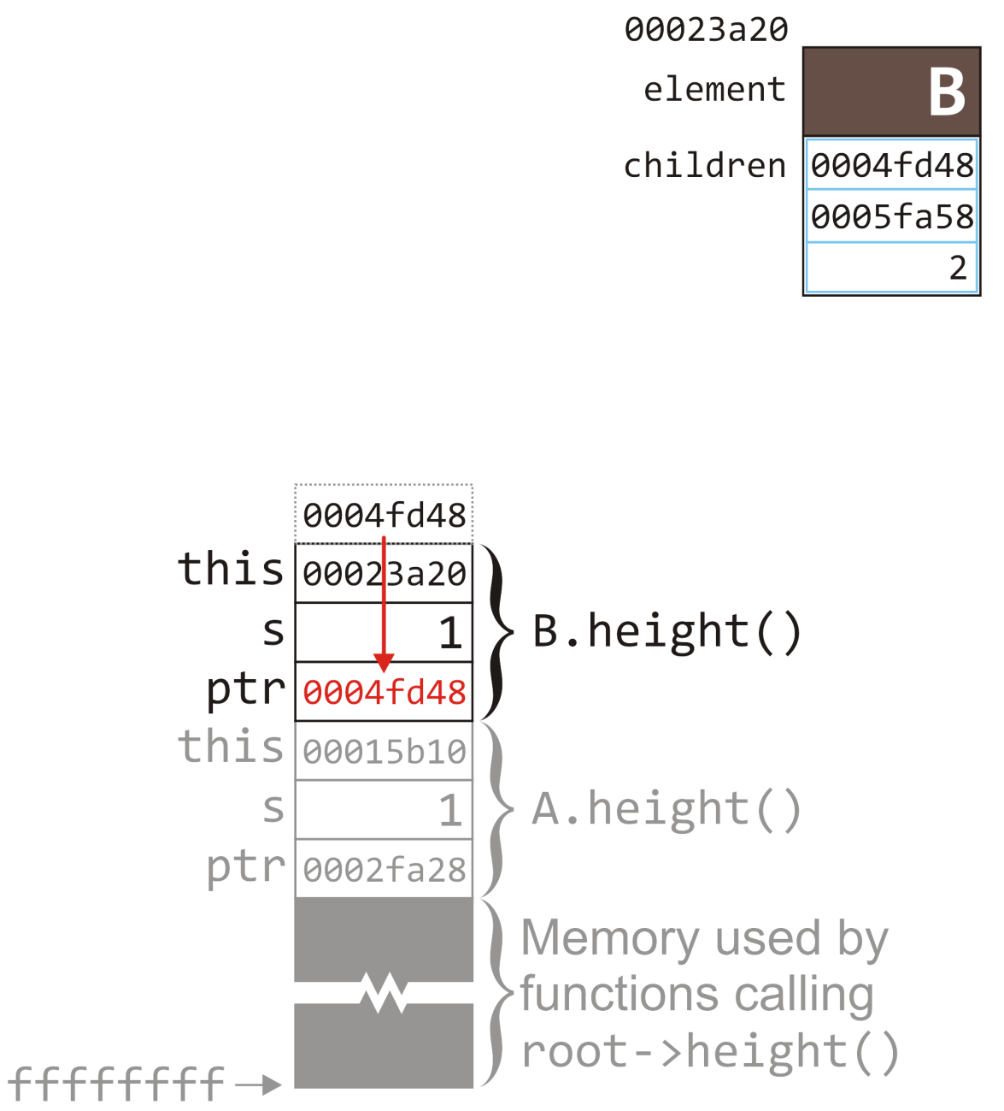
Example
19.1
The return value is assigned to the ptr associated with this function call
B.size()
int Simple_tree::size() const {
int s = 1;
for (
Single_node<Simple_tree *> *ptr = children.head();
ptr != 0; ptr = ptr->next()
) {
s += ptr->value()->size();
}
return s;
}
A.size()
root->size();

Slide 35
Example
19.1
The return value is assigned to the ptr associated with this function call
We check that ptr != 0 and proceed to the body of the loop
B.size()
int Simple_tree::size() const {
int s = 1;
for (
Single_node<Simple_tree *> *ptr = children.head();
ptr != 0; ptr = ptr->next()
) {
s += ptr->value()->size();
}
return s;
}
A.size()
root->size();

Slide 36
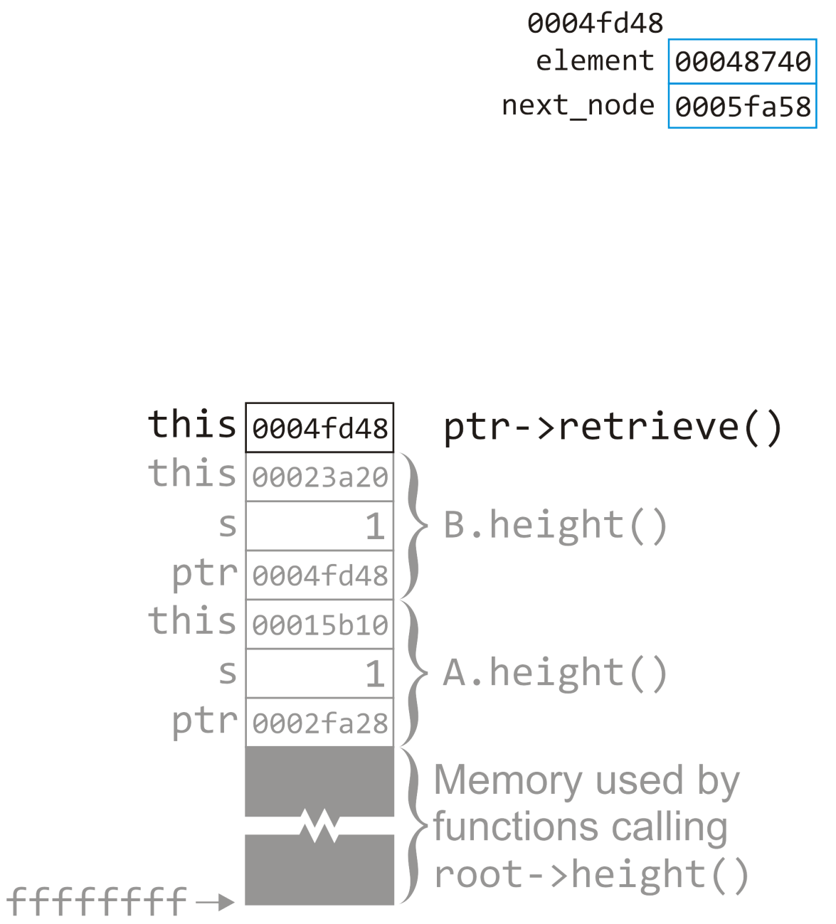
Example
19.1
The call to value() returns a pointer to the first child of node B
children is a linked list of pointers
B.size()
Simple_tree *Single_node::value() const {
return node_value;
}
A.size()
root->size();

Slide 37
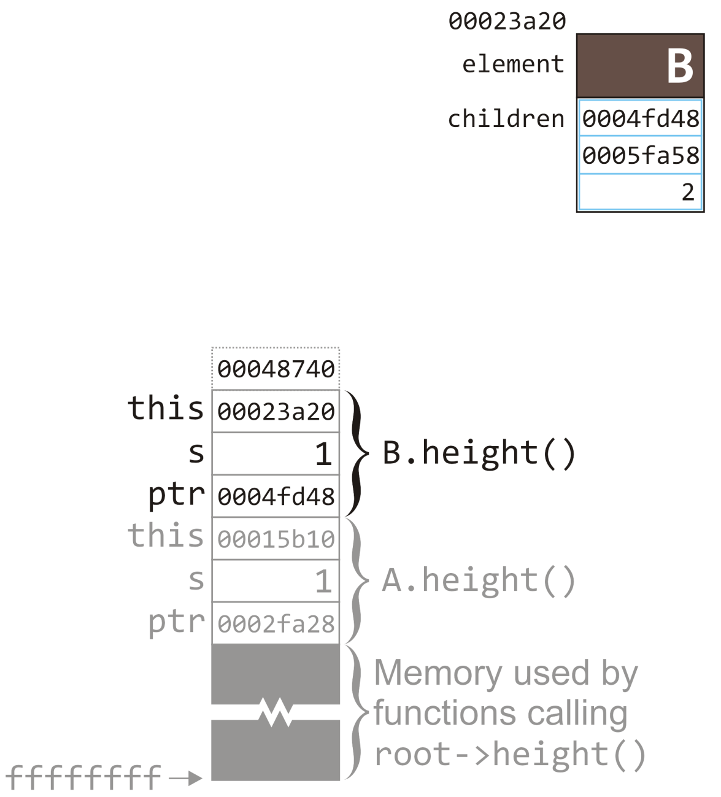
Example
19.1
The return value to value() is again, left on top of the stack and we will recursively call size on the node at that address
B.size()
int Simple_tree::size() const {
int s = 1;
for (
Single_node<Simple_tree *> *ptr = children.head();
ptr != 0; ptr = ptr->next()
) {
s += ptr->value()->size();
}
return s;
}
A.size()
root->size();

Slide 38
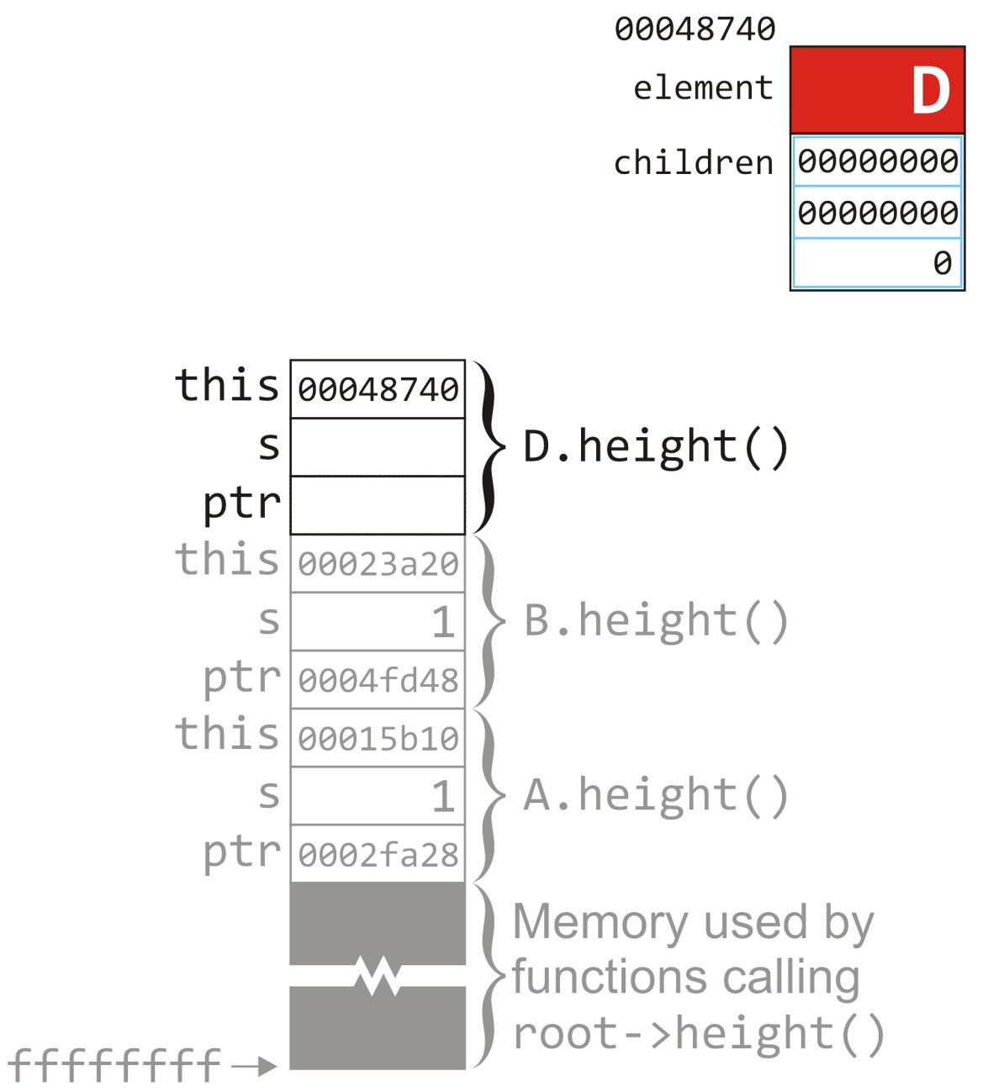
Example
19.1
The first child of node B is node D
As before, we set up three entries on the stack for local variables
D.size()
B.size()
int Simple_tree::size() const {
int s = 1;
for (
Single_node<Simple_tree *> *ptr = children.head();
ptr != 0; ptr = ptr->next()
) {
s += ptr->value()->size();
}
return s;
}
A.size()
root->size();

Slide 39
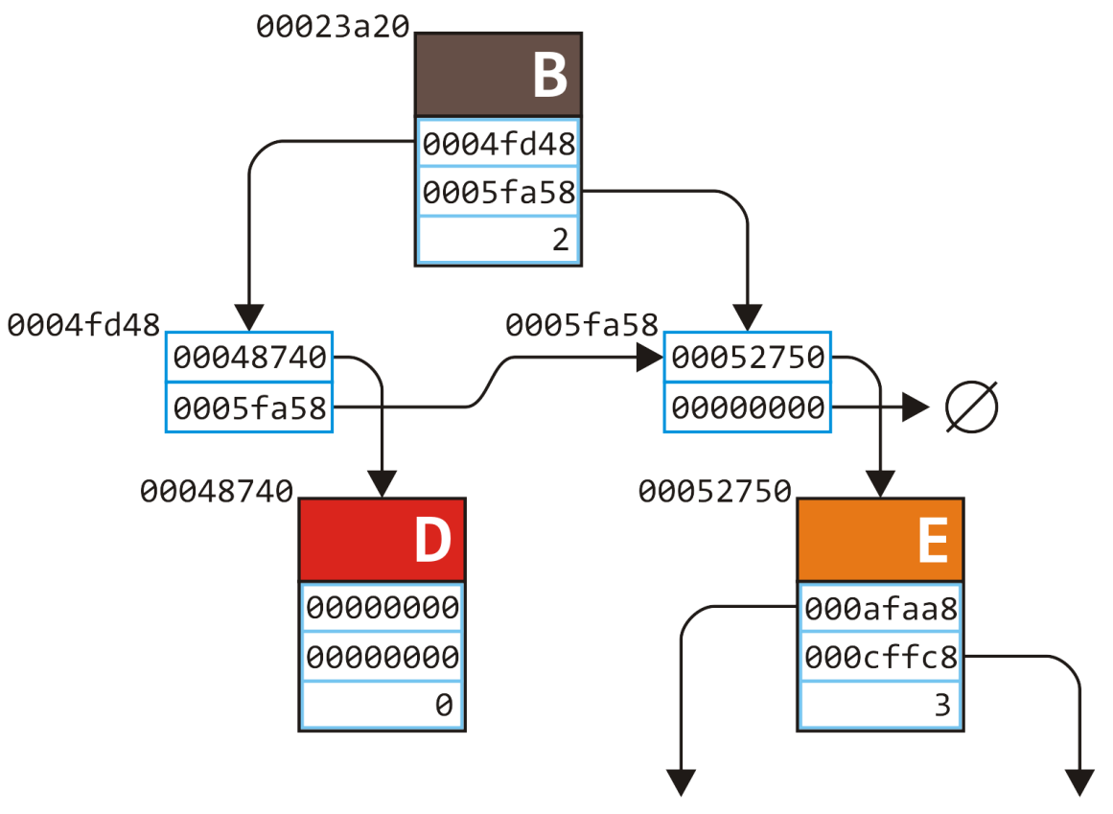
Example
19.1
Looking at where we are in the tree
D.size()
B.size()
A.size()
root->size();

Slide 40
Example
19.1
We initialize the local variable s for this function call
D.size()
B.size()
int Simple_tree::size() const {
int s = 1;
for (
Single_node<Simple_tree *> *ptr = children.head();
ptr != 0; ptr = ptr->next()
) {
s += ptr->value()->size();
}
return s;
}
A.size()
root->size();

Slide 41
Example
19.1
We initialize the local variable s for this function call
Again, we must also access the head of this linked list
D.size()
B.size()
int Simple_tree::size() const {
int s = 1;
for (
Single_node<Simple_tree *> *ptr = children.head();
ptr != 0; ptr = ptr->next()
) {
s += ptr->value()->size();
}
return s;
}
A.size()
root->size();

Slide 42
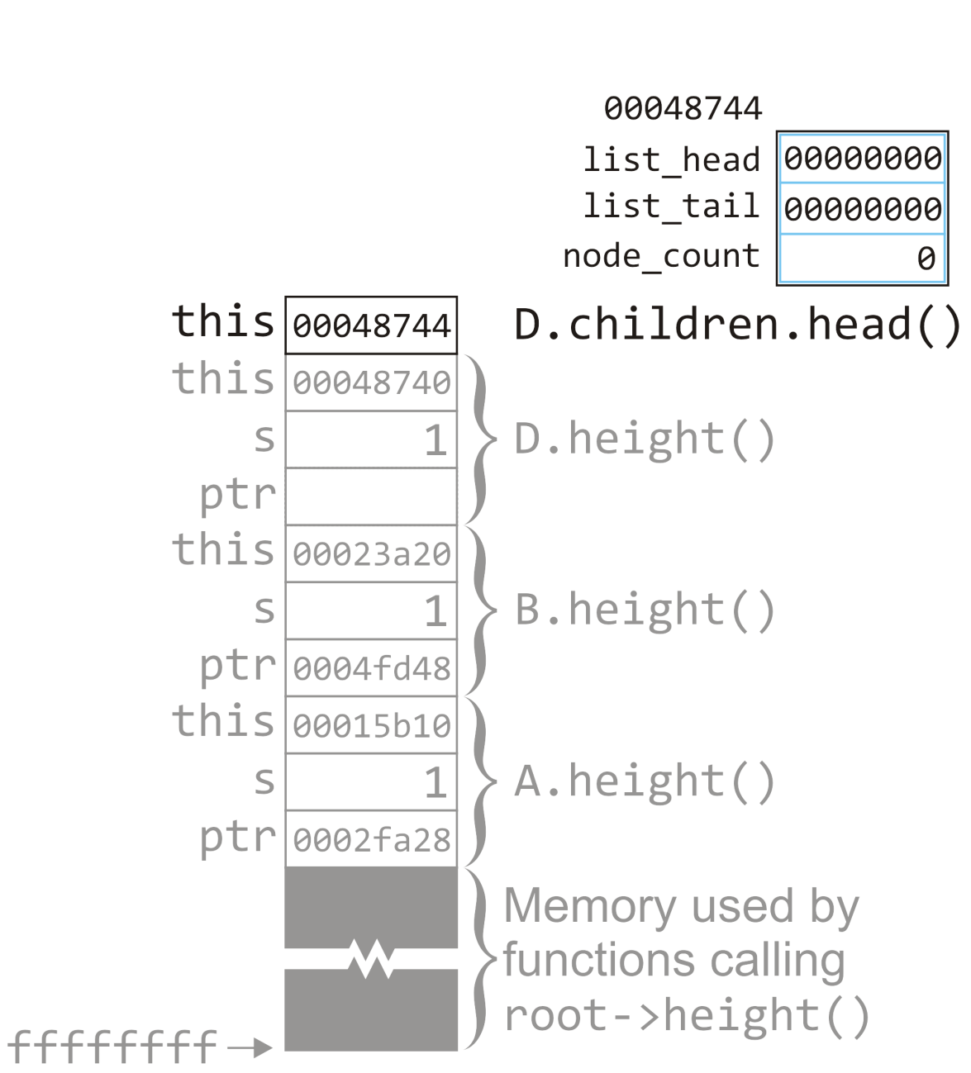
Example
19.1
With this call, we now return 00000000
D.size()
B.size()
Simple_node *Single_list::head() const {
return list_head;
}
A.size()
root->size();

Slide 43
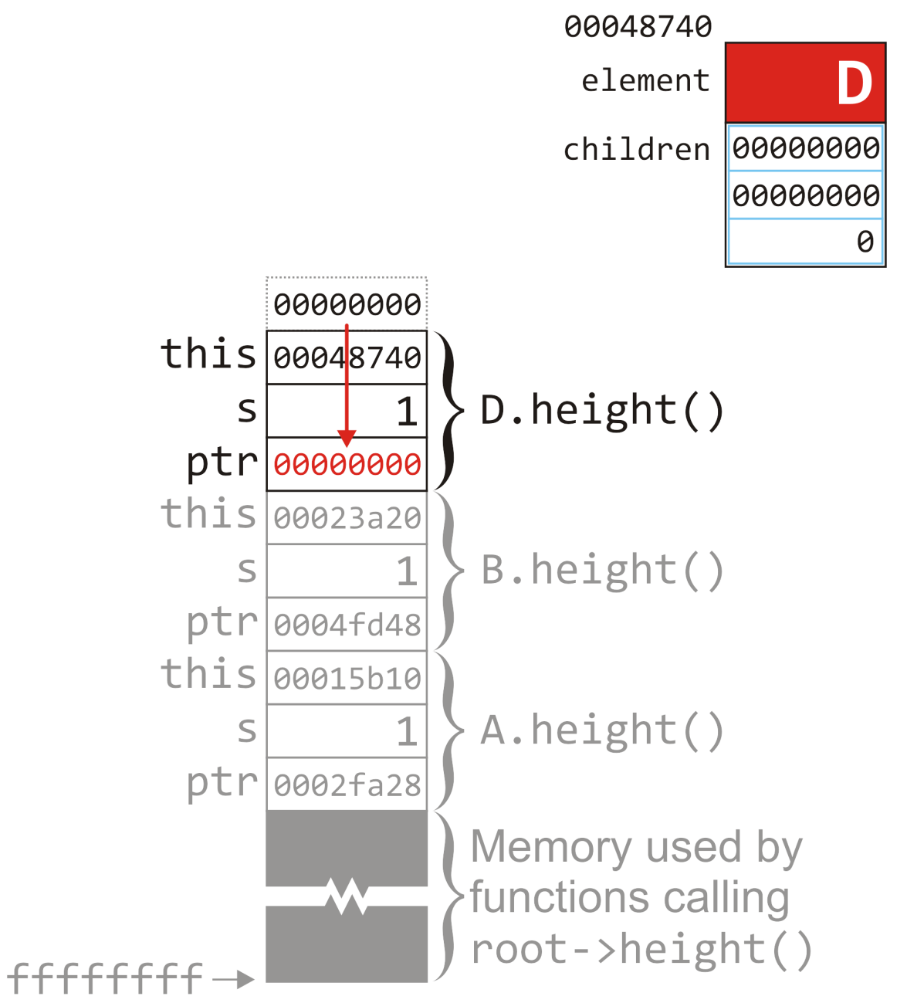
Example
19.1
The return value is copied to the top of the stack and we return to size() called on node D
The return value is copied to the location for ptr
D.size()
B.size()
int Simple_tree::size() const {
int s = 1;
for (
Single_node<Simple_tree *> *ptr = children.head();
ptr != 0; ptr = ptr->next()
) {
s += ptr->value()->size();
}
return s;
}
A.size()
root->size();

Slide 44
Example
19.1
The return value is copied to the top of the stack and we return to size() called on node D
The return value is copied to the location for ptr
In this case, ptr != 0 returns
false
We jump to the return statement
D.size()
B.size()
int Simple_tree::size() const {
int s = 1;
for (
Single_node<Simple_tree *> *ptr = children.head();
ptr != 0; ptr = ptr->next()
) {
s += ptr->value()->size();
}
return s;
}
A.size()
root->size();

Slide 45
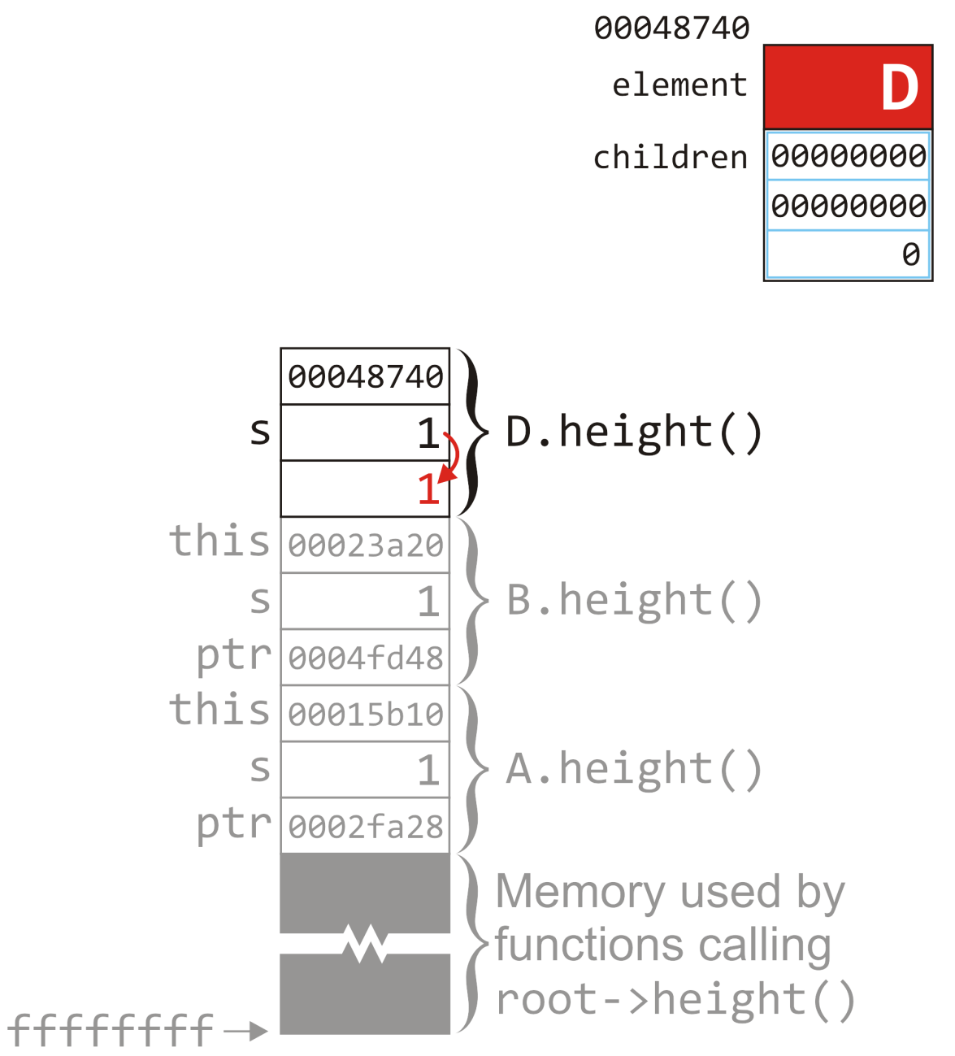
Example
19.1
Because we are returning, we must copy the return value to the location immediately above the memory allocated for calling function
D.size()
B.size()
int Simple_tree::size() const {
int s = 1;
for (
Single_node<Simple_tree *> *ptr = children.head();
ptr != 0; ptr = ptr->next()
) {
s += ptr->value()->size();
}
return s;
}
A.size()
root->size();

Slide 46
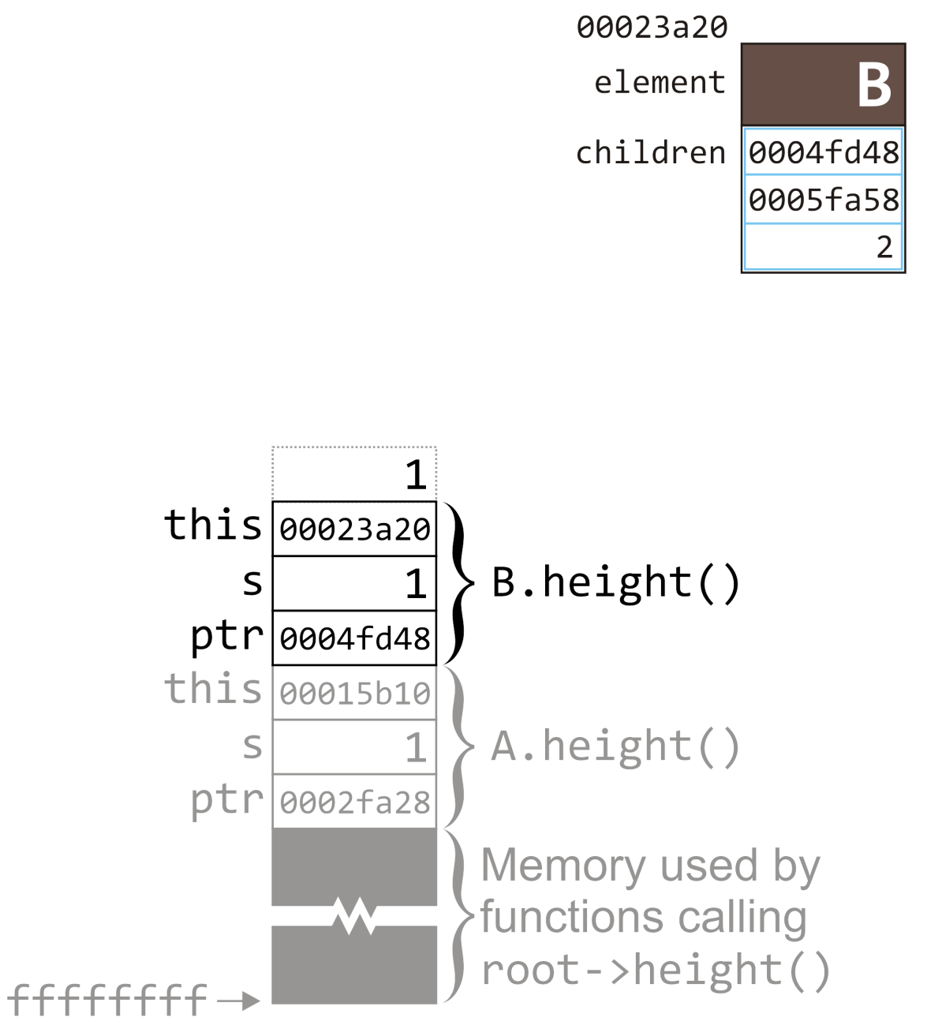
Example
19.1
We are just finished the call to
ptr->value()->size()
where ptr had the address of node D
We must now deal with this return value
B.size()
int Simple_tree::size() const {
int s = 1;
for (
Single_node<Simple_tree *> *ptr = children.head();
ptr != 0; ptr = ptr->next()
) {
s += ptr->value()->size();
}
return s;
}
A.size()
root->size();

Slide 47
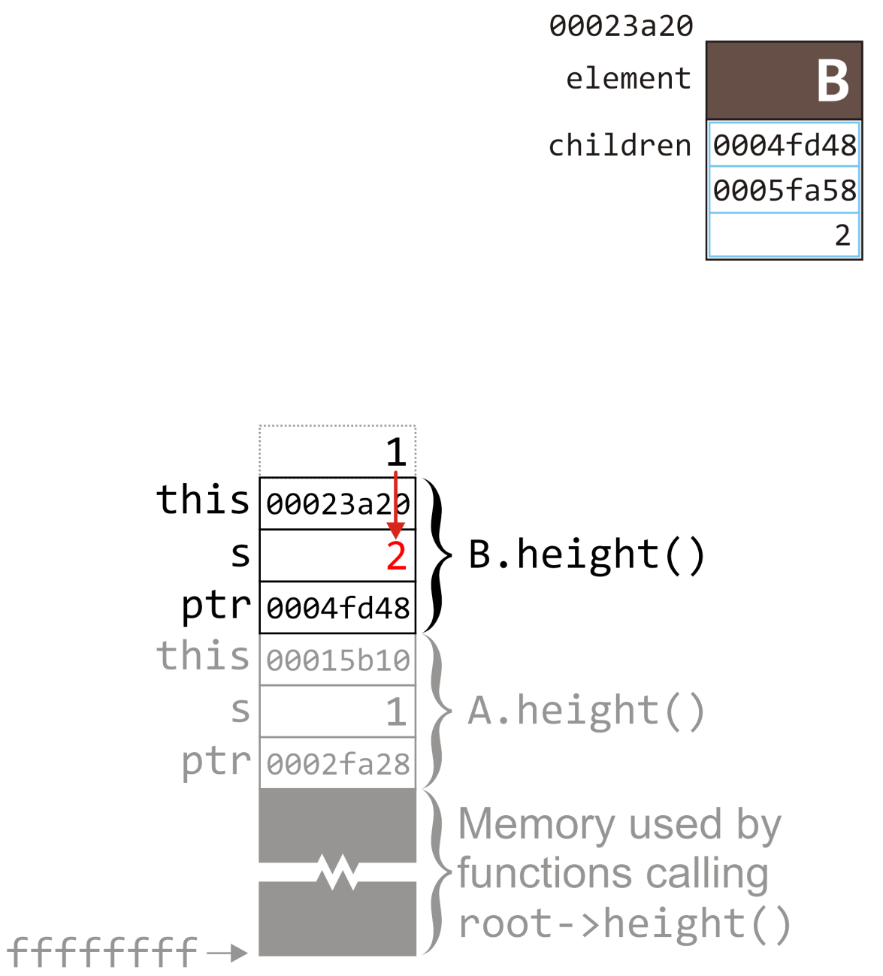
Example
19.1
In this case, we add it to the local variable s
B.size()
int Simple_tree::size() const {
int s = 1;
for (
Single_node<Simple_tree *> *ptr = children.head();
ptr != 0; ptr = ptr->next()
) {
s += ptr->value()->size();
}
return s;
}
A.size()
root->size();

Slide 48
Example
19.1
At this point, we have finished executing the body of this loop—we next proceed to the increment statement : ptr = ptr->next()
B.size()
int Simple_tree::size() const {
int s = 1;
for (
Single_node<Simple_tree *> *ptr = children.head();
ptr != 0; ptr = ptr->next()
) {
s += ptr->value()->size();
}
return s;
}
A.size()
root->size();

Slide 49
Example
19.1
At this point, we have finished executing the body of this loop—we next proceed to the increment statement : ptr = ptr->next()
B.size()
A.size()
root->size();

Slide 50
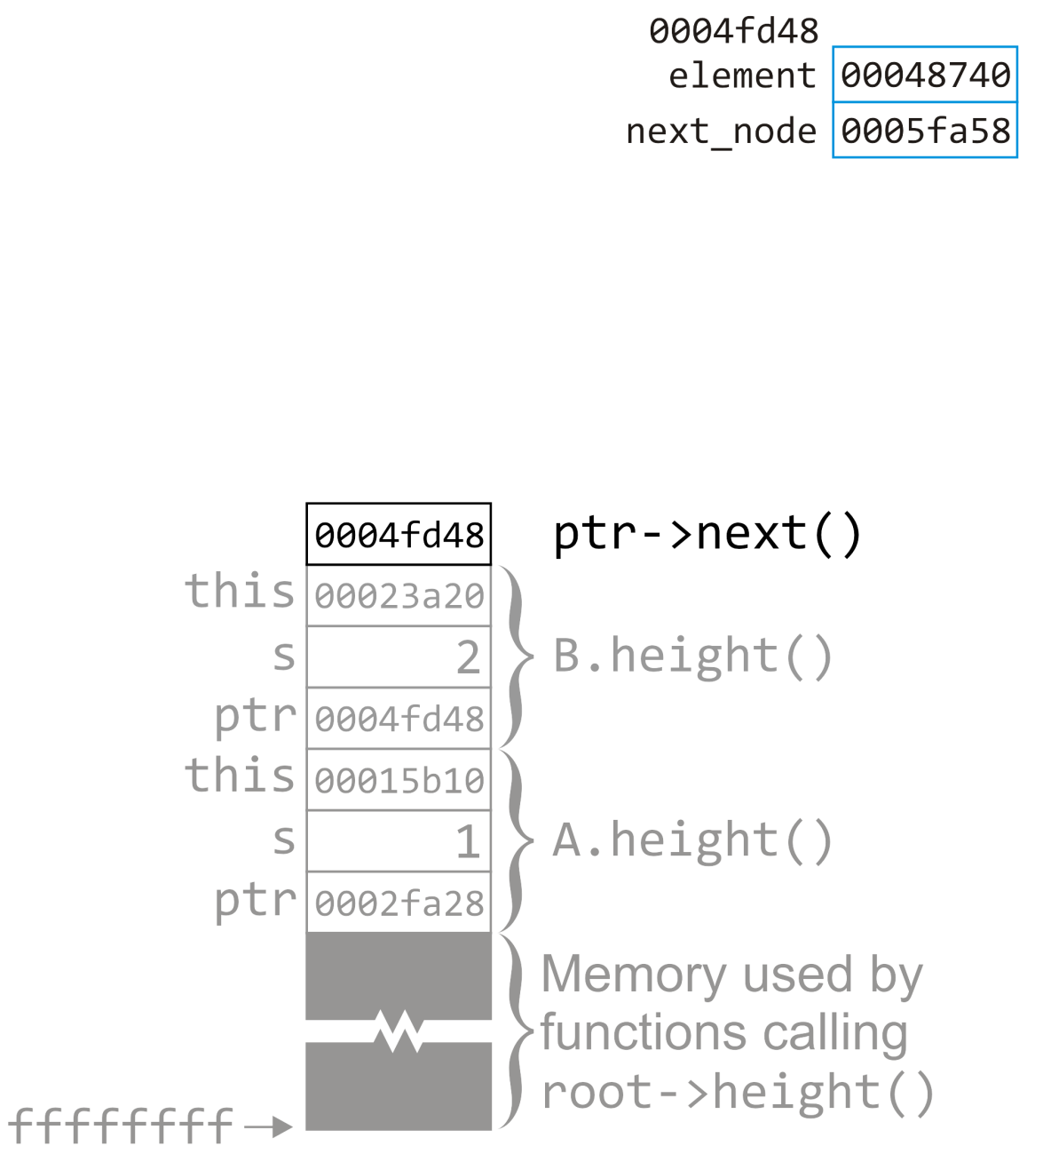
Example
19.1
Again, we start with a function call on the node stored at 0004fd48—this requires information placed onto the stack
The address 0005fa58 is the return value
B.size()
Simple_tree *Single_node::next() const {
return next_node;
}
A.size()
root->size();

Slide 51
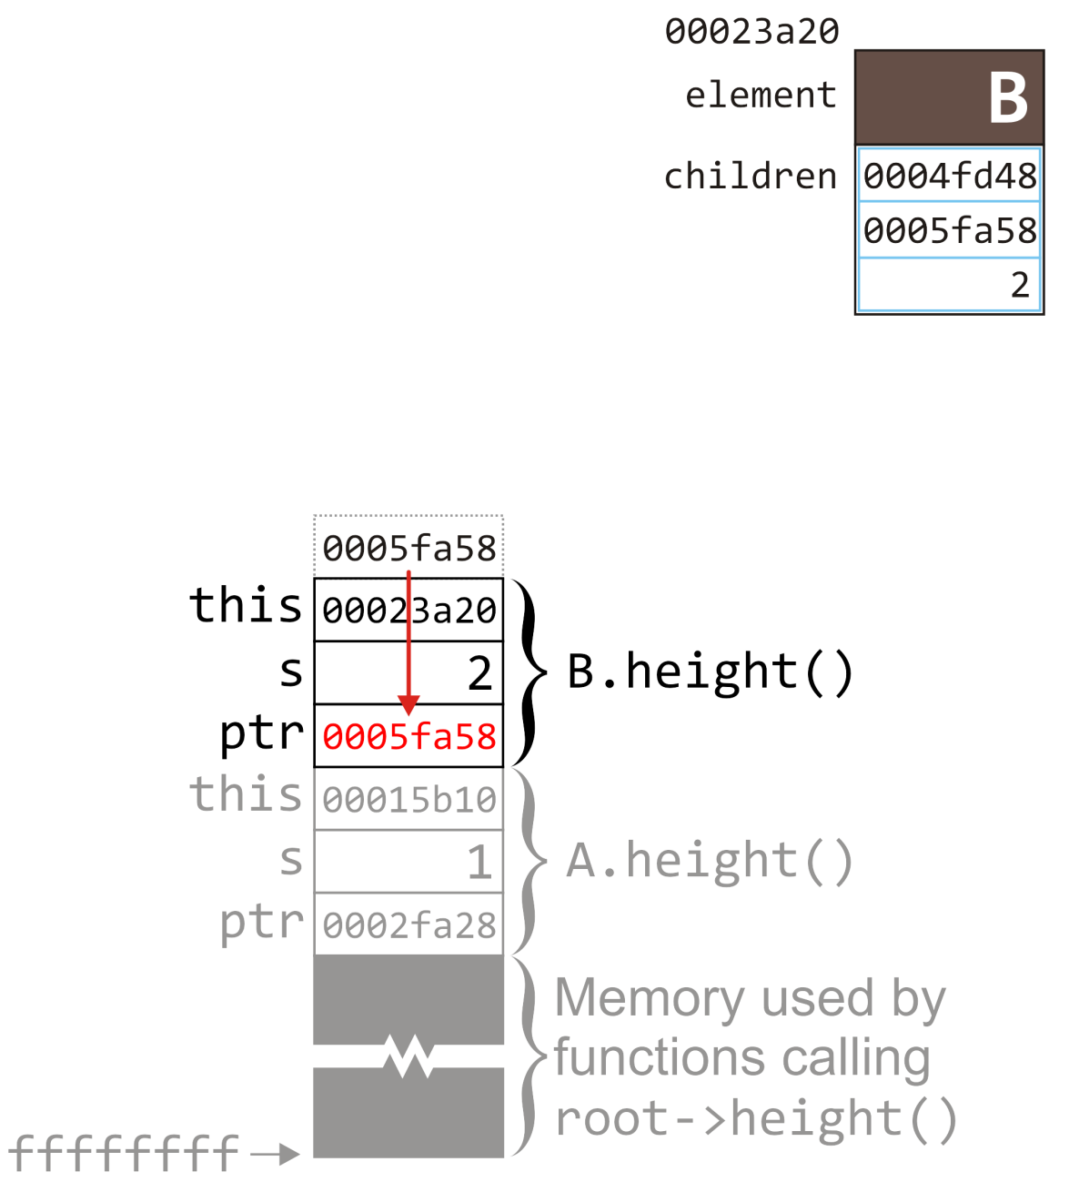
Example
19.1
The return value is copied to the memory location for ptr
B.size()
int Simple_tree::size() const {
int s = 1;
for (
Single_node<Simple_tree *> *ptr = children.head();
ptr != 0; ptr = ptr->next()
) {
s += ptr->value()->size();
}
return s;
}
A.size()
root->size();

Slide 52
Example
19.1
The return value is copied to the memory location for ptr
The test ptr != 0 evaluates to true, so we continue into the body
B.size()
int Simple_tree::size() const {
int s = 1;
for (
Single_node<Simple_tree *> *ptr = children.head();
ptr != 0; ptr = ptr->next()
) {
s += ptr->value()->size();
}
return s;
}
A.size()
root->size();

Slide 53
Example
19.1
We call ptr->value() on this node in the body of the for loop
This will return the address 00052750
B.size()
Simple_tree *Single_node::value() const {
return node_value;
}
A.size()
root->size();

Slide 54
Example
19.1
We call ptr->value() on this node in the body of the for loop
This will return the address 00052750
We are currently at the second node in the linked list
B.size()
A.size()
root->size();

Slide 55
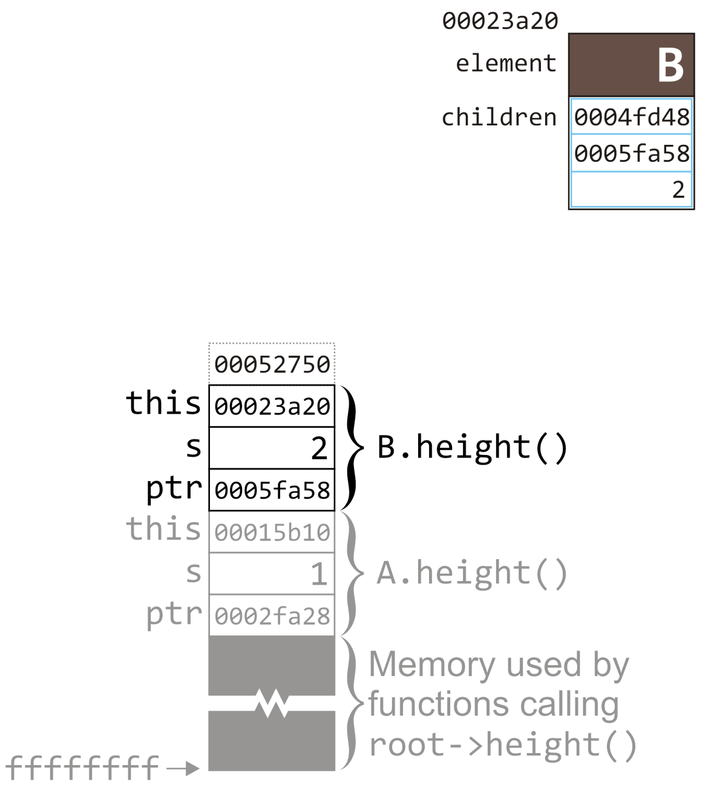
Example
19.1
This value is placed on top of the stack
We will proceed to call size() on the tree node at this address
B.size()
int Simple_tree::size() const {
int s = 1;
for (
Single_node<Simple_tree *> *ptr = children.head();
ptr != 0; ptr = ptr->next()
) {
s += ptr->value()->size();
}
return s;
}
A.size()
root->size();

Slide 56
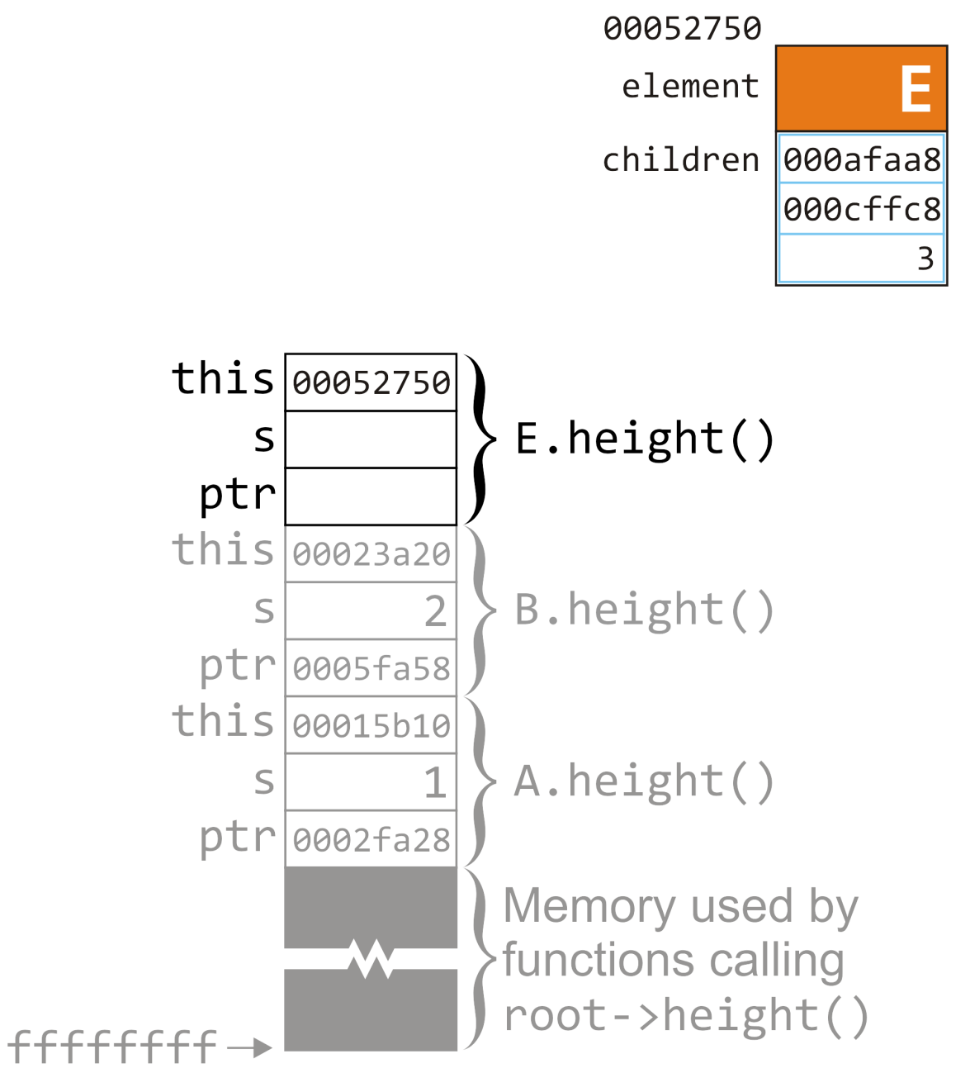
Example
19.1
As before, we allocate memory for a call to size() on a tree node
We will repeat the process on tree node E and, in turn, on all its descendants
E.size()
B.size()
A.size()
root->size();

Slide 57
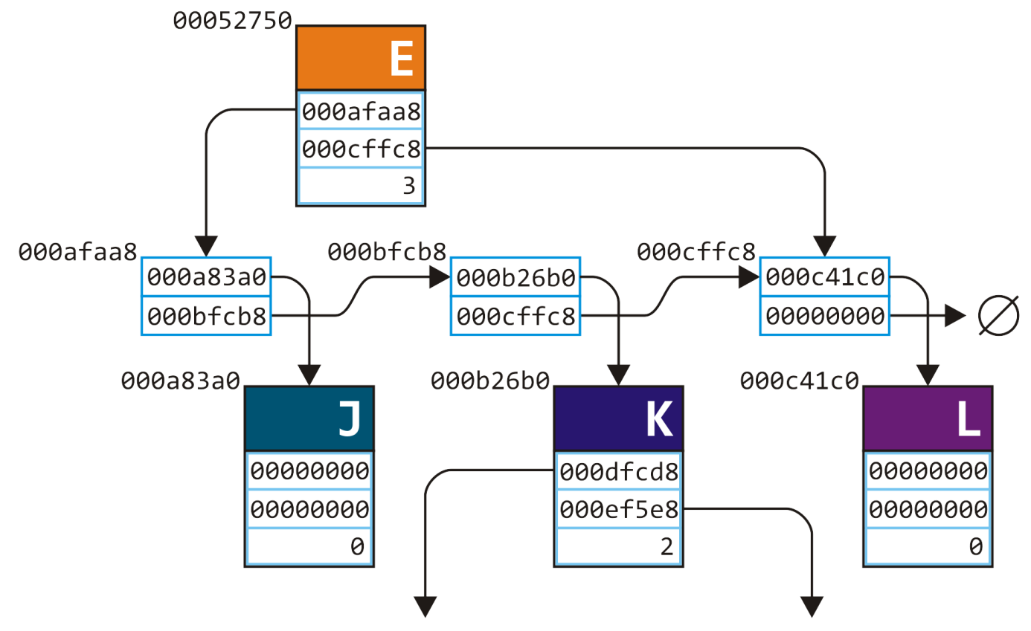
Example
19.1
This is the node we are now recursively calling size() on
Node K has two children, each of which are leaf nodes

Slide 58
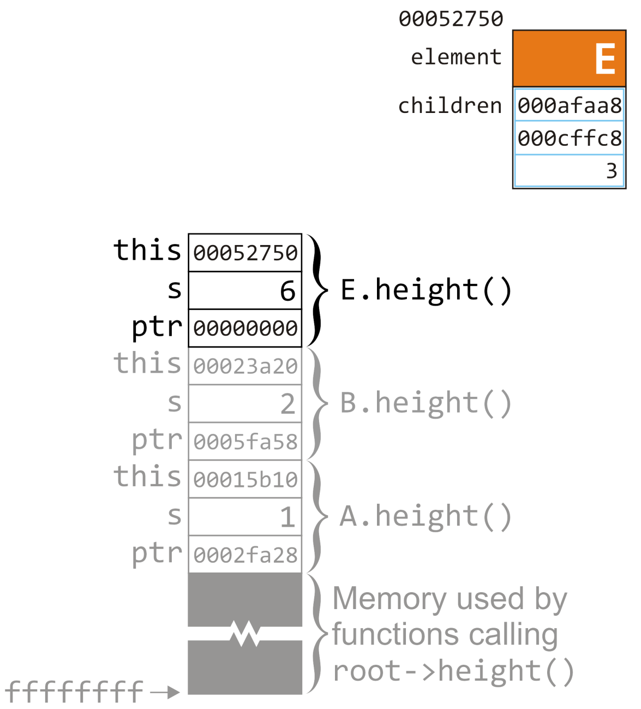
Example
19.1
It should be obvious that, at the end, s will be assigned 6 and ptr is assigned 0
We are at the end of this tree node’s linked list
When ptr != 0 returns false, we end the for loop
E.size()
B.size()
int Simple_tree::size() const {
int s = 1;
for (
Single_node<Simple_tree *> *ptr = children.head();
ptr != 0; ptr = ptr->next()
) {
s += ptr->value()->size();
}
return s;
}
A.size()
root->size();

Slide 59
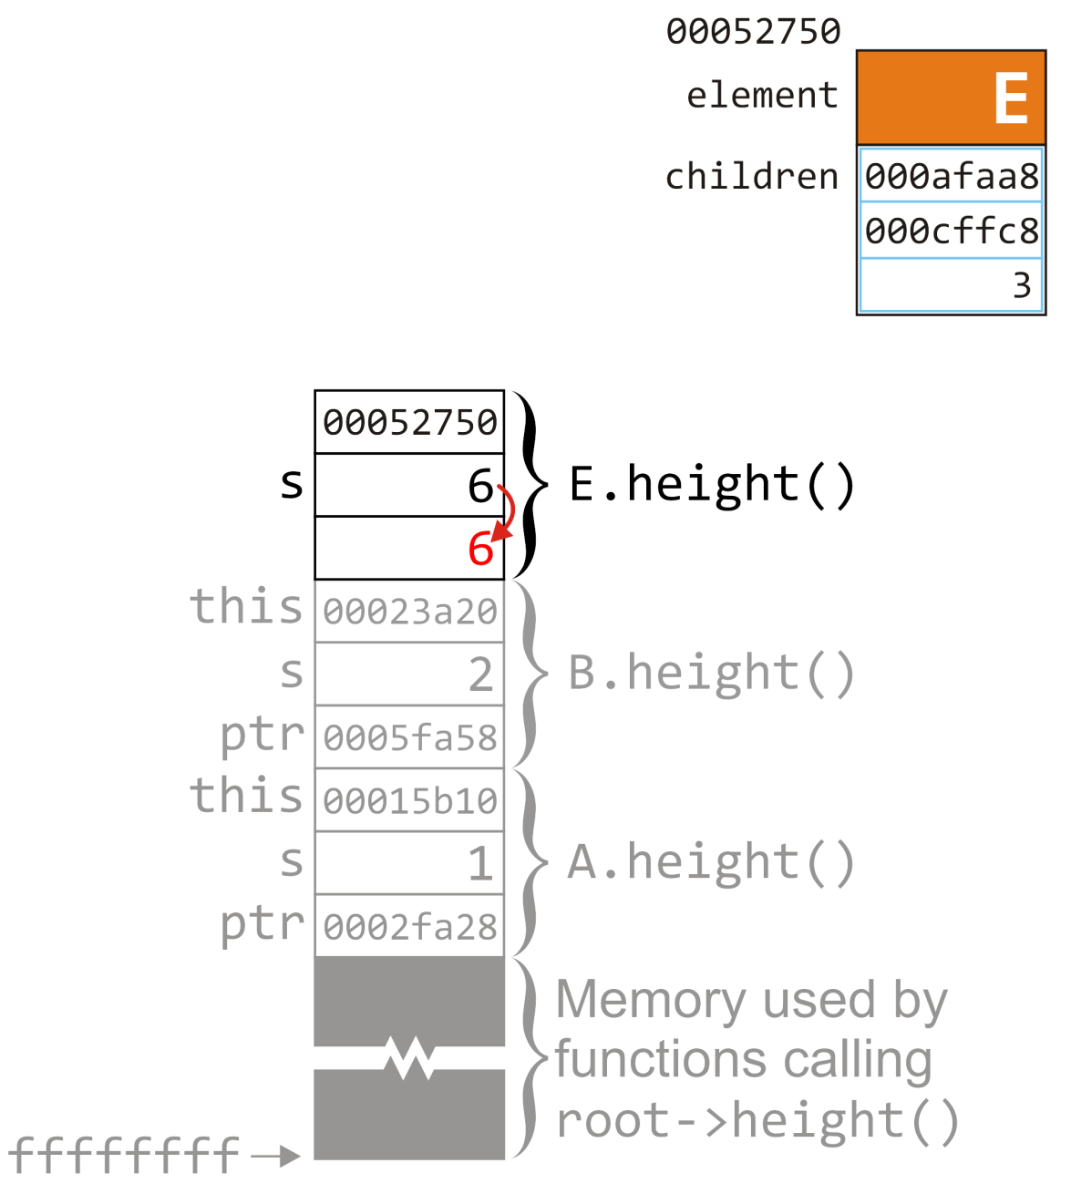
Example
19.1
In preparation to return, we copy the value of s to the appropriate location
E.size()
B.size()
int Simple_tree::size() const {
int s = 1;
for (
Single_node<Simple_tree *> *ptr = children.head();
ptr != 0; ptr = ptr->next()
) {
s += ptr->value()->size();
}
return s;
}
A.size()
root->size();

Slide 60
Example
19.1
We are now back in tree node B and we add the returned value onto the local variable s for the current function call
B.size()
int Simple_tree::size() const {
int s = 1;
for (
Single_node<Simple_tree *> *ptr = children.head();
ptr != 0; ptr = ptr->next()
) {
s += ptr->value()->size();
}
return s;
}
A.size()
root->size();

Slide 61
Example
19.1
We are now back in tree node B and we add the returned value onto the local variable s for the current function call
We are finished executing the body of the loop, so we proceed to ptr = ptr->next()
B.size()
int Simple_tree::size() const {
int s = 1;
for (
Single_node<Simple_tree *> *ptr = children.head();
ptr != 0; ptr = ptr->next()
) {
s += ptr->value()->size();
}
return s;
}
A.size()
root->size();

Slide 62
Example
19.1
We call next() on the node at the address ptr
In this case, it is 00000000
B.size()
Simple_tree *Single_node::next() const {
return next_node;
}
A.size()
root->size();

Slide 63
Example
19.1
We call next() on the node at the address ptr
In this case, it is 00000000
We are at the end of this linked list
B.size()
A.size()
root->size();

Slide 64
Example
19.1
This value is copied to the memory location of ptr for the function call on tree node B
B.size()
int Simple_tree::size() const {
int s = 1;
for (
Single_node<Simple_tree *> *ptr = children.head();
ptr != 0; ptr = ptr->next()
) {
s += ptr->value()->size();
}
return s;
}
A.size()
root->size();

Slide 65
Example
19.1
This value is copied to the memory location of ptr for the function call on tree node B
ptr != 0 evaluates to false, so we end the loop
B.size()
int Simple_tree::size() const {
int s = 1;
for (
Single_node<Simple_tree *> *ptr = children.head();
ptr != 0; ptr = ptr->next()
) {
s += ptr->value()->size();
}
return s;
}
A.size()
root->size();

Slide 66
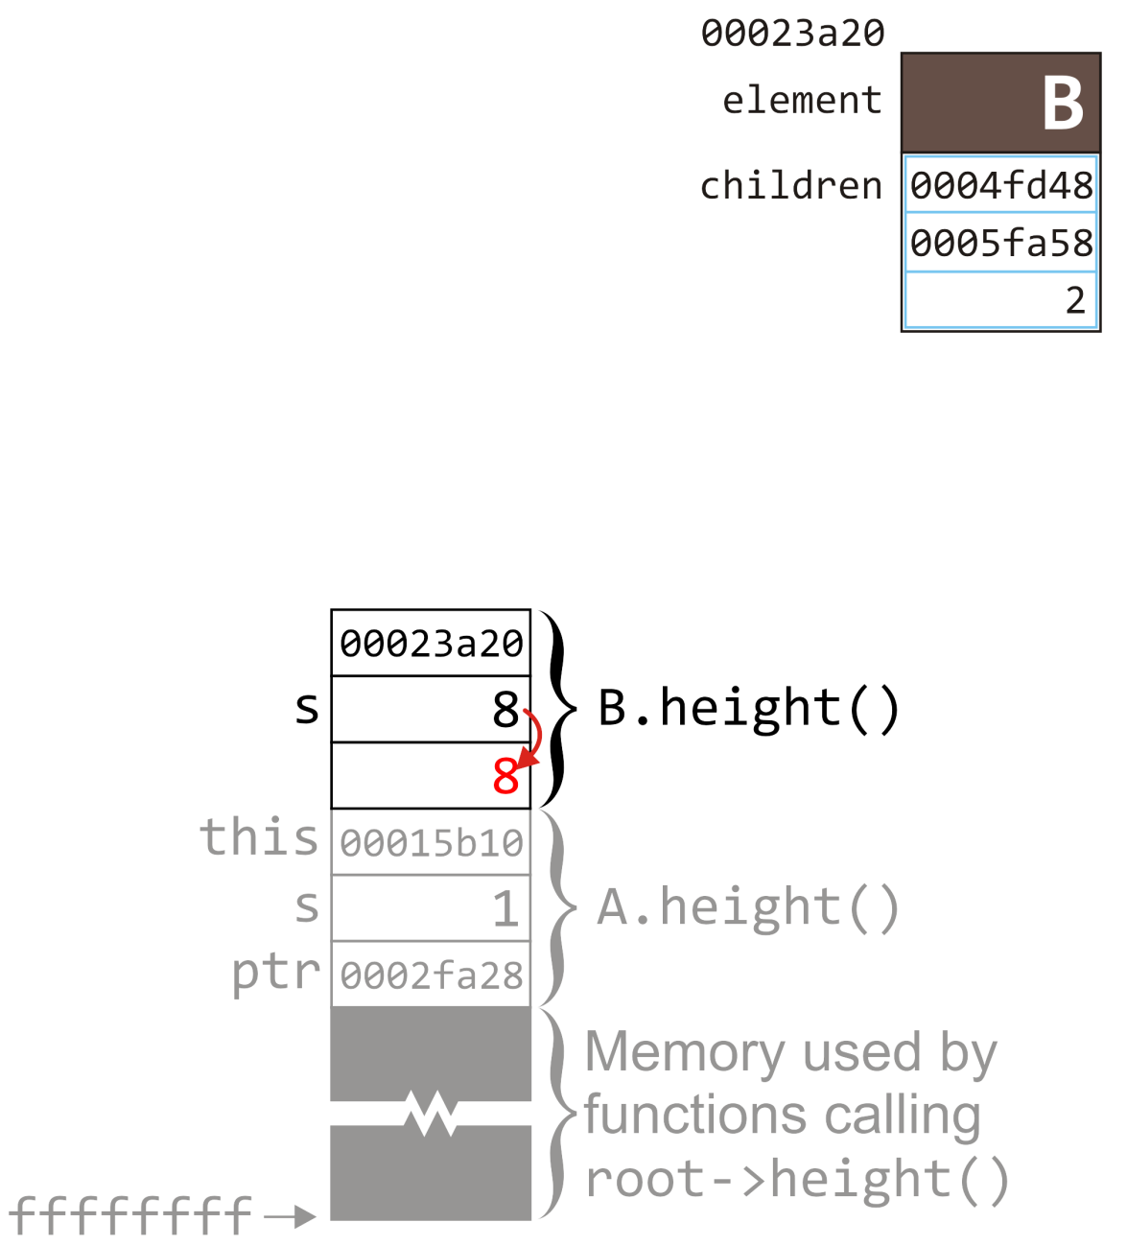
Example
19.1
We prepare to return the value of s by copying its value to the location immediately above the memory for the previous function call
B.size()
int Simple_tree::size() const {
int s = 1;
for (
Single_node<Simple_tree *> *ptr = children.head();
ptr != 0; ptr = ptr->next()
) {
s += ptr->value()->size();
}
return s;
}
A.size()
root->size();

Slide 67
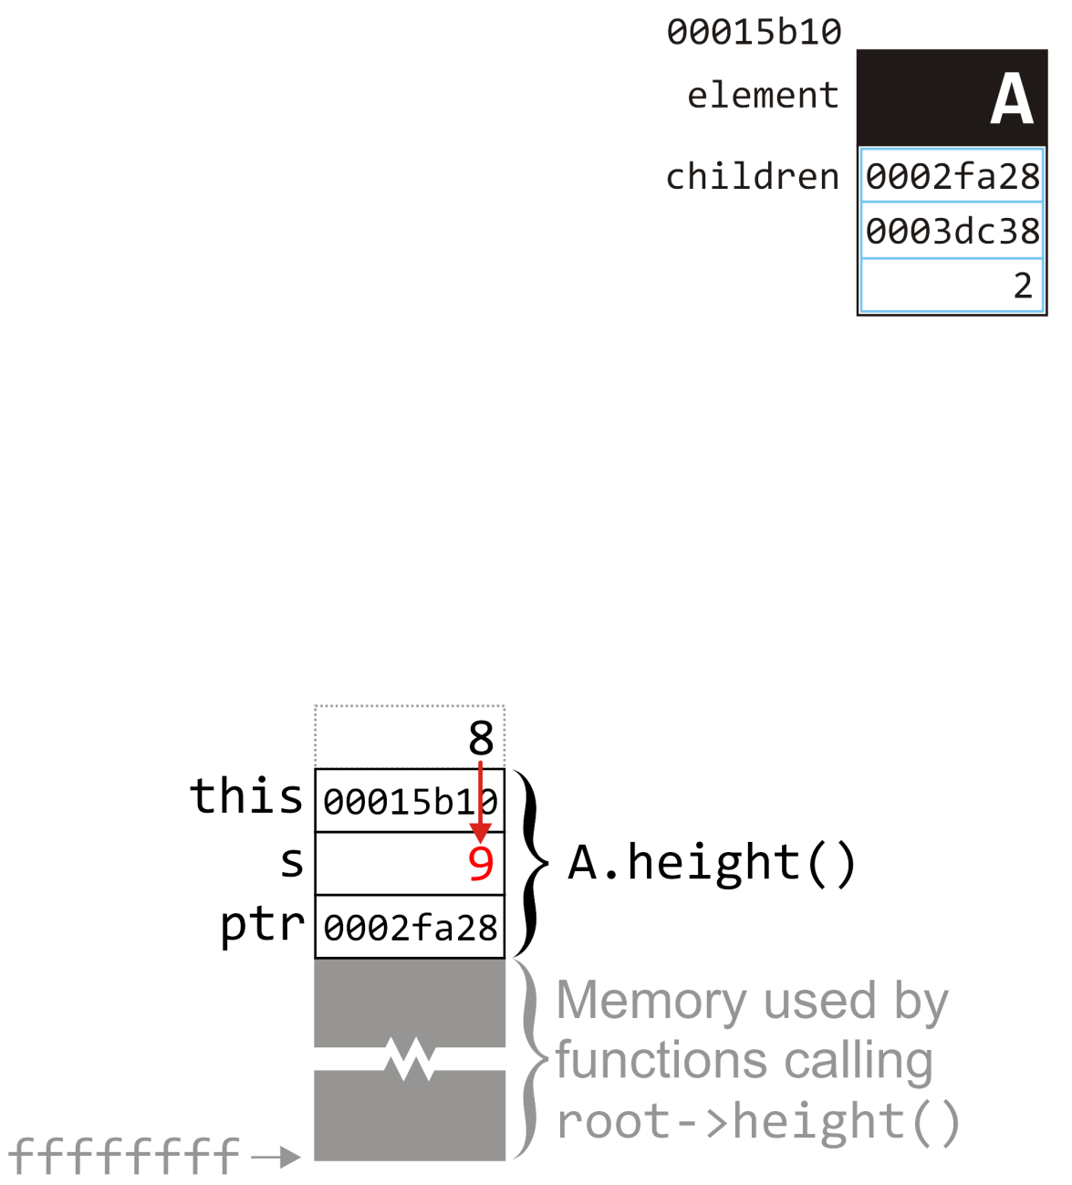
Example
19.1
Now that we’re back in the function call on tree node A, we add the return value onto s: 1 + 8 = 9
int Simple_tree::size() const {
int s = 1;
for (
Single_node<Simple_tree *> *ptr = children.head();
ptr != 0; ptr = ptr->next()
) {
s += ptr->value()->size();
}
return s;
}
A.size()
root->size();

Slide 68
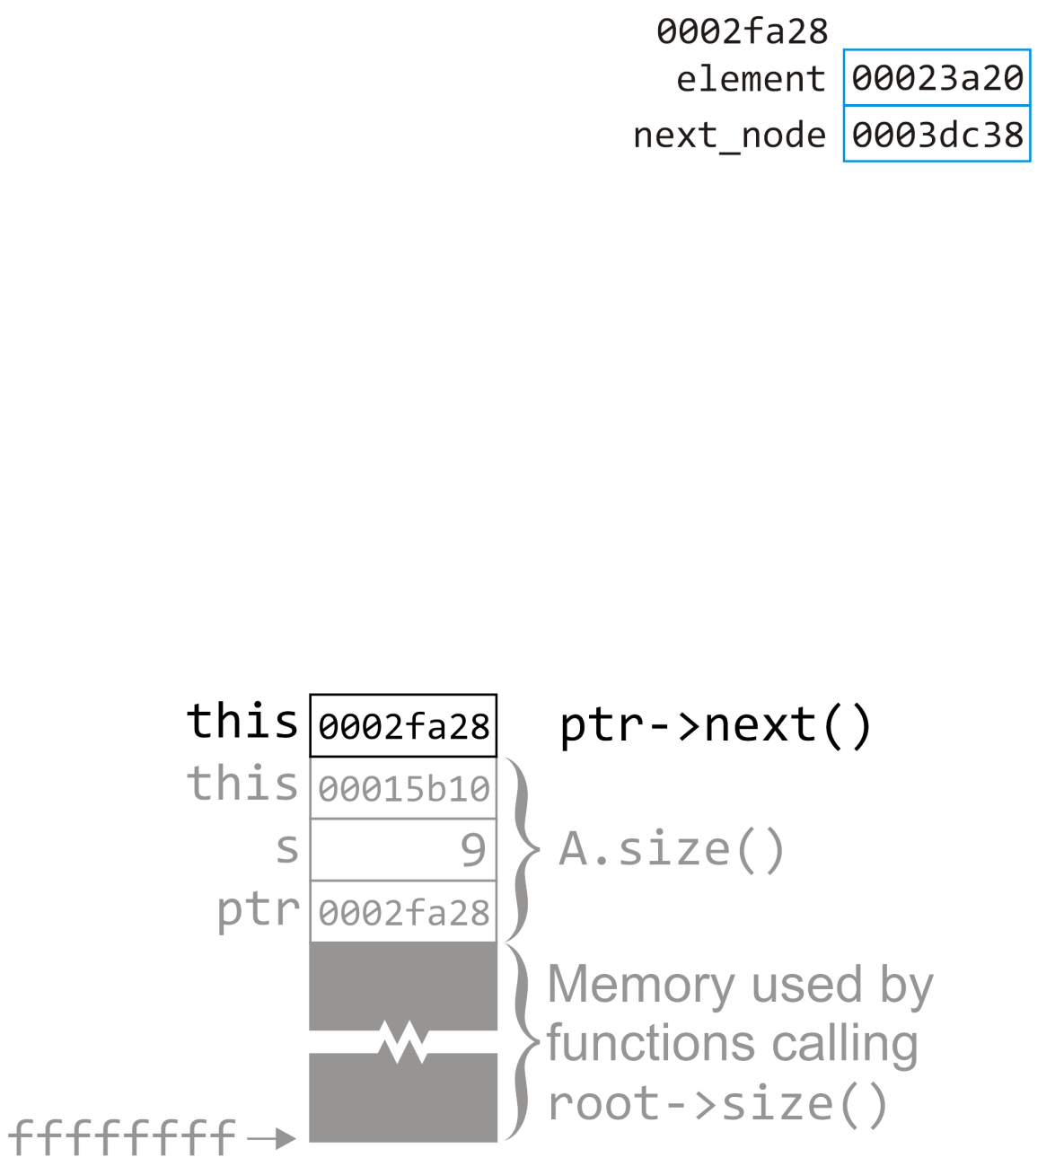
Example
19.1
The body of the loop is over; we call next() on the node at the address stored in ptr
Simple_tree *Single_node::next() const {
return next_node;
}
A.size()
root->size();

Slide 69
Example
19.1
The body of the loop is over; we call next() on the node at the address stored in ptr
A.size()
root->size();

Slide 70
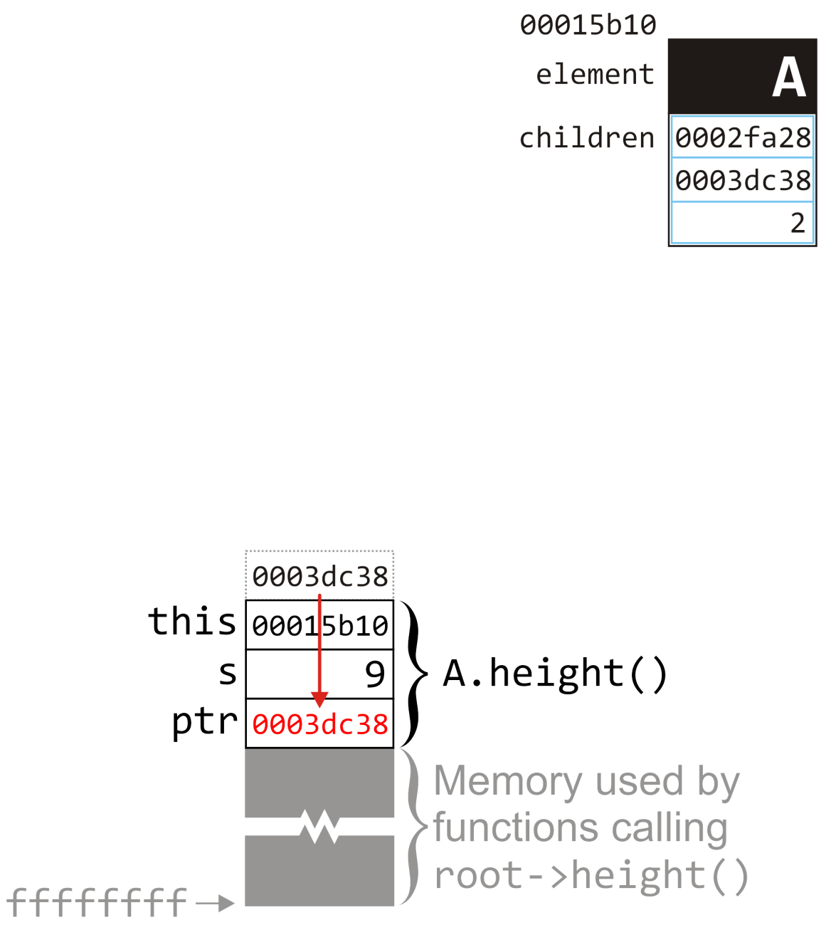
Example
19.1
The returned value is assigned to ptr
int Simple_tree::size() const {
int s = 1;
for (
Single_node<Simple_tree *> *ptr = children.head();
ptr != 0; ptr = ptr->next()
) {
s += ptr->value()->size();
}
return s;
}
A.size()
root->size();

Slide 71
Example
19.1
The returned value is assigned to ptr
We note that it is ptr != 0
int Simple_tree::size() const {
int s = 1;
for (
Single_node<Simple_tree *> *ptr = children.head();
ptr != 0; ptr = ptr->next()
) {
s += ptr->value()->size();
}
return s;
}
A.size()
root->size();

Slide 72
Example
19.1
The returned value is assigned to ptr
We note that it is ptr != 0
We call ptr->value()
int Simple_tree::size() const {
int s = 1;
for (
Single_node<Simple_tree *> *ptr = children.head();
ptr != 0; ptr = ptr->next()
) {
s += ptr->value()->size();
}
return s;
}
A.size()
root->size();

Slide 73
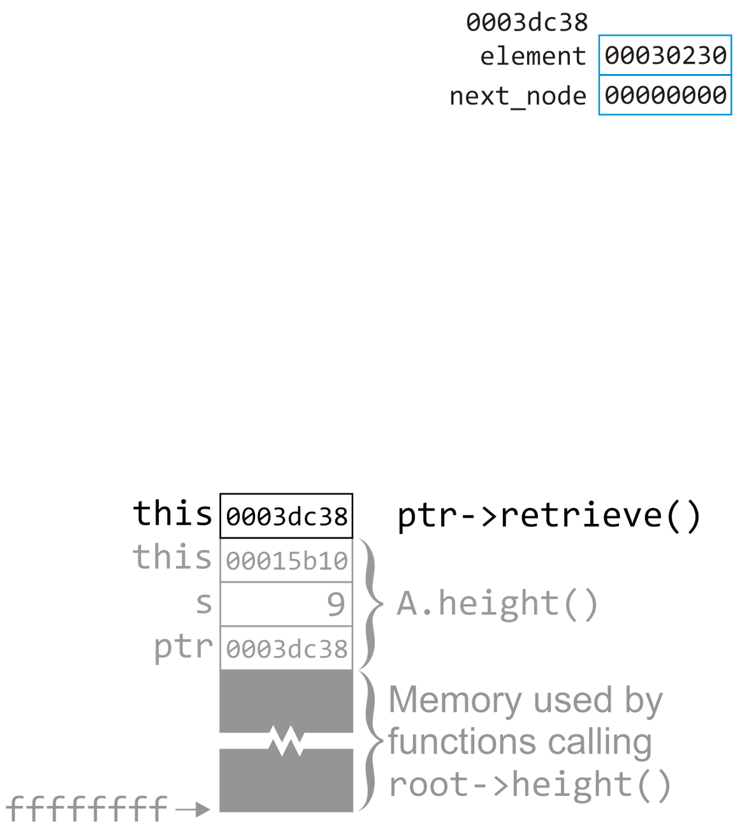
Example
19.1
This node stores the address of the tree node at 0030230
This is the value returned
Simple_tree *Single_node::value() const {
return node_value;
}
A.size()
root->size();

Slide 74
Example
19.1
This node stores the address of the tree node at 0030230
This is the value returned
A.size()
root->size();

Slide 75
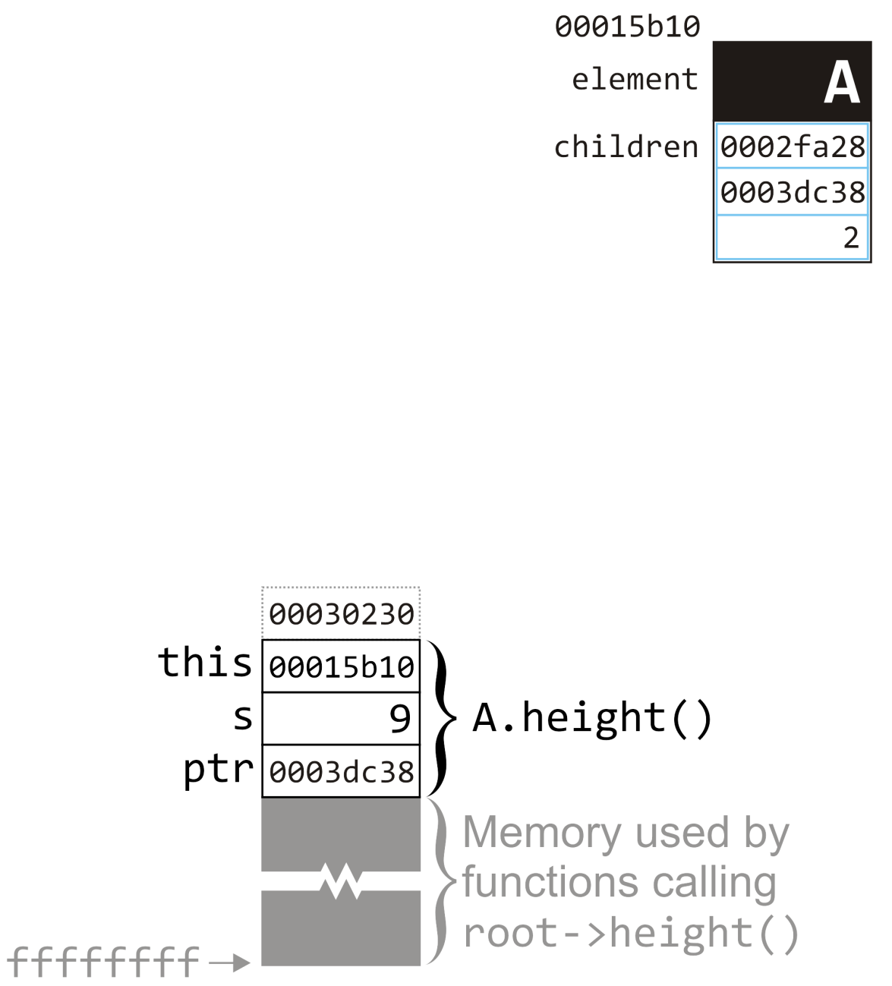
Example
19.1
We call size() on this tree node
int Simple_tree::size() const {
int s = 1;
for (
Single_node<Simple_tree *> *ptr = children.head();
ptr != 0; ptr = ptr->next()
) {
s += ptr->value()->size();
}
return s;
}
A.size()
root->size();

Slide 76
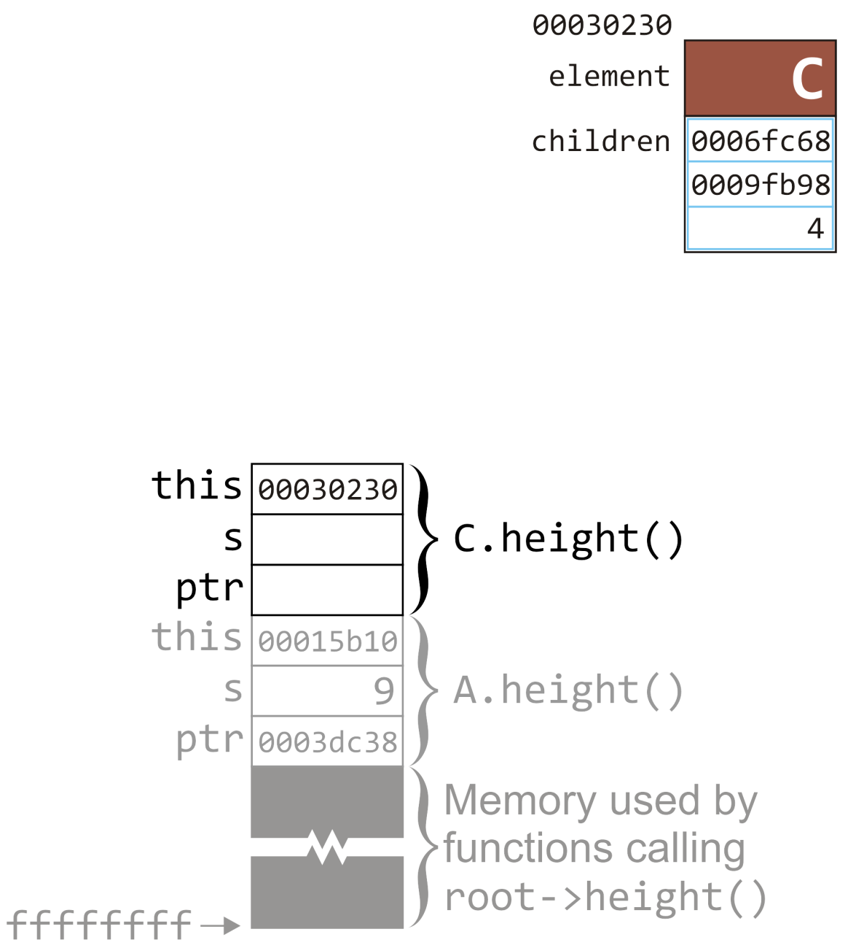
Example
19.1
Again, we won’t go through the whole process
After walking through the linked list, we will note that the number of nodes in this tree is 5
C.size()
A.size()
root->size();

Slide 77
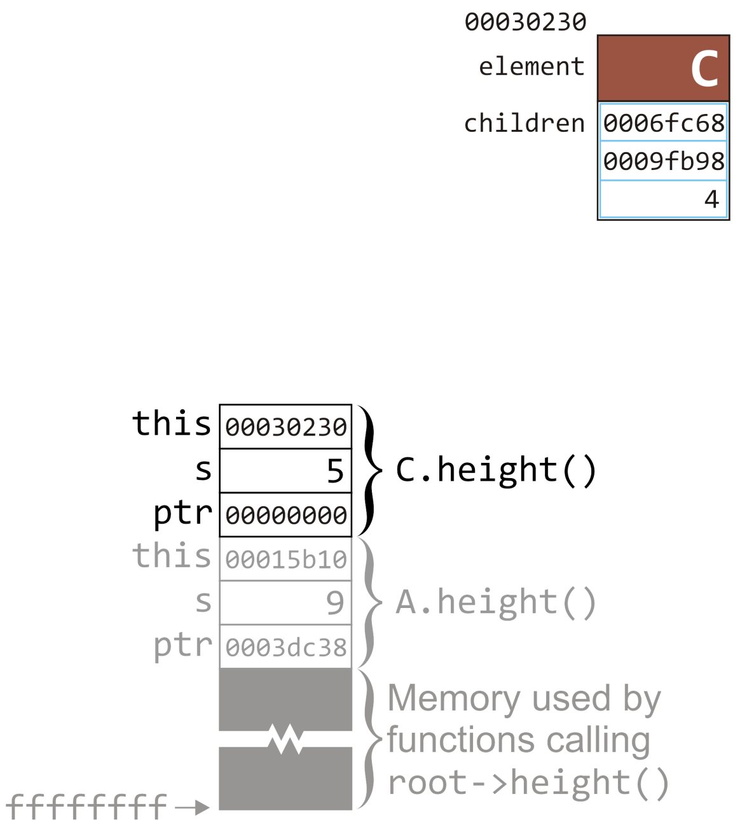
Example
19.1
By the end, s is assigned 5 and ptr is 00000000
C.size()
int Simple_tree::size() const {
int s = 1;
for (
Single_node<Simple_tree *> *ptr = children.head();
ptr != 0; ptr = ptr->next()
) {
s += ptr->value()->size();
}
return s;
}
A.size()
root->size();

Slide 78
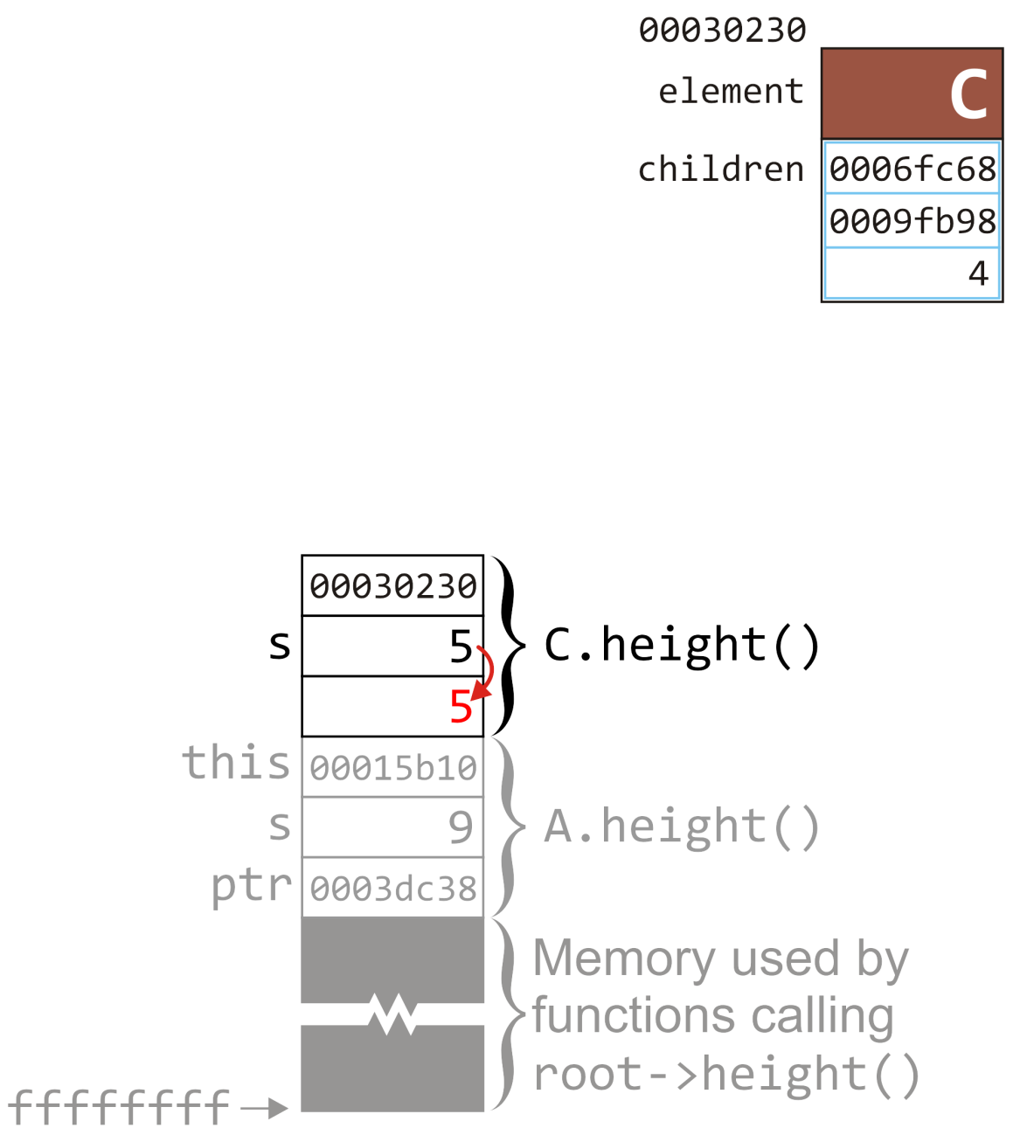
Example
19.1
The condition ptr != 0 is false, so we prepare to return by copying the value of s into the appropriate location
C.size()
int Simple_tree::size() const {
int s = 1;
for (
Single_node<Simple_tree *> *ptr = children.head();
ptr != 0; ptr = ptr->next()
) {
s += ptr->value()->size();
}
return s;
}
A.size()
root->size();

Slide 79
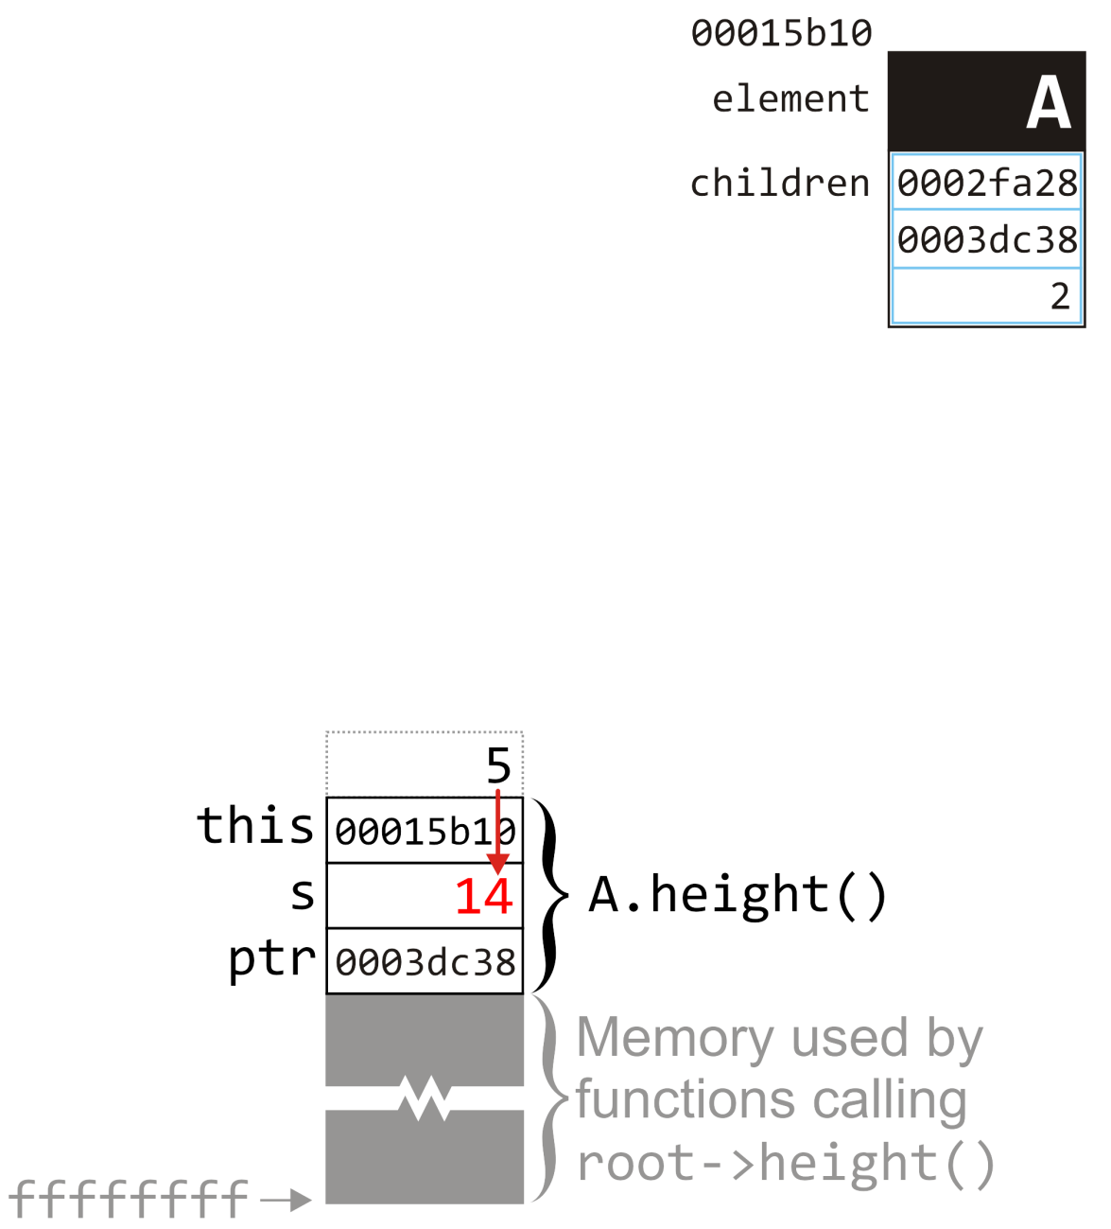
Example
19.1
The calling function adds the return value to so
The new value is 9 + 5 = 14
int Simple_tree::size() const {
int s = 1;
for (
Single_node<Simple_tree *> *ptr = children.head();
ptr != 0; ptr = ptr->next()
) {
s += ptr->value()->size();
}
return s;
}
A.size()
root->size();

Slide 80
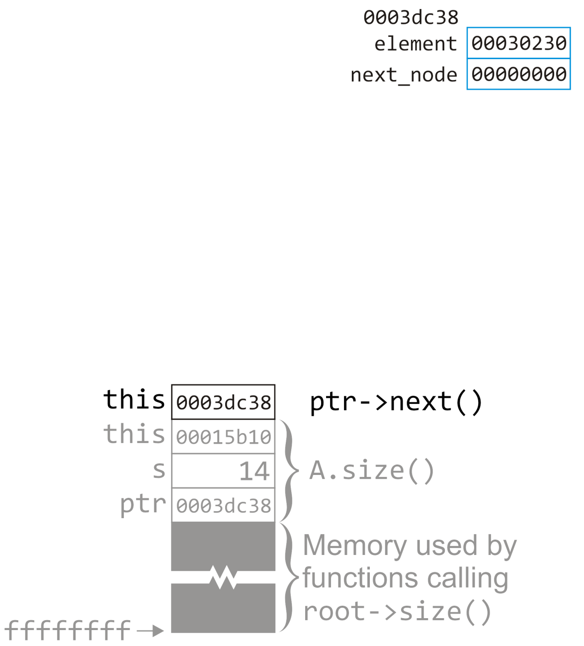
Example
19.1
The loop is over, so we call ptr->next()
int Simple_tree::size() const {
int s = 1;
for (
Single_node<Simple_tree *> *ptr = children.head();
ptr != 0; ptr = ptr->next()
) {
s += ptr->value()->size();
}
return s;
}
A.size()
root->size();

Slide 81
Example
19.1
The loop is over, so we call ptr->next()
A.size()
root->size();

Slide 82
Example
19.1
The returned value of ptr->next() is copied to the appropriate location for the variable ptr
int Simple_tree::size() const {
int s = 1;
for (
Single_node<Simple_tree *> *ptr = children.head();
ptr != 0; ptr = ptr->next()
) {
s += ptr->value()->size();
}
return s;
}
A.size()
root->size();

Slide 83
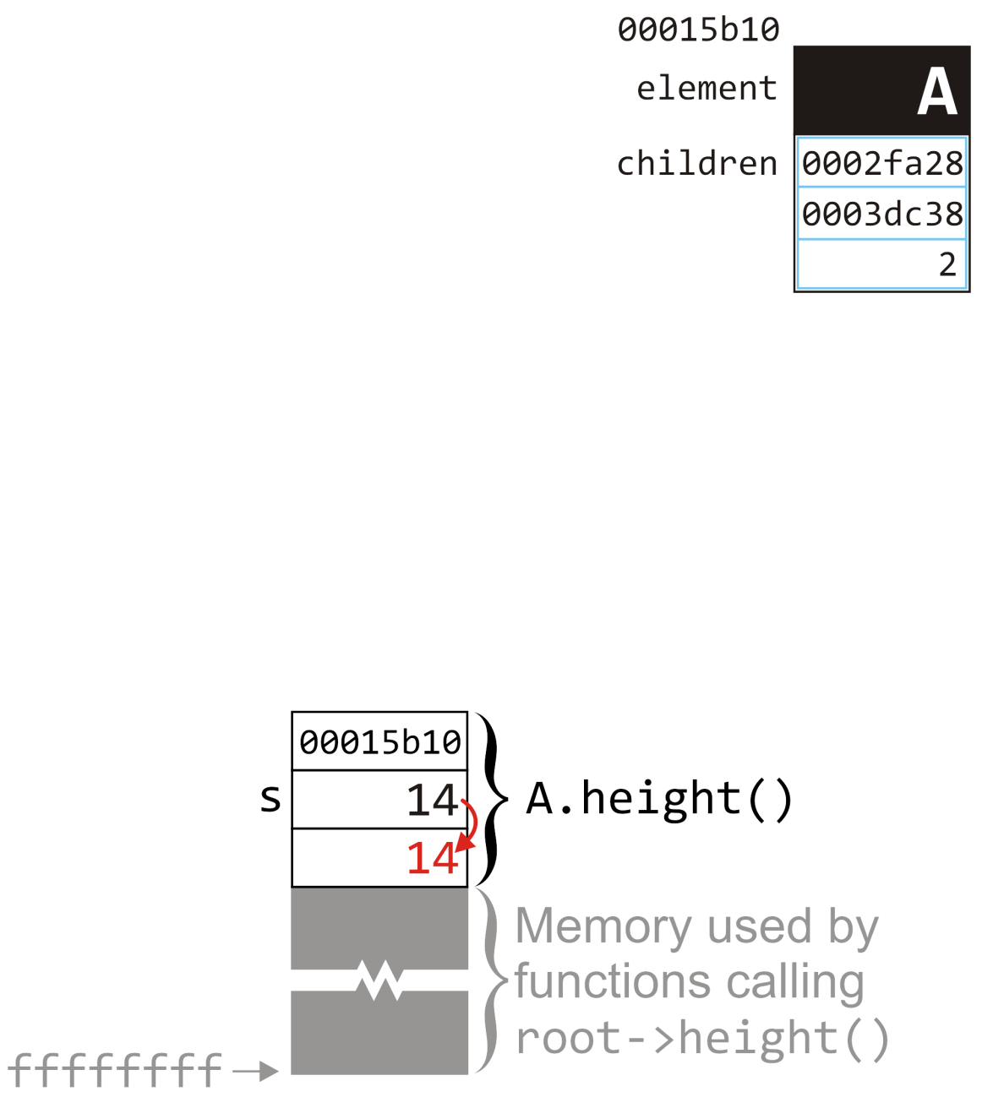
Example
19.1
At this point, ptr != 0 returns false, so we prepare to return by copying the local variable s to the appropriate location
int Simple_tree::size() const {
int s = 1;
for (
Single_node<Simple_tree *> *ptr = children.head();
ptr != 0; ptr = ptr->next()
) {
s += ptr->value()->size();
}
return s;
}
A.size()
root->size();

Slide 84
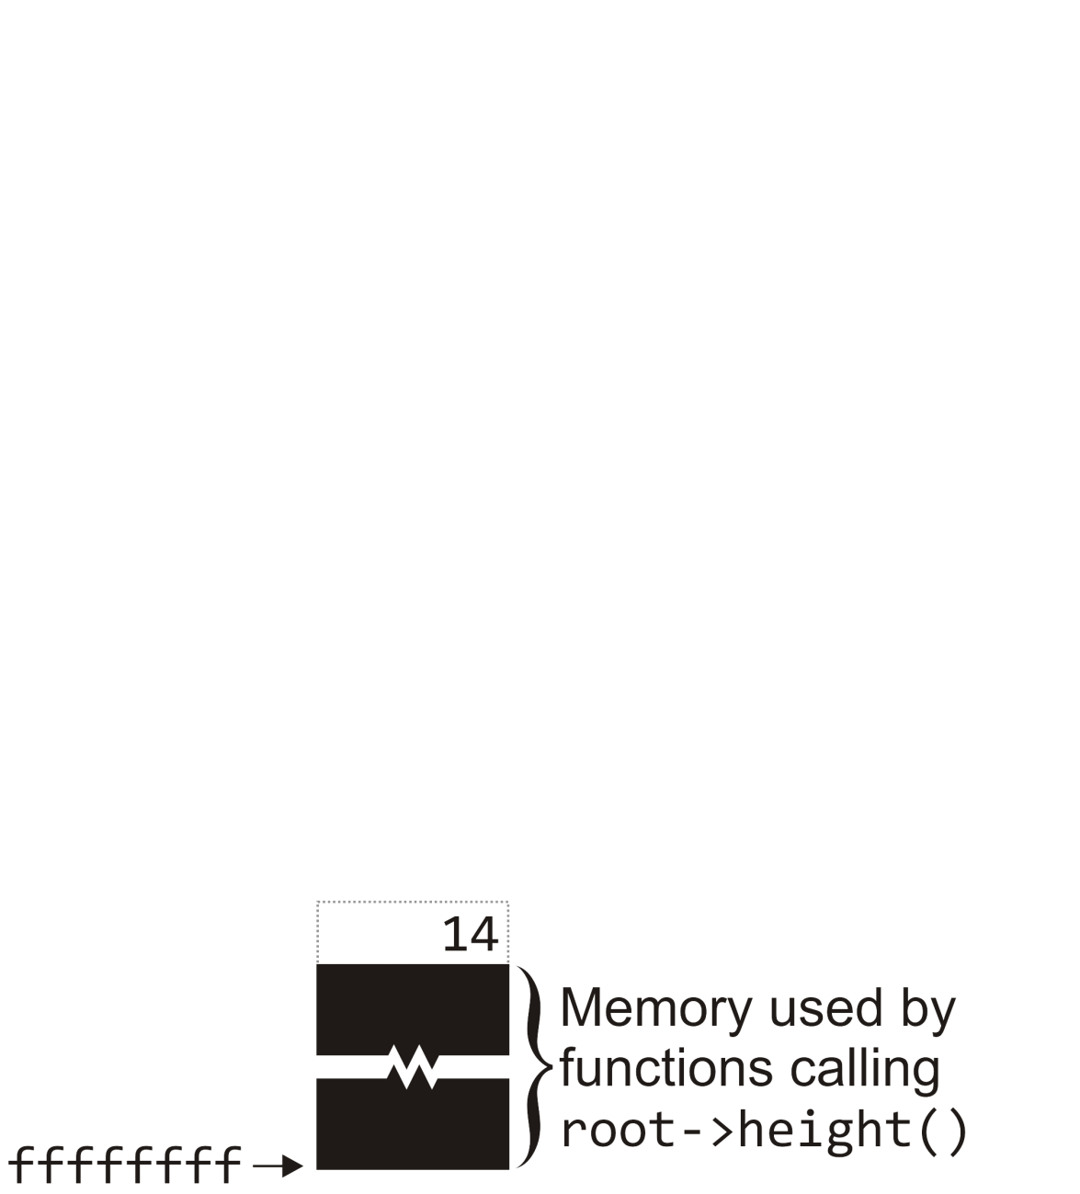
Example
19.1
We have returned to whatever function originally called
root->size();
That function can access the value returned by the call, either assigning it, using it as a further function call, or possibly discarding it
root->size();

Slide 85
Comments
19.1
In this example, we have gone step-by-step through these function calls—you may have even noted a few places where optimizations could have occurred
Good compilers will optimize code—you will see more of this in the course ECE 351 Compilers

Slide 86
Summary
In this topic, we have at an in-depth study of recursion on a tree
A step-by-step process visiting the various nodes within the tree
The process is very methodological and recursive
If time permits, I will try to prepare slides demonstrating recursion on a binary tree with a more complex function

Slide 87
References
Wikipedia, http://en.wikipedia.org/wiki/Recursion_(computer_science)
[1] Donald E. Knuth, The Art of Computer Programming, Volume 1: Fundamental Algorithms, 3rd Ed., Addison Wesley, 1997, §2.2.1, p.238.
These slides are provided for the ECE 250 Algorithms and Data Structures course. The material in it reflects Douglas W. Harder’s best judgment in light of the information available to him at the time of preparation. Any reliance on these course slides by any party for any other purpose are the responsibility of such parties. Douglas W. Harder accepts no responsibility for damages, if any, suffered by any party as a result of decisions made or actions based on these course slides for any other purpose than that for which it was intended.

