Slide 1
3.5 Linked Lists

Slide 2
Outline
In this topic, we will look at linked lists
The Node and List classes
Accessors and mutators
The implementation of various member functions
Stepping through a linked list
Defining the copy and assignment operator
Defining move constructors and move assignment operators
Discussed efficiencies

Slide 3
Definition
A linked list is a data structure where each object is stored in a node
As well as storing data, the node must also contains a reference/pointer to the node containing the next item of data

Slide 4
Linked Lists
1
We must dynamically create the nodes in a linked list
Thus, because new returns a pointer, the logical manner in which to track a linked lists is through a pointer
A Node class must store the data and a reference to the next node (also a pointer)

Slide 5
Node Class
1
The node must store data and a pointer:
class Node {
public:
Node( int = 0, Node * = nullptr );
int value() const;
Node *next() const;
private:
int node_value;
Node *next_node;
};

Slide 6
Node Constructor
1.1
The constructor assigns the two member variables based on the arguments
List::Node::Node( int e, Node *n ):
node_value( e ),
next_node( n ) {
// empty constructor
}
The default values are given in the class definition:
class Node {
public:
Node( int = 0, Node * = nullptr );
int value() const;
Node *next() const;
private:
int node_value;
Node *next_node;
};

Slide 7
Accessors
The two member functions are accessors which simply return the node_value and the next_node member variables, respectively
int List::Node::value() const { return node_value;
}
List::Node *List::Node::next() const {
return next_node;
}
Member functions that do not change the object acted upon are variously called accessors, readonly functions, inspectors, and, when it involves simply returning a member variable, getters

Slide 8
Accessors
In C++, a member function cannot have the same name as a member variable
Possible solutions:
 | Member Variables | Member Functions
Vary capitalization | next_node | Next_node() or NextNode()
Prefix with “get” | next_node | get_next_node() / getNextNode()
Use an underscore | next_node_ | next_node()
Different names | next_node | next()
Always use the naming convention and coding styles used by your employer—even if you disagree with them
Consistency aids in maintenance

Slide 9
Linked List Class
Because each node in a linked lists refers to the next, the linked list class need only link to the first node in the list
The linked list class requires member variable: a pointer to a node
class List {
public:
class Node {...};
private:
Node *list_head;
// ...
};

Slide 10
Structure
To begin, let us look at the internal representation of a linked list
Suppose we want a linked list to store the values
42 95 70 81
in this order

Slide 11
Structure
A linked list uses linked allocation, and therefore each node may appear anywhere in memory
Also the memory required for each node equals the memory required by the member variables
4 bytes for the linked list (a pointer)
8 bytes for each node (an int and a pointer)
We are assuming a 32-bit machine

Slide 12
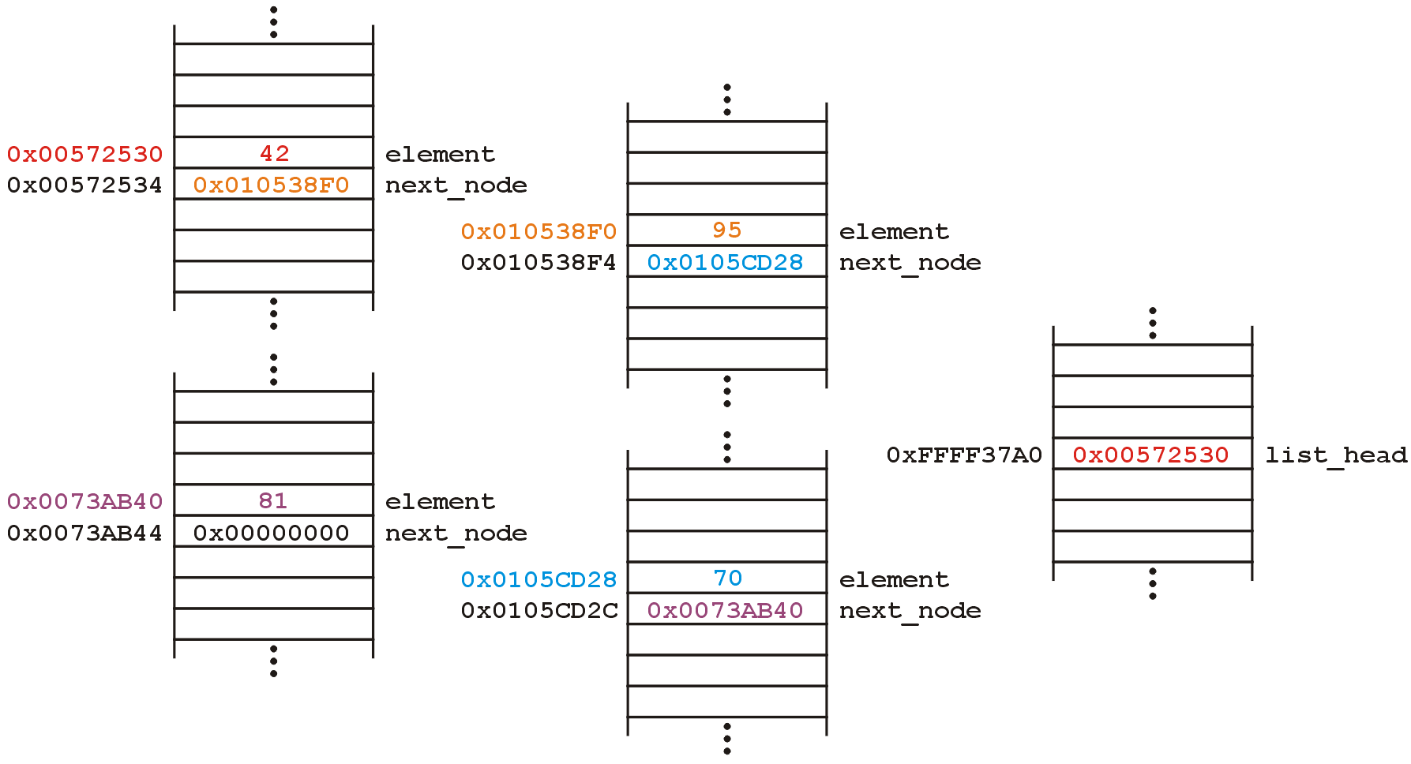
Structure
Such a list could occupy memory as follows:
Linked List Object

Slide 13
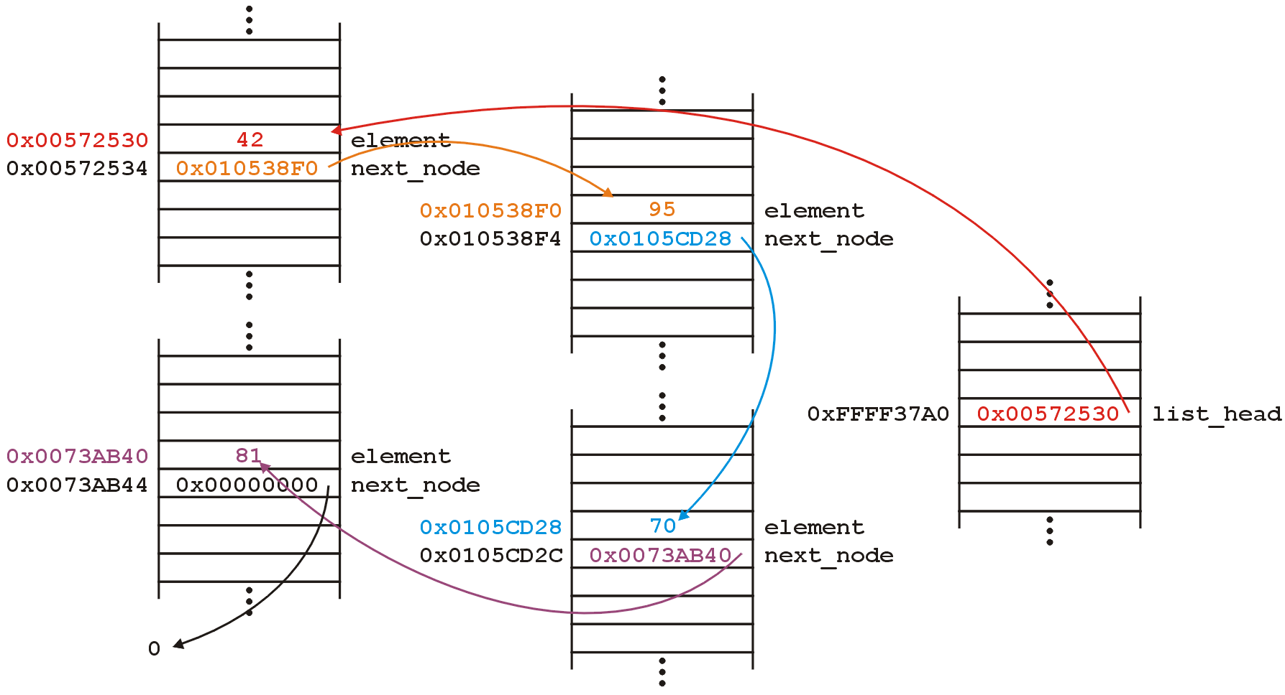
Structure
The next_node pointers store the addresses of the next node in the list

Slide 14
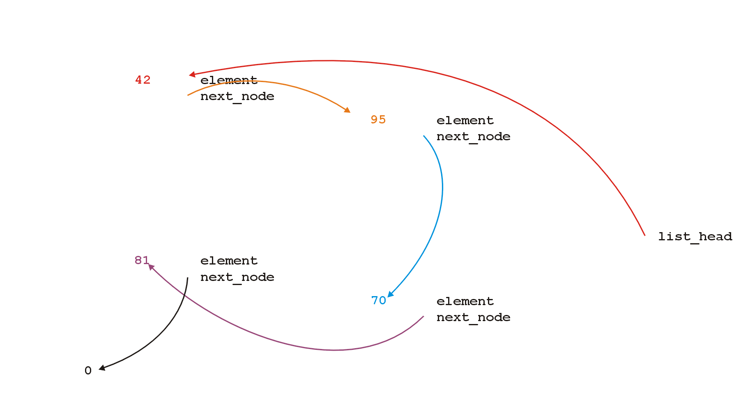
Structure
Because the addresses are arbitrary, we can remove that information:

Slide 15
Structure
We will clean up the representation as follows:
We do not specify the addresses because they are arbitrary and:
The contents of the circle is the value
The next_node pointer is represented by an arrow
list_

Slide 16
Operations
First, we want to create a linked list
We also want to be able to:
insert into,
access, and
erase from
the values stored in the linked list

Slide 17
Operations
We can do them with the following operations:
Adding, retrieving, or removing the value at the front of the linked list
void push_front( int );
int front() const;
void pop_front();
We may also want to access the head of the linked list
Node *begin() const;
Member functions that may change the object acted upon are variously called mutators, modifiers, and, when it involves changing a single member variable, setters

Slide 18
Operations
All these operations relate to the first node of the linked list
We may want to perform operations on an arbitrary node of the linked list, for example:
Find the number of instances of an integer in the list:
int count( int ) const;
Remove all instances of an integer from the list:
int erase( int );

Slide 19
Linked Lists
Additionally, we may wish to check the state:
Is the linked list empty?
bool empty() const;
How many objects are in the list?
int size() const;
The list is empty when the list_head pointer is set to nullptr

Slide 20
Linked Lists
Consider this simple (but incomplete) linked list class:
class List {
public:
class Node {...};
List();
// Accessors
bool empty() const;
int size() const;
int front() const;
Node *begin() const;
Node *end() const;
int count( int ) const;
// Mutators
void push_front( int );
int pop_front();
int erase( int );
private:
Node *list_head;
};

Slide 21
Linked Lists
The constructor initializes the linked list
We do not count how may objects are in this list, thus:
we must rely on the last pointer in the linked list to point to a special value
in C++, that standard value is nullptr

Slide 22
The Constructor
Thus, in the constructor, we assign list_head the value nullptr
List::List():list_head( nullptr ) {
// empty constructor
}
We will always ensure that when a linked list is empty, the list head is assigned nullptr

Slide 23
Allocation
The constructor is called whenever an object is created, either:
Statically
The statement List ls; defines ls to be a linked list and the compiler deals with memory allocation
Dynamically
The statement List *pls = new List(); requests sufficient memory from the OS to store an instance of the class
In both cases, the memory is allocated and then the constructor is called

Slide 24
Static Allocation
Example:
int f() {
List ls; // ls is declared as a local variable on the stack
ls.push_front( 3 );
cout << ls.front() << endl;
// The return value is evaluated
// The compiler then calls the destructor for local variables
// The memory allocated for 'ls' is deallocated
return 0;
}

Slide 25
Dynamic Allocation
Example:
List *f( int n ) {
List *pls = new List(); // pls is allocated memory by the OS
pls->push_front( n );
cout << pls->front() << endl;
// The address of the linked list is the return value
// After this, the 4 bytes for the pointer 'pls' is deallocated
// The memory allocated for the linked list is still there
return pls;
}

Slide 26
Static Allocation
What if I do?
List *f() {
List ls; // ls is declared as a local variable on the stack
ls.push_front( 3 );
cout << ls.front() << endl;
// The return value is evaluated
// The compiler then calls the destructor for local variables
// The memory allocated for 'ls' is deallocated
return &ls;
}

Slide 27
bool empty() const
Starting with the easier member functions:
bool List::empty() const {
if ( list_head == nullptr ) {
return true;
} else {
return false;
}
}
Better yet:
bool List::empty() const {
return ( list_head == nullptr );
}

Slide 28
Node *begin() const
The member function Node *begin() const is easy enough to implement:
List::Node *List::begin() const {
return list_head;
}
This will always work: if the list is empty, it will return nullptr

Slide 29
Node *end() const
The member function Node *end() const equals whatever the last node in the linked list points to
In this case, nullptr
List::Node *List::end() const {
return nullptr;
}

Slide 30
int front() const
To get the first value in the linked list, we must access the node to which the list_head is pointing
Because we have a pointer, we must use the -> operator to call the member function:
int List::front() const {
return begin()->value();
}

Slide 31
int front() const
The member function int front() const requires some additional consideration, however:
what if the list is empty?
If we tried to access a member function of a pointer set to nullptr, we would access restricted memory
The operating system would terminate the running program

Slide 32
int front() const
Instead, we can use an exception handling mechanism where we thrown an exception
We define a class
class underflow {
// empty
};
and then we throw an instance of this class:
throw underflow();

Slide 33
int front() const
Thus, the full function is
int List::front() const {
if ( empty() ) {
throw underflow(); }
return begin()->value();
}

Slide 34
int front() const
Why is empty() better than
int List::front() const {
if ( list_head == nullptr ) {
throw underflow(); }
return list_head->node_value;
}
?
Two benefits:
More readable
If the implementation changes we do nothing

Slide 35
void push_front( int )
Next, let us add a value to the list
If it is empty, we start with:
and, if we try to add 81, we should end up with:

Slide 36
void push_front( int )
To visualize what we must do:
We must create a new node which:
stores the value 81, and
is pointing to 0
We must then assign its address to list_head
We can do this as follows:
list_head = new Node( 81, nullptr );
We could also use the default value...

Slide 37
void push_front( int )
Suppose however, we already have a non-empty list
Adding 70, we want:

Slide 38
void push_front( int )
To achieve this, we must we must create a new node which:
stores the value 70, and
is pointing to the current list head
we must then assign its address to list_head
We can do this as follows:
list_head = new Node( 70, list_head );

Slide 39
void push_front( int )
Thus, our implementation could be:
void List::push_front( int n ) {
if ( empty() ) {
list_head = new Node( n, nullptr );
} else {
list_head = new Node( n, begin() );
}
}

Slide 40
void push_front( int )
We could, however, note that when the list is empty, list_head == 0, thus we could shorten this to:
void List::push_front( int n ) {
list_head = new Node( n, list_head );
}

Slide 41
void push_front( int )
Are we allowed to do this?
void List::push_front( int n ) {
list_head = new Node( n, begin() );
}
Yes: the right-hand side of an assignment is evaluated first
The original value of list_head is accessed first before the function call is made

Slide 42
void push_front( int )
Question: does this work?
void List::push_front( int n ) {
Node new_node( n, begin() );
list_head = &new_node;
}
Why or why not? What happens to new_node?
How does this differ from
void List::push_front( int n ) {
Node *new_node = new Node( n, begin() );
list_head = new_node;
}

Slide 43
int pop_front()
Erasing from the front of a linked list is even easier:
We assign the list head to the next pointer of the first node
Graphically, given:
we want:

Slide 44
int pop_front()
Easy enough:
int List::pop_front() {
int e = front();
list_head = begin()->next();
return e;
}
Unfortunately, we have some problems:
The list may be empty
We still have the memory allocated for the node containing 70

Slide 45
int pop_front()
Does this work?
int List::pop_front() {
if ( empty() ) {
throw underflow();
}
int e = front();
delete begin();
list_head = begin()->next();
return e;
}

Slide 46
int pop_front()
int List::pop_front() {
if ( empty() ) {
throw underflow();
}
int e = front();
delete begin();
list_head = begin()->next();
return e;
}

Slide 47
int pop_front()
int List::pop_front() {
if ( empty() ) {
throw underflow();
}
int e = front();
delete begin();
list_head = begin()->next();
return e;
}

Slide 48
int pop_front()
int List::pop_front() {
if ( empty() ) {
throw underflow();
}
int e = front();
delete begin();
list_head = begin()->next();
return e;
}

Slide 49
int pop_front()
The problem is, we are accessing a node which we have just deleted
Unfortunately, this will work more than 99% of the time:
The running program (process) may still own the memory
Once in a while it will fail ...
... and it will be almost impossible to debug
http://xkcd.com/379/

Slide 50
int pop_front()
The correct implementation assigns a temporary pointer to point to the node being deleted:
int List::pop_front() {
if ( empty() ) {
throw underflow();
}
int e = front();
Node *ptr = list_head;
list_head = list_head->next();
delete ptr;
return e;
}

Slide 51
int pop_front()
int List::pop_front() {
if ( empty() ) {
throw underflow();
}
int e = front();
Node *ptr = begin();
list_head = begin()->next();
delete ptr;
return e;
}

Slide 52
int pop_front()
int List::pop_front() {
if ( empty() ) {
throw underflow();
}
int e = front();
Node *ptr = begin();
list_head = begin()->next();
delete ptr;
return e;
}

Slide 53
int pop_front()
int List::pop_front() {
if ( empty() ) {
throw underflow();
}
int e = front();
Node *ptr = begin();
list_head = begin()->next();
delete ptr;
return e;
}

Slide 54
int pop_front()
int List::pop_front() {
if ( empty() ) {
throw underflow();
}
int e = front();
Node *ptr = begin();
list_head = begin()->next();
delete ptr;
return e;
}

Slide 55
Stepping through a Linked List
The next step is to look at member functions which potentially require us to step through the entire list:
int size() const;
int count( int ) const;
int erase( int );
The second counts the number of instances of an integer, and the last removes the nodes containing that integer

Slide 56
Stepping through a Linked List
The process of stepping through a linked list can be thought of as being analogous to a for-loop:
We initialize a temporary pointer with the list head
We continue iterating until the pointer equals nullptr
With each step, we set the pointer to point to the next object

Slide 57
Stepping through a Linked List
Thus, we have:
for ( Node *ptr = begin(); ptr != end(); ptr = ptr->next() ) {
// do something
// use ptr->fn() to call member functions
// use ptr->var to assign/access member variables
}

Slide 58
Stepping through a Linked List
Analogously:
for ( Node *ptr = begin(); ptr != end(); ptr = ptr->next() )
for ( int i = 0; i != N; ++i )

Slide 59
Stepping through a Linked List
With the initialization and first iteration of the loop, we have:
ptr != nullptr and thus we evaluate the body of the loop and then set ptr to the next pointer of the node it is pointing to

Slide 60
Stepping through a Linked List
ptr != nullptr and thus we evaluate the loop and increment the pointer
In the loop, we can access the value being pointed to by using ptr->value()

Slide 61
Stepping through a Linked List
ptr != nullptr and thus we evaluate the loop and increment the
pointer
Also, in the loop, we can access the next node in the list by using ptr->next()

Slide 62
Stepping through a Linked List
ptr != nullptr and thus we evaluate the loop and increment the
pointer
This last increment causes ptr == nullptr

Slide 63
Stepping through a Linked List
Here, we check and find ptr != nullptr is false, and thus we exit
the loop
Because the variable ptr was declared inside the loop, we can no longer access it

Slide 64
int count( int ) const
To implement int count(int) const, we simply check if the argument matches the value with each step
Each time we find a match, we increment the count
When the loop is finished, we return the count
The size function is simplification of count

Slide 65
int count( int ) const
The implementation:
int List::count( int n ) const {
int node_count = 0;
for ( Node *ptr = begin(); ptr != end(); ptr = ptr->next() ) {
if ( ptr->value() == n ) {
++node_count;
}
}
return node_count;
}

Slide 66
int erase( int )
To remove an arbitrary value, i.e., to implement int erase( int ), we must update the previous node
For example, given
if we delete 70, we want to end up with

Slide 67
Accessing Private Member Variables
Notice that the erase function must modify the member variables of the node prior to the node being removed
Thus, it must have access to the member variable next_node
We could supply the member function
void set_next( Node * );
however, this would be globally accessible
Possible solutions:
Friends
Nested classes
Inner classes

Slide 68
C++ Friends
In C++, you could explicitly break encapsulation by declaring the class List to be a friend of the class Node:
class A {
private:
int class_size;
// ... declaration ...
friend class B;
};
Now, any member function of class B has access to all private member variables of class A

Slide 69
C++ Friends
For example, if the Node class was one class, and the List class was a friend of the Node class, List::erase could modify nodes:
int List::erase( int n ) {
int node_count = 0;
// ...
for ( Node *ptr = begin(); ptr != end(); ptr = ptr->next() ) {
// ...
if ( some condition ) {
ptr->next_node = ptr->next()->next();
// ...
++node_count;
}
}
return node_count;
}

Slide 70
Nested Classes
In C++, you can nest one class inside another, which is what we do:
class Outer {
private:
class Nested {
private:
int node_value;
public:
int get() const;
void set( int );
};
Nested stored;
public:
int get() const;
void set( int );
};

Slide 71
Nested Classes
The function definitions are as one would expect:
int Outer::Nested::get() const {
return node_value;
}
void Outer::Nested::set( int n ) {
node_value = n;
}
int Outer::get() const {
return stored.get();
}
void Outer::set( int n ) {
// Not allowed, as node_value is private
// stored.node_value = n;
stored.set( n );
}

Slide 72
Inner Classes
In Java/C#, there is also the notion of an inner class
This is an elegant object-oriented solution
Any instance of the inner class is linked to the instance of the outer class that created it
That inner class can access the member variables of the outer class
If Node was an inner class of List, the node could determine its position with the list (not possible in C++):
int List::Node::position() const {
int posn = 1;
for ( Node *ptr = list_head; ptr != this; ptr = ptr->next() ) {
} // empty loop body
return posn;
}

Slide 73
Destructor
We dynamically allocated memory each time we added a new int into this list
Suppose we delete a list before we remove everything from it
This would leave the memory allocated with no reference to it

Slide 74
Destructor
Thus, we need a destructor:
class List {
private:
Node *list_head;
public:
List();
~List();
// ...etc...
};

Slide 75
Destructor
The destructor has to delete any memory which had been allocated but has not yet been deallocated
This is straight-forward enough:
while ( !empty() ) {
pop_front();
}

Slide 76
Destructor
Is this efficient?
It runs in O(n) time, where n is the number of objects in the linked list
Given that delete is approximately 100× slower than most other instructions (it does call the OS), the extra overhead is negligible...

Slide 77
Making Copies
Is this sufficient for a linked list class?
Initially, it may appear yes, but we now have to look at how C++ copies objects during:
Passing by value (making a copy), and
Assignment

Slide 78
Pass by Value
Recall that when you pass an integer to a function, a copy is made, so any changes to that parameter does not affect the original:
#include <iostream>
void increment( int n ) {
++n;
}
int main() {
int counter = 0;
increment( counter );
std::cout << counter << std::endl; // counter is still 0
}

Slide 79
Pass by Reference
If you want to change the value, you can pass by reference:
#include <iostream>
void increment( int &n ) {
++n;
}
int main() {
int counter = 0;
increment( counter );
std::cout << counter << std::endl; // counter is now 1
}

Slide 80
Pass by Pointer (C)
In C, you would pass the address of the object to change it:
#include <stdio.h>
void increment( int *pn ) {
++(*pn);
}
int main() {
int counter = 0;
increment( &counter );
printf( "%d", counter ); // counter is now 1
}

Slide 81
Modifying Arguments
Pass by reference could be used to modify a list
void reverse( List &list ) {
List tmp;
while ( !list.empty() ) {
tmp.push_front( ls.pop_front() );
}
// All the member variables of 'list' and 'tmp' are swapped
std::swap( list, tmp );
// The memory for 'tmp' will be cleaned up
}

Slide 82
Modifying Arguments
If you wanted to prevent the argument from being modified, you could declare it const:
double average( List const &ls, int min, int max ) {
double sum = 0, count = 0;
for ( List::Node *ptr = begin();
ptr != end(); ptr = ptr->next() ) {
sum += ptr->value();
++count;
}
return sum/count;
}
Note: this reveals a weakness in our model—we will discuss iterators later…

Slide 83
Modifying Arguments
What if you want to pass a copy of a linked list to a function—where the function can modify the passed argument, but the original is unchanged?
By default, all the member variables are simply copied over into the new instance of the class
This is the default copy constructor
Because a copy is made, the destructor must also be called on it
void send_copy( List ls ) {
// The compiler creates a new instance and copies the values
// The function does something with 'ls'
// The compiler ensures the destructor is called on 'ls'
}

Slide 84
Modifying Arguments
First, the list prim is created and three values are pushed onto it
void send_copy( List ls ) {
// The compiler creates a new instance and copies the values
// The function does something with 'ls'
// The compiler ensures the destructor is called on 'ls'
}
int main() {
List prim;
for ( int i = 2; i <= 4; ++i ) {
prim.push_front( i*i );
}
send_copy( prim );
std::cout << prim.empty() << std::endl;
return 0;
}

Slide 85
Modifying Arguments
Next, we call send_copy and assigns the parameter ls a copy of the argument prim
The default is to copy member variables:
ls.list_head = prim.list_head
void send_copy( List ls ) {
// The compiler creates a new instance and copies the values
// The function does something with 'ls'
// The compiler ensures the destructor is called on 'ls'
}
int main() {
List prim;
for ( int i = 2; i <= 4; ++i ) {
prim.push_front( i*i );
}
send_copy( prim );
std::cout << prim.empty() << std::endl;
return 0;
}

Slide 86
Modifying Arguments
When send_copy returns, the destructor is called on the parameter ls
void send_copy( List ls ) {
// The compiler creates a new instance and copies the values
// The function does something with 'ls'
// The compiler ensures the destructor is called on 'ls'
}
int main() {
List prim;
for ( int i = 2; i <= 4; ++i ) {
prim.push_front( i*i );
}
send_copy( prim );
std::cout << prim.empty() << std::endl;
return 0;
}

Slide 87
Modifying Arguments
When send_copy returns, the destructor is called on the parameter ls
void send_copy( List ls ) {
// The compiler creates a new instance and copies the values
// The function does something with 'ls'
// The compiler ensures the destructor is called on 'ls'
}
int main() {
List prim;
for ( int i = 2; i <= 4; ++i ) {
prim.push_front( i*i );
}
send_copy( prim );
std::cout << prim.empty() << std::endl;
return 0;
}

Slide 88
Modifying Arguments
When send_copy returns, the destructor is called on the parameter ls
void send_copy( List ls ) {
// The compiler creates a new instance and copies the values
// The function does something with 'ls'
// The compiler ensures the destructor is called on 'ls'
}
int main() {
List prim;
for ( int i = 2; i <= 4; ++i ) {
prim.push_front( i*i );
}
send_copy( prim );
std::cout << prim.empty() << std::endl;
return 0;
}

Slide 89
Modifying Arguments
Back in main(), prim.list_head still stores the address of the Node containing 16, memory that has since been returned to the OS
Additionally, the destructor will be called on prim once main() exits
void send_copy( List ls ) {
// The compiler creates a new instance and copies the values
// The function does something with 'ls'
// The compiler ensures the destructor is called on 'ls'
}
int main() {
List prim;
for ( int i = 2; i <= 4; ++i ) {
prim.push_front( i*i );
}
send_copy( prim );
std::cout << prim.empty() << std::endl;
return 0;
}

Slide 90
Modifying Arguments
What do we really want?
void send_copy( List ls ) {
// The compiler creates a new instance and copies the values
// The function does something with 'ls'
// The compiler ensures the destructor is called on 'ls'
}
int main() {
List prim;
for ( int i = 2; i <= 4; ++i ) {
prim.push_front( i*i );
}
send_copy( prim );
std::cout << prim.empty() << std::endl;
return 0;
}

Slide 91
Modifying Arguments
What do we really want?
We really want a copy of the linked list
If this copy is modified, it leaves the original unchanged
void send_copy( List ls ) {
// The compiler creates a new instance and copies the values
// The function does something with 'ls'
// The compiler ensures the destructor is called on 'ls'
}
int main() {
List prim;
for ( int i = 2; i <= 4; ++i ) {
prim.push_front( i*i );
}
send_copy( prim );
std::cout << prim.empty() << std::endl;
return 0;
}

Slide 92
Copy Constructor
You can modify how copies are made by defining a copy constructor
The default copy constructor simply copies the member variables
In this case, this is not what we want
The signature for the copy constructor is
Class_name( Class_name const & );
In this case, we would define the member function
List( List const & );

Slide 93
Copy Constructor
If such a function is defined, every time an instance is passed by value, the copy constructor is called to make that copy
Additionally, you can use the copy constructor as follows:
List ls1;
ls1.push_front( 4 );
ls1.push_front( 2 );
List ls2( ls1 ); // make a copy of ls1
When an object is returned by value, again, the copy constructor is called to make a copy of the returned value

Slide 94
Copy Constructor
Thus, we must define a copy constructor:
The copy constructor allows us to initialize the member variables
List::List( List const &list ):list_head( nullptr ) {
// Make a copy of list
}
We now want to go from
to

Slide 95
Copy Constructor
Naïvely, we step through list and call push_front( int ):
List::List( List const &list ):list_head( nullptr ) {
for ( Node *ptr = list.begin(); ptr != list.end(); ptr = ptr->next() ) {
push_front( ptr->value() );
}
}
Does this work?
How could we make this work?
We need a push_back( int ) member function:
List::List( List const &list ):list_head( nullptr ) {
for ( Node *ptr = list.begin(); ptr != list.end(); ptr = ptr->next() ) {
push_back( ptr->value() );
}
}

Slide 96
Copy Constructor
Unfortunately, to make push_back( int ) more efficient, we need a pointer to the last node in the linked list
We require a list_tail member variable
Otherwise, push_back( int ) becomes a Θ(n) function
This would make the copy constructor Θ(n²)
In Project 1, you will define and use the member variable list_tail

Slide 97
Copy Constructor
First, make life simple: if list is empty, we are finished, so return
List::List( List const &list ):list_head( nullptr ) {
if ( list.empty() ) {
return;
}
}

Slide 98
Copy Constructor
Otherwise, the list being copied is not empty…
List::List( List const &list ):list_head( nullptr ) {
if ( list.empty() ) {
return;
}
}

Slide 99
Copy Constructor
Copy the first node—we no longer modifying list_head
List::List( List const &list ):list_head( nullptr ) {
if ( list.empty() ) {
return;
}
push_front( list.front() );
}

Slide 100
Copy Constructor
We need what we want to copy next and where we want to copy it
List::List( List const &list ):list_head( nullptr ) {
if ( list.empty() ) {
return;
}
push_front( list.front() );
}
Note, we will need to loop through the list… How about a for loop?

Slide 101
Copy Constructor
We modify the next pointer of the node pointed to by copy
List::List( List const &list ):list_head( nullptr ) {
if ( list.empty() ) {
return;
}
push_front( list.front() );
for (
Node *original = list.begin()->next(), *copy = begin();
original != list.end();
original = original->next(), copy = copy->next()
) {
copy->next_node = new Node( original->value(), nullptr );
}
}

Slide 102
Copy Constructor
Then we move each pointer forward:
List::List( List const &list ):list_head( nullptr ) {
if ( list.empty() ) {
return;
}
push_front( list.front() );
for (
Node *original = list.begin()->next(), *copy = begin();
original != list.end();
original = original->next(), copy = copy->next()
) {
copy->next_node = new Node( original->value(), nullptr );
}
}

Slide 103
Copy Constructor
We’d continue copying until we reach the end
List::List( List const &list ):list_head( nullptr ) {
if ( list.empty() ) {
return;
}
push_front( list.front() );
for (
Node *original = list.begin()->next(), *copy = begin();
original != list.end();
original = original->next(), copy = copy->next()
) {
copy->next_node = new Node( original->value(), nullptr );
}
}

Slide 104
Assignment
What about assignment?
Suppose you have linked lists:
List lst1, lst2;
lst1.push_front( 35 );
lst1.push_front( 18 );
lst2.push_front( 94 );
lst2.push_front( 72 );

Slide 105
Assignment
This is the current state:
Consider an assignment:
lst2 = lst1;
What do we want? What should this do?
The default is to copy the member variables from lst1 to lst2

Slide 106
Assignment
Because the only member variable of this class is list_head, the value it is storing (the address of the first node) is copied over
It is equivalent to writing:
lst2.list_head = lst1.list_head;
Graphically:

Slide 107
Assignment
What’s wrong with this picture?
We no longer have links to either of the nodes storing 72 or 94
Also, suppose we call the member function
lst1.pop_front();
This only affects the member variable from the object lst1

Slide 108
Assignment
Now, the second list lst2 is pointing to memory which has been deallocated...
What is the behavior if we make this call?
lst2.pop_front();
The behaviour is undefined, however, soon this will probably lead to an access violation

Slide 109
Assignment
Like making copies, we must have a reasonable means of assigning
Starting with
We need to erase the content of lst2 and copy over the nodes in lst1

Slide 110
Assignment
First, to overload the assignment operator, we must overload the function named operator =
This is a how you indicate to the compiler that you are overloading the assignment (=) operator
The signature is:
List &operator = ( List );

Slide 111
Return by Value
Now, suppose you create the following function:
List initialize( int a, int b ) {
List ls;
for ( int i = b; i >= a; --i ) {
ls.push_front( i );
}
return ls;
}
and call
List vec = initialize( 3, 6 );

Slide 112
Return by Value
Because ls is a local variable, it will be garbage collected once the function returns—thus, we would normally make a copy
List initialize( int a, int b ) {
List ls;
for ( int i = b; i >= a; --i ) {
ls.push_front( i );
}
return ls;
}

Slide 113
Return by Value
Because ls is a local variable, it will be garbage collected once the function returns—thus, we would normally make a copy
Create a copy
List initialize( int a, int b ) {
List ls;
for ( int i = b; i >= a; --i ) {
ls.push_front( i );
}
return ls;
}

Slide 114
Return by Value
Because ls is a local variable, it will be garbage collected once the function returns—thus, we would normally make a copy
Create a copy
Call the destructor on ls
List initialize( int a, int b ) {
List ls;
for ( int i = b; i >= a; --i ) {
ls.push_front( i );
}
return ls;
}

Slide 115
Return by Value
Because ls is a local variable, it will be garbage collected once the function returns—thus, we would normally make a copy
Create a copy
Call the destructor on ls
Remove the memory for ls from the stack
List initialize( int a, int b ) {
List ls;
for ( int i = b; i >= a; --i ) {
ls.push_front( i );
}
return ls;
}

Slide 116
Return by Value
Why are we allocating and deallocating so much memory?
Until C++-11, this was the only way
List initialize( int a, int b ) {
List ls;
for ( int i = b; i >= a; --i ) {
ls.push_front( i );
}
return ls;
}

Slide 117
Return by Value
Wouldn’t it be easier to link vec.list_head to the first node in ls and then set ls.list_head = nullptr?
List initialize( int a, int b ) {
List ls;
for ( int i = b; i >= a; --i ) {
ls.push_front( i );
}
return ls;
}

Slide 118
Return by Value
Wouldn’t it be easier to link vec.list_head to the first node in ls and then set ls.list_head = nullptr?
The destructor called on ls does nothing and the memory for it is popped from the stack
List initialize( int a, int b ) {
List ls;
for ( int i = b; i >= a; --i ) {
ls.push_front( i );
}
return ls;
}

Slide 119
Move Constructors
The move constructor was added to the C++-11 standard
It is called when an rvalue is being assigned—as an rvalue, it will be deleted anyway
The instance ls is being deleted as soon as it is copied
If a move constructor is defined, it will be called instead of a copy constructor
List( List &&list ):list_head( list.list_head ) {
// make 'list' empty so that nothing is
// done when it is passed to the destructor
list.list_head = nullptr;
}

Slide 120
Assignment
The right-hand side is passed by value (a copy is made) The return value is passed by reference
List &operator = ( List rhs );
Note that rhs is a copy of the list, it is not a pointer to a list
Use rhs.begin() or rhs.list_head

Slide 121
Assignment
We will swap all the values of the member variables between the left- and right-hand sides
rhs is already a copy, so we swap all member variables of it and *this
List &operator = ( List rhs ) {
// 'rhs' is passed by value--it is a copy of the
// right-hand side of the assignment
// Swap all the entries of the copy with this
return *this;
}

Slide 122
Assignment
List &List::operator = ( List rhs ) {
std::swap( *this, rhs );
// Memory for rhs was allocated on the stack
// and the destructor will delete it
return *this;
}

Slide 123
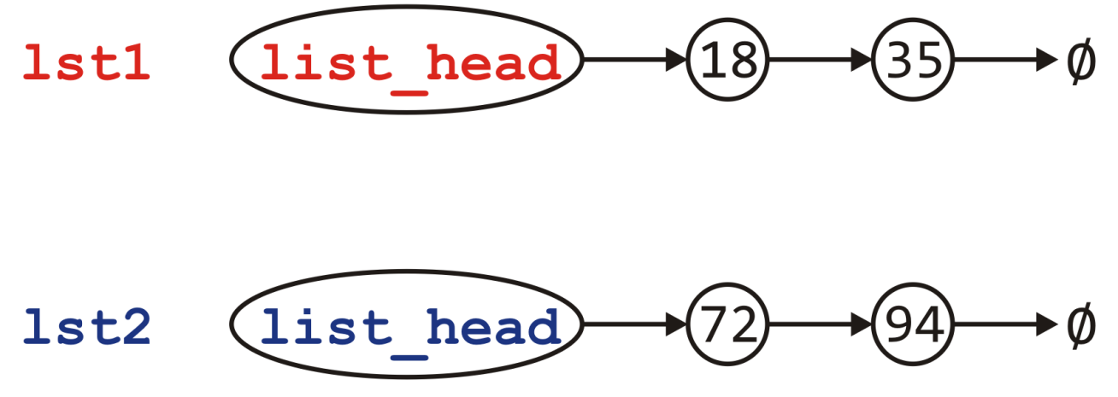
Assignment
Visually, we are doing the following:
List &List::operator = ( List rhs ) {
swap( *this, rhs );
return *this;
}

Slide 124
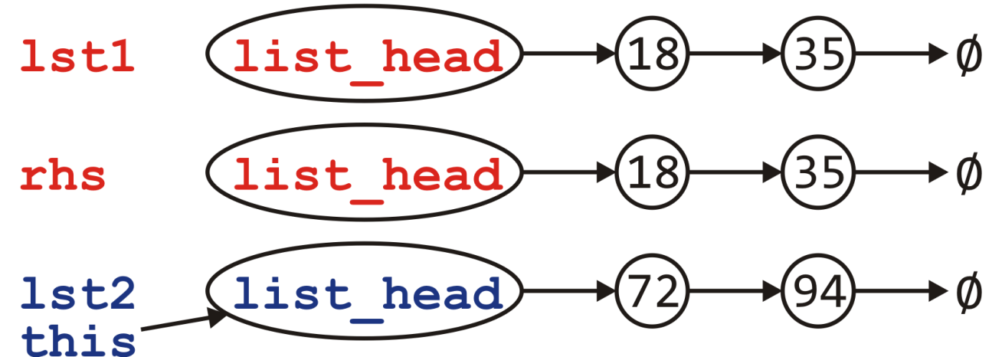
Assignment
Visually, we are doing the following:
Passed by value, the copy constructor is called to create rhs
List &List::operator = ( List rhs ) {
std::swap( *this, rhs );
return *this;
}

Slide 125
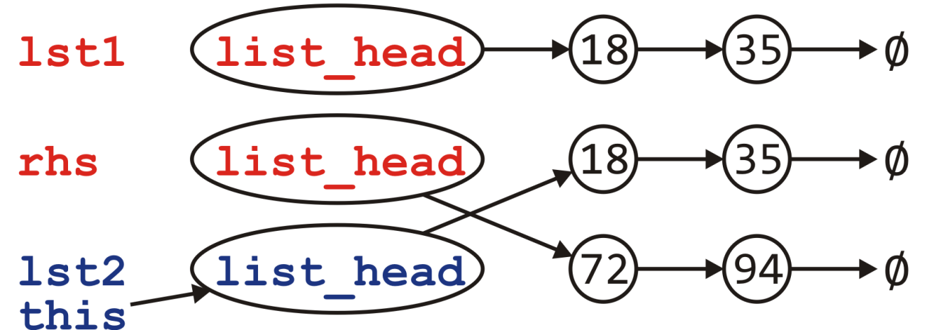
Assignment
Visually, we are doing the following:
Passed by value, the copy constructor is called to create rhs
Swapping the member variables of *this and rhs
List &List::operator = ( List rhs ) {
std::swap( *this, rhs );
return *this;
}

Slide 126
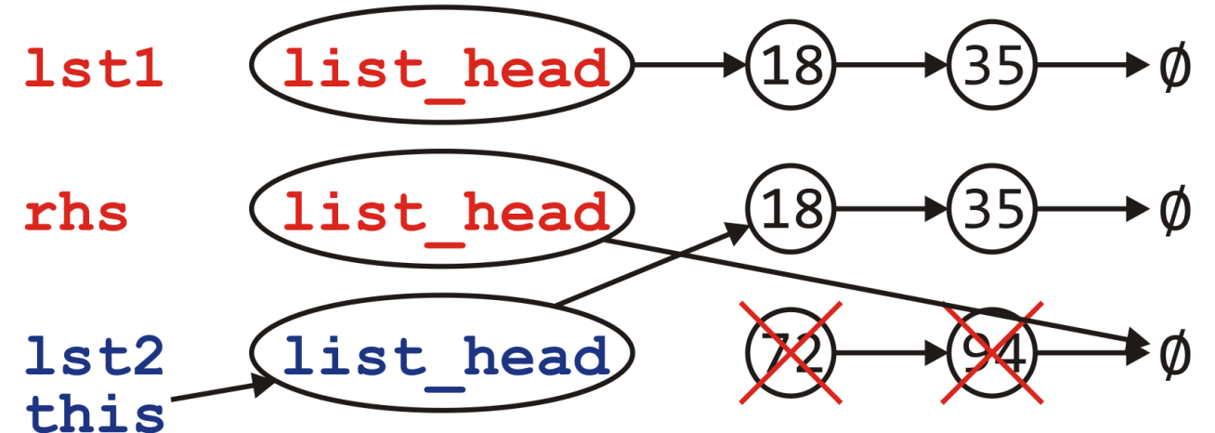
Assignment
Visually, we are doing the following:
Passed by value, the copy constructor is called to create rhs
Swapping the member variables of *this and rhs
We return and the destructor is called on rhs
List &List::operator = ( List rhs ) {
std::swap( *this, rhs );
return *this;
}

Slide 127
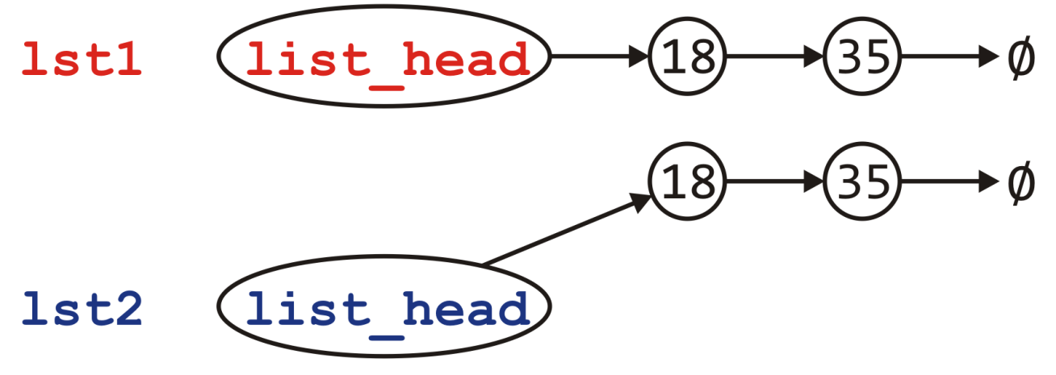
Assignment
Visually, we are doing the following:
Passed by value, the copy constructor is called to create rhs
Swapping the member variables of *this and rhs
We return and the destructor is called on rhs
Back in the calling function, the two lists contain the same values
List &List::operator = ( List rhs ) {
std::swap( *this, rhs );
return *this;
}

Slide 128
Assignment
Can we do better?
This idea of copy and swap is highly visible in the literature
If the copy constructor is written correctly, it will be fast
Is it always the most efficient?
Consider the calls to new and delete
Each of these is very expensive…
Would it not be better to reuse the nodes if possible?
Reference: Howard Hinnant

Slide 129
Assignment
Can we do better?
This idea of copy and swap is highly visible in the literature
If the copy constructor is written correctly, it will be fast
Is it always the most efficient?
Consider the calls to new and delete
Each of these is very expensive…
Would it not be better to reuse the nodes if possible?
No calls to new or delete
Reference: Howard Hinnant

Slide 130
Assignment
What is the plan?
First, we must pass by reference—no copying
Ensure we are not assigning something to itself
If the right-hand side is empty, it’s straight-forward:
Just empty this list
Otherwise, step through the right-hand side list and for each node there
If there is a corresponding node in this, copy over the value, else
There is no corresponding node; create a new node and append it
If there are any nodes remaining in this, delete them
Special case:
Dealing with the first node which is pointed to by list_head and not a next_node member variable

Slide 131
Assignment
The implementation must be more carefully written
List &List::operator = ( List const &rhs ) {
if ( this == &rhs ) {
return *this;
}
if ( rhs.empty() ) {
while ( !empty() ) {
pop_front();
}
return *this;
}

Slide 132
Assignment
if ( empty() ) {
list_head = new Node( rhs.front() );
} else {
begin()->node_value = rhs.front();
}
Node *this_node = list_head,
*rhs_node = rhs.begin()->next();
while ( rhs_node != 0 ) {
if ( this_node->next() == 0 ) {
this_node->next_node = new Node( rhs_node->value() );
this_node = this_node->next();
} else {
this_node->next();
this_node->node_value = rhs_node->value();
}
rhs_node = rhs_node->next();
}

Slide 133
Assignment
while ( this_node->next() != 0 ) {
Node *tmp = this_node->next();
this_node->next_node = this_node->next()->next();
delete tmp;
}
return *this;
}

Slide 134
Move Assignment
Similarly, we need a move assignment:
List &List::operator = ( List &&rhs ) {
while ( !empty() ) {
pop_front();
}
list_head = rhs.begin();
rhs.list_head = 0;
return *this;
}

Slide 135
Linked Lists
Thus, the complete class is:
class List {
private:
Node *list_head;
void swap( List & );
public:
// Constructors and destructors
List();
List( List const & );
List( List && );
~List();
// Assignment operators
List &operator = ( List );
List &operator = ( List && );
// Accessors
bool empty() const;
int size() const;
int front() const;
Node *begin() const;
Node *end() const;
int count( int ) const;
// Mutators
void push_front( int );
int pop_front();
int erase( int );
};

Slide 136
Linked Lists
With asymptotic analysis of linked lists, we can now make the following statements:
* these become Θ(1) if we have a tail pointer
 | front | arbitrary | back
insert | Θ(1) | O(n) | Θ(n) *
access | Θ(1) | O(n) | Θ(n) *
erase | Θ(1) | O(n) | Θ(n)

Slide 137
Efficient Allocation
In all our examples, we use new and delete to allocate and deallocate nodes
This is exceptionally inefficient
It requires the operating system to allocate and deallocate memory with each node
Could we pre-allocate memory for a number of nodes and use them?
Suggestions?

Slide 138
Efficient Allocation
Consider the following strategy:
Allocate an array of N nodes
The address of the node is the index in the array
Therefore, next_node is an integer
Each time we require a new node, use one of these
If all the nodes in the block are used, we double the size of the array of the allocated nodes and move the objects over
To track which nodes are being used, we could use a stack
Initially, the stack would contain the values from 0 to N – 1
If we need an unused entry in the array, pop the next index from the top of the stack
If we no longer are using a node, push its index onto the stack

Slide 139
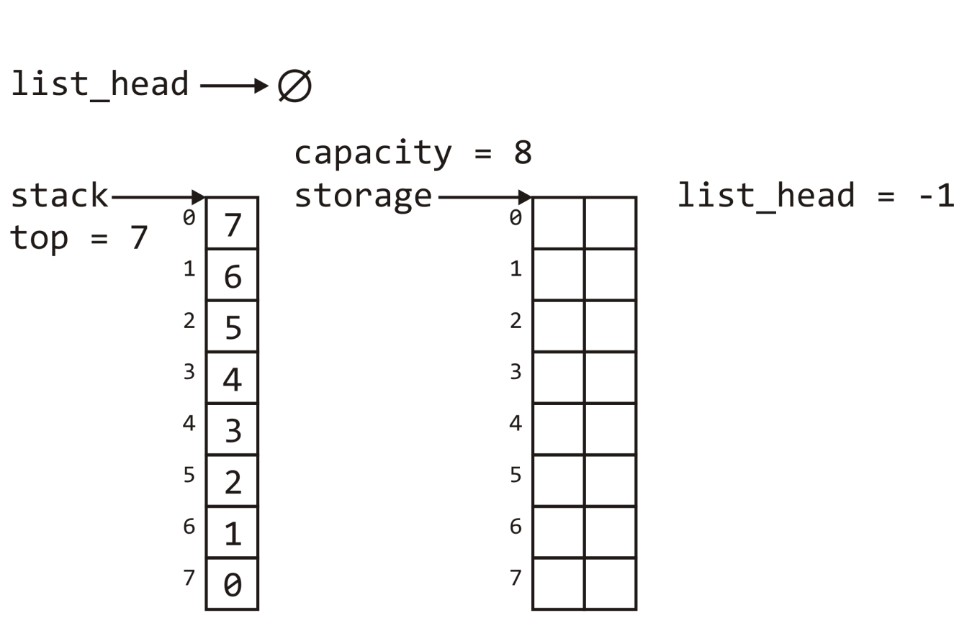
Efficient Allocation
We would use -1 to represent the end of the list
More intelligently, we would define a constant:
int const NULL = -1;

Slide 140
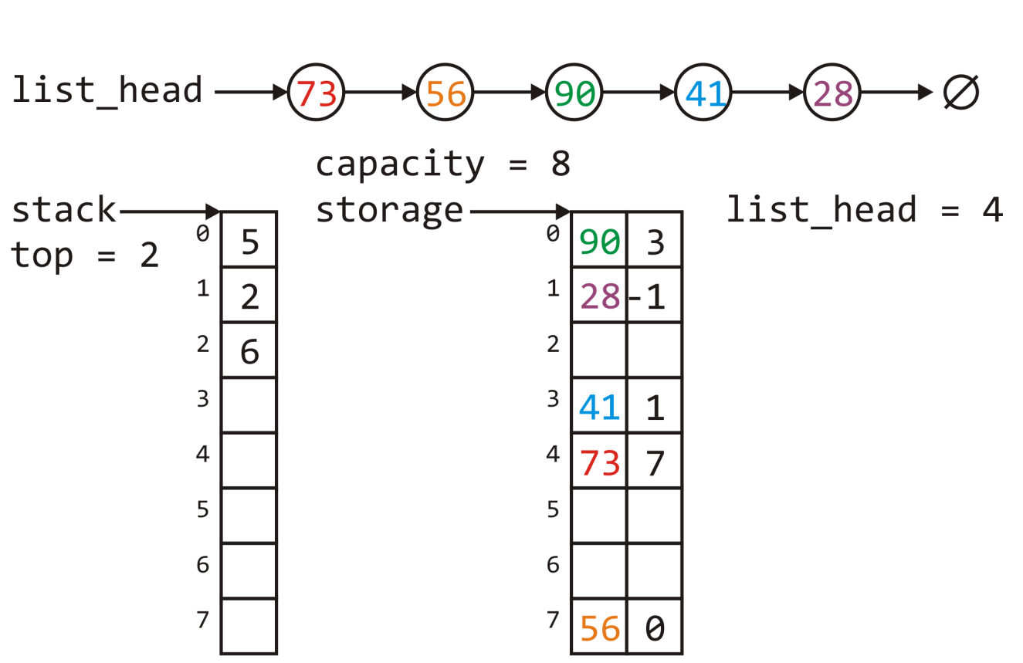
Efficient Allocation
After a few calls to push_front and erase, we could end up with an allocation as follows:

Slide 141
Efficient Allocation
If we wanted to call pop_front, we would:
Push 4 onto the stack
Updated list_head to be 7

Slide 142
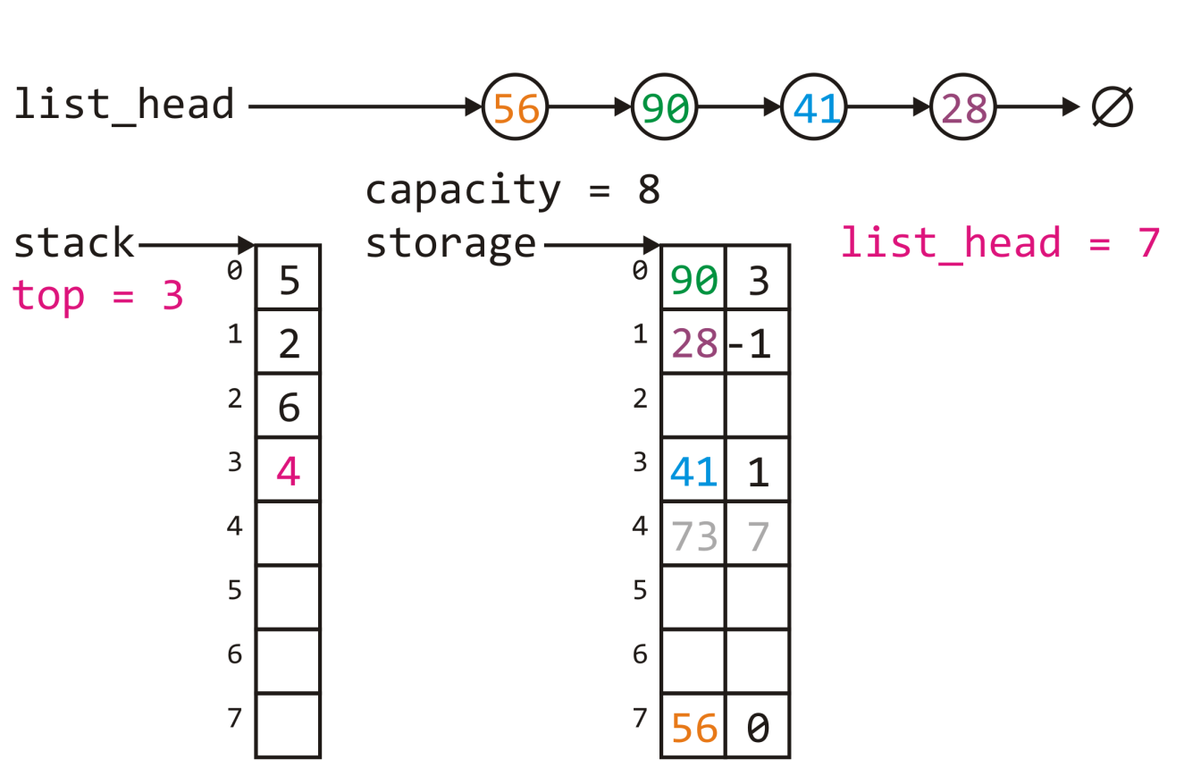
Efficient Allocation
If we wanted to call pop_front, we would:
Push 4 onto the stack
Updated list_head to be 7
The result:

Slide 143
Efficient Allocation
If we wanted to push 99 onto the front of this list, we would:
Get to top of the stack, 6
At this location, place 99 and the current value of list_head
Update list_head = 6

Slide 144
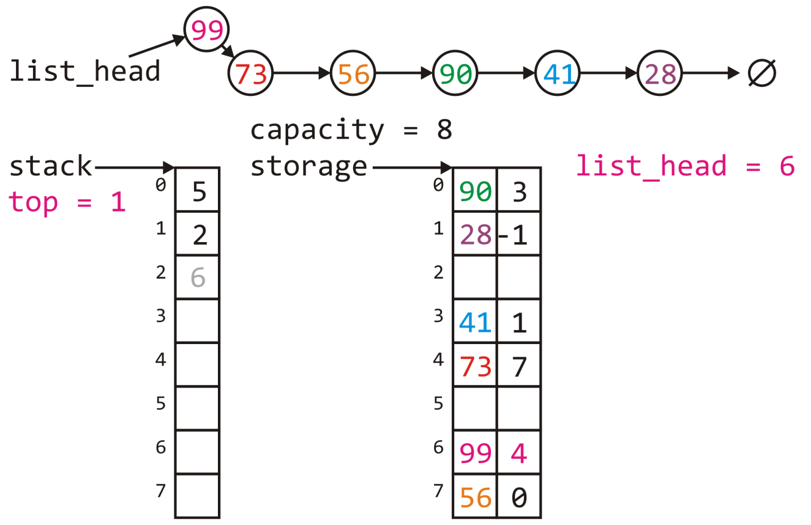
Efficient Allocation
This results in:

Slide 145
Efficient Allocation
Originally, we would require n calls to new() to insert n objects into the linked list
This updated allocation strategy requires lg(n) calls to new and n copies

Slide 146
Summary
We have considered the implementation of linked lists in C++
Aspects of the Node class
Accessors and mutators
The implementation of various member functions
Stepping through a linked list
Defining the copy and assignment operator
Defining move constructors and move assignment operators
Discussed efficiencies

Slide 147
References
Donald E. Knuth, The Art of Computer Programming, Volume 3: Sorting and Searching, 2nd Ed., Addison Wesley, 1998, §5.4, pp.248-379.
Wikipedia, https://en.wikipedia.org/wiki/Linked_list
http://stackoverflow.com/error?aspxerrorpath=/questions/8848363/rvalue-reference-with-assignement-operator
These slides are provided for the ECE 250 Algorithms and Data Structures course. The material in it reflects Douglas W. Harder’s best judgment in light of the information available to him at the time of preparation. Any reliance on these course slides by any party for any other purpose are the responsibility of such parties. Douglas W. Harder accepts no responsibility for damages, if any, suffered by any party as a result of decisions made or actions based on these course slides for any other purpose than that for which it was intended.

