Slide 1
Turing completeness

Slide 2
Outline
In this topic, we will:
Ask what is computable
Describe a Turing machine
Define Turing completeness

Slide 3
Computability
How do we define what is and what is not computable?
Is it possible to write a C++ function which cannot be written using Pascal, Java, or C#, or vice versa?
For example, do pointers (not available in Java) make C++ more powerful than Java?
Is BASIC really that bad?

Slide 4
Computability
Consider INTERCAL
16-bit integers .1 … .65535
32-bit integers ,1 … ,65535
Arrays of 16-bit integers :1 … :65535
Arrays of 32-bit integers ;1 … ;65535
Each variable has its own stack
You can push the current value onto the stack, or pop back a previous value
There are five operations: interleave, select, and, or, xor
Can you do everything you do in C in INTERCAL and vice versa?

Slide 5
Computability
Does computability depend on the processor?
The VAX had a machine instruction POLY for polynomial evaluation using Horner’s rule
Is the instruction set of the Intel Core 2 processor significantly different from the Motorola MC6800?

Slide 6
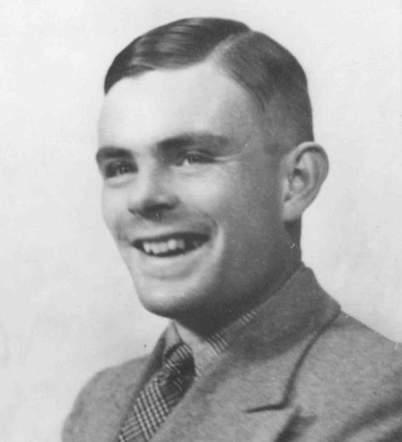
Computability
To study computability, Alan Turing developed a simple and basic but surprisingly powerful symbol-manipulating device:
He called it the a-machine (for automatic)
It has since been christened the Turing machine
First described in 1936
Five years before the first computer (the Z3)

Slide 7
Computability
The Turing machine has four components:
An arbitrary-length tape
Divided into linearly-ordered entries
Each entry is from a finite alphabet Γ which usually includes a blank B
In this example, Γ = {B, 0, 1}

Slide 8
Computability
The Turing machine has four components:
An arbitrary-length tape
A head that can
Read a symbol off the tape,
Write a symbol to the tape, and/or
Move to the next entry to the left or the right

Slide 9
Computability
The Turing machine has four components:
An arbitrary-length tape
A head
A state
The state is one of a finite set of symbols Q
In this example, Q = {b, c, e, f}
The initial state of the machine is denoted q₀ ∈ Q
Certain states may halt the computation

Slide 10
Computability
The Turing machine has four components:
An arbitrary-length tape
A head
A state
A transition table
Q × Γ → Q × Γ × {L, R, N}
L moves one entry to the left
R moves one entry to the right
N indicates no shift
There is at most one entry in this table for each pair of current settings
Current |  | New
State | Symbol read | State | Symbol to write | Direction
b | B | c | 0 | R
c | B | e | B | R
e | B | f | 1 | R
f | B | b | B | R

Slide 11
Computability
Currently, the state is e and the symbol under the head is B
Current |  | Next
State | Symbol read | State | Symbol to write | Direction
b | B | c | 0 | R
c | B | e | B | R
e | B | f | 1 | R
f | B | b | B | R

Slide 12
Computability
The transition table dictates that the machine must:
The state is set to f
Print symbol 1 onto the tape
Move one entry to the right
Current |  | Next
State | Symbol read | State | Symbol to write | Direction
b | B | c | 0 | R
c | B | e | B | R
e | B | f | 1 | R
f | B | b | B | R

Slide 13
Computability
The state and symbol under the head have been updated
Current |  | Next
State | Symbol read | State | Symbol to write | Direction
b | B | c | 0 | R
c | B | e | B | R
e | B | f | 1 | R
f | B | b | B | R

Slide 14
Computability
The state is f and the symbol under the head is the blank B:t
The state is set to b
A blank is printed to the tape
Move one entry to the right
Current |  | Next
State | Symbol read | State | Symbol to write | Direction
b | B | c | 0 | R
c | B | e | B | R
e | B | f | 1 | R
f | B | b | B | R

Slide 15
Computability
Again, the state is b, the symbol a blank, and therefore:
Set the state to c
Print the symbol 0 to the tape
Move one entry to the right
Current |  | Next
State | Symbol read | State | Symbol to write | Direction
b | B | c | 0 | R
c | B | e | B | R
e | B | f | 1 | R
f | B | b | B | R

Slide 16
Computability
The result is the state c and a blank symbol is under the head:
Set the state to e
Write a blank to the tape
Move one entry to the right
Current |  | Next
State | Symbol read | State | Symbol to write | Direction
b | B | c | 0 | R
c | B | e | B | R
e | B | f | 1 | R
f | B | b | B | R

Slide 17
Computability
The result is the state e and a blank symbol B under the head
This is the state we were in four steps ago
This machine never halts...
Current |  | Next
State | Symbol read | State | Symbol to write | Direction
b | B | c | 0 | R
c | B | e | B | R
e | B | f | 1 | R
f | B | b | B | R

Slide 18
Computability
This was Turing’s first example in his 1937 paper On Computable Numbers, with an Application to the Enscheidungsproblem
It demonstrates a machine which can compute the sequence
0 1 0 1 0 1 0 ···

Slide 19
Computability
This Turing machine adds two numbers:
Tape symbols: Γ = {B, 1}
States: Q = {a, b, c, d, e, H}
Initial state: q₀ = a
Halting state: H
Note there is exactly one entry for each pair in Q \ {H} × Γ
It may not be necessary to have one for each, but you cannot have more than one transition for a given state and symbol
Current |  | Next
State | Symbol read | State | Symbol to write | Direction
a | B | a | B | R
a | 1 | b | 1 | R
b | B | c | 1 | R
b | 1 | b | 1 | R
c | B | d | B | L
c | 1 | b | 1 | R
d | B | d | B | L
d | 1 | e | B | L
e | B | H | B | R
e | 1 | e | 1 | L

Slide 20
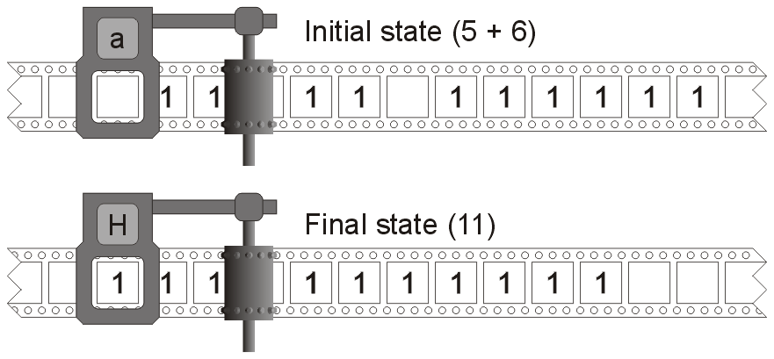
Computability
After 22 steps, a group of five ones and a group of six ones are merged into a single group of eleven ones
This represents 5 + 6 = 11

Slide 21
Computability
What’s more remarkable is the Turing-Church thesis:
For any algorithm which can be calculated given arbitrary amounts of time and storage, there is an equivalent Turing machine for that algorithm
This is a hypothesis; however, almost a century has not produced any counter-examples
A computational system
e.g., a programming language compiled into machine code and run on a processor
is said to be Turing complete if it can compute every function computable on a Turing machine

Slide 22
Computability
The converse appears to be true, too:
Any function in any Turing complete computational system can also be computed using an appropriate Turing machine
Modern computers are faster, but they are not more powerful than a Turing machine
Thus, the Turing machine well defines the concept of computability as it is understood today

Slide 23
Computability
Looking at some of the first computers, not all were Turing complete:
Incidentally, Zuse was a civil engineer...
Name | Date | Place | Decimal/ Binary | Electronic | Programmable | Turing Complete
Zuse Z3 | 1941 | Germany | binary | No | Yes | Yes
Alanasoff-Berry Computer | 1941 | USA | binary | Yes | No | No
Colossus | 1943 | UK | binary | Yes | Partially | No
IBM ASCC | 1944 | USA | decimal | No | Yes | Yes
ENIAC | 1944 | USA | decimal | Yes | Partially | Yes
 | 1948 | USA | decimal | Yes | Yes | Yes
http://en.wikipedia.org/wiki/Computers

Slide 24
Computability
All modern programming languages are also Turing equivalent
thus, BASIC and C# are no worse than Java or C++

Slide 25
Computability
Some are, practically speaking, less useful:
this is a Turing-complete language with eight single-character commands
for the C++ equivalence, declare char *ptr;
Char | Operation | C++ Equivalent
> | increment the pointer | ++ptr;
< | decrement the pointer | --ptr;
+ | increment the byte at the pointer | ++(*ptr);
– | decrement the byte at the pointer | --(*ptr);
. | output the value the byte | putchar(*ptr);
, | input one byte and store it at the pointer | *ptr = getchar();
[ | jump forward to the command after the matching ] if the byte at the pointer is zero | while( *ptr ) {
] | jump back to the command after the matching [ if the byte at the pointer is nonzero | }
http://en.wikipedia.org/wiki/Brainfuck

Slide 26
References
Wikipedia, http://en.wikipedia.org/wiki/Computability
Wikipedia, http://en.wikipedia.org/wiki/Turing_machine
Wikipedia, http://en.wikipedia.org/wiki/Church–Turing_thesis
These slides are provided for the ECE 250 Algorithms and Data Structures course. The material in it reflects Douglas W. Harder’s best judgment in light of the information available to him at the time of preparation. Any reliance on these course slides by any party for any other purpose are the responsibility of such parties. Douglas W. Harder accepts no responsibility for damages, if any, suffered by any party as a result of decisions made or actions based on these course slides for any other purpose than that for which it was intended.

