Slide 1
Stochastic algorithms

Slide 2
Outline
In this topic, we will cover:
Concepts about random numbers
Random number generators
Monte Carlo methods
Monte Carlo integration
Randomized quicksort
Skip lists

Slide 3
Stochastic
The word stochastic comes from Greek: στόχος,
The relative translation is a word describing a target stick for archery practices
The pattern of arrow hits represents a stochastic process
http://marshfieldrodandgunclub.com/Archery

Slide 4
Random Numbers
I flipped a coin 30 times:
HTHTHHHTTTHHHTHTTTTTTHHHHHHTTH
One may almost suggest such a sequence is not random: what is the probability of getting 6 tails and then 6 heads?
Unfortunately, this is exactly what I got with the first attempt to generate such a sequence, and is as random a sequence as I can generate
Humans see patterns where none are…

Slide 5
Random Numbers
Generating random numbers is difficult…
A small radioactive source is believed to have been used to generate the Rand Corporation's book A Million Random Digits with 100,000 Normal Deviates
Called an electronic “roulette wheel”
uses a “random frequency pulse source”
20,000 lines with 50 decimal digits per line divided into five columns of ten digits each
Available at the low price of USD $90
http://www.wps.com/projects/million/index.html

Slide 6
Random Numbers
Problem: humans will not open the book to a random page...
The instructions include:
“...open the book to an unselected page...
blindly choose a 5-digit number; this
number reduced modulo 2 determines the
starting line; the two digits to the right...
determine the starting column...”
73735 45963 78134 63873
02965 58303 90708 20025
98859 23851 27965 62394
33666 62570 64775 78428
81666 26440 20422 05720
15838 47174 76866 14330
89793 34378 08730 56522
78155 22466 81978 57323
16381 66207 11698 99314
75002 80827 53867 37797
99982 27601 62686 44711
84543 87442 50033 14021
77757 54043 46176 42391
80871 32792 87989 72248
30500 28220 12444 71840
Column: 81978 / 20000 = 4
Line: 81978 % 20000 = 01978

Slide 7
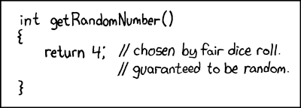
Random Numbers
Strategy 0:
Roll a die
Not very useful, especially for computers
http://xkcd.com/221/

Slide 8
Random Numbers
Strategy 1:
Use the system clock
This is very useful for picking one 5-decimal-digit number about once a day
It is also very poor for picking many random numbers, as any program doing so will most likely do so periodically

Slide 9
Random Numbers
Strategy 2:
Use the keyboard
Certain encryption programs use intervals between keystrokes to generate random numbers
The user is asked to generate some text which is then analyzed
Random, but slow and tedious

Slide 10
Random Numbers
Our best hope is to generate (using mathematics) a sequence of numbers which appears to be random
A sequence of numbers which appears to be random but is not is said to be pseudo-random
We will look at one random number generator

Slide 11
Linear Congruential Generators
The first pseudo-random number generator which we will look as described by Lehmer in 1951
It is called a linear congruential generator because:
it uses a linear multiplier
it produces objects of the same shape

Slide 12
Linear Congruential Generators
Select an initial value x₀ (called the seed)
Choose two fixed values A > 0 and M > 1
Given x_{i}, calculate
x_{i + 1} = Ax_{i} mod M
There are some restrictions on these values:
M should be prime
A and x₀ should both be relatively prime to M

Slide 13
Linear Congruential Generators
For example, if M = 17, A = 6, and x₀ = 3, the first 17 numbers are:
3, 1, 6, 2, 12, 4, 7, 8, 14, 16, 11, 15, 5, 13, 10, 9, 3
The 17th number equals the first, so after this, the sequence will repeat itself
A different seed generates a different sequence, e.g., with x₀ = 4 we get
4, 7, 8, 14, 16, 11, 15, 5, 13, 10, 9, 3, 1, 6, 2, 12, 4
however, it is only a shift...

Slide 14
Linear Congruential Generators
The choice of A will affect quality of the sequence
Given the previous seed and modulus, but if we choose A = 2, we get the sequence
3, 6, 12, 7, 14, 11, 5, 10, 3, 6, 12, 7, 14, 11, 5, 10, 3
which you may note repeats itself earlier than when we used A = 2

Slide 15
Linear Congruential Generators
If we choose the prime M = 2³¹ – 1, then one value of A recommended by Lehmer is A = 48271
This generates a sequence of 2³¹ – 2 unique numbers before it repeats
We can then use modulus to map this onto a smaller range, or division

Slide 16
Linear Congruential Generators
A word on linear congruential generators and the like:
“Any one who considers arithmetical methods
of producing random digits is, of course, in a
state of sin...” John von Neumann
The point here is, these methods produce pseudo-random numbers and not actually random numbers

Slide 17
Linear Congruential Generators
The C++ standard library comes equipped with the int rand() function
Don’t use it...
Most C++ standard libraries come with:
Function Name | Range
long lrand48() | 0, 1, ..., 2³¹ – 1
long mrand48() | –2³¹, ..., 2³¹ – 1
double drand48() | [0, 1)

Slide 18
Linear Congruential Generators
By default, these use a 48-bit seed with x₀ = 0 and
x_{k + 1} = (Ax_{k} + C) mod M
where
A = 25214903917 10111011110111011001110011001101101₂
C = 11 1011₂
M = 2⁴⁸
and where the most significant bits of x_{k + 1} are used

Slide 19
Linear Congruential Generators
All three generates use the same value
Suppose that x_{k + 1} is the value is the following 48 bits:

Slide 20
Linear Congruential Generators
lrand48() uses the most significant 31 bits
Recall the avalanche effect

Slide 21
Linear Congruential Generators
mrand48() uses the most significant 32 bits
This is a simple cast: the 1st bit is the sign bit
This number is positive—use 2s complement to get the value

Slide 22
Linear Congruential Generators
drand48() uses all 48 bits and treats it as a fractional value in [0, 1)
The mantissa stores 52 bits with an implied leading 1.
The last five bits will be 0

Slide 23
Linear Congruential Generators
These can be easily mapped onto different ranges:
long lrand48ab( long a, long b ) {
return a + lrand48() % (b – a + 1);
}
double drand48ab( double a, double b ) {
return a + drand48()*(b – a);
}

Slide 24
Other Pseudo-Random Number Generators
Other random number generators:
In 1995, George Marsaglia published his diehard battery of statistical tests for pseudo-random number generators
long random() | Non-linear additive feedback RAND_MAX varies from platform to platform
Mersenne Twister | Matrix linear recurrence over a finite binary field F₂ Excellent for simulations, poor for cryptography, long periods By Matsumoto and Nishimura in 1997
Blum-Blum-Shub | Slow but good for cryptography x_{k + 1} = x_{k}² mod pq where p and q are large prime numbers By Blum, Blum and Shub in 1986

Slide 25
Linear Congruential Generators
The course text discusses a few further features which are of note:
Do not attempt to come up with your own random number generators: use what is in the literature
Using the given value of M
00111111111111111111111111111111₂ = 3FFF₁₆
calculating Ax_{i} may cause an overflow
It is possible to program Ax_{i} mod M to avoid this

Slide 26
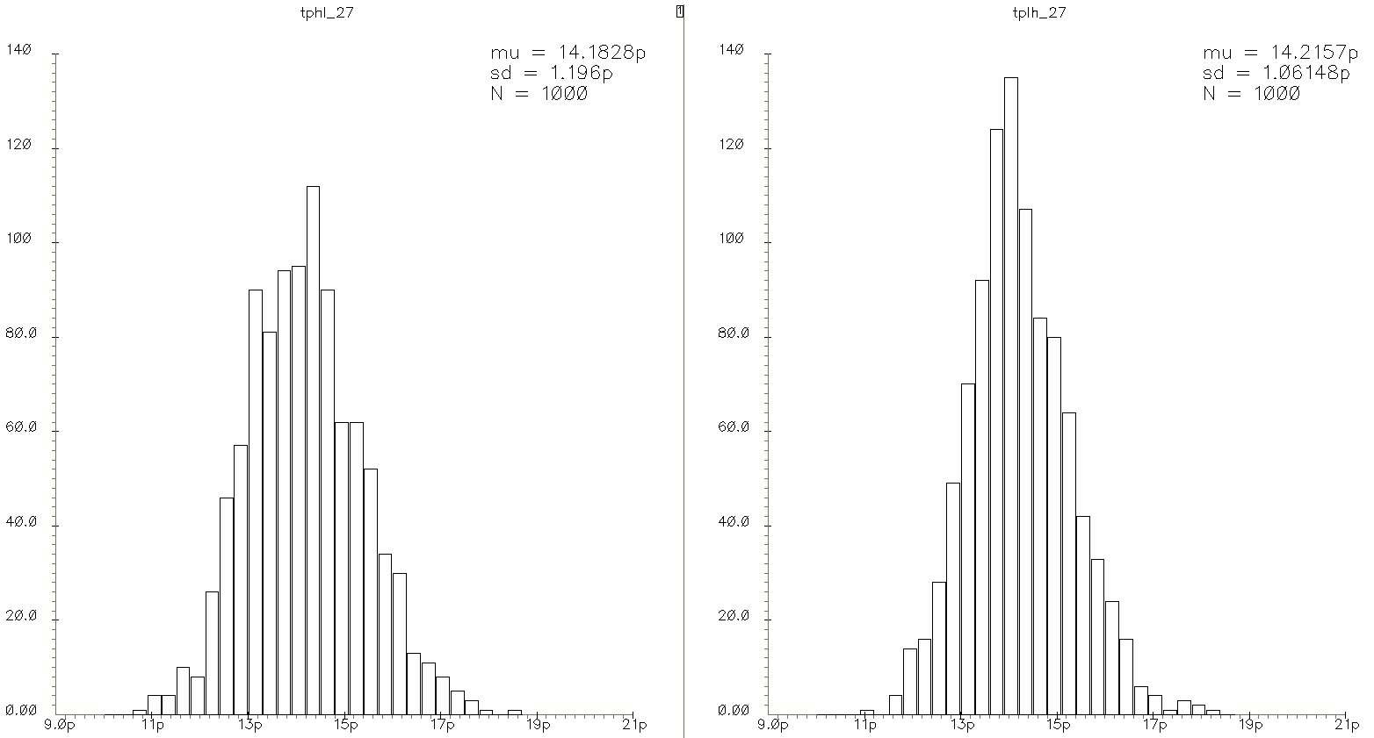
Normal Distributions
If you take 1000 similar inverters and measure their delays, you will find that the delay are not all the same:
All will be close to some expected value (the mean μ)
Most will be close to μ while some will be further away
David Rennie, ECE 437

Slide 27
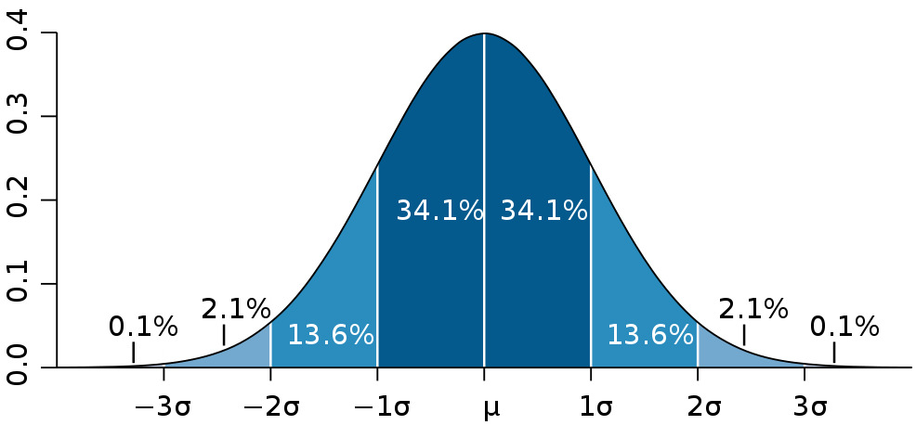
Normal Distributions
The spread is defined by the standard deviation σ
If the mean and standard deviation of a manufacturing process is known, then
99.7 % will fall within 3σ of the mean
99.993 % will fall within 4σ of the mean
Many natural systems follow such distributions
The variability in a resistor or capacitor, etc.
David Rennie, ECE 437

Slide 28
Normal Distributions
A standard normal has a mean μ = 0 and standard deviation σ = 1
David Rennie, ECE 437

Slide 29
Normal Distributions
There are more efficient algorithms:
The Marsaglia polar method is efficient, is to choose two pseudo-random numbers u₁ and u₂ from the uniform distribution on (–1, 1) and if s = u₁² + u₂² < 1, calculate
both of which are independent (one gives no information about the other) and normally distributed
If these functions are not available, calculate twelve pseudo-random numbers from the uniform distribution on [0, 1] and subtract 6
The distribution approximates a normal distribution via the central limit theorem

Slide 30
Normal Distributions
Recall the Greek origin of the word stochastic
Here are two archery targets with ten hits generated using the Marsaglia polar method
for ( int i = 0; i < 10; ++i ) {
double x, y, s;
do {
x = 2.0*drand48() - 1;
y = 2.0*drand48() - 1;
s = x*x + y*y;
} while ( s >= 1.0 );
s = std::sqrt( -2.0*std::log(s)/s ); // log(x) is the natural logarithm
cout << "(" << x*s << ", " << y*s << ")" << std::endl;
}
Notes:
The second has half the standard deviation of the first.

Slide 31
Monte Carlo Methods
Consider the following operations:
integration, equality testing, simulations
In some cases, it may be impossible to accurately calculate correct answers
integrals in higher dimensions over irregular regions
simulating the behaviour of the arrival of clients in a client-server model

Slide 32
Monte Carlo Methods
An algorithm which attempts to approximate an answer using repeated sampling is said to be a Monte Carlo method
Conor Ogle
http://www.gouv.mc/

Slide 33
Monte Carlo Methods
Consider the problem of determining if p is a prime number
If p is not prime, then given a random number 1 < x ≤ 2 ln²(p), the Miller-Rabin primality test has at least a 75% chance of showing that p is not prime
Uses Fermat’s little theorem (not x^{n} + y^{n} = z^{n})
Therefore, test n different integers, and the probability of not being able to show that a composite p is not prime is 1/4^{n}

Slide 34
Monte Carlo Integration
We will look at a technique for estimating an integral on irregular region V, i.e.,
Here, V may be a region in R^{n} where the dimension could be reasonably high
It may either be unreasonable or impossible to perform an exact approximation using calculus
If the dimension is too high, it may be unreasonable to even us a uniform grid of points

Slide 35
Monte Carlo Integration
To solve this, the average value of a function is
Solving for the integral, we get:
Thus, if we can approximate the average value , we can approximate the integral

Slide 36
Monte Carlo Integration
Similarly, suppose we wish to integrate a scalar-valued function f(v) over a region
The formula for the average value is the same:
Solving for the integral, we get
If we can approximate both the average value and the volume of the region |V|, we can approximate the integral

Slide 37
Monte Carlo Integration
First, we will look at the easier problem of determining the volume of this region by estimating:
Suppose we know that V ⊆ [0, 1]^{n} = S for some dimension n
Let |V| be the volume of the region
In this case, given our previous algorithm, we can easily pick a random point in S by creating a vector v = (x₁, ..., x_{n})^{T} where each x_{k} ∈ [0, 1]
Create M random vectors in S, and count the number m that fall inside V

Slide 38
Monte Carlo Integration
If the distribution of the vectors v ∈ S is random, then the proportion m/M of these vectors in V will be approximately the ratio |V|/|S|, that is, the volume of V over the volume of S
Therefore

Slide 39
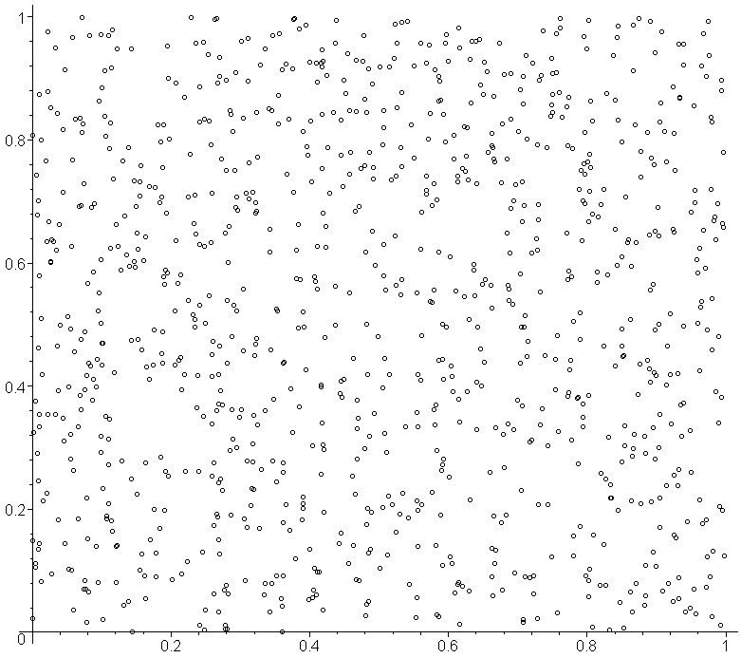
Monte Carlo Integration
For example, let us find the area of a circle
Choose 1000 points in [0, 1] × [0, 1]:

Slide 40
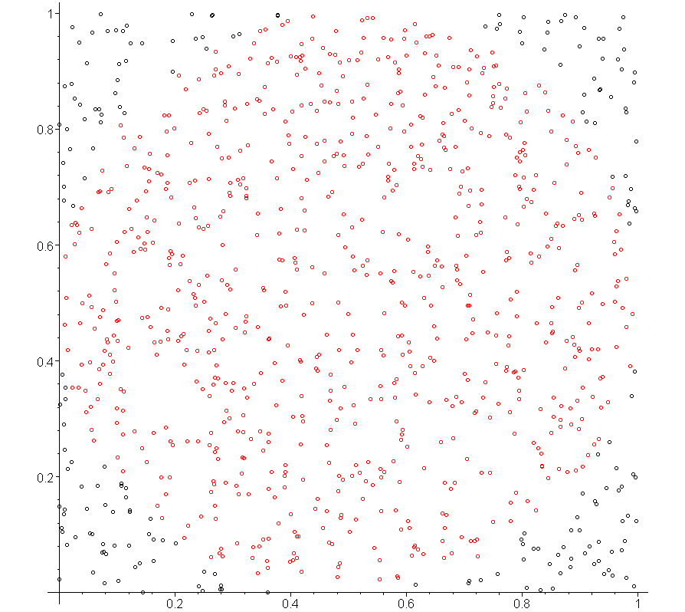
Monte Carlo Integration
If we only consider those points which are less than 0.5 distance from the center, we get:

Slide 41
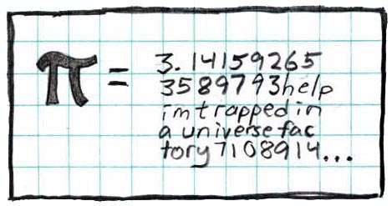
Monte Carlo Integration
By coincidence, the number of points within the given circle was exactly 800 (in this case)
By our algorithm, this would mean that an approximation of the area of that circle is 800/1000 = 0.8
The correct area is 0.25π ≈ 0.7853981635
0.8 is not that poor an approximation...
http://xkcd.com/10/

Slide 42
Monte Carlo Integration
Suppose we wanted to integrate the function
over the circle given in the previous region
For each point (x₁, x₂) that is in the circle, evaluate the function and average these
In this example, we have:

Slide 43
Monte Carlo Integration
In this case, the approximation of the integral is
To determine how well this algorithm works, use geometry, calculus and Maple

Slide 44
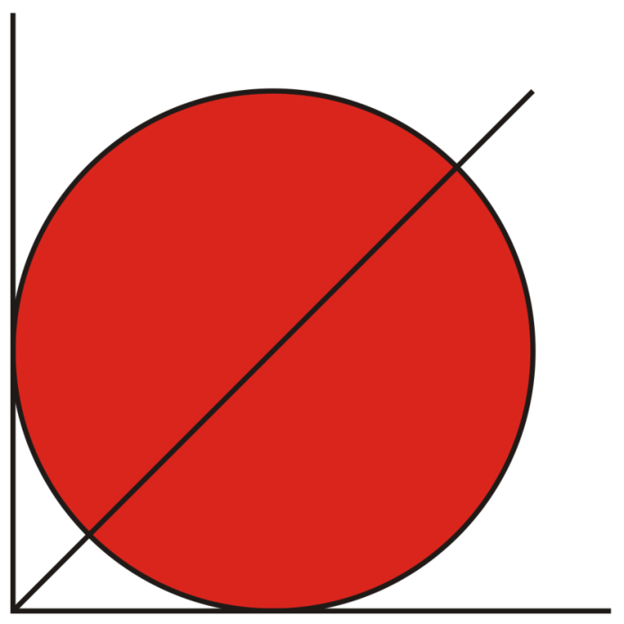
Monte Carlo Integration
The region we are integrating over has:
For any value of x such that 0 ≤ x ≤ 1,
We have that y runs from to
y
x

Slide 45
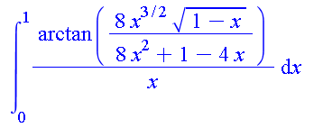
Monte Carlo Integration
> lcirc := 1/2 – sqrt(x - x^2);
ucirc := 1/2 + sqrt(x – x^2);
> int( int( 1/(x^2 + y^2), y = lcirc..ucirc ), x = 0..1 );
> evalf( % ); # Maple got one integral, we need numerical # algorithms for the second
2.1775860903
Our approximation:

Slide 46
Monte Carlo Integration
Our approximation was, again, reasonably close considering we did no calculus:
The relative error is 1.2 %

Slide 47
Monte Carlo Testing
Suppose you have created a reasonably complex IC
Your design will assume “ideal” characteristics
Reality is different: Consider the propagation delay of an inverter
David Rennie, ECE 437

Slide 48
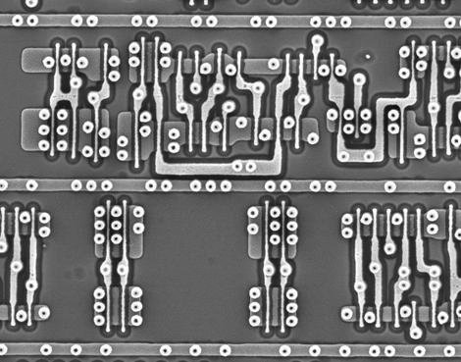
Monte Carlo Testing
Suppose you have created a reasonably complex IC
Accurate shapes will impossible for wiring and transistors
David Rennie, ECE 437

Slide 49
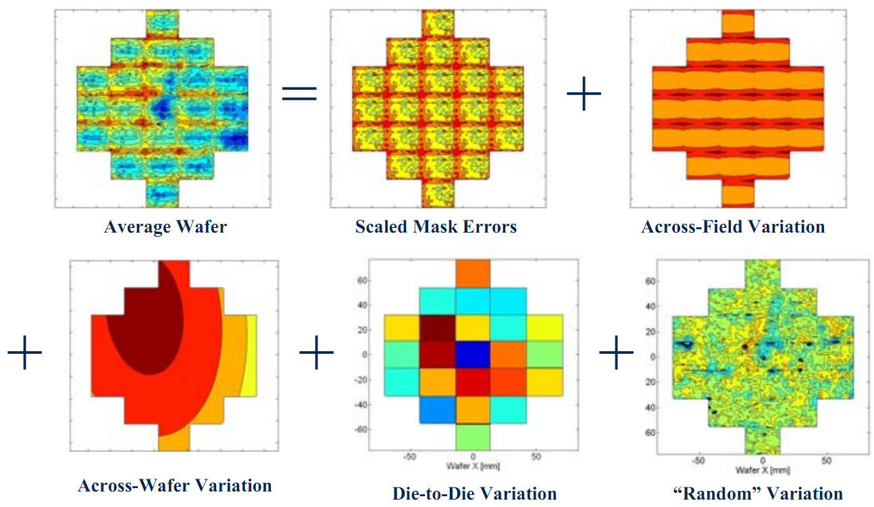
Monte Carlo Testing
Suppose you have created a reasonably complex IC
There will be variability in doping
Friedberg and Spanos, SPIE05

Slide 50
Monte Carlo Testing
Variability in digital gates will require designers to compensate for uncertainties
Possible solutions:
Use and design for the worst-case delay for each gate
Consequences: unnecessary, pessimistic and results in over-engineering
Use statistics
In ECE 316, you will learn about probability distributions
This, however, is computationally prohibitive

Slide 51
Monte Carlo Testing
A reasonable solution is to run a few hundred simulations where the parameter on the circuit elements, the delays, etc. are perturbed randomly within the expected distribution
Suppose one resistor is 120 Ω ± 5 Ω
For each simulation, create a standard normal variable x and then calculate 120 + 5x
This number will be a random sample with mean 120 and a standard deviation of 5
Run the simulation with this resistor at that particular random value

Slide 52
Randomized quicksort
Recall from quicksort that we select a pivot and then separate the elements based on whether they are greater than or less than the pivot
If we always choose the median of the first, middle, and last entries an array when performing quicksort, this gives us an algorithm for devising a list which will run in Θ(n²) time
The median-of-three algorithm, however, ensures that quicksort will not perform poorly if we pass it an already sorted list

Slide 53
Randomized quicksort
Building this worst-case would be difficult: for each sub-list, the median of the three must be either:
the second smallest number, or
the second largest number
For example, this will give us one iteration of the worst case:
1, 3, 4, 5, 6, 7, 8, 2, 9, 10, 11, 12, 13, 14, 15

Slide 54
Randomized quicksort
However, further if we want three steps to fail, we must have the following form:
1, 3, 5, 7, 8, 9, 10, 2, 4, 6, 11, 12, 13, 14, 15
1, 2, 3, 5, 7, 8, 9, 10, 4, 6, 11, 12, 13, 14, 15
1, 2, 3, 4, 5, 7, 8, 9, 10, 6, 11, 12, 13, 14, 15
Watching this pattern, we may hypothesize that the worst case scenario is the input
1, 3, 5, 7, 9, 11, 13, 2, 4, 6, 8, 10, 12, 14, 15

Slide 55
Randomized quicksort
If instead of choose three random numbers and take the median of those three, then we would still partition the points into two sub-lists which are, on average, of a ratio of size 2:1
This will still give us, on average, the expected run time

Slide 56
Randomized quicksort
However, because the choice of these three changes with each application of quicksort, we cannot create one sequence which must result in Θ(n²) behaviour
Thus, for a given list, it may run more slow than with the deterministic algorithm, but it will also speed up other cases, and we cannot construct one example which must fail

Slide 57
Skip lists
A linked list has desirable insertion and deletion characteristics if we have a pointer to one of the nodes
Searching a linked list with n elements, however is O(n)
Can we achieve some of the characteristics of an array for searching?

Slide 58
Skip lists
In an array, we have a means of finding the central element in O(1) time
To achieve this in a linked list, we require a pointer to the central element

Slide 59
Skip lists
Consider the following linked list...
searching is O(n):

Slide 60
Skip lists
Suppose, however, if we had an array of head pointers

Slide 61
Skip lists
First, we could point to every second node
but this is still O(n/2) = O(n)

Slide 62
Skip lists
We continue by pointing to every 4th entry

Slide 63
Skip lists
And then every 8th entry, and so on...

Slide 64
Skip lists
Suppose we search for 47
Following the 4th-level pointer, first 32 < 47 but the next pointer is 0

Slide 65
Skip lists
Suppose we search for 47
Continuing with the 3rd-level pointer from 32, 53 > 47

Slide 66
Skip lists
Suppose we search for 47
Continuing with the 2nd-level pointer from 32, 47 > 42 but 53 < 47

Slide 67
Skip lists
Suppose we search for 47
Continuing with the 1st-level pointer from 42, we find 47

Slide 68
Skip lists
Suppose we search for 24
With the 4th-level pointer, 32 > 24

Slide 69
Skip lists
Suppose we search for 24
Following the 3rd-level pointers, 4 < 24 but 32 > 24

Slide 70
Skip lists
Suppose we search for 24
Following the 2nd-level pointer from 14, 23 < 24 but 32 > 24

Slide 71
Skip lists
Suppose we search for 24
Following the 1st-level pointer from 23, 25 > 24
Thus, 24 is not in the skip list

Slide 72
Skip lists
Problem: in order to maintain this structure, we would be forced to perform a number of expensive operations
E.g., suppose we insert the number 8

Slide 73
Skip lists
Suppose that with each insertion, we don’t require that the exact shape is kept, but rather, only the distribution of how many next pointers a node may have
Instead, note that:
1 node has 4 next pointers
2 nodes have 3 next pointers
4 nodes have 2 next pointers, and
8 nodes have only 1 next pointer

Slide 74
Skip lists
If we are inserting into a skip list with 2^{h} – 1 ≤ n < 2^{h + 1}, we will choose a height between 1 and h such that the probability of having the height k is
We will choose a value between 1 and ⌊lg(n + 1)⌋
For example:
Table 1. For 7 ≤ n < 15 Table 2. For 15 ≤ n < 31
Height | Probability
1 | 4/7
2 | 2/7
3 | 1/7
Height | Probability
1 | 8/15
2 | 4/15
3 | 2/15
4 | 1/15

Slide 75
Skip lists
Table 2. For 15 ≤ n < 31
Value | k
0001 | 1
0010 | 2
0011 | 1
0100 | 3
0101 | 1
0110 | 2
0111 | 1
1000 | 4
1001 | 1
1010 | 2
1011 | 1
1100 | 3
1101 | 1
1110 | 2
1111 | 1
To get such a distribution, we need a number from 1 to 2^{h} – 1 and determine the location of the least-significant bit
that is equal to 1
Table 1. For 7 ≤ n < 15
Value | k
001 | 1
010 | 2
011 | 1
100 | 3
101 | 1
110 | 2
111 | 1

Slide 76
Skip List Example
This is relatively easy to program:
int new_height() const {
int n = 1 << height;
// Generate a random number between 1 and 2^height - 1, inclusive
int rand = ( lrand48() % (n - 1) ) + 1;
// Starting with the least-significant bit, check if it equals 1
for ( int mask = 1, k = 1; true; mask <<= 1, ++k ) {
// If the bit is set to 1, return k
if ( rand & mask ) {
return k;
}
}
// This should never be executed: requires #include <cassert>
assert( false );
}

Slide 77
Skip List Example
For example, suppose we insert the following numbers into a skip list:
94, 28, 15, 45, 31, 52, 88, 76

Slide 78
Skip List Example
The first number, 94, is placed into the list as if it were a sorted linked list

Slide 79
Skip List Example
The second number, 28, is also simply inserted into the correct location

Slide 80
Skip List Example
Now ⌊lg(3 + 1)⌋ = 2; hence for the third number, 15, we pick a random number between 1 and 3: 3 = 11₂

Slide 81
Skip List Example
Similarly with for the next number, 45, we pick a random number between 1 and 3: 1 = 01₂

Slide 82
Skip List Example
When we insert 31, the random number was 2 = 10₂:

Slide 83
Skip List Example
For 52, the random number is 3 = 11₂:

Slide 84
Skip List Example
Inserting 88, we find ⌊lg(7 + 1)⌋ = 3: 5 = 101₂:

Slide 85
Skip List Example
Inserting 76, the random number is 4 = 100₂:

Slide 86
Skip List Example
The problem with skip lists is that it doesn’t seem initially intuitive that it works
We need significantly larger examples
There is an implementation of skip lists at
http://ece.uwaterloo.ca/~ece250/Algorithms/Skip_lists/

Slide 87
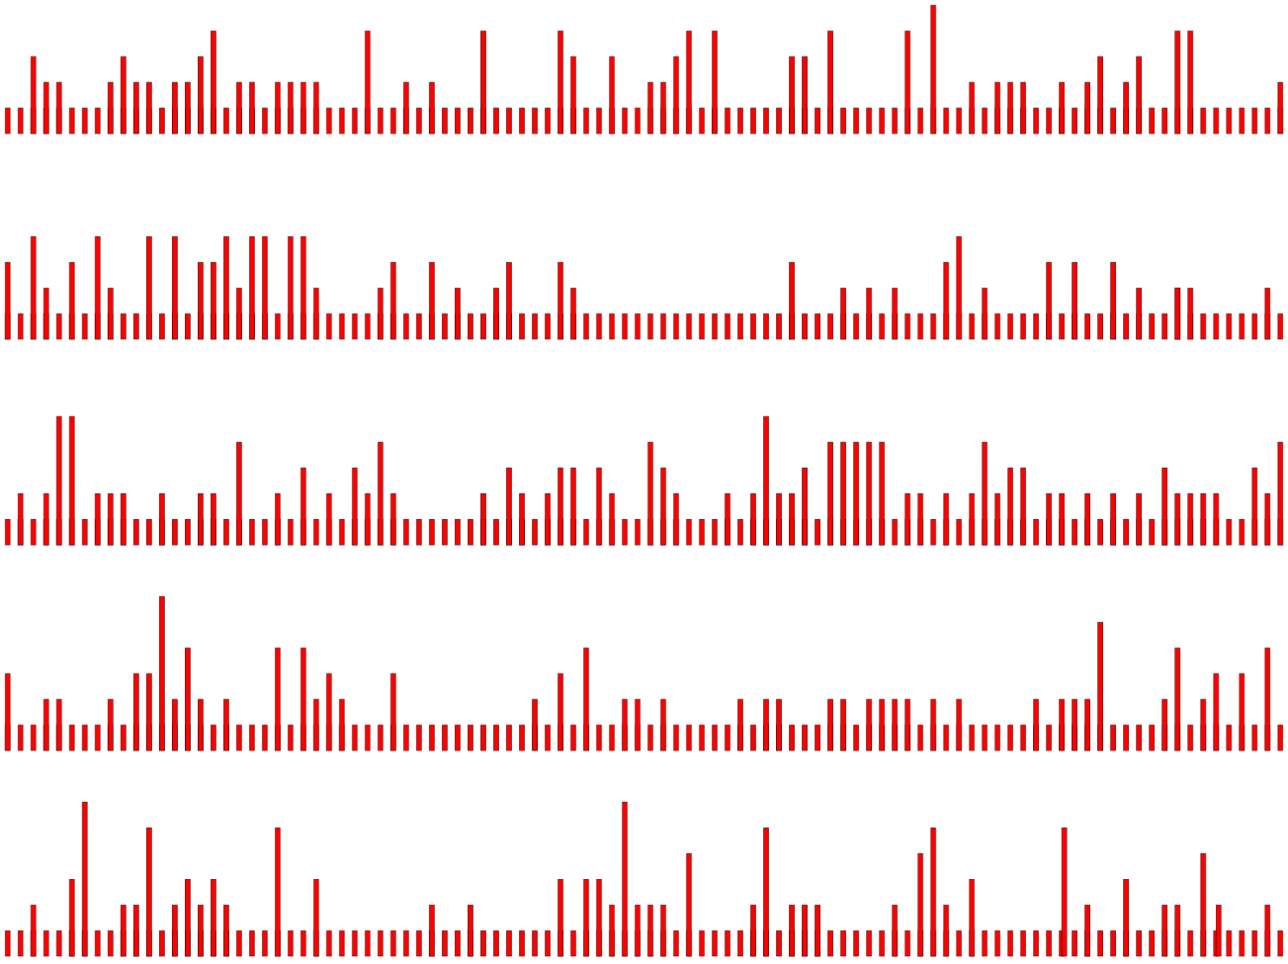
Skip List Example
The following are five examples of skip lists of randomly generated lists

Slide 88
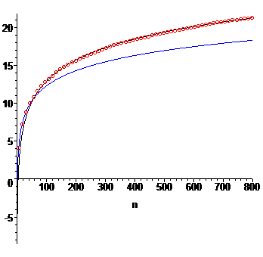
Skip List Search Time
This plot shows:
The average number of searches for a binary search (blue)
The average number of searches in a skip list with a best fitting line of the form a + b ln(n)

Slide 89
References
Wikipedia, http://en.wikipedia.org/wiki/Topological_sorting
[1] Cormen, Leiserson, and Rivest, Introduction to Algorithms, McGraw Hill, 1990, §11.1, p.200.
[2] Weiss, Data Structures and Algorithm Analysis in C++, 3rd Ed., Addison Wesley, §9.2, p.342-5.
These slides are provided for the ECE 250 Algorithms and Data Structures course. The material in it reflects Douglas W. Harder’s best judgment in light of the information available to him at the time of preparation. Any reliance on these course slides by any party for any other purpose are the responsibility of such parties. Douglas W. Harder accepts no responsibility for damages, if any, suffered by any party as a result of decisions made or actions based on these course slides for any other purpose than that for which it was intended.

