Slide 1
Connectedness

Slide 2
Outline
We will use graph traversals to determine:
Whether one vertex is connected to another
The connected sub-graphs of a graph

Slide 3
Connected
First, let us determine whether one vertex is connected to another
v_{j} is connected to v_{k} if there is a path from the first to the second
Strategy:
Perform a breadth-first traversal starting at v_{j}
While looping, if the vertex v_{k} ever found to be adjacent to the front of the queue, return true
If the loop ends, return false

Slide 4
Connected
Consider implementing a breadth-first traversal on a graph:
Choose any vertex, mark it as visited and push it onto queue
While the queue is not empty:
Pop to top vertex v from the queue
For each vertex adjacent to v that has not been visited:
Mark it visited, and
Push it onto the queue
This continues until the queue is empty
Note: if there are no unvisited vertices, the graph is connected,

Slide 5
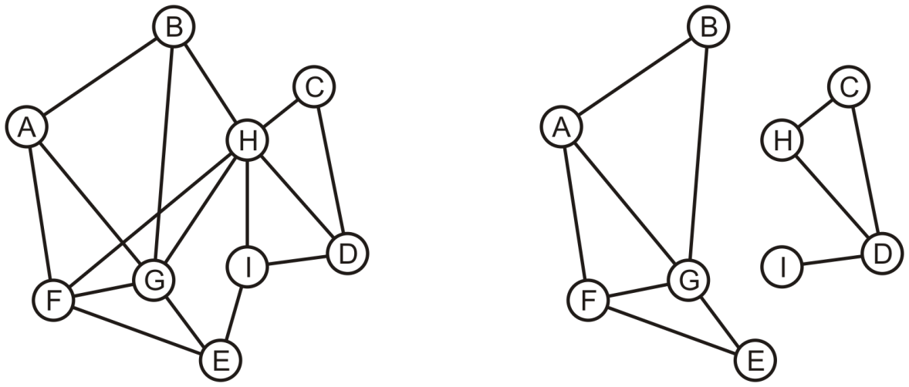
Determining Connections
Is A connected to D?

Slide 6
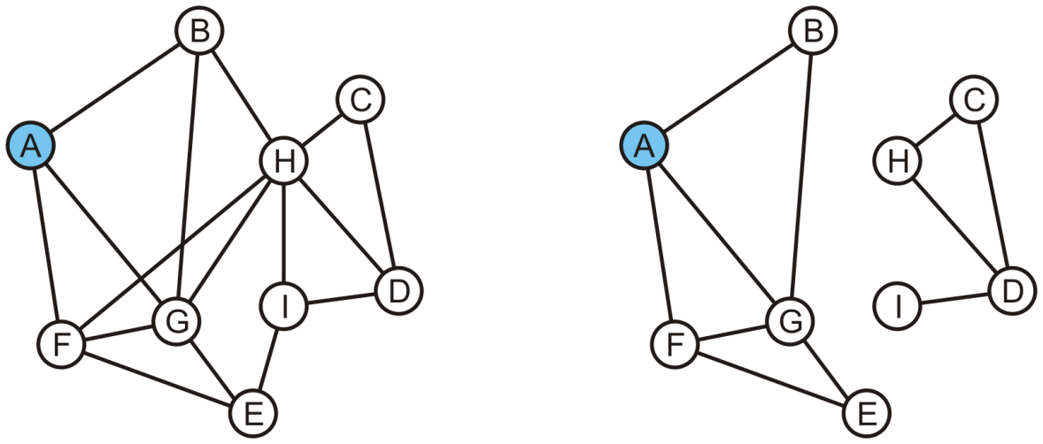
Determining Connections
Vertex A is marked as visited and pushed onto the queue
A
A

Slide 7
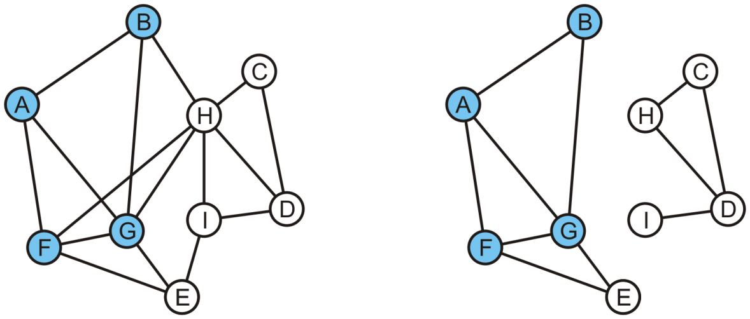
Determining Connections
Pop the head, A, and mark and push B, F and G
B | F | G
B | F | G

Slide 8
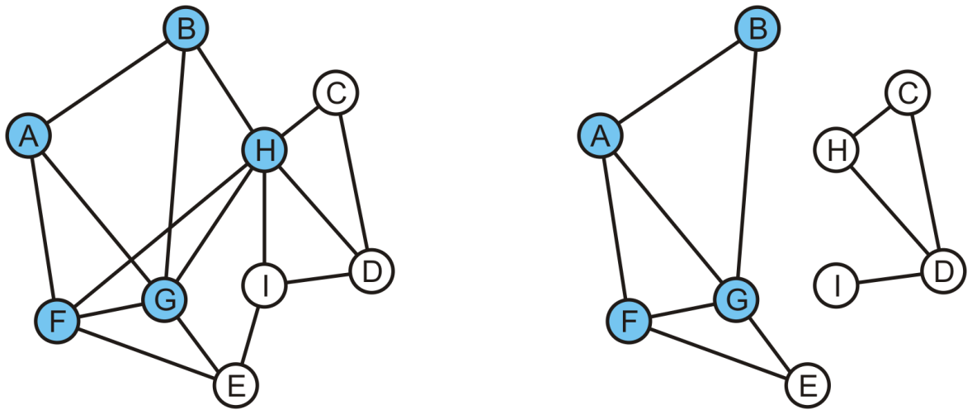
Determining Connections
Pop B and mark and, in the left graph, mark and push H
On the right graph, B has no unvisited adjacent vertices
F | G | H
F | G

Slide 9
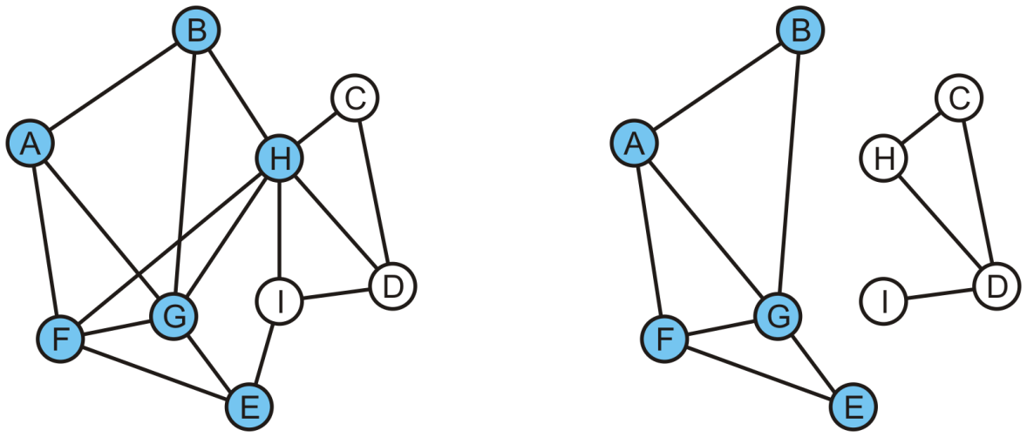
Determining Connections
Popping F results in the pushing of E
G | H | E
G | E

Slide 10
Determining Connections
In either graph, G has no adjacent vertices that are unvisited
H | E
E

Slide 11
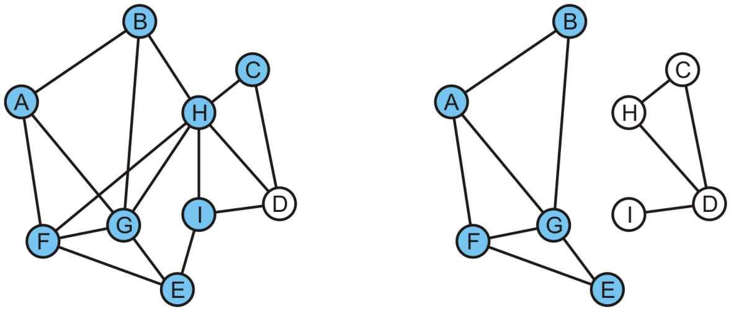
Determining Connections
Popping H on the left graph results in C and I being pushed
C | I | D

Slide 12
Determining Connections
The queue op the right is empty
We determine A is not connected to D
C | I | D

Slide 13
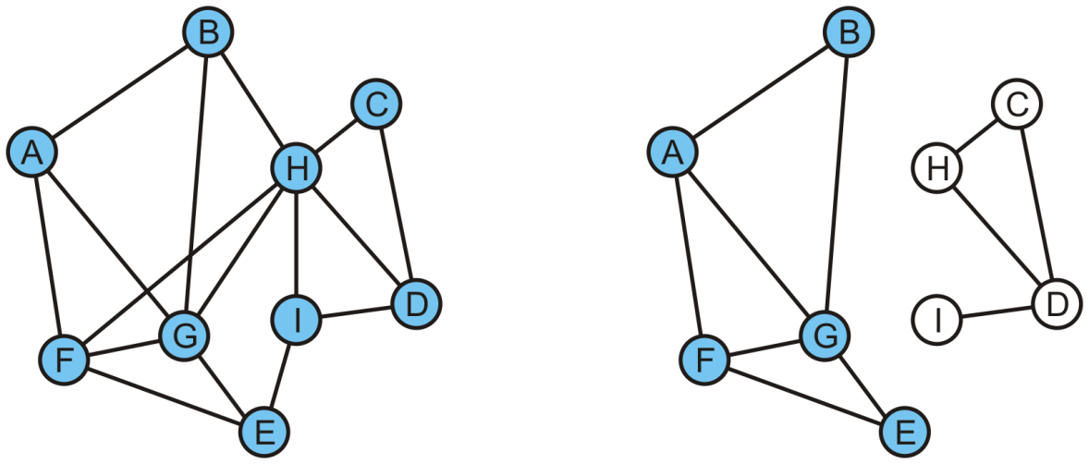
Determining Connections
On the left, we pop C and return true because D is adjacent to C
In the left graph, A is connected to D
I

Slide 14
Determining Connections
On the left, we pop C and return true because D is adjacent to C
In the left graph, A is connected to D
I

Slide 15
Connected Components
If we continued the traversal, we would find all vertices that are connected to A
Suppose we want to partition the vertices into connected sub-graphs
While there are unvisited vertices in the tree:
Select an unvisited vertex and perform a traversal on that vertex
Each vertex that is visited in that traversal is added to the set initially containing the initial unvisited vertex
Continue until all vertices are visited
We would use a disjoint set data structure for maximum efficiency

Slide 16
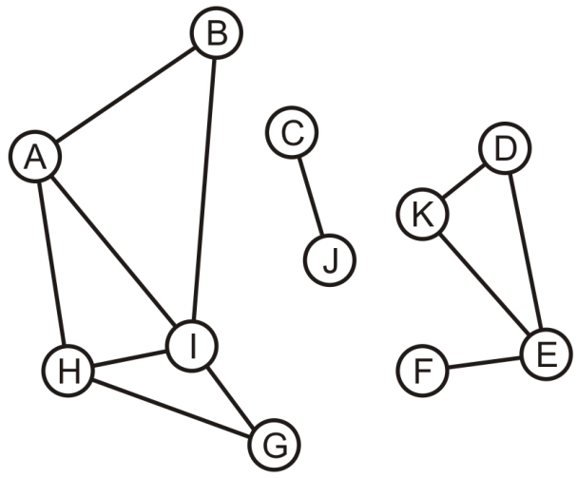
Connected Components
Here we start with a set of singletons
A | B | C | D | E | F | G | H | I | J | K
A | B | C | D | E | F | G | H | I | J | K

Slide 17
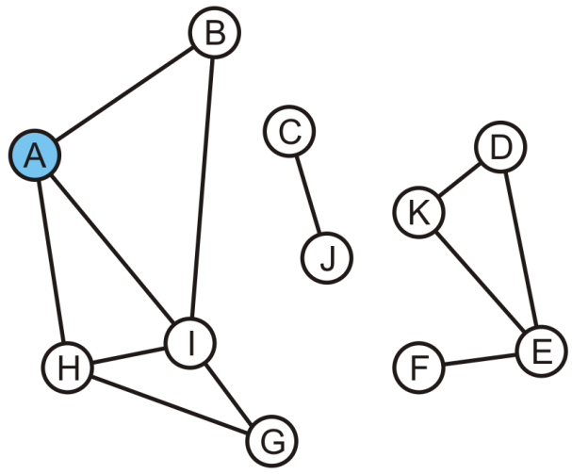
Connected Components
The vertex A is unvisited, so we start with it
A | B | C | D | E | F | G | H | I | J | K
A | B | C | D | E | F | G | H | I | J | K

Slide 18
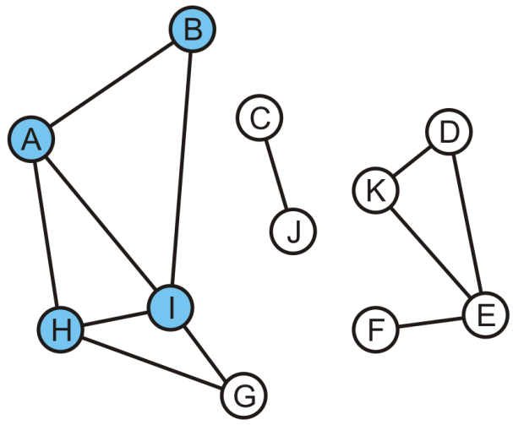
Connected Components
Take the union of with its adjacent vertices: {A, B, H, I}
A | B | C | D | E | F | G | H | I | J | K
A | A | C | D | E | F | G | A | A | J | K

Slide 19
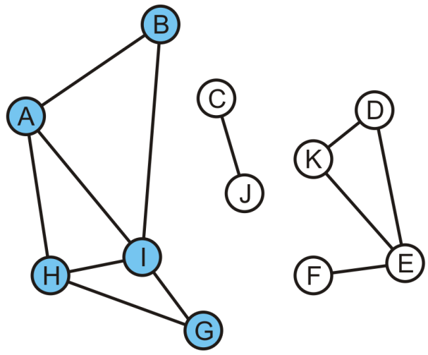
Connected Components
As the traversal continues, we take the union of the set {G} with the set containing H: {A, B, G, H, I}
The traversal is finished
A | B | C | D | E | F | G | H | I | J | K
A | A | C | D | E | F | A | A | A | J | K

Slide 20
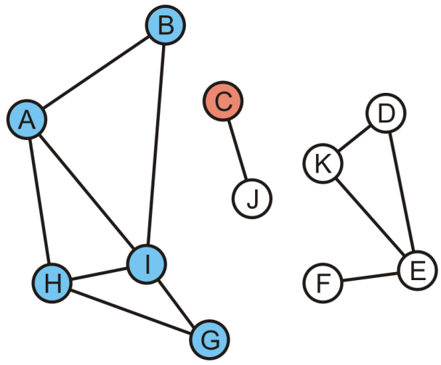
Connected Components
Start another traversal with C: this defines a new set {C}
A | B | C | D | E | F | G | H | I | J | K
A | A | C | D | E | F | A | A | A | J | K

Slide 21
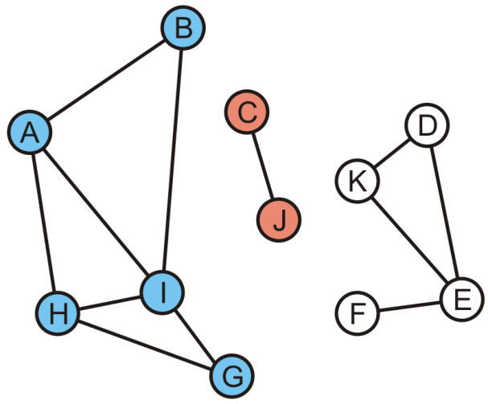
Connected Components
We take the union of {C} and its adjacent vertex J: {C, J}
This traversal is finished
A | B | C | D | E | F | G | H | I | J | K
A | A | C | D | E | F | A | A | A | C | K

Slide 22
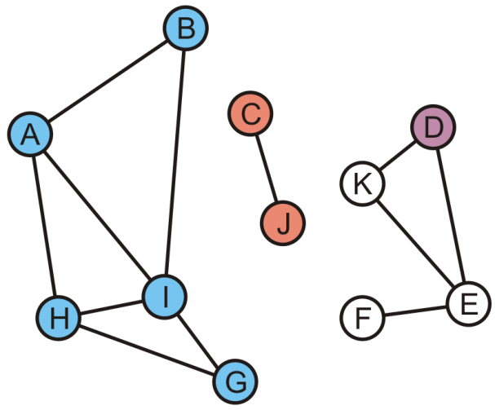
Connected Components
We start again with the set {D}
A | B | C | D | E | F | G | H | I | J | K
A | A | C | D | E | F | A | A | A | C | K

Slide 23
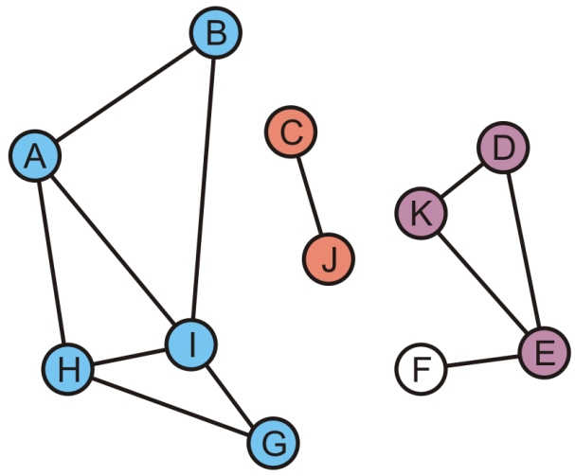
Connected Components
K and E are adjacent to D, so take the unions creating {D, E, K}
A | B | C | D | E | F | G | H | I | J | K
A | A | C | D | D | F | A | A | A | C | D

Slide 24
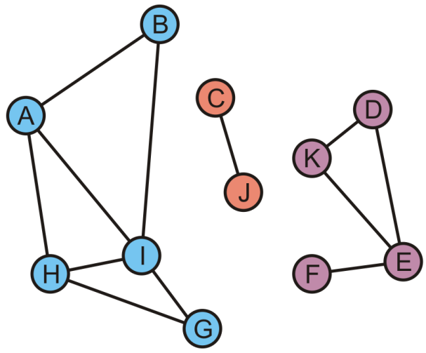
Connected Components
Finally, during this last traversal we find that F is adjacent to E
Take the union of {F} with the set containing E: {D, E, F, K}
A | B | C | D | E | F | G | H | I | J | K
A | A | C | D | D | D | A | A | A | C | D

Slide 25
Connected Components
All vertices are visited, so we are done
There are three connected sub-graphs {A, B, G, H, I}, {C, J}, {D, E, F, K}
A | B | C | D | E | F | G | H | I | J | K
A | A | C | D | D | D | A | A | A | C | D

Slide 26
Tracking Unvisited Vertices
How do you implement a list of unvisited vertices so as to:
Find an unvisited vertex in Θ(1) time
Remove a vertex that has been visited from this list in Θ(1) time
?
We cannot simply flag vertices as visited, as this would require O(|V|) time to find an unvisited vertex
The solution will have to use Θ(|V|) additional memory…

Slide 27
Tracking Unvisited Vertices
Create two arrays:
One array, unvisited, will contain the unvisited vertices
The other, loc_in_unvisited, will contain the location of vertex v_{i} in the first array
0 | 1 | 2 | 3 | 4 | 5 | 6 | 7 | 8 | 9 | 10
A | B | C | D | E | F | G | H | I | J | K
A | B | C | D | E | F | G | H | I | J | K
0 | 1 | 2 | 3 | 4 | 5 | 6 | 7 | 8 | 9 | 10

Slide 28
Tracking Unvisited Vertices
Suppose we visit D
D is in entry 3
0 | 1 | 2 | 3 | 4 | 5 | 6 | 7 | 8 | 9 | 10
A | B | C | D | E | F | G | H | I | J | K
A | B | C | D | E | F | G | H | I | J | K
0 | 1 | 2 | 3 | 4 | 5 | 6 | 7 | 8 | 9 | 10

Slide 29
Tracking Unvisited Vertices
Suppose we visit D
D is in entry 3
Copy the last unvisited vertex into this location and update the location array for this value
0 | 1 | 2 | 3 | 4 | 5 | 6 | 7 | 8 | 9 | 10
A | B | C | K | E | F | G | H | I | J
A | B | C | D | E | F | G | H | I | J | K
0 | 1 | 2 | 3 | 4 | 5 | 6 | 7 | 8 | 9 | 3

Slide 30
Tracking Unvisited Vertices
Suppose we visit G
G is in entry 6
0 | 1 | 2 | 3 | 4 | 5 | 6 | 7 | 8 | 9 | 10
A | B | C | K | E | F | G | H | I | J
A | B | C | D | E | F | G | H | I | J | K
0 | 1 | 2 | 3 | 4 | 5 | 6 | 7 | 8 | 9 | 3

Slide 31
Tracking Unvisited Vertices
Suppose we visit G
G is in entry 6
Copy the last unvisited vertex into this location and update the location array for this value
0 | 1 | 2 | 3 | 4 | 5 | 6 | 7 | 8 | 9 | 10
A | B | C | K | E | F | J | H | I
A | B | C | D | E | F | G | H | I | J | K
0 | 1 | 2 | 3 | 4 | 5 | 6 | 7 | 8 | 6 | 3

Slide 32
Tracking Unvisited Vertices
Suppose we now visit K
K is in entry 3
0 | 1 | 2 | 3 | 4 | 5 | 6 | 7 | 8 | 9 | 10
A | B | C | K | E | F | J | H | I
A | B | C | D | E | F | G | H | I | J | K
0 | 1 | 2 | 3 | 4 | 5 | 6 | 7 | 8 | 6 | 3

Slide 33
Tracking Unvisited Vertices
Suppose we now visit K
K is in entry 3
Copy the last unvisited vertex into this location and update the location array for this value
0 | 1 | 2 | 3 | 4 | 5 | 6 | 7 | 8 | 9 | 10
A | B | C | I | E | F | J | H
A | B | C | D | E | F | G | H | I | J | K
0 | 1 | 2 | 3 | 4 | 5 | 6 | 7 | 3 | 6 | 3

Slide 34
Tracking Unvisited Vertices
If we want to find an unvisited vertex, we simply return the last entry of the first array and return it
0 | 1 | 2 | 3 | 4 | 5 | 6 | 7 | 8 | 9 | 10
A | B | C | I | E | F | J | H
A | B | C | D | E | F | G | H | I | J | K
0 | 1 | 2 | 3 | 4 | 5 | 6 | 7 | 3 | 6 | 3

Slide 35
Tracking Unvisited Vertices
In this case, an unvisited vertex is H
Removing it is trivial: just decrement the count of unvisited vertices
0 | 1 | 2 | 3 | 4 | 5 | 6 | 7 | 8 | 9 | 10
A | B | C | I | E | F | J
A | B | C | D | E | F | G | H | I | J | K
0 | 1 | 2 | 3 | 4 | 5 | 6 | 7 | 3 | 6 | 3

Slide 36
Tracking Unvisited Vertices
The actual algorithm is exceptionally fast:
The initialization is Θ(|V|)
int unvisited[nV];
int loc_in_unvisited[nV];
for ( int i = 0; i < nV; ++i ) {
unvisited[i] = i;
loc_in_unvisited[i] = i;
}

Slide 37
Tracking Unvisited Vertices
The actual algorithm is exceptionally fast:
Determining if the vertex v_{k} is visited is fast: Θ(1)
bool is_unvisited( int k ) const {
return loc_in_unvisited[k] < count &&
unvisited[ loc_in_unvisited[k] ] == k;
}

Slide 38
Tracking Unvisited Vertices
The actual algorithm is exceptionally fast:
Marking vertex v_{k} as having been visited is also fast: Θ(1)
void erase( int k ) {
if ( !is_unvisited() ) {
return; // It has already been marked as visited
}
--count;
int posn = loc_in_unvisited[k];
unvisited[posn] = unvisited[count];
loc_in_unvisited[unvisited[count]] = posn;
}

Slide 39
Tracking Unvisited Vertices
The actual algorithm is exceptionally fast:
Returning a vertex that is unvisited is also fast: Θ(1)
int return unvisited() {
if ( count == 0 ) {
throw underflow();
}
--count;
return unvisited[count];
}

Slide 40
Summary
This topic covered connectedness
Determining if two vertices are connected
Determining the connected sub-graphs of a graph
Tracking unvisited vertices

Slide 41
References
Wikipedia, http://en.wikipedia.org/wiki/Connectivity_(graph_theory)
These slides are provided for the ECE 250 Algorithms and Data Structures course. The material in it reflects Douglas W. Harder’s best judgment in light of the information available to him at the time of preparation. Any reliance on these course slides by any party for any other purpose are the responsibility of such parties. Douglas W. Harder accepts no responsibility for damages, if any, suffered by any party as a result of decisions made or actions based on these course slides for any other purpose than that for which it was intended.

