Slide 1
Welcome to ece 150 Fundamentals of programming

Slide 2
Outline
In this topic, we will
Look at the purpose of this course
Go over the main sections of the course syllabus
Give you a warning about plagiarism
Discuss using generative artificial intelligence in this course

Slide 3
Course outcomes
By the end of this course, you will be able to
Program computers to carry out operational tasks using the C++ language
Demonstrate ability to perform both procedural programming and object-oriented programming
Develop and implement programs to solve electrical and computer engineering problems
Demonstrate ability to test and debug programs

Slide 4
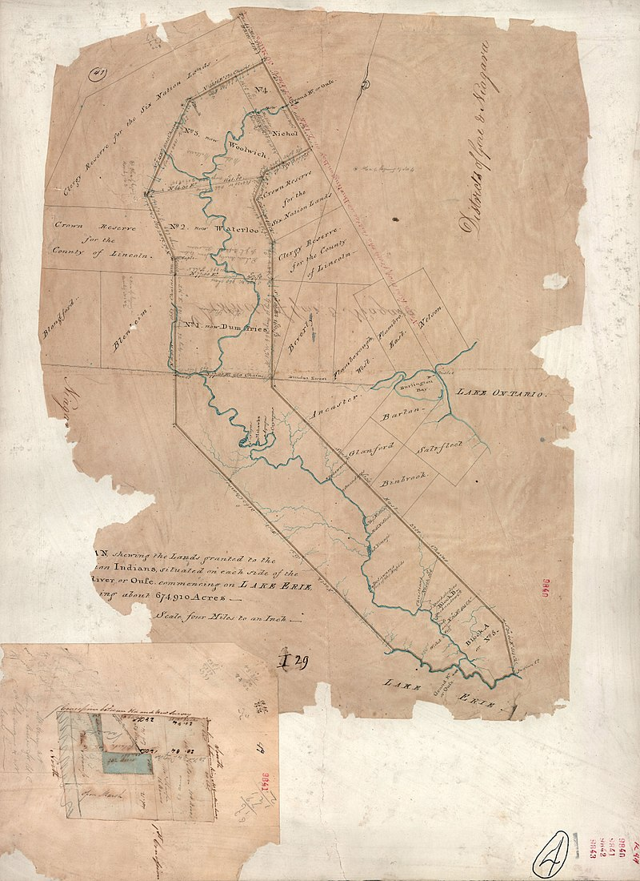
Territorial acknowledgement
We acknowledge that we live and work on the traditional territory of the Attawandaron (Neutral), Anishnaabeg and Haudenosaunee (Iroquois) peoples. The University of Waterloo is situated on the Haldimand Tract, the land promised to the Six Nations of the Haudenosaunee (the Cayuga, Mohawk, Oneida, Onondaga, Seneca and Tuscarora peoples) that includes six miles on each side of the Grand River.

Slide 5
Course topics
The topics will be broken into six sections:
Programming fundamentals:
Syntax, local variables and types, functions and parameters, various operators, control statements (conditional and looping statements) and arrays
Addresses and pointers
Algorithms
Classes
Linked lists
Inheritance and polymorphism

Slide 6
Course websites
Lecture material and notes are available
https://ece.uwaterloo.ca/~ece150/
Additional material would be available on LEARN
https://learn.uwaterloo.ca/

Slide 7
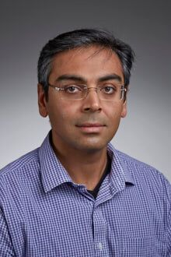
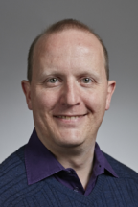
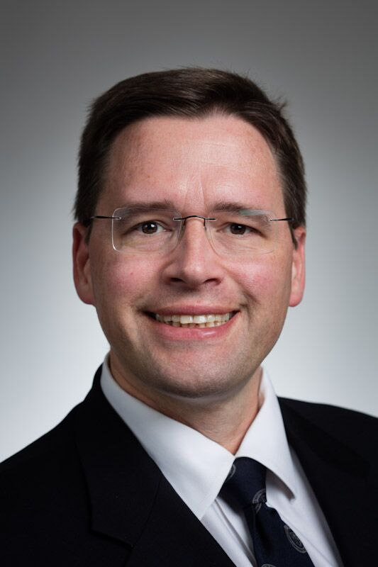
Course instructors
Prof. Hiren Patel, Ph.D., P.Eng.
Email: hiren.patel@uwaterloo.ca
Office: e5 4018
Website: https://caesr.uwaterloo.ca
Prof. Werner Dietl, Ph.D.
Email: wdietl@uwaterloo.ca
Office: EIT 4007
Website: https://ece.uwaterloo.ca/~wdietl/
Douglas W. Harder, M.Math., LEL
Email: dwharder@uwaterloo.ca
Office: e3 3157
Website: https://ece.uwaterloo.ca/~dwharder/

Slide 8
Course grading scheme
This course has four graded projects and two graded examinations:
A mid-term and a final examination
If your final examination grader is greater than any one of these grades, that higher grade replaces the lower one
Late policy
No late submissions will be accepted
Any missed grade is automatically replaced by your final examination grade
We do not require a Verification of Illness form or a doctor’s note or other documentation
There is no make-up mid-term examination

Slide 9
Course grading scheme
Let your grades be P₁, P₂, P₃, P₄, M and F, each out of 100
If F is greater than any other grade, the other grade is replaced by F
Your examination grade E is:
E = ¼M + ¾F
The final is worth three times that of the mid-term
Your project grade P is:
P = 0.09P₁ + 0.27P₂ + 0.27P₃ + 0.37P₄
If E ≥ 55, all your projects count and your final grade is ⅔E + ⅓P
If E ≤ 45, none of your projects count, so your final grade is E
For 45 < E < 55, each grade n above 45 allows your projects to count 10n% of ⅓P towards your final grade
Your final grade will be E = (¹/₃₀ n)P + (1 – ¹/₃₀n)E
*
* Unless the grade is
the result of Policy 71

Slide 10
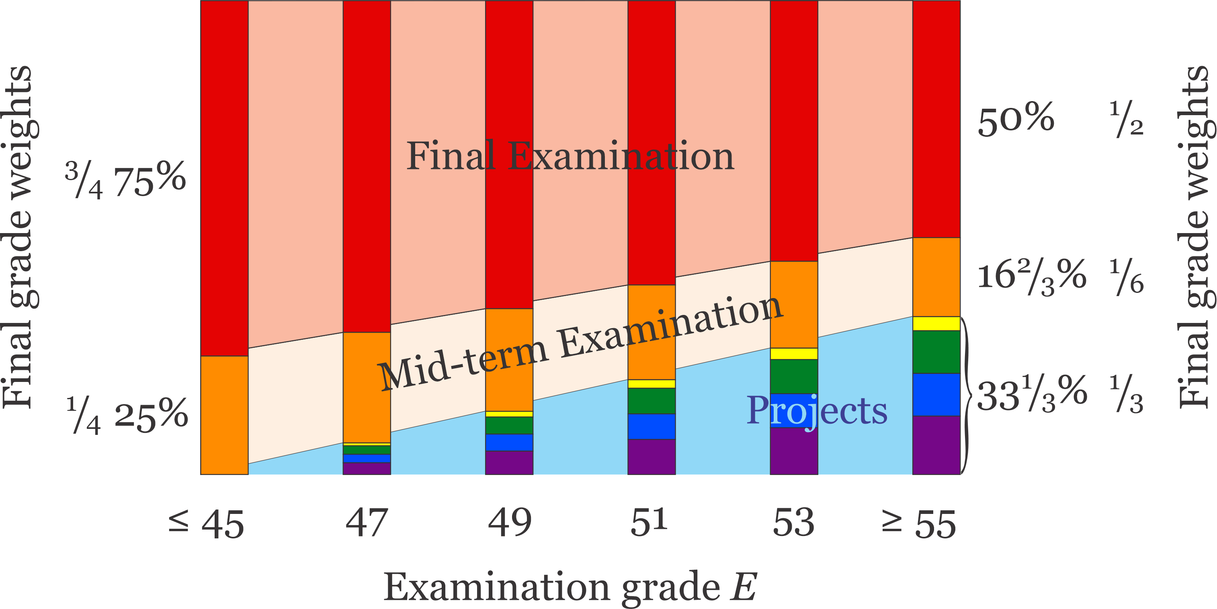
Course grading scheme
Visually, you can see the examinations and project weights here:

Slide 11
Communication with instructor
E-mail is a good way to reach us, but please follow a few simple guidelines
Only use your uWaterloo email address to send email
No forwarding through gmail or others
Put “ECE150” in the subject to increase the priority
Be concise and clear when describing your concern
Be patient, we will do our best to respond to you quickly
You can always contact the WEEF teaching assistants (TAs)

Slide 12
Collaboration versus plagiarism
We encourage students to work together
Teaching others is one of the best way to ensure you have a mastery of the subject matter
You may assist your friends
You should only examine another student’s code if you believe you have a reasonable solution, and they are clearly having issues that you have already solved
You should help the student you are helping understand the problem
Never give the student the correct solution—this will not help that individual and they will become dependent on you

Slide 13
Academic misconduct
It is considered to be academic misconduct if:
You send your solutions in any format (including a verbal reading thereof) to anyone else, even if they then forward those solutions to a third party
You submit code that you were not the sole author thereof
You edit or dictate someone else’s code
You search the web for a similar problem with a posted solution
You get a solution from a student in a previous year and submit it, or something very similar with only cosmetic or minor changes
You post your code on GitHub or replit.com or any other publicly accessible web site and someone else downloads and submits your code
Leave your computer unattended and a peer accesses that computer to access your code

Slide 14
Academic misconduct
This is critical:
DO NOT SEND OR COMMUNICATE YOUR SOLUTIONS TO YOUR PEERS
In every instance of plagiarism in the past two years,
there was clear evidence that code was shared or copied from a common source

Slide 15
Academic misconduct
A few points to remember:
You will likely think there is only one solution,
so sending your code will help your friend fix their code
Problem: There are many solutions, and your solution probably will not help your peer fix that person’s own approach
Your friend promised not to plagiarize
Problem: When a student is under stress, that student will forget such promises, and as the deadline approaches, the pressure will build to the point of being unbearable

Slide 16
Academic misconduct
A few points to remember:
This may be your best friend from secondary school, or even elementary school, or it may be a friendship you’ve recently cultivated
Problem: We have had cases where students who knew each other since Grade 1 ended up in a case of plagiarism
Your friend plagiarized your code, got caught, and then swears up and down and left and right that no code was copied
Problem: You have just lost at least 10% of your final grade, and you will be prone to believing your friend
This will ruin your first-year experience
Remember, each plagiarism case was sent to the Associate Dean of Undergraduate studies, and that individual concurred that plagiarism was evident
Also, the evidence for each plagiarism case was shown to a 2a class representative, and that student concurred that plagiarism was evident

Slide 17
Academic misconduct
A few points to remember:
You may think: but my code was perfect, why am I being penalized
Issue: You have helped someone else plagiarize, so you are just as much to blame as the other person. Also, you are getting something out of the deal:
You feel good because that student immediately shows you gratitude
You’ve just scratched that student’s back,
they will have the opportunity in the future to scratch yours
You may be from a culture that pressures you to help your peers
Solution: So help them, but do not send them your code
It requires much more effort to help them, but that effort will pay off

Slide 18
Academic misconduct
Important:
Help your friends, and if necessary, you may have to lose some sleep, but do not send them your code, even after the deadline
Helping your friends will also help you
In many cases last year, it was clear the intention of the student supplying the solution was trying to help the other student
This is critical:
DO NOT SEND OR COMMUNICATE YOUR SOLUTIONS TO YOUR PEERS

Slide 19
Penalties
If you are found guilty of academic misconduct, the result is
Zero on the entire assessment, and that zero will not be replaced by the final examination grade
A penalty of 5% from your final grade per infraction
On subsequent offences, the penalties may increase:
A required selection of courses in ethics
A failing grade in the course
A two-year suspension
A 7-year suspension
Expulsion

Slide 20
Example
Suppose you copied your friend’s code on Project 3:
Suppose you got:
43% on the mid-term examination
54% on the final examination
86% on the projects, including Project 3
Suppose your friend got:
75% on the mid-term examination
82% on the final examination
95% on the projects
If you hand in the plagiarized Project 3, your grade is 61
If you don’t hand in the project, your grade is 59
The final examination replaces the 0 in Project 3
If you are caught, with penalties, your grade is now 51

Slide 21
Fairness
To be fair to all students, all accusations of plagiarism will have their names redacted and shown to the class representatives
The class representatives will have the option of suggesting that a particular case is not a clear demonstration of plagiarism
Last year, we showed all cases to the class representatives, and they disputed none of the accusations
The class representatives from your class can request to see those cases, as well
Last year, all accusations resulted in a finding of guilty
We do not malevolently try to go after every possible case, we only file accusations when it is clear plagiarism occurred
We need you to understand that there are consequences…

Slide 22
How to succeed
Watch the lectures and take notes
They should make it easier to understand the main concepts
Practice programming
There is no substitute for solving problems using programming
Clarify confusions early
Seek help from your peers, WEEF tutors and TAs
Ask instructor
Don’t just view the information once
Repeatedly reviewing the content will help you remember concepts
Work ahead
A large portion of the course’s lecture material is already available for you to study in advance

Slide 23
Use of artificial intelligence
There are amazing:
ChatGPT, Github co-pilot and replit.com ghostwriter
Many of the problems given in your undergraduate studies can be solved by one of these tools, but this doesn’t help you learn
You may not use any artificial intelligence tools for the projects
You can use these tools to learn the C++ syntax, and to find issues with your solutions to various problems

Slide 24
Use of artificial intelligence
For example, using ChatGPT (because it the most accessable):
Ask it “Why does this code not compile?” and then cut-and-paste your code into ChatGPT
Usually it will find your syntax errors
It may also make some other suggestions
If your code does not seem to work in solving a problem, ask it “Why does this not solve ….” or “Why does this not find …”
You can even ask: “Do you have any suggestions to improve this code?”

Slide 25
Use of artificial intelligence
Remember: engineering is about problem solving, but artificial intelligence usually does solve new and unique problems
You must develop your problem-solving toolkit starting with problems for which we know there is a solution
If you cheat yourself by using artificial intelligence instead of your own intelligence, you will not be able to tackle real-world unique and novel problems
You will be an artificial intelligence technician, not an engineer

Slide 26
Summary
Following this lesson, you now
Understand this course’s outcomes and topics
Know the grading scheme
Understand the policies related to plagiarism, penalties, and late submissions
Have been provided suggestions on how to succeed in this course
Understand how to use artificial intelligence to help you succeed

Slide 27
References
[1] https://ugradcalendar.uwaterloo.ca/courses/ECE/150
[2] https://ece.uwaterloo.ca/~ece150/
[3] https://openai.com/ for ChatGPT
[4] https://en.wikipedia.org/wiki/GitHub_Copilot
[5] https://en.wikipedia.org/wiki/Generative_artificial_intelligence

Slide 28
Colophon
These slides were prepared using the Georgia typeface. Mathematical equations use Times New Roman, and source code is presented using Consolas.
The photographs of lilacs in bloom appearing on the title slide and accenting the top of each other slide were taken at the Royal Botanical Gardens on May 27, 2018 by Douglas Wilhelm Harder. Please see
https://www.rbg.ca/
for more information.

Slide 29
Disclaimer
These slides are provided for the ece 150 Fundamentals of Programming course taught at the University of Waterloo. The material in it reflects the authors’ best judgment in light of the information available to them at the time of preparation. Any reliance on these course slides by any party for any other purpose are the responsibility of such parties. The authors accept no responsibility for damages, if any, suffered by any party as a result of decisions made or actions based on these course slides for any other purpose than that for which it was intended.

